Slide 1
Latest Developments in HFIP Research
Frank Marks
NOAA/AOML Hurricane Research Division
9 November 2012
Notes:
Hurricane Earl 2 September 2010

Slide 2

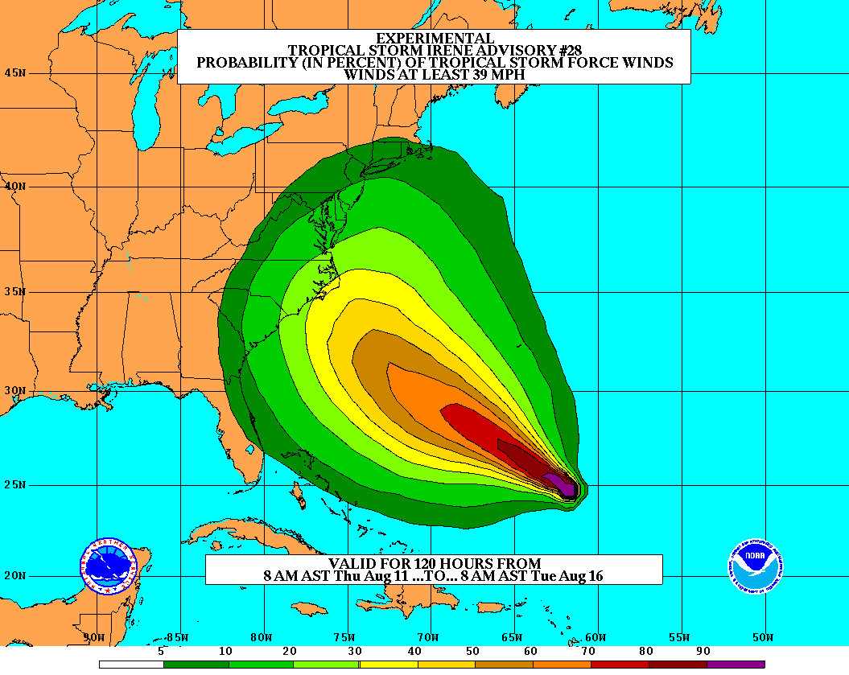
Goals
Improve Forecast Accuracy
  Hurricane impact areas (track) – 50%
  in 10 years
  Severity (intensity) – 50% in 10 years
  Rapid intensity change detection
Extend forecast reliability out to 7 days
Quantify, bound and reduce forecast uncertainty to enable risk management decisions
http://www.hfip.org/
Notes:
http://www.nrc.noaa.gov/HFIPDraftPlan.html
HFIP Team
Frank Marks, research lead
Ed Rappaport, operations lead
Fred Toepfer, project manager
Robert Gall, development manager
Mark DeMaria
Chris Fairall
Jim McFadden
Daniel Melendez
HFIP executieve oversight board:
OAR AA/Robert Detrick, co-chair
NWS AA (acting)/Laura Furgione, co-chair
NCEP/Louis Uccellini,
NHC/Rick Knabb,
NESDIS/Mark DeMaria,
NOS/Jesse Feyen,
AOML/Bob Atlas
PPI/Paul Doremus
NMFS/Bonnie Ponwith,
NOS/Liz Scheffler,
NMAO-PM Aircraft/Mike Devany
OFCM/Sam Williamson
Executive Secretariat: OAR/Brian Orndorff and NWS/Nasheema Lett
http://www.hfip.org/

Slide 3

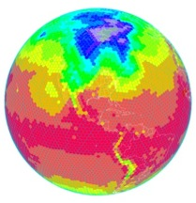
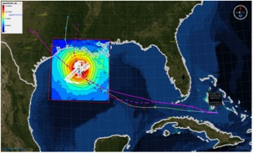
HFIP Activities
Traditional Hurricane Research Activities:
Observations, analysis, database, & instrument R&D (IFEX)
Statistical-dynamical model development
Advances in operational models (Stream 1)
New HFIP Research Thrusts:
Experimental global and regional hurricane model development (Stream 2)
Data assimilation techniques and observing system strategy analysis development (Stream 1 & 2)
Model evaluation tool development (Stream 1.5)
Application and tool development for forecasters
D1
D2
Partnership: NCEP, AOC, AOML, ESRL, GFDL, DTC, USWRP, NESDIS/STAR
http://www.hfip.org/documents/
Notes:
http://www.hfip.org/documents/
Two Stream Approach to HFIP developments:
Stream 1– Operational Transition and Implementation
Stream 2 – Advanced Technology Demonstration
Unconstrained by near-term availability of operational computing
Uses both NOAA’s and computing resources from major supercomputing centers for testing and evaluation.
Emphasis is on high resolution global and regional models run as ensembles
Real-time or near real time runs during hurricane season
Stream 1.5 (JHT-like)
NHC Forecaster Defined.
Subset of Stream 2 that forecasters see as particularly promising or provides demonstrated capability
Will be configured to run in real-time and products made available to NHC.

Slide 4
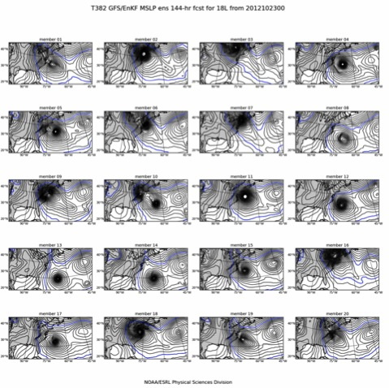
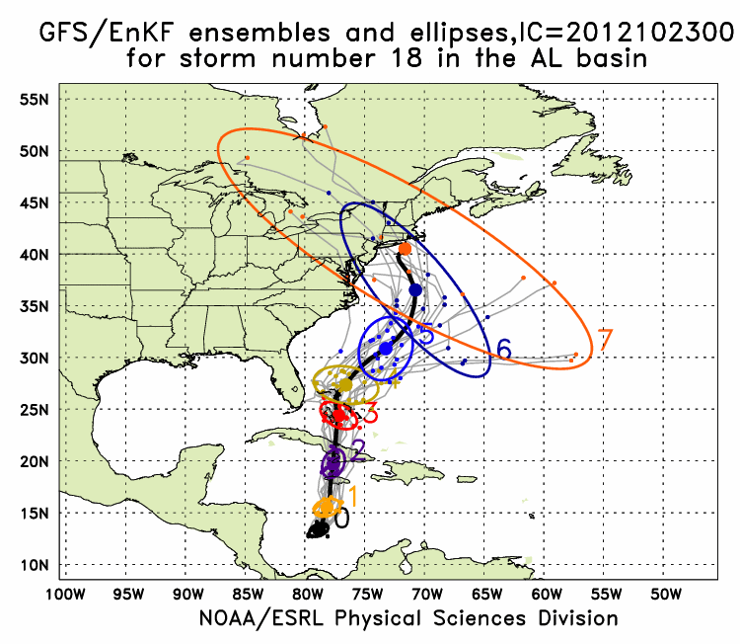
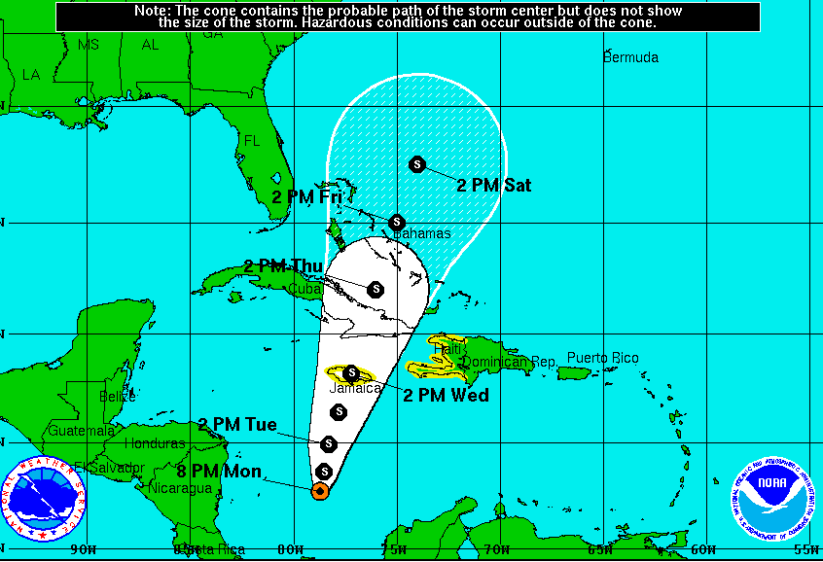
Global Model Development – GFS/EnKF
Sandy (18L) – init 00Z 23 October
GFS/EnKF T382 20 member ensemble
7-Day forecast – 20 member ensemble
Observed
http://www.esrl.noaa.gov/psd/forecasts/gfsenkf/ens/
Global Model Team - Tom Hamill & Jeff Whitaker (ESRL)
Notes:
Model data available at: http://www.esrl.noaa.gov/psd/forecasts/gfsenkf/ens/
Global Ensembles:
80-member T254 GFS ensembles cycled every 6-h continuously from 1 August to current time
Look at 20 members of the 80 member ensemble
Left panels shows ellipse plot of 20 members at each forecast time – ellipse shape shows the spread along/across track
Right panel show surface pressure post stamp images of 20 members

Slide 5
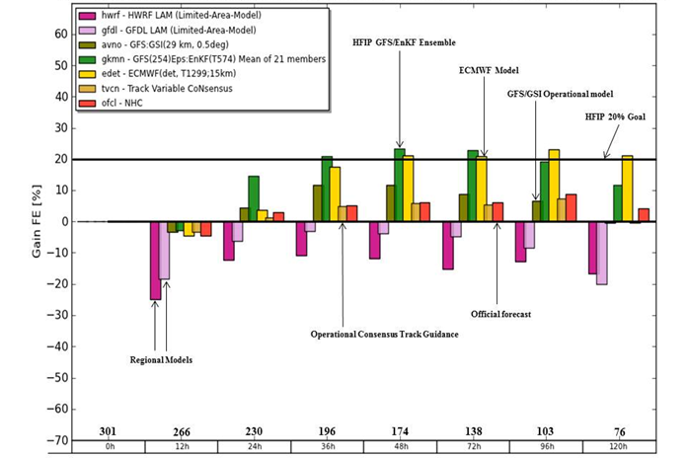
Global Model Development
Track Error (2010-2011)
Global Model Team – Mike Fiorino (ESRL)
Notes:
Track Error of Models (2010-2011) (% Improvement over HFIP baseline – average track error for three years of operational model guidance errors for 2006-2008 when HFIP began)
purples are the operational regional models
Greens represent the operational GFS and the HFIP GFS at lower resolution than the operational GFS but with ENKF data assimilation of central pressure
Yellows (ECMWF) and browns (UKMET) are two of the better global models
Orange is the best multi-model ensemble track guidance used by NHC
Dark orange is the Official NHC forecast error
Note that the HFIP GFS/EnKF model which is at ¼ the spatial resolution of ECMWF is competitive and also exceeds the 20% improvement goal of HFIP for 5 years.

Slide 6
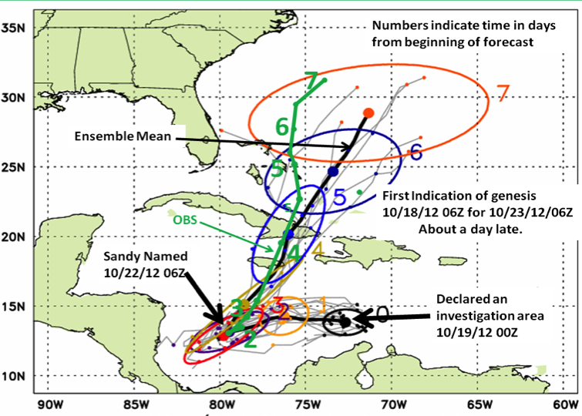
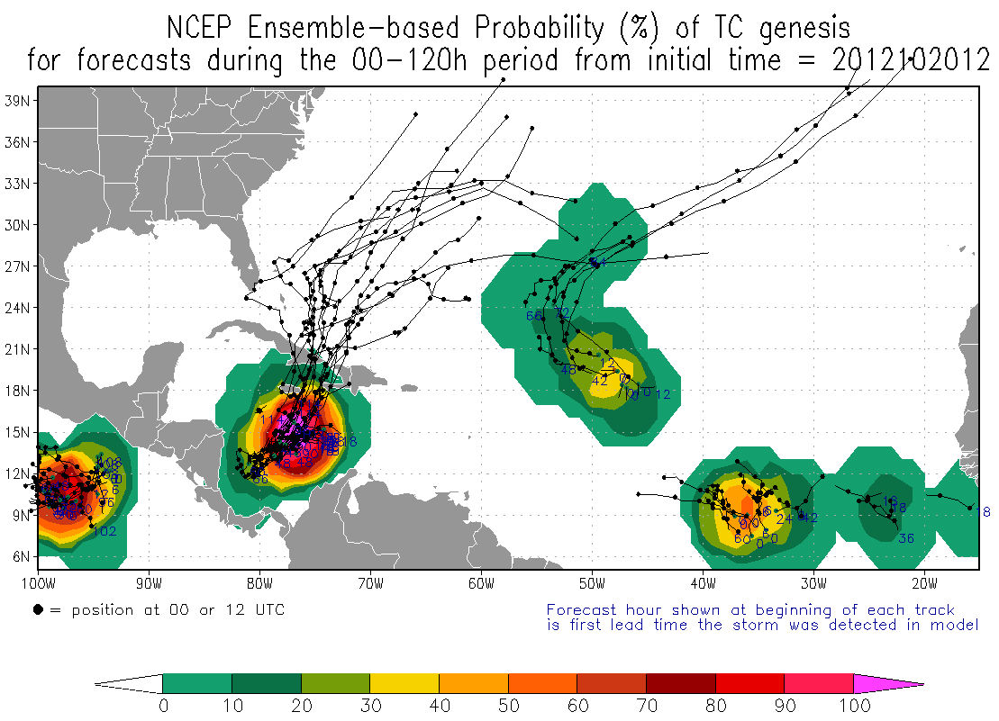
Global Model Development – Ensemble – Genesis
Global Model Team - Tom Hamill & Jeff Whitaker (ESRL)
Notes:
In the case of Irene new tools to forecast genesis developed by HFIP using the HFIP global model ensembles from GFS/EnKF (30 members) and FIM (10 members) were able to detect and track the system that formed into Irene 5 days before it was named by NHC and 2 days before NHC declared it an INVEST area
Thin black lines are the disturbance tracks from each of the ensemble members, the small black dots the location of each of the ensemble members at 24 h intervals after the initial time, and the colored ellipses enclose 75% of the ensemble positions. Note that the ellipses elongate along track (reflecting speed uncertainty) in the early forecasts, and elongate perpendicular to the track (reflecting uncertainty in the storm turn to the N at the later forecast times. At day 3 & 4 when the storm was named the uncertainty is the least.
The solid green line is the observed Best Track from NHC starting when the storm was named.
Model data available at: http://www.esrl.noaa.gov/psd/forecasts/gfsenkf/ens/

Slide 7
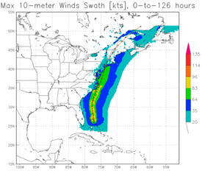
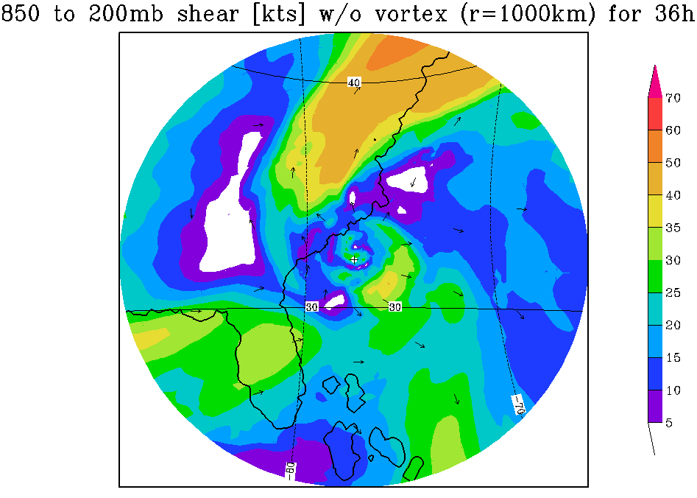
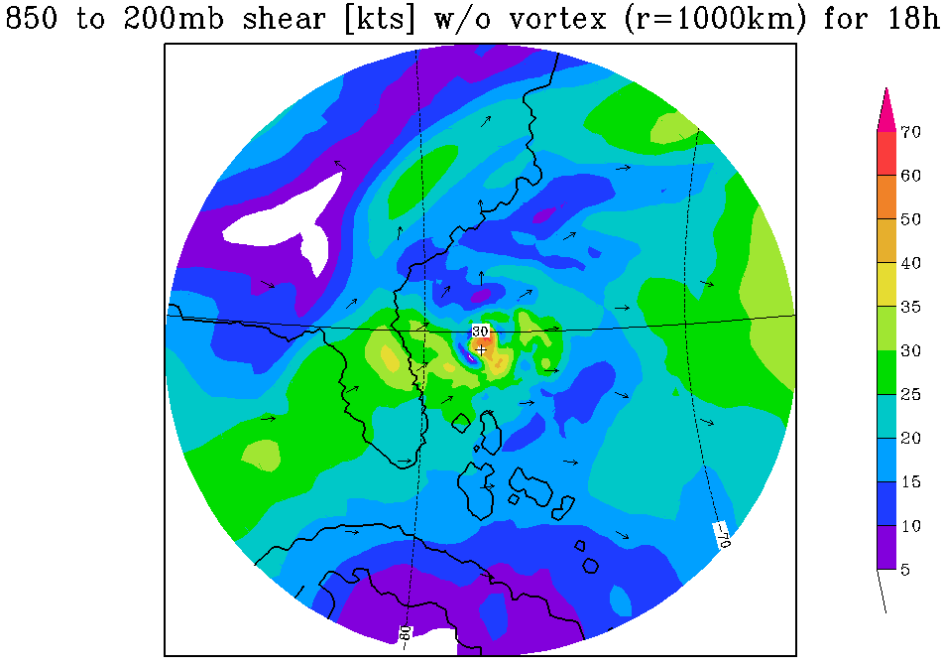
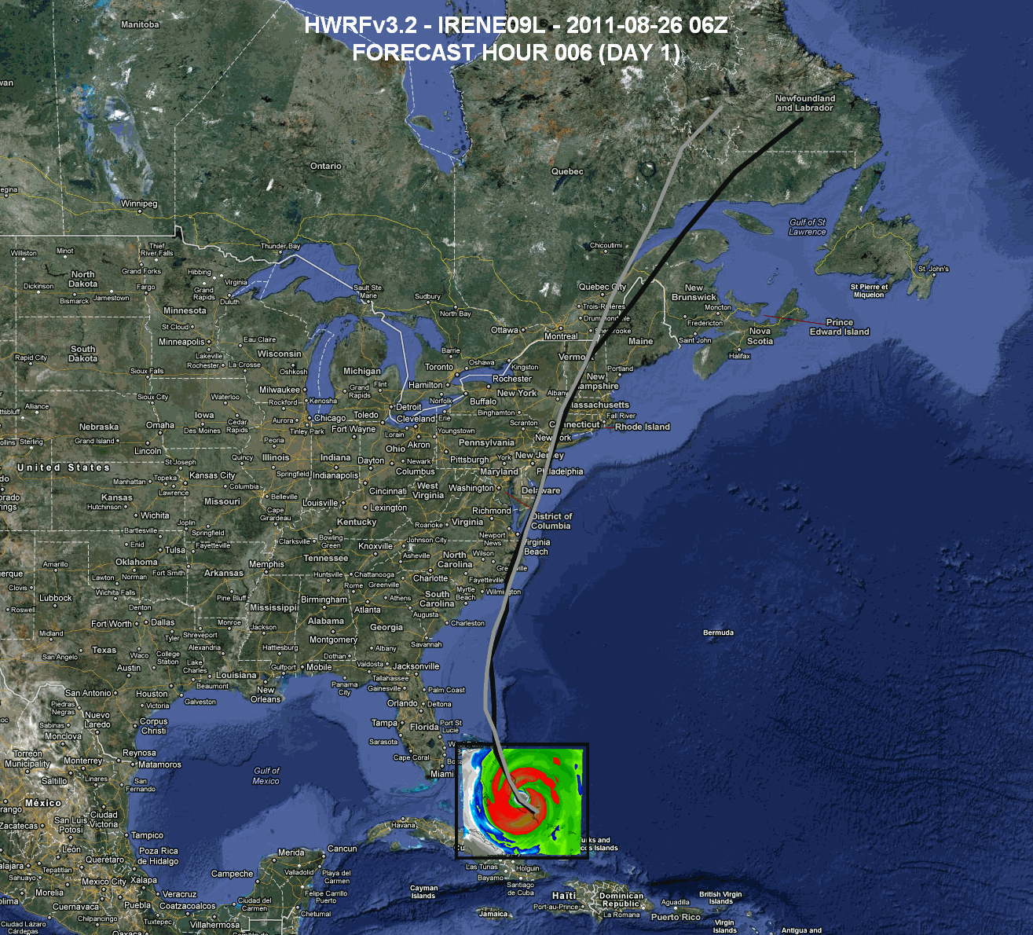
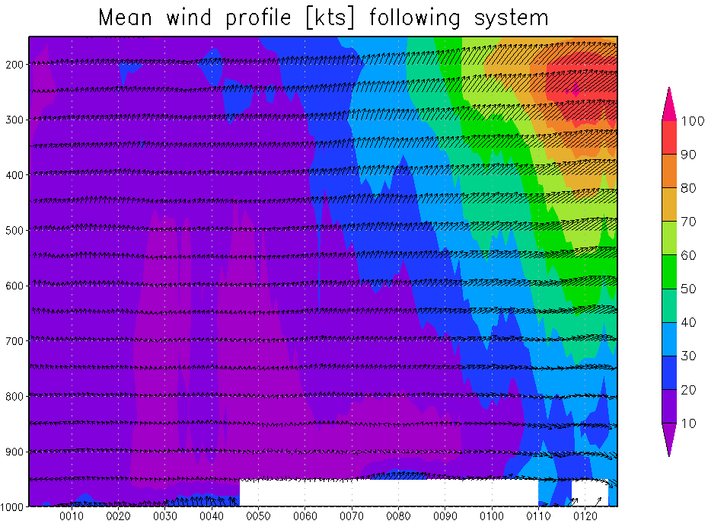
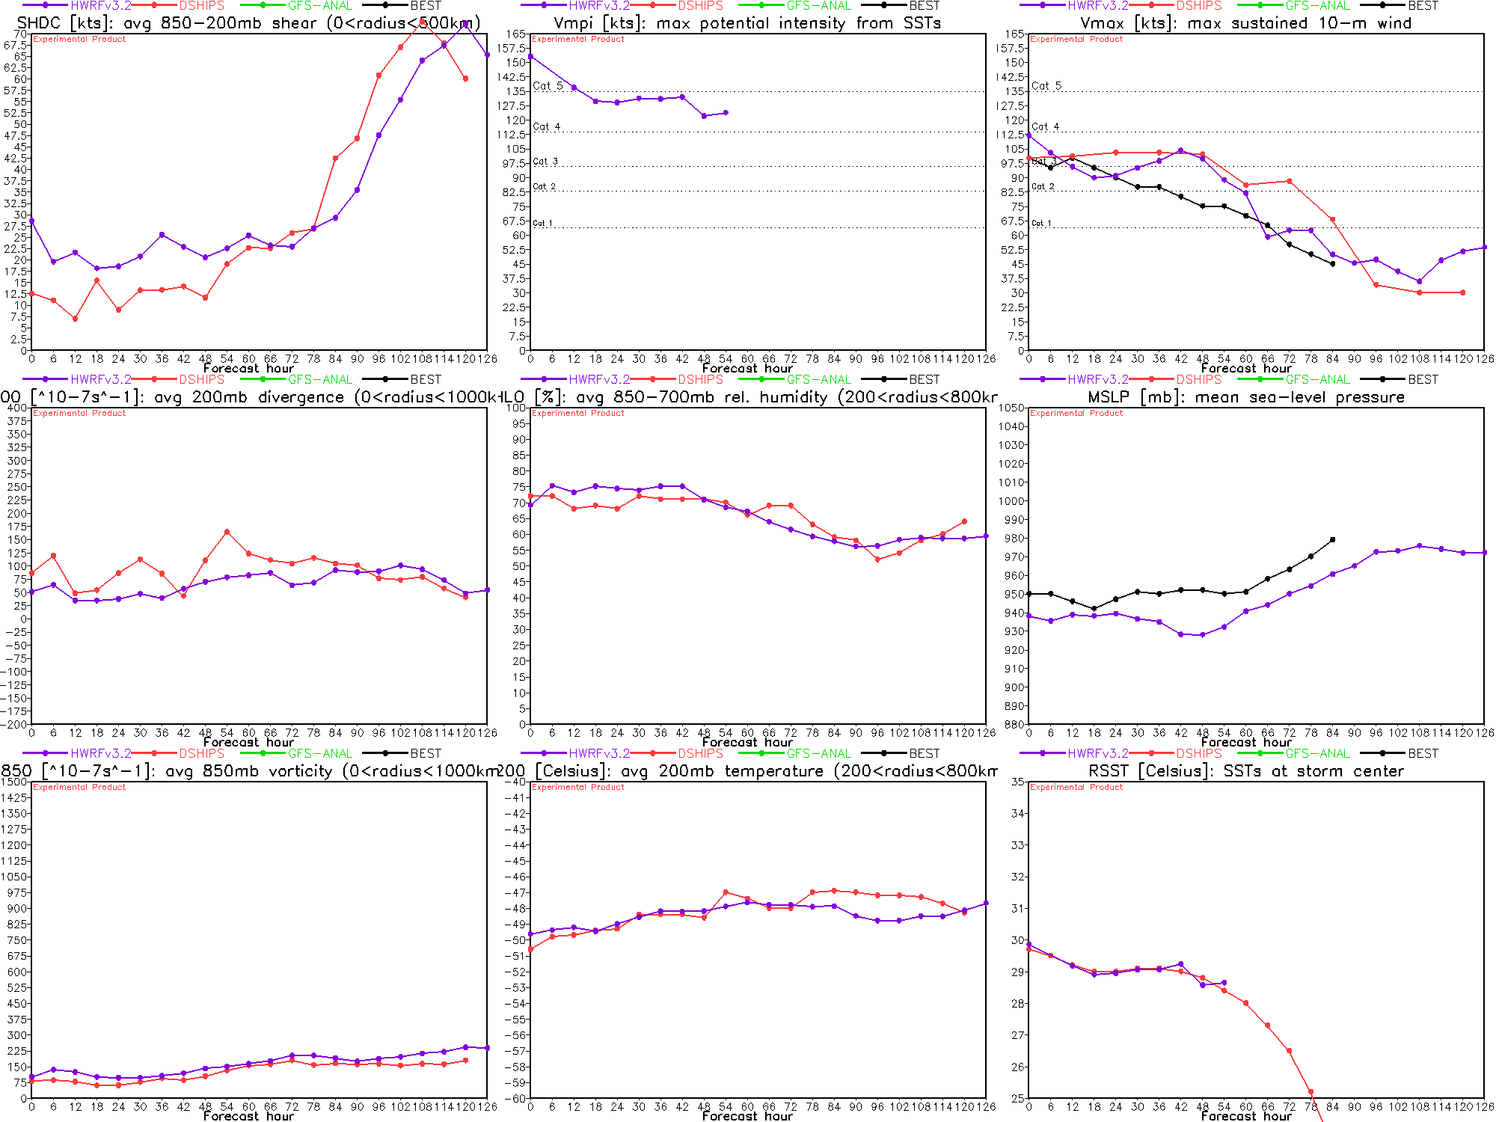
Regional Model Development: HWRF
https://storm.aoml.noaa.gov/realtime
HFIP stream 1.5* (27/9/3 km resolution)
  Advanced nesting algorithm providing resolutions to 3 km
  Viable operational pathway & potential transition to operations
  Pathway to Improved structure and intensity predictions*
  Extension of initialization algorithm down to 3 km resolution
All Storms of 2011 (4 cycles/day)
19 main products; e.g.,
  Synthetic microwave imagery
  SHIPS predictors
  Shear and Steering
  Time-height cross-sections
  Swaths (wind and rainfall)
* 2012 NCEP operational
Regional Model Team - Gopal, X. Zhang AOML/HRD, V. Tallapragada (EMC)
Notes:
Demo 2011 season; Not only we have improved the products but also added a suite of NOAA HWRF systems at different configurations.
Example of Hurricane Dora 2004 (initialized at 18Z on 18 July 2011)
Top left: 10-m wind swath for 126 h forecast
Bottom left: time-height cross section of mean wind over 3 km nest centered on storm
Top right: storm-relative vertical wind shear on 3-km nest for 24 h and 30 h forecast – note decreasing NE shear over center
Bottom right: SHIPS type predictors for regional model
Overlay: moving 3-km inner nest showing 10-m wind evolution
Model products available at: http://storm.aoml.noaa.gov/realtime

Slide 8
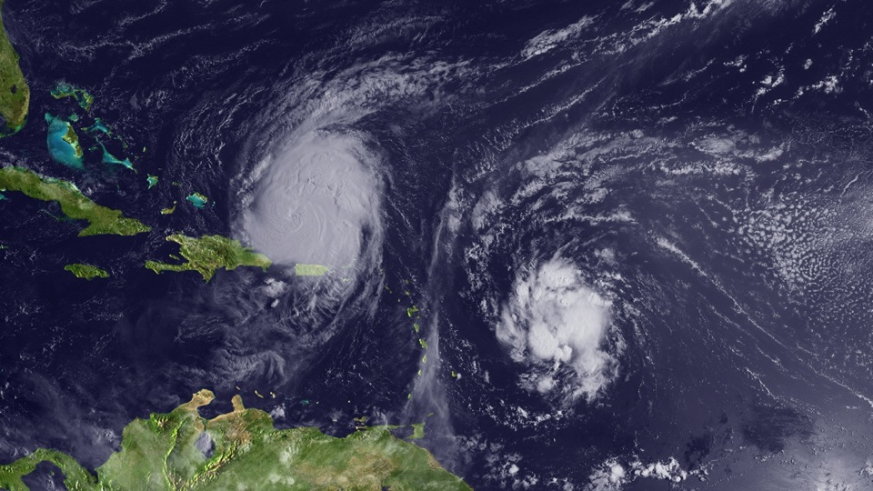
Regional Model Development: What Next?
Earl
Fiona
Notes:
Current regional hurricane model strategy is developed from GFDL model approach developed in 1977 – one forecast run per storm. So if there is two storms operations needs resources for two complete model runs. Not only inefficient, but causes issues with initialization when two storms are in the outer next interacting. Current storm occurrence climatology suggests that more that 50% of the time there is two storms active at the same forecast time.

Slide 9
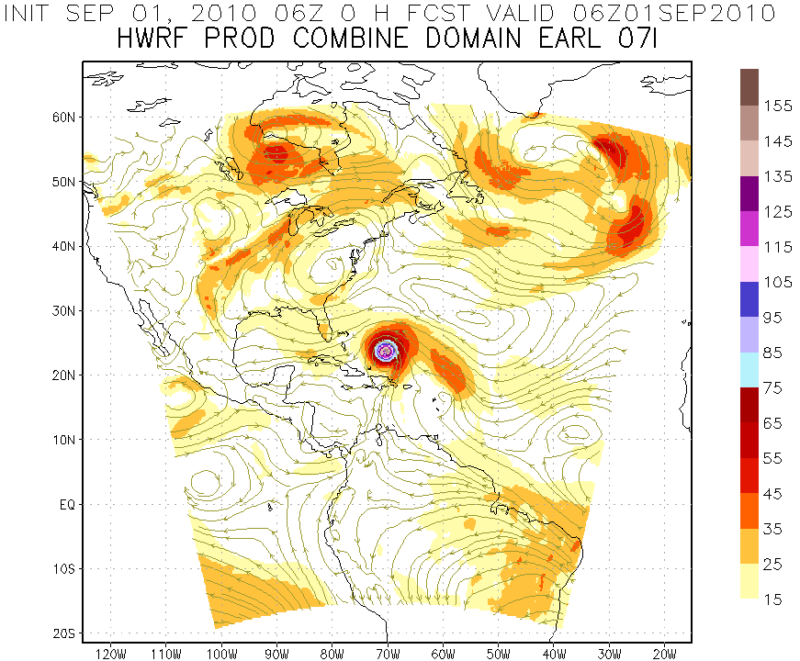
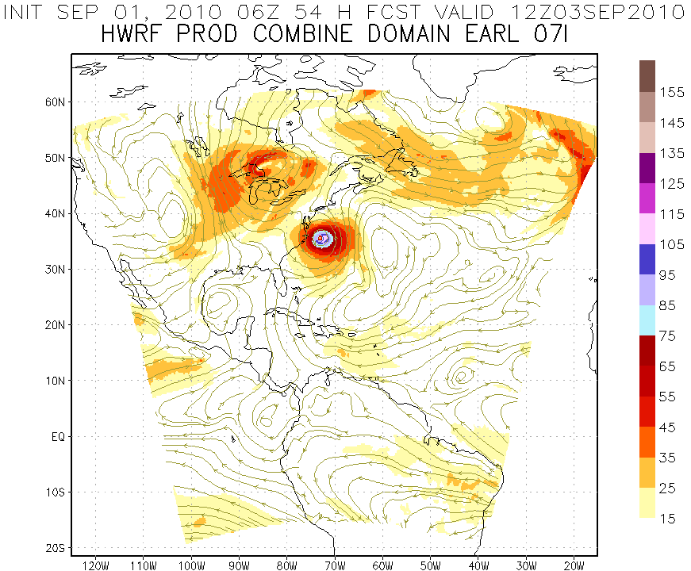
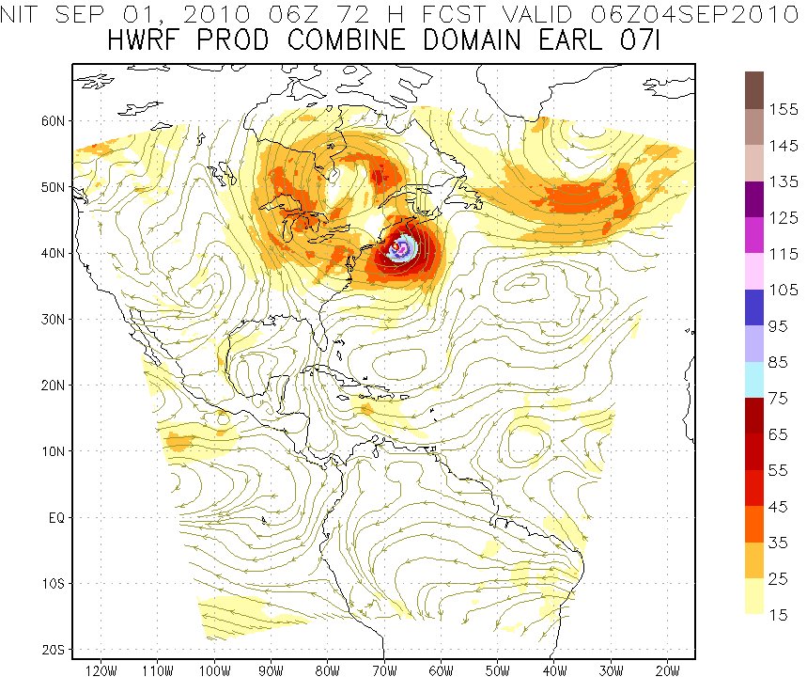
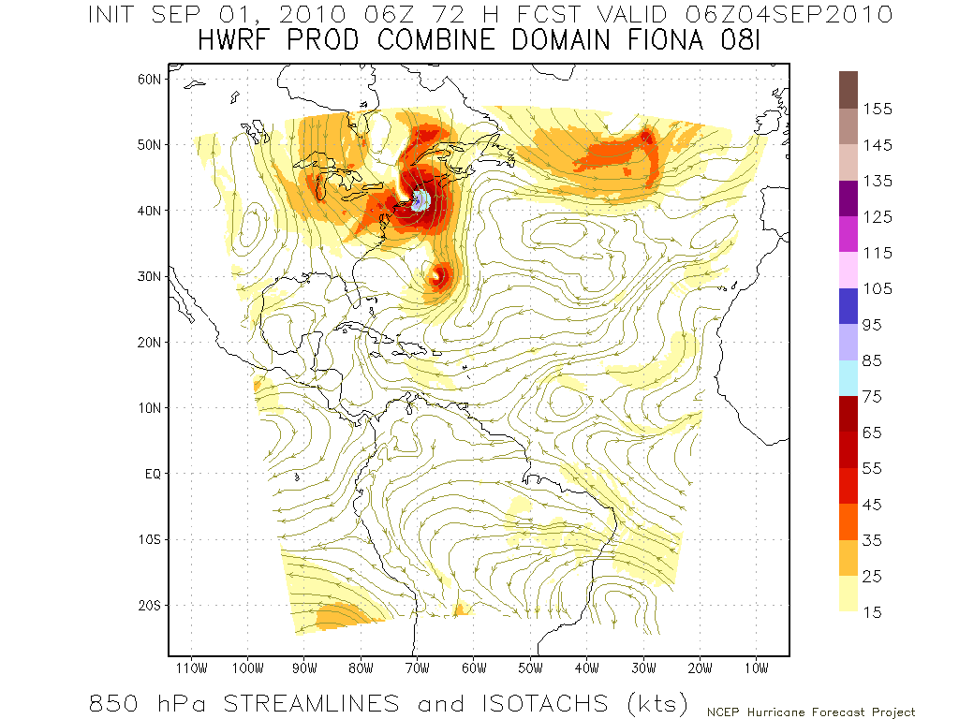
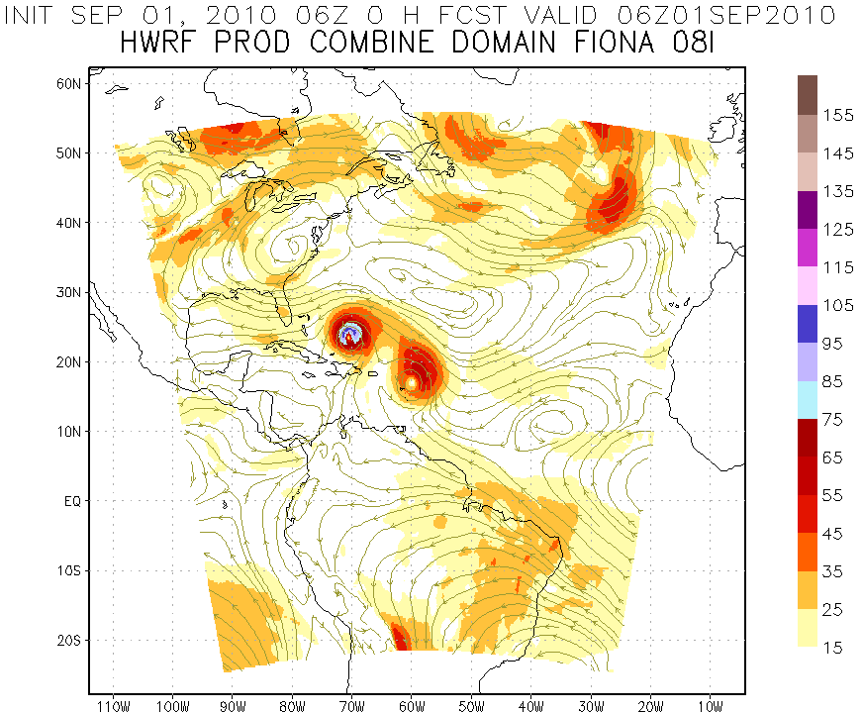
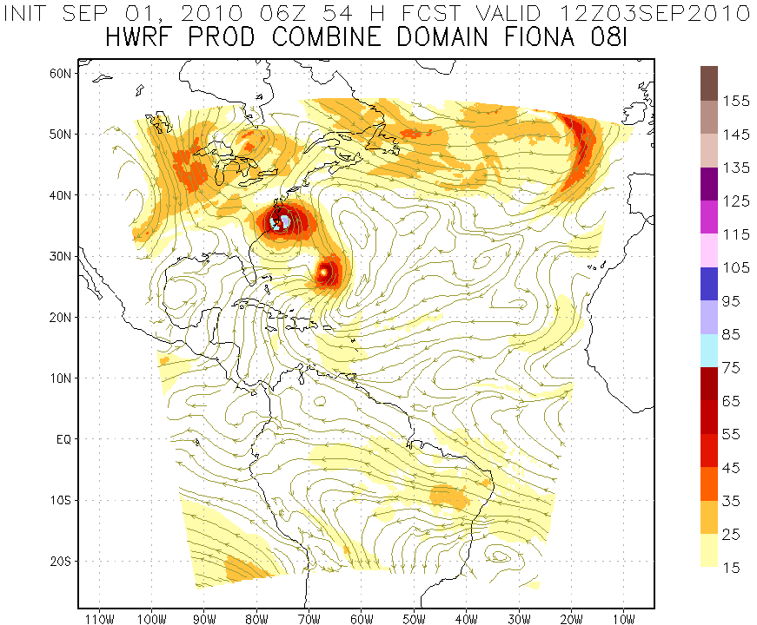
Regional Model Development: Storm-storm interactions?
Earl
Earl
Earl
Fiona
Initialize Earl Vortex
850hPa Streamlines and Isotachs (kts)
Earl
Earl
Earl
Fiona
Fiona
Fiona
Initialize Fiona Vortex
http://www.emc.ncep.noaa.gov/gc_wmb/vxt
Notes:
Example of initialization problem hen two storms are in the same outer nest for each initialization time. Forecast performance depends on which storm initialization you look at. In this case when initializing for Earl the forecast looks similar to best track. However, forecast initialized for Fiona at the same time looks nothing like reality with Fiona remaining a weak hurricane and has Earl making landfall in the outer banks.

Slide 10
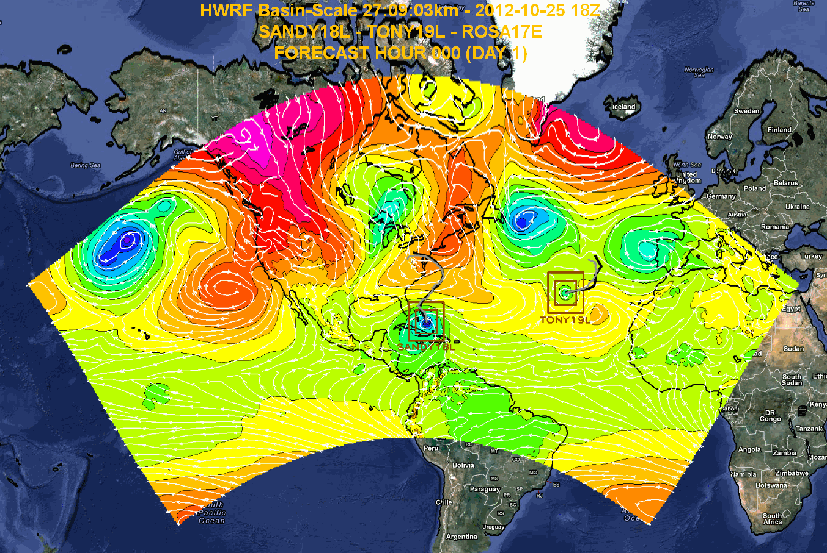
Regional Model Development: HWRF Basin-Scale
Regional Model Team - Gopal, X. Zhang, T. Quirino AOML/HRD
Notes:
Earl and Danielle forecast initialized at 0000Z 27 August 2011
Large “basin-scale” domain is at 27 km resolution with inner nest at 9-km using operational HWRF as the basis. Outer domain covers the EPAC and ATL TC development regions with one domain which remains fixed from cycle to cycle.
10

Slide 11


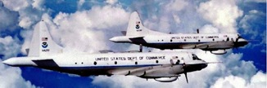
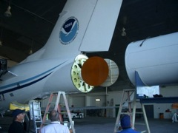
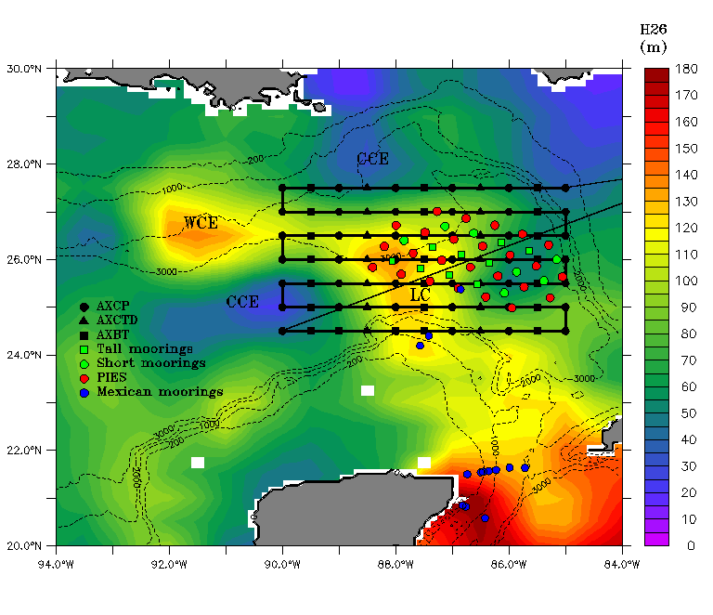

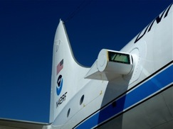
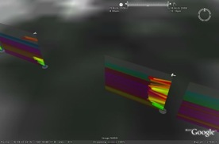
Improved Use of Observations:
HFIP & Intensity Forecast Experiment (IFEX)
In-situ
  Wind, press., temp.
Expendables
  Dropsondes
  AXBT, AXCP, buoy
Remote Sensors
  Doppler Radar
  SFMR/HIRAD
  WSRA
  Scatterometer/profiler
  UAS - LALE
Improve prediction of TC intensity change by:
  collecting observations through the TC life cycle
  developing and refining measurement technologies
  improving understanding of physical processes important in TC intensity change
GALE UAS
NASA Global Hawk
G-IV Tail Doppler Radar
AXBT profiles of Loop Current
ONR DWL
DWL profiles from TCS-08
Notes:
UR image depicts dropsonde profiles in eyewall of Hurricane Guillermo (1997)
LR image is Doppler Wind Lidar profiles from TCS-08
See IFEX paper (Rogers et al 2006): http://dx.doi.org/10.1175/BAMS-87-11-1523
HRD IFEX website: http://www.aoml.noaa.gov/hrd/HFP2011/index.html

Slide 12
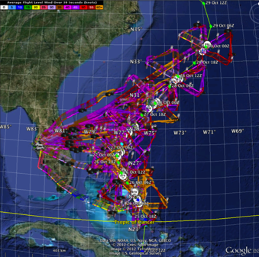
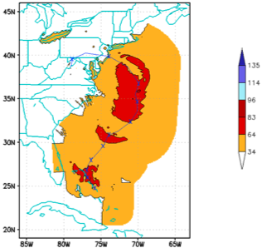
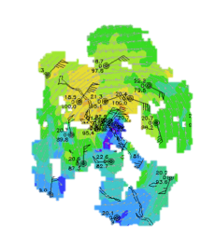
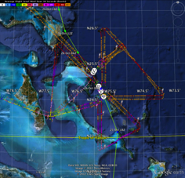
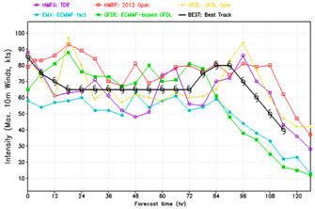
Improved Models & Data:
IFEX 2012: Sandy
4 P-3 Flights
22 August – 24 August 2011
TDR-Experiment: Doppler data transmitted in real-time for assimilation into HWRF
HWRF/GSI
20121026 00UTC
7 WP-3D TDR missions from 00 UTC 26 – 12 UTC 29 September 2012 at 12 h Doppler sampling (HEDAS/GSI)
3 G-IV missions (1 G-IV TDR mission)
Sampled Hurricane Sandy from passage N of Cuba to landfall
HWRF/GSI
20121026 00UTC
Aberson, Aksoy, Gamache, Gopal (AOML/HRD), Tong (EMC)
Notes:
Map shows flight tracks for all of the NOAA missions (color coded are the flight level winds for the P-3 missions, dropsonde symbols denote G-IV patterns)
Flight track plots courtesy of Tropical Atlantic - http://tropicalatlantic.com/recon/
Model data available at: http://storm.aoml.noaa.gov/realtime

Slide 13
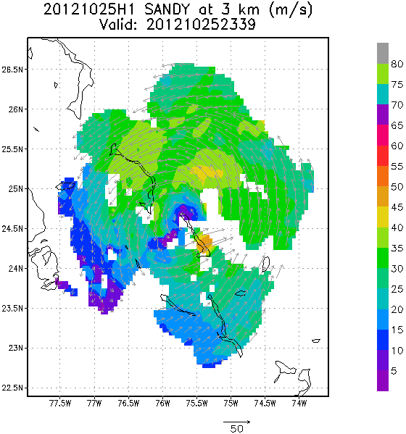
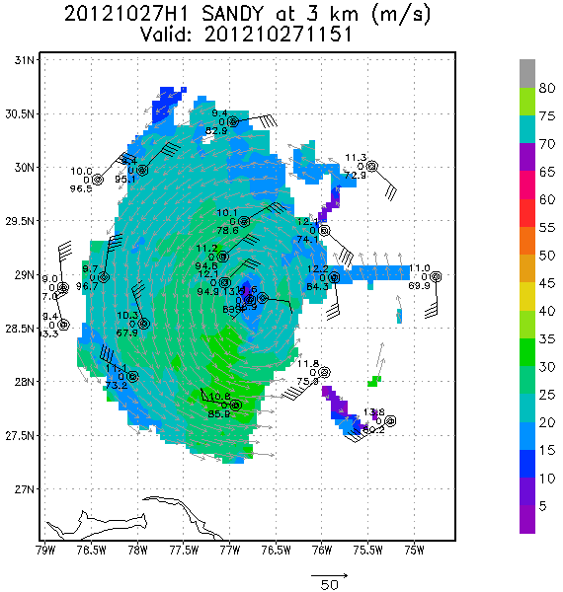
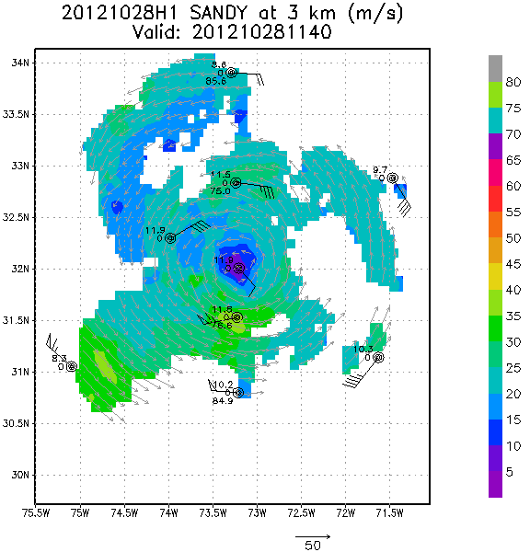
Improved Models & Data:
IFEX 2012: Sandy
Real-time P-3 Tail Doppler Composite at 3 km altitude
m/s
Flight 121025H1
Flight 121027H1
Flight 121028H1
S. Murillo, P. Reasor (AOML/HRD)
Notes:
Colors denote Doppler winds and station codes denote dropsondes
West-east vertical cross section of wind speed (shaded, m/s).

Slide 14
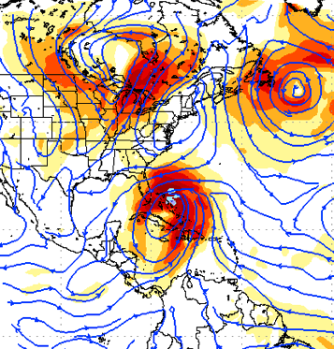
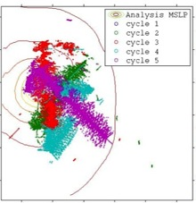
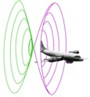
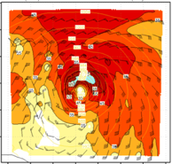
Improved Models & Data:
Assimilation of data into models
Synergy of high resolution forecast and airborne observations
P-3 and G-IV QC Doppler observations
Data assimilation
Improving initial condition in storm core region
Improving high resolution regional forecast
Wind intensity at 10 m
Hurricane Sandy (2012)
F. Zhang (PSU), Tong (EMC), Aberson, Aksoy, Gamache (AOML/HRD)
Notes:
See papers: Zhang et al (2011) - http://www.agu.org/pubs/crossref/2011/2011GL048469.shtml
Aksoy et al (2012) - http://dx.doi.org/10.1175/MWR-D-11-00212.1

Slide 15
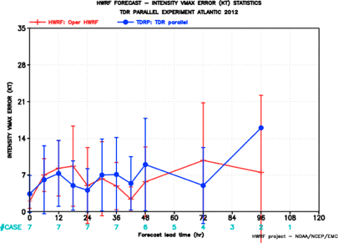
Improved Models & Data:
Impact of airborne Doppler radar
HRD HWRF/EnKF
EMC HWRF/1-Way Hybrid/GSI
All cases with Doppler data Hurricane Sandy
PSU WRF/EnKF
3 HFIP teams assimilated TDR data in real-time
EMC (Tong)
HRD (Aberson)
PSU (F. Zhang)
With TDR
F. Zhang (PSU), Tong (EMC), Aberson, Aksoy, Gamache (AOML/HRD)
Notes:
Intensity Error (kt) of Models for all Sandy cases with airborne Doppler data available from NOAA P-3
See papers: Zhang et al (2011) - http://www.agu.org/pubs/crossref/2011/2011GL048469.shtml
Aksoy et al (2012) - http://dx.doi.org/10.1175/MWR-D-11-00212.1

Slide 16
Improved Models & Data:
Impact of airborne Doppler radar
% Improvement over HFIP baseline
cases
All cases with Doppler data 2008-2011
Aircraft data impact
Need help of Research community to address
F. Zhang (PSU), Aberson, Aksoy, Gamache (AOML/HRD)
Notes:
Intensity Error of Models for all cases (2009-2011) with airborne Doppler data available from NOAA P-3s (% Improvement over HFIP baseline – average intensity error for three years of operational model guidance errors for 2006-2008 when HFIP began)
Black lines are the baseline intensity skill (solid), 20%improvement threshold (large dash), and 50% improvement threshold (small dash)
Green lines represent the average intensity errors for two different regional models: small dash - Advanced Research WRF or ARW used by the bulk of the research community; and solid - high-resolution research version of HWRF developed at HRD and transitioned to EMC for operational implementation this summer
Red line is the average intensity error for the high-resolution research HWRF without the Doppler data
Note that from 36-96 h the average error is very close to or exceeding the 20% improvement threshold for HFIP at 5 years
We are busily investigating the reason for lack of improved skill from 0-24 h when the data should have the most impact. We identified some model biases due to physical parameterizations which we are working with EMC to correct thanks to the ability to use observations to improve the initial conditions.
See papers: Zhang et al (2011) - http://www.agu.org/pubs/crossref/2011/2011GL048469.shtml
Aksoy et al (2012) - http://dx.doi.org/10.1175/MWR-D-11-00212.1

Slide 17
HFIP Success to Date
HFIP focused research efforts within NOAA & interagency partners
HFIP defined solution to transition research into operations with Stream 1.5 products available to NHC forecasters in real-time
  Transitioned global hybrid DA system and 3-km HWRF into operations this season
HFIP making significant progress – 5-year goals within reach
  Global ensembles providing 20% improvement in track guidance
  Improved model initialization and higher resolution models, along with inner core data shows significant (20-40%) improvement in intensity
  3-5 day lead-time hurricane genesis product
http://www.hfip.org/documents/reports2.php
Notes:
http://www.hfip.org/documents/reports2.php

Slide 18
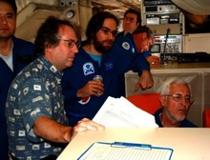
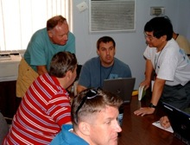

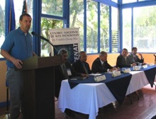
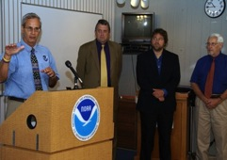
Keys to Success
  Partnership: NOAA Research working closely with NOAA Operations, and Federal & Academic Partners (NASA, NSF, ONR, NRL, NCAR)
  More integrated use & support of Testbeds (JHT, DTC, JCSDA)
  Blend traditional hurricane and HFIP research activities
  Manpower (diversity) to evaluate model performance with hurricane data sets is a critical need
CBLAST
IFEX/RAINEX
DOTSTAR
IFEX/TCSP
IFEX/PREDICT/GRIP

Slide 19
Questions?

Slide 20
HFIP Technical Scope
What NOAA HFIP Funds
Builds and tests the technology necessary to transition hurricane research to NWS operations:
  Advance hurricane forecast system/global forecast system to reduce error in intensity and track guidance
  Make better use of existing observing systems; define requirements for future systems to enhance research and operations capabilities and impacts
  Expand and improve forecaster tools and applications to add value to model guidance
Does not include the acquisition or operation of “operational” observing systems
HFIP bridges Research and Operations
Notes:
Much of the improvement in tropical cyclone forecasting is attributed to advances in regional and global NWP modeling systems. These advances are mainly the result of: improvements in observations; data assimilation techniques; improved model physics in global forecast systems and high resolution regional models; the development of ensemble-based model guidance; and significant investments in supercomputing at operational NWP centers.
The HFIP Portfolio has 3 major components that describe WHAT needs to be done to achieve our goals.
Model improvements
Focuses on the strategies to optimize new and existing observing system and platforms for BOTH modeling and direct use by the forecasters
More tools and applications beyond traditional models and direct obs into the forecasters suite of tools

Slide 21
HFIP Charter and Leadership
HFIP Charter signed August 1, 2007
Hurricane Executive Oversight Board
  Jointly chaired by AA for National Weather Services and AA for Oceanic and Atmospheric Research
    Laura Furgione, NWS Director (Acting), co-chair
    Dr. Bob Detrick, AA for OAR, co-chair
  Cross-NOAA Membership
HFIP Management
  Project Manager: Fred Toepfer, NWS/OST
  Development Manager: Robert Gall, UCAR, IPA
  Research Lead: Frank Marks, OAR/AOML/HRD
  Operations Lead: Ed Rappaport, NWS/NHC

Slide 22
Scientific Research Committee Membership
Name Organization Area of Expertise Term of Service
Mike Montgomery NPS TC dynamics 3 years
Dave Nolan Miami TC regional models 3 years
Gary Barnes UH/Manoa TC structure 3 years
Jim Price Woods Hole Coupled models 2 years
Bob Hart FSU TC environment interaction 2 years
Jim Goerss NRL Monterey Global models/ensembles 2 years

Slide 23
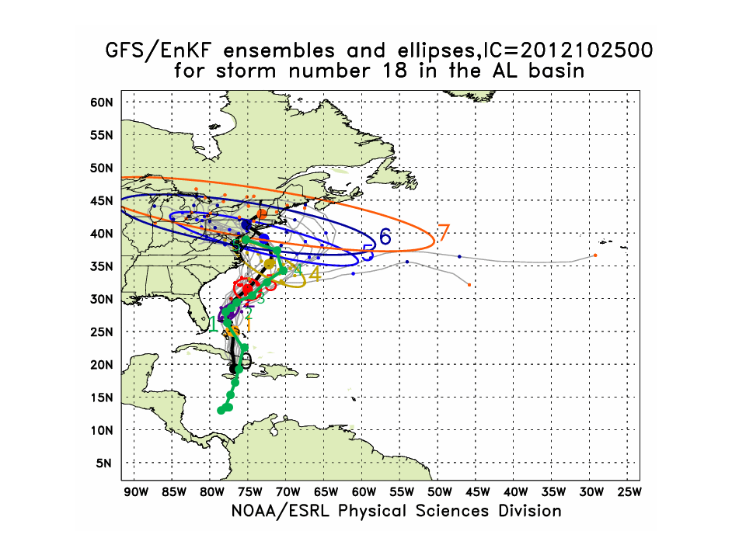
Global Model Development – Ensemble – Uncertainty
Numbers indicate time in days from beginning of forecast
Ensemble Mean
5 day forecast before landfall
Observed
Sandy Named 10/22/12 06Z
HFIP Global Ensemble Forecast
Hurricane Sandy 00Z Thursday 10/25/2012
Global Model Team - Tom Hamill & Jeff Whitaker (ESRL)
Notes:
In the case of Irene new tools to forecast genesis developed by HFIP using the HFIP global model ensembles from GFS/EnKF (30 members) and FIM (10 members) were able to detect and track the system that formed into Irene 5 days before it was named by NHC and 2 days before NHC declared it an INVEST area
Thin black lines are the disturbance tracks from each of the ensemble members, the small black dots the location of each of the ensemble members at 24 h intervals after the initial time, and the colored ellipses enclose 75% of the ensemble positions. Note that the ellipses elongate along track (reflecting speed uncertainty) in the early forecasts, and elongate perpendicular to the track (reflecting uncertainty in the storm turn to the N at the later forecast times. At day 3 & 4 when the storm was named the uncertainty is the least.
The solid green line is the observed Best Track from NHC starting when the storm was named.
Model data available at: http://www.esrl.noaa.gov/psd/forecasts/gfsenkf/ens/

Slide 24
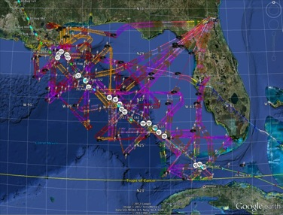
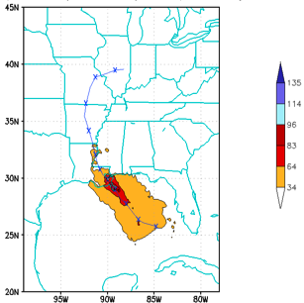
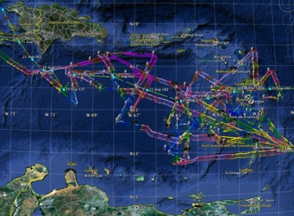
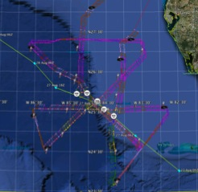


Improved Models & Data:
IFEX 2012: Isaac
4 P-3 Flights
22 August – 24 August 2011
HWRF/GSI
20120827 12UTC
Doppler data transmitted in real-time for assimilation into HWRF
5 P-3 Flights
26 August – 28 August 2011
4 missions from 22-24 Aug 2012 and 5 missions from 26-28 Aug 2012 at 12 h Doppler sampling (HEDAS/GSI) & 6 G-IV missions
Sampled Isaac as a tropical storm to hurricane at landfall
HWRF/GSI
20120827 12UTC
Aberson, Aksoy, Gamache, Gopal (AOML/HRD), Tong (EMC)
Notes:
Map shows flight tracks for all of the NOAA missions (color coded are the flight level winds for the P-3 missions, dropsonde symbols denote G-IV patterns)
Flight track plots courtesy of Tropical Atlantic - http://tropicalatlantic.com/recon/
Model data available at: http://storm.aoml.noaa.gov/realtime

Slide 25


Improved Models & Data:
Assimilation of data into models
Synergy of high resolution forecast and airborne observations
P-3 and G-IV QC Doppler observations
Data assimilation
Improving initial condition in storm core region
Improving high resolution regional forecast
Wind intensity at 10 m
Hurricane Isaac (2012)
F. Zhang (PSU), Aberson, Aksoy, Gamache, Gopal (AOML/HRD)
Notes:
See papers: Zhang et al (2011) - http://www.agu.org/pubs/crossref/2011/2011GL048469.shtml
Aksoy et al (2012) - http://dx.doi.org/10.1175/MWR-D-11-00212.1

Slide 26









VORTEX-SCALE HURRICANE DATA ASSIMILATION
EVOLUTION OF THE STRUCTURE OF ISAAC
08/23 00Z
08/27 00Z
08/29 00Z
Puerto Rico
It took Isaac more than a week to consolidate its wind circulation
New Orleans
Florida Keys
10-m Wind Speed
Cuba
While in the Caribbean (08/23), Isaac had a disorganized wind structure and no clear-cut warm core
Caribbean Sea
Barbados
700-hPa Wind Speed
Isaac became organized as it passed the Florida Keys (08/27), but still had a very tilted wind structure
The wind structure finally consolidated just before landfall near New Orleans (08/29) as Isaac became a hurricane
700-hPa Temp. Pert.

Slide 27


VORTEX-SCALE HURRICANE DATA ASSIMILATION
IMPACT ON THE FORECASTS OF ISAAC
Track Error (km)
Intensity Error (kt)
+
+
HWRF: Operational HWRF Forecast
HWEK: Parallel HWRF Forecast with Vortex DA (lower error is better)
Freq. of Superior Performance of HWEK against HWRF (above 50% indicates non-random improvement)
For Isaac, short-range (up to 48 h) HWRF forecasts initialized with
vortex-scale data assimilation were superior to the
operational HWRF forecasts in both track and intensity

