Slide 1
NOAA Hurricane Forecast Improvement Project
Frank Marks
NOAA/AOML Hurricane Research Division NOAA HFIP Research Lead
1 May 2012
Notes:
Hurricane Earl 2 September 2010

Slide 2
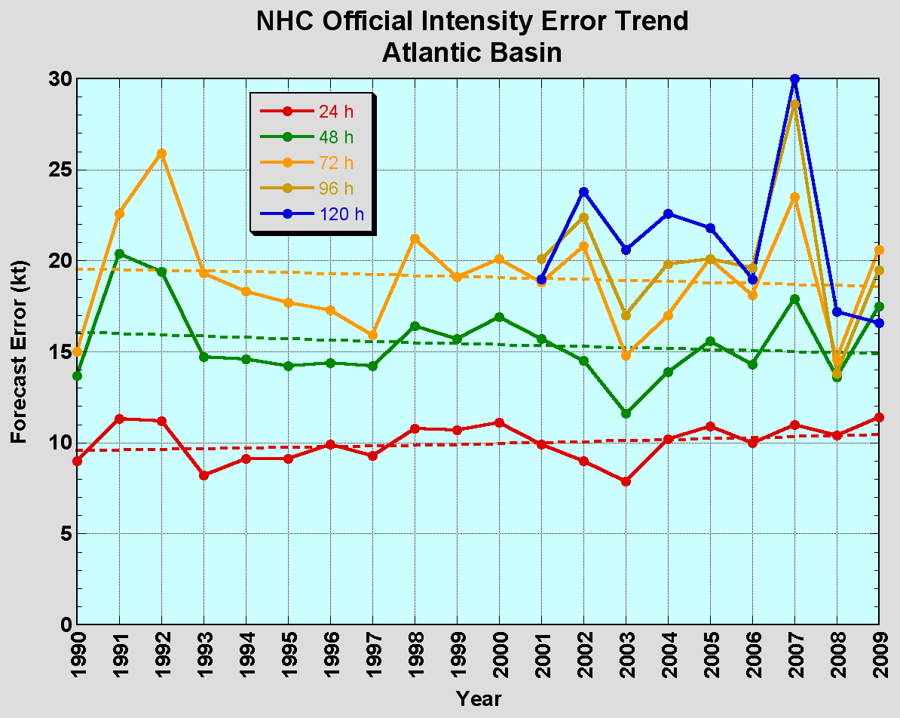
The Good – track forecast improvements
Current Capabilities
The Bad - Intensity no real gains
No progress with intensity in last 15-20 years
Errors cut in half over past 15 years
10-year improvement - As accurate at 48 hours as we were at 24 hours in 1999
24-48h intensity forecast off by 1 category
Off by 2 categories perhaps 5-10% of time

Slide 3
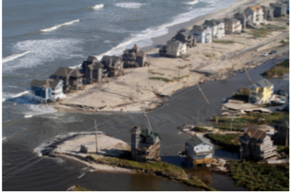
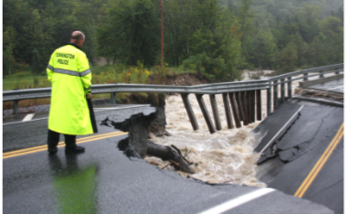
Improvements still needed!
NOAA’s National Weather Service (NWS) mission is to fulfill this commitment through building a Weather Ready Nation.
NWS must contribute to hazard resiliency by continually assessing and improving its services to the Nation.
Hurricane Irene (2011):
41 deaths
$7 to $10 Billion damage
Major infrastructure losses
Power lost to 8 million
Virginia Beach, Va
Hatteras Island, N.C.
Woodford, Vt.
Jim R. Bounds/AP
Austen Danforth/Bennington Banner/AP
Brendan Hoffman/Getty Images

Slide 4
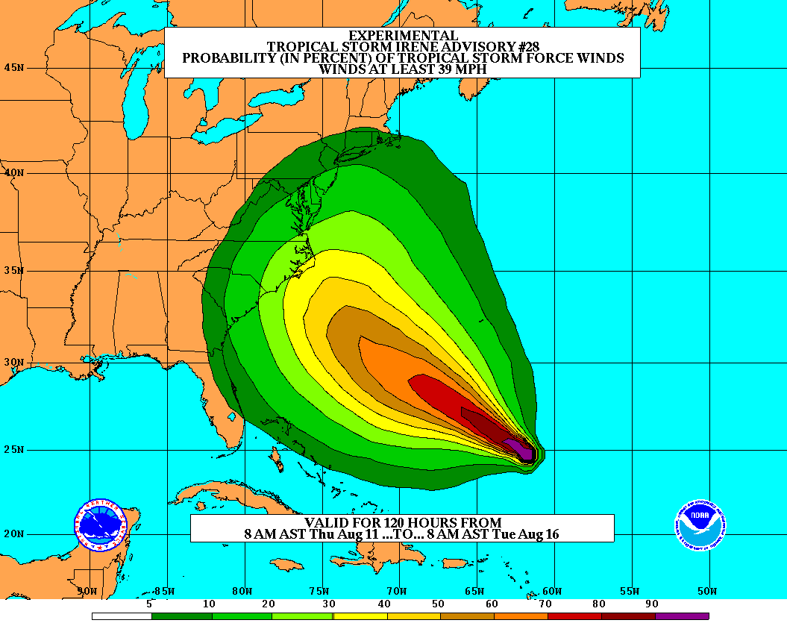
Goals
Improve Forecast Accuracy
Hurricane impact areas (track) – 50% in 10 years
Severity (intensity) – 50% in 10 years
Storm surge impact locations and severity
Extend forecast reliability out to 7 days
Quantify, bound and reduce forecast uncertainty to enable risk management decisions
Notes:
http://www.nrc.noaa.gov/HFIPDraftPlan.html
HFIP Team
Frank Marks, research lead
Ed Rappaport, operations lead
Fred Toepfer, project manager
Robert Gall, development manager
Mark DeMaria
Chris Fairall
Jim McFadden
Scott Kiser
Daniel Melendez
Roger Pierce
HFIP executieve oversight board:
OAR DAA/Sandy MacDonald, co-chair
NWS AA/Jack Hayes, co-chair
NCEP/Louis Uccellini,
TPC/Bill Read,
NESDIS/Mark DeMaria,
NOS/Jesse Feyen,
AOML/Bob Atlas
PPI/Paul Doremus
NMFS/Bonnie Ponwith,
NOS/Liz Scheffler,
NMAO-PM Aircraft/Phil Kenul,
OFCM/Sam Williamson
Executive Secretariat: OAR/Joseph Bartosik and NWS/John Iacabucci

Slide 5
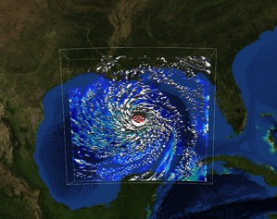
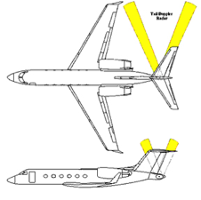
How to get there?
Science (9 Teams)
Improved understanding by combining observations & models
Higher resolution coupled models (hurricane/global) – critical to storm evolution forecasts – especially intensity changes
Forecast techniques to communicate uncertainty (ensemble)
Information Technology
Increased computing power - run advanced hurricane/global models and reduce uncertainty
IT infrastructure for inter-agency data exchange
Observing Strategy
Improved use of existing and planned systems
Improved Products for Forecasters
Notes:
HFIP 2008-2009 activities
HRH Workshop:
http://www.dtcenter.org/plots/hrh_test/workshop2009/presentations/1_Gall_HRH%20HFIP%20presentation.pdf
http://www.dtcenter.org/plots/hrh_test/index.php
HFIP-TACC Real-time test
ftp://ftp.aoml.noaa.gov/pub/hrd/marks/HFIP-TACC_Summary.pdf
Diagnostics Team Workshop:
http://rammb.cira.colostate.edu/research/tropical_cyclones/hfip/workshop_2009/

Slide 6
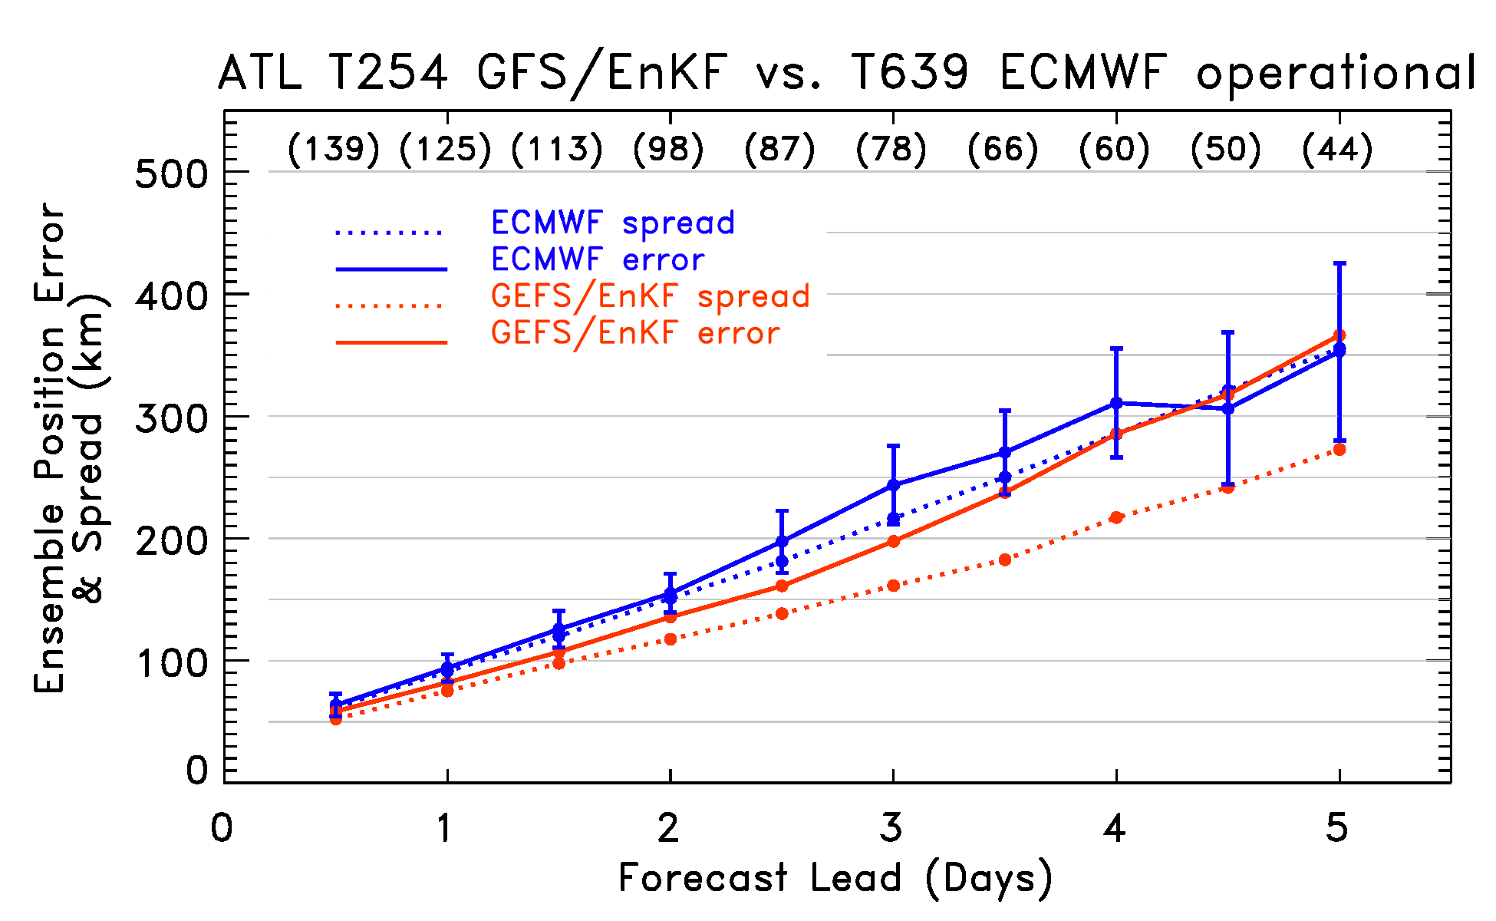
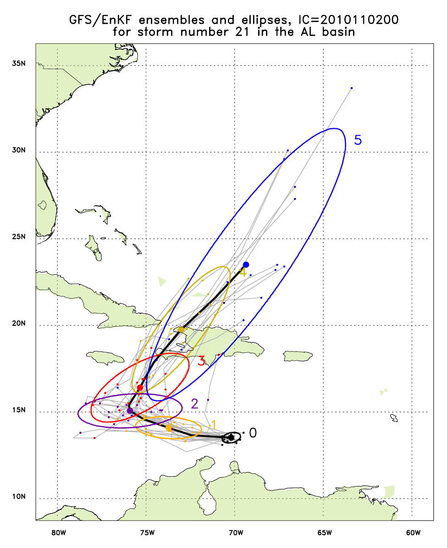
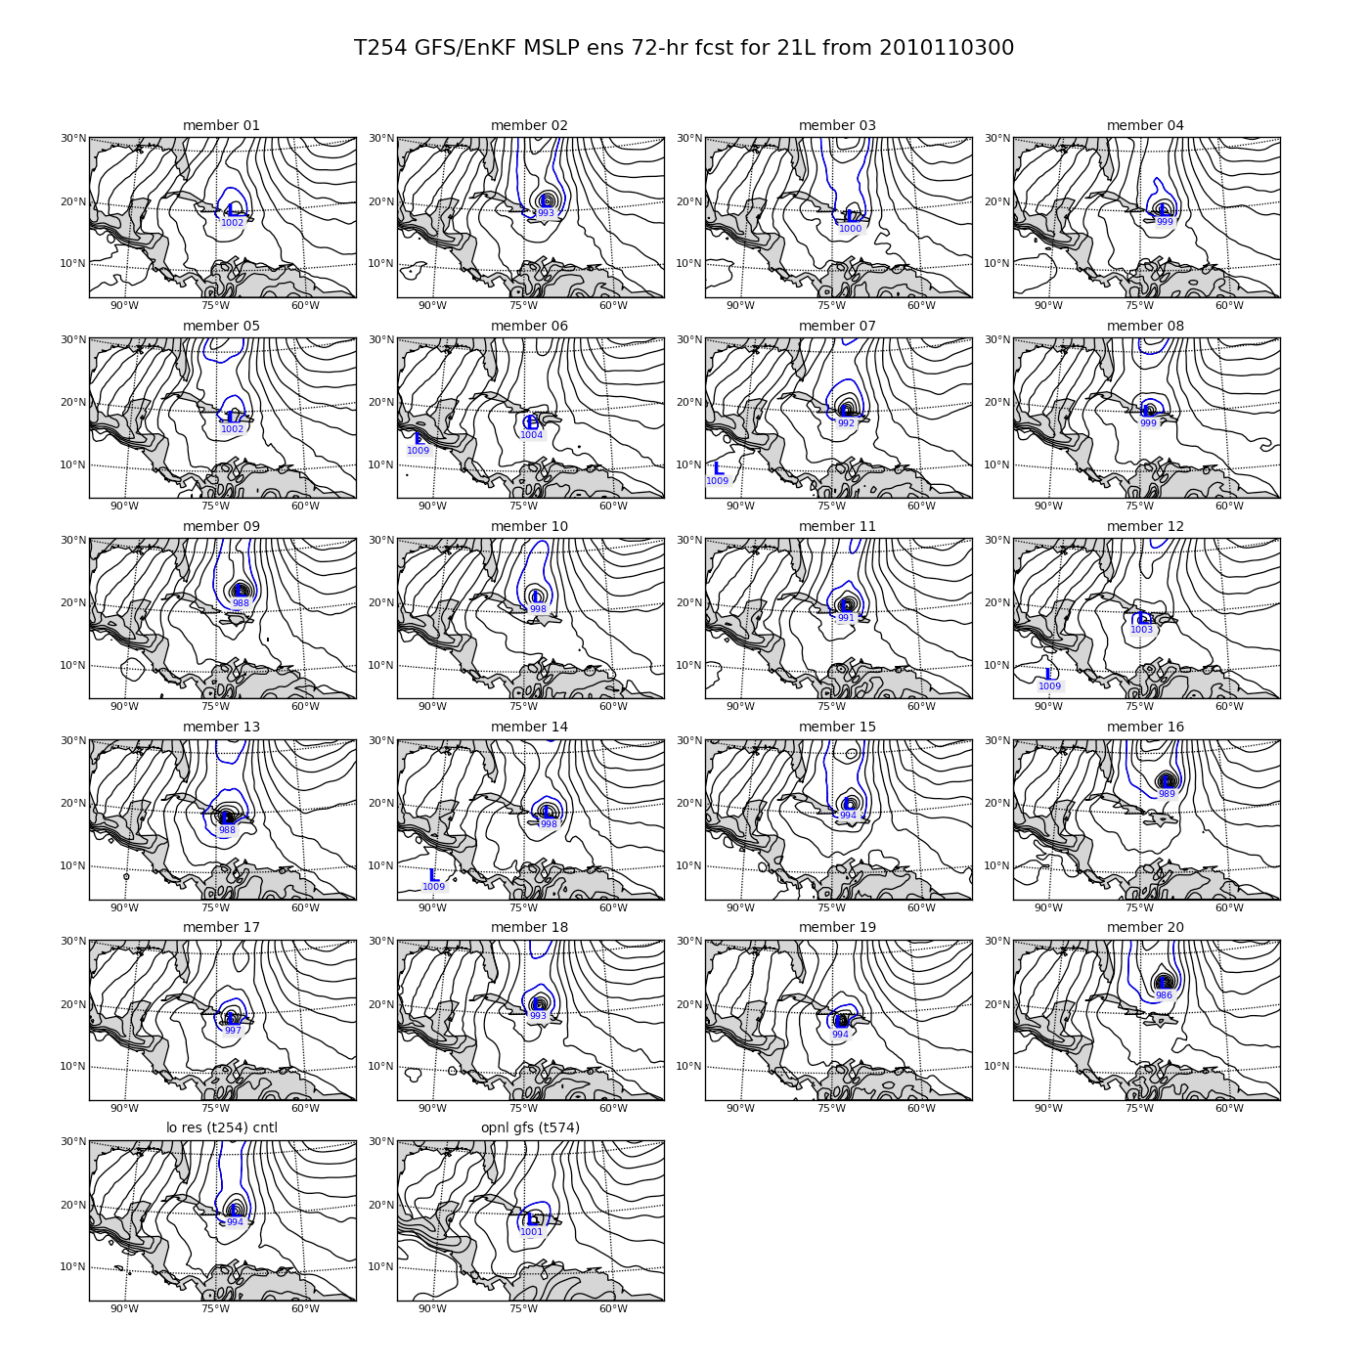
Global Model Development – GFS/EnKF
Tomas (21L) – init 00Z 2 November
http://ruc.noaa.gov/hfip/gfsenkf
Global Model Team - Tom Hamill & Jeff Whitaker (ESRL)
Notes:
Global Ensembles:
80-member T254 GFS ensembles cycled every 6-h continuously from 1 August to current time
Look at 20 members of the 80 member ensemble
Left panels shows ellipse plot of 20 members at each forecast time – ellipse shape shows the spread along/across track
Right panel show surface pressure post stamp images of 20 members

Slide 7
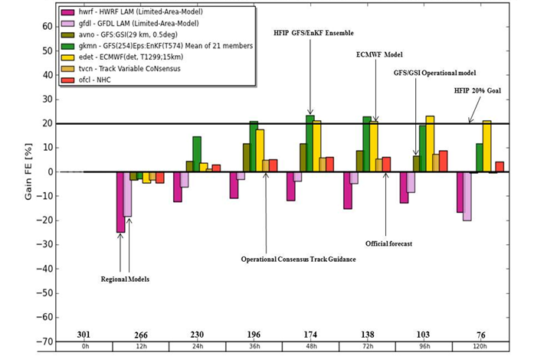
Global Model Development
Track Error (2010-2011)
Global Model Team – Mike Fiorino (ESRL)

Slide 8
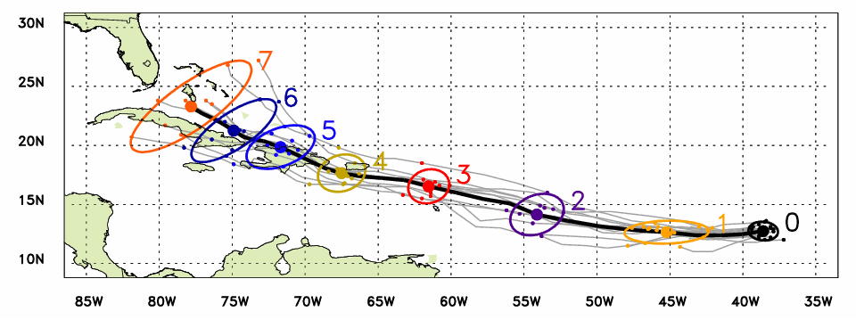
Global Model Development - Genesis
Observed Track (Aug 21 – 26)
Ensemble mean track
Ellipse includes 80% of members
Forecast lead time in days
Irene named
Irene declared an investigation area at 1200Z on August 18, 2011
Irene named at 0000Z August 21, 2011
Initial indication of the formation of Irene from ensemble at 00Z 16 August 2011
2 days before it was declared an investigation area
5 days before it was named
Global Model Team - Tom Hamill & Jeff Whitaker (ESRL)

Slide 9
Regional Model Development: HWRF
NCEP Operational HWRF (2.0) 2007
AOML/HRD Research HWRF (V3.0.1) 2008
High-resolution research HWRF system compliments operations
Improved resolution and improved understanding of forecast at 3 km resolution
Incorporate observations on vortex scale for improved model initialization
Incorporate appropriate representation of physical processes in tropics for 1-3 km resolution
Code management and community support through unified repository supported by DTC
HWRF Vortex
Assimilation & GSI
WRF pre-processing system Flexibility for testing initial
Conditions for research
Hurricane EnKF Data
Assimilation System (HEDAS)
NMM dynamics with
one moving nest
NMM dynamics with
multiple moving nests
Operating resolution 27:9
Operating resolution
27:9, 9:3 and 27:9:3
Ocean Coupled
GFDL/GFS Physics/
Slab LSM
GFDL/GFS Physics/
NOAH LSM Consistent w/ 3 km res.
Framework also
Includes Idealized
Cases/ 1-D HYCOM
HWRF post-processor
& HPLOT
Diapost: High Res. Hurricane Post-Processing system
Tropical Prediction System
(HWRF-GEN) Basin-Scale &
Multiple-Movable Nests and Hybrid/Ensemble DA
Release Version HWRF V3.2
HFIP Stream 1.5 Real-Time Configuration in 2011
Operational HWRF (2011)
2012
operational HWRF
Coupling to HYCOM, Waves, NOAH LSM, Storm Surge and Inundation models, Hybrid DA, HWRF Ensembles, Other TC basins

Slide 10
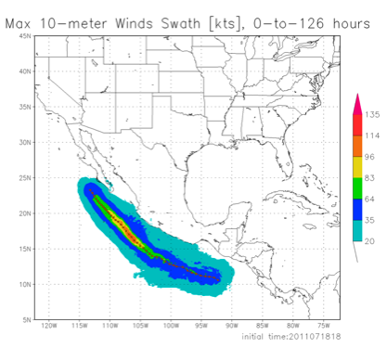
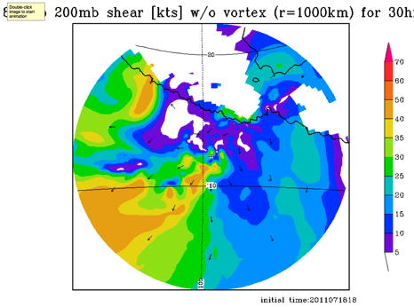
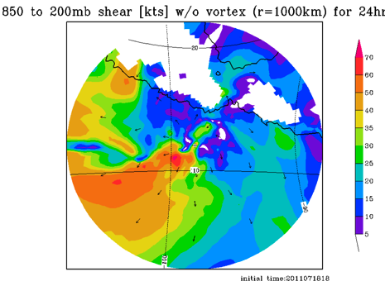
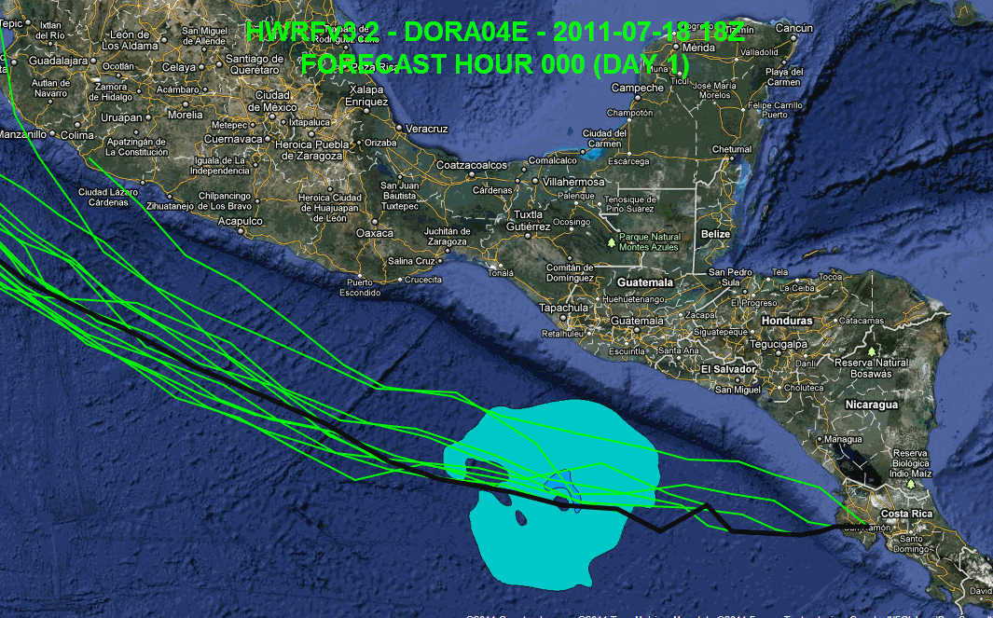
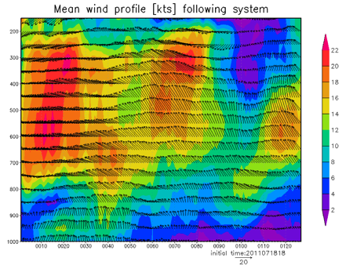
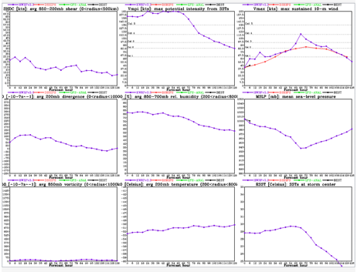
Regional Model Development: HWRF
https://storm.aoml.noaa.gov/realtime
HFIP stream 2/1.5 (27/9/3 km resolution)
Advanced nesting algorithm providing resolutions to 3 km
Viable operational pathway & potential transition to operations
Pathway to Improved structure and intensity predictions*
Extension of initialization algorithm down to 3 km resolution
All Storms of 2011 (4 cycles/day)
19 main products; e.g.,
Synthetic microwave imagery
SHIPS predictors
Shear and Steering
Time-height cross-sections
Swaths (wind and rainfall)
Regional Model Team - Gopal, Xuejin Zhang, Kevin Yeh, AOML/HRD
Notes:
Demo 2011 season; Not only we have improved the products but also added a suite of NOAA HWRF systems at different configurations.
Example of Hurricane Dora 2004 (initialized at 18Z on 18 July 2011)
Top left: 10-m wind swath for 126 h forecast
Bottom left: time-height cross section of mean wind over 3 km nest centered on storm
Top right: storm-relative vertical wind shear on 3-km nest for 24 h and 30 h forecast – note decreasing NE shear over center
Bottom right: SHIPS type predictors for regional model
Overlay: moving 3-km inner nest showing 10-m wind evolution

Slide 11
Regional Model Development: HWRF
Regional Model Team - Gopal, Xuejin Zhang, Kevin Yeh, AOML/HRD
Notes:
Danielle, Earl and Fiona
3-km from 9:3 will be used as the base line for operations at 27:9:3
11

Slide 12
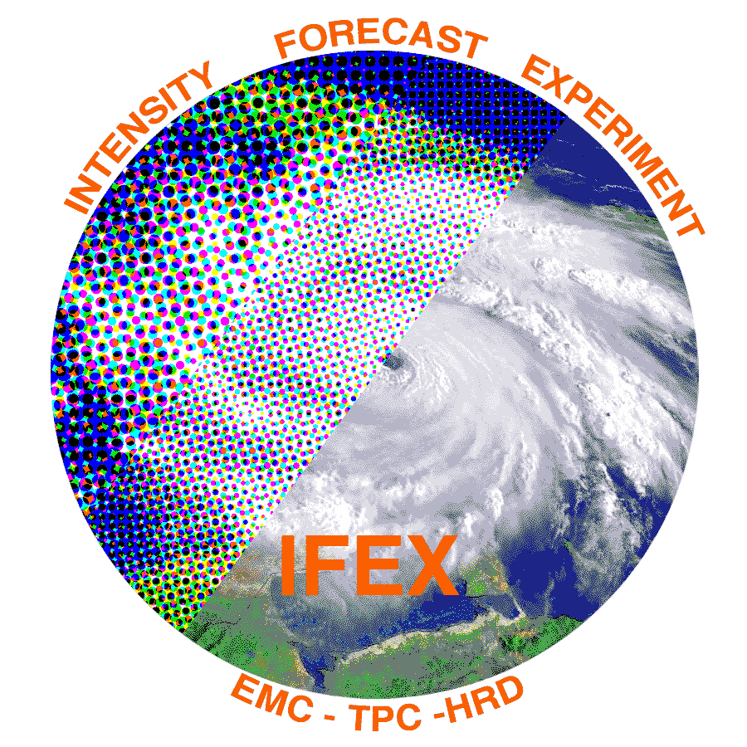
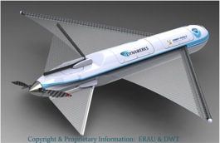
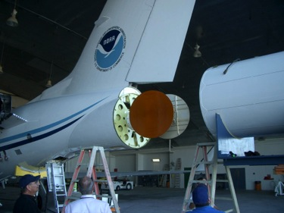
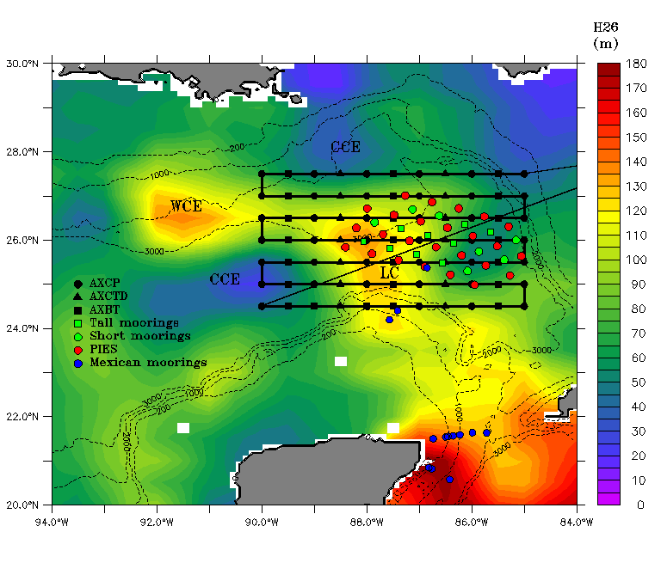
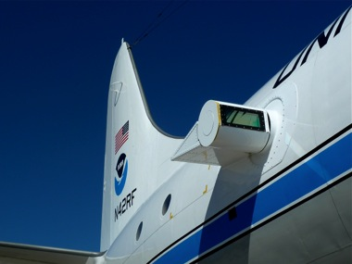
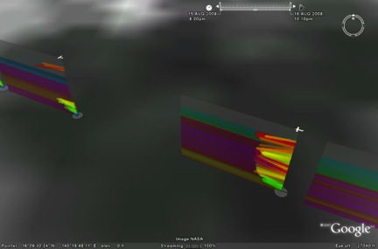
Improved Use of Observations: HFIP & Intensity Forecast Experiment (IFEX)
In-situ
Wind, press., temp.
Expendables
Dropsondes
AXBT, AXCP, buoy
Remote Sensors
Doppler Radar
SFMR/HIRAD
WSRA
Scatterometer/profiler
UAS - LALE
Improve prediction of TC intensity change by:
collecting observations through the TC life cycle
developing and refining measurement technologies
improving understanding of physical processes important in TC intensity change
GALE UAS
NASA Global Hawk
G-IV Tail Doppler Radar
AXBT profiles of Loop Current
ONR DWL
DWL profiles from TCS-08
S. Murillo, R. Rogers (AOML/HRD)
Notes:
UR image depicts dropsonde profiles in eyewall of Hurricane Guillermo (1997)
LR image is Doppler Wind Lidar profiles from TCS-08

Slide 13
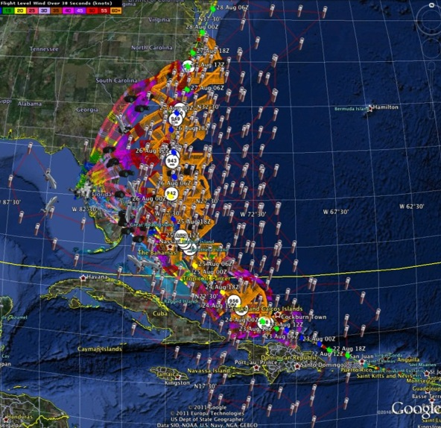
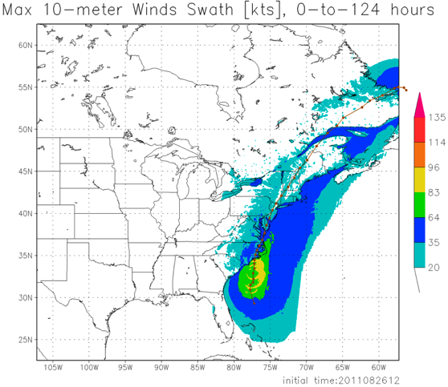
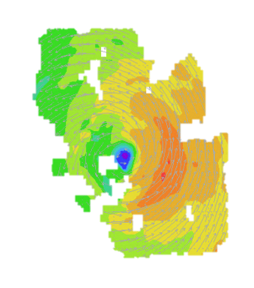
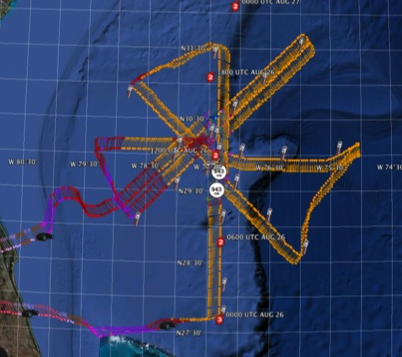
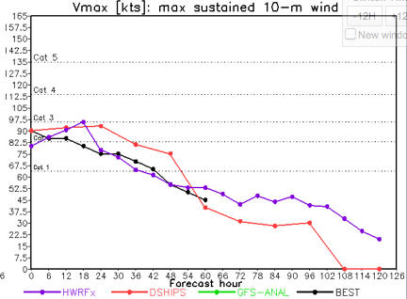
Improved Models & Data: IFEX 2011: Irene
HWRF/HEDAS
20110826 12UTC
Doppler SO (EnKF) transmitted in real-time for assimilation into HWRF
20110826I1
0926-1416 UTC
7 P-3 Flights
23 August – 27 August 2011
HWRF/HEDAS
20110826 12UTC
7 missions from 23-27 Aug 2011 at ~12 h sampling of Doppler SO (HEDAS) & 8 G-IV missions
Sampled Irene as a major hurricane through landfall
Aberson, Aksoy, Gamache, Gopal (AOML/HRD)
Notes:
Map shows flight tracks for all of the NOAA missions (color coded are the flight level winds for the P-3 missions, dropsonde symbols denote G-IV patterns)

Slide 14
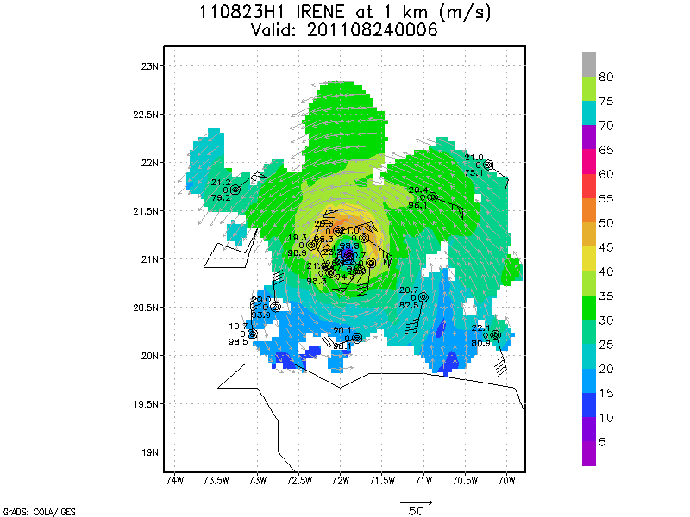
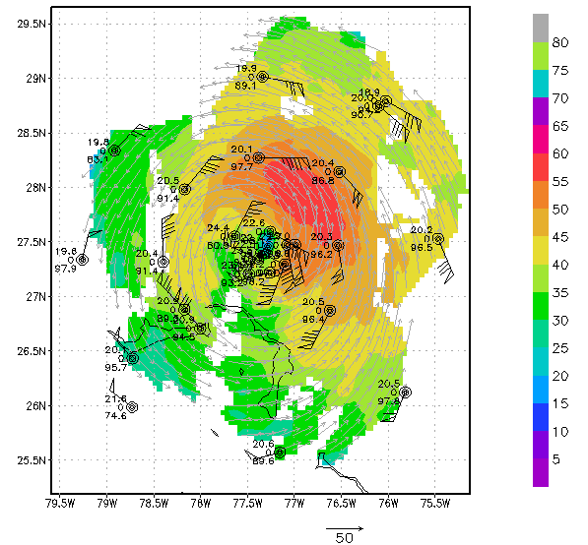
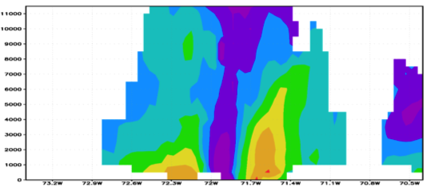
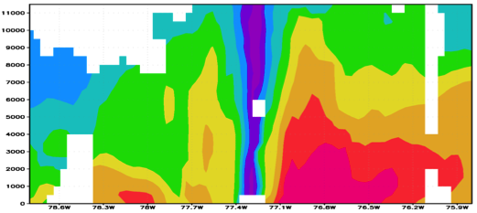
Improved Models & Data: IFEX 2011: Irene
Real-time P-3 Tail Doppler and Dropsonde Composite at 1 km altitude
m/s
Flight 110823H1
Flight 110825H1
South
North
South
North
S. Murillo, R. Rogers (AOML/HRD)
Notes:
Colors denote Doppler winds and station codes denote dropsondes
West-east vertical cross section of wind speed (shaded, m/s).

Slide 15
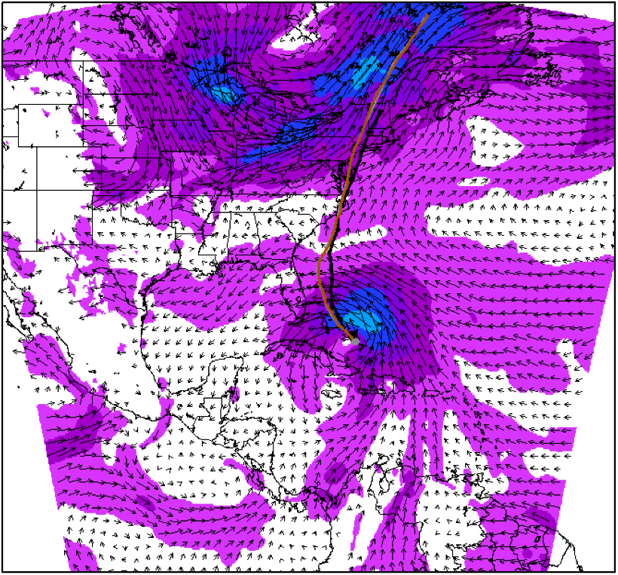
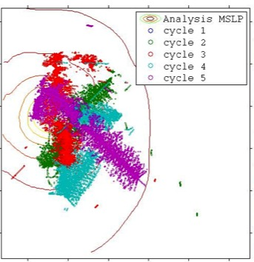
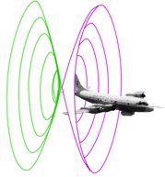
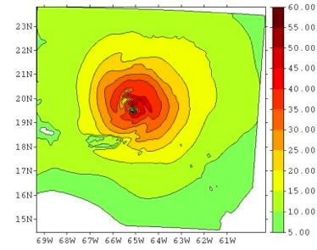
Improved Models & Data: Assimilation of data into numerical models
Synergy of high resolution forecast and airborne observations
P-3 and G-IV observations – superobs (SO)
Data assimilation
Improving the initial condition in storm core region
Improving the high resolution regional forecast
Wind intensity at 10 m
Hurricane Irene(2011)
F. Zhang (PSU), Aberson, Aksoy, Gamache, Gopal (AOML/HRD)

Slide 16
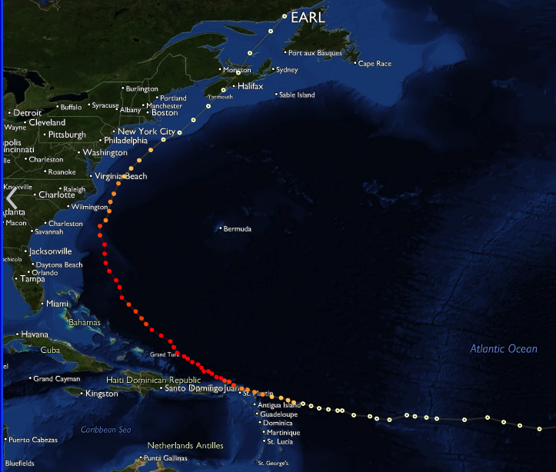
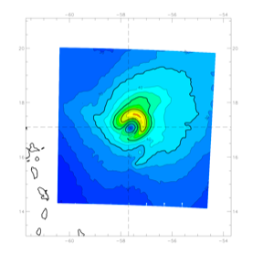
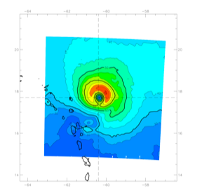
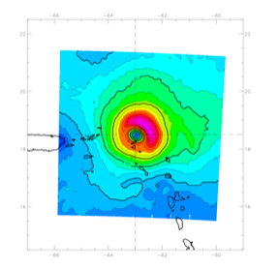
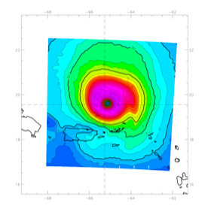
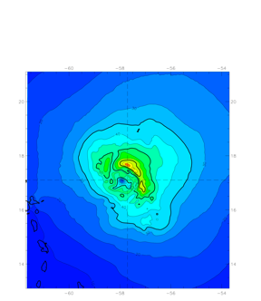
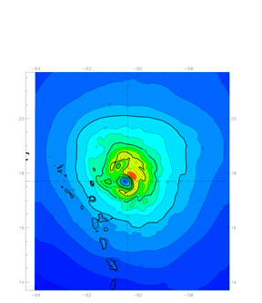
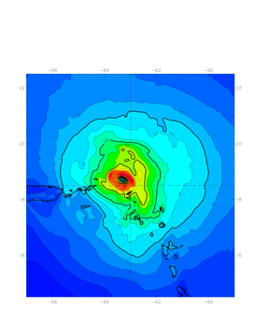
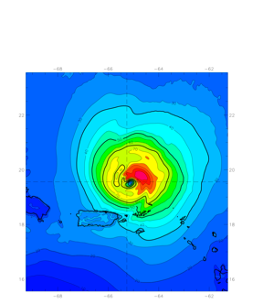
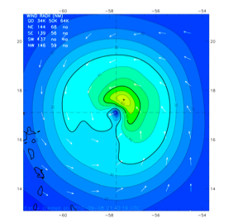
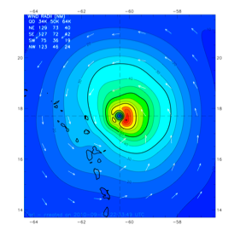
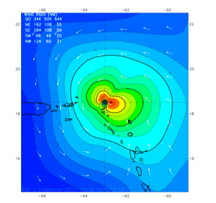
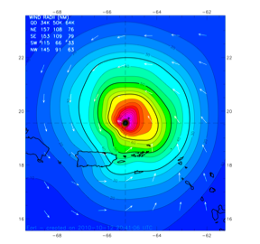
Improved Use of Observations: Assessing Doppler radar – HEDAS
08-29 12Z
08-30 00Z
08-30 12Z
08-31 00Z
4 assimilation cycles during RI
Forecast Initialized: 2010 08 29 12Z
2010 08 30 00Z
2010 08 30 12Z
2010 08 31 00Z
Ensemble Initialized 6-h before forecast
Data Assimilated:
NOAA42/43
Dropsonde * U V T Q (from RH)
Flight Level U V T Q (from TD)
SFMR Surface Wind
Tail Doppler Radar: Radial Wind
NOAA49
Dropsonde * U V T Q
Flight Level U V T Q
USAF WC-130
Dropsonde * U V T Q
Flight Level U V T Q
* No Surface T Q Assimilated for Drops
HWRF ICs
10-m Wind
Speed
HEDAS
10-m Wind
Speed
201008301800
955mb 125kts
201008291200
1007mb 30kts
Corresponding
H*Wind
Analysis
J. Gamache, A. Aksoy, T. Vukicevic, Gopal (AOML/HRD)

Slide 17
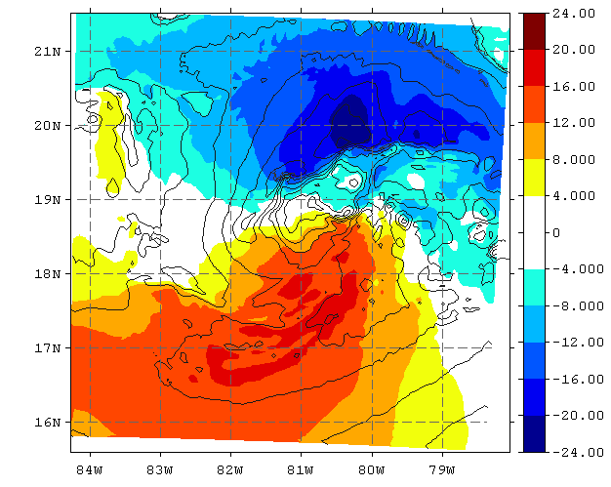
Improved Use of Observations: Observing Strategy Analysis
Use Model (HWRFV3.2) & DA (HEDAS) system to evaluate observing strategies in TC environments
Microwave satellite imagery (37- & 85-GHz)
Doppler radar
Microwave surface winds (SFMR, HIRAD)
Airborne Doppler radar
Nature: U (m/s)–shaded
Wind Speed–cont.
Analysis
Ens. Spread – shaded
Ens. Mean – contoured
Compare observed & simulated microwave T_{b}
Surface (10 m) Wind Speed (m/s)
SFMR
70 km wide HIRad swath 20 km alt.
E. Uhlhorn, T. Vukicevic, A. Aksoy, S. Lorsolo (AOML/HRD)

Slide 18
HFIP Success to Date
HFIP focused research efforts within NOAA & interagency partners
HFIP defined solution for transitioning research into operations with Stream 1.5 products available to NHC forecasters in real-time
HFIP making significant progress – 5-year goals within reach
Global ENKF ensembles providing 20% improvement in track guidance
Improved model initialization and higher resolution models, along with inner core data shows significant (20-40%) improvement in intensity
Demonstration of Skill for track at 7 days underway
3-5 day lead-time hurricane genesis product with acceptable POD’s and FAR’s in development
Still uncertain progress toward goal for POD/FAR of rapid intensification of 90%/10% at day 1 and 60%/40% at day 5.

Slide 19
Ongoing Challenges
Operational high performance computing resources – capacities and capabilities to meet HFIP goals
Appropriate physics packages, initialization for high resolution (1-3 km) regional models
Improved observing strategies for hurricane core and near storm environment –
Better use of satellite data at resolutions appropriate for hurricane
Aircraft/UAV data

Slide 20
HFIP Research Priorities
Advancement in DA techniques
Techniques to maximize the usefulness of observations
Identification and analyses of sources of model errors
Physics Advancements
Air-sea and BL processes
Microphysical/aerosol/radiation processes
Advanced model diagnostic techniques
Analyses and forecast of vortex low-order wavenumber evolution
Analyses and forecast of large-scale and hurricane environment evolution (e.g. shear/track)
Development of high resolution ensembles (little progress to date)
Identify techniques to utilize ensemble members for improved intensity guidance

Slide 21
Outreach
Our blog
http://noaahrd.wordpress.com
HRD Web page
http://www.aoml.noaa.gov/hrd
Facebook
http://www.facebook.com/noaahrd
Twitter
http://twitter.com/#!/HRD_AOML_NOAA
Tweets from the eye
Visiting scientist program

Slide 22
Questions?

