Slide 1
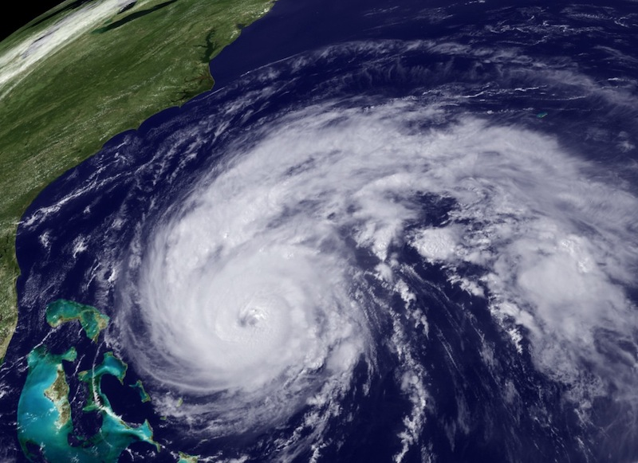
NOAA Hurricane Forecast Improvement Project
Frank Marks
NOAA HFIP Lead
8 March 2011
Notes:
Hurricane Earl 2 September 2010

Slide 2
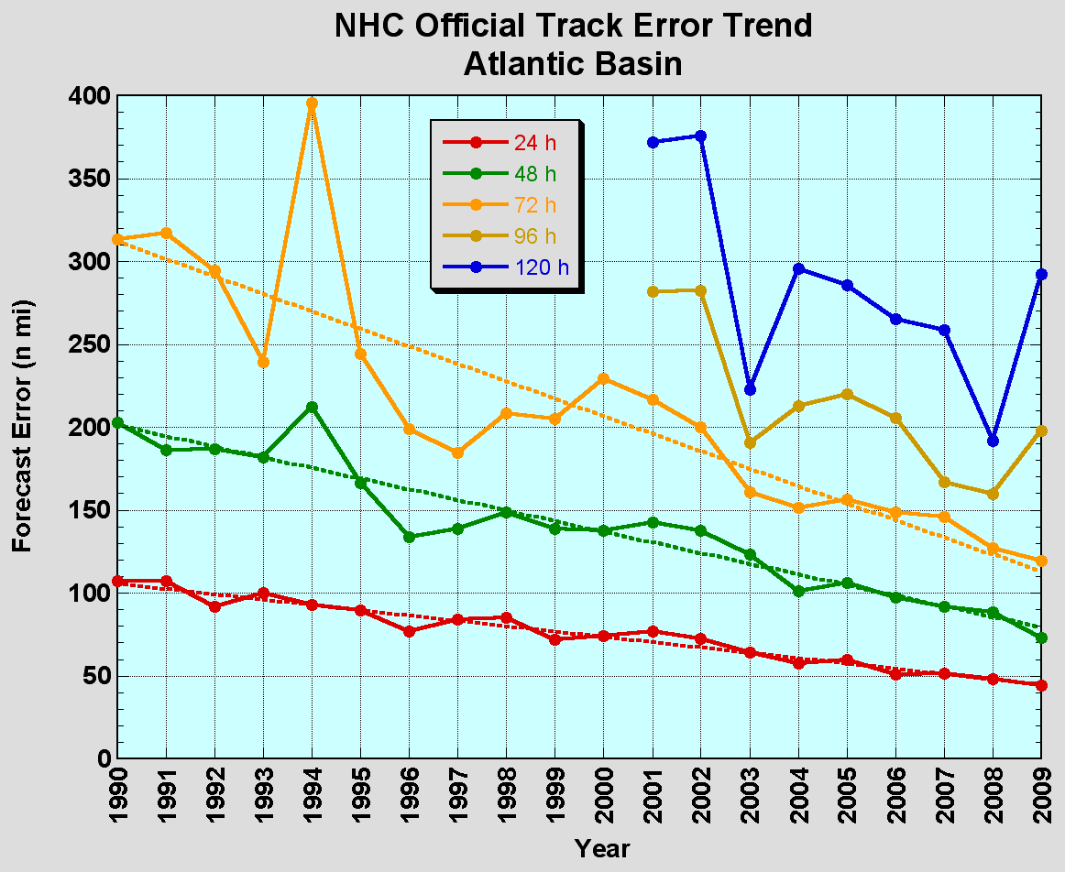
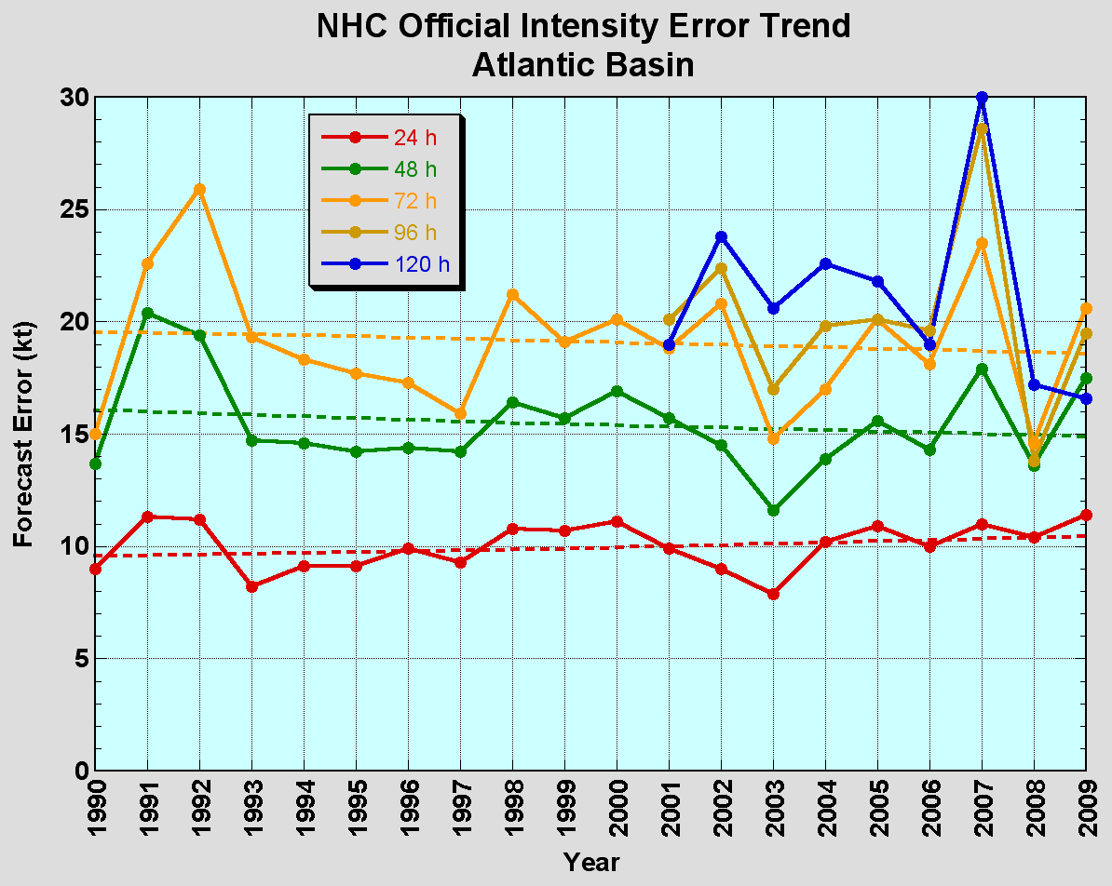
The Good – track forecast improvements
Current Capabilities
The Bad - Intensity no real gains
No progress with intensity in last 15-20 years
Errors cut in half over past 15 years
10-year improvement - As accurate at 48 hours as we were at 24 hours in 1999
24-48h intensity forecast off by 1 category
Off by 2 categories perhaps 5-10% of time

Slide 3
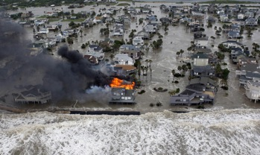
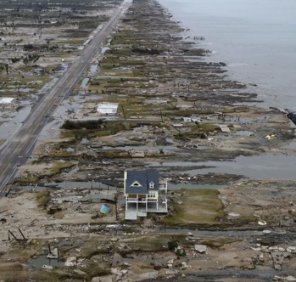
Improvements still needed!
Risk to life and property continues to escalate in coastal regions
  Population continues to increase – 50% of US population now live within 50 miles of coast.
  Value of coastal infrastructure and economic activity continues to rise – estimated at over $3 Trillion
More accurate hurricane forecasts and warnings can reduce response and recovery costs
  More accurate forecast ➔ fewer false alarms, reduced warning footprint
Galveston–Ike 2008
Bolivar Peninsula after Ike 2008

Slide 4

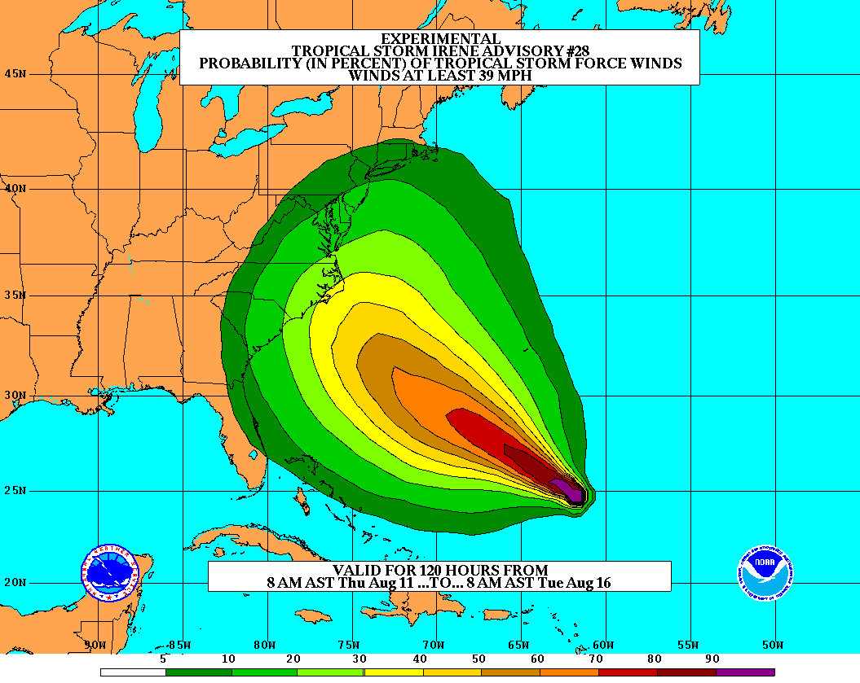
Goals
Improve Forecast Accuracy
  Hurricane impact areas (track) – 50%
  in 10 years
  Severity (intensity) – 50% in 10 years
  Storm surge impact locations
  and severity
Extend forecast reliability out to 7 days
Quantify, bound and reduce forecast uncertainty to enable risk management decisions
Notes:
http://www.nrc.noaa.gov/HFIPDraftPlan.html
HFIP Team
Frank Marks, research lead
Ed Rappaport, operations lead
Fred Toepfer, project manager
Robert Gall, development manager
Mark DeMaria
Chris Fairall
Jim McFadden
Scott Kiser
Daniel Melendez
Roger Pierce
HFIP executieve oversight board:
OAR DAA/Sandy MacDonald, co-chair
NWS AA/Jack Hayes, co-chair
NCEP/Louis Uccellini,
TPC/Bill Read,
NESDIS/Mark DeMaria,
NOS/Jesse Feyen,
AOML/Bob Atlas
PPI/Paul Doremus
NMFS/Bonnie Ponwith,
NOS/Liz Scheffler,
NMAO-PM Aircraft/Phil Kenul,
OFCM/Sam Williamson
Executive Secretariat: OAR/Joseph Bartosik and NWS/John Iacabucci

Slide 5
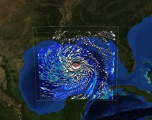

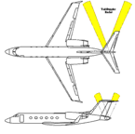

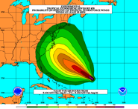
How to get there?
Science (8 Teams)
  Improved understanding from combination of observations & models
  Higher resolution coupled models – critical to storm evolution forecasts – especially intensity changes
  Forecast techniques to understand, reduce &communicate uncertainty
Information Technology
  Increased computing power - run advanced hurricane/global models and reduce uncertainty
  IT infrastructure for inter-agency data exchange
Observing Strategy
Improved use of existing and planned systems
Improved Products for Forecasters
Notes:
HFIP 2008-2009 activities
HRH Workshop:
http://www.dtcenter.org/plots/hrh_test/workshop2009/presentations/1_Gall_HRH%20HFIP%20presentation.pdf
http://www.dtcenter.org/plots/hrh_test/index.php
HFIP-TACC Real-time test
ftp://ftp.aoml.noaa.gov/pub/hrd/marks/HFIP-TACC_Summary.pdf
Diagnostics Team Workshop:
http://rammb.cira.colostate.edu/research/tropical_cyclones/hfip/workshop_2009/

Slide 6

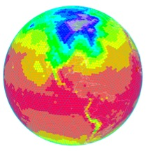
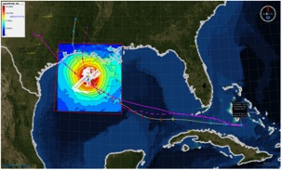
HFIP Activities
Traditional Hurricane Research Activities:
Observations, analysis, database, & instrument R&D (IFEX)
Statistical-dynamical model development
Advances in operational models (Stream 1)
New HFIP Research Thrusts:
Experimental global and regional hurricane model development (Stream 2)
Data assimilation techniques and observing system strategy analysis development (Stream 1 & 2)
Model evaluation tool development
Socioeconomic research and development
D1
D2
Partnership: NCEP, AOC, AOML, ESRL, GFDL, DTC, USWRP, NESDIS/STAR
Notes:
Two Stream Approach to HFIP developments:
Stream 1– Operational Transition and Implementation
Stream 2 – Advanced Technology Demonstration
Unconstrained by near-term availability of operational computing
Uses both NOAA’s and computing resources from major supercomputing centers for testing and evaluation.
Emphasis is on high resolution global and regional models run as ensembles
Real-time or near real time runs during hurricane season
Stream 1.5 (JHT-like)
NHC Forecaster Defined.
Subset of Stream 2 that forecasters see as particularly promising or provides demonstrated capability
Will be configured to run in real-time and products made available to NHC.

Slide 7
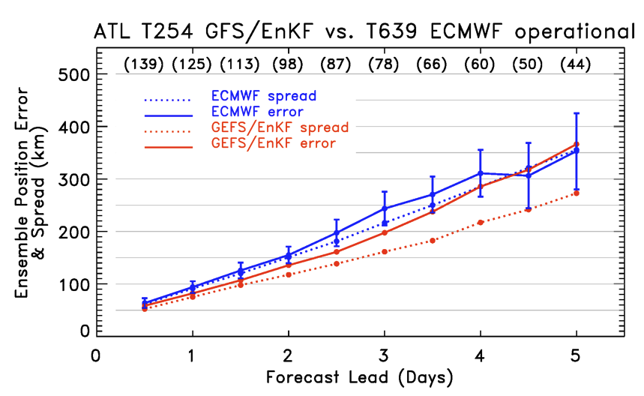
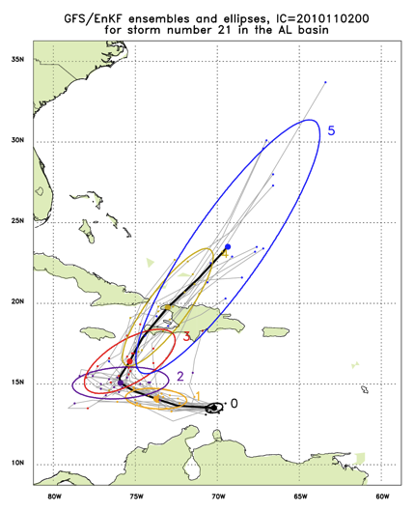
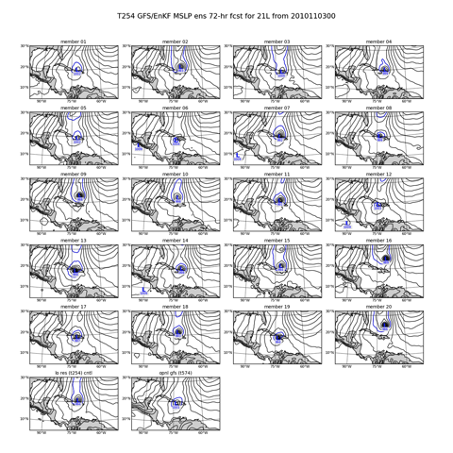
Global Model Development – GFS/EnKF
Tomas (21L) – init 00Z 2 November
http://ruc.noaa.gov/hfip/gfsenkf
Global
Courtesy of Tom Hamill & Jeff Whitaker (ESRL)
Notes:
Global Ensembles:
80-member T254 GFS ensembles cycled every 6-h continuously from 1 August to current time
Look at 20 members of the 80 member ensemble
Left panels shows ellipse plot of 20 members at each forecast time – ellipse shape shows the spread along/across track
Right panel show surface pressure post stamp images of 20 members

Slide 8

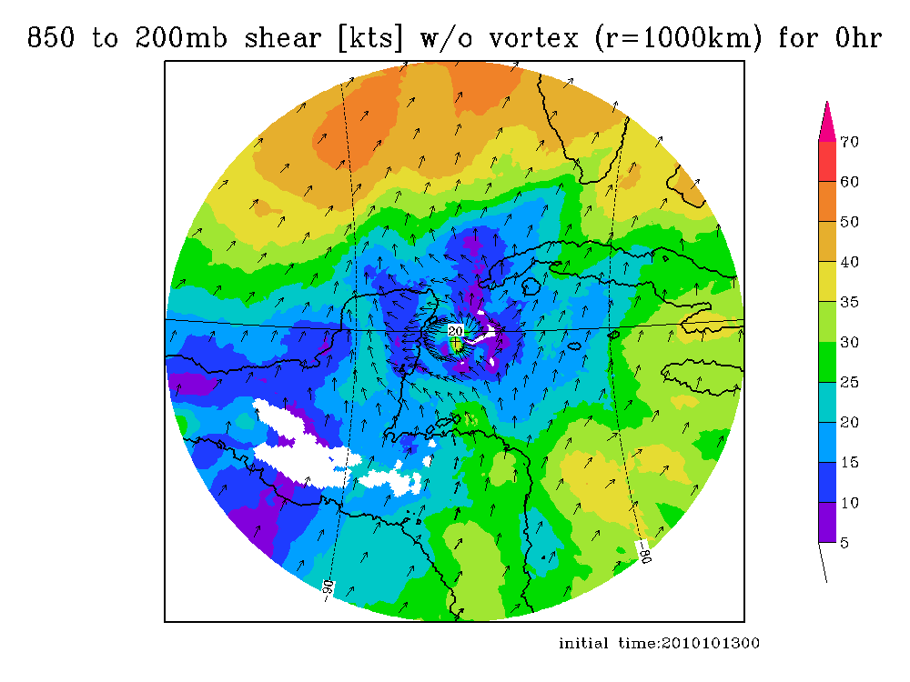
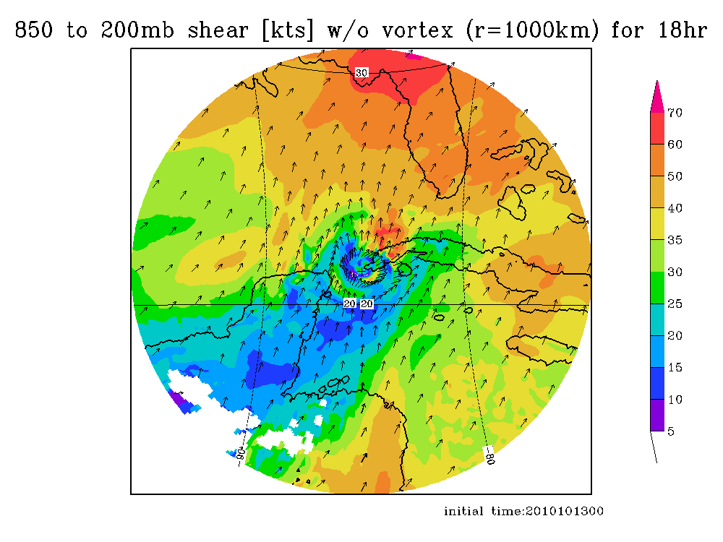
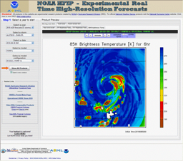
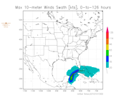
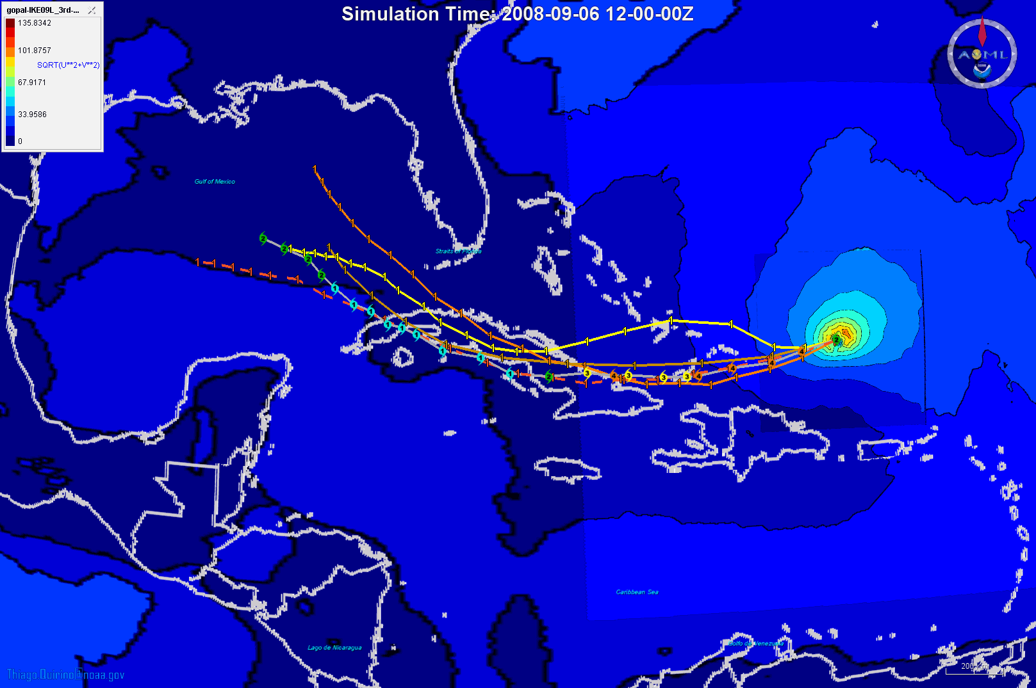
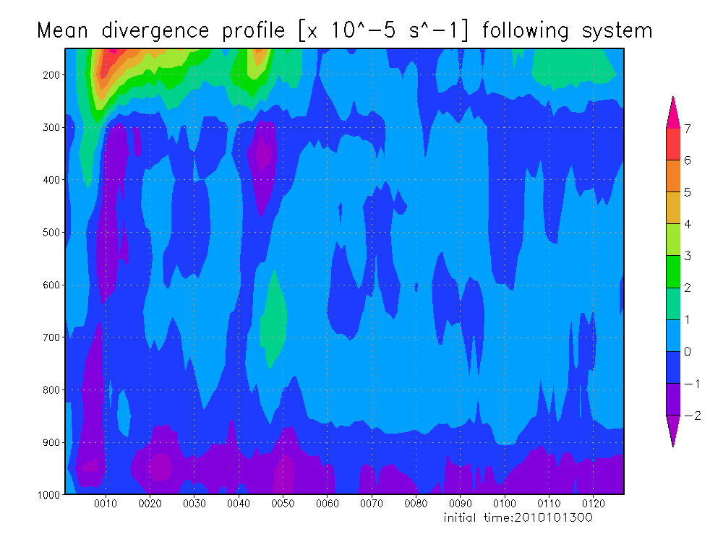
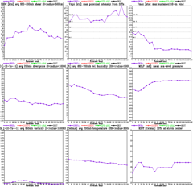
https://storm.aoml.noaa.gov/realtime
HFIP stream 2 (9/3 km resolution)
  HWRFX with HWRF IC
  HWRFX with HEDAS IC
  HWRFV3.2-HRD
All Storms of 2010
  4 cycles per day
  431 cases in 24 storms
19 main products; e.g.,
  Synthetic microwave imagery
  SHIPS predictors
  Shear and Steering
  Time-height cross-sections
  Swaths (wind and rainfall)
Gopal, Xuejin Zhang, Kevin Zhang, AOML/HRD
Notes:
Demo 2011 season; Not only we have improved the products but also added a suite of NOAA HWRF systems at different configurations.
Example of Hurricane Paula

Slide 9
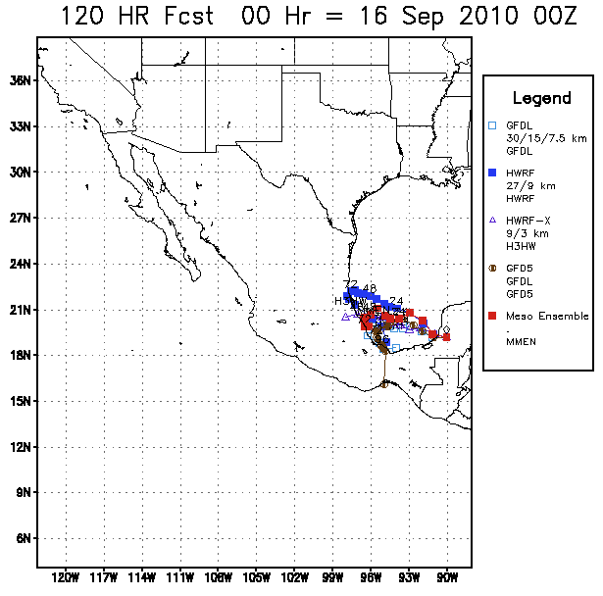
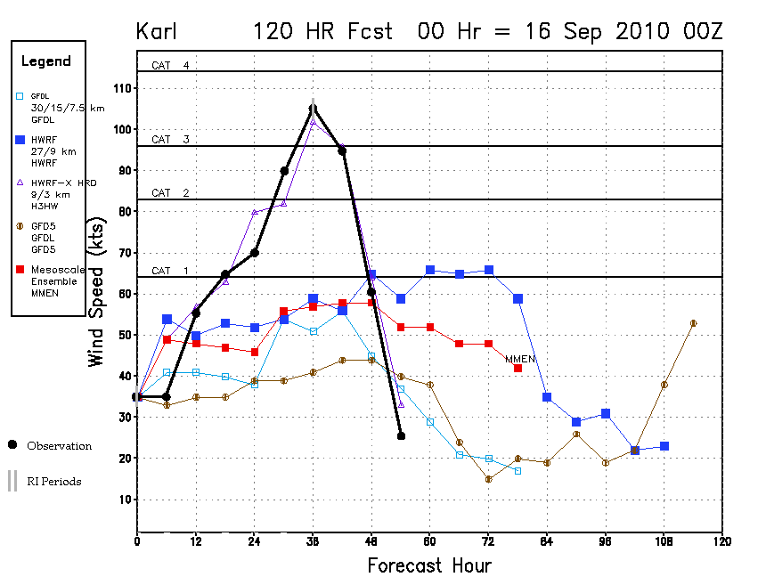
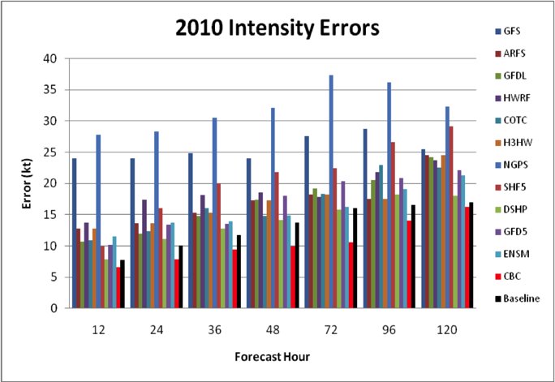
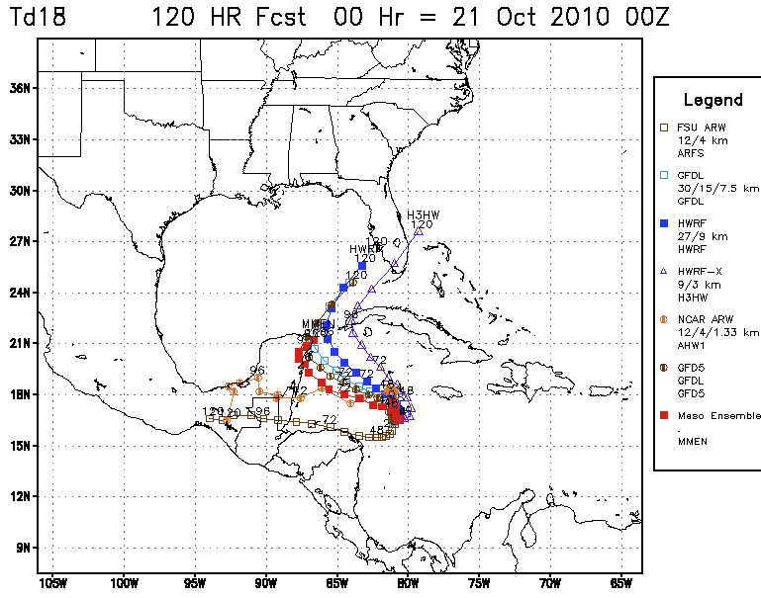
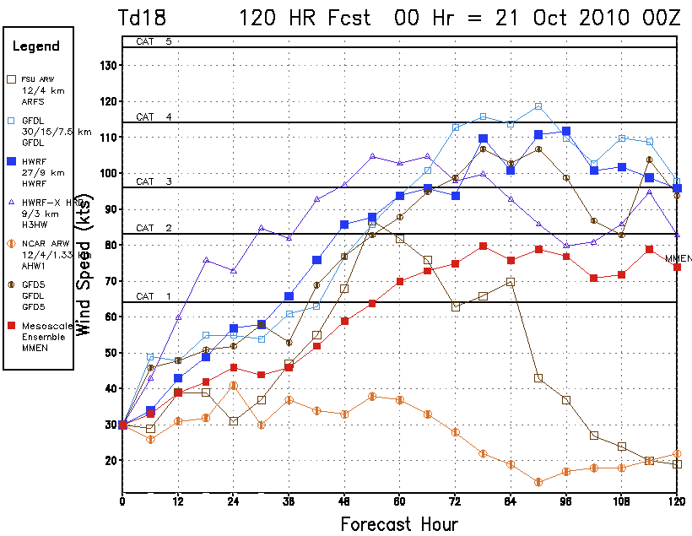
Multi-model Ensembles
Hurricane Karl
2010 season:
Multi-model regional ensemble
Regional models do better on intensity for strong hurricanes (Karl), but worse for weak systems (TD18/ Richard)
Hurricane Karl
TD 18 (Richard)
TD 18 (Richard)
TD 18 (Richard)
Correlation Based Consensus (CBC) of multiple models provides superior performance
Courtesy of DTC & FSU

Slide 10
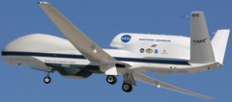
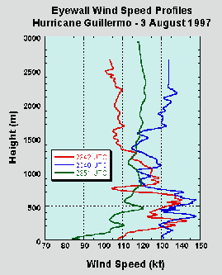
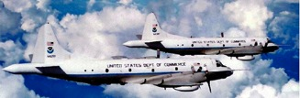

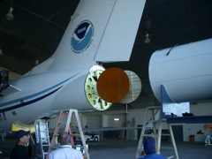

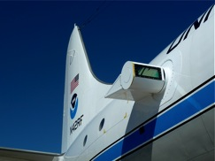
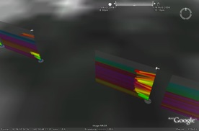
Improved Use of Observations:
Intensity Forecast experiment (IFEX 2010)
In-situ
  Wind, press., temp.
Expendables
  Dropsondes
  AXBT, AXCP, buoy
Remote Sensors
  Doppler Radar
  SFMR/HIRAD
  WSRA
  Scatterometer/profiler
  UAS
Global Hawk UAS
G-IV Tail Doppler Radar
ONR DWL
Rob Rogers, AOML/HRD
Notes:
UR image depicts dropsonde profiles in eyewall of Hurricane Guillermo (1997)
LR image is Doppler Wind Lidar profiles from TCS-08

Slide 11
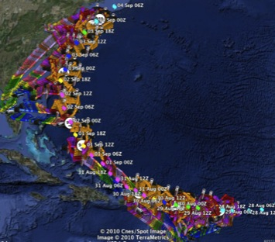
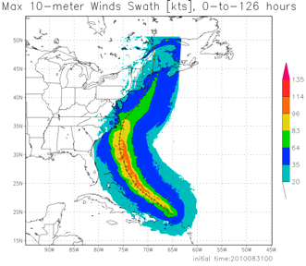
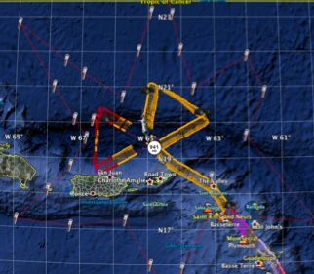
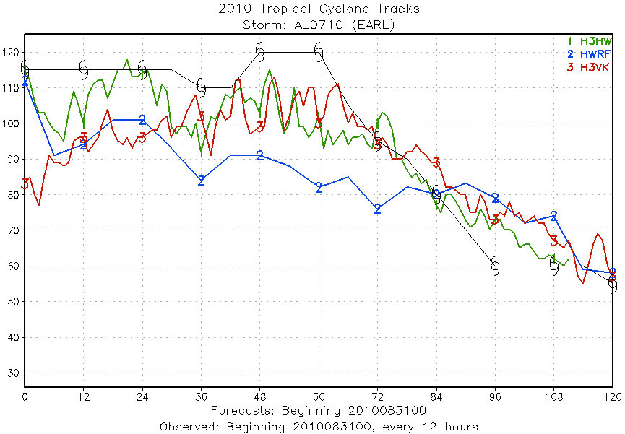
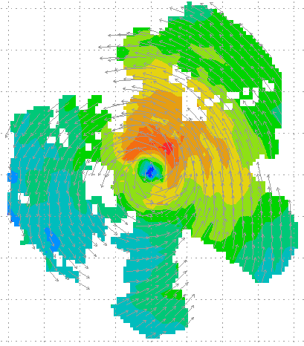
Improved Use of Observations:
HFIP 2010 Demo: Earl
11 P-3 Flights
28 August – 3 September 2010
HWRFx/HEDAS
20100831 00UTC
Doppler SO (EnKF) transmitted in real-time to HRD for assimilation into HWRFx model
20100830I1
2126-0229 UTC
5 missions at 12-h intervals
00Z 28 – 12Z 30 August, 6 missions at 12-h intervals 00Z 1 September – 00Z 3 September collecting Doppler SO (HEDAS)
HWRFx/HEDAS
20100831 00UTC
J. Gamache, A. Aksoy, T. Vukicevic, Gopal (AOML/HRD)
Notes:
Left hand image - Flight pattern for 11 P-3 Doppler mission For Earl beginning 00Z 28 August 2010, ending at 12Z 3 September 2010
middle image – show real-time Doppler analyses for three legs mission centered on 00Z 30 August used to generate Sos
Right images – HWRFx forecasts track and maximum wind swath (top), and intensity (bottom) initialized at 00Z 30 August
IFEX 2010: Hurricane Earl WP-3D (11 missions: 5 missions at 12-h intervals, 00Z 28 – 12Z 30 August, & 6 missions at 12-h intervals, 00Z 1 September – 00Z 3 September collecting Doppler SO (HEDAS)
Deployed 756 dropwindsondes and 238 AXBTs. 55 real-time TDR analyses transmitted to NHC and Doppler radial files transmitted to EMC. TDR superobs transmitted in Paloma, Bill and Danny provided real-time assimilation of TDR data into ARW model at TACC. 60 real-time H*Wind surface analyses

Slide 12
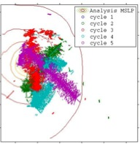
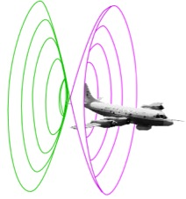
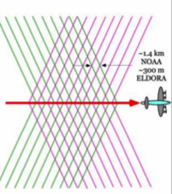
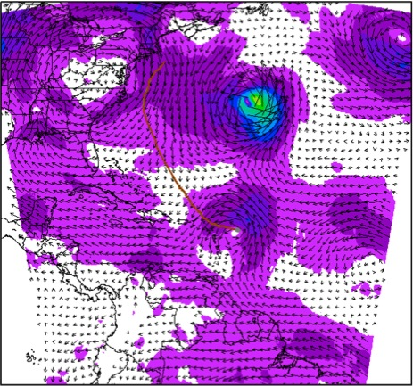
Improved Use of Observations:
Assimilate Doppler Radar
EnKF data assimilation of inner core observations
20°
D2
V_{r} SOs
22Z 29 August-01Z 30 August
Real-time SOs transmitted during P-3 mission and assimilated into HWRFx using HEDAS
D2
Hurricane Earl (2010)
D1
J. Gamache, A. Aksoy, T. Vukicevic, Gopal (AOML/HRD)
Notes:
Top left image shows how airborne Doppler scans through storm with alternating fore/aft beams every 0.7 km resulting in herringbone patterns of beam intersections with 1.4 km resolution along track and 150 m resolution across track.
Bottom right image shows ARW domain used this summer by HEDAS to assimilate the Doppler superobs – in this case for Hurricane Earl when it was rapidly intensifying just NE of the Leeward Islands. The inset shows SOs used from 5 legs (represented by colors) across the storm. IFEX 2010 made 5 back to back P-3 flights every 12 h during the RI of Earl from 00Z 29 August to 12Z 31 August.
A superob (SO) is an average of several observations in proximity to each other. This averaging reduces the number of costly assimilations and avoids assimilating correlated data
Doppler SOs are averages of the observations of radial component of wind along pointing vector where all observations pointing in nearly same direction at nearly same distance from aircraft
Azimuthal grid resolution (around fuselage axis): 3-5 degrees depending upon radius
Radial grid resolution: 2 km
Along track resolution: 1 min = ~7-8 km
All radial velocity observations within a grid box are candidates for SOs, but only the 25 points closest to grid point used
Velocities >2 SD from bin average rejected
Bins with SD > 2XSD rejected
~5000 SOs per penetration of hurricane

Slide 13
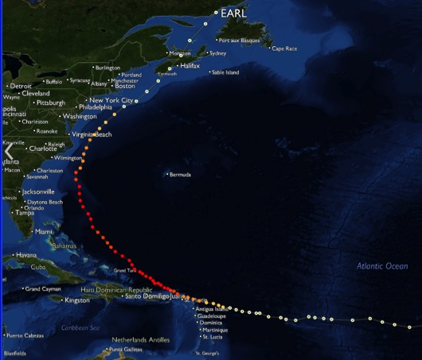
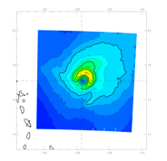
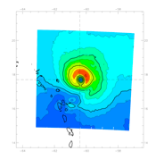
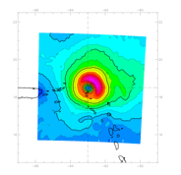
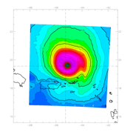
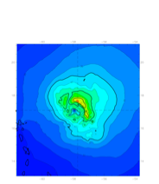
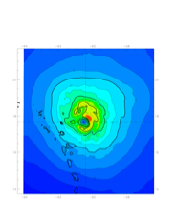
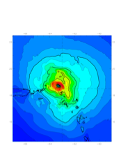
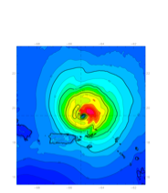




Improved Use of Observations:
Assessing Doppler radar – HEDAS
08-29 12Z
08-30 00Z
08-30 12Z
08-31 00Z
4 assimilation cycles during RI
Forecast Initialized: 2010 08 29 12Z
  2010 08 30 00Z
2010 08 30 12Z
2010 08 31 00Z
Ensemble Initialized 6-h before forecast
Data Assimilated:
NOAA42/43
Dropsonde * U V T Q (from RH)
Flight Level U V T Q (from TD)
SFMR Surface Wind
Tail Doppler Radar: Radial Wind
NOAA49
Dropsonde * U V T Q
Flight Level U V T Q
USAF WC-130
Dropsonde * U V T Q
Flight Level U V T Q
* No Surface T Q Assimilated for Drops
HWRF ICs
10-m Wind
Speed
HEDAS
10-m Wind
Speed
201008301800
955mb 125kts
201008291200
1007mb 30kts
Corresponding
H*Wind
Analysis
All HEDAS results can be found at:
https://storm.aoml.noaa.gov/realtime
J. Gamache, A. Aksoy, T. Vukicevic, Gopal (AOML/HRD)

Slide 14








Improved Use of Observations:
Observing Strategy Analysis
Use Model (HWRFV3.2) & DA (HEDAS) system to evaluate observing strategies in TC environments
Microwave satellite imagery (37- & 85-GHz)
Doppler radar
Microwave surface winds (SFMR, HIRAD)
Airborne Doppler radar
Nature: U (m/s)–shaded
Wind Speed–cont.
Analysis
Ens. Spread – shaded
Ens. Mean – contoured
Compare observed & simulated microwave T_{b}
Surface (10 m) Wind Speed (m/s)
SFMR
70 km wide HIRad swath 20 km alt.
E. Uhlhorn, T. Vukicevic, A. Aksoy, S. Lorsolo (AOML/HRD)

Slide 15
HFIP Science Priorities
Advancement in DA techniques for hurricane NWP
Physics Advancements
  Microphysical processes
  Air-sea processes and BL processes
R&D for determining optimal resolution and complexity of coupling
Advanced model diagnostic techniques
  Analyses and forecast of large-scale and hurricane environment evolution
  Identification and analyses of sources of model errors
Development of high resolution ensembles
  Identify resolution and optimality of number of ensemble members
  Improve intensity guidance
Techniques to maximize the usefulness of observations

Slide 16

Questions?

