Slide 1
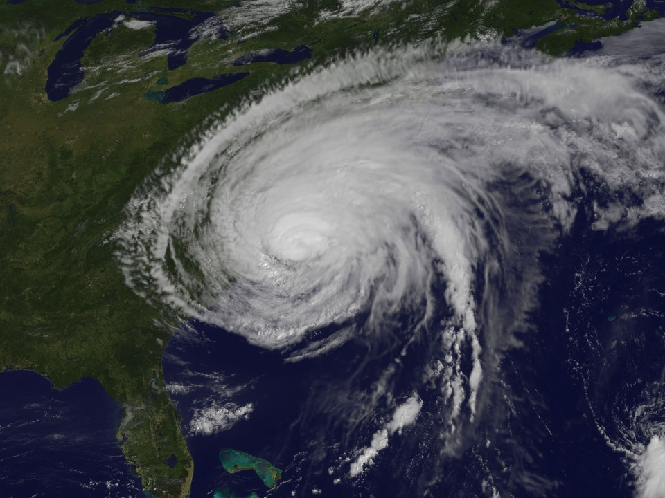
Future Directions for Hurricane Research
Frank Marks
NOAA/AOML Hurricane Research Division
7 November 2011
Notes:
Hurricane Irene 27 August 2011

Slide 2
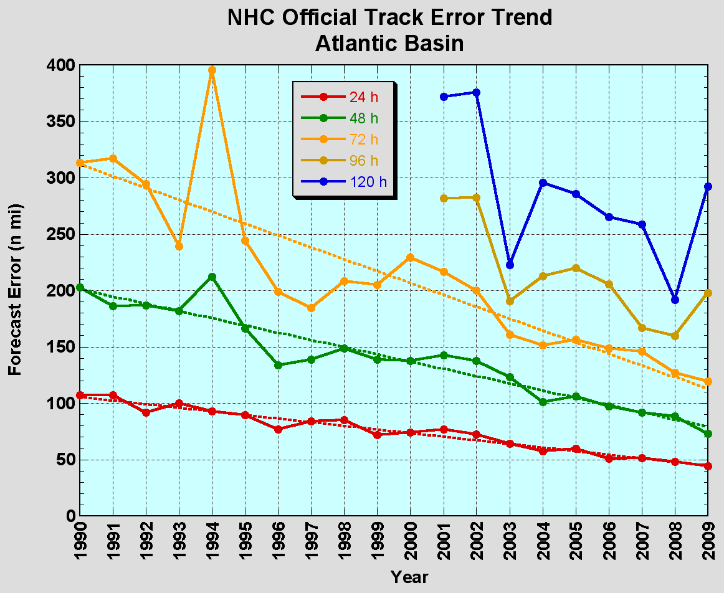
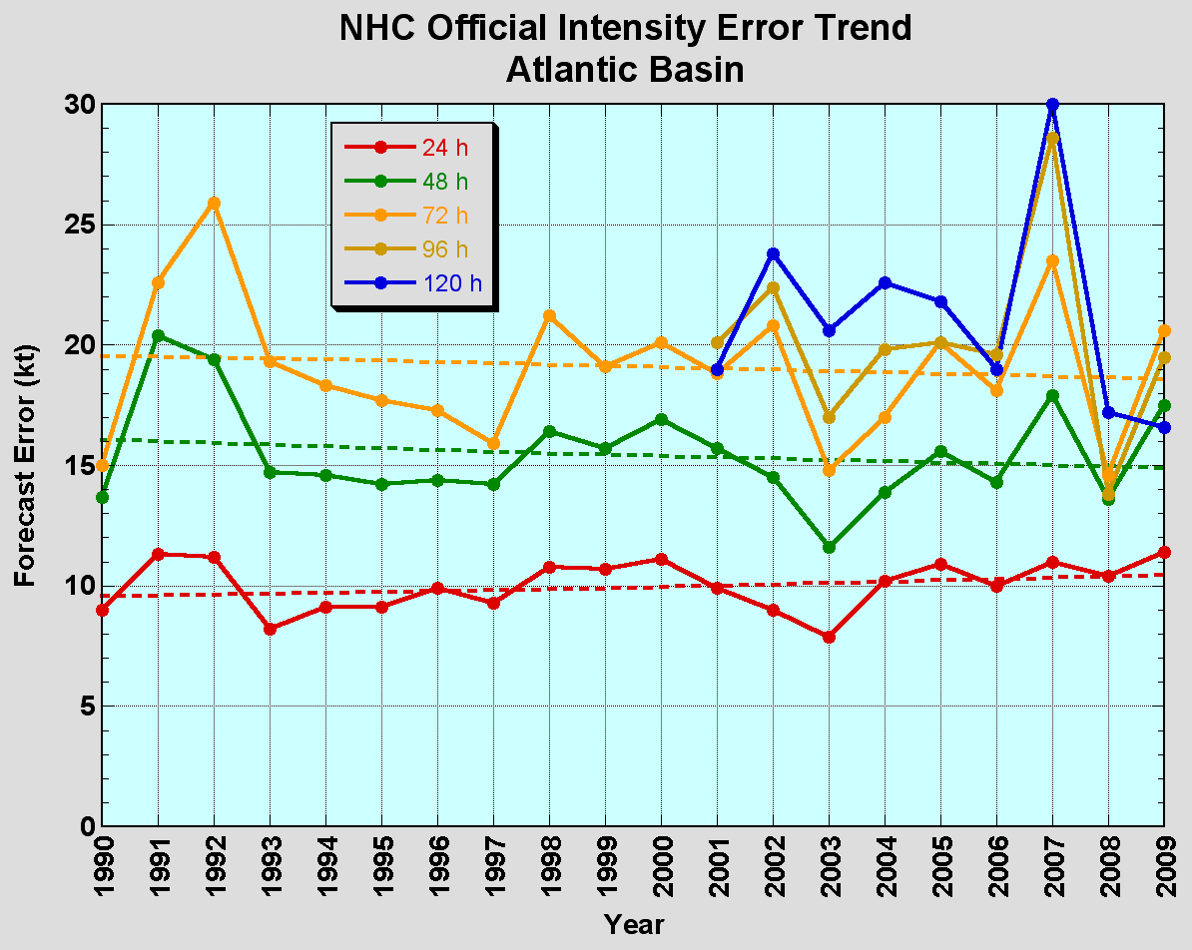
The Good – track forecast improvements
Current Capabilities
The Bad - Intensity no real gains
No progress with intensity in last 15-20 years
Errors cut in half over past 15 years
10-year improvement - As accurate at 48 hours as we were at 24 hours in 1999
24-48h intensity forecast off by 1 category
Off by 2 categories perhaps 5-10% of time

Slide 3
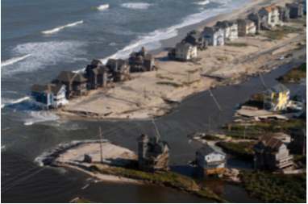
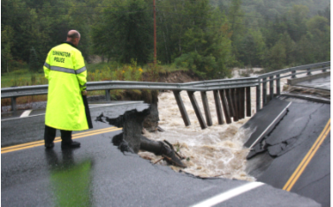
Improvements still needed!
NWS Strategic Plan emphasizes Decision Support Services (DSS)
More accurate forecasts are needed of all the impacts of hurricanes
  Wind
  Surge
  Fresh water flooding
  Severe weather
Irene 2011
  42 deaths (primarily flood)
  $7–$10 Billion damage (wind, surge, flood)
  Major infrastructure losses (wind, surge, flood)
  Power lost to 8 million (primarily wind)
Galveston–Ike 2008
Jim R. Bounds/AP
Hatteras Island, N.C.
Woodford, Vt.
Austen Danforth/Bennington Banner/AP

Slide 4
Hurricane Research Priorities
Advancement in DA techniques
Techniques to maximize the usefulness of observations
  Identification and analyses of sources of model errors
Physics Advancements
  Air-sea and BL processes
  Microphysical/aerosol/radiation processes
Advanced model diagnostic techniques
  Analyses and forecast of vortex low-order wavenumber evolution
  Analyses and forecast of large-scale and hurricane environment evolution (e.g. shear/track)
Development of high resolution ensembles (little progress to date)
  Identify techniques to utilize ensemble members for improved intensity guidance

Slide 5
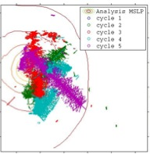
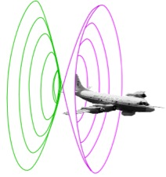
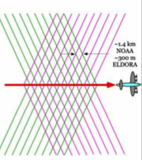
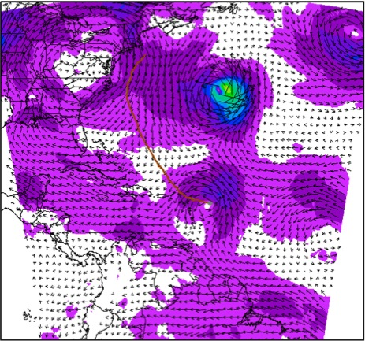
Improved Use of Observations:
Assimilate Doppler Radar
EnKF data assimilation of inner core observations
20°
D2
V_{r} SOs
22Z 29 August-01Z 30 August
Real-time SOs transmitted during P-3 mission and assimilated into HWRFx using HEDAS
D2
Hurricane Earl (2010)
D1
F. Zhang (PSU), A. Aksoy, S. Aberson (AOML/HRD)
Notes:
Top left image shows how airborne Doppler scans through storm with alternating fore/aft beams every 0.7 km resulting in herringbone patterns of beam intersections with 1.4 km resolution along track and 150 m resolution across track.
Bottom right image shows ARW domain used this summer by HEDAS to assimilate the Doppler superobs – in this case for Hurricane Earl when it was rapidly intensifying just NE of the Leeward Islands. The inset shows SOs used from 5 legs (represented by colors) across the storm. IFEX 2010 made 5 back to back P-3 flights every 12 h during the RI of Earl from 00Z 29 August to 12Z 31 August.
A superob (SO) is an average of several observations in proximity to each other. This averaging reduces the number of costly assimilations and avoids assimilating correlated data
Doppler SOs are averages of the observations of radial component of wind along pointing vector where all observations pointing in nearly same direction at nearly same distance from aircraft
Azimuthal grid resolution (around fuselage axis): 3-5 degrees depending upon radius
Radial grid resolution: 2 km
Along track resolution: 1 min = ~7-8 km
All radial velocity observations within a grid box are candidates for SOs, but only the 25 points closest to grid point used
Velocities >2 SD from bin average rejected
Bins with SD > 2XSD rejected
~5000 SOs per penetration of hurricane

Slide 6
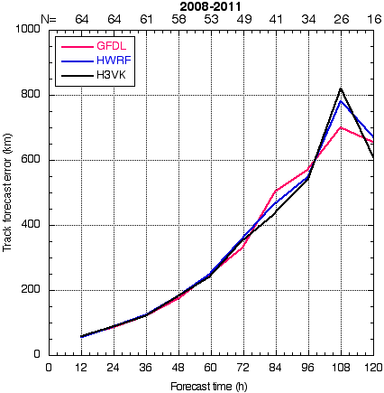
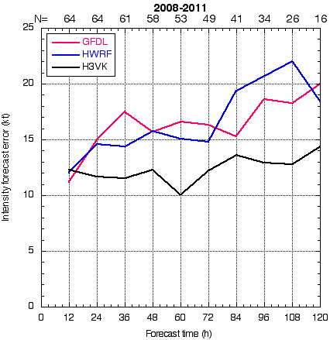
Improved Use of Observations:
Assessing Doppler radar – EnKF results
Performance of 2008-2011 Forecasts
with assimilation of P-3 airborne radar
Track Error (km)
Intensity Error (kt)
Track Error (km)
Intensity Error (kt)
HFIP baseline
HFIP baseline
PSU WRF-EnKF
H3VK – HWRF-x/HEDAS
HEDAS
F. Zhang (PSU), A. Aksoy, S. Aberson (AOML/HRD)

Slide 7
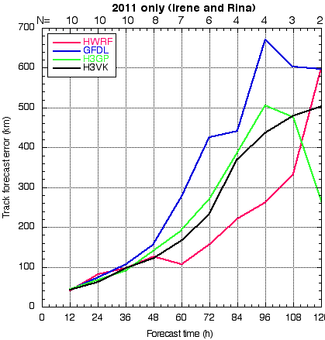
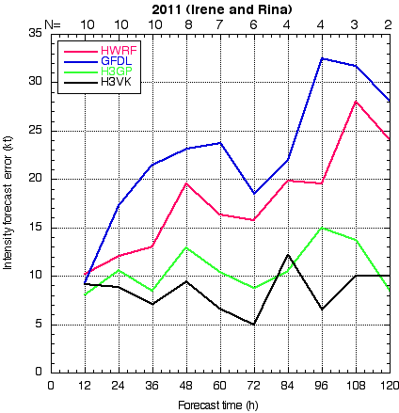
Improved Use of Observations:
Assessing Doppler radar – EnKF results
Performance of the 2011 Real-time Forecasts
with assimilation of P-3 airborne radar (Irene & Rina)
Track Error (km)
Intensity Error (kt)
Track Error (km)
Intensity Error (kt)
HFIP baseline
HFIP baseline
H3GP – HWRFV3.2 27/9/3
H3VK – HWRF-x/HEDAS
PSU WRF-EnKF
HEDAS
F. Zhang (PSU), A. Aksoy, S. Aberson (AOML/HRD)

Slide 8
Improved Use of Observations:
Assimilate Doppler Radar
The Good:
Radar data appears to be critical in initializing regional models (likely requires EnKF background error covariances to use effectively)
    May solve intensity problem for storms effecting U.S.
    Need increased use of satellite data for storms further away
  The Not So Good (needs improvement):
  There is a short-term forecast bias. Good initial analysis do not lead to improved intensity forecast until 36-48 h. Why?

Slide 9
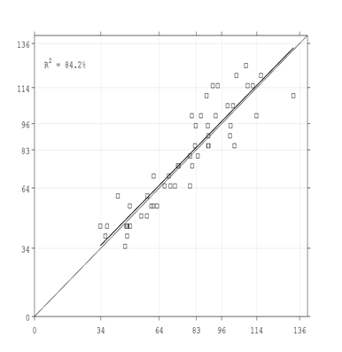
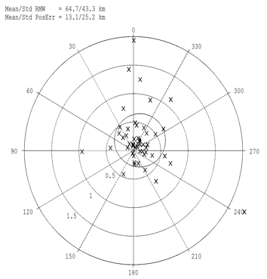
Improved Use of Observations:
Assimilate Doppler Radar
The good:
  Position error to within 0.2 RMW (~12 km)
  Good fit of analysis intensity to best track intensity
Position Error (x RMW)
Intensity (kt)
Degrees relative
to storm motion
Best Track (kt)
◆
RMW-relative distance (r)
from observed center
TS
H-1
H-2
H-3
H-4
HEDAS Analysis (kt)
A. Aksoy (AOML/HRD)

Slide 10
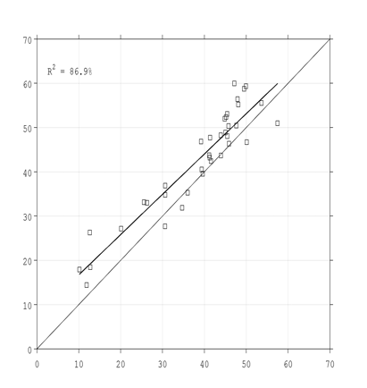
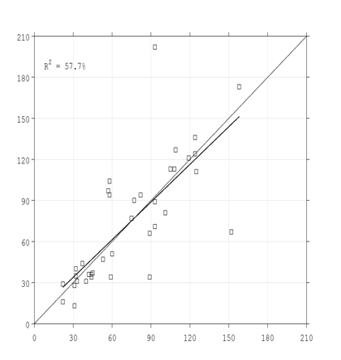
Improved Use of Observations:
Assimilate Doppler Radar
The good:
    RMW captured to within 10 km
Max. Tangential Wind Speed (m/s)
1-km RMW (km)
Radar Observed (m/s)
Radar Observed (km)
HEDAS Analysis (m/s)
HEDAS Analysis (km)
A. Aksoy (AOML/HRD)

Slide 11
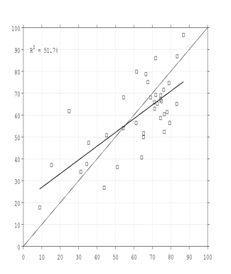
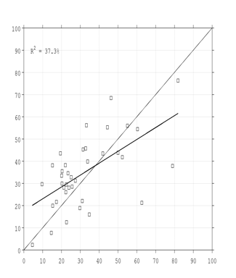
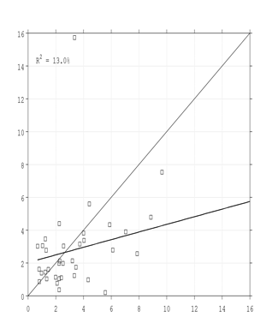
Improved Use of Observations:
Assimilate Doppler Radar
The good:
  Wavenumbers 0 and 1 captured well
Variance Explained (%) by Wavenumber Components of 1-km Tangential Wind Speed
Wavenumber 0
Wavenumber 1
Wavenumber 2
100
100
16
70-80%
Radar Observed (%)
20-30%
2-3%
100
100
16
HEDAS Analysis (%)
HEDAS Analysis (%)
HEDAS Analysis (%)
A. Aksoy, T. Vukicevic (AOML/HRD)

Slide 12
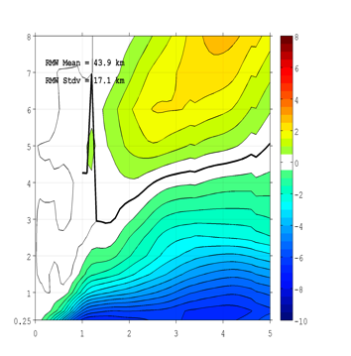
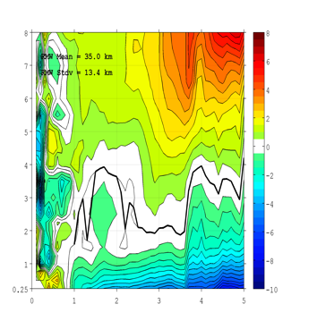
Improved Use of Observations:
Assimilate Doppler Radar
RZ-Mean Radial Wind Speed (m/s)
Composited for 13 Major Hurricane Cases
Where research is needed:
  Importance of higher-wavenumber structure (e.g., Shear vs track)
  Boundary layer structure (HWRF V3.2 better than HWRF-x)
  Vertical correlations and localization in DA
  How well does the radar sample the radial wind?
HEDAS
Radar Observed
Height (km)
Distance from Center (xRMW)
Distance from Center (xRMW)
A. Aksoy, T. Vukicevic (AOML/HRD)

Slide 13
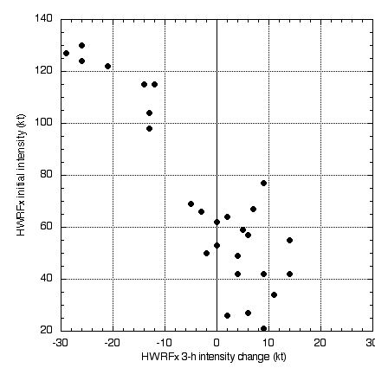
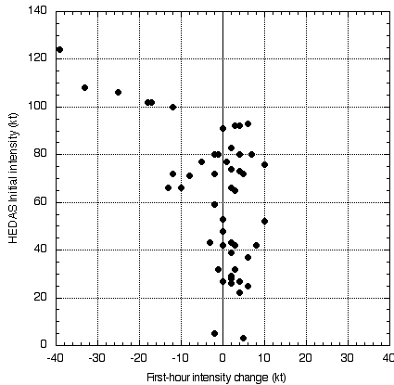
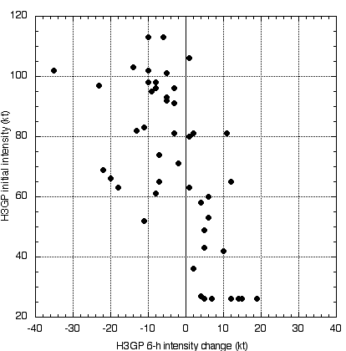
Short-term forecast bias
Identifying the source of bias:
Vortex spin-down at hourly time scales creates large negative intensity bias for high intensity cases
HWRFx with bogus vortex
HWRFx with HEDAS IC
HWRF_3.2
Intensity
65 kt
65 kt
65 kt
-30
30
-40
40
-40
40
Change over 3 h
Change over 1 h
Change over 6 h
Spin-down occurs regardless of initialization method
Strength of spin-down is dependent on initial intensity: more for higher intensities
Tomislava Vukicevic (AOML/HRD)

Slide 14
Lessons learned & research challenges
Negative intensity bias in short-term forecasts is common among high-resolution systems and causes significant errors in the forecast at 6-36 h range
Bias most noticeable in high initial intensity cases
In such cases vortex spin-down occurs at hourly time scales
Spin-down profoundly affects data assimilation results and the impact of data assimilation on the forecast
Other groups working on vortex-scale DA systems should look at similar diagnostics to evaluate model behavior
Need theory of vortex adjustment to help eliminate loss of information in DA cycling and better analysis for forecast
Tomislava Vukicevic (AOML/HRD)

Slide 15
Improving Physics:
The Good:
HWRF V3.2 has improved structure a lower initial intensity bias than HWRFx
    Improved PBL and surface exchange based on observations (e.g., CBLAST, IFEX) shows dramatic improvements
  The Not So Good (needs improvement):
  Appears that surface layer & PBL may be too warm & moist. Why? Assumptions in PBL diffusion for enthalpy?
  37-GHz and 85-GHz synthetic satellite imagery compare well to observations, however, synthetic IR satellite observations have warm bias. Why?
  Appears to be to much condensate when compared to observations, particularly above melting level and at top of PBL. Why?
  What about the ocean impacts? Few HFIP models are coupled.

Slide 16
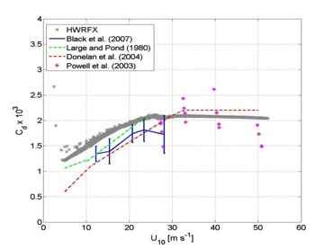
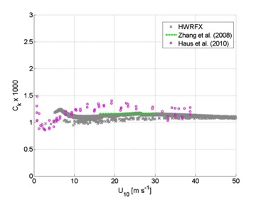
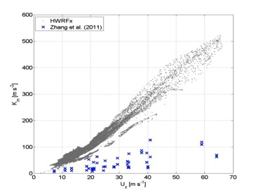
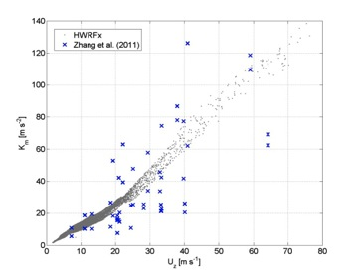
Improving Physics:
PBL Physics Consistent with Observations
Modified GFS Scheme
Original GFS Scheme
Gopalakrishnan et al. 2011
Notes:
16

Slide 17
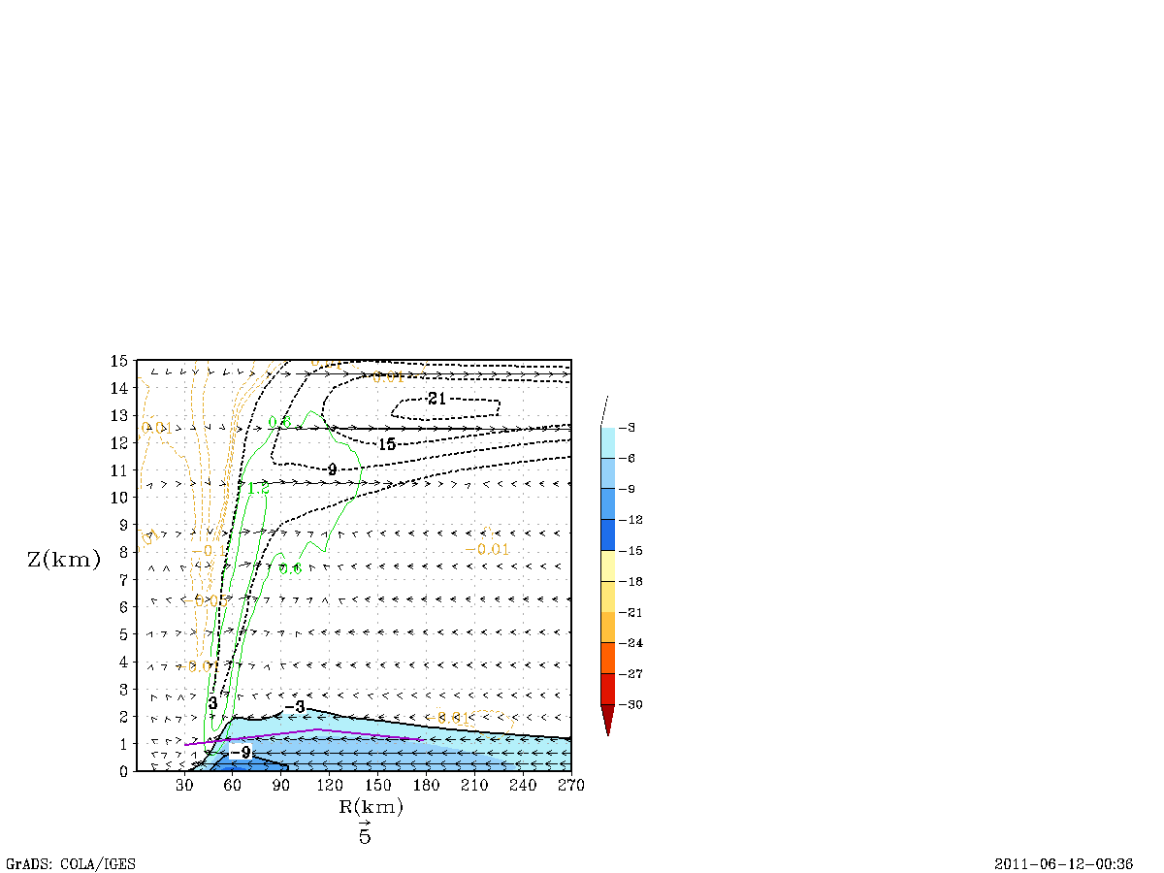
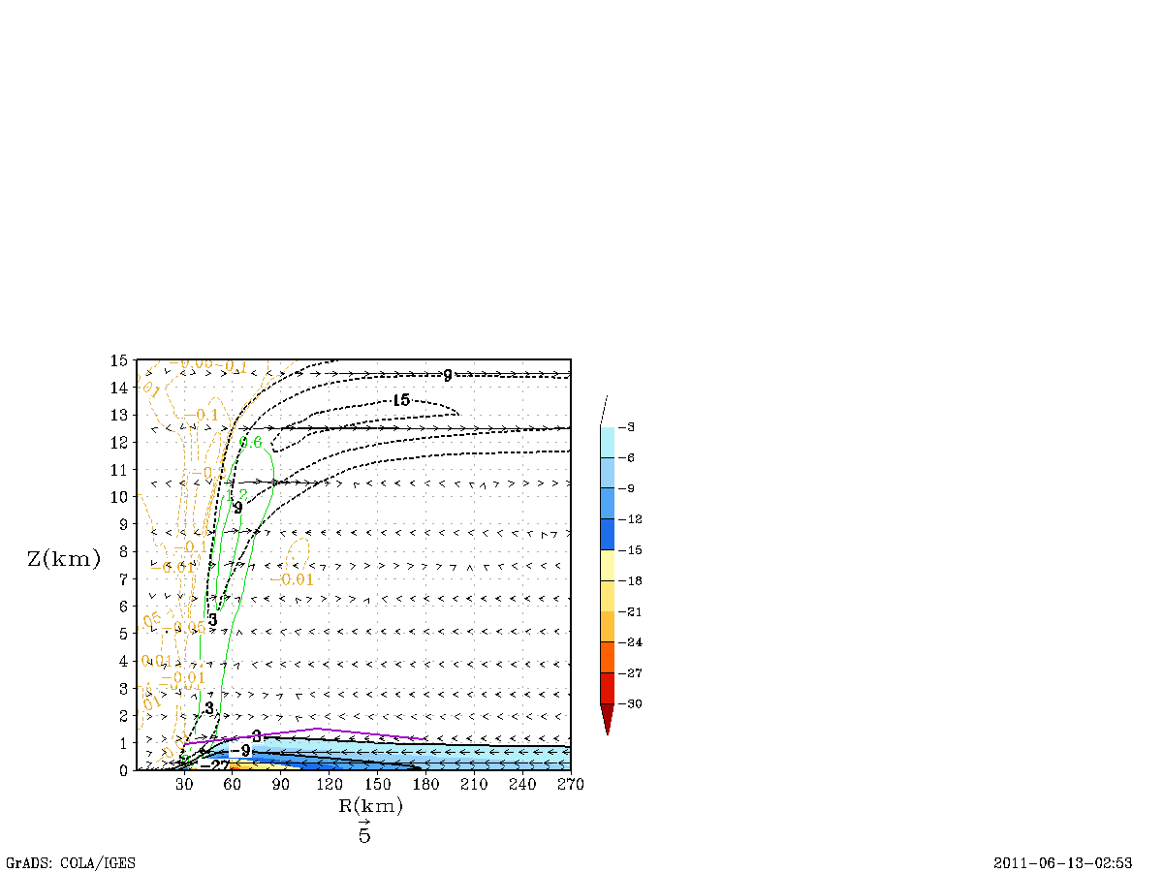
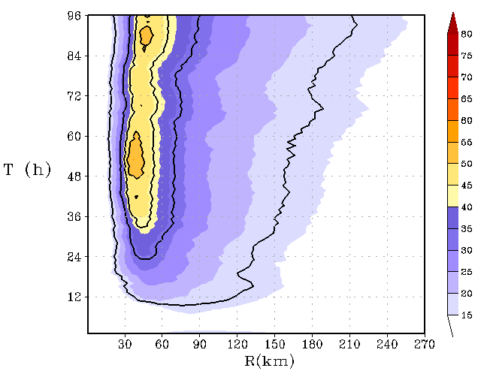
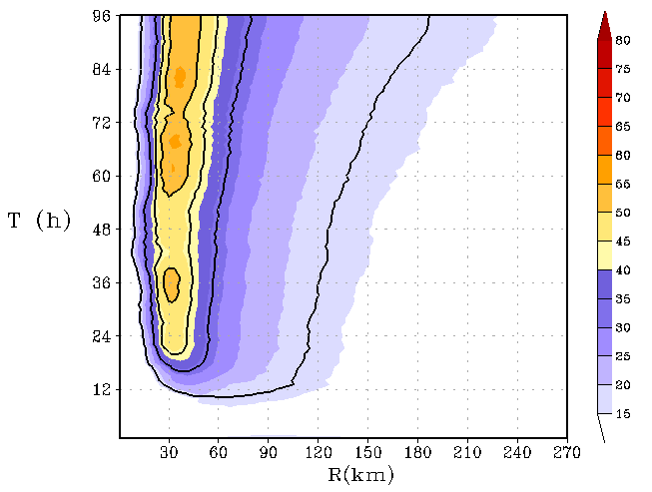
Improved Structure Predictions:
3 KM HWRF
Original Formulation
Latest Formulation
Azimuthally averaged secondary circulation: Radial Wind and W
Hovemöller of 10-m wind speed
Gopalakrishnan et al. 2011
Notes:
17

Slide 18
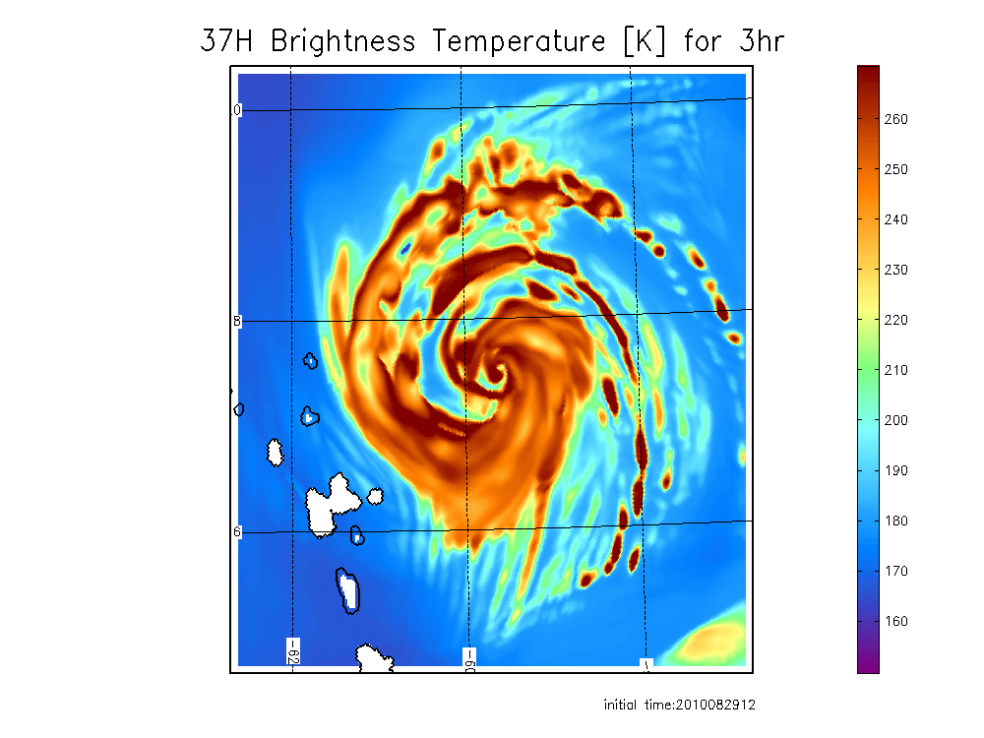
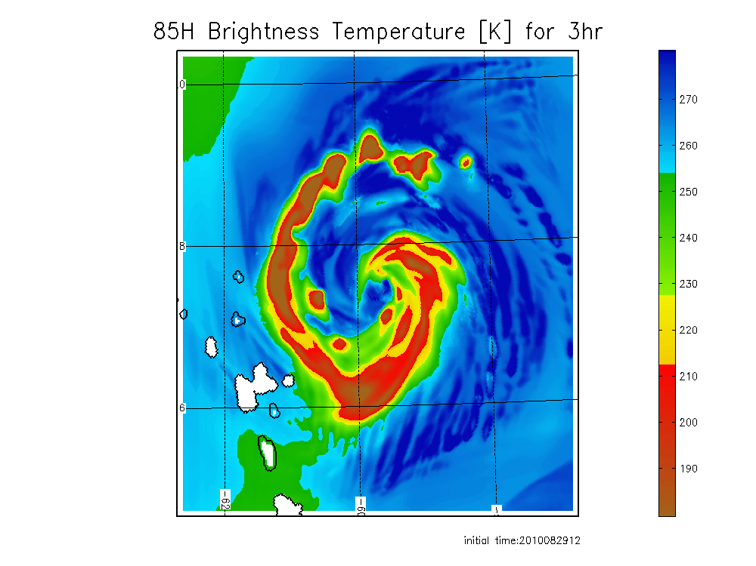
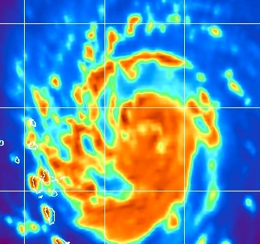
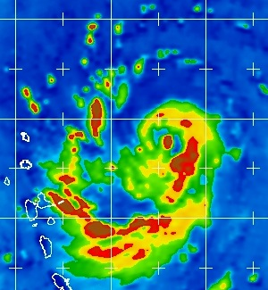
Improving Physics:
Synthetic Satellite
Use Model (HWRFV3.2) to evaluate Microwave satellite imagery (37- & 85-GHz)
Observed
The good:
  Structure & peak similar
The not so good:
  Distribution is slightly skewed
Hristove-Veleva (NASA/JPL) & Vukicevic (AOM/HRD)

Slide 19
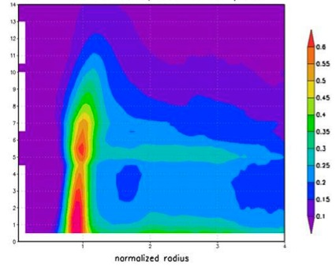
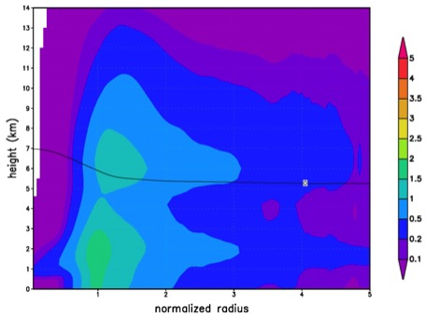
Improving Physics:
Synthetic Satellite
Use Model (HWRFV3.2) to evaluate total condensate to observed radar estimate
Observed
g m⁻³
Model
g m⁻³
height (km)
The good:
  Structure in eyewall similar with double peak
The not so good:
  Model values three times those in observations
  Model PBL vertical distribution is opposite observed

Slide 20
Improving Diagnostics:
The Good:
HFIP models are showing improved intensity (peak 10-m wind) verifications
  The Not So Good (needs improvement):
  Some models with improved intensity do not show improved tracks. Why?
  Intensity verification has little correlation with improved modeling of storm evolution or structure. Why?
  Model intensity estimates poorly represent sampling errors in time and space appropriately for intensity estimates. Estimates at coarse time and space resolutions are compared as if they are the same.
  No model team is diagnosing the low wavenumber (#0 & #1) structure which is more closely related to vortex evolution. Why?

Slide 21
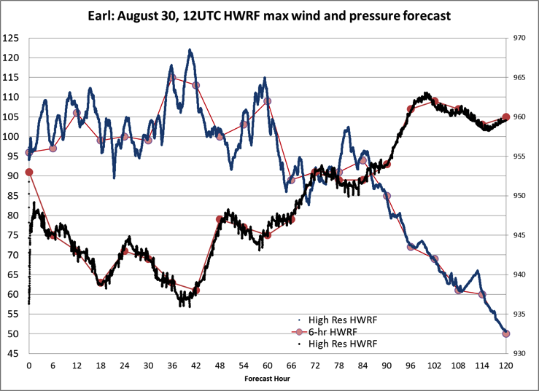
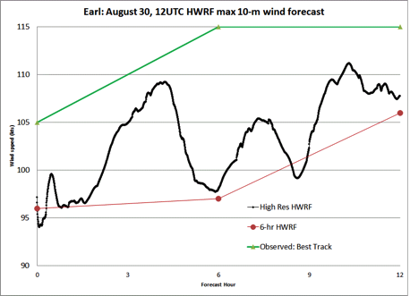
Intensity evaluation:
Sampling issues
The good
Model pressure & wind tracks best track intensity
The not so good
Model peak wind much noisier than best track & pressure. Why?
HWRF initial: 953mb
Minimum: 936mb @ 00:03:54
Dave Zelinsky (NHC)

Slide 22
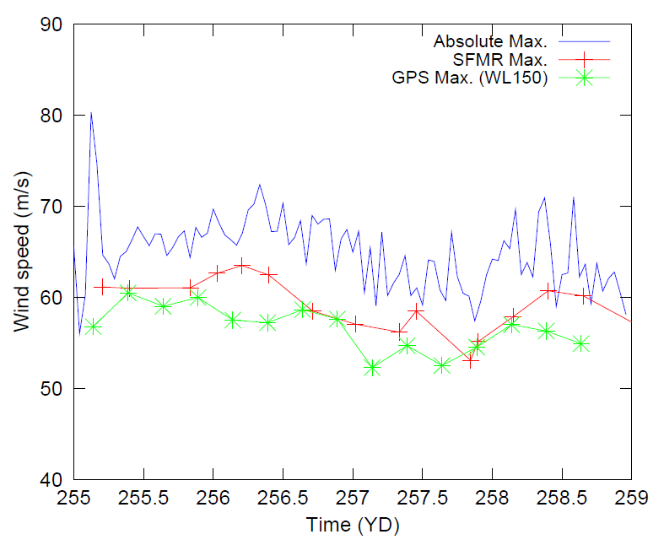
Intensity evaluation:
Sampling issues
The good
Used 1.3 km model run to generate simulated flight-level, SFMR & dropsonde max. wind for each flight to illustrate sampling issues
The not so good
Retrieved max. wind is dependent on spatial and temporal resolution of model output
Model groups are not evaluating sampling issues and NHC is unaware of impact
SFMR | GPS (0.9Rmax)
8.8% | 12.7%
Uhlhorn (AOML/HRD) & Nolan (RSMAS)

Slide 23
Summary
NWS Strategic Plan is outlining plans for a “Weather Ready Nation” based around Decision Support Services (DSS) implying forecasts of all the impacts of hurricanes are essential
Current forecast verification and metrics fall short of those needed to support NWS Strategic Plan goals
HFIP research must expand diagnostics to include all impacts from hurricanes (e.g., wind, surge, inland flooding, severe weather)
Next generation hurricane researchers must look beyond track and intensity!!

Slide 24
Plans for future generation
In 1998 organized UCAR/ASP Summer Colloquium on Hurricanes at Landfall (http://www.asp.ucar.edu/colloquium/1998/).
Provided current generation of hurricane researchers (11/22):
Student | Student
Paul Bogner | Chris Hennon
Ed Bracken | Daniel Jacob*
Parks Camp | Sharan Majumdar*
Dan Cecil* | Shirley Murillo*
Jennifer Collins | Shangyau Nong
Mark Croxford | Greg Postel
Jason Dunion* | Paul Reasor*
Sytske Drury (Kimball)* | Robert Rogers*
Matthew D. Eastin* | Douglas Schneider
Robert Hart* | John Schroeder*
Rita Hausmann | Holly Snell
Time for another colloquium to develop the next generation
Use HFIP capacity to develop program
Focus on key research issues and utilize models, DA, and observations
Recommend organizers should be members of 1998 class

Slide 25
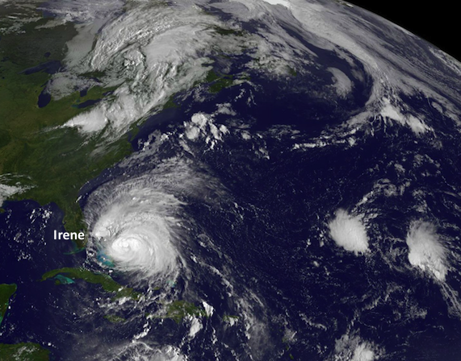
Questions?

