Slide 1
HFIP Advancements in Hurricane Research
Frank Marks NOAA/AOML Hurricane Research Division
NOAA HFIP Lead
19 August 2011

Slide 2
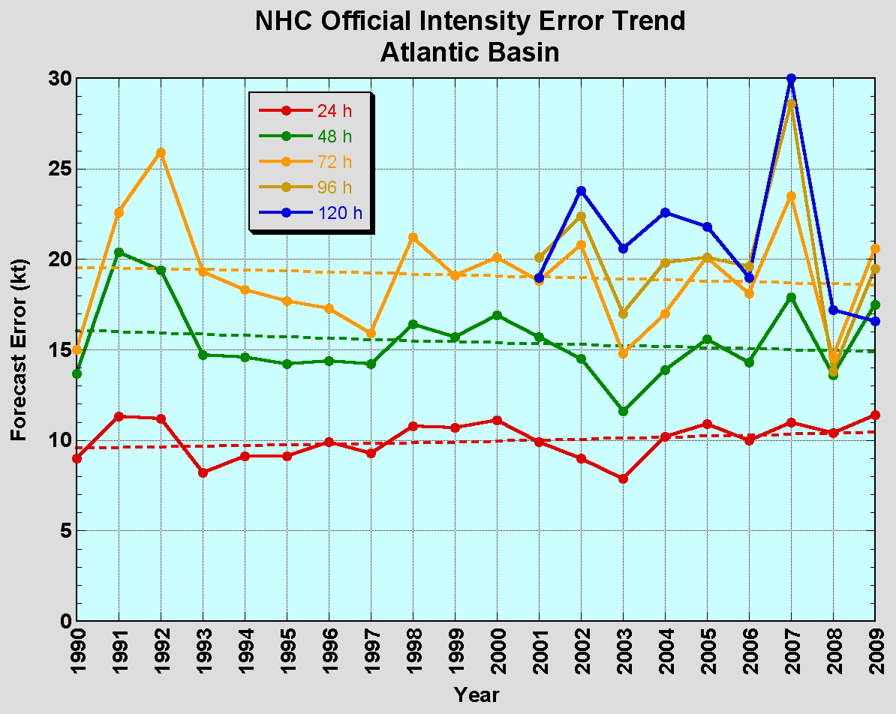
The Good – Track forecast improvements
Current Capabilities
The Bad - Intensity forecasts no real gains
No progress with intensity in last 15-20 years
Errors cut in half over past 15 years
10-year improvement - As accurate at 48h as we were at 24h in 2000
24-48h intensity forecast off by 1 category
Off by 2 categories 5-10% of time

Slide 3
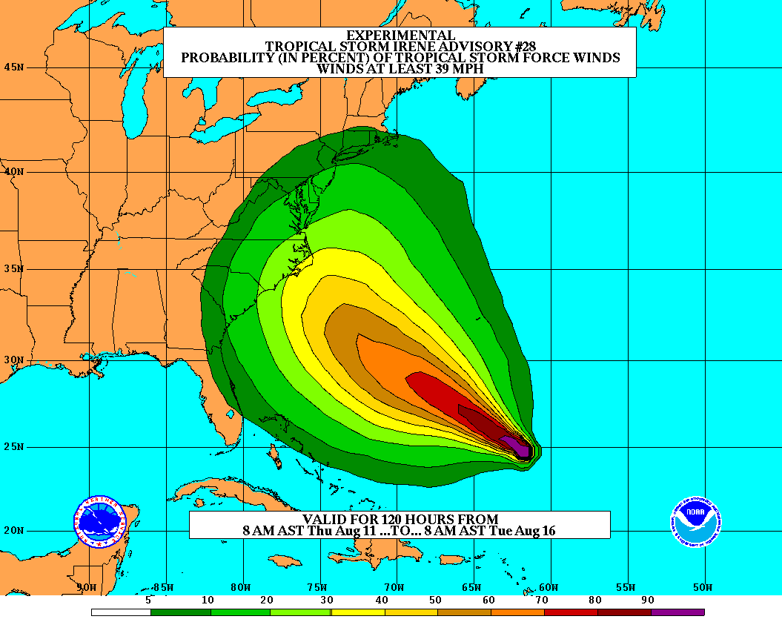
Goals
Improve Forecast Accuracy
Hurricane impact areas (track) – 50% in 10 years
Severity (intensity) – 50% in 10 years
Special Focus on Rapid Intensity Change (RI)
Extend forecast reliability out to 7 days
Quantify, bound and reduce forecast uncertainty to enable risk management decisions
http://www.hfip.org/
Notes:
http://www.nrc.noaa.gov/HFIPDraftPlan.html
HFIP Team
Frank Marks, research lead
Ed Rappaport, operations lead
Fred Toepfer, project manager
Robert Gall, development manager
Mark DeMaria
Chris Fairall
Jim McFadden
Scott Kiser
Daniel Melendez
Roger Pierce
HFIP executieve oversight board:
OAR DAA/Sandy MacDonald, co-chair
NWS AA/Jack Hayes, co-chair
NCEP/Louis Uccellini,
TPC/Bill Read,
NESDIS/Mark DeMaria,
NOS/Jesse Feyen,
AOML/Bob Atlas
PPI/Paul Doremus
NMFS/Bonnie Ponwith,
NOS/Liz Scheffler,
NMAO-PM Aircraft/Phil Kenul,
OFCM/Sam Williamson
Executive Secretariat: OAR/Joseph Bartosik and NWS/John Iacabucci

Slide 4
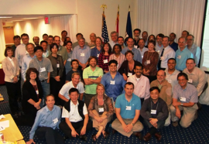
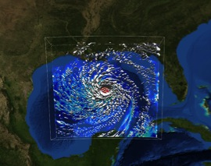
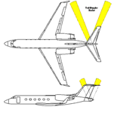
How to get there?
Science (8 Teams)
Improved understanding from combining observations & models
Higher resolution coupled models – critical to storm evolution forecasts – especially intensity changes
Forecast techniques to understand, reduce & communicate uncertainty
Information Technology
Increased computing power - run advanced hurricane/global models & reduce uncertainty
IT infrastructure for interagency data exchange
Observing Strategy
Improved use of existing and planned systems
Improved Products for Forecasters
Notes:
HFIP 2008-2009 activities
HRH Workshop:
http://www.dtcenter.org/plots/hrh_test/workshop2009/presentations/1_Gall_HRH%20HFIP%20presentation.pdf
http://www.dtcenter.org/plots/hrh_test/index.php
HFIP-TACC Real-time test
ftp://ftp.aoml.noaa.gov/pub/hrd/marks/HFIP-TACC_Summary.pdf
Diagnostics Team Workshop:
http://rammb.cira.colostate.edu/research/tropical_cyclones/hfip/workshop_2009/

Slide 5
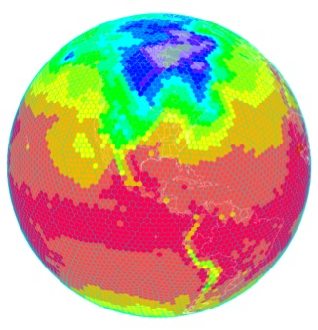
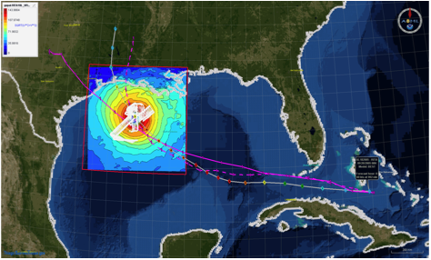
What: HFIP Activities
Traditional Hurricane Research Activities:
Observations, analysis, database, & instrument R&D (IFEX)
Statistical-dynamical model development
Advances in operational models (Stream 1)
New HFIP Research Thrusts:
Experimental global and regional hurricane model development (Stream 2)
Data assimilation techniques and observing system strategy analysis development (Stream 1 & 2)
Model evaluation tool development
Application and tool development for forecasters
D1
D2
Partnership: NCEP, AOC, AOML, ESRL, GFDL, DTC, USWRP, NESDIS/STAR
Notes:
Two Stream Approach to HFIP developments:
Stream 1– Operational Transition and Implementation
Stream 2 – Advanced Technology Demonstration
Unconstrained by near-term availability of operational computing
Uses both NOAA’s and computing resources from major supercomputing centers for testing and evaluation.
Emphasis is on high resolution global and regional models run as ensembles
Real-time or near real time runs during hurricane season
Stream 1.5 (JHT-like)
NHC Forecaster Defined.
Subset of Stream 2 that forecasters see as particularly promising or provides demonstrated capability
Will be configured to run in real-time and products made available to NHC.

Slide 6
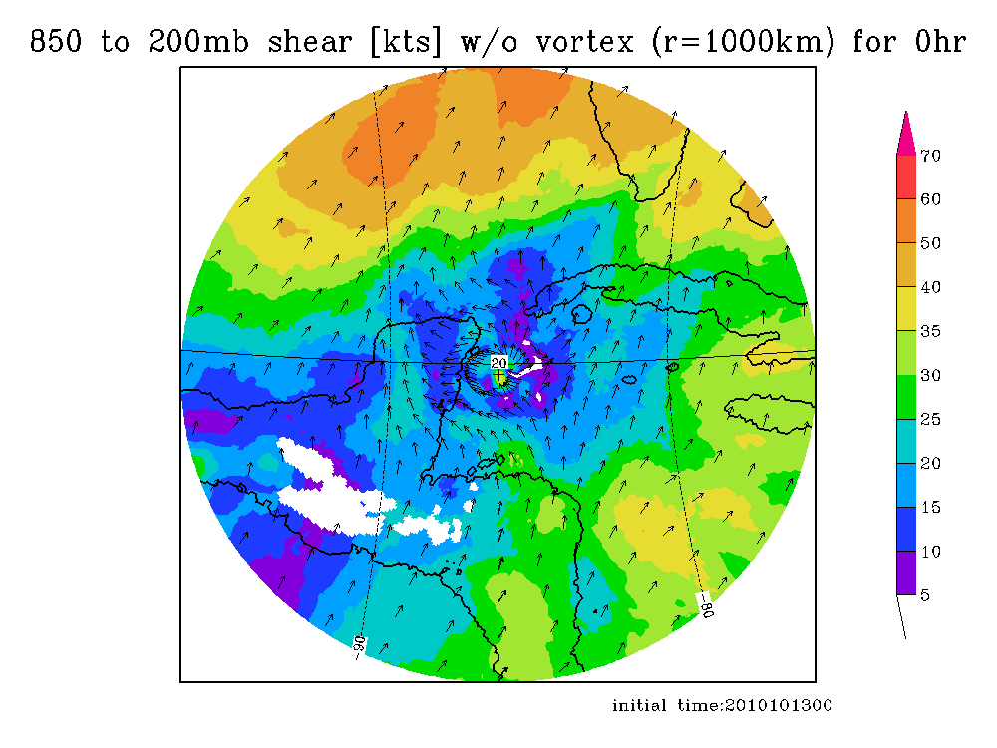
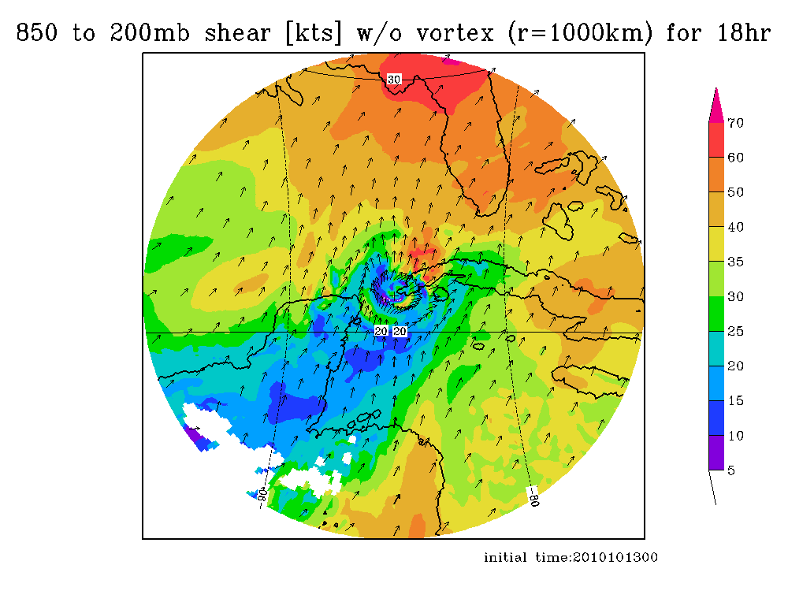
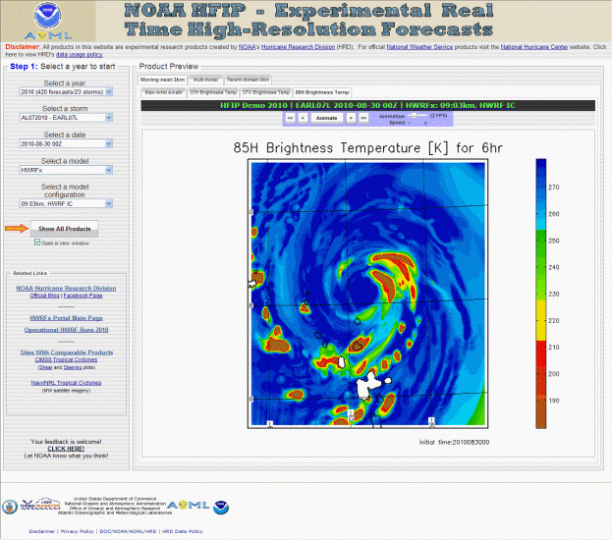
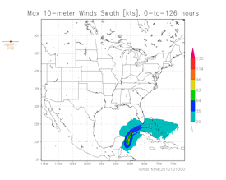
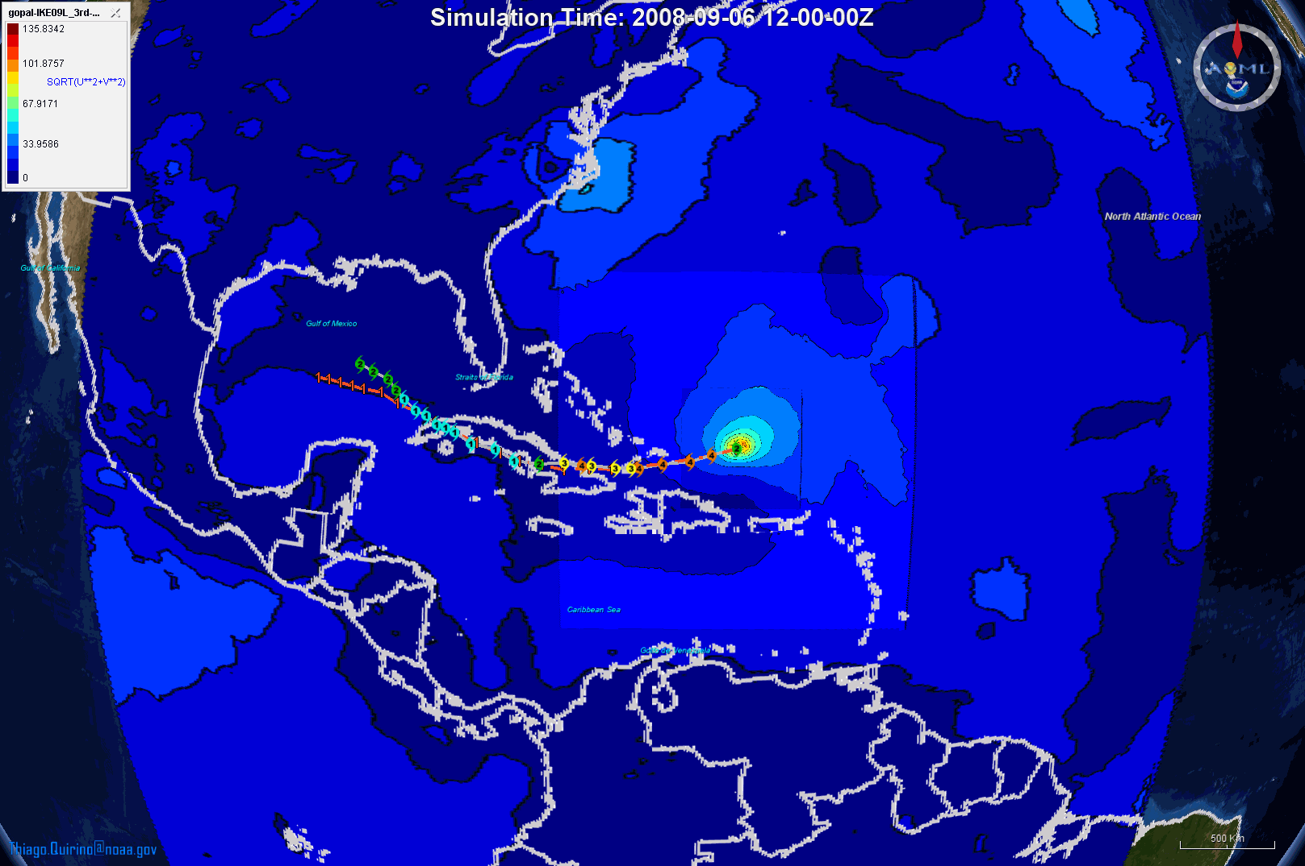
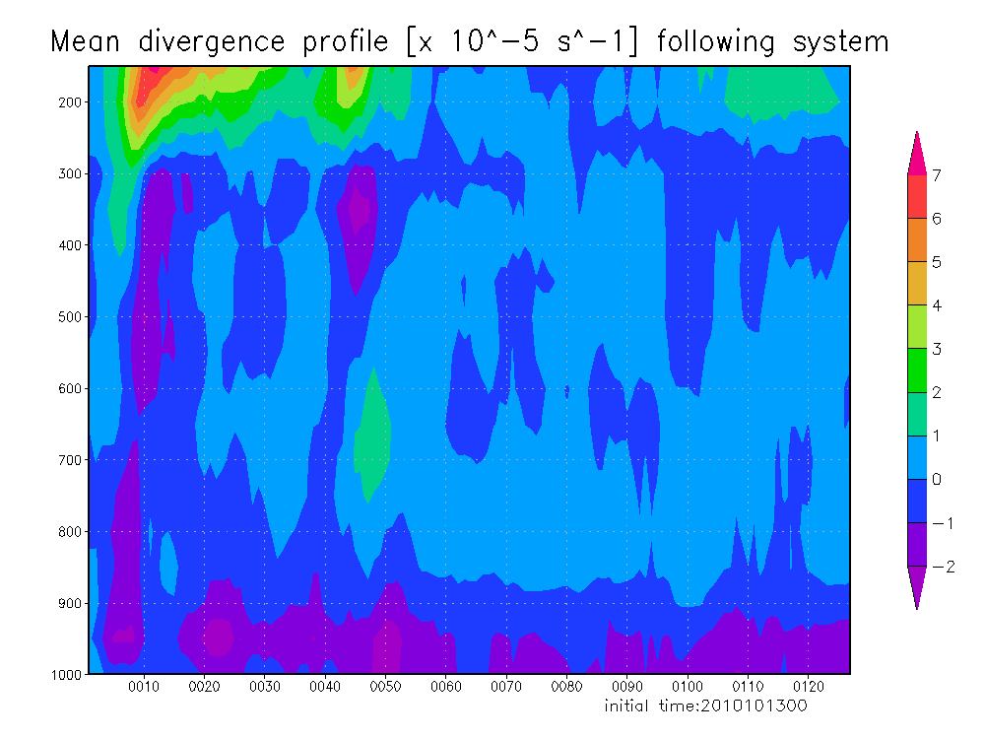
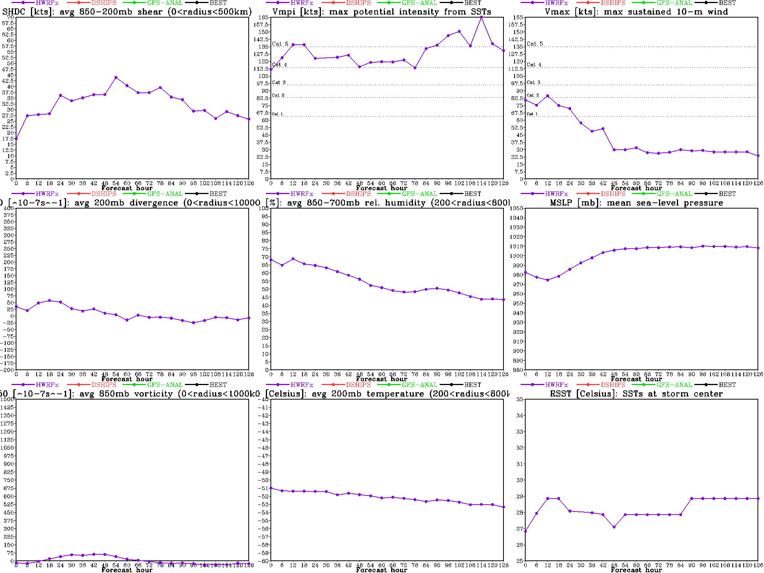
Regional Model Development: HWRF
http://storm.aoml.noaa.gov/realtime
HFIP stream 2 (9/3 km resolution)
HWRFx with HWRF IC
HWRFx with HEDAS IC
HWRFV3.2
All Storms of 2010
4 cycles per day
431 cases in 24 storms
19 main products; e.g.,
Synthetic microwave imagery
SHIPS predictors
Shear and Steering
Time-height cross-sections
Swaths (wind and rainfall)
Regional Model Team - Gopal, Xuejin Zhang, Kevin Yeh, AOML/HRD
Notes:
Demo 2011 season; Not only we have improved the products but also added a suite of NOAA HWRF systems at different configurations.
Example of Hurricane Paula

Slide 7
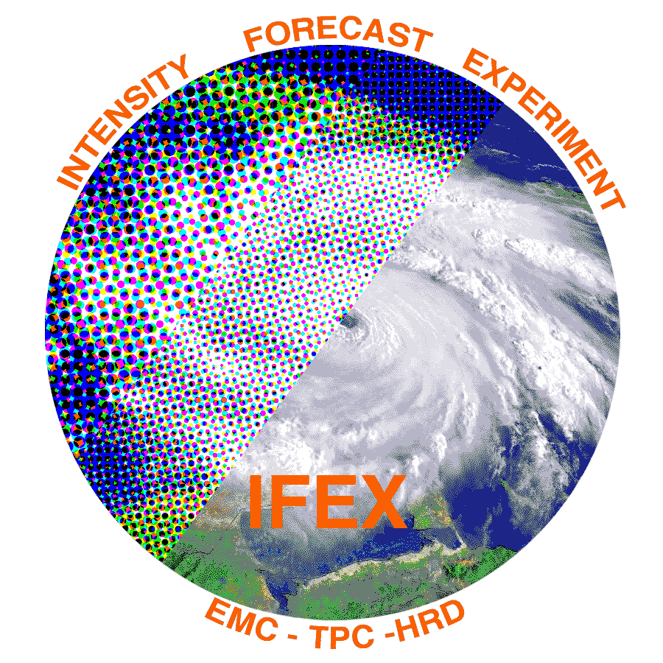
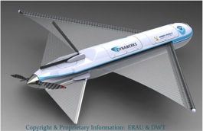
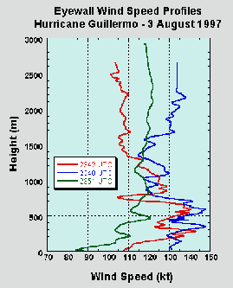
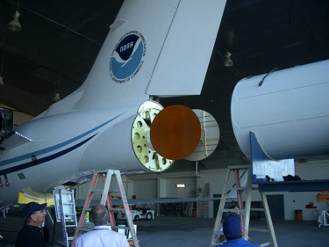
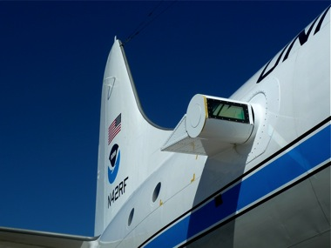
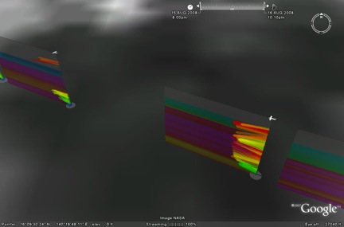
Improved Use of Observations: Intensity Forecast experiment (IFEX)
In-situ
Wind, press., temp.
Expendables
Dropsondes
AXBT, AXCP, buoy
Remote Sensors
Doppler Radar
SFMR/HIRAD
WSRA
Scatterometer/profiler
UAS - LALE
GALE UAS
G-IV Tail Doppler Radar
ONR DWL
Observations Team - Rob Rogers, AOML/HRD
Notes:
UR image depicts dropsonde profiles in eyewall of Hurricane Guillermo (1997)
LR image is Doppler Wind Lidar profiles from TCS-08

Slide 8
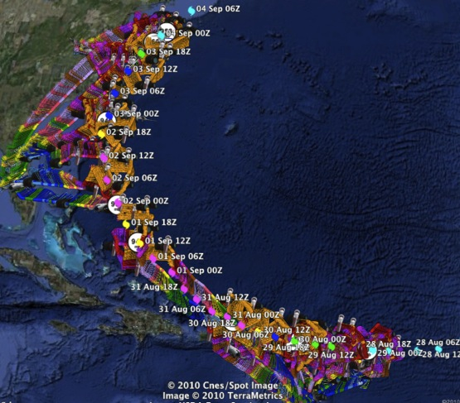
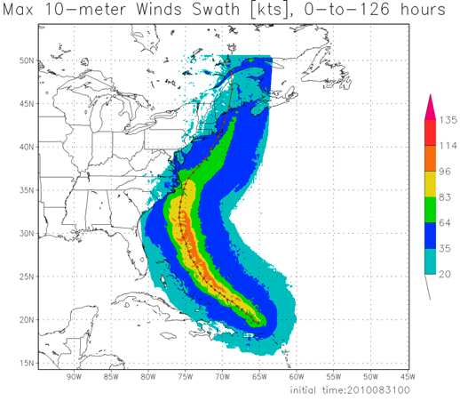
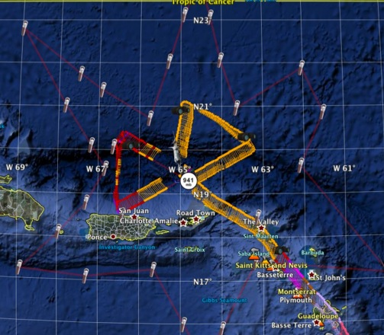
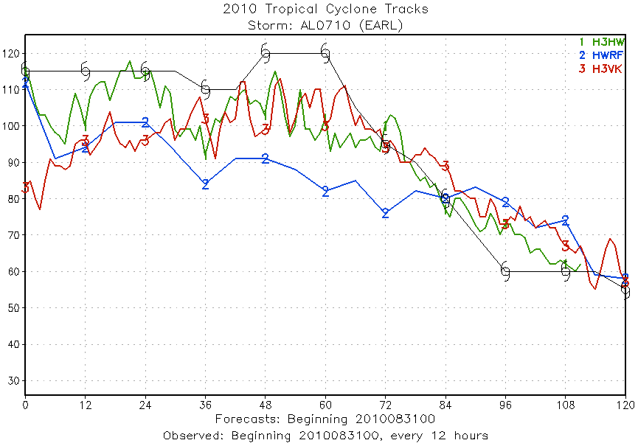
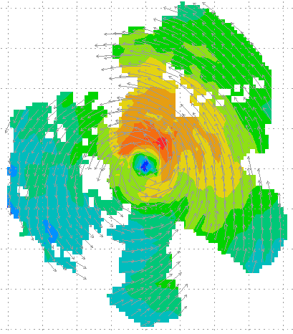
Improved Use of Observations: HFIP 2010 Demo: Earl
11 P-3 Flights
28 August – 3 September 2010
HWRFx/HEDAS
20100831 00UTC
Doppler SO (EnKF) transmitted in real-time to HRD for assimilation into HWRFx model
20100830I1
2126-0229 UTC
5 missions at 12-h intervals
00Z 28 – 12Z 30 August, 6 missions at 12-h intervals 00Z 1 September – 00Z 3 September collecting Doppler SO (HEDAS)
HWRFx/HEDAS
20100831 00UTC
J. Gamache, A. Aksoy, T. Vukicevic, Gopal (AOML/HRD)
Notes:
Left hand image - Flight pattern for 11 P-3 Doppler mission For Earl beginning 00Z 28 August 2010, ending at 12Z 3 September 2010
middle image – show real-time Doppler analyses for three legs mission centered on 00Z 30 August used to generate Sos
Right images – HWRFx forecasts track and maximum wind swath (top), and intensity (bottom) initialized at 00Z 30 August
IFEX 2010: Hurricane Earl WP-3D (11 missions: 5 missions at 12-h intervals, 00Z 28 – 12Z 30 August, & 6 missions at 12-h intervals, 00Z 1 September – 00Z 3 September collecting Doppler SO (HEDAS)
Deployed 756 dropwindsondes and 238 AXBTs. 55 real-time TDR analyses transmitted to NHC and Doppler radial files transmitted to EMC. TDR superobs transmitted in Paloma, Bill and Danny provided real-time assimilation of TDR data into ARW model at TACC. 60 real-time H*Wind surface analyses

Slide 9
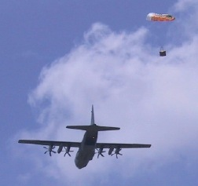
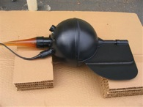
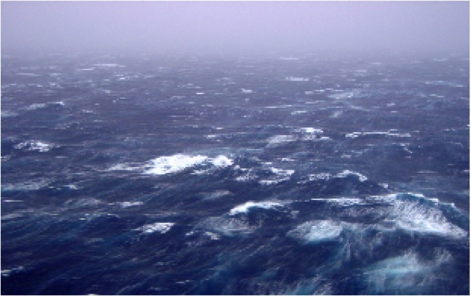
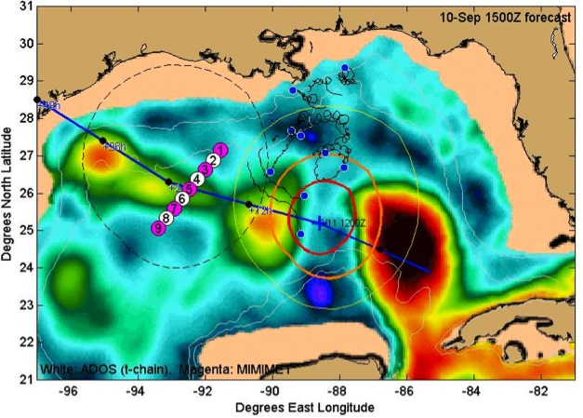
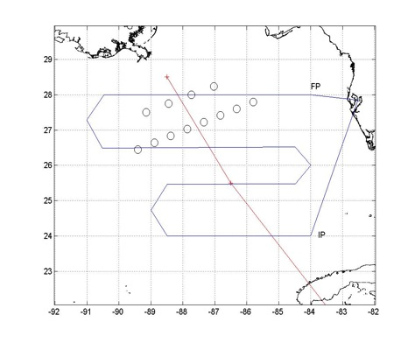
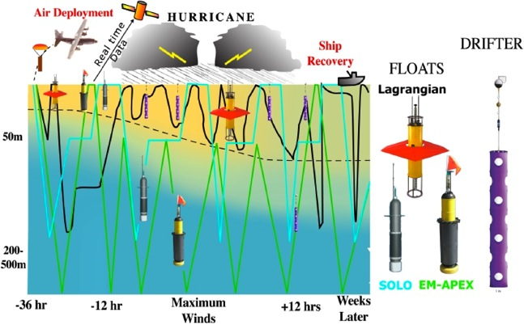
Improved Use of Observations: Air-sea interaction & upper ocean
Targeted upper ocean observations
TC impact on upper ocean effect of Hurricanes Gustav and Ike (2008)
CBLAST
Waves from 200’ in Isabel
E. Uhlhorn, AOML/HRD, R. Lumpkin AOML/PhOD
Notes:
Drifter array in Gustav and Ike were placed by AFRC WC-130 ahead of storm. Gustav array still functioning when Ike was crossing Gulf. Also deployed AXBT grid post-Gustave which proved to be pre-Ike, followed by in storm Ike AXBT drops and post-Ike array. Revealed warm eddy and cold eddy left behind from Gustav interactions with Loop current.
Upper right picture shows sea-height anomaly (color) with superposition of Ike track and radii of hurricane (red circle) and storm force (yellow circle )winds. Black curly lines are tracks of Gustav drifters and circles are planned deployment locations for Ike drifters and floats. Thin black line shows P-3 track during pre-Ike AXBT pattern. Dropped over 300 AXBTs in Gustav and Ike.

Slide 10
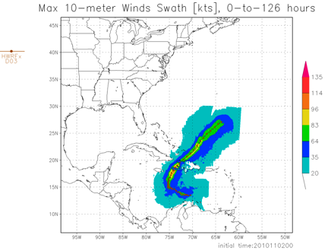
What in 2011?
2011 HFIP model demonstration
Global model ensemble
80 member GFS hybrid-EnKF
Regional model ensemble
≥15 HWRF members (2@27:9:3 km, ≥10@9:3 km)
≥10 COAMPS-TC members (45:15:5 km)
≥10 ARW members (40.5:13.5:4.5 km)
IFEX 2011
Continuation of IFEX objectives (Rogers et al, 2006)
320 flight hours two P-3s & G-IV available in June
Crews available for 2-per-day missions
IFEX 2011 home page

Slide 11
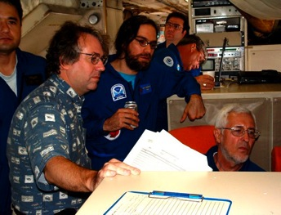
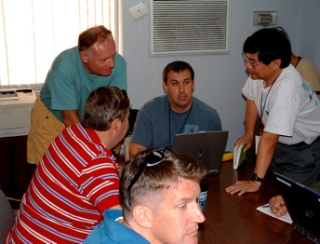
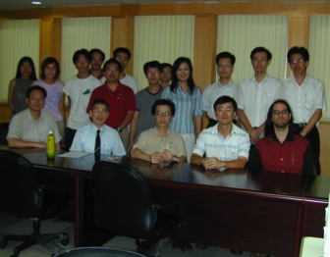
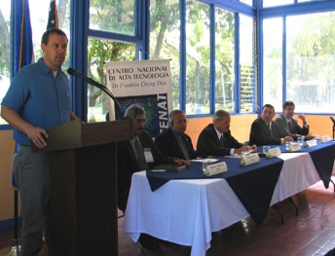
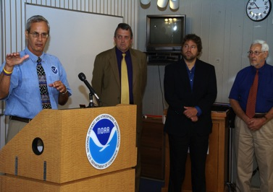
Keys to Success
Partnership: AOML, ESRL, GFDL, DTC, USWRP, NESDIS/STAR working closely with Operations (EMC, NHC, AOC) and Federal & Academic Partners (NASA, NSF, ONR, NRL, NCAR, BOEMRE)
More integrated use & support of Testbeds: JHT, DTC, JCSDA
Blend Traditional hurricane research activities and HFIP research activities
Manpower (diversity) to evaluate model performance with hurricane data sets is a critical need
CBLAST
IFEX/RAINEX
DOTSTAR
IFEX/TCSP
IFEX/PREDICT/GRIP

Slide 12
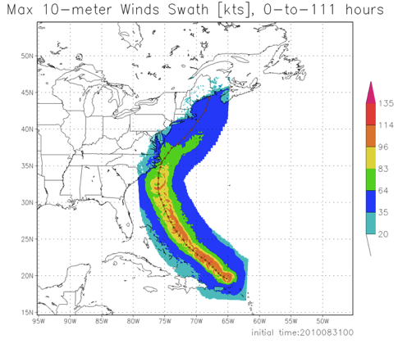
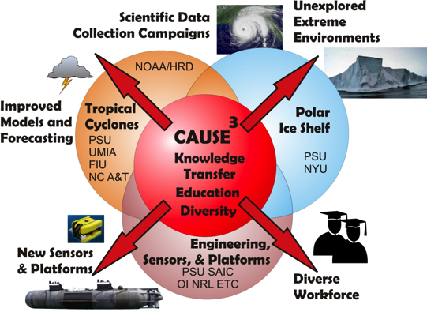
CAUSE³ Collaboration
NOAA focus –
Improved Track, Intensity, and Structure forecasts
CAUSE³ focus –
Understand energy & momentum transfer in mixed layer beneath tropical cyclones
Earl

Slide 13
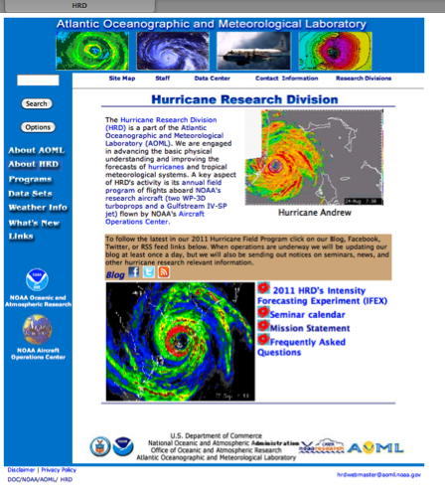
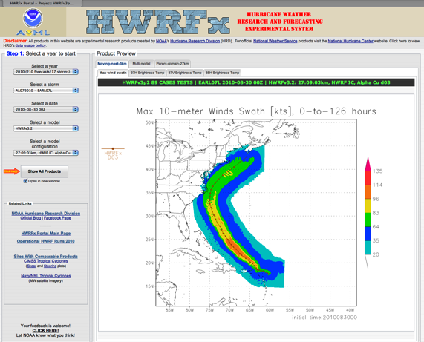
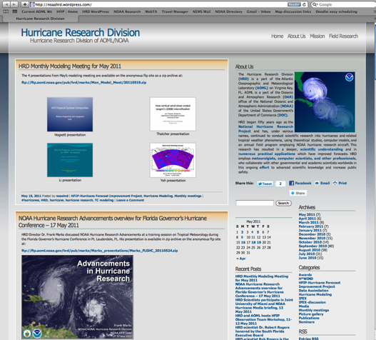
Outreach
Web Page
Web Portal
Web Log (Blog)
https://storm.aoml.noaa.gov/hwrfxprojects/?projectName=HFIP+Demo+2010
http://noaahrd.wordpress.com
http://www.aoml.noaa.gov/hrd/

