Slide 1


Advancing Tropical Cyclone Forecasts Using Aircraft Observations:
A Historical Perspective
Frank Marks
NOAA/AOML Hurricane Research Division
25 January 2012

Slide 2



Excellent References
Dorst, N. M., 2007: The National Hurricane Research Project: 50 Years of Research, Rough Rides, and Name Changes. Bull. Amer. Meteor. Soc., 88, 1566–1588.
Aberson, S. D., M. L. Black, R. A. Black, R. W. Burpee, J. J. Cione, C. W. Landsea, and F. D. Marks, 2006: Twenty-five years of tropical cyclone research with the NOAA P-3 aircraft. Bull. Amer. Meteor. Soc., 87, 1039–1055.

Slide 3
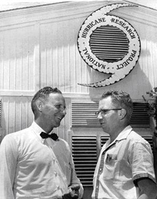
National Hurricane Research Project
Study hurricane formation
Study hurricane structure and dynamics
Seek means for hurricane modification
Seek means for improvement of forecasts
NHRP, 1959
NHRP used two WB-50s and a WB-47 aircraft, provided and operated by U.S. Air Force Air Weather Service.
Weather Bureau supplied instrumentation, and NHRP participated in missions in 1956-1958 hurricane seasons.

Slide 4
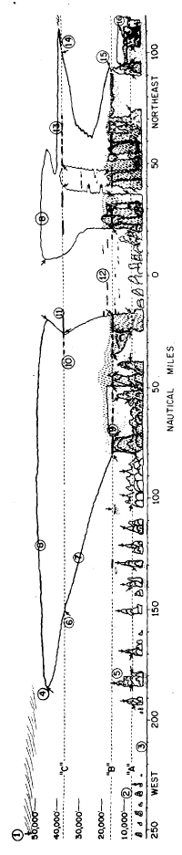
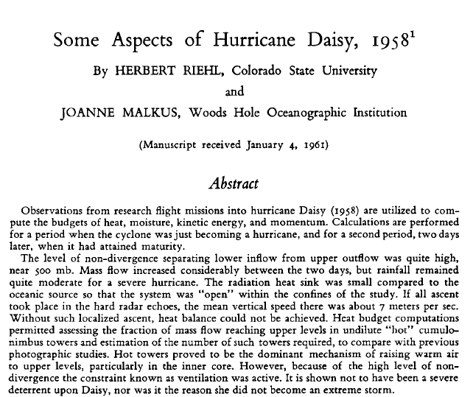
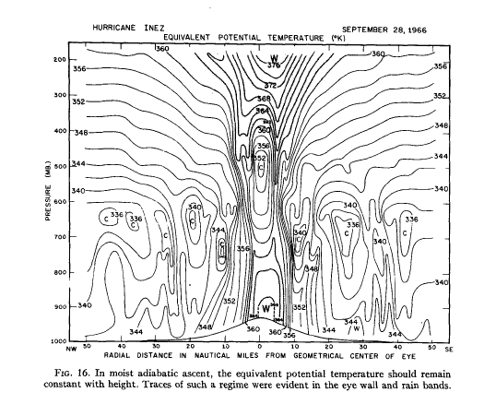
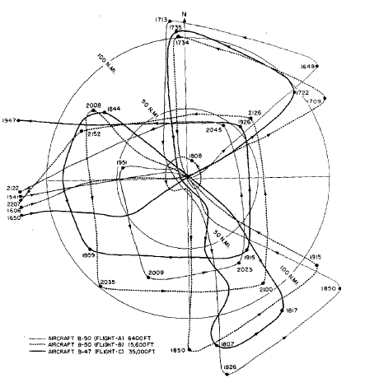
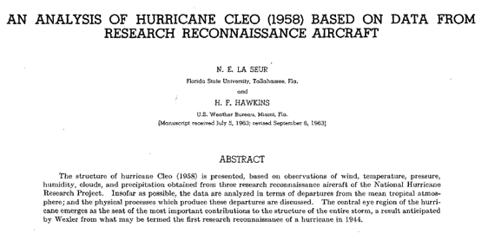
NHRP Discoveries

Slide 5
STORMFURY (1961-1984)
Modification Strategy
Well thought-out, mainstream science
Trigger symmetric instability, or
Construct an outer eyewall, through cloud seeding with AgI
Required abundant supercooled water
Expanded eye should have weaker winds through partial conservation of angular momentum

Slide 6
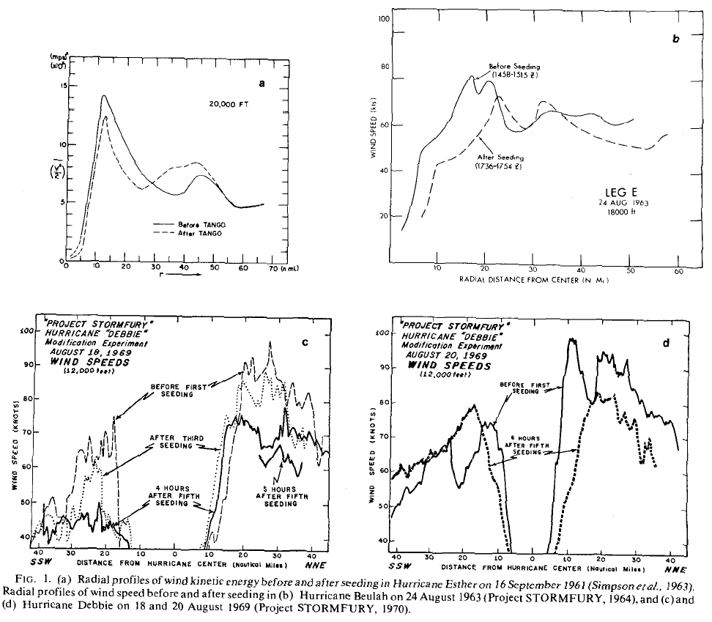
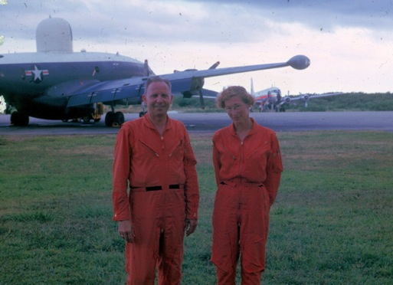
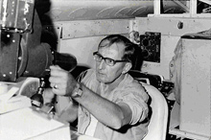
STORMFURY apparent successes

Slide 7
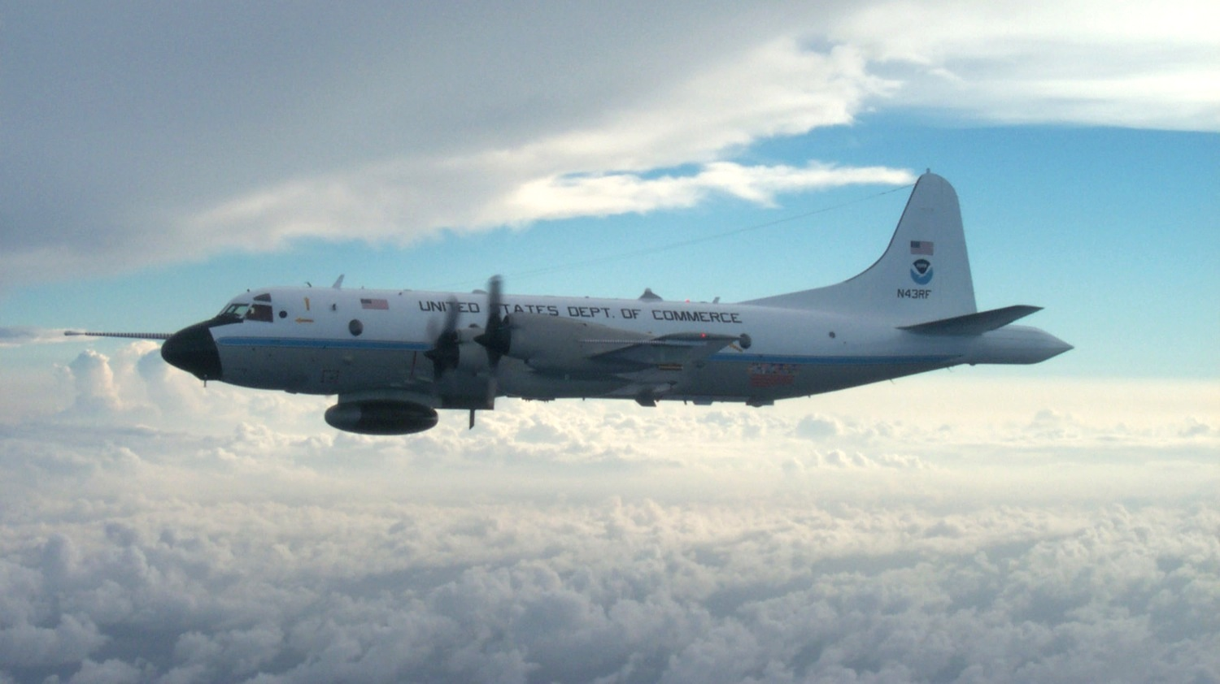
NOAA WP-3Ds (1976-today)

Slide 8
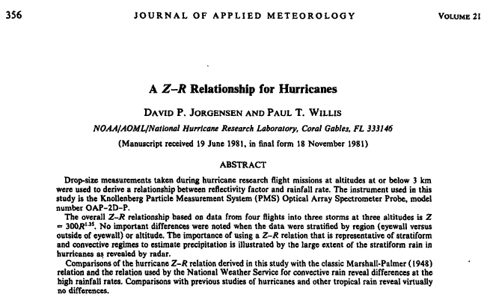
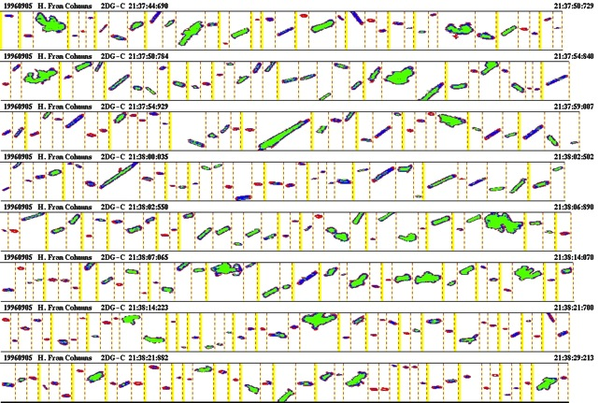
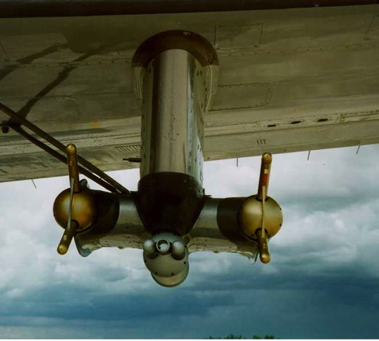
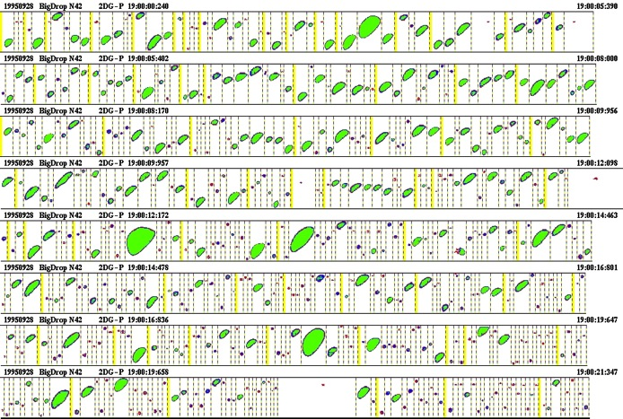
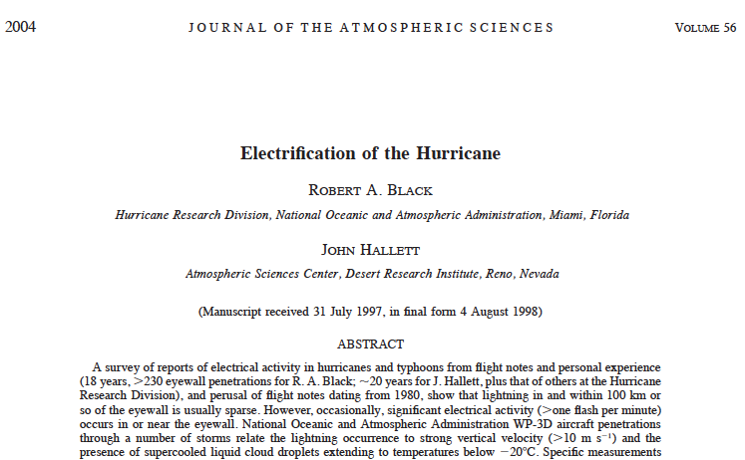
Microphysics
ICE
WATER
Notes:
Ice: Grey Probe, 1.92 mm view, 30 um resolution
Water: Precipitation Probe, 9.60 mm view, 150 um resolution

Slide 9
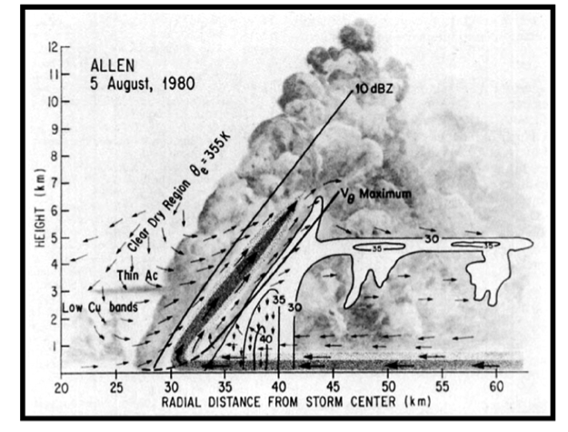
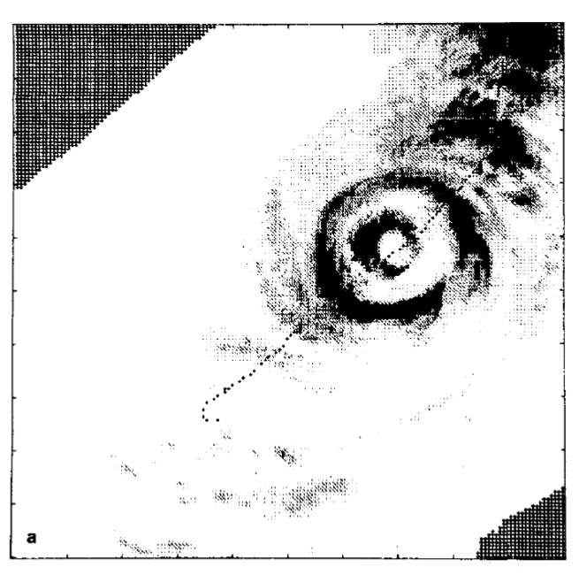
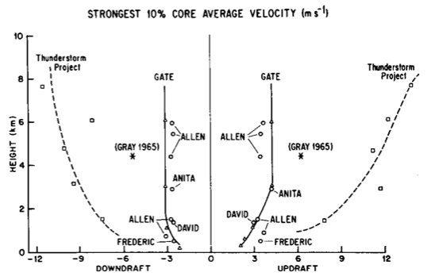
Inner core structure
Weak updrafts & little supercooled water
Eyewall Replacement
Jorgensen (1982)
Willoughby et al (1982)

Slide 10

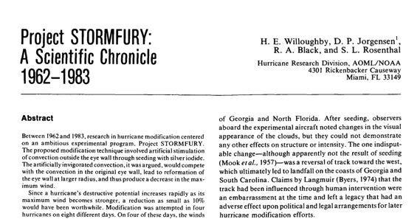
STORMFURY
Abandoned:
August 1985
Limited supercooled water
Eye expansion happens in unmodified hurricanes
Political difficulty with finding experimental subjects

Slide 11

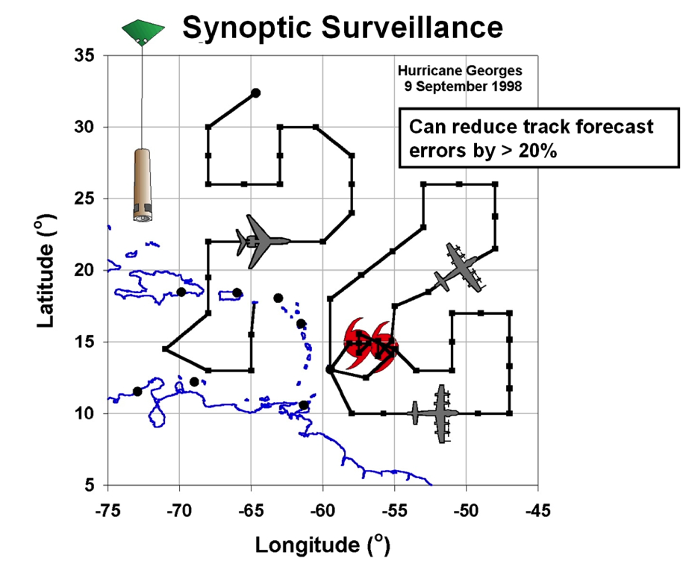
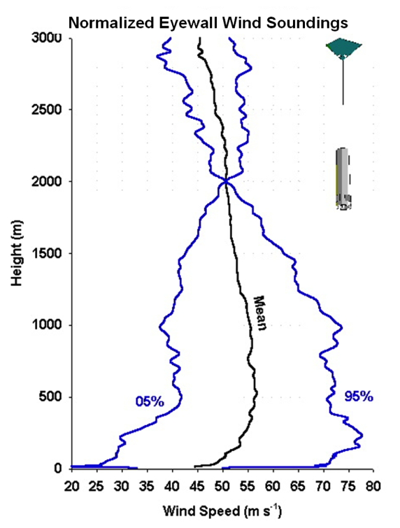
GPS Dropwindsondes
S. Aberson, AOML/HRD, J. Franklin NHC

Slide 12
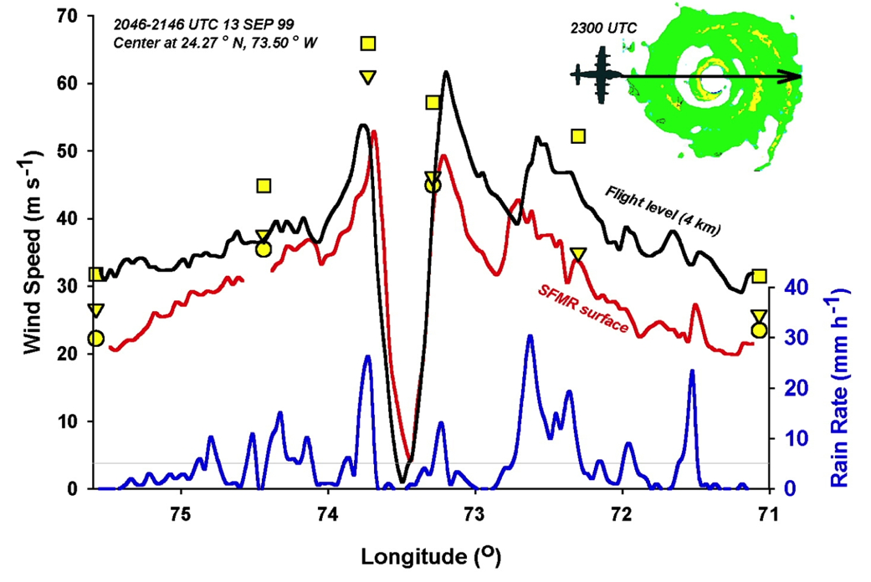
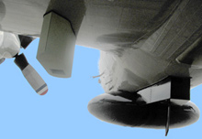
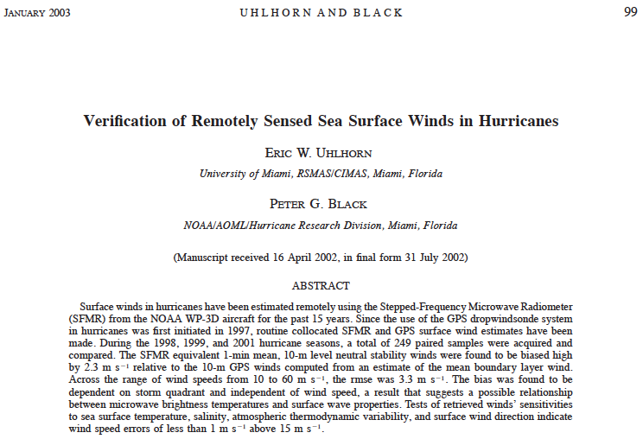
Stepped Frequency Microwave Radiometer (SFMR)
E. Uhlhorn, AOML/HRD

Slide 13
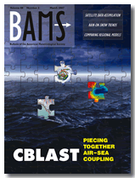
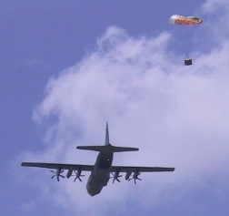
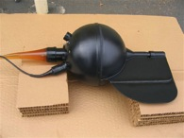
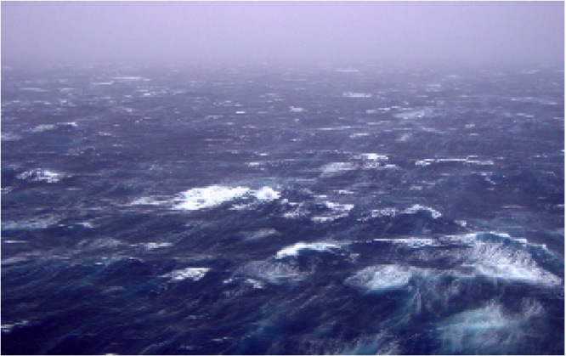
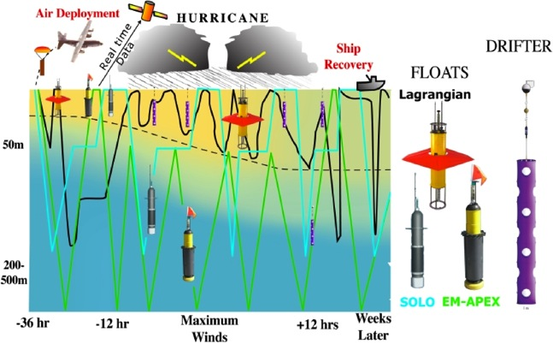
Upper Ocean Observations
Targeted upper ocean observations
TC impact on upper ocean effect of Hurricanes Gustav and Ike (2008)
CBLAST
Waves from 200’ in Isabel
E. Uhlhorn, AOML/HRD, R. Lumpkin AOML/PhOD
Notes:
Drifter array in Gustav and Ike were placed by AFRC WC-130 ahead of storm. Gustav array still functioning when Ike was crossing Gulf. Also deployed AXBT grid post-Gustave which proved to be pre-Ike, followed by in storm Ike AXBT drops and post-Ike array. Revealed warm eddy and cold eddy left behind from Gustav interactions with Loop current.
Upper right picture shows sea-height anomaly (color) with superposition of Ike track and radii of hurricane (red circle) and storm force (yellow circle )winds. Black curly lines are tracks of Gustav drifters and circles are planned deployment locations for Ike drifters and floats. Thin black line shows P-3 track during pre-Ike AXBT pattern. Dropped over 300 AXBTs in Gustav and Ike.

Slide 14

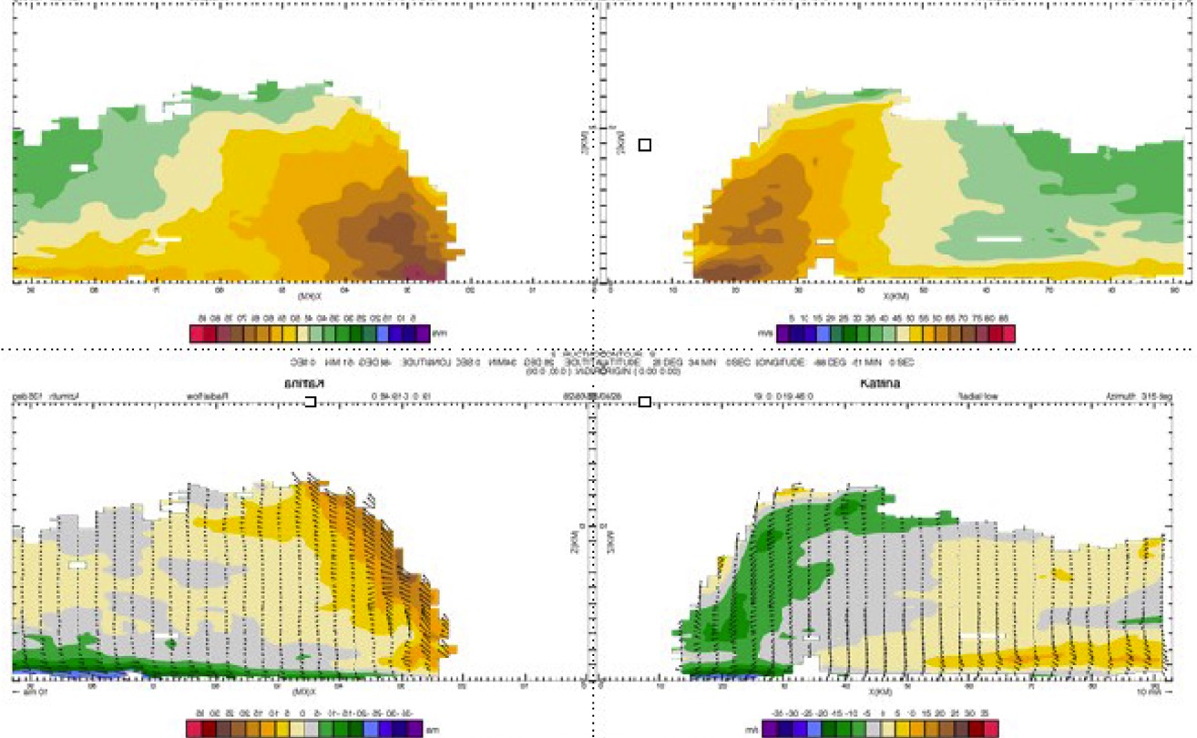
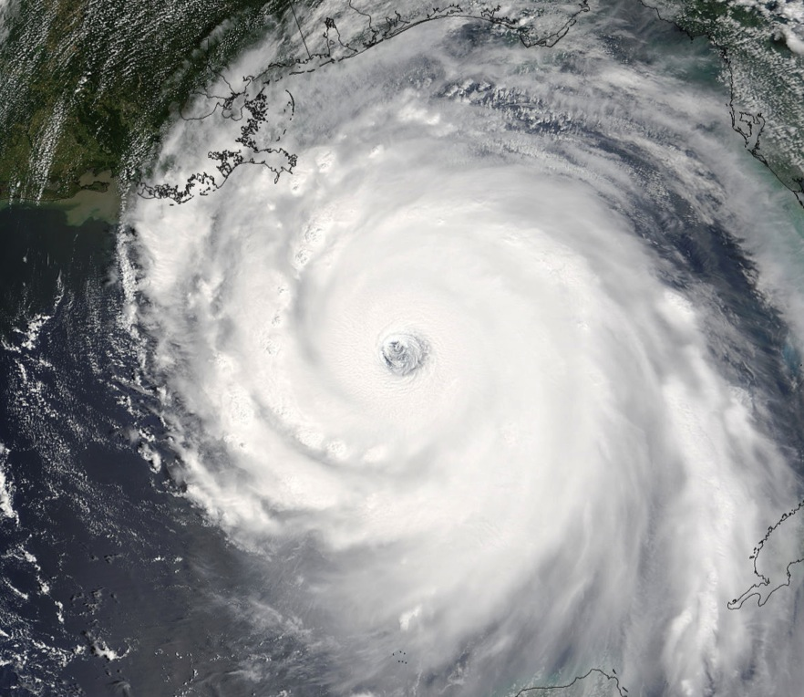
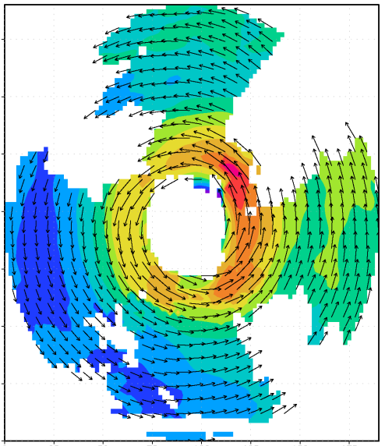

Airborne Doppler Radar
Airborne Doppler-analyzed wind field Hurricane Katrina, 28 September 2005
V_{θ}
150
100
distance (km)
V_{r}, w
50
0
0
50
100
150
distance (km)
John Gamache, AOML/HRD
Notes:
IFEX is multi-year data collection effort to test data flow to initialize HWRF and for use in model data sets. IFEX is partnership with NWS, NESDIS, & AOC
• HRD developed the capability to make a three-dimensional analysis from automatically quality-controlled Doppler data as part of JHT and a G-IV Doppler radar upgrade proposals. Horizontal and vertical cross sections of these analyses were transmitted from the P3 to NHC. The three-dimensional analyses have a vertical resolution of .5 km and a horizontal resolution of 4 km. Analyses of the horizontal and vertical distribution of radius-height-averaged winds are examples of those sent to NHC in nearly all storms for the late phase of IFEX. HRD cooperated with NHC to produce analyses of the greatest interest to NHC, namely the 4-km x 4-km x 0.5-km analyses at 500 m and 1 km.
• Goal is to provide QC Doppler radar-radial-velocity observations from NOAA G-IV and WP-3D aircraft in real time to EMC for assimilation into HWRF. HWRF will be able to use data at 1.5 km horizontal resolution and finer vertical resolution to initialize winds in TC core and immediate environments. Only way to consistently obtain such data is X-Band airborne Doppler radar. 14 real-time analyses sent via SATCOM for NHC in Katrina
Katrina: 5 analyses on 25 August
4 analyses on 27 August
5 analyses on 28 August

Slide 15
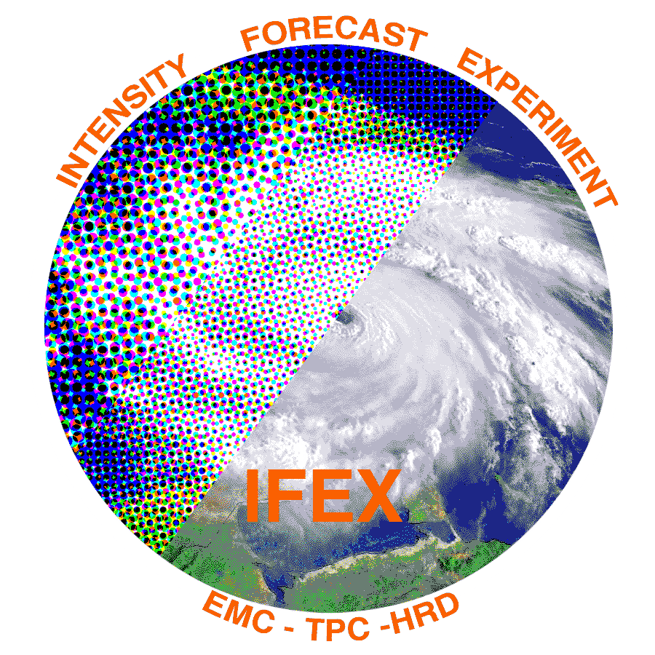
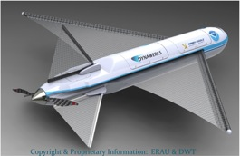

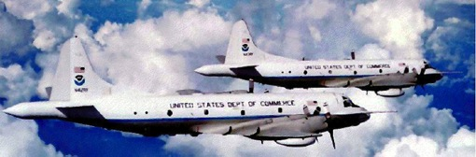
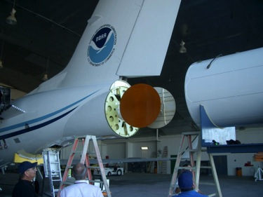
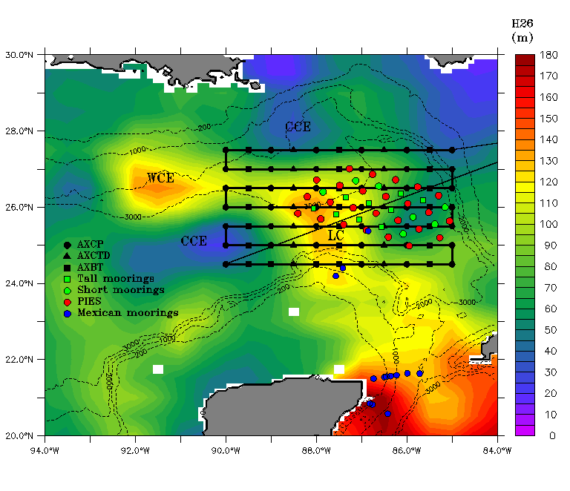

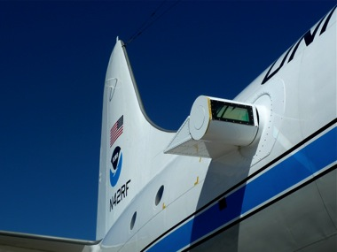
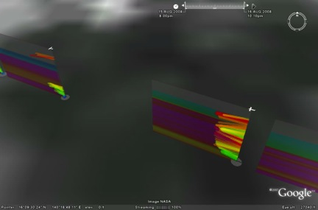
Improved Use of Observations:
HFIP & Intensity Forecast Experiment (IFEX)
In-situ
  Wind, press., temp.
Expendables
  Dropsondes
  AXBT, AXCP, buoy
Remote Sensors
  Doppler Radar
  SFMR/HIRAD
  WSRA
  Scatterometer/profiler
  UAS - LALE
Improve prediction of TC intensity change by:
  collecting observations through the TC life cycle
  developing and refining measurement technologies
  improving understanding of physical processes important in TC intensity change
GALE UAS
NASA Global Hawk
G-IV Tail Doppler Radar
AXBT profiles of Loop Current
ONR DWL
DWL profiles from TCS-08
Notes:
UR image depicts dropsonde profiles in eyewall of Hurricane Guillermo (1997)
LR image is Doppler Wind Lidar profiles from TCS-08

Slide 16
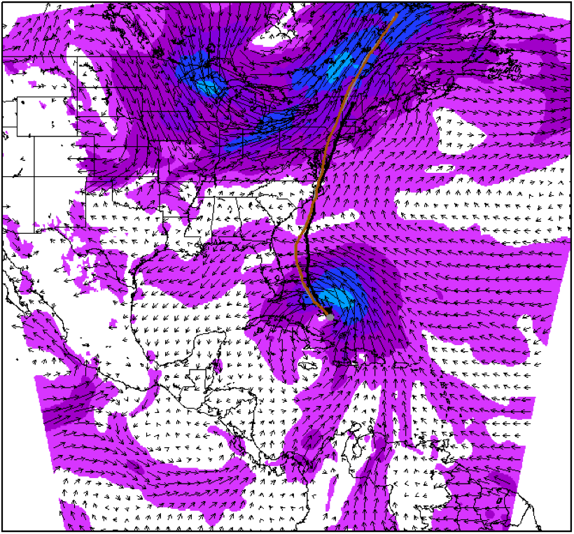
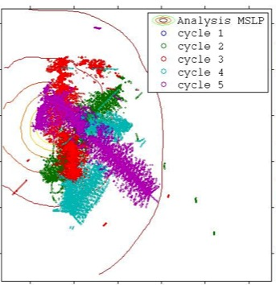
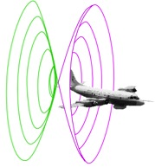
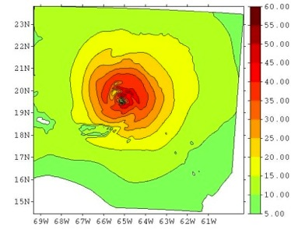
Improved Models & Data:
Assimilation of data into numerical models
Synergy of high resolution forecast and airborne observations
P-3 and G-IV observations – superobs (SO)
Data assimilation
Improving the initial condition in storm core region
Improving the high resolution regional forecast
Wind intensity at 10 m
Hurricane Irene(2011)
F. Zhang (PSU), Aberson, Aksoy, Gamache, Gopal (AOML/HRD)

Slide 17
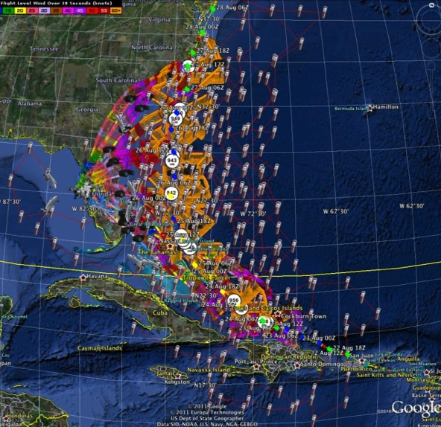
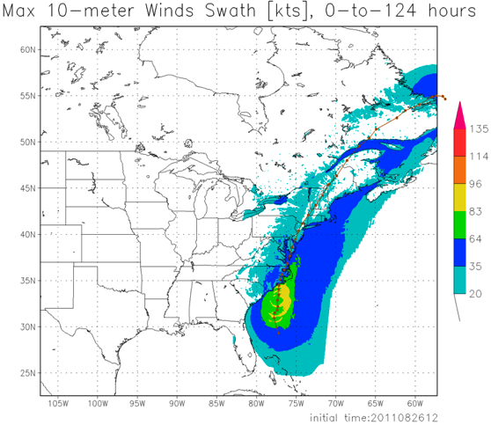
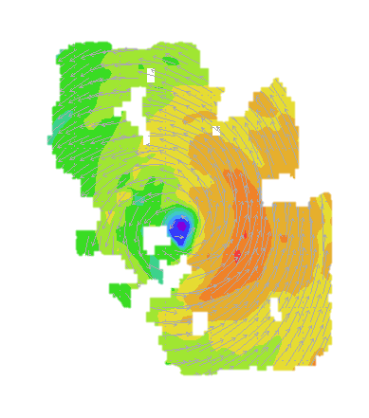
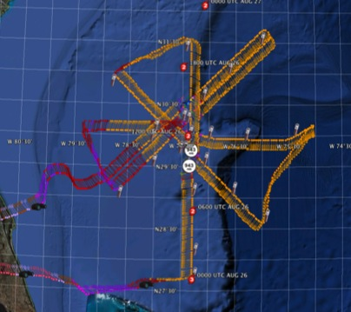
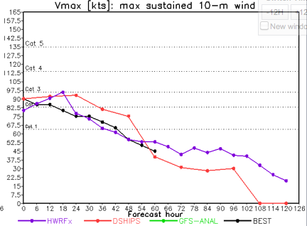
Improved Models & Data:
IFEX 2011: Irene
HWRF/HEDAS
20110826 12UTC
Doppler SO (EnKF) transmitted in real-time for assimilation into HWRF
20110826I1
0926-1416 UTC
7 P-3 Flights
23 August – 27 August 2011
HWRF/HEDAS
20110826 12UTC
7 missions from 23-27 Aug 2011 at ~12 h sampling of Doppler SO (HEDAS) & 8 G-IV missions
Sampled Irene as a major hurricane through landfall
Aberson, Aksoy, Gamache, Gopal (AOML/HRD)
Notes:
Map shows flight tracks for all of the NOAA missions (color coded are the flight level winds for the P-3 missions, dropsonde symbols denote G-IV patterns)

Slide 18
Improved Models & Data:
EnKF DA of inner core Doppler data
% Improvement over HFIP baseline
79 82 82 81 76 65 46 cases
All cases with Doppler data 2008-2011
Need help of Research community to address
F. Zhang (PSU) & Aberson (HRD)
Notes:
2004-2010 for Intensity improvement
HEDAS – HWRF Ensemble Kalman filter (EnKF) data assimilation system developed at HRD and very similar to PSU system – right now using an older research version of HWRF (HWRFx)
PSU EnKF – Advanced Research WRF (ARW) EnKF data assimilation system developed by Fuqing Zhang (PSU)
For both the track and intensity goals, the HFIP baseline was computed from a consensus (equally-weighted average) of operational guidance models was utilized, evaluated for the Atlantic Basin over the period 2006-2008.
Intensity error (kt) baseline by forecast hour (HR)
HR BASE
0 2.2
12 7.7
24 10.1
36 11.7
48 13.7
72 16.0
96 16.6
120 17.0

Slide 19
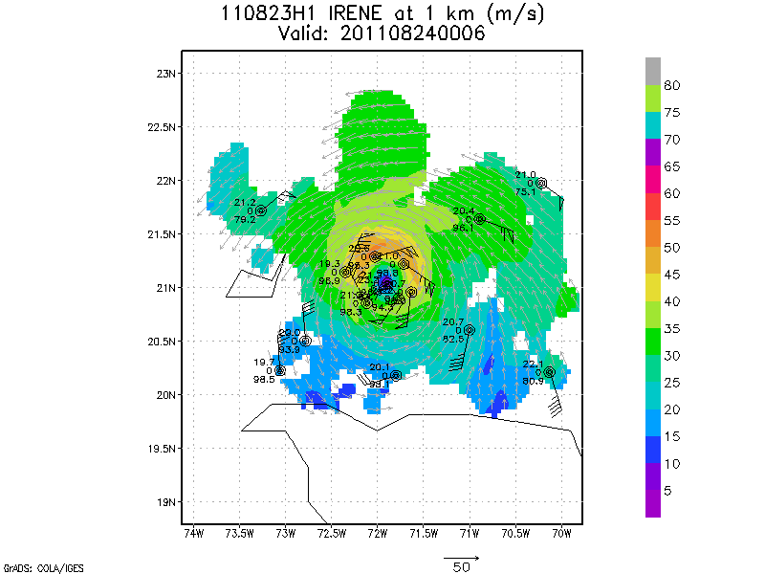
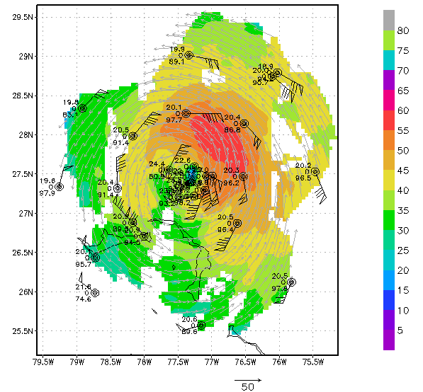



Improved Models & Data:
IFEX 2011: Irene
Real-time P-3 Tail Doppler and Dropsonde Composite at 1 km altitude
m/s
Flight 110823H1
Flight 110825H1
West
East
West
East
S. Murillo, R. Rogers (AOML/HRD)
Notes:
Colors denote Doppler winds and station codes denote dropsondes
West-east vertical cross section of wind speed (shaded, m/s).

Slide 20







Improved Models & Data:
Earl (2010) Rapid Intensification
Geographic coverage of P-3 RI flights
Temporal coverage of P-3 RI flights
DC-8
DC-8
C-130
C-130
C-130
C-130
G-IV
G-IV
G-IV
100828I
100829H
100829I
100830H
100830I
P-3
P-3
P-3
P-3
P-3
Axisymmetric tangential wind (shaded, m s⁻¹)
14
Flight 1 – 100828I1
Flight 2 – 100829H1
Flight 3 – 100829I1
Flight 4 – 100830H1
Flight 5 – 100830I1
12
10
height (km)
8
6
4
2
0
25
50
75
100
125
150
25
50
75
100
125
150
25
50
75
100
125
150
25
50
75
100
125
150
25
50
75
100
125
150
radius (km)
radius (km)
radius (km)
radius (km)
radius (km)
Rob Rogers, AOML/HRD
Notes:
Evolution of axisymmetric mean tangential wind profile during the RI of Hurricane Earl (first 5 P-3 missions (red bars in top right image)

Slide 21




Improved Models & Data:
Model evaluation: Wind Structure
Hurricane Bill 1600 UTC, 19 August 2009
HWRF 10m winds
Data Coverage
H*Wind 10m winds
IKE : for winds > TS force: 371 TJ, for winds > hurricane force: 109 TJ
IKE : for winds > TS force: 92 TJ, for winds > hurricane force: 30 TJ
Analyzed max wind: 117 kt from HWRF, 37 nm
Analyzed max wind: 107 kt from Tail Doppler, 23 nm
S. Murillo, M. Powell (AOML/HRD)

Slide 22




Improved Models & Data:
Model evaluation: Vortex-scale
Doppler
Tangential wind (m/s)
Height (km)
HWRFx
Tangential wind (m/s)
Radial wind (m/s)
Vertical velocity (m/s)
Height (km)
normalized radius
normalized radius
normalized radius
R*=R/RMW
R. Rogers, J. Zhang, P. Reasor, & S. Lorsolo (AOML/HRD)
Notes:
Comparison of composites using different horizontal resolution

Slide 23






Future Aircraft Observations
GRIP & HS3:
NASA GRIP Global Hawk
Green-NASA DC-8
Purple-NASA WB57
Orange-NASA Global Hawk
Red-PREDICT G-V
Yellow-NOAA G-IV
Blue-NOAA P-3
HIWRAP
High Altitude Imaging Wind and Rain Profiler
(Horizontal wind vectors and ocean surface winds)
Mistsondes
High Altitude Lightweight Dropsonde
(Vertical profiles of temp, humidity, pressure & winds)
HAMSR
High Altitude MMIC Sounding Radiometer
(Temp, H2Ov, Cloud liquid & ice distribution)
LIP
Lightning Instrument Package
(Lightning and Electrical Storm observation)
GRIP & HS3 Teams – S. Braun (NASA/GSFC)

Slide 24









Communicating in the field
Our blog
http://noaahrd.wordpress.com
HRD Web page
http://www.aoml.noaa.gov/hrd
Facebook
http://www.facebook.com/noaahrd
Twitter
http://twitter.com/#!/HRD_AOML_NOAA
Tweets from the eye
Visiting scientist program

Slide 25

Notes:
205 storms flown total up to 2005, 89 prior to my arrival at HRD in 1980, 126 since 1980

