Slide 1
Were Sandy’s Track and Intensity Changes Unusual?
Frank Marks, Hua Chen, & Gopal
NOAA/AOML Hurricane Research Division
9 January 2014
Notes:
Hurricane Sandy 28 October 2012

Slide 2
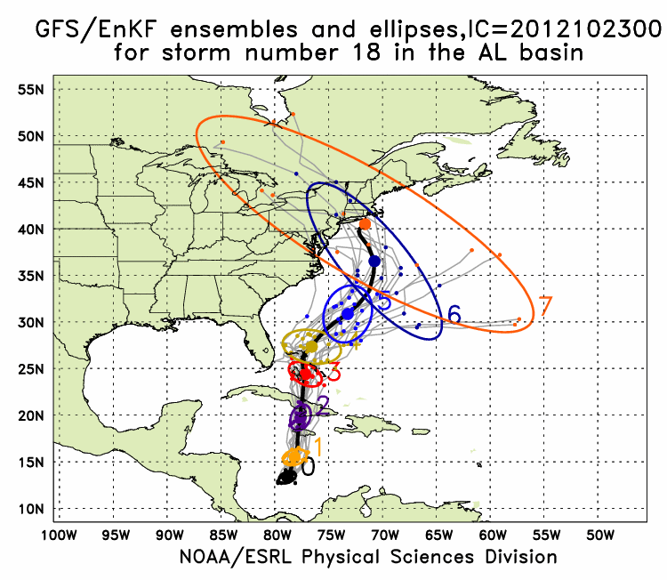
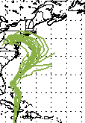
Sandy Track:
GFS/EnKF & HWRF
GFS/EnKF T382 20 member ensemble
HWRF
12Z 23 October – 00Z 29 October
Observed
Observed
http://www.esrl.noaa.gov/psd/forecasts/gfsenkf/ens/
http://www.emc.ncep.noaa.gov/gc_wmb/vxt/
Notes:
Model data available at: http://www.esrl.noaa.gov/psd/forecasts/gfsenkf/ens/
Global Ensembles:
80-member T254 GFS ensembles cycled every 6-h continuously from 1 August to current time
Look at 20 members of the 80 member ensemble
Left panels shows plots of the deterministic operational HWRF tracks starting at 1200 UTC 23 October to 0000 UTC 29 October

Slide 3
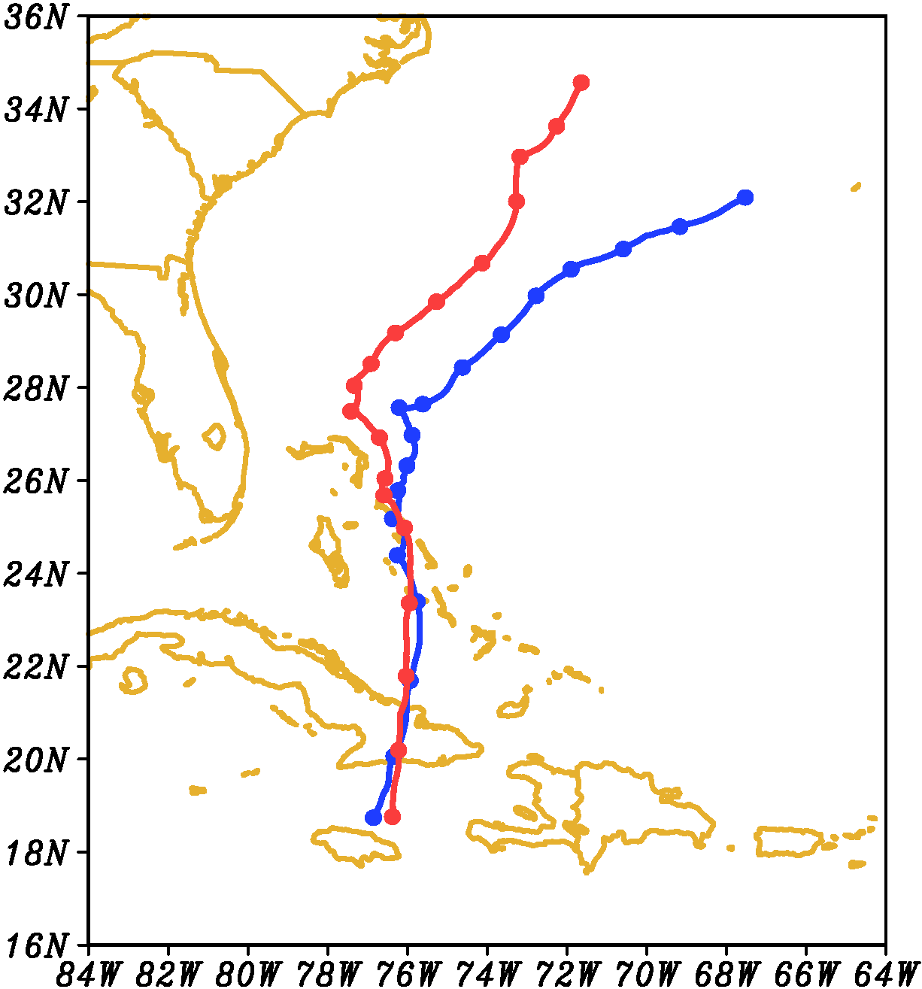
Sandy Track
Start 00Z 25 October
96 h
00Z 24 October
(blue)
00Z 25 October
(red)
Tracks very similar to 36 h
(12Z 26 October)
96 h
72 h
72 h
48 h
48 h
24 h
24 h
00:00OCT25
Notes:
Images from: http://www.nhc.noaa.gov/verification/verify5.shtml

Slide 4
Basin HWRF 500 hPa
00Z 24-00Z 25
00Z 24-00Z 25
Init: 00Z 24 October
Init: 00Z 24 October
Init: 00Z 25 October
Init: 00Z 25 October

Slide 5
Basin HWRF 200 hPa
00Z 24-00Z 25
00Z 24-00Z 25
Init: 00Z 24 October
Init: 00Z 24 October
Init: 00Z 25 October
Init: 00Z 25 October

Slide 6
Sandy Track
Start 00Z 25 October
00Z 24 October
00Z 25 October
36 h: 12Z 26 October
18 h: 18Z 25 October
Notes:
Images from: http://www.nhc.noaa.gov/verification/verify5.shtml

Slide 7
Sandy Vertical Wind Shear
Start 00Z 25 October
36 h: 12Z 26 October
18 h: 18Z 25 October
00Z 25OCT

Slide 8
Vortex Tilt
2-8 km Altitude
00Z 26Oct
12Z 26Oct

Slide 9
Potential Vorticity
2-8 km Altitude
Init: 00Z 24 October
Init: 00Z 25 October

Slide 10
R-Z Mean Tangential Wind
Init: 00Z 24 October
Init: 00Z 25 October

Slide 11
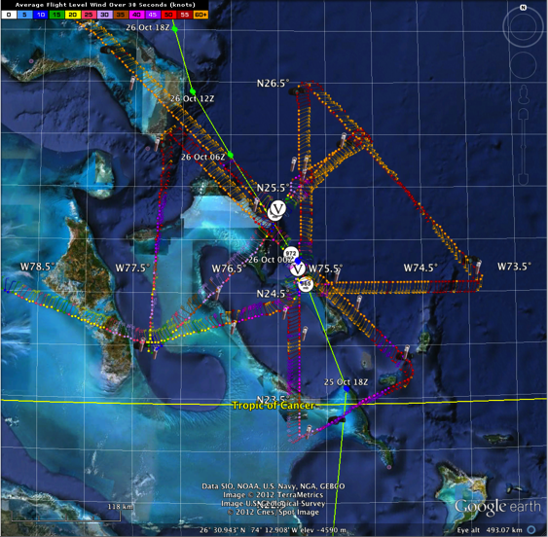
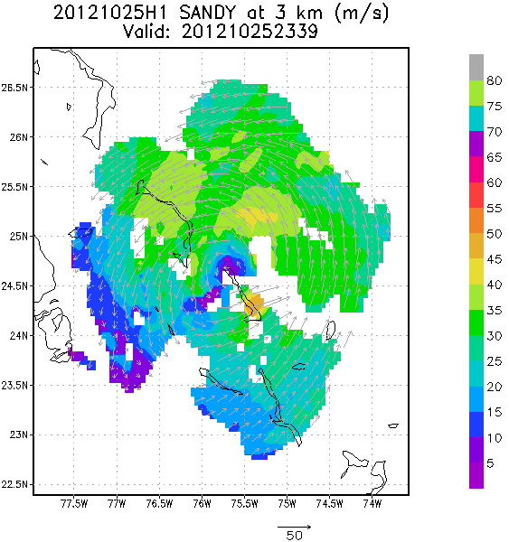
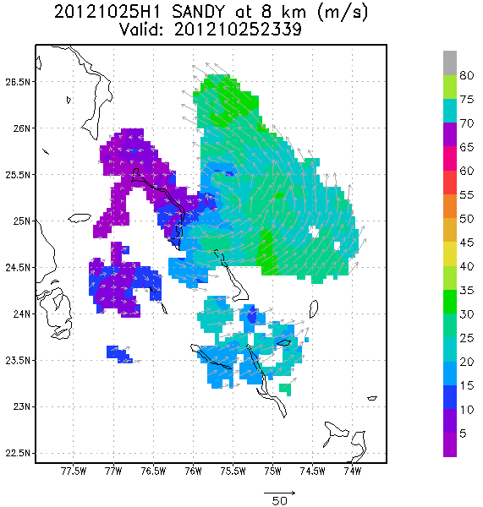
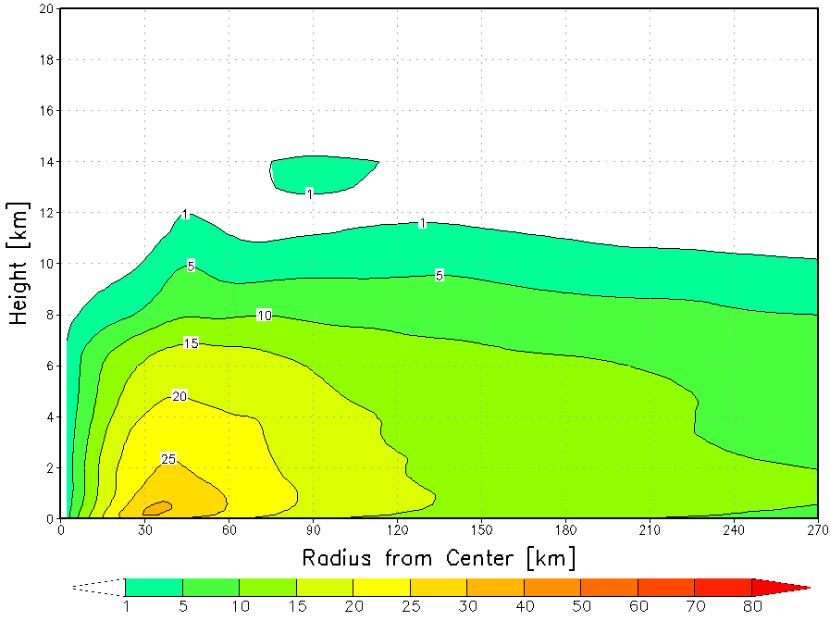
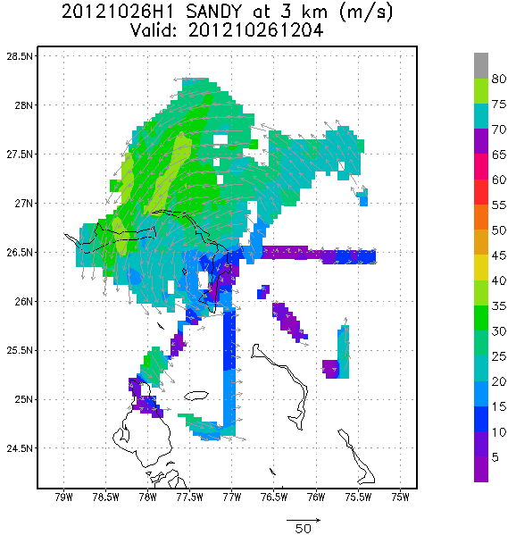
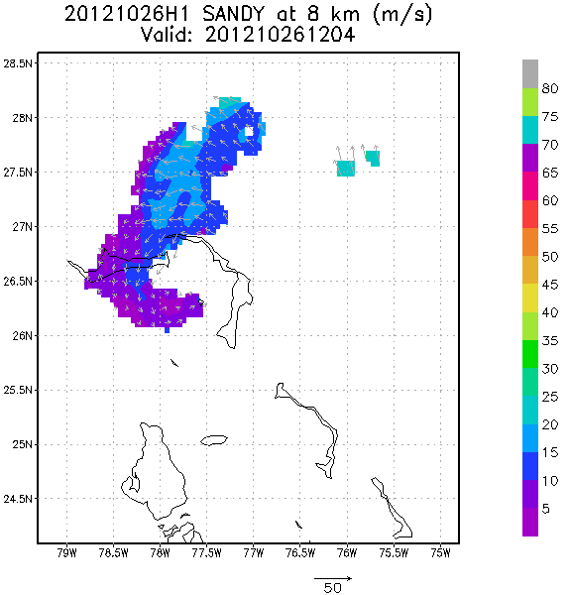
TDR Analyses
00Z 26 October
12Z 26 October
Notes:
http://www.nws.noaa.gov/om/assessments/pdfs/Irene2012.pdf
http://www.nhc.noaa.gov/data/tcr/AL182012_Sandy.pdf

Slide 12
Layer Means
30-42 h (06Z-18Z 26 October) mean
18 m s⁻¹
5.0 m s⁻¹
5.0 m s⁻¹
Init: 00Z 24 OCT
Init: 00Z 25 OCT
850-200mb shear
Notes:
m/s

Slide 13
Summary
Sandy’s track and intensity were not unusual
Two HWRF simulations initialized 24 h apart have similar tracks and intensity until 06Z 26 October
  Large scale similar at 500 hPa, but 200 hPa trough over GOM further east and stronger in early run
  Simulations have similar track and intensity until 00Z 26 October
  Early run has stronger, slower storm, while later run storm further north
  Shear over both storms identical from SW at 18 m s⁻¹
Track and intensity result of different vortex-shear interaction
  Both storms interact with sheer from 18Z 25 to 12Z 26 October
  Storm with track closer to observed appears less resilient, became very shallow altering steering flow from deep SSW to shallow SE
  Change in steering led to track bifurcation

Slide 14
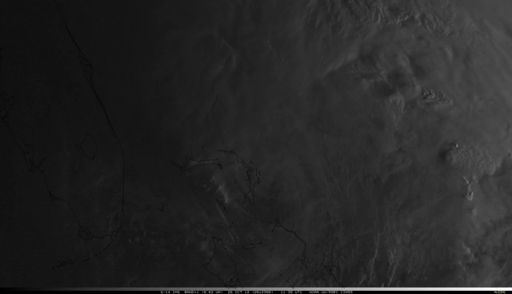
Questions?
Notes:
VIS satellite loop1030-1500Z 26 October

