Slide 1

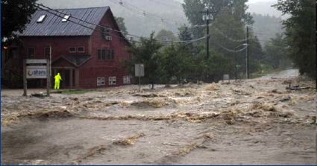
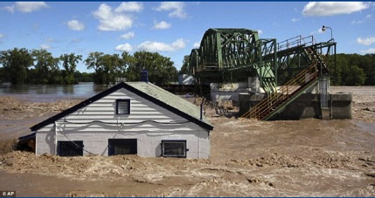

NOAA Service Assessment
Hurricane Irene
21-29 August 2011
Frank Marks and Wes Browning
(Co-team leads)
May 18, 2012

Slide 2

Hurricane Irene
Service Assessment
Outline

Slide 3
Hurricane Irene
Service Assessment
Event Overview

Slide 4
Hurricane Irene
Service Assessment
Event Statistics and Impacts

Slide 5
Hurricane Irene
Service Assessment
Service Assessment Team
Dr. Frank Marks, Team Leader, OAR/AOML Hurricane Research Division
Wes Browning, Technical Lead, Meteorologist in Charge, St. Louis, MO
Dr. Vankita Brown, Social Scientist, NWSHQ OCWWS
Dr. Terri Adams-Fuller, Social Scientist, Howard University
Dr. Susan Jasko, Social Scientist, California University of Pennsylvania
Monica Allen, NOAA Public Affairs Specialist, Marine Fisheries
Sean Wink, SOD Chief, Salt Lake City, UT
Aimee Fish, Meteorologist, Environmental and Scientific Services Div., AK
John Gordon, Meteorologist in Charge, Louisville, KY
Alan Haynes, Service Coordination Hydrologist, CNRFC
John Brost, Science and Operations Officer, Tucson, AZ
Dr. William Hooke, Senior Policy Fellow and Director at AMS, Washington, DC
Ray Tanabe, MIC HFO/Director, Central Pacific Hurricane Center
Scott Lindsey, Service Coordination Hydrologist, ARRFC
Mike Clay, Chief TV Meteorologist, Tampa, FL
Dr. John Kelley, Meteorologist, NOS, Durham, NH
John Winkelman, Coastal Engineer, USACE New England District
Rick Dittmann, Meteorologist in Charge, Pocatello, ID

Slide 6
Hurricane Irene
Service Assessment
Process
Focus on:
  Coordination and Collaboration
  Resource Allocation
  Decision Support Service
  Data Collection, Dissemination, and Forecast Models
Interviews covered 13 WFOs, 3 RFCs, NCEP, 4 FEMA Regions, other Federal and State partners
Recommendations classified as Operational (resolvable in the near-term) or Strategic (requiring substantial time and resources to address)
Captured 82 recommendations, 34 Operational and 48 Strategic

Slide 7

Hurricane Irene
Service Assessment
Inundation (Inland & Coastal)

Slide 8
Hurricane Irene
Service Assessment
Improved guidance products for local DSS

Slide 9
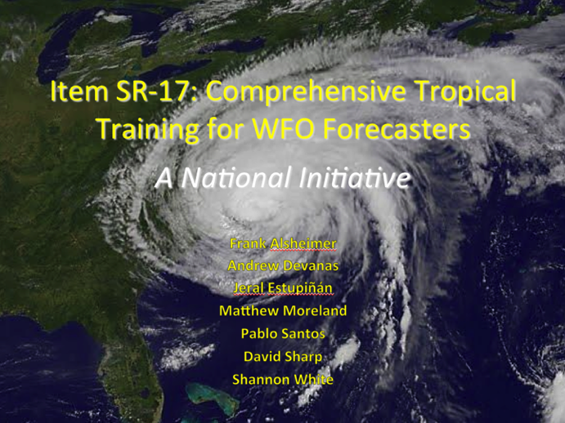
Hurricane Irene
Service Assessment
Training/Hiring

Slide 10
Hurricane Irene
Service Assessment
Resiliency (Backup/Communications)
VSAT

Slide 11
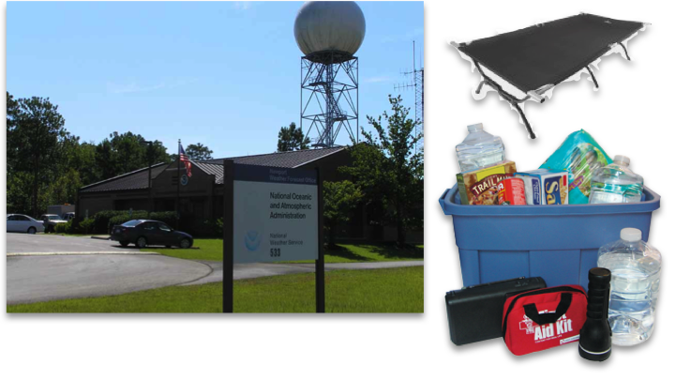
Hurricane Irene
Service Assessment
Safety/Infrastructure

Slide 12
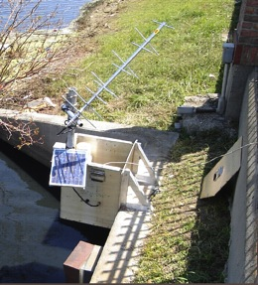
Hurricane Irene
Service Assessment
Quality & Availability of Data

Slide 13


Hurricane Irene
Service Assessment
Decision Support Services

Slide 14
Hurricane Irene
Service Assessment
Next Steps

