Slide 1
NOAA Hurricane Forecast Improvement Project
Frank Marks
NOAA/AOML Hurricane Research Division NOAA HFIP Research Lead
1 May 2012
Notes:
Hurricane Irene 27 August 2011

Slide 2
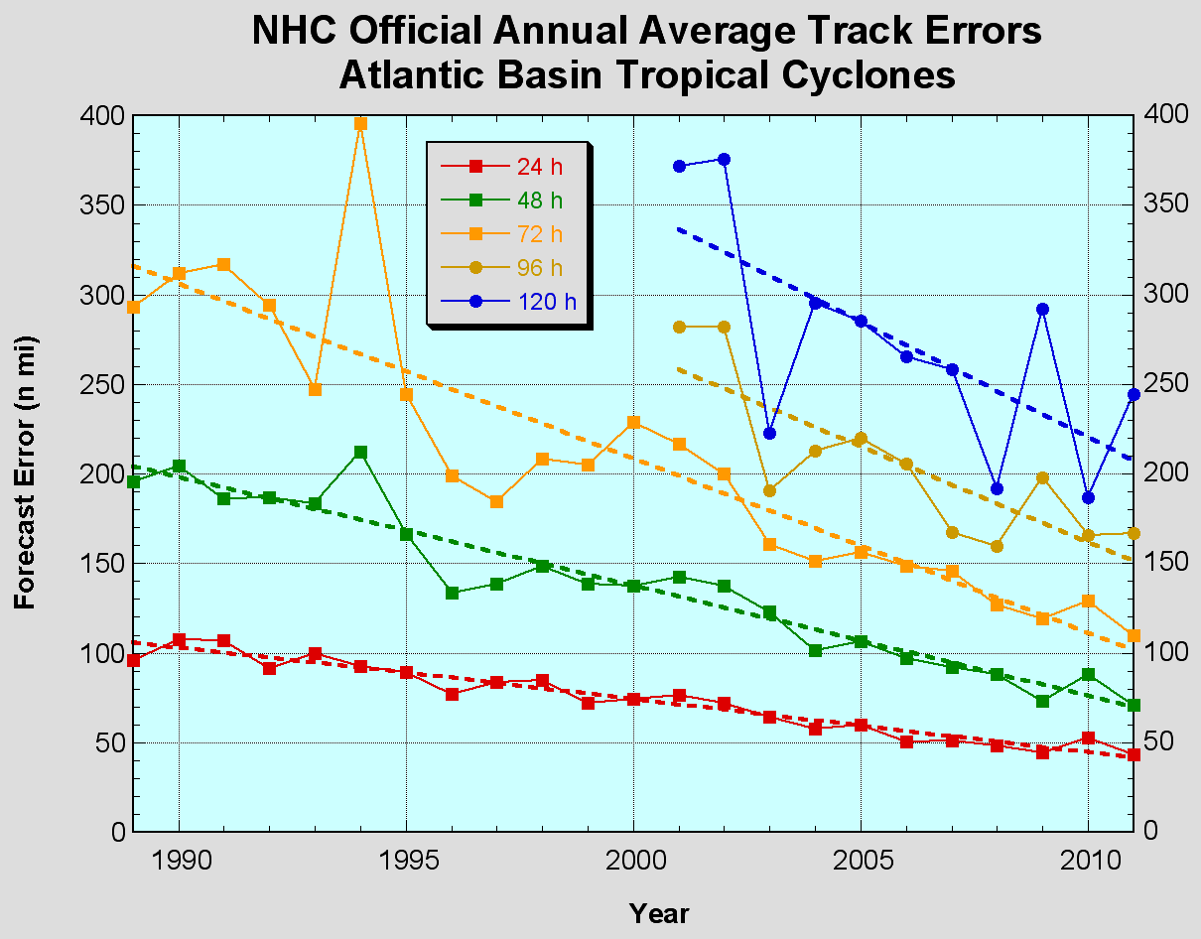
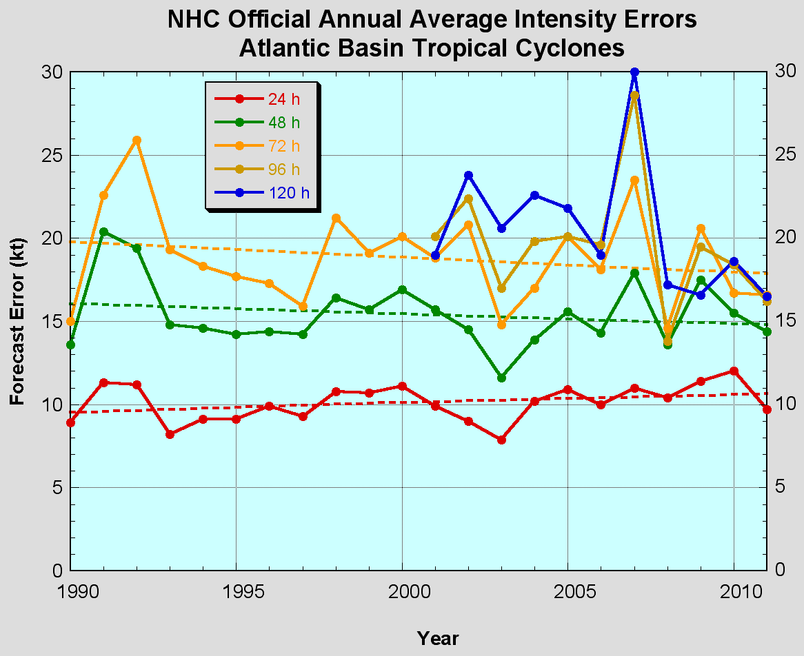
The Good – track forecast improvements
Current Capabilities
The Bad - Intensity no real gains
No progress with intensity in last 15-20 years
Errors cut in half over past 15 years
10-year improvement - As accurate at 48 hours as we were at 24 hours in 1999
24-48h intensity forecast off by 1 category
Off by 2 categories perhaps 5-10% of time
Notes:
Images from: http://www.nhc.noaa.gov/verification/verify5.shtml

Slide 3
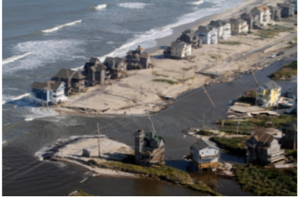
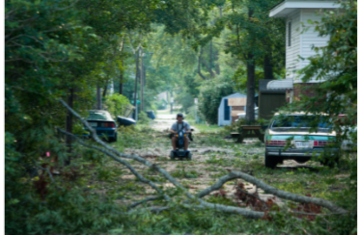
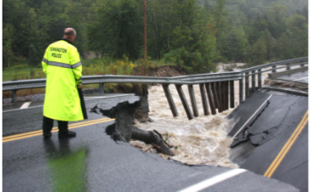
Improvements still needed!
NOAA’s National Weather Service (NWS) mission is to fulfill this commitment through building a Weather Ready Nation.
NWS must contribute to hazard resiliency by continually assessing and improving its services to the Nation.
Hurricane Irene (2011):
41 deaths
$7 to $10 Billion damage
Major infrastructure losses
Power lost to 8 million
Virginia Beach, Va
Hatteras Island, N.C.
Woodford, Vt.
Jim R. Bounds/AP
Austen Danforth/Bennington Banner/AP
Brendan Hoffman/Getty Images

Slide 4
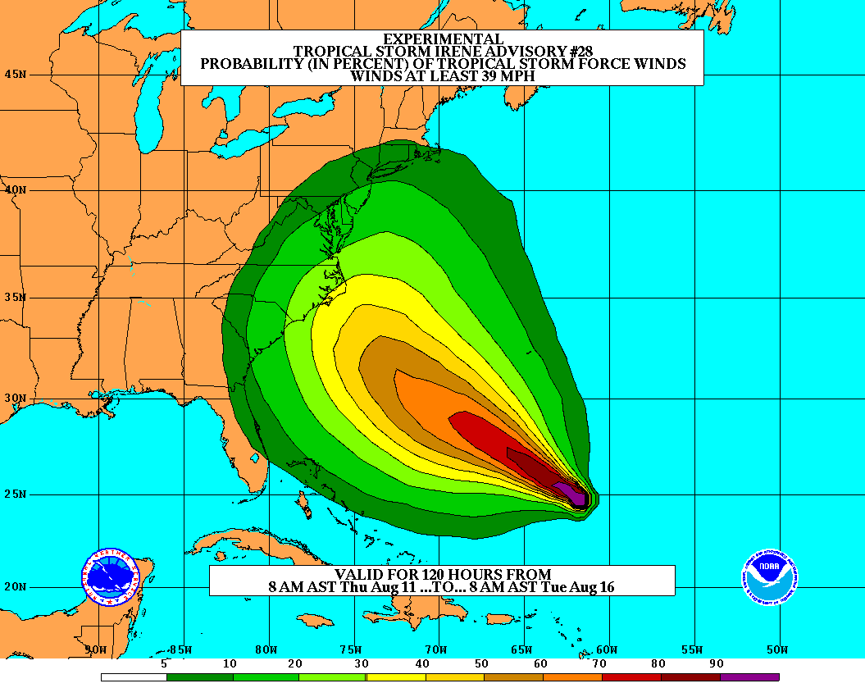
Goals
Improve Forecast Accuracy
Hurricane impact areas (track) – 50% in 10 years
Severity (intensity) – 50% in 10 years
Storm surge impact locations and severity
Extend forecast reliability out to 7 days
Quantify, bound and reduce forecast uncertainty to enable risk management decisions
Notes:
http://www.hfip.org/
http://www.nrc.noaa.gov/HFIPDraftPlan.html
HFIP Team
Frank Marks, research lead
Ed Rappaport, operations lead
Fred Toepfer, project manager
Robert Gall, development manager
Mark DeMaria
Chris Fairall
Jim McFadden
Daniel Melendez
HFIP executieve oversight board:
OAR DAA/Sandy MacDonald, co-chair
NWS AA/Jack Hayes, co-chair
NCEP/Louis Uccellini,
TPC/Bill Read,
NESDIS/Mark DeMaria,
NOS/Jesse Feyen,
AOML/Bob Atlas
PPI/Paul Doremus
NMFS/Bonnie Ponwith,
NOS/Liz Scheffler,
NMAO-PM Aircraft/Mike Devany
OFCM/Sam Williamson
Executive Secretariat: OAR/Brian Ornsdorff and NWS/Nasheema Lett

Slide 5
HFIP Success to Date
HFIP focused research efforts within NOAA & interagency partners
HFIP defined solution for transitioning research into operations with Stream 1.5 products available to NHC forecasters in real-time
HFIP making significant progress – 5-year goals within reach
Global ENKF ensembles providing 20% improvement in track guidance
Improved model initialization and higher resolution models, along with inner core data shows significant (20-40%) improvement in intensity
3-5 day lead-time hurricane genesis product with acceptable POD’s and FAR’s in development
Demonstration of Skill for track at 7 days underway
Still uncertain progress toward goal for POD/FAR of rapid intensification of 90%/10% at day 1 and 60%/40% at day 5.
Notes:
Successes to date shown in 4 Red bullets/sub bullets are demonstrated in the 4 following slides

Slide 6
Real-time System Priorities
Establish Experimental Numerical Forecast System (Stream 1.5) for Hurricane Season using NOAA’s R&D computing acquired by HFIP
Include global and regional ensembles, advanced DA and advanced statistical models
Global Hybrid DA same configuration as new operational system except ENKF Ensembles at twice the resolution
Use R&D computing to demonstrate capacity to reach HFIP 5-year intensity and track goals
Deliver experimental guidance to NHC in real-time
NHC defines real-time guidance for product suite selection
Notes:
HFIP dedicated HPC for development/demonstration NOAA Jet system at ESRL in Boulder
• “Jet” composed of 3 systems with a total of 22400 processors
“Jet” system performance in 2012 is estimated at 235 Tflops
Current Operational Computing peaks at 73.6 Tflops and the new operational development machine “Zeu”s is comparable to “Jet”

Slide 7
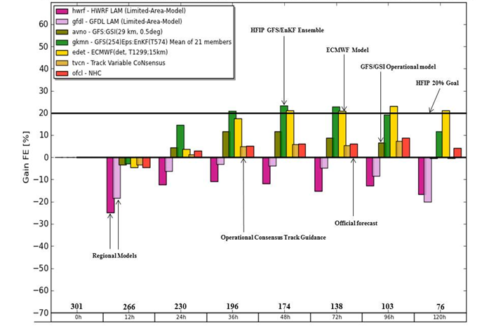
Global Model Development
Track Error (2010-2011)
Global Model Team – Mike Fiorino (ESRL)
Notes:
Track Error of Models (2010-2011) (% Improvement over HFIP baseline – average track error for three years of operational model guidance errors for 2006-2008 when HFIP began)
purples are the operational regional models
Greens represent the operational GFS and the HFIP GFS at lower resolution than the operational GFS but with ENKF data assimilation of central pressure
Yellows (ECMWF) and browns (UKMET) are two of the better global models
Orange is the best multi-model ensemble track guidance used by NHC
Dark orange is the Official NHC forecast error
Note that the HFIP GFS/EnKF model which is at ¼ the spatial resolution of ECMWF is competitive and also exceeds the 20% improvement goal of HFIP for 5 years.

Slide 8
Improved Use of Observations: Impact of airborne Doppler radar
% Improvement over HFIP baseline
cases
All cases with Doppler data 2008-2011
Need help of Research community to address
F. Zhang (PSU), Aberson, Aksoy, Gamache (AOML/HRD)
Notes:
Intensity Error of Models for all cases (2009-2011) with airborne Doppler data available from NOAA P-3s (% Improvement over HFIP baseline – average intensity error for three years of operational model guidance errors for 2006-2008 when HFIP began)
Black lines are the baseline intensity skill (solid), 20%improvement threshold (large dash), and 50% improvement threshold (small dash)
Green lines represent the average intensity errors for two different regional models: small dash - Advanced Research WRF or ARW used by the bulk of the research community; and solid - high-resolution research version of HWRF developed at HRD and transitioned to EMC for operational implementation this summer
Red line is the average intensity error for the high-resolution research HWRF without the Doppler data
Note that from 36-96 h the average error is very close to or exceeding the 20% improvement threshold for HFIP at 5 years
We are busily investigating the reason for lack of improved skill from 0-24 h when the data should have the most impact. We identified some model biases due to physical parameterizations which we are working with EMC to correct thanks to the ability to use observations to improve the initial conditions.

Slide 9
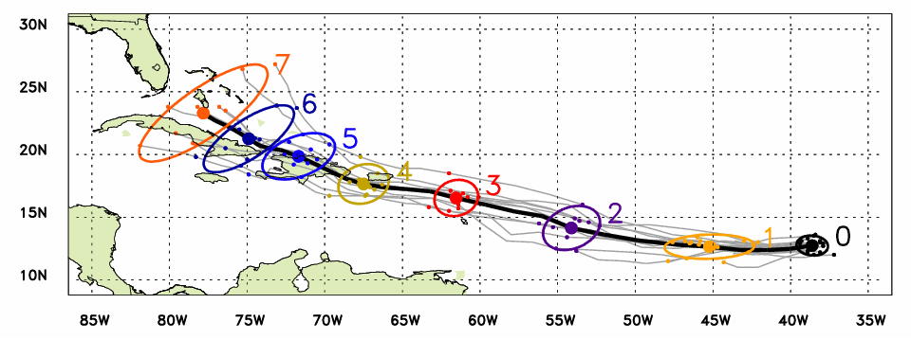
Global Model Development - Genesis
Observed Track (Aug 21 – 26)
Ensemble mean track
Ellipse includes 80% of members
Forecast lead time in days
Irene named
Irene declared an investigation area at 1200Z on August 18, 2011
Irene named at 0000Z August 21, 2011
Initial indication of the formation of Irene from ensemble at 00Z 16 August 2011
2 days before it was declared an investigation area
5 days before it was named
Global Model Team - Tom Hamill & Jeff Whitaker (ESRL)
Notes:
Genesis is critical to HFIP success as many hurricanes do not last 5-7 days so Genesis is critical to 5-7 day lead times
In the case of Irene new tools to forecast genesis developed by HFIP using the HFIP global model ensembles from GFS/EnKF (30 members) and FIM (10 members) were able to detect and track the system that formed into Irene 5 days before it was named by NHC and 2 days before NHC declared it an INVEST area
Thin black lines are the disturbance tracks from each of the ensemble members, the small black dots the location of each of the ensemble members at 24 h intervals after the initial time, and the colored ellipses enclose 75% of the ensemble positions. Note that the ellipses elongate along track (reflecting speed uncertainty) in the early forecasts, and elongate perpendicular to the track (reflecting uncertainty in the storm turn to the N at the later forecast times. At day 3 & 4 when the storm was named the uncertainty is the least.
The solid green line is the observed Best Track from NHC starting when the storm was named.

Slide 10
Ongoing Challenges
Operational high performance computing resources – capacities and capabilities to meet HFIP goals
Appropriate physics packages, initialization for high resolution (1-3 km) regional models
Improved observing strategies for hurricane core and near storm environment –
Better use of satellite data at resolutions appropriate for hurricane
Aircraft/UAV data
Notes:
See 2011 Annual report - http://www.hfip.org/documents/03262012_2011_annual_report.pdf
Also review paper submitted to Bulletin of the AMS

Slide 11
HFIP Research Priorities
Advancement in DA techniques
Techniques to maximize the usefulness of observations
Identification and analyses of sources of model errors
Physics Advancements
Air-sea and BL processes
Microphysical/aerosol/radiation processes
Advanced model diagnostic techniques
Analyses and forecast of vortex low-order wavenumber evolution
Analyses and forecast of large-scale and hurricane environment evolution (e.g. shear/track)
Development of high resolution ensembles (little progress to date)
Identify techniques to utilize ensemble members for improved intensity guidance

Slide 12
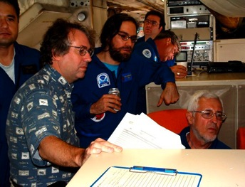
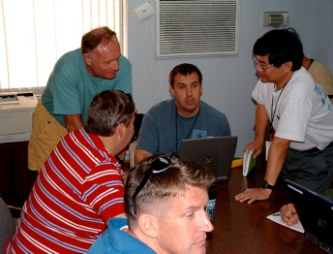
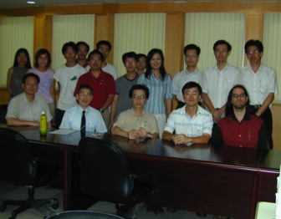
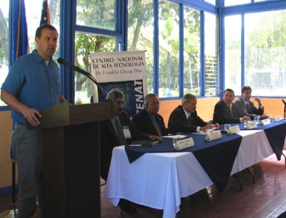
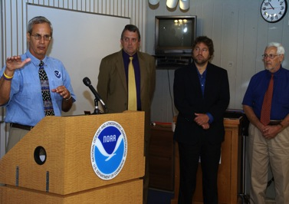
Keys to Success
Partnership: AOML, ESRL, GFDL, DTC, USWRP, NESDIS/STAR working closely with Operations (EMC, NHC, AOC) and Federal & Academic Partners (NASA, NSF, ONR, NRL, NCAR, MMS)
More integrated use & support of Testbeds: JHT, DTC, JCSDA
Blend Traditional hurricane research activities and HFIP research activities
Manpower (diversity) to evaluate model performance with hurricane data sets is a critical need
CBLAST
IFEX/RAINEX
DOTSTAR
IFEX/TCSP
IFEX/PREDICT/GRIP

Slide 13
Questions?

