Slide 1
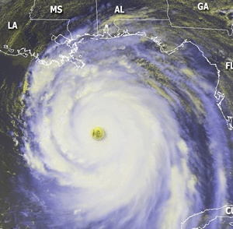
Analysis of Federally Funded Tropical Cyclone R&D
Dr. Frank Marks (NOAA) and Dr. Ron Ferek (Navy)
Co-Chairs

Slide 2
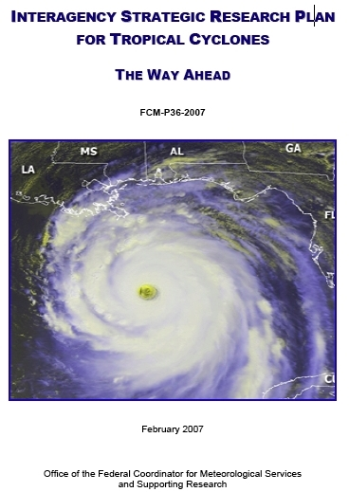
Joint Action Group/ Tropical Cyclone Research (JAG/TCR)
February 2005: Federal Coordinator formed JAG/TCR
Formed as result of principal action item from 58th IHC
Supported by Interdepartmental Committee for Meteorological Services and Supporting Research (ICMSSR)
February 2007: JAG/TCR work culminated with publication of Interagency Strategic Research Plan for Tropical Cyclones: The Way Ahead

Slide 3
Outcome of Interagency Plan
Form Working Group/Tropical Cyclone Research (WG/TCR) to:
Summarize operational needs of three operational tropical cyclone forecast and warning centers: TPC/NHC, CPHC, JTWC (Table 1)
Present research priorities to aid in meeting needs of operational tropical cyclone forecast and warning centers (Table 2)
Coordinate TC research:
Update Tables 1 and 2 regularly (every 2 years)
Map agency efforts against TC research needs and operational priorities
Analyze results
Update information at IHC annually
Publish results & analysis of agency research

Slide 4
Operational Priorities
Table 1

Slide 5
Research Needs
Table 2

Slide 6
Agency Contribution to Research Needs
Man-Years vs. Detailed Research Topic
Mapped using Detailed Research Need in Table 2
Intensity / Structure
Track
Genesis
QPF
Surge
Model Development
Observations
[Seasonal]

Slide 7
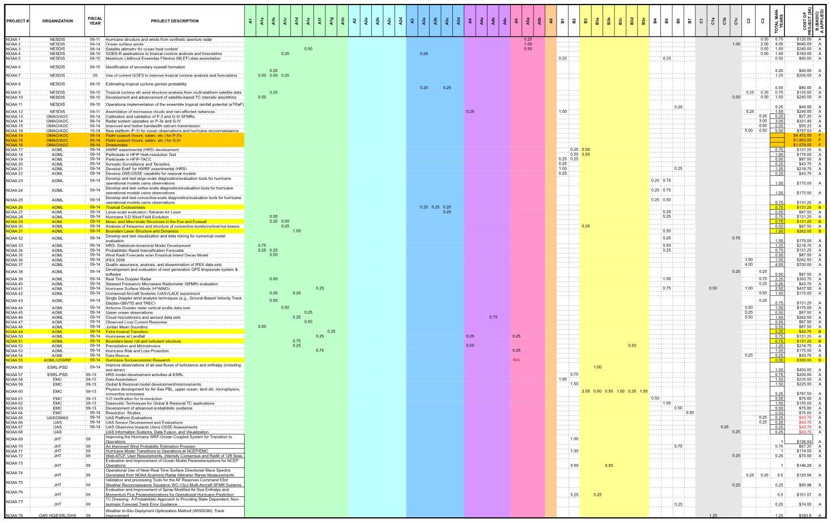
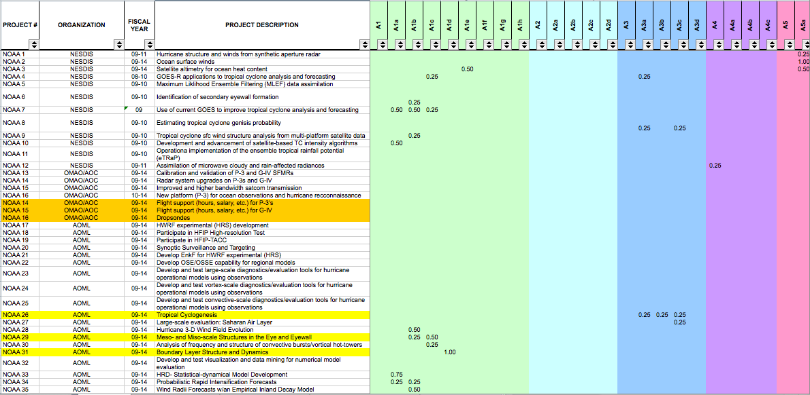
Agency Research Contributions
Tabulated each agency research contribution (Man-year and $)
Notes:
Rules:
For each row/project, complete columns E thru AX, where applicable, with man-year data. Do not fill in a cell with less than .25 man-years.
Try to put your man-year data in the top 3-4 research areas that best match the research

Slide 8
Analysis of Tropical Cyclone R&D
2008 Overview
First-ever snapshot analysis of all identified agency R&D efforts mapped against:
Research needs (Table 2)
Operational priorities of TC forecasting and warning centers (Table 1)
Encompassed R&D activities during FY 2008-2009
NOAA, Navy, NSF, NASA, USACE, DOI/MMS, DHS/S&T
Total of 228 man-years
General research: 112
Model development: 70
Observations: 47

Slide 9
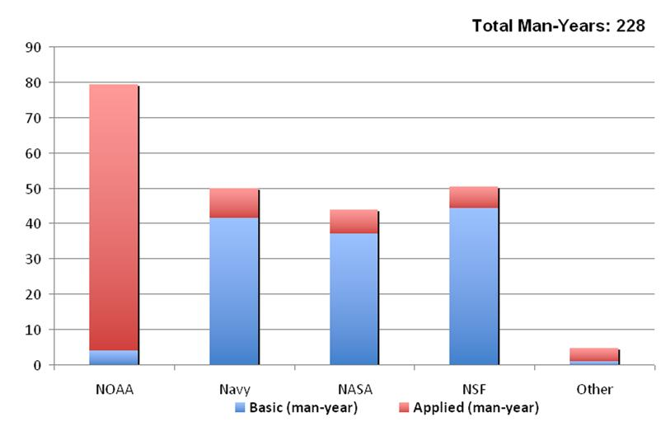
Analysis of Tropical Cyclone R&D
Interagency Partnerships
Strong partnerships exist between federal agencies on tropical cyclone research efforts
Substantial investments from multiple agencies are required to address the research needs that support operational priorities
Addressing operational priorities require both basic and applied research

Slide 10
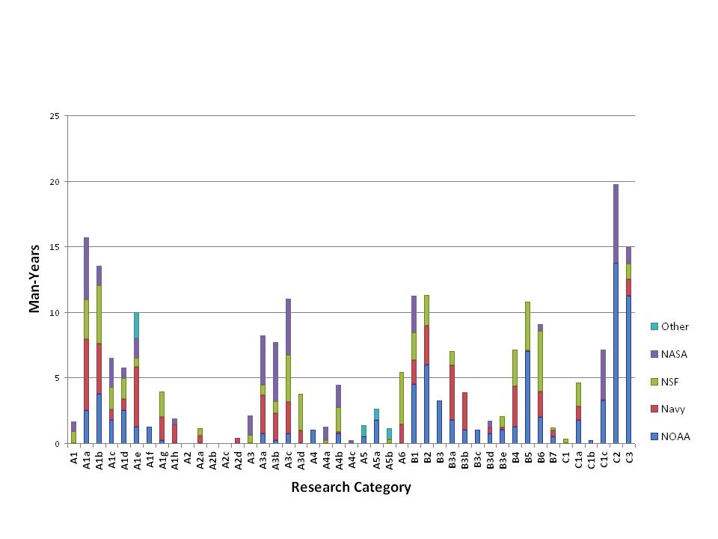
Analysis of Tropical Cyclone R&D
Intensity / Structure
Track
Genesis
QPF
Surge
Model Development
Obs
[Seasonal]
Figure above summarizes the amount of research activity for each of the detailed research need categories described in Table 2
Investment from multiple agencies for most research areas
Members of the Working Group did not attempt to evaluate whether there was sufficient research being conducted in each of the research categories

Slide 11
Research Needs Mapped onto Ops Priorities
Table 1

Slide 12
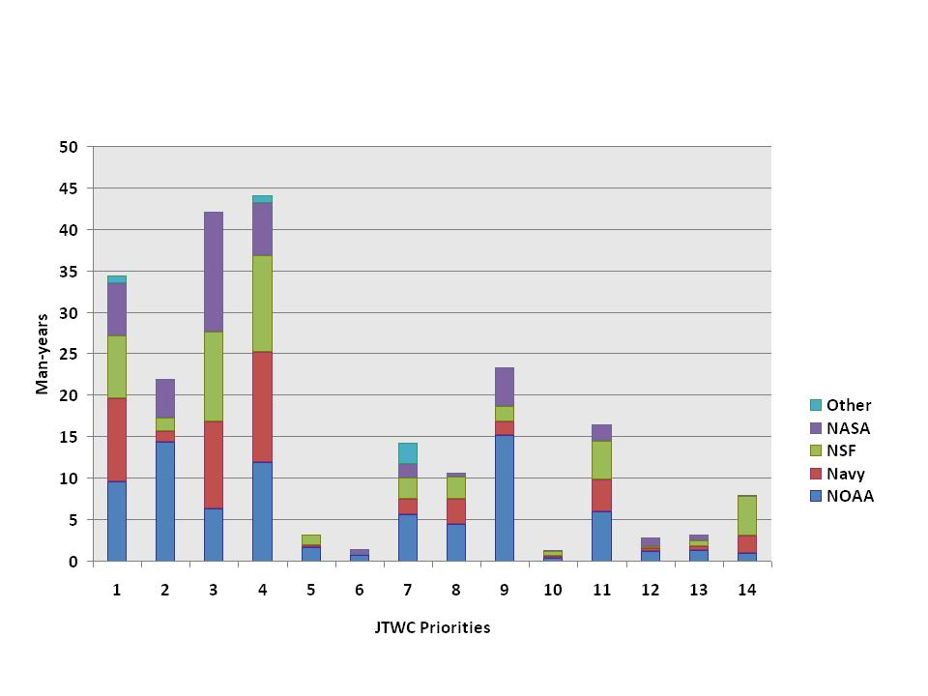
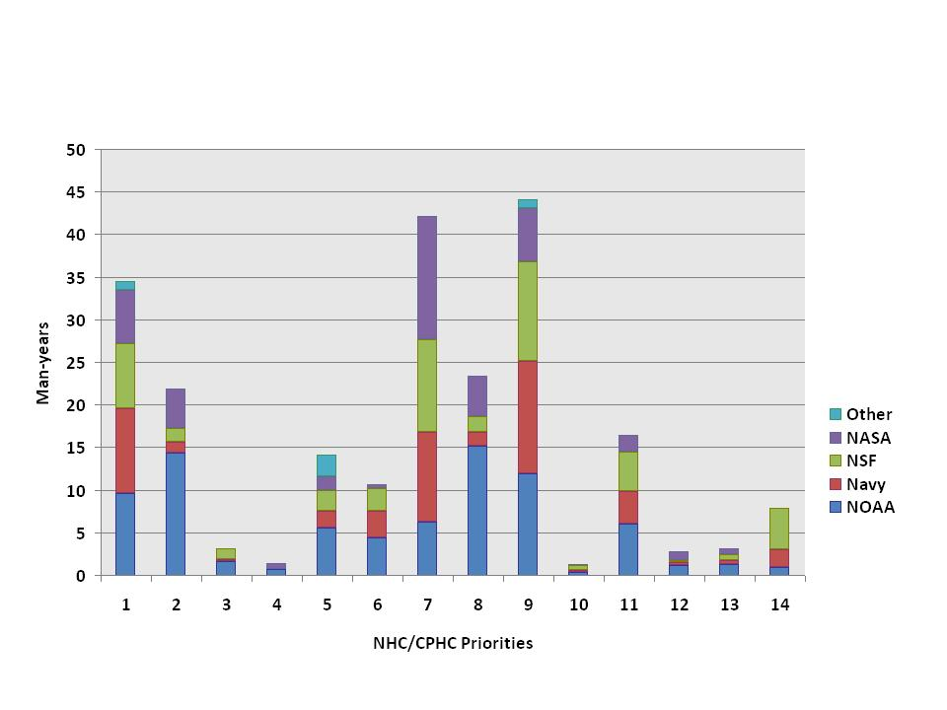
Analysis of Tropical Cyclone R&D
Research Needs Mapped to Operational Priorities
JTWC Priorities
NHC / CPHC Priorities
Research is better aligned to JTWC priorities versus NHC / CPHC priorities
Reviewing the top 10 priorities, there are apparent mismatches to JTWC & NHC / CPHC operational priorities
Circles indicate apparent mismatches with low research investments

Slide 13
Where do we go from here?
Just completed the 2010 snapshot
Mapping 2010 research activities to 2009 and new 2011 JHT AO operational priorities
Compare 2008 and 2010 research activities mapped to 2009 JHT AO operational priorities

Slide 14
Analysis of Tropical Cyclone R&D
2008-2010 Comparison
Total = 211
HFIP = 75
HFIP
Track
Surge
Model Development
Observations
Track
Surge
Model Development
Observations
Intensity / Structure
QPF
Intensity / Structure
QPF
Genesis
Seasonal
Genesis
Seasonal

Slide 15
QUESTIONS?

