Slide 1
Thermodynamic soundings from AIRS/AMSU: Relevance to tropical cyclones
Contributors: Brian Kahn (JPL), Chris Collimore (UCLA), Eric Fetzer (JPL), Svetla Hristova-Veleva (JPL), Bill Irion (JPL), Xianan Jiang (JPL/JIFRESSE), Shaima Nasiri (Texas A&M), Hui Su (JPL), Duane Waliser (JPL), Longtao Wu (JPL), Qing Yue (JPL)

Slide 2
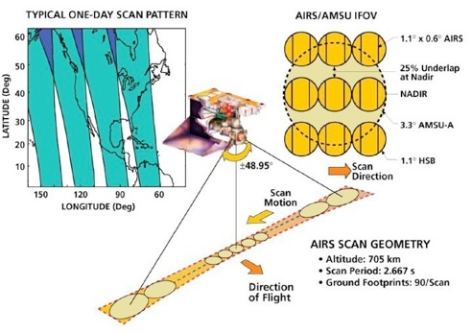
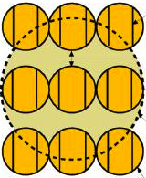
AIRS/AMSU Retrievals based on “Cloud-Clearing”
1.4 by 2.5 km
45km at Nadir

Slide 3
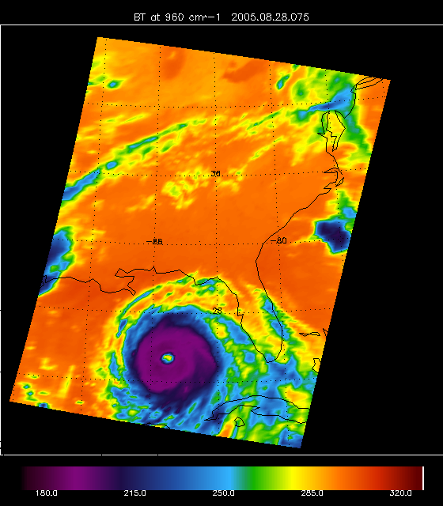
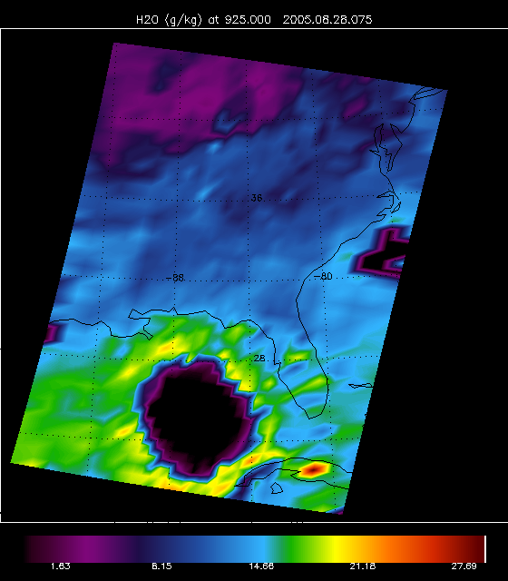
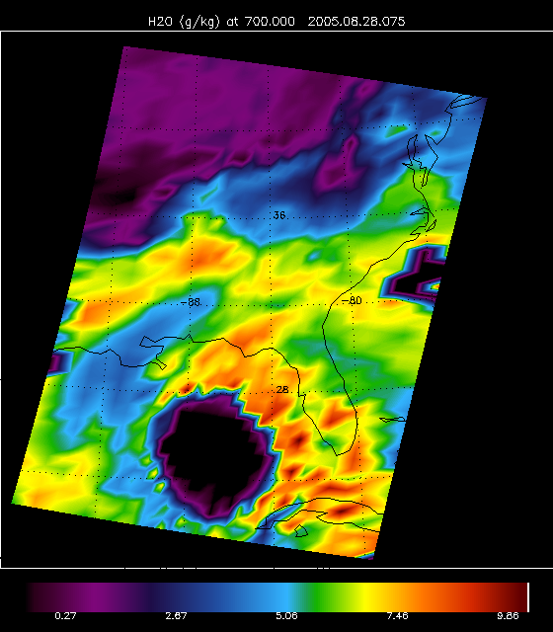
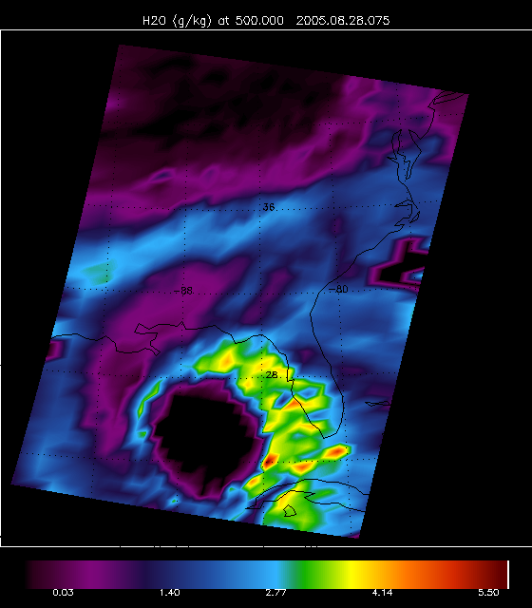
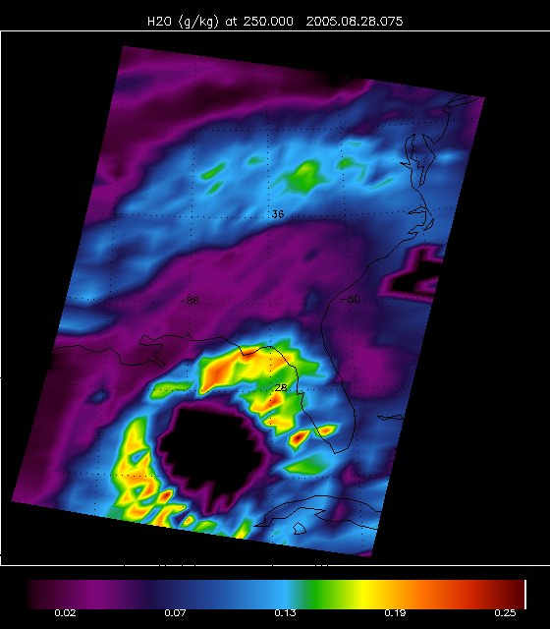
Katrina (08–28–2005) 130 AM local time
“Halo” of high q (g/kg) around storm
Encroaching mid-level “dry slot”
Data drop-outs in thick cloud
AIRS T_{b} @ 960 cm^{–1}
AIRS q (g/kg) at 925 hPa
AIRS q (g/kg) at 700 hPa
AIRS q (g/kg) at 500 hPa
AIRS q (g/kg) at 250 hPa

Slide 4
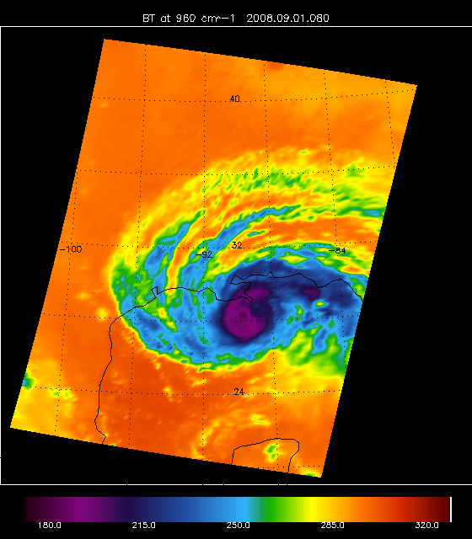
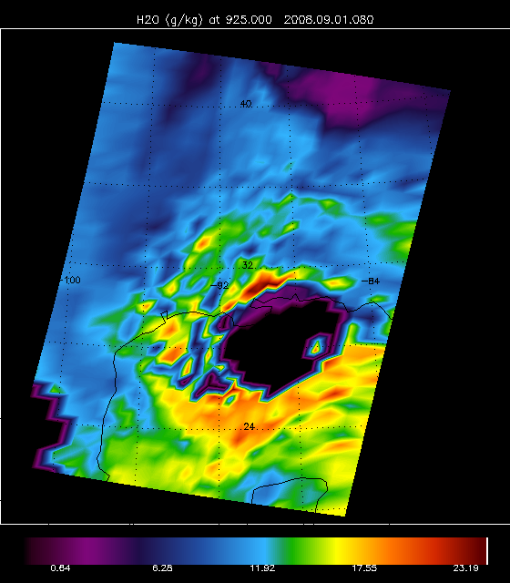
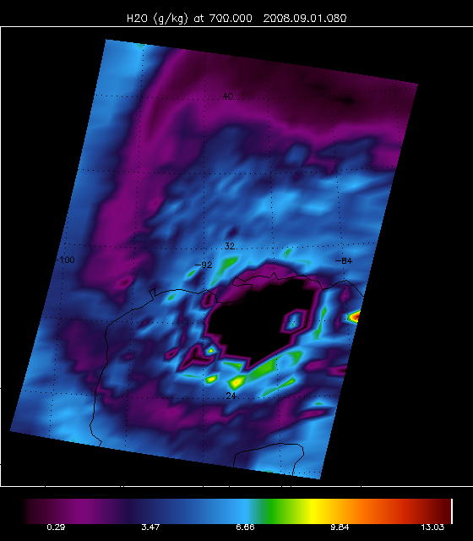
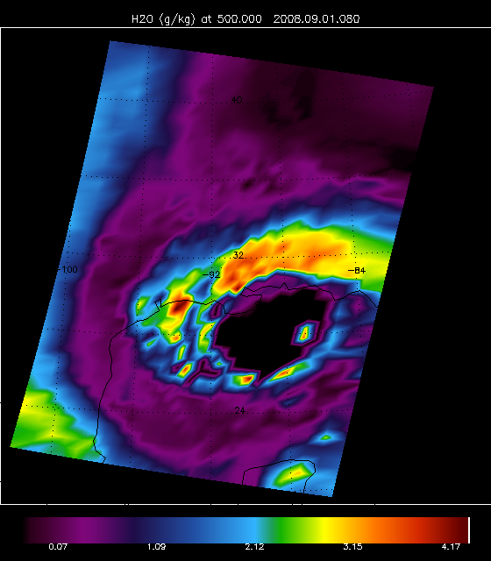
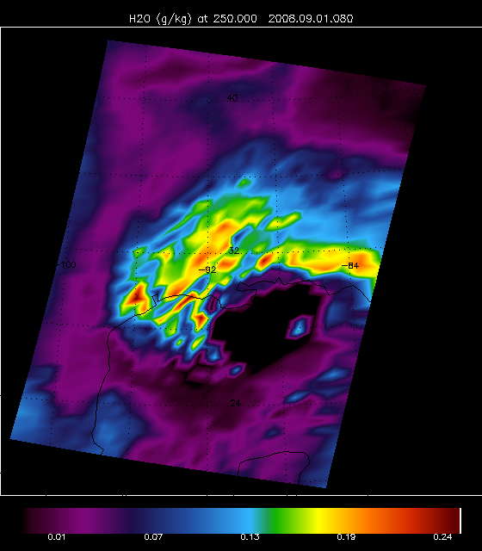
Gustav (09–01–2008) 130 AM local time
“Halo” of high q (g/kg) at low levels
Large mid-and high-level “dry slot”
Data drop-outs & noise in thick cloud
AIRS T_{b} @ 960 cm^{–1}
AIRS q (g/kg) at 925 hPa
AIRS q (g/kg) at 700 hPa
AIRS q (g/kg) at 500 hPa
AIRS q (g/kg) at 250 hPa

Slide 5
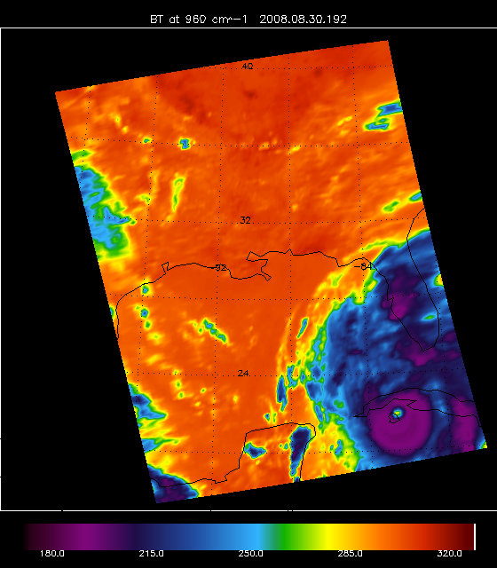
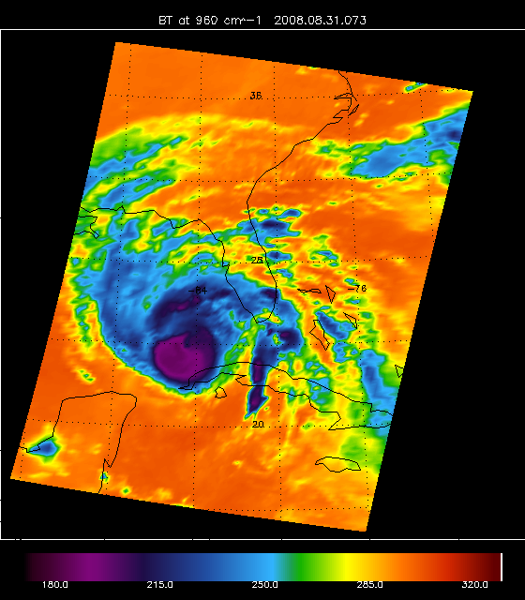
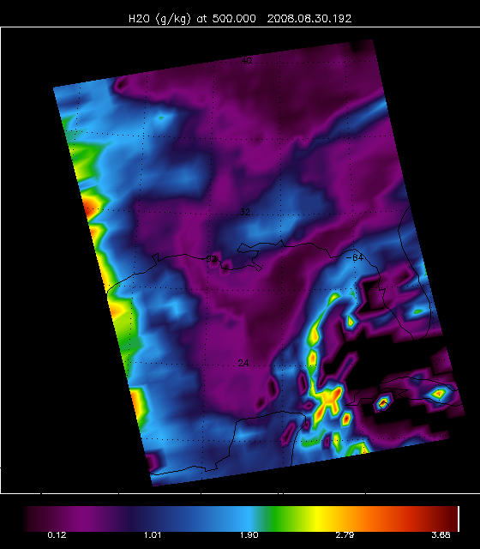
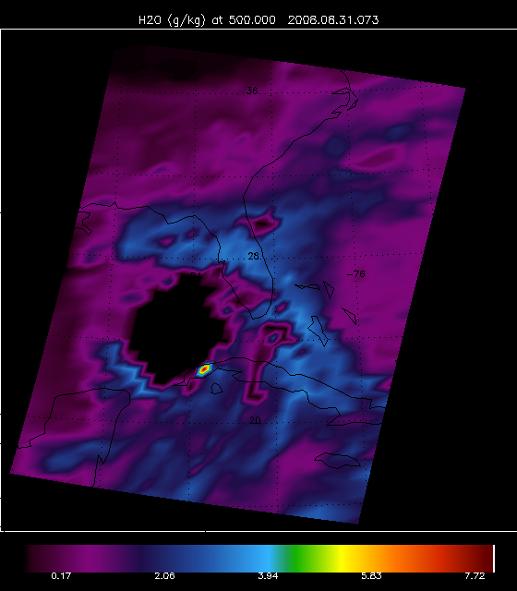
Gustav (2008)
08–30 on left, 08–31 on right
500 hPa q (g/kg)
“Halo” of high q to west when Cat 4
Dry air intrusion next day when Cat. 3 and continued weakening
Note data drop-outs & noise in thick cloud
AIRS T_{b} @ 960 cm^{–1}
AIRS q (g/kg) at 500 hPa

Slide 6
How does AIRS/AMSU sample in different cloud types?
q (g/kg) differences relative to tropical mean value
Differences as a function of cloud type (2B-CLDCLASS from CloudSat)
% yield very high in some clouds and much lower in others
Courtesy: Qing Yue and Eric Fetzer

Slide 7
Backup Slides

Slide 8
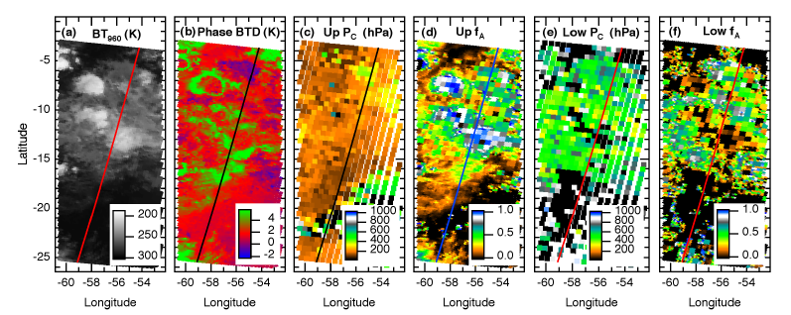
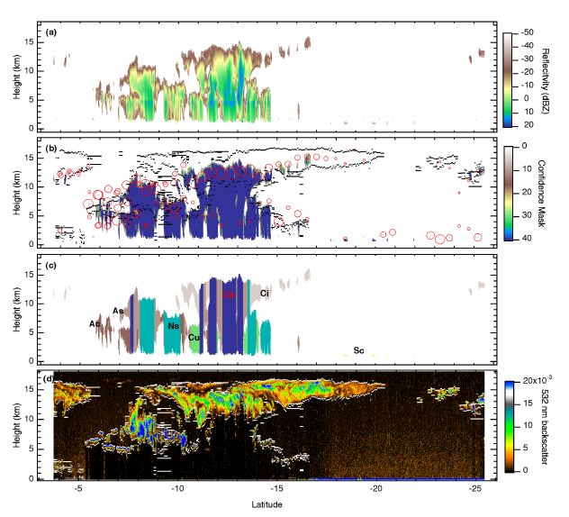
Standard AIRS Cloud Products
Cloud type validation with CloudSat & CALIPSO (Kahn et al., 2008, ACP)
Other comparisons to the Microwave Limb Sounder (MLS), Moderate Resolution Imaging Spectroradiometer (MODIS)

Slide 9
Ele (2002)
09–06 central Pacific
New cloud products for Version 6
Cloud Thermodynamic Phase (upper right)
Ice cloud optical thickness (lower left)
Ice cloud effective diameter (lower right)
AIRS T_{b} @ 960 cm^{–1}
AIRS Cloud Phase

Slide 10
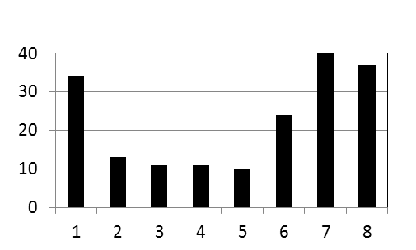
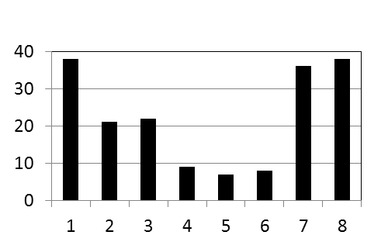
Eastern Pacific MJO & Tropical Cyclone Genesis (1998-2009)
OBS
GFDL HiRAM (50km)
Phase 1+8
Phase 1+8
Shading: Rainfall anomalies
Dots: TC genesis
Phase 2+3
Phase 2+3
OBS
TC Counts
Phase 4+5
Phase 4+5
MJO Phases
HiRAM
TC Counts
Phase 6+7
Phase 6+7
MJO Phases
mm/day
Courtesy of Xianan Jiang et al. (2011)

Slide 11
3. Summary
The recently developed GFDL HiRAM exhibits improved capability in representing both the intraseasonal oscillation and TC activities. In particular, the modulation of the TC activity by the MJO over the eastern Pacific is faithfully simulated .
Further analysis on the MJO composite GPI evolution illustrates that both 850mb vorticity and mid-level relative humidity play critical roles in modulating the intraseasonal TC activity.
The results presented here suggests great potential of intraseasonal TC forecast based on high-resolution dynamical models with improved physics.

Slide 12
Azimuthal average q (g/kg) and RH (%) from AIRS
Best track data from JTWC for 2 Pacific TCs
CAPE from AIRST & q
Azimuthal-averaged q
Azimuthal-averaged RH
Courtesy: Longtao Wu and Hui Su

