Slide 1
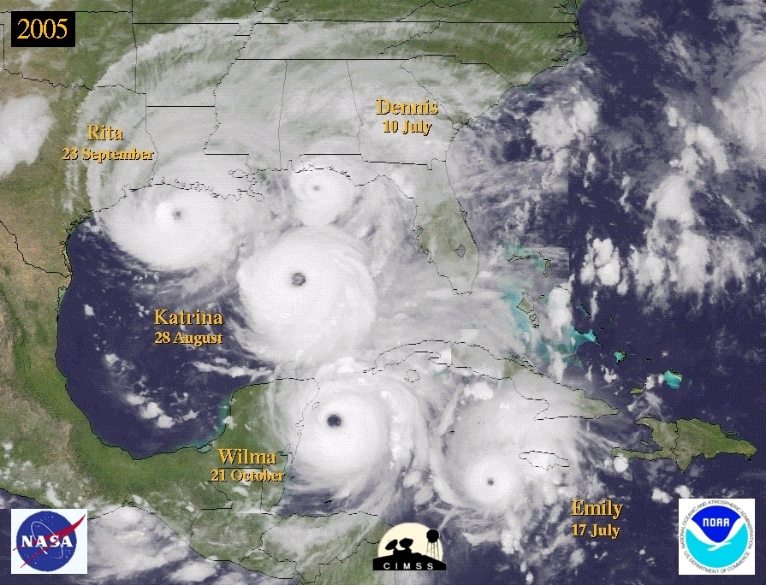

Hurricanes and Climate Change:
Expectations versus Observations
23 February, 2011
West Central Florida AMS Chapter Banquet
Chris Landsea, National Hurricane Center, Miami, USA
Chris.Landsea@noaa.gov

Slide 2


How is global warming affecting:
Tropical cyclone frequency, intensity, genesis, track, and overall activity?
Notes:
2
This is the NOAA dork logo…

Slide 3
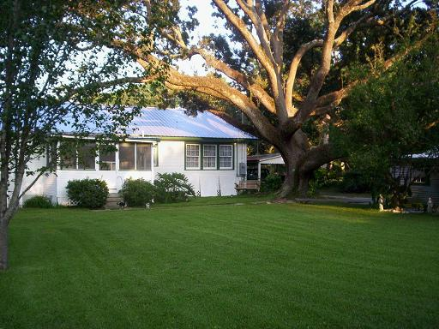
Before Katrina…
David & Kimberly King Waveland, MS

Slide 4
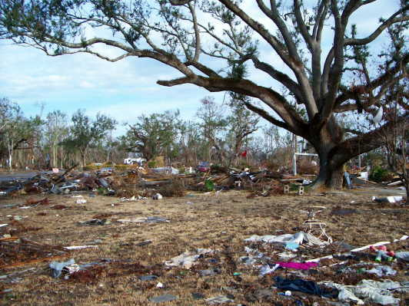
…After Katrina
David & Kimberly King Waveland, MS

Slide 5
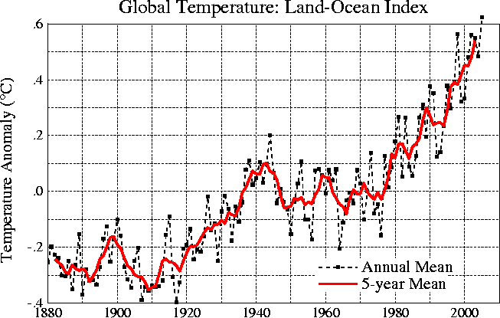
Global Warming –
Past Temperature Changes
Source: NASA/GISS http://data.giss.nasa.gov/gistemp/graphs/

Slide 6
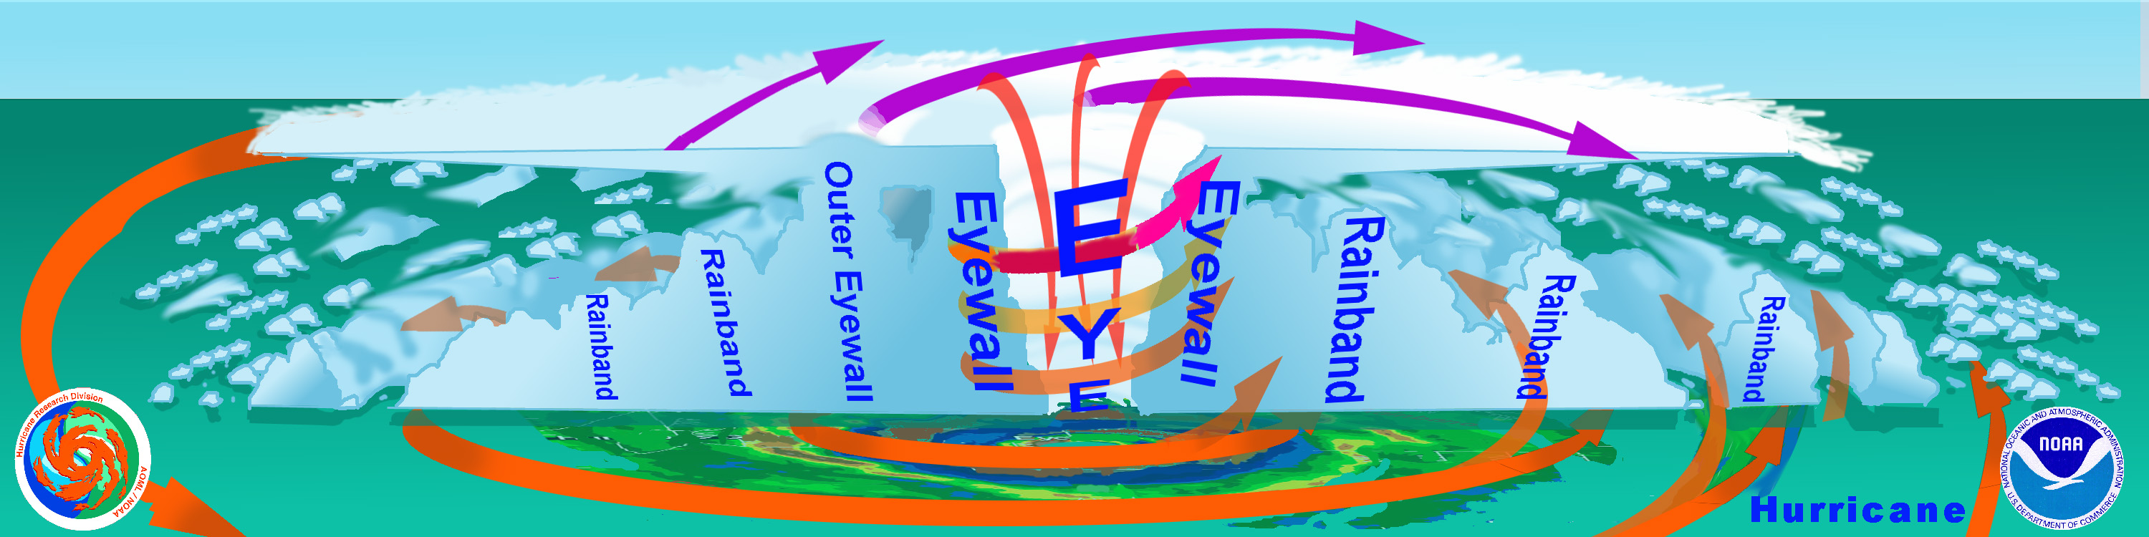
Nature's great heat engine...
The Hurricane
Outflow (“Exhaust”)
Energy Release
(“Cylinders”)
Ocean (“Fuel”)

Slide 7
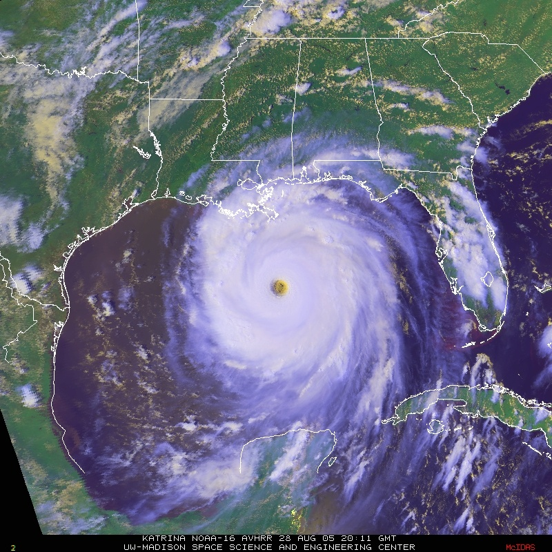
Global Warming and Hurricane Winds:
Theory and Modeling Work Suggest ~1% Increase Today

Slide 8
Global Warming and Hurricane Winds:
Theory and Modeling Work Suggest ~1% Increase Today
1-2 mph of Katrina’s 175 mph Winds

Slide 9
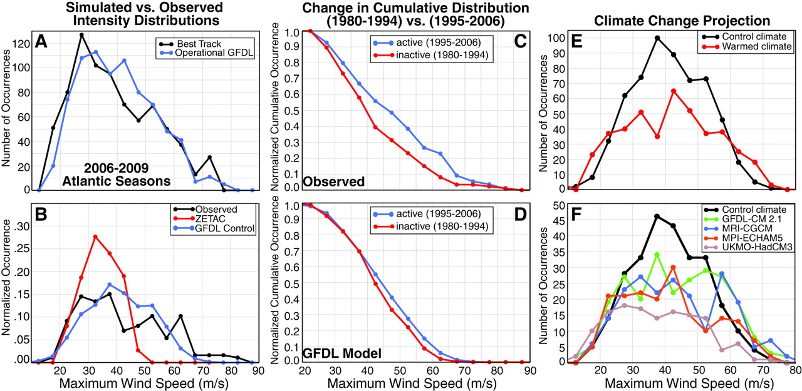
Global Warming and Hurricanes:
Theory and Modeling Work Suggest ~3% wind increase with a DECREASE in frequency by late 21st Century
Bender et al. (2010)
10 m/s
20
30
40
50
60

Slide 10
Global Warming and Hurricanes:
Theory and Modeling Work Suggest ~3% wind increase with a DECREASE in frequency by late 21st Century
Slightly Stronger Hurricanes
Bender et al. (2010)
10 m/s
20
30
40
50
60
Notes:
10

Slide 11
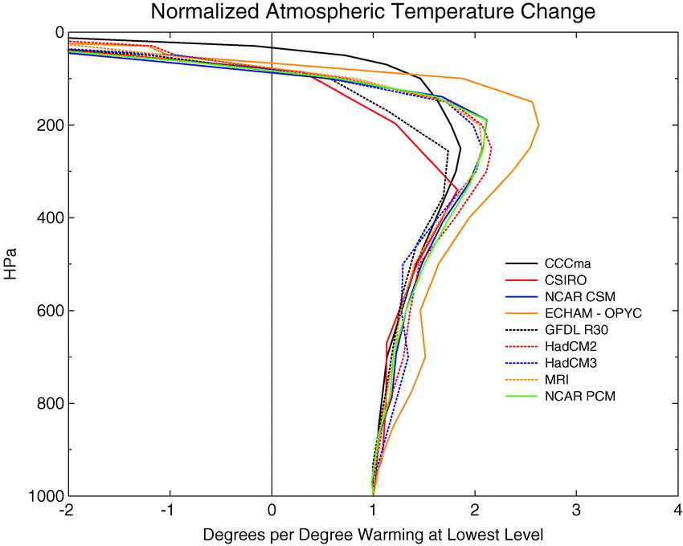
Knutson and
Tuleya (2004)

Slide 12
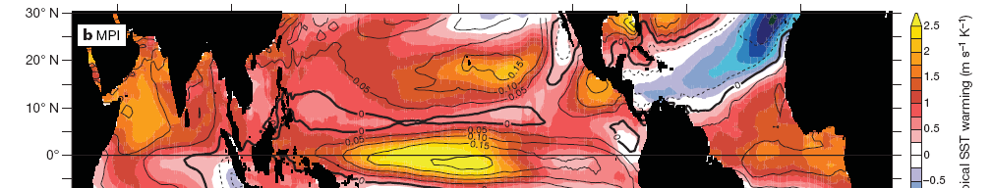
Maximum Potential Intensity Change
Atlantic Basin: +1% stronger per ºC SST change
Vecchi and Soden (2007)

Slide 13
Global Warming and Hurricanes:
Theory and Modeling Work Suggest ~3% wind increase with a DECREASE in frequency by late 21st Century
Bender et al. (2010)
10 m/s
20
30
40
50
60
Notes:
13

Slide 14
Global Warming and Hurricanes:
Theory and Modeling Work Suggest ~3% wind increase with a DECREASE in frequency by late 21st Century
Fewer Tropical Storms and Hurricanes
Bender et al. (2010)
10 m/s
20
30
40
50
60
Notes:
14

Slide 15
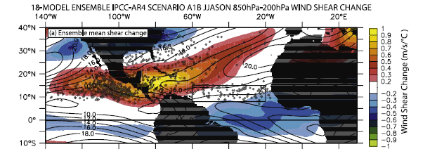
Increased Wind Shear from Global Warming
Vecchi and Soden (2007)

Slide 16
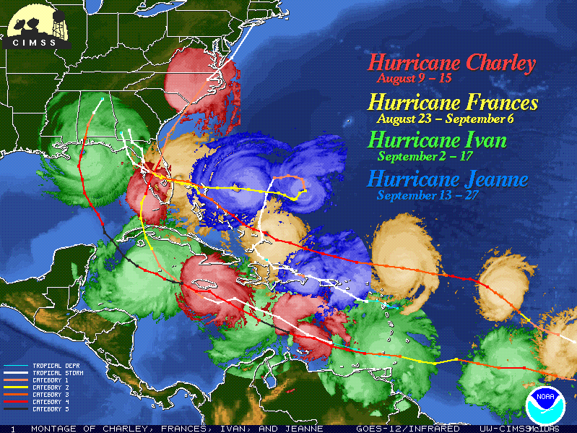
NOAA Dork Logo
Notes:
This is the NOAA dork logo…

Slide 17
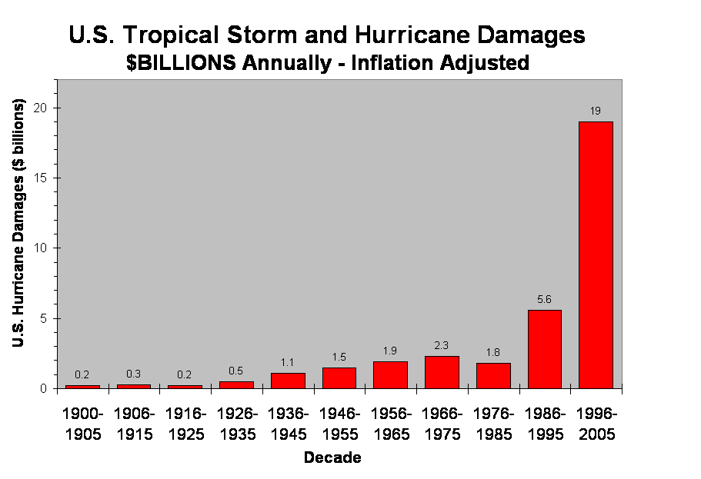

Slide 18
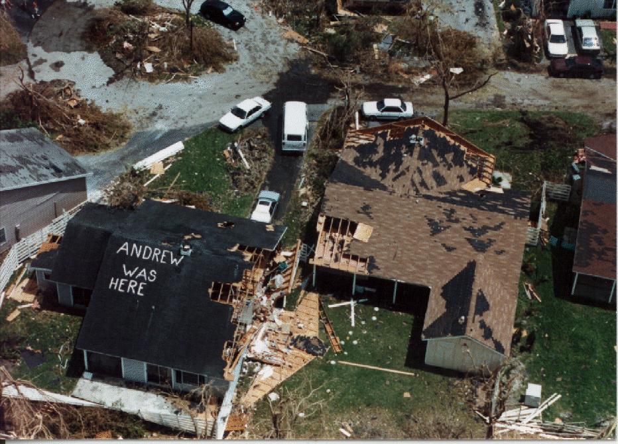
Increases in personal wealth (people have more “stuff”, and larger homes to stow their stuff, etc.) has led to greatly increased damage from hurricanes.

Slide 19
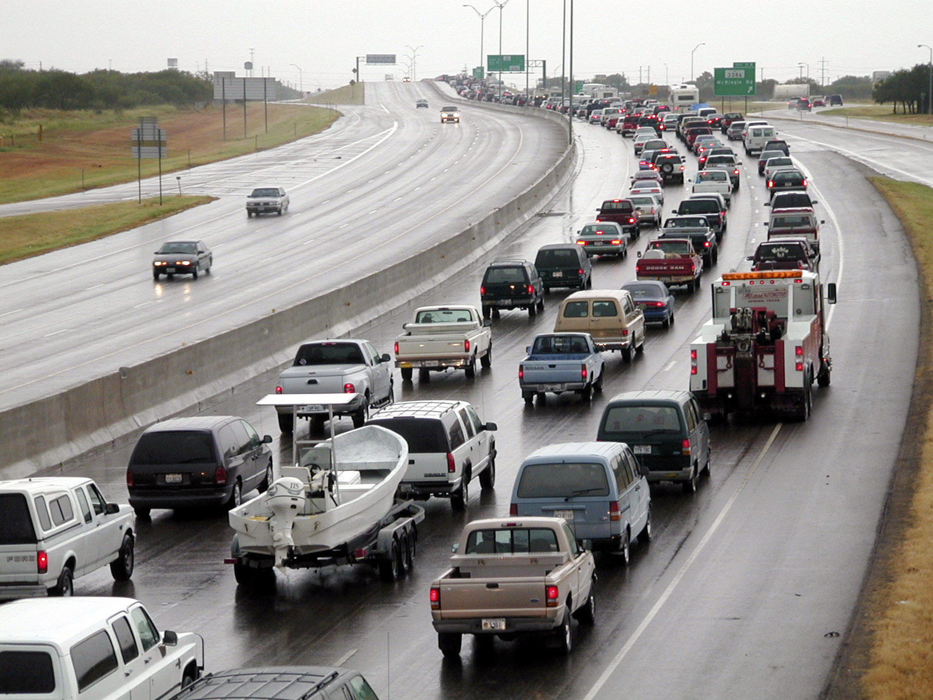
Notes:
This is the NOAA dork logo…

Slide 20
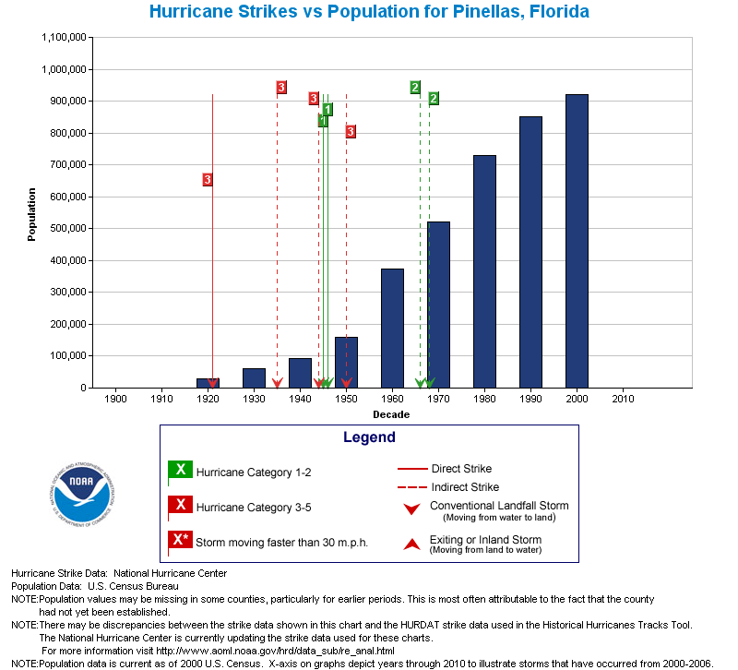
Notes:
20

Slide 21
NORMALIZED DAMAGE…
Estimated direct damage if past storms made
landfall with present-day societal conditions
ND = f(inflation, coastal population, wealth)
Pielke and Landsea (1998)
ND = f(inflation, coastal housing, wealth)
Pielke et al. (2008)

Slide 22
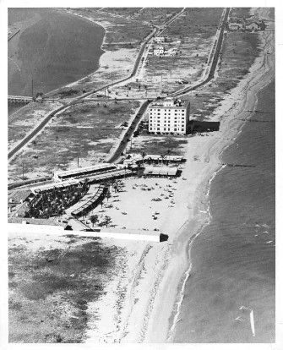
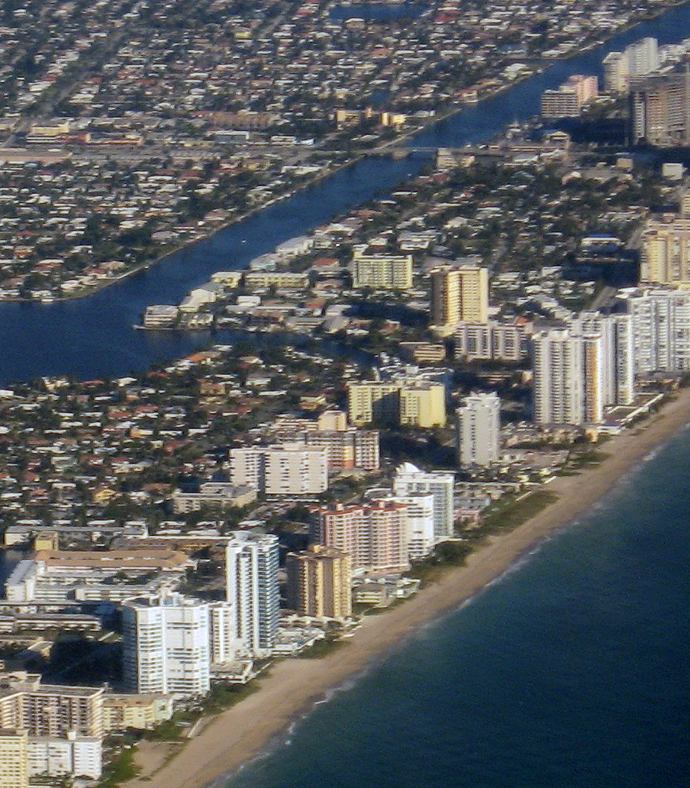
1926 Great Miami Hurricane
$140-157 Billion Today
Miami Beach 1926
Miami Beach 2006
Wendler Collection
Joel Gratz © 2006

Slide 23
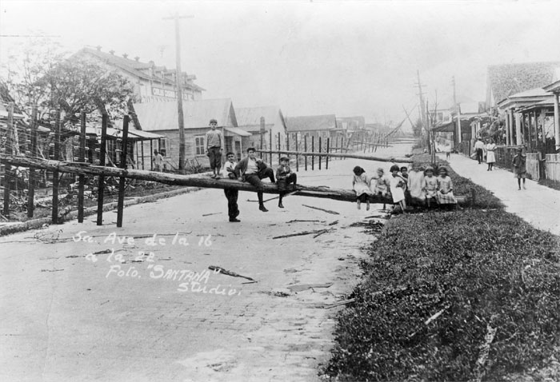
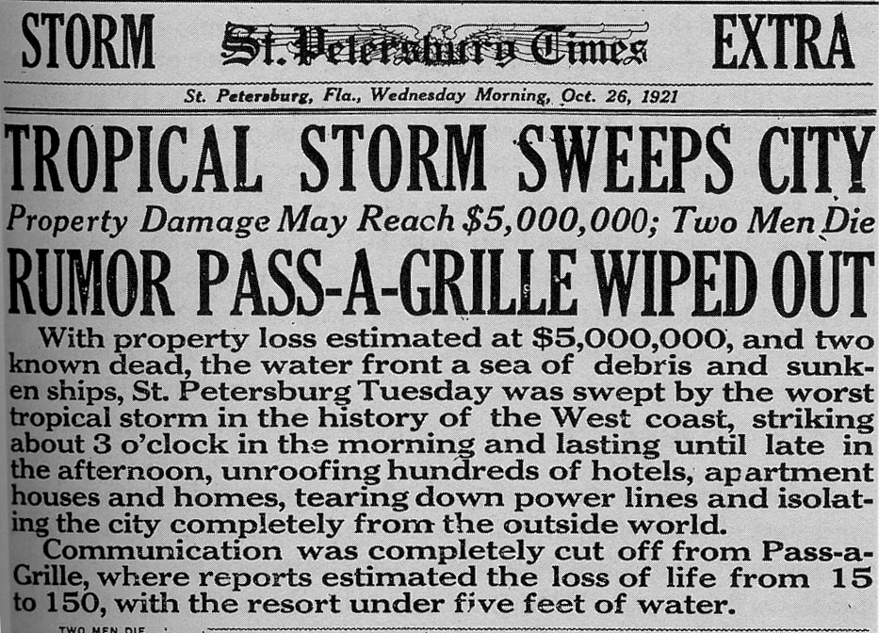
1921 Tampa Bay Hurricane
952 mb Central Pressure
105 kt Max 1 min Winds (estimated)
$3 Million in 1921 >>> $4 Billion today

Slide 24
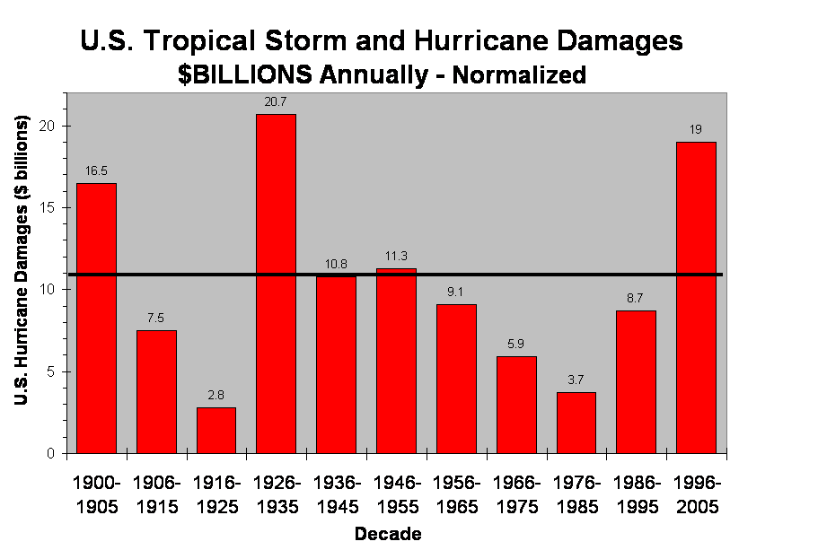
Notes:
24

Slide 25
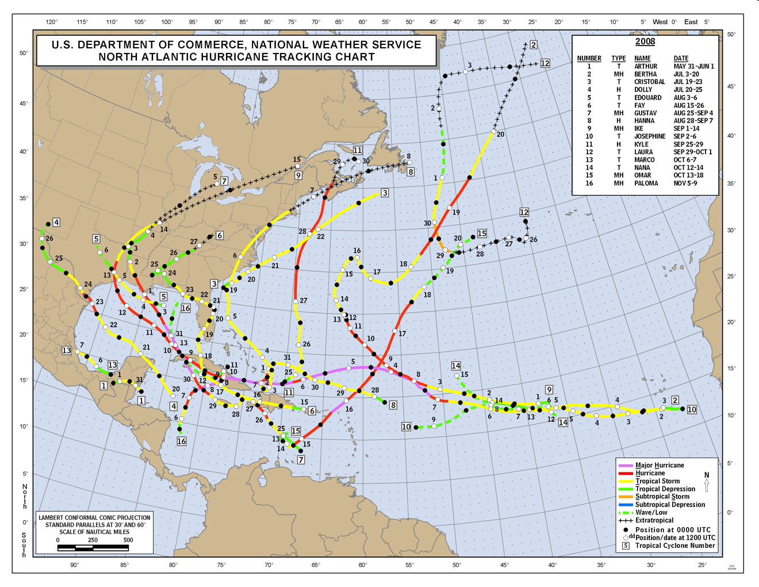
What does the Atlantic hurricane database (HURDAT) show for changes in time of tropical cyclone frequency and intensity?

Slide 26
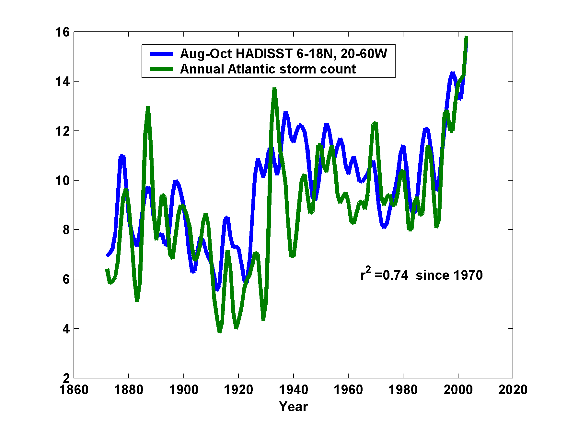
“This record [of Atlantic tropical cyclone counts] … shows a strong, long-term relationship with tropical Atlantic August-October SST…The underlying factor appears to be the influence of (primarily anthropogenic) forced large-scale warming.”
Linking Atlantic storm numbers to ocean temperatures

Slide 27
“Although wind estimates prior to the 1940s are problematic, detection of the existence of tropical cyclones is less so,
because without aircraft and satellites to
warn them off, ships often encountered
storms at sea, at least peripherally. A reasonably reliable record of annual North Atlantic tropical cyclone counts is thus available back into the late nineteenth century.”
--- Mann and Emanuel (2006)

Slide 28
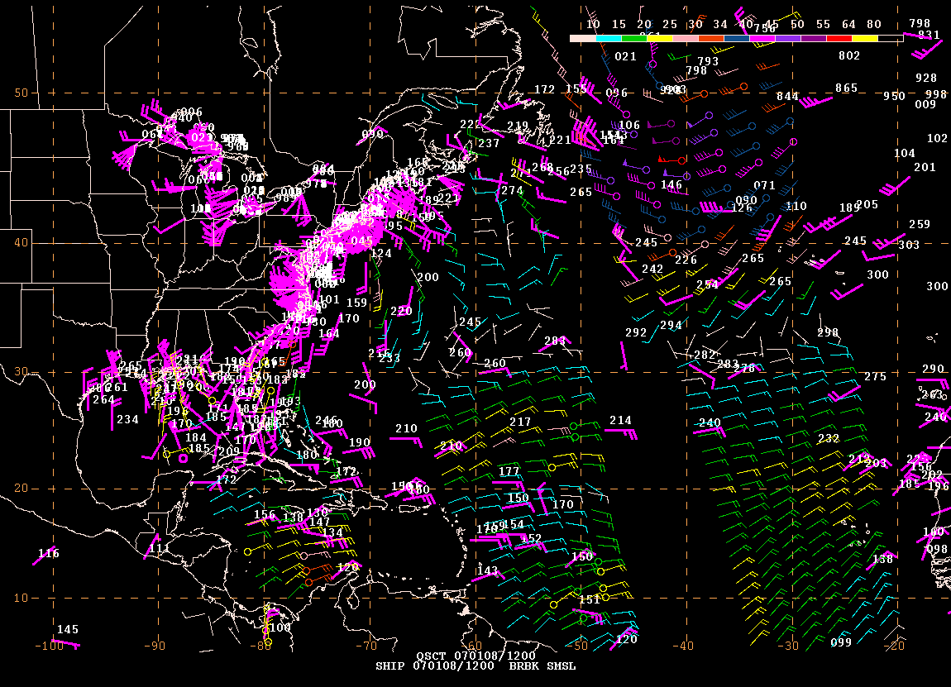
A Typical Day in 2011 – Marine Data Available around 12 UTC

Slide 29
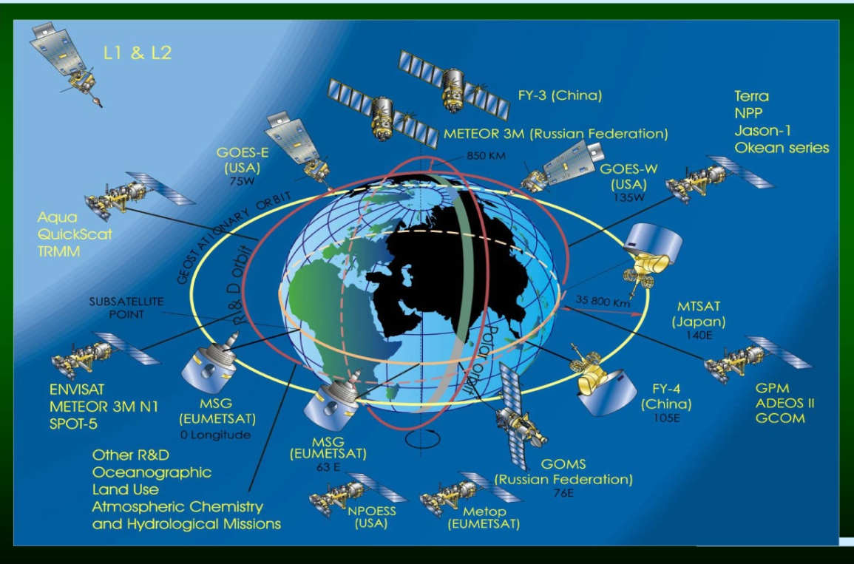
A Typical Day in 2011 – Marine Data Available around 12 UTC

Slide 30

A Typical Day in 2011 – Marine Data Available around 12 UTC

Slide 31
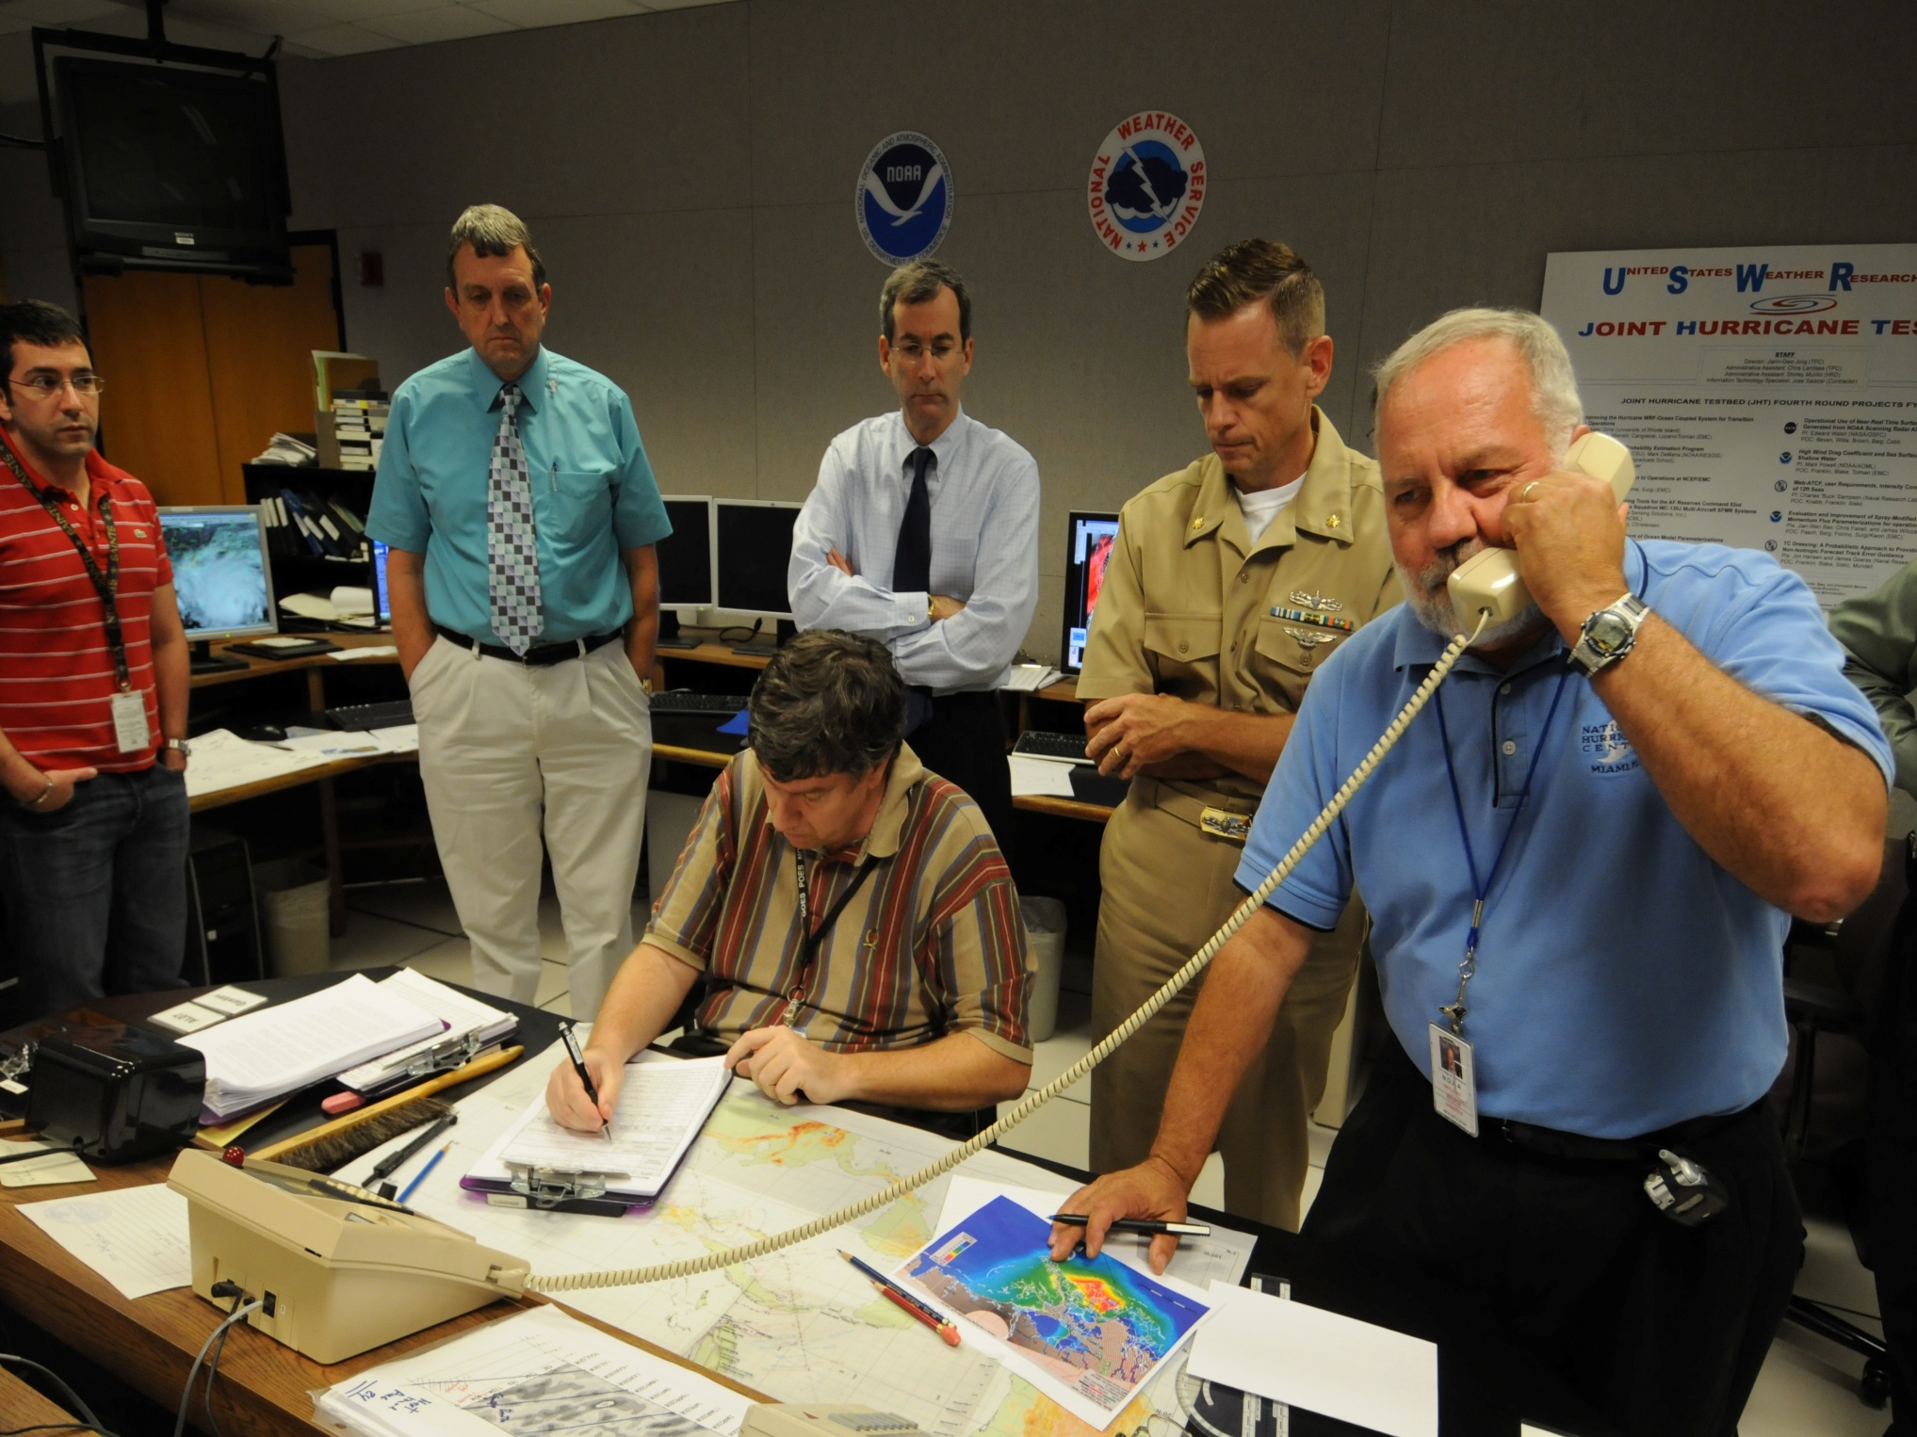
A Typical Day in 2008 –Marine Data Available around 12 UTC

Slide 32
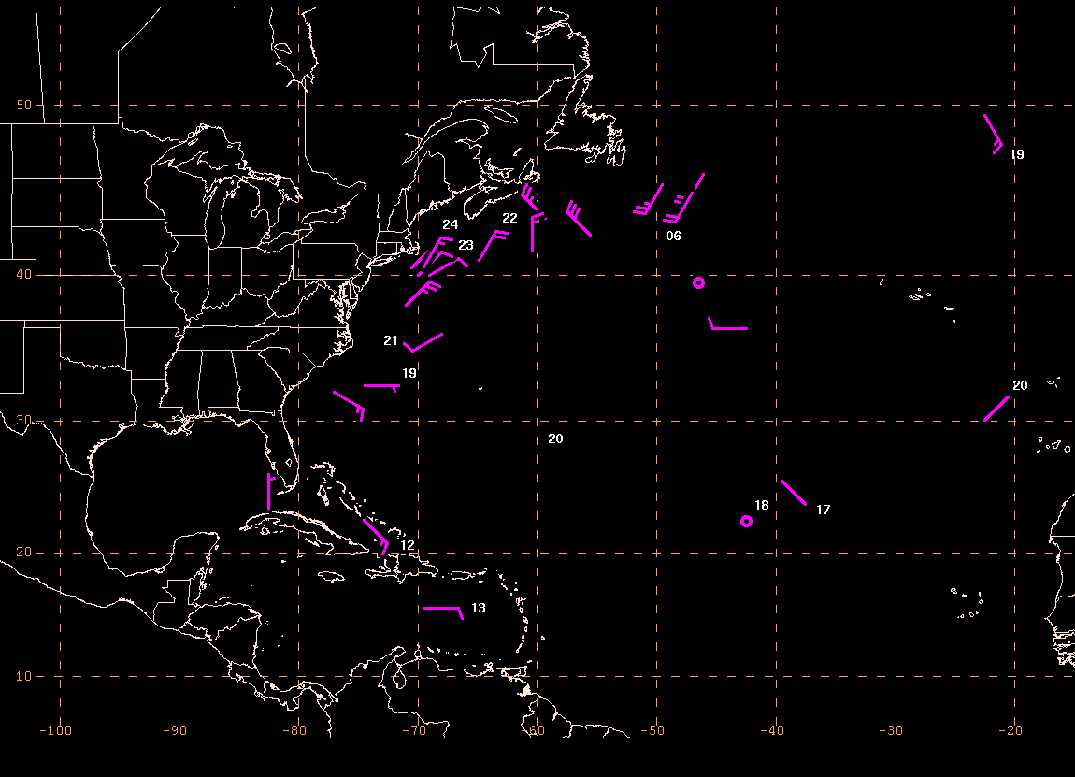
A Typical Day in 1911 – Marine Data Available around 12 UTC

Slide 33

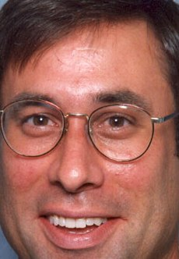
A Typical Day in 1911 – Marine Data Available around 12 UTC

Slide 34
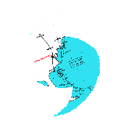
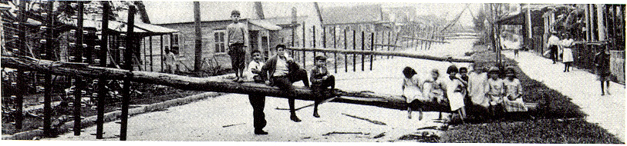
Atlantic Hurricane Database Re-Analysis Project
http://www.aoml.noaa.gov/hrd/data_sub/re_anal.html
1851 through 1930 changes accepted and officially adopted by NHC. Revisions for 1931 to 1953 have been submitted and are being considered. Remainder of 20th Century currently being reanalyzed.
RE-ANALYSES NEED TO BE CONDUCTED GLOBALLY!!!
"Florida's Hurricane History"

Slide 35
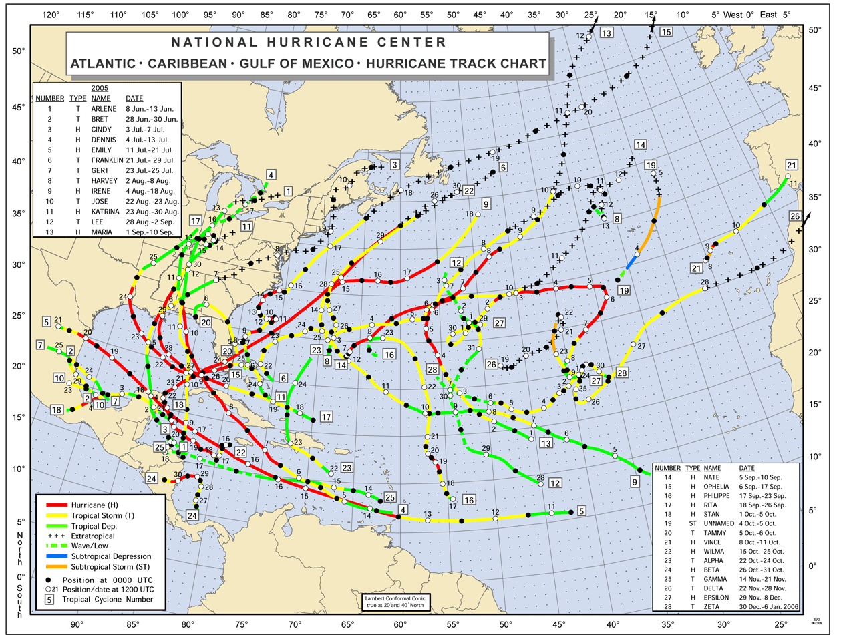
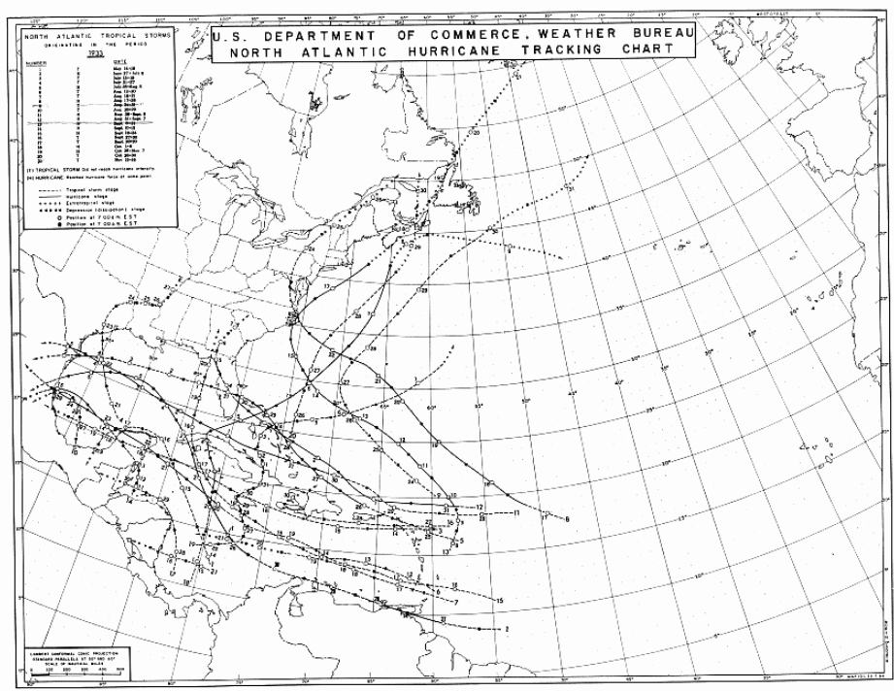
2005 Hurricane Season
Open Atlantic
Ocean Differences
1933 Hurricane Season

Slide 36
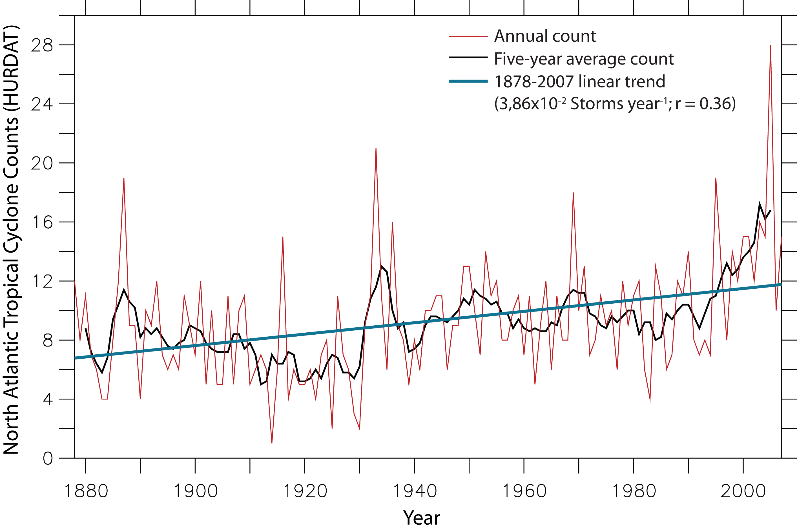
Tropical Storm and Hurricane Numbers – A Very Large Trend over a Century
12
7

Slide 37
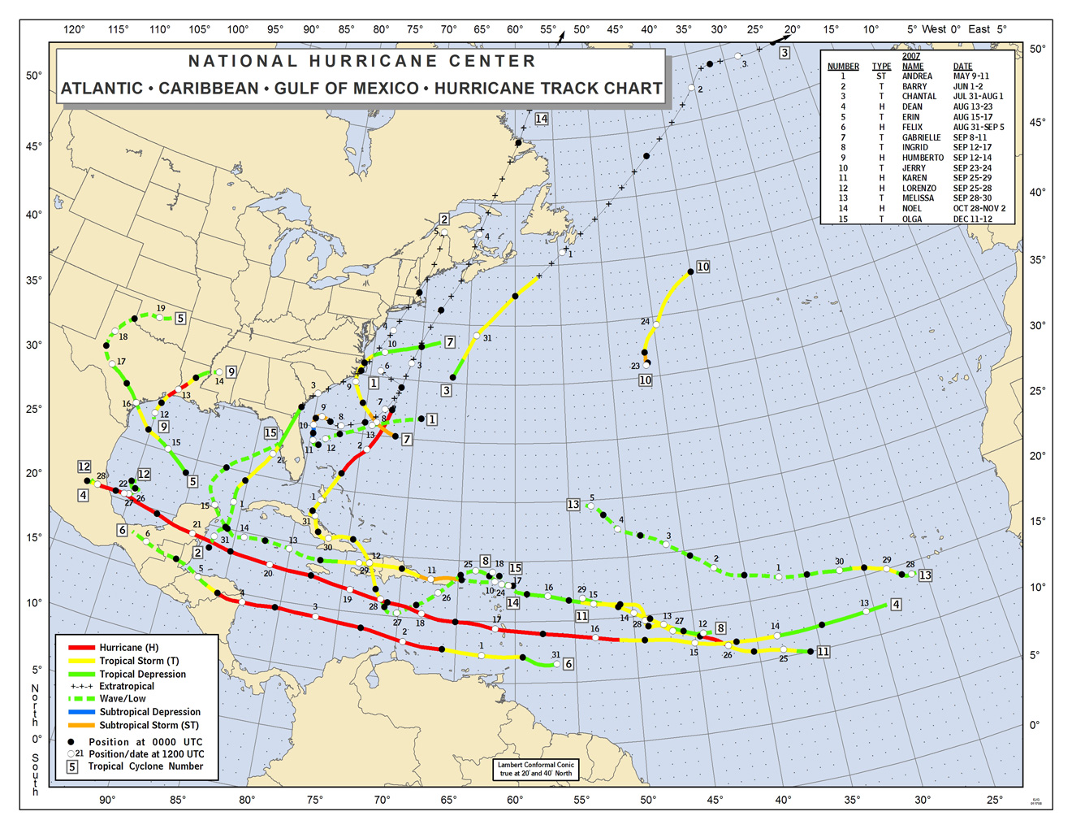
2007 Hurricane Season -
15 Tropical Storms & Hurricanes…
…9 of which were very short-lived (< 36 hr)

Slide 38
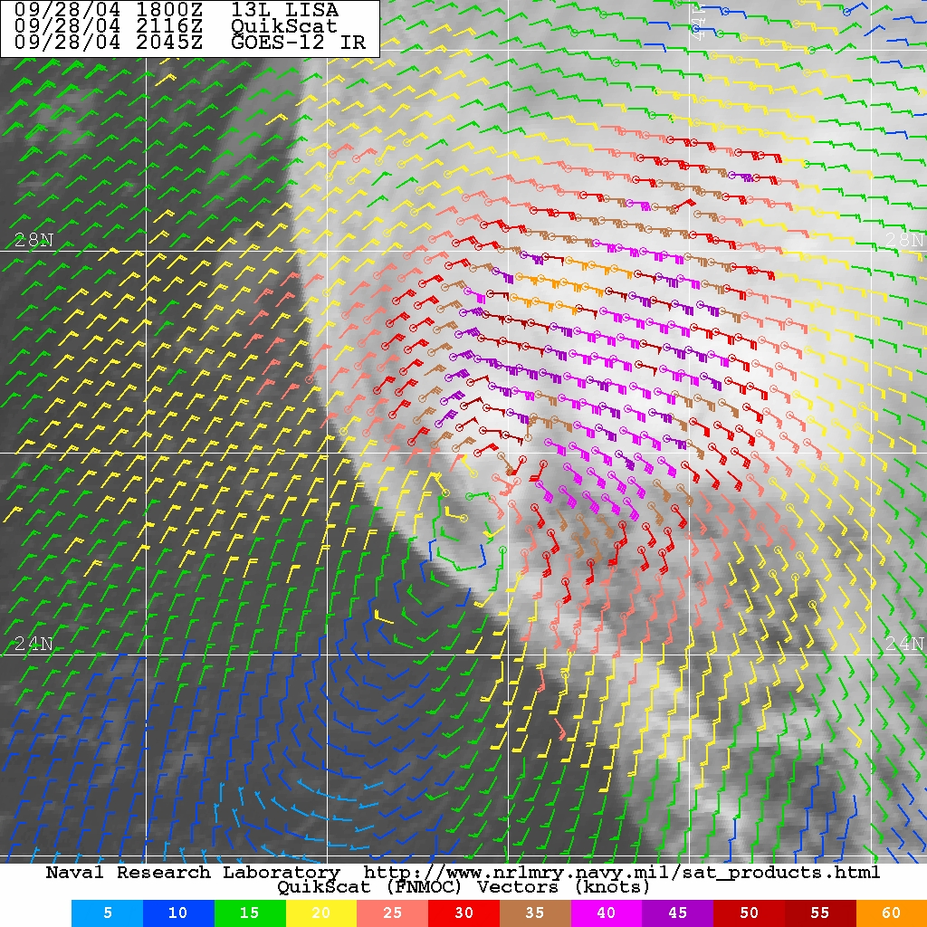
New Tools and Technologies ~ Additional TCs lately?
Hart’s Cyclone Phase
Space Analyses
Quikscat Surface Vectors
AMSU Tropospheric
Temperatures

Slide 39
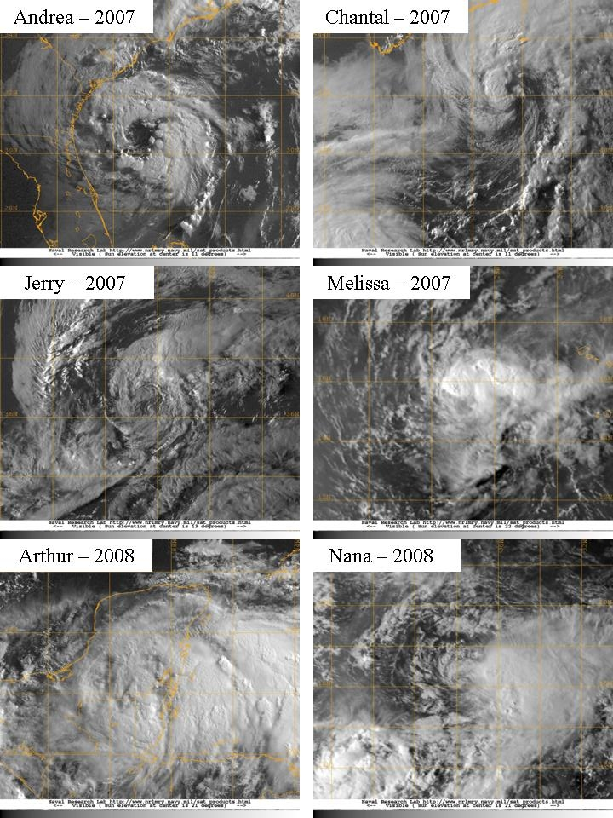
Six weak, short-lived storms in recent seasons –
Unlikely to have been “named” previously

Slide 40
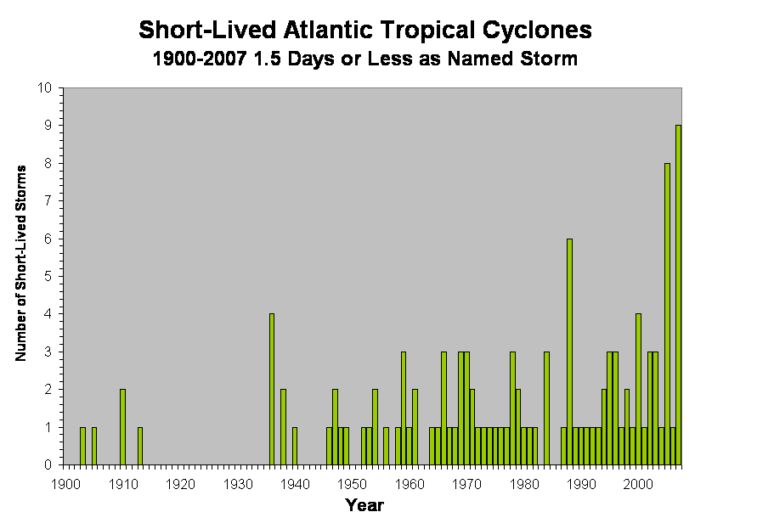
1900-1943: Only Ships and Coastal Stations

Slide 41
1944-1965: Aircraft Reconnaissance Available

Slide 42
1966-2001: Geostationary Satellite Imagery Available

Slide 43
2002 onward: AMSU, QuikScat, Cyclone Phase Space, Advanced Dvorak

Slide 44
Big Upward Trend – Consistent with Technological Improvements

Slide 45
Tropical Storm and Hurricane Numbers – A Very Large Trend over a Century
12
7

Slide 46
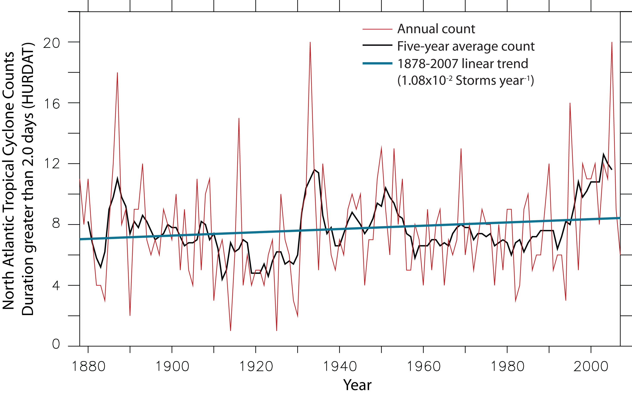
Tropical Storm and Hurricane Numbers
- Trend Nearly Gone after Removal of
Very Short-Lived Cyclones
8
7

Slide 47
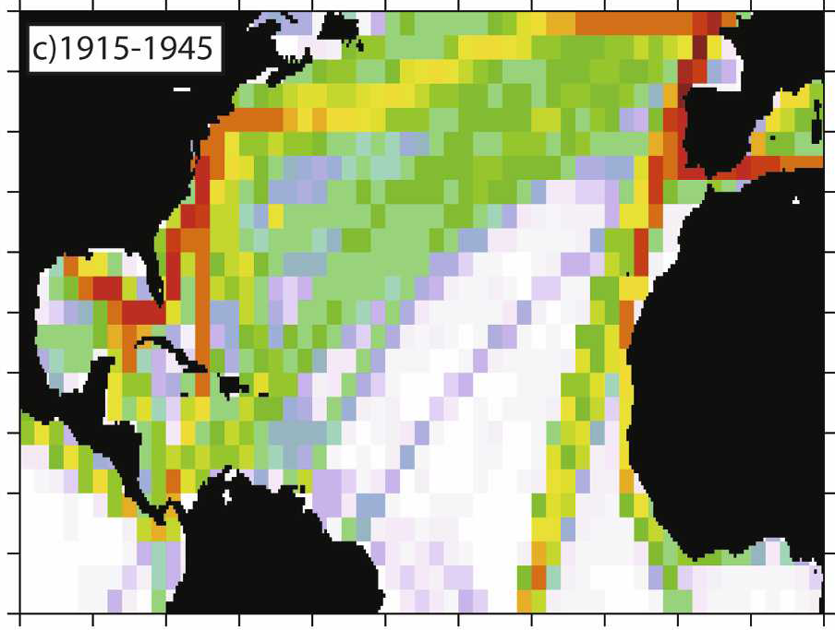
Atlantic ship traffic changes
Vecchi and Knutson (2008)

Slide 48
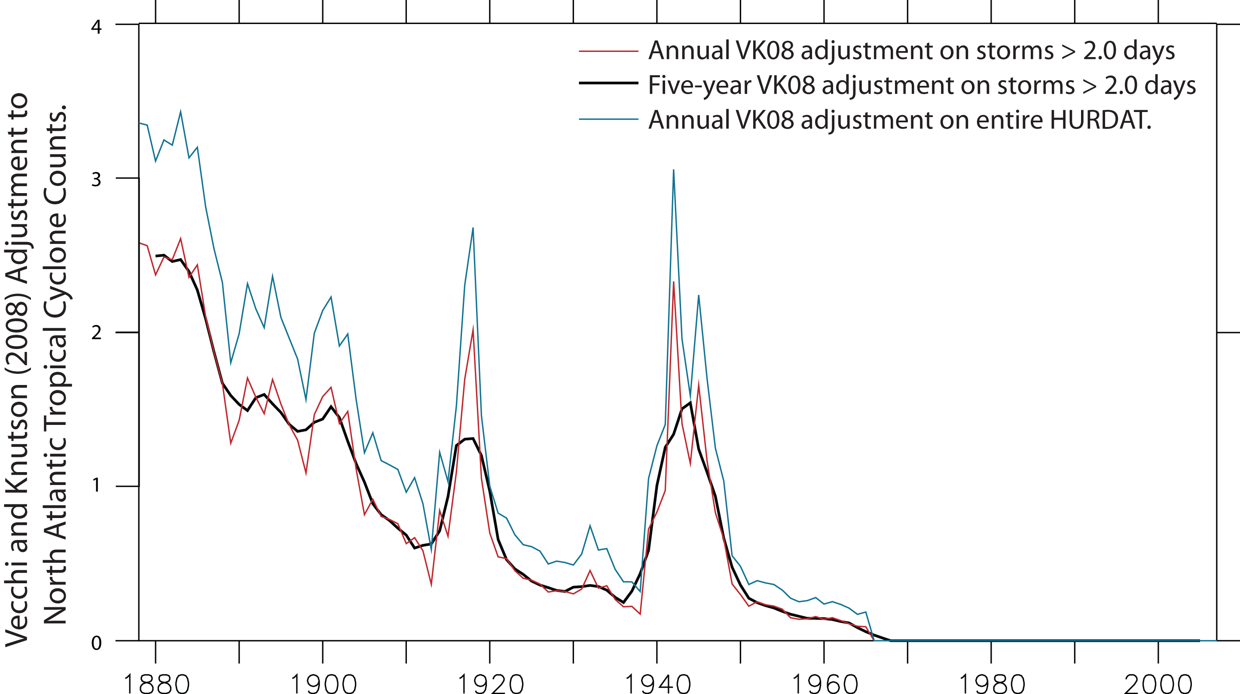
Estimated Number of “Missed” Tropical Storms and Hurricanes of Medium to Long Duration
2-3 per year
in 1880s
1-2 per year
in 1900s
<1 per year
in 1950s

Slide 49
Tropical Storm and Hurricane Numbers
- Trend Nearly Gone after Removal of
Very Short-Lived Cyclones
8
7
Notes:
49

Slide 50
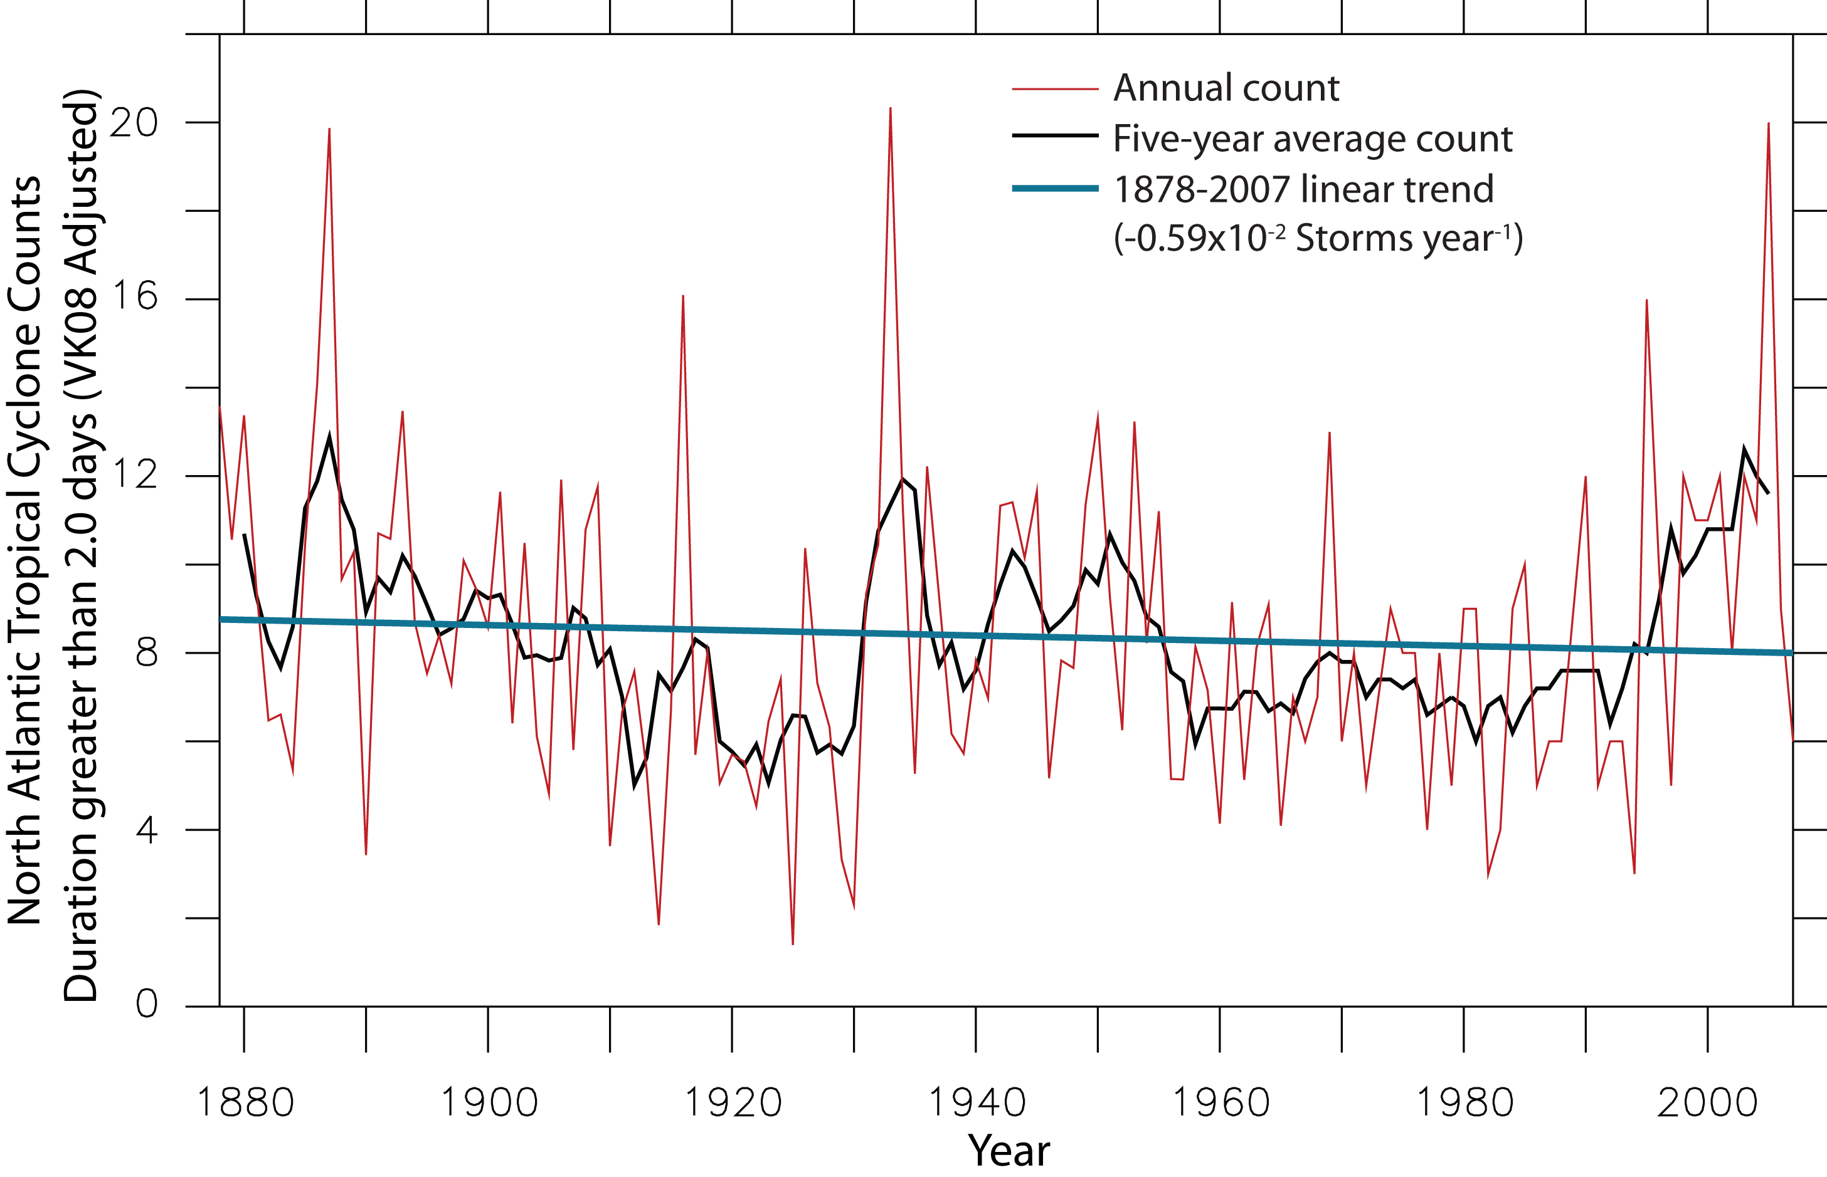
Tropical Storm and Hurricane Numbers –
Upward Trend Gone After Adding in “Missed” and Removing Very Short-Lived Cyclones
9
8

Slide 51
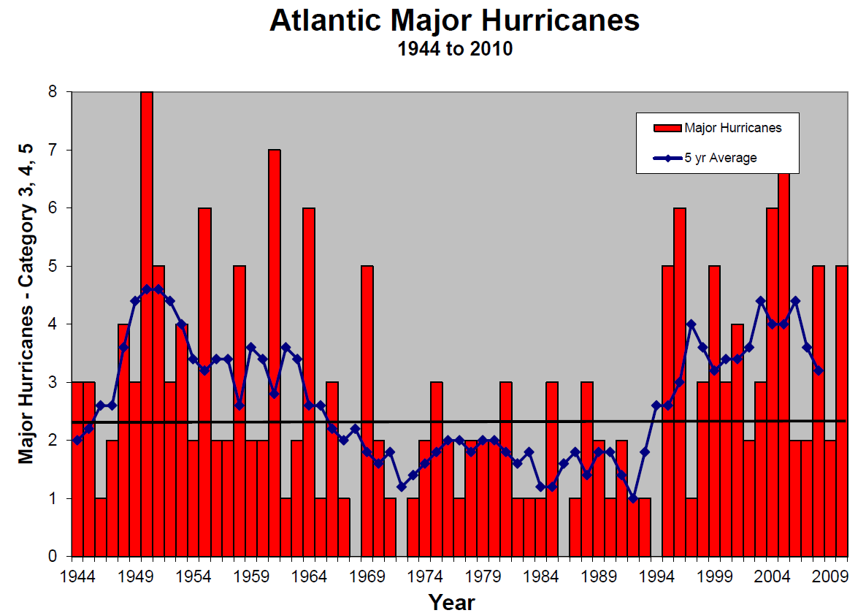

Slide 52
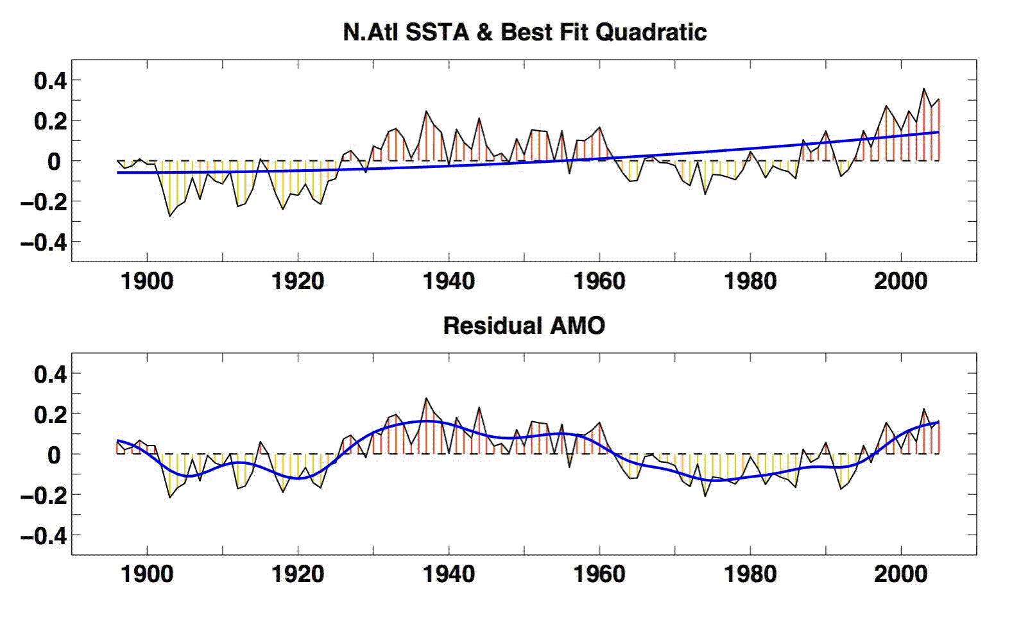
North Atlantic SSTs and Quadratic Trend
Residual Atlantic Multidecadal Oscillation
Enfield and Cid (2009)

Slide 53

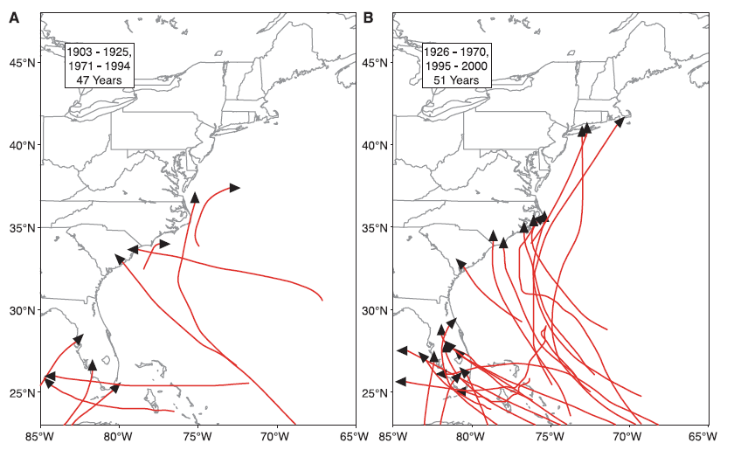
AMO Cool Phase
AMO Warm Phase
Notes:
53

Slide 54
Overall Tropical Storm and Hurricane Changes Due to Global Warming by 2100
Frequency: Numbers may see a moderate decrease (~25%)
Wind Intensity: Small increase (~3% stronger)
Storm Surge: Small increase (~3% higher) produced by the
hurricane (must also add on additional amount from
general sea level rise)
Rainfall: Moderate increase per cyclone (~10% within
200 mi of storm), but reduced frequency may
offset increases
Genesis/Track: Not as clear, but no indications for large
alterations
Notes:
54

Slide 55
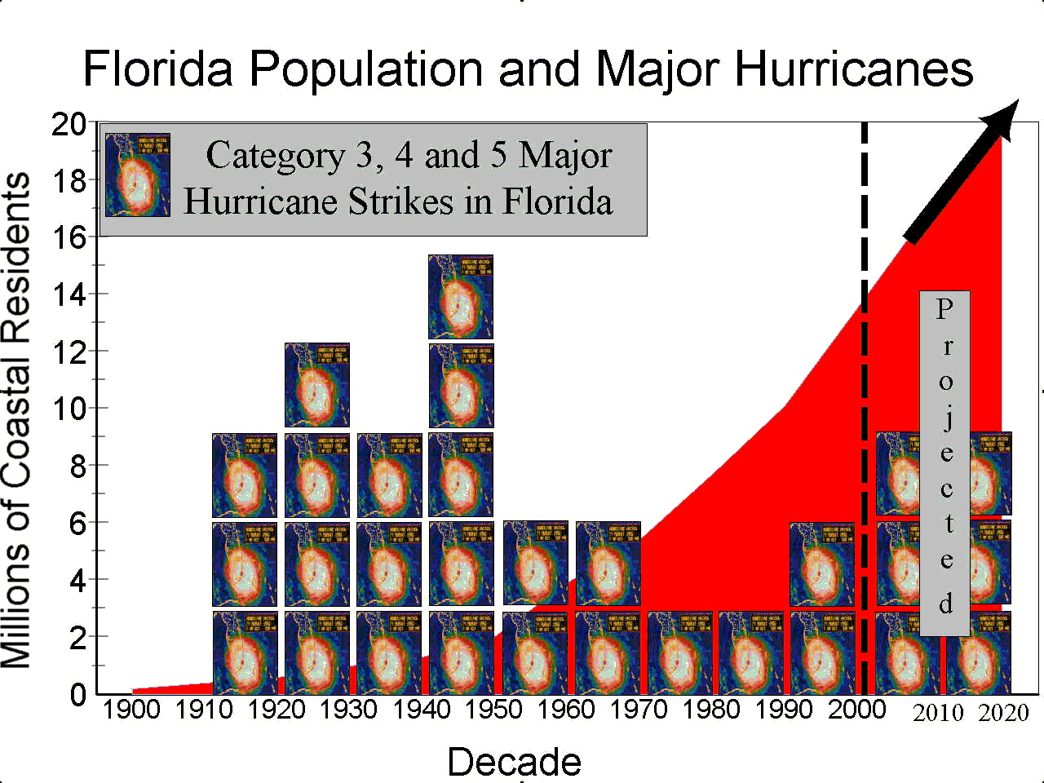

Slide 56
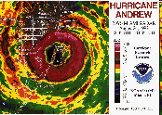
Five Major Landfalling Hurricanes in Florida – 2000-2009
Notes:
56

Slide 57
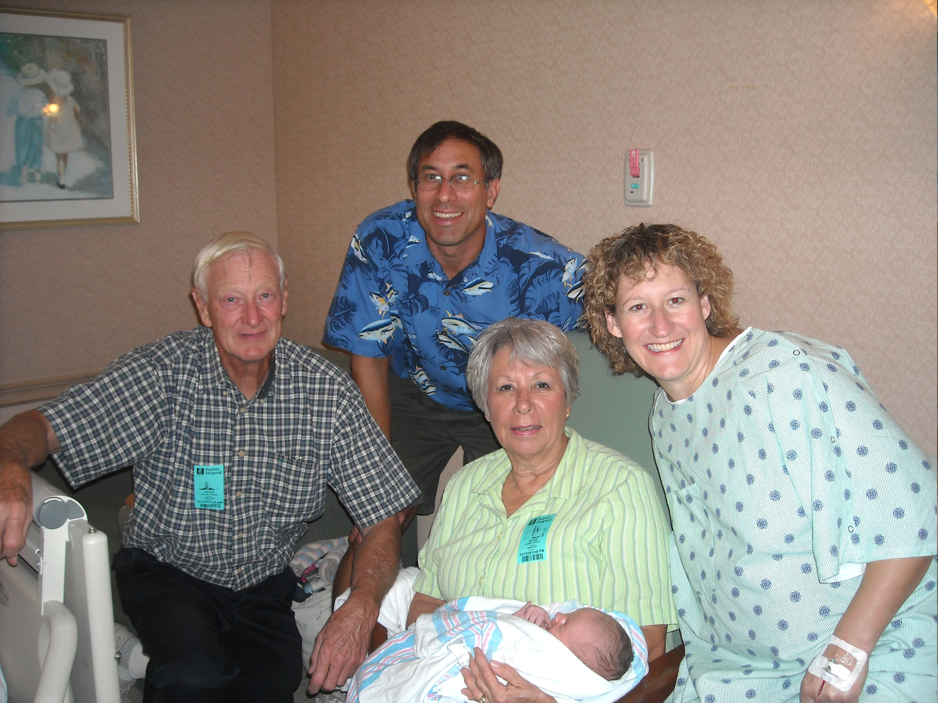

Slide 58
Hurricanes and Climate Change:
Expectations versus Observations
23 February, 2011
West Central Florida AMS Chapter Banquet
Chris Landsea, National Hurricane Center, Miami, USA
Chris.Landsea@noaa.gov

Slide 59
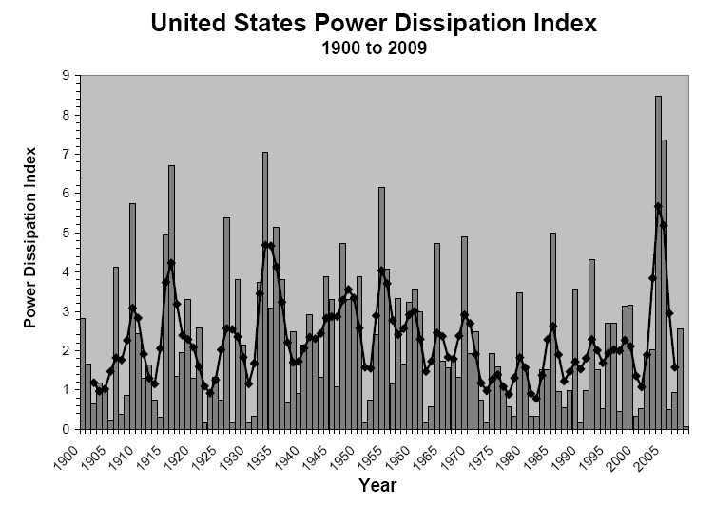
Notes:
59

Slide 61
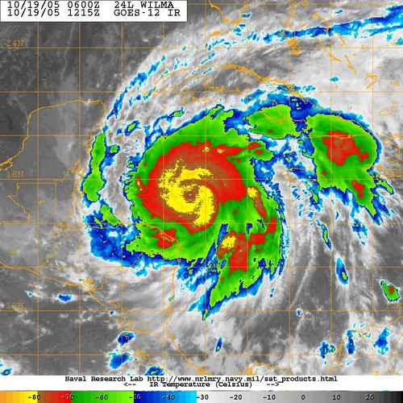
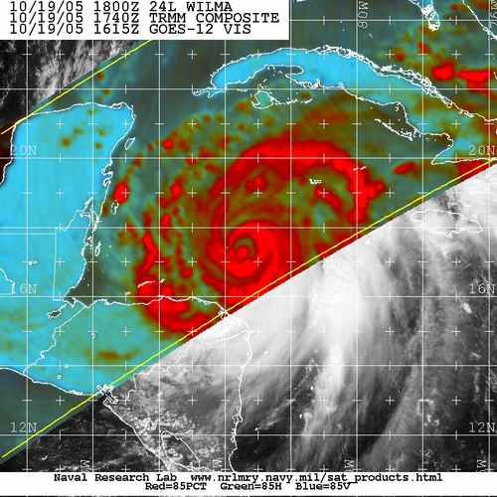
2005’s Hurricane Wilma
Strongest Hurricane Ever Observed
with 882 mb Central Pressure…

Slide 62
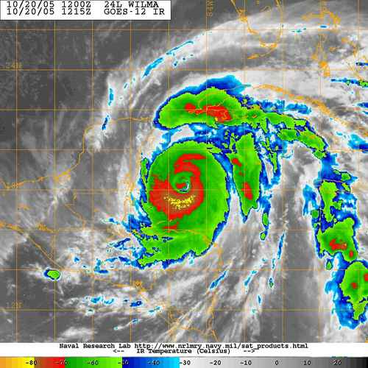

…but only a Category 5 (> 135 kt) for 18 hours over
the open Caribbean Sea

Slide 63



Hurricane Aircraft Reconnaissance in 1940s and early 1950s:
U.S. Navy’s PB4Y2

Slide 64
U.S. Navy’s PB4Y2:
No night flights
No central
pressure for major
hurricanes
No wind
instrumentation

Slide 66

Observation Capabilities:
Huge Improvements over Time

Slide 67


Galveston 1900
How many direct measurements/estimates of strongest winds and/or central pressure?
Carol 1954
Wilma

Slide 68
Wilma 2005 – Best Track Winds

Slide 69
Galveston 1900 - 1
How many direct measurements/estimates of strongest winds and/or central pressure?
Carol 1954 - 7
Wilma -280

Slide 70

1940s –
Extremely Busy Decade for U.S. Landfalling Major Hurricanes

Slide 71

Ten Most Recent Atlantic Basin Category 5 Hurricanes

Slide 73
Recent Category 5 Hurricanes:
Today’s Monitoring versus 1940s
Recent Category 5 Hurricane | Best Track Peak (kt) | Duration as Cat 5 (days) | 1940s Peak (kt) | Best Track ACE (10⁴ kt²) | 1940s ACE (10⁴ kt²)
Andrew - 1992 | 150 | 0.62 | 145 – Cat 5 | 28 | 25
Mitch – 1998 | 155 | 1.75 | 140 – Cat 5 | 36 | 34
Isabel – 2003 | 145 | 1.75 | 115 – Cat 4 | 63 | 41
Ivan – 2004 | 145 | 2.50 | 135 – Cat 4 | 70 | 64
Emily – 2005 | 140 | 0.25 | 125 – Cat 4 | 33 | 30
Katrina - 2005 | 150 | 0.75 | 120 – Cat 4 | 20 | 19
Rita – 2005 | 155 | 1.00 | 135 – Cat 4 | 25 | 25
Wilma – 2005 | 160 | 0.75 | 125 – Cat 4 | 39 | 34
Dean – 2007 | 150 | 1.00 | 130 – Cat 4 | 35 | 35
Felix - 2007 | 150 | 1.00 | 130 – Cat 4 | 18 | 16
Average | 150.0 | 1.37 | 130.0 – Cat 4 | 36.7 | 32.3

Slide 74
Recent Category 5 Hurricanes:
Today’s Monitoring versus 1940s
Raw Category 5 hurricane records show dramatic long-term trend and recent “unprecedented” increase
Monitoring abilities in 1940s, however, had extreme difficulty in detecting Category 5 hurricanes
Of the 10 most recent Category 5’s, only 2 (both landfallers) would have been identified as Category 5 in 1940s
Substantial undercount (~20%) to integrated measures of activity (ACE, PDI) in 1940s
Because accurate detection of these extreme hurricanes has increased substantially over last few decades, TRENDS IN CATEGORY 5 HURRICANES ARE UNRELIABLE

Slide 75
“Florida’s Coming Hurricane Calamities”
Miami Herald
Chris Landsea & Bill Gray
22 July, 2002
“This works out to about three major hurricanes making landfall in Florida per decade in the active era versus one and a half major hurricane per decade in the quiet era - a doubling in the major hurricane landfalls expected…The combined effect in the next few decades of more landfalling major hurricanes in Florida with very large and increasing coastal populations with much more property at risk leads to a recipe for disaster…We anticipate that the rate of economic loss in the state of Florida due to hurricane landfalls will be about SIX TO EIGHT TIMES the rate that occurred during the 1970s, 1980s and 1990s …In addition to impacts financially, concerns loom about the possibility of a large number of fatalities from a major hurricane making landfall. If an incomplete evacuation occurs due to either an unanticipated rapid intensification of a hurricane at landfall or due to apathetic residents choosing foolishly not to evacuate until too late on congested roadways, then hundreds or even thousands of Florida residents could drown in a hurricane's storm surge. “
Notes:
75

Slide 76


Slide 77
Changes in “Naming” Criteria
““[The National Hurricane Center] seems to be naming a lot more than they used to. This year, I would put four storms in the very questionable category, and maybe even six. In the past, we would have waited to see if another observation supported naming the system. We would have been a little more conservative."
Neil Frank, National Hurricane Center Director, 1974-1987

Slide 78


Slide 79

The Webster et al. study began with 1970 data…

Slide 80


Slide 81


Slide 83


Slide 84

Satellite era -
59% strike land

Slide 85
Pre-satellite era -
75% strike land

Slide 86

Frequency of Tropical Cyclones in Today’s Climate
Today’s Climate
Landsea and Bengtsson (2008)

Slide 87
Frequency of Tropical Cyclones in Today’s Climate
…Based upon Differing Thresholds of Duration
Landsea and Bengtsson (2008)

Slide 88
Frequency of Tropical Cyclones in Today’s Climate
Today’s Climate
Bengtsson et al. (2007)
Landsea and Bengtsson (2008)

Slide 89
Frequency of Tropical Cyclones in Today’s Climate
Versus Global Warming Climate
Today’s Climate Late 21st Century
Bengtsson et al. (2007)
Landsea and Bengtsson (2008)

Slide 90
Changes in “Naming” Criteria
“If it was quite marginal as to whether or not a storm would be upgraded to tropical storm status or equivalent, that decision would likely be influenced by proximity to possible impacts on land within the next 48 hours or so. That is, I suspect that the margin of acceptable error for most of us would be a little larger over the open sea as compared to potential landfall for such storms
that are not all that strong anyway.”
Bob Sheets, National Hurricane Center Director, 1987-1995
Notes:
90

Slide 91
Linking frequency of Atlantic tropical cyclones to SSTs
Holland and Webster (2007)

Slide 92
“Questions have been raised over the quality of the NATL data even for such a broad brush accounting. We have carefully examined the data record and considered as yet unpublished analyses by other investigators. Our conclusion is that the number of earlier missed storms most likely lies between 1 and 3 per year prior to 1900, less than 2 in the early nineteenth century [sic] and dropping off to essentially zero by 1960.”
--- Holland and Webster (2007)

Slide 93
“This record [of Atlantic tropical cyclone counts] … shows a strong, long-term relationship with tropical Atlantic August-October SST…The underlying factor appears to be the influence of (primarily anthropogenic) forced large-scale warming.”
“Overall, there appears to have been a substantial 100-year trend leading to related increases of over 0.78C in SST and over 100% in tropical cyclone and hurricane numbers. It is concluded that the overall trend in SSTs, and tropical cyclone and hurricane numbers is substantially influenced by greenhouse warming.”

Slide 94
Linking frequency of Atlantic tropical cyclones to SSTs
Mann and Emanuel (2006)

Slide 95

Merging paleotempestology (sediment core records) with modern hurricane data
Mann et al. (2009)

Slide 96


