Slide 1
The Weather Merit Badge
A Study Guide
By
Jay R. Stockton
Senior Forecaster, National Weather Service,
WFO Medford Oregon
Updated 09/15/2015
Notes:
This guide provides a concise step-by-step study guide for the Weather merit badge. It is patterned to track the badge requirements as listed in official publications of the Boy Scouts of America.

Slide 2
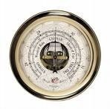
Requirement 1
Define Meteorology. Explain what weather is and what climate is. Discuss how the weather affects farmers, sailors, aviators, and the outdoor construction industry. Tell why weather forecasts are important to each of these groups.

Slide 3
Definition of Meteorology
Meteorology is the study of the atmosphere and its weather.
From ”meteoron”, which is Greek for “things in the air”, and
“Logos”, also Greek, which in this context means “knowledge or discussion”.
Notes:
Let’s start with the definition of meteorology. Meteorology is the study of the atmosphere and its weather. It is not limited to the atmosphere of the earth. Meteorologists study other planets and even atmospheric conditions around stars and in deep space.
The word meteorology is derived from two greek words. The first is "meteoron", which means “thing in the air”. The second is “logos”, which in this context means knowledge or discussion. So meteorology literally means “knowledge (or discussion) of things in the air”.
There are many different kinds of “meteorons”. A lithometeor is made of particles from the ground, such as flying dust and smoke. A hydrometeor is one composed of water, such as a raindrop or snowflake. Electrometeors include lightning and the aurora. Photometeors include rainbows, fogbows, halos, and mirages.

Slide 4
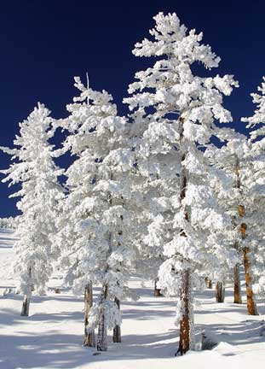
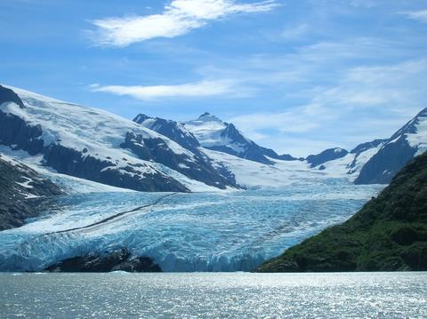
Weather and Climate
Weather: Short term (seconds
to days) variations in the
atmosphere.
Climate: The average course or condition of the weather at a given location, usually over a period of years.
Notes:
Now let’s talk about weather and climate. Weather consists of the short term (seconds to days) variations in the atmosphere with respect to heat or cold, wetness or dryness, calmness or storminess, clearness or cloudiness. Climate is defined as the average course or condition of the weather at a given location, usually over a period of years, as exhibited by temperature, wind velocity, and precipitation.
Another way to say this is that climate is what you expect, weather is what you get.
…

Slide 5
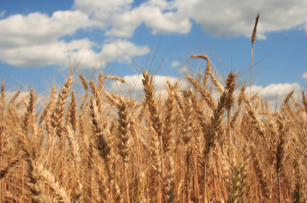
Effects on Agriculture
Rain - Too much or too little and good or bad timing
Hail – Can damage crops
Strong winds – Also can damage crops
Frosts and Freezes –
Can kill vegetation
Notes:
Farmers are greatly affected by the amount and type of precipitation their crops receive during the growing season. Crops can be damaged by too little or too much rain or by the timing of the rain. Hailstones from thunderstorms can damage fruit. Strong winds from any number of sources can break plants or affect the spraying of pesticides. Frosts and freezes can also damage or kill plants.

Slide 6
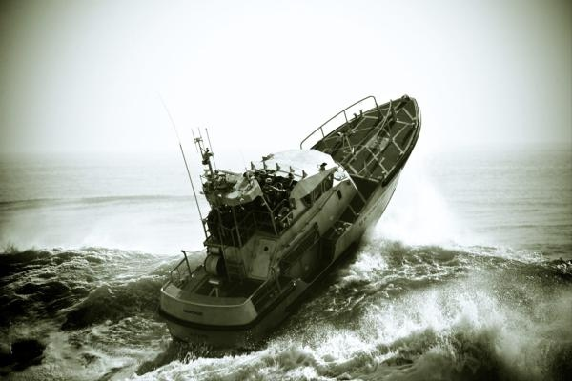
Effects on Mariners
Winds and Seas are the most important factors
Fog – sailors can get disoriented
Freezing Spray – can capsize a boat
Notes:
Sailors are especially vulnerable to weather as they usually cannot find shelter quickly. Winds are the most important factor as strong winds can generate rough seas, especially if they blow over a long expanse of water upstream from the boat. Sailors can get lost in fog, and freezing spray during cold conditions can damage and even capsize a boat.

Slide 7
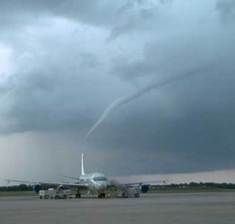
Effects on Aviators
Icing – Can weigh down an aircraft and increase drag
Turbulence – Can cause loss of control, injure pilots and passengers and damage equipment
Low ceilings and visibilities –
Can obscure terrain and
make it difficult for the pilot
to see where he is
Notes:
Aviators are primarily concerned about three things: Icing, turbulence, and low ceilings and visibilities. Icing is caused by liquid water collecting and then freezing on the aircraft. This makes the airplane heavier, less aerodynamic, and harder to handle. Turbulence, primarily due to strong horizontal and vertical winds, can jostle the airplane, causing difficulty in handling as well as possibly damaging the plane. Low ceilings can obscure terrain and low visibilities make it difficult for the pilot to see where he is going.

Slide 8
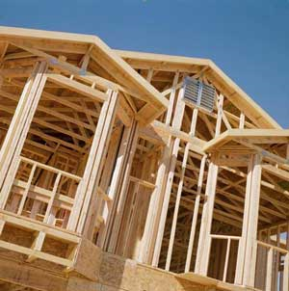
Effects on Construction
Rain – Certain jobs require dry weather
Wind – Can damage
unfinished structures
Temperatures – Can
affect ability to do certain
tasks
Severe weather can destroy many structures
Notes:
The outdoor construction industry is mostly concerned about rain, because certain jobs can only be done in dry weather. Other concerns include strong winds, which can damage structures that are not completely built yet, and temperatures, which can affect the ability to do certain tasks. Of course severe weather, like tornadoes and hurricanes, can destroy all sorts of structures.

Slide 9
Requirement 2
Name five dangerous weather-related conditions. Give the safety rules for each when outdoors and explain the difference between a severe weather watch and a warning. Discuss the safety rules with your family.
Notes:
There are many dangerous weather related conditions. In this discussion, we will cover the five listed in the Weather Merit Badge Series book. The scout may select other conditions not listed here.

Slide 10
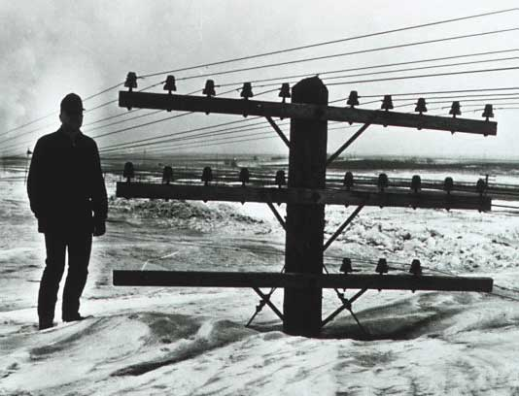
Winter Storms
These can include snow/ice storms, blizzards, and extreme cold combined with strong winds.
Notes:
Winter Storms: These can include snow/ice storms, blizzards, and extreme cold combined with strong winds.

Slide 11
Winter Storm Safety Rules
Stay dry!
Covered exposed body parts
Avoid overexertion
Seek protection from wind
Build fire, if possible
Stay in car, if available
Notes:
Winter Storm Safety Rules: Stay dry, cover all exposed parts of your body, and avoid overexertion. Seek protection from the wind and build a fire if you can. If you are in a car, stay with the car, tie a brightly colored ribbon to the antenna, clear the exhaust pipe, and run the heater around 10 minutes an hour.

Slide 12
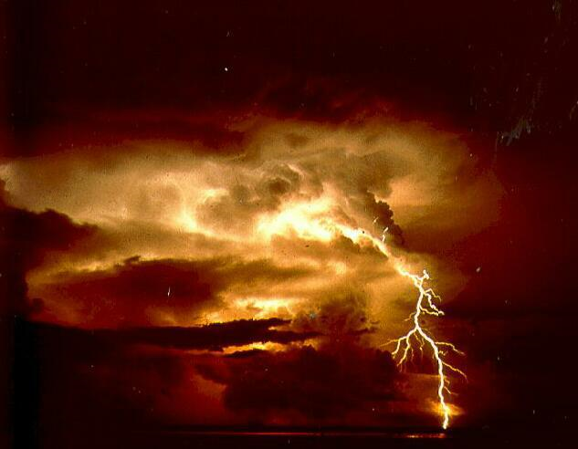
Thunderstorms
These are large cumulonimbus clouds with lightning and thunder. They may contain heavy rain, strong winds, and large hail.
Notes:
Thunderstorms: These are large cumulonimbus clouds with lightning and thunder. They may contain heavy rain, strong winds, and large hail.

Slide 13
Thunderstorm Safety Rules
Seek shelter in a house or car
Become the smallest target you can
Stay away from open areas and tall objects such as trees or poles
Stay away from water, metallic objects, or anything that uses or conducts electricity
Notes:
Thunderstorm Safety Rules: Seek shelter such as a house or car. If that is not possible, become the smallest target that you can. Try crouching in a low area, but avoid gullies and stream beds. Stay away from open areas and tall objects such as trees or power poles. Stay away from water, metallic objects, and anything that uses electricity.

Slide 14
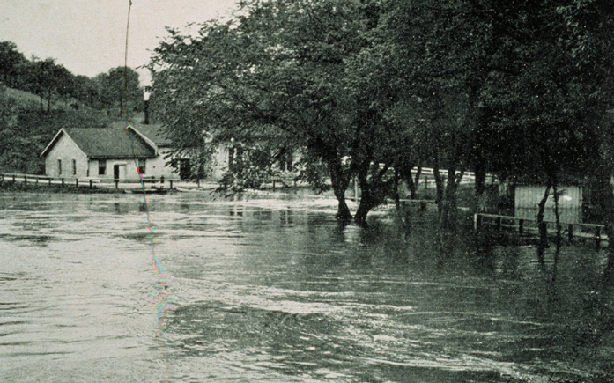
Flash Floods and Floods
Flash Floods generally occur due to intense rainfall over a small area or from a dam break, and the waters rise and fall rapidly.
Floods generally occur on larger rivers and cover a wider area. Floods can take days to rise, crest, and subside.
Notes:
Flash Floods and Floods: These occur when creeks or rivers overflow their banks, or when urban drainage systems fail. The flash flood occurs within six hours of the event that caused it. Floods generally occur on larger rivers and cover a wider area. Flood events can take days to rise, crest, and subside.

Slide 15
Flood Safety Rules
Get to higher ground!
Do not camp in gullies or near stream beds
Do not drive into water, especially running water
Notes:
Flood Safety Rules: Get to higher ground. Do not camp in gullies or near stream beds. Do not drive into water, especially running water.

Slide 16
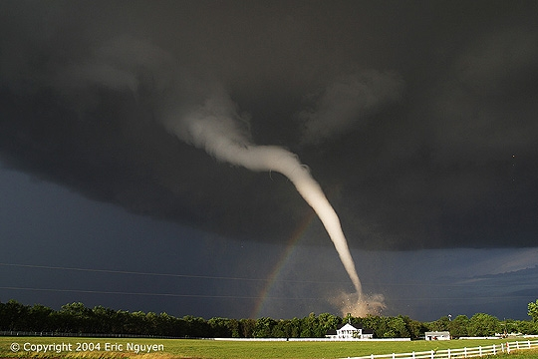
Tornadoes
Violently rotating columns of air descending from thunderstorm clouds and in contact with the earth
Usually visible as a funnel shaped cloud
Winds can be as high as 300 MPH
Usually less than a few hundred yards wide, last a few minutes, and trace a path of 1 mile or less.
Notes:
Tornadoes: These are violently rotating columns of air, in contact with the ground, that descend from cumulonimbus clouds. They are often (but not always) visible as a funnel cloud. Winds near a tornado can be as high as 300 mph. Most tornadoes are less than a few hundred yards wide, last for a few minutes, and trace a path of a mile or less. However, there have been tornadoes that were a mile wide, last for an hour or more, and produce damage paths more than 100 miles long.

Slide 17
Tornado Safety Rules
Main danger is from flying debris, so seek shelter in a basement or a centrally located bathroom
If trapped outside, find a low place that is not flooded, lie face down and cover your head
Notes:
Tornado Safety Rules: The main danger from tornadoes is flying debris. Therefore the best option is to get to a place that provides as much protection as possible. If you have a basement, seek refuge there and get under a large object, such as a workbench. If you have no basement, the best place to go is a center room in the house, especially a bathroom, where the plumbing reinforces the walls. For the best possible protection, get into the bathtub with a mattress over your body. Stay away from windows. If caught in the open, find a low place that is not flooded, lie face down and cover your head.

Slide 18
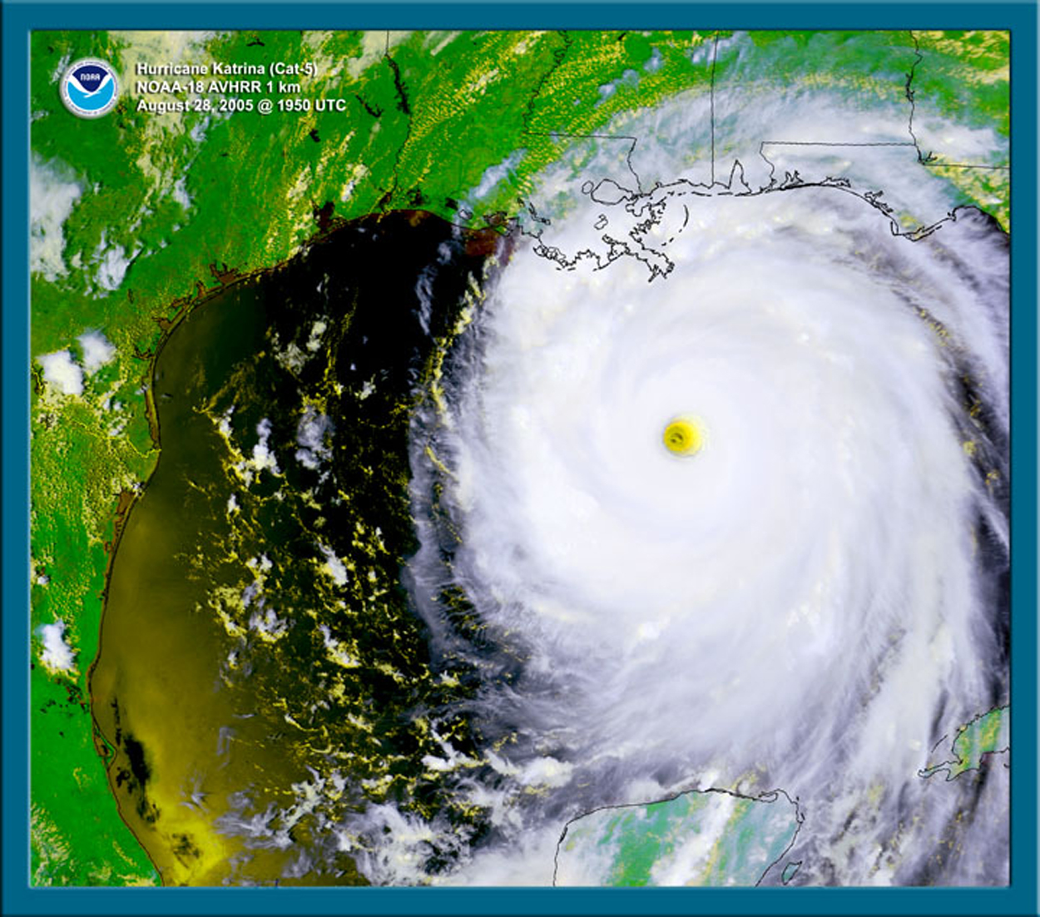
Hurricanes
Large cyclone with winds exceeding 74 mph and up to 200 mph
Can be from 60 to 600 miles in diameter
Develops over warm water and breaks up over cold water or land
Notes:
Hurricanes: A hurricane is a large tropical cyclone with sustained winds exceeding 74 mph that occurs in the Atlantic or eastern Pacific oceans. They are known by a variety of terms in other parts of the world. The energy source for these storms is warm ocean water underneath the storm. Sustained winds can range up to 200 mph with higher gusts, and size can range from 60 to well over 600 miles in diameter. Hurricanes break up rapidly after they move over land.

Slide 19
Hurricane Safety Rules
Leave the danger area
If trapped, get to shelter on higher ground.
Other safety rules are similar to those for floods
Notes:
Hurricane Safety Rules: Most hurricane damage is caused by the storm surge, which is high water that piles up ahead of the storm. Most hurricane deaths are caused by drowning. Therefore the safety rules are similar to that for floods. Leave the danger area. If that is not possible, get to the highest shelter you can find.

Slide 20
Weather Watches
Issued when the risk of a hazardous weather or warning event has increased significantly, but its occurrence, location, and/or timing is still uncertain.
Notes:
Watch: Issued when the risk of a hazardous weather or warning event has increased significantly, but its occurrence, location, and/or timing is still uncertain.

Slide 21
Weather Warnings
Issued when a hazardous weather or flooding event is occurring, about to occur, or has a high probability of occurring.
Now it’s up to you to discuss this with your family. It just might save your lives someday!
Notes:
Warning: Issued when a hazardous weather or flooding event is occurring, about to occur, or has a high probability of occurring.

Slide 22
Requirement 3
Explain the difference between high and low pressure systems in the atmosphere. Tell which is related to good and to poor weather. Draw cross sections of a cold front and a warm front, showing the location and movements of the cold and warm air, the frontal slope, the locations and types of clouds associated with each type of front, and the location of precipitation.

Slide 23
Atmospheric Pressure
Atmospheric pressure is simply the weight of the air above a point on the earth or in the air. The column of air above a square inch of the earth’s surface weighs about 15 pounds.
Notes:
Atmospheric pressure is simply the weight of the atmosphere directly above any point on the ground or in the air. Therefore, one would expect the highest pressure values to be recorded at ground-based stations at or below sea level, while the lowest pressure values would be found on very high mountain peaks or in the air above those peaks.

Slide 24
High and Low Pressure Pt. 1
Pressure varies horizontally as well as vertically
This is due to uneven heating of the earth’s surface by the sun
High pressure tends to develop towards the poles while low pressure develops near the equator
The atmosphere tries to even out areas of high and low pressure, creating weather in the process
Notes:
When meteorologists speak of high and low pressure, however, they are talking about the horizontal variation of pressure, usually at sea level. These variations occur because the sun heats the earth unevenly. The equator receives a lot more heating than the poles do. Cold air is denser than warm air, so an air mass of cold air would weigh more than warm air. Thus, areas of high pressure tend to develop at the poles and low pressure at the equator.
Have you ever noticed how water in a swimming pool tends to flatten out after the swimmers leave and the wind dies down? If left undisturbed, the water in the pool will seek a state of equilibrium where all the water is at the same level. The atmosphere is always trying to attain a similar state of equilibrium, but it cannot actually reach that state since it is always being disturbed. So, the atmosphere is constantly trying to move areas of high pressure toward low pressure, just like water runs down a hill. In this process, the atmosphere creates what we know as weather.

Slide 25
High and Low Pressure Pt. 2
Low pressure is associated with rising air
Clouds and precipitation form in areas of rising air
High pressure is associated with sinking air
Air warms and dries out as it sinks
Notes:
In general, areas of low pressure are associated with rising air. Rising air helps clouds and precipitation form, so those things tend to occur near lows. High pressure is associated with sinking air, which suppresses the formation of clouds, so high pressure is associated with clear skies.

Slide 26
Cold Front – Planer and Cross Sectional Views
Notes:
Frontal cross-sections are depicted on the next four slides. The first two slides depict cold fronts, while the last two show warm fronts. Together, they provide all the information needed to meet this part of the requirement.

Slide 27
Cold Front – 3D view
Notes:
Key for cloud abbreviations in the 3-D views:
Vertically developing clouds Cb Cumulonimbus
Cu Cumulus
Low Clouds (below 6500 feet) St Stratus
Ns Nimbostratus
Sc Stratocumulus
Middle Clouds (6500-18000 feet) Ac Altocumulus
As Altostratus
High Clouds (above 18000 feet) Ci Cirrus
Cs Cirrostratus
Cc Cirrocumulus

Slide 28
Warm Front – Planer and Cross Sectional Views

Slide 29
Warm Front – 3D views
Notes:
Key for cloud abbreviations in the 3-D views:
Vertically developing clouds Cb Cumulonimbus
Cu Cumulus
Low Clouds (below 6500 feet) St Stratus
Ns Nimbostratus
Sc Stratocumulus
Middle Clouds (6500-18000 feet) Ac Altocumulus
As Altostratus
High Clouds (above 18000 feet) Ci Cirrus
Cs Cirrostratus
Cc Cirrocumulus

Slide 30
Requirement 4
Tell what causes wind, why it rains, and how lightning and hail are formed.
Notes:
Requirement 4: Tell what causes wind, why it rains, and how lightning and hail are formed.

Slide 31
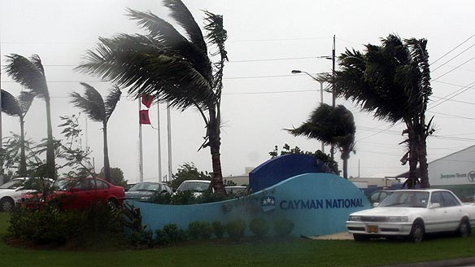
What Causes Wind?
As mentioned in Requirement 3, the atmosphere is constantly trying to make the air pressure equal everywhere, moving air from high to low pressure. Wind, which is defined as moving air, naturally results from this process.
Notes:
As mentioned in Requirement 3, the atmosphere is constantly trying to make the air pressure equal everywhere, moving areas with higher pressure toward areas with lower pressure. Wind gets created in this process.

Slide 32
Example: Sea Breezes
Land heats faster than water
In the afternoon, the land area is hotter than the water
Warm air rises over the land, creating an area of lower pressure
Cooler air from the ocean moves in to replace the rising air (a sea breeze)
Notes:
Now let’s discuss how rain is formed. One needs two things to make rain: A source of water and rising air.
Water can come from a variety of sources, but before anything can happen, that water needs to evaporate into the air. When this happens, it becomes invisible water vapor. Air can hold only a certain amount of water vapor, and this amount increases as the temperature gets warmer. When air is holding all the water it can at a given temperature, we say that it is saturated.
Now if we take this air and raise it, we lower the air pressure pushing down on it. This in turn forces the temperature to drop. As the air cools, its ability to hold water decreases and eventually it becomes saturated. At this point in the process, clouds begin to form. If we keep lifting the air, it becomes even cooler and even more water condenses into the cloud. The water droplets hit each other and combine to form bigger and bigger water droplets. Eventually the droplets get so big that they can no longer be suspended in the air. At that point it falls out as rain.

Slide 33
Example: Land Breezes
Land cools faster than water
At night, the land becomes cooler than the water
Relatively warmer air rises over the water, creating an area of lower pressure.
Cooler air from land moves in to replace the rising air (land breeze)
Notes:
The opposite occurs at night…the land cools faster than the sea. Then the air rises offshore, and air moves in from land to replace it. This is called a land breeze. Both processes are illustrated in the next slide.

Slide 34
Sea/Land Breezes Illustrated

Slide 35
Rain Formation Part 1
Two things are needed to form rain:
A water source, and
Rising air
Next, the water must evaporate into the air, transforming into invisible water vapor.
Notes:
Now let’s discuss how rain is formed. One needs two things to make rain: A source of water and rising air.
Water can come from a variety of sources, but before anything can happen, that water needs to evaporate into the air. When this happens, it becomes invisible water vapor. Air can hold only a certain amount of water vapor, and this amount increases as the temperature gets warmer. When air is holding all the water it can at a given temperature, we say that it is saturated.

Slide 36
Rain Formation Part 2
Air at a given temperature can hold a certain amount of water vapor. When it contains that amount of vapor, it is saturated.
If the air is raised upward in the atmosphere, it cools. Cooler air can’t hold as much water vapor, and the excess condenses and forms clouds.
Notes:
Water can come from a variety of sources, but before anything can happen, that water needs to evaporate into the air. When this happens, it becomes invisible water vapor. Air can hold only a certain amount of water vapor, and this amount increases as the temperature gets warmer. When air is holding all the water it can at a given temperature, we say that it is saturated.
Now if we take this air and raise it, we lower the air pressure pushing down on it. This in turn forces the temperature to drop. As the air cools, its ability to hold water decreases and eventually it becomes saturated. At this point in the process, clouds begin to form

Slide 37
Rain Formation Part 3
The cloud droplets combine to form bigger droplets.
When the droplets get so large that they can no longer be suspended in the air, they fall as rain.
Notes:
If we keep lifting the air, it becomes even cooler and even more water condenses into the cloud. The water droplets hit each other and combine to form bigger and bigger water droplets. Eventually the droplets get so big that they can no longer be suspended in the air. At that point it falls out as rain.

Slide 38
Rain Formation Illustrated

Slide 39
Lightning
Associated with thunderstorms
As a thunderstorm develops, positive and negative charges form on the ground and in various parts of the cloud.
When the charge separation gets strong enough, a bolt of electricity jumps between an area of positive charge and an area of negative charge.
This bolt of electricity is what we see as lightning. It can be cloud-to-cloud, cloud-to-ground, and even cloud-to-air.
Notes:
Lightning and hail are both created by thunderstorms.
As a thunderstorm develops, positive and negative charges collect on the ground and in various parts of the cumulonimbus cloud. Charges act a bit like pressure in that the atmosphere is always striving to have charges distributed evenly. Therefore, when the areas of positive and negative charge get large enough, a bolt of electricity jumps from one to the other to equalize the charge. We see this bolt of electricity as lightning. Lightning can be cloud-to-cloud, cloud-to-ground, or even cloud-to-air.

Slide 40
Hail Formation
Also associated with thunderstorms
Thunderstorms have updrafts and downdrafts, usually rain falls in a downdraft
Sometimes updrafts form under downdrafts, and rain is swept back up above the freezing level and freezes, and then it falls again.
This can happen many times. The growing hailstone acquires another layer of ice with each cycle.
Eventually the hailstone gets too heavy to be held up by the updraft and it falls to the ground.
Notes:
Hail is formed by a different process. Thunderstorms have updrafts (rising air) and downdrafts (descending air). Usually rain falls in a downdraft. Sometimes updrafts can develop below downdrafts. When this occurs, the rain is carried back up into the cloud. If it gets pushed above the freezing level, it will condense into ice. Eventually this ice will begin falling again in a downdraft. This updraft/downdraft process can be repeated many times and the developing hailstone will pick up a layer of ice with each cycle. At some point the ball of ice will be too large for the updraft to support it, and then it will fall as hail. Hail is usually marble-size or smaller and has cycled through the above process 2-3 times. However, hail as large as softballs have been recorded and these go through the cycle many times. The diagram below illustrates the process.

Slide 41
Hail Formation Illustrated

Slide 42
Requirement 5
Identify and describe clouds in the low, middle, and upper levels of the atmosphere. Relate these to specific types of weather.

Slide 43
Cloud Types
There are four general types of clouds:
Vertically developing clouds (0-50000 ft)
Cumulonimbus and Cumulus
Low Clouds (below 6500 feet)
Stratus, Nimbostratus, and Stratocumulus
Middle Clouds (6500-20000 ft)
Altocumulus, Altostratus
High Clouds (above 20000 ft)
Cirrus, Cirrocumulus, Cirrostratus
Notes:
Let’s start by listing the clouds by type:
Cloud Type Cloud Name
Vertically developing clouds (0-50000 feet) Cumulonimbus, Cumulus
Low Clouds (below 6500 feet) Stratus, Nimbostratus, Stratocumulus
Middle Clouds (6500-20000 feet) Altocumulus, Altostratus
High Clouds (above 20000 feet) Cirrus, Cirrostratus, Cirrocumulus

Slide 44
Cloud Types Illustrated

Slide 45
Clouds and Weather
Cumulonimbus clouds form showers and thunderstorms
Nimbostratus clouds are associated with steady precipitation
Other clouds generally are not associated with precipitation, but may produce rain or snow that evaporates before it reaches the ground (virga).
Notes:
Cumulonimbus clouds are associated with showers and thunderstorms, while nimbostratus clouds are associated with steady precipitation, like snow and rain. The nimbus or nimbo designation indicates that the clouds are precipitating water or ice. The other clouds typically do not produce precipitation that reaches the ground, although they may produce precipitation that evaporates in the air before it reaches the ground. Meteorologists call this kind of precipitation “virga”.

Slide 46
Requirement 6
Draw a diagram of the water cycle and label its major processes. Explain the water cycle to your counselor.

Slide 47
The Water Cycle Illustrated
Notes:
The water cycle is best explained through a diagram. The main points to remember are that the total amount of water on earth is roughly the same at all times, and that this water is constantly being cycled from the ocean to the land and back again. There are some non-oceanic sources of water, such as springs, but many of these depend on water filtering in from the ground above.

Slide 48
The Water Cycle: Main Points to Remember
Total amount of water on earth doesn’t change much.
Water is constantly being recycled from ocean to land and back again.
Notes:
The water cycle is best explained through a diagram. The main points to remember are that the total amount of water on earth is roughly the same at all times, and that this water is constantly being cycled from the ocean to the land and back again. There are some non-oceanic sources of water, such as springs, but many of these depend on water filtering in from the ground above.

Slide 49
Requirement 7
Identify some human activities that can alter the environment, and describe how they affect the climate and people.
Notes:
Human activities pollute the atmosphere in many ways, several of which are described in the following slides.

Slide 50
Acid Rain
Acid Rain is normal rained mixed with pollutants containing sulfur particles
Sulfur particles react with water to form a dilute solution of sulfuric acid
Main source of pollutants is from power plants burning high-sulfur content coal
Notes:
Human activity releases pollutants into the atmosphere. Some of these pollutants contain sulfur particles, and these can mix with water in the atmosphere to form what we call acid rain. The biggest sources of atmospheric sulfur are power plants that burn coal with a high sulfur content. Acid rain tends to occur downwind from these plants, and so the worst areas for acid rain are the northeastern U.S. and southeastern Canada.

Slide 51
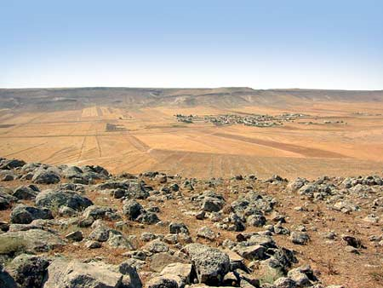
Human Effects on Weather
Desertification of land due to overgrazing, unsound farm practices, or mining
Breakdown of ozone layer due to chloroflourocarbons
(CFCs)
Global warming due
to excessive carbon
dioxide in the
atmosphere
Notes:
Human activities pollute the atmosphere in many ways. Several more are discussed below.
Overgrazing, unsound farming practices, and mining can cause desertification of the land. In this process, fertile land becomes parched soil and sand dunes that can support minimal plant life.
Certain industrial chemicals known as chlorofluorocarbons have become widely distributed in the atmosphere, and these chemicals can break apart molecules of ozone in the ozone layer high in the atmosphere. This layer filters out ultraviolet light from the sun that are harmful to plants and animals, including humans. Its loss would lead to many more cases of sunburn and skin cancer, among other things.
Global warming is a topic that has been in the news a lot lately. The earth’s atmosphere and oceans have definitely warmed over the past several decades. This has already begun to effect many people who live near sea level and near the north and south poles.
Natural processes put a lot of carbon dioxide in the atmosphere and human activities put in a lesser amount. Many scientists contend that the human contribution has created an excess of carbon dioxide that has led to global warming and that this warming will continue unless we cut back on our contributions. Others contend that the current warming cycle is primarily a natural event and the atmosphere will begin to cool several years from now. No one knows for sure what will happen.

Slide 52
How People Are Affected
Desertification of land destroys farmland and leads to less food production
The breakdown of the ozone layer allows more solar ultraviolet radiation, leading to more skin cancer cases.
Global warming raises sea level, threatening inundation of low-lying areas where many people live.
Notes:
Human activities pollute the atmosphere in many ways. Acid rain is just one result of these activities. Several more are discussed below.
Overgrazing, unsound farming practices, and mining can cause desertification of the land. In this process, fertile land becomes parched soil and sand dunes that can support minimal plant life.
Certain industrial chemicals known as chlorofluorocarbons have become widely distributed in the atmosphere, and these chemicals can break apart molecules of ozone in the ozone layer high in the atmosphere. This layer filters out ultraviolet light from the sun that are harmful to plants and animals, including humans. Its loss would lead to many more cases of sunburn and skin cancer, among other things.
Global warming is a topic that has been in the news a lot lately. The earth’s atmosphere and oceans have definitely warmed over the past several decades. This has already begun to effect many people who live near sea level and near the north and south poles.
Natural processes put a lot of carbon dioxide in the atmosphere and human activities put in a lesser amount. Many scientists contend that the human contribution has created an excess of carbon dioxide that has led to global warming and that this warming will continue unless we cut back on our contributions. Others contend that the current warming cycle is primarily a natural event and the atmosphere will begin to cool several years from now. No one knows for sure what will happen.

Slide 53
Requirement 8
Describe how the tilt of the earth’s axis helps determine the the climate of a region near the equator, near the poles, and across the area in between.
Notes:
Human activities pollute the atmosphere in many ways, several of which are described in the following slides.

Slide 54
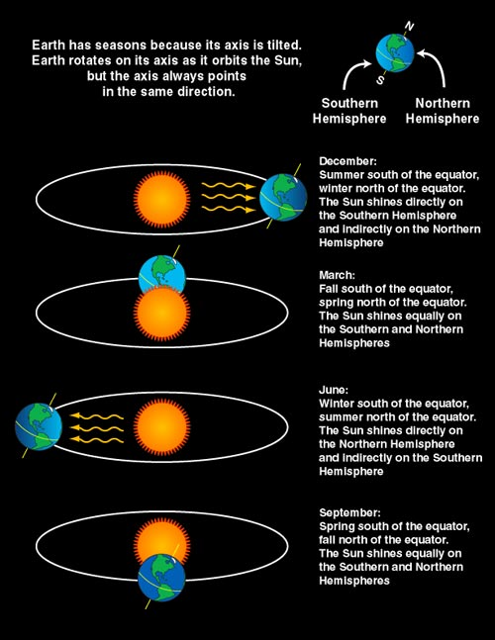
Because of the Earth’s tilt, we have seasons!
Notes:
The tilt of the earth’s axis is what causes seasons on earth. Between the fall equinox in September and the spring equinox in March, the north pole is tilted away from the sun. Therefore, the northern hemisphere experiences shorter days and less direct sunlight, which causes the area to cool. Winter occurs in the middle of this stretch. Meanwhile, the southern hemisphere is experiencing the summer season since the south pole is tilted toward the sun and the hemisphere is getting longer days and more direct sunlight, causing the area to warm.
Between the spring equinox in March and the fall equinox in September, the scenario is reversed. The north pole is tilted toward the sun, so the northern hemisphere warms while the southern hemisphere cools.
The effect of the tilt increases as one travels poleward from the equator. In the tropics, there is relatively little difference between summer and winter. Temperatures remain about the same, but precipitation increases during the summer months. By the time one reaches the polar areas, the difference is much greater. North of the Arctic Circle and south of the Antarctic Circle, the sun never rises during the cold season and never sets during the warm season. The difference between summer high temperatures and winter low temperatures can exceed 150 degrees.
A common stated misconception is that the seasons are due to variations in the distance from the earth to the sun. While this may have a measurable effect, it is miniscule compared to the effect of the axis tilt. For the record, the earth is closest to the sun during the northern hemisphere winter.

Slide 55
Requirement 9 Part a
Do either this requirement OR the one following in Part b:
a. Make one of the following instruments: wind vane, anemometer, rain gauge, hygrometer. Keep a daily weather log for one week using information from this instrument as well as from other sources such as local radio and television stations, NOAA Weather Radio, and Internet sources (with your parent's permission). Record the following information at the same time every day: wind direction and speed, temperature, precipitation, and types of clouds. Be sure to make a note of any morning dew or frost. In the log, also list the weather forecasts from radio or television at the same time each day and show how the weather really turned out.

Slide 56
Making Weather Instruments
Here are some links to pages describing how to make weather instruments:
Wind vane: http://www.ehow.com/how_2154709_make-wind-vane.html
Anemometer: http://www.ehow.com/how_2225384_make-an-anemometer.html
Rain gage: http://www.ehow.com/how_2086258_make-simple-rain-gauge.html
Hygrometer: http://www.ehow.com/how_2079001_make-simple-hygrometer.html
Notes:
Resources for Requirement 9a, including many useful web links, can be found at this site:
http://meritbadge.org/wiki/index.php/Weather
A form to record your observations can be found on the next page of this guide.
http://meritbadge.org/wiki/images/a/a0/Weather.pdf
If you need more weather observations to fill out your observation sheet, they can be found on your local National Weather Service (NWS) web site at:
http://weather.gov
When you arrive at this site, you will see a map of the United States. Click at your location on the map and your local NWS web site will come up with a more detailed map of your area. Click at your location once again and you will see a weather forecast for your area. On the right side of the page toward the bottom, you will see the latest weather observation taken at a site near your location.
Here are links to pages that tell you how to make your own weather instruments:
Wind vane: http://www.ehow.com/how_2154709_make-wind-vane.html
Anemometer: http://www.ehow.com/how_2225384_make-an-anemometer.html
Rain gage: http://www.ehow.com/how_2086258_make-simple-rain-gauge.html
Hygrometer: http://www.ehow.com/how_2079001_make-simple-hygrometer.html

Slide 57
Weather Observations
Resouces for this requirement can be found at this site:
http://meritbadge.org/wiki/index.php/Weather
An observation form can be found in “A Concise Study Guide for the Weather Merit Badge” which can be found here:
http://meritbadge.org/wiki/images/a/a0/Weather.pdf
If you need more weather observations, go to this site:
http://weather.gov
Notes:
Resources for Requirement 9a, including many useful web links, can be found at this site:
http://meritbadge.org/wiki/index.php/Weather
A form to record your observations can be found on the next page of this guide.
http://meritbadge.org/wiki/images/a/a0/Weather.pdf
If you need more weather observations to fill out your observation sheet, they can be found on your local National Weather Service (NWS) web site at:
http://weather.gov
When you arrive at this site, you will see a map of the United States. Click at your location on the map and your local NWS web site will come up with a more detailed map of your area. Click at your location once again and you will see a weather forecast for your area. On the right side of the page toward the bottom, you will see the latest weather observation taken at a site near your location.

Slide 58
Requirement 9 Part b
Do either this requirement OR the one listed in Part a:
b. Visit a National Weather Service office or talk with a local radio or television weathercaster, private meteorologist, local agricultural extension service officer, or university meteorology instructor. Find out what type of weather is most dangerous or damaging to your community. Determine how severe weather and flood warnings reach the homes in your community.

Slide 59
Weather Experts Near You
National Weather Service meteorologist
Television meteorologist
Private meteorologist
Agricultural Extension Service Officer
College professor
Notes:
Requirement 9b may require you to do some travelling, but you likely will not have to go too far. If you live in a rural area, the closest person on the list is most likely an agricultural extension service officer. If you live in a city, you are more likely to find a radio or television broadcaster or private meteorologist.

Slide 60
Finding a NWS Meteorologist
Your best bet for finding out how warnings reach homes and dangerous weather in your community.
Go to this link:
http://www.weather.gov/organization.php
There you will find a list of NWS offices. Click on
an office near you and you will see their
homepage. Contact information can be found at
the bottom of that page.
Notes:
Talking to a National Weather Service meteorologist is your best bet for finding answers to how a warning reaches homes in your community. A list of National Weather Service offices may be found here:
http://www.weather.gov/organization.php
Click on one of the office links and you will see the home page for that office. Contact information can be found at the bottom of the office home page.

Slide 61
Requirement 10 Part a
Do either this requirement OR the one following in Part b:
a. Give a talk of at least five minutes to a group (such as your unit or a Cub Scout pack) explaining the outdoor safety rules in the event of lightning, flash floods, and tornadoes. Before your talk, share your outline with your counselor for approval.

Slide 62
Resources for Requirement 10a
All needed information can be found in the section covering Requirement 2
Once you have prepared the outline, get it approved by your Weather merit badge counselor.
Notes:
All the information needed to prepare the talk for Requirement 9a can be found elsewhere in this guide in the section covering Requirement 2. Once you have prepared the outline, share it with your counselor.

Slide 63
Requirement 10 Part b
Do either this requirement OR the one listed in Part a:
b. Read several articles about acid rain and give a prepared talk of at least five minutes to a group (such as your unit or a Cub Scout pack) about the articles. Before your talk, share your outline with your counselor for approval.

Slide 64
Resources for Requirement 10b
Some required information can be found in the section covering Requirement 7.
Try googling “acid rain”
Here are some handy links:
Wikipedia entry on acid rain: http://en.wikipedia.org/wiki/Acid_rain
EPA article on acid rain: http://www.epa.gov/acidrain/what/index.html
USGS article on acid rain: http://ga.water.usgs.gov/edu/acidrain.html
Once you have prepared the outline, get it approved by your Weather merit badge counselor.
Notes:
Some of the required information was discussed under Requirement 7 in this presentation. For more information, there are many articles online that discuss acid rain. Try googling “acid rain”.
Here are some of the resources found on the internet:
Wikipedia entry on acid rain: http://en.wikipedia.org/wiki/Acid_rain
US Environmental Protection Agency article on acid rain: http://www.epa.gov/acidrain/what/index.html
US Geological Survey article on acid rain: http://ga.water.usgs.gov/edu/acidrain.html
Once you have prepared the outline, share it with your counselor.

Slide 65
Requirement 11
Find out about a weather-related career opportunity that interests you. Discuss with and explain to your counselor what training and education are required for such a position, and the responsibilities required of such a position.

Slide 66
Career Opportunities
TV/Radio weathercaster
NWS forecaster
Private weather firm forecaster
Military meteorologist
Professor or researcher at a university or other institution
Notes:
There are a variety of weather-related career opportunities available for qualified individuals. The most familiar of these is the weathercaster on the television newscast.
Many meteorologists work as forecasters for the National Weather Service (NWS), which is a federal government agency with offices spread across the country. The military also employs meteorologists.
Others work for private forecasting companies such as Accuweather and The Weather Channel. Typically these companies provide weather forecasts to newspapers and radio stations, as well as specialized weather forecasts required by individual customers.
Many meteorologists work as researchers and teachers at universities across the country and the rest of the world. There are also several institutions dedicated to research, the largest of which is the National Center for Atmospheric Research (NCAR) in Boulder Colorado.

Slide 67
Training and Education
Most jobs positions require a degree in Meteorology, Atmospheric Science or a related field
Meteorology is a specialized branch of physics, so a strong foundation in math and science is important.
Notes:
Meteorology is essentially a specialized field of physics, so a strong foundation in math and science is required. Most job positions in meteorology require a college degree in Meteorology, Atmospheric Science, or a related field.

Slide 68
Required Responsibilities
Forecasters make decisions that affect lives and property
Forecasters often work nights, weekends, and holidays
Must be dependable, capable, and responsible to perform this job well
Notes:
Forecasters working for this agency issue weather warnings to the public that have and will save lives and property. Forecasters work nights, weekends, and holidays and often have to put in extra hours during severe weather events. One has to be dependable, capable, and responsible to perform this job well.

Slide 69
References
Glossary of Meteorology, 2nd Edition (2000), published by the American Meteorological Society. ISBN: 1-878220-34-9
Weather, Boy Scouts of America Merit Badge Series (2006), published by the Boy Scouts Of America. ISBN: 978-0-8395-3274-3
Notes:
Glossary of Meteorology, 2nd Edition (2000), published by the American Meteorological Society. ISBN: 1-878220-34-9
Weather, Boy Scouts of America Merit Badge Series (2006), published by the Boy Scouts Of America. ISBN: 978-0-8395-3274-3

Slide 70
Resources
A handy site for rank advancement, award and merit badge requirements, including lots of useful web links, can be found here:
http://meritbadge.org/wiki/index.php?title=Main_Page
The page for merit badges in general can be found here:
http://meritbadge.org/wiki/index.php/Merit_Badges
The specific site for the Weather merit badge worksheet is:
http://meritbadge.org/wiki/index.php/Weather
Notes:
A handy site for rank advancement, award and merit badge requirements, including lots of useful web links, can be found here:
http://meritbadge.org/wiki/index.php?title=Main_Page
The page for merit badges in general can be found here:
http://meritbadge.org/wiki/index.php/Merit_Badges
The specific site for the Weather merit badge worksheet is:
http://meritbadge.org/wiki/index.php/Weather

Slide 71
Disclaimer and Copyright
Copyright notice: (c) 2015, Jay R. Stockton.
This publication is not for sale and may not be re-sold, under any circumstances. It may be freely distributed or re-distributed (printed, or otherwise) for educational purposes only.
Uncited images/tables/charts/etc. used in this publication were obtained from government sources. If, for whatever reason, there is any copyright claim, then they are used herein under the "Fair Use" doctrine.
Notes:
Copyright notice: (c) 2010, Jay R. Stockton. This publication is not for sale and may not be re-sold, under any circumstances. It may be freely distributed or re-distributed (printed, or otherwise) for educational purposes only. Uncited images/tables/charts/etc. used in this publication were obtained from government sources. If, for whatever reason, there is any copyright claim, then they are used herein under the "Fair Use" doctrine.

Slide 72
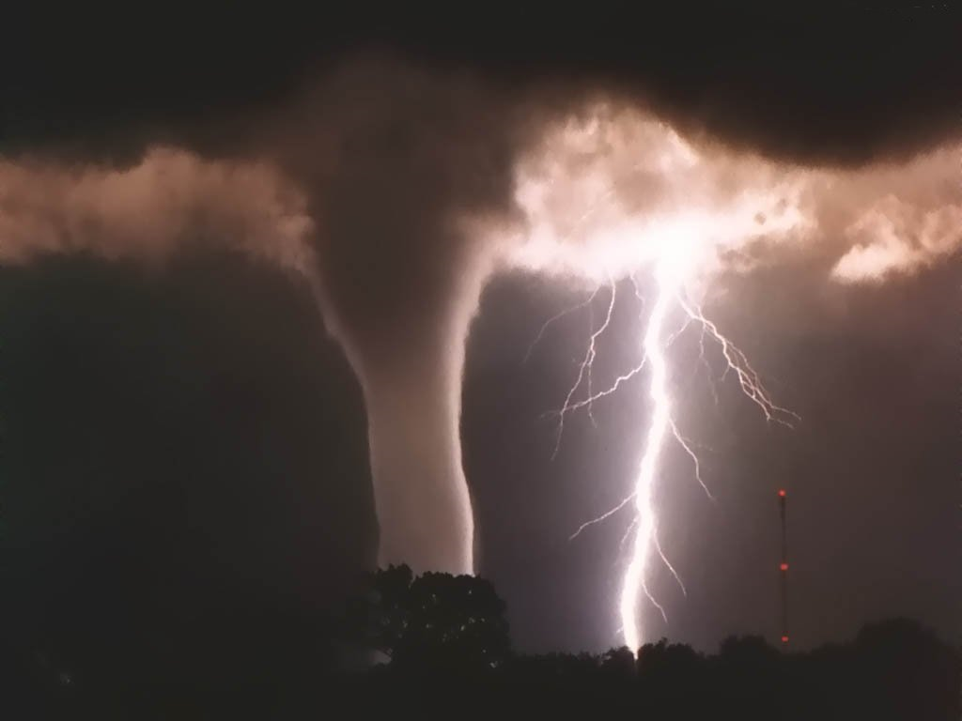
THE END
Notes:
Los Endos!

