Slide 1



The Likely Effects and Impacts of a Direct Hit by a Hurricane on Pinellas County and How Prepared is Pinellas County for such a Hit…
Chris Landsea
Science and Operations Officer
National Hurricane Center
LSPAA First Friday Forum
May 6th, 2011
Notes:
1

Slide 2
…”Dang, is it Hurricane Season Again, Already?”
Chris Landsea
Science and Operations Officer
National Hurricane Center
LSPAA First Friday Forum
May 6th, 2011
Notes:
2

Slide 3
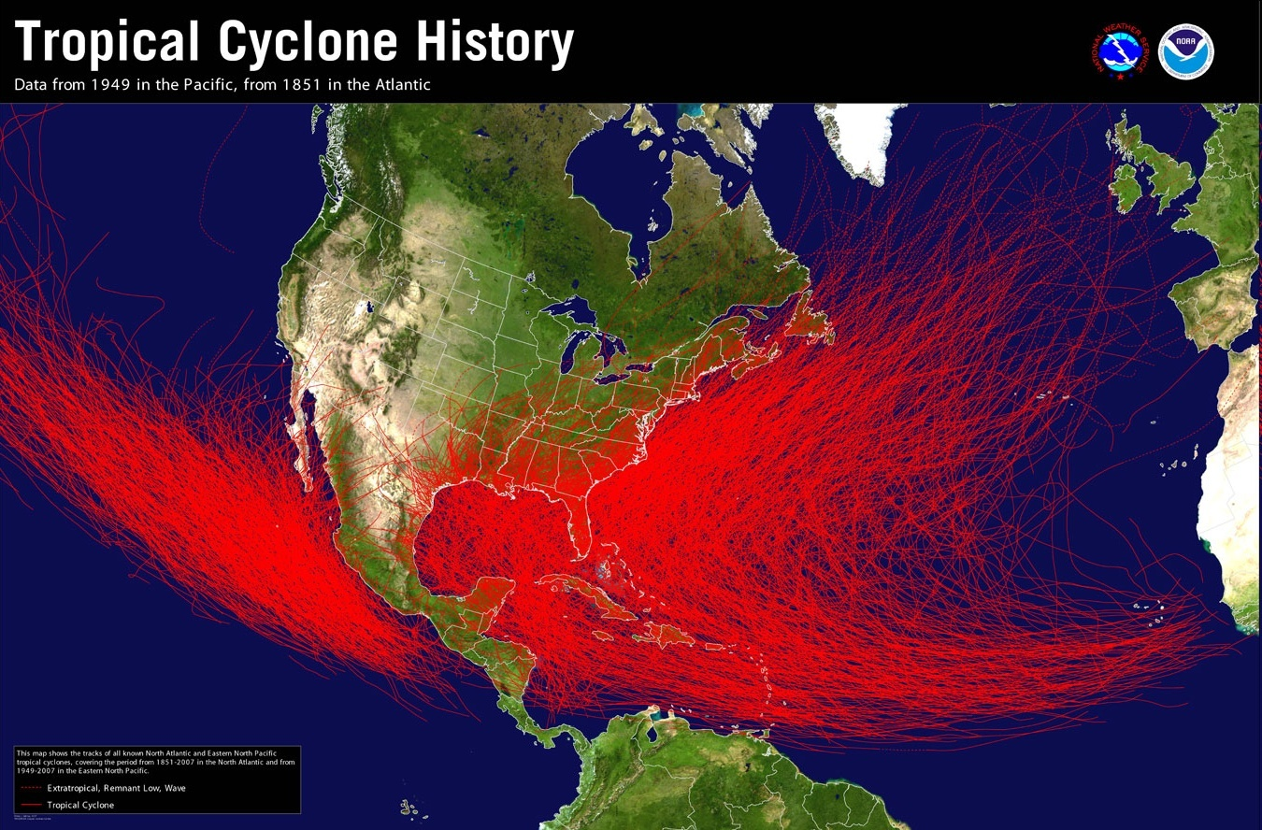

Slide 4
What is a Hurricane?
A type of Tropical Cyclone
Closed surface circulation
Winds rotate counter-clockwise
Produces organized thunderstorm activity
Tropical Depression
Sustained winds are less than 39 mph
Tropical Storm
Sustained winds are between 39-73 mph
Hurricane
Sustained winds are 74 mph or greater
Notes:
4

Slide 5
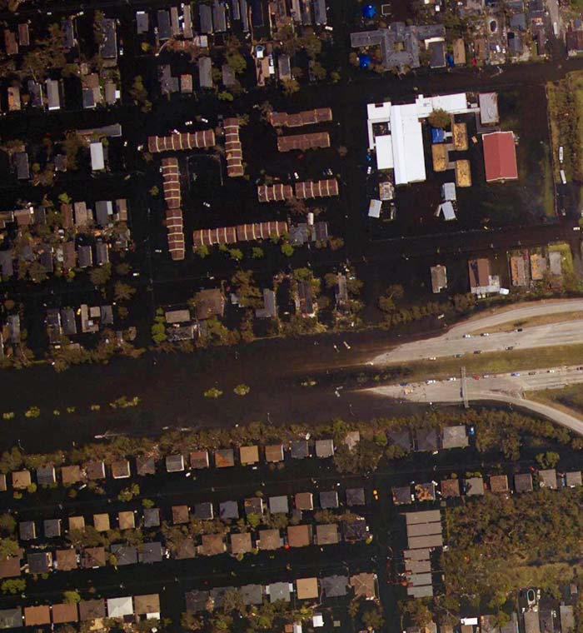
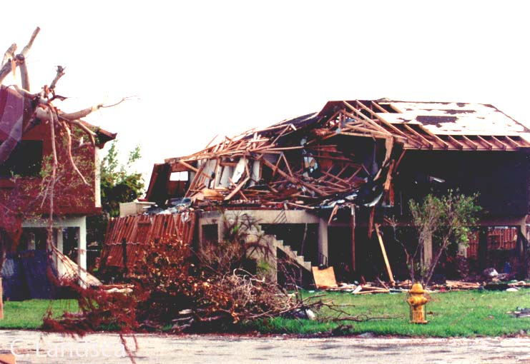

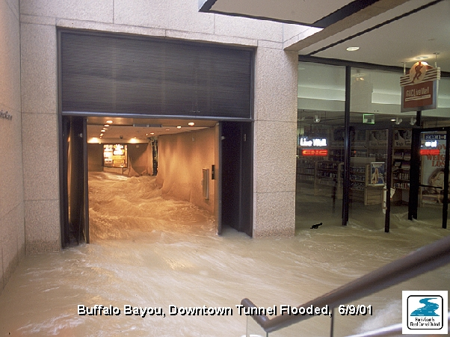
Wind-caused Damage
Storm Surge
Tornadoes
Inland Flooding

Slide 6

Before Katrina…
David & Kimberly King Waveland, MS
Notes:
6

Slide 7
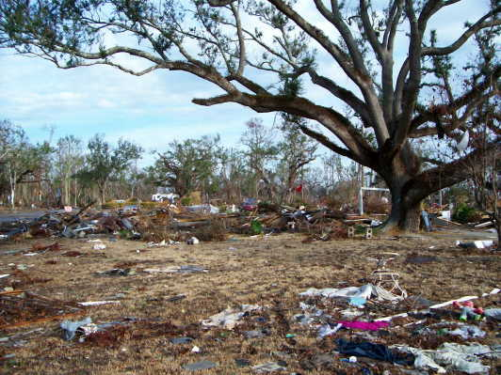
…After Katrina
David & Kimberly King Waveland, MS
Notes:
7

Slide 8
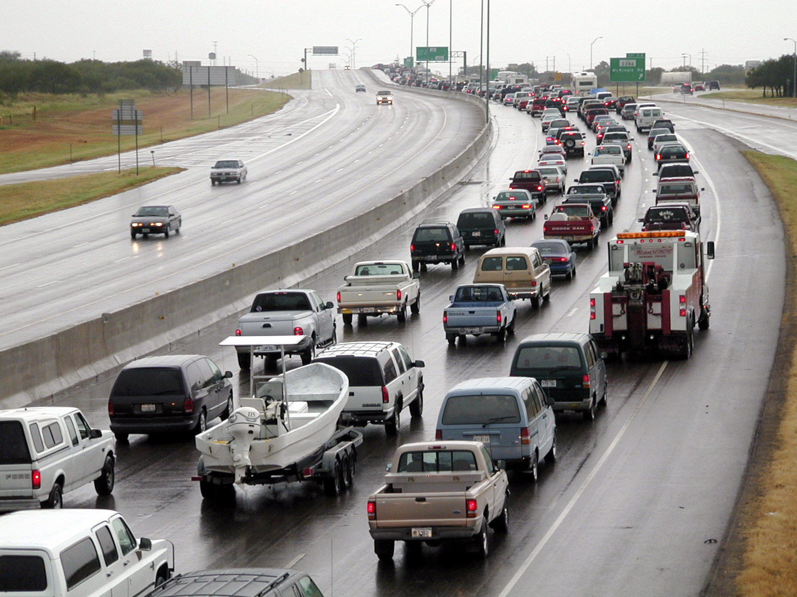
Notes:
This is the NOAA dork logo…

Slide 9
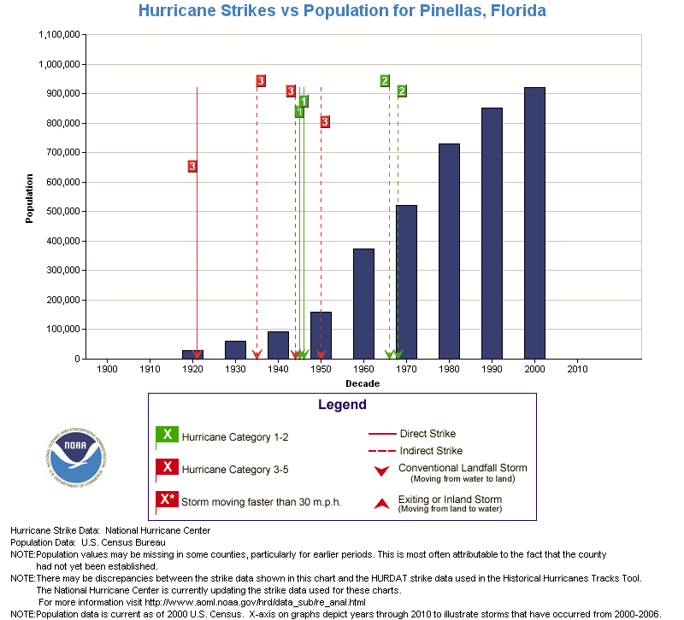
Notes:
This is the NOAA dork logo…

Slide 10
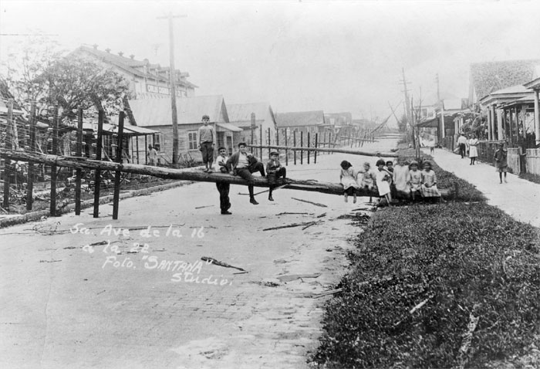
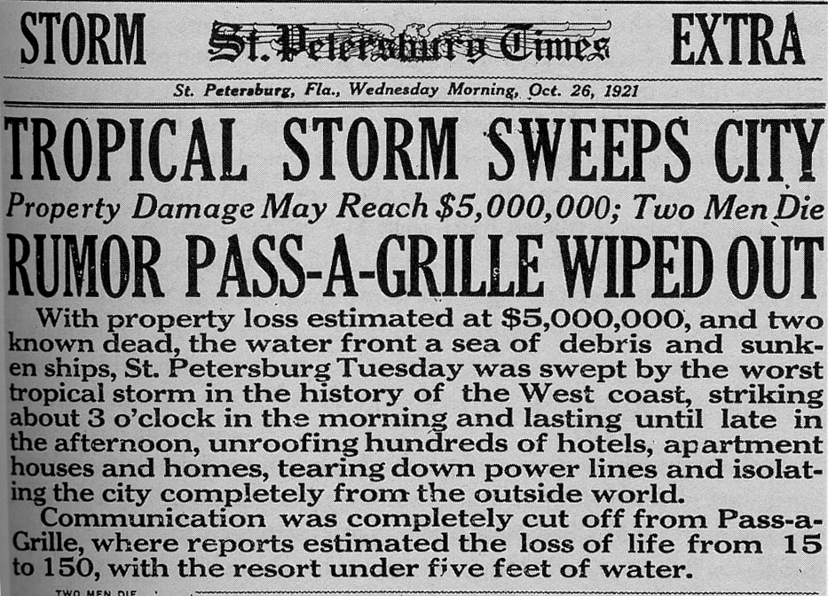
1921 Tampa Bay Hurricane
120 mph Winds
$3 Million in 1921 >>> $4 Billion today

Slide 11

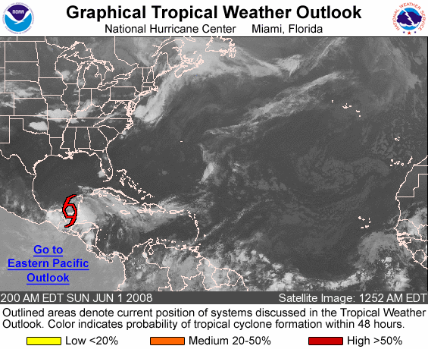
Graphical Tropical Weather Outlook
became operational in 2009
will provide exact chance for formation
  Shows on satellite pictures the current locations of areas of disturbed weather and provides categorical estimates of development potential over the next 48 hours.
Notes:
11

Slide 12
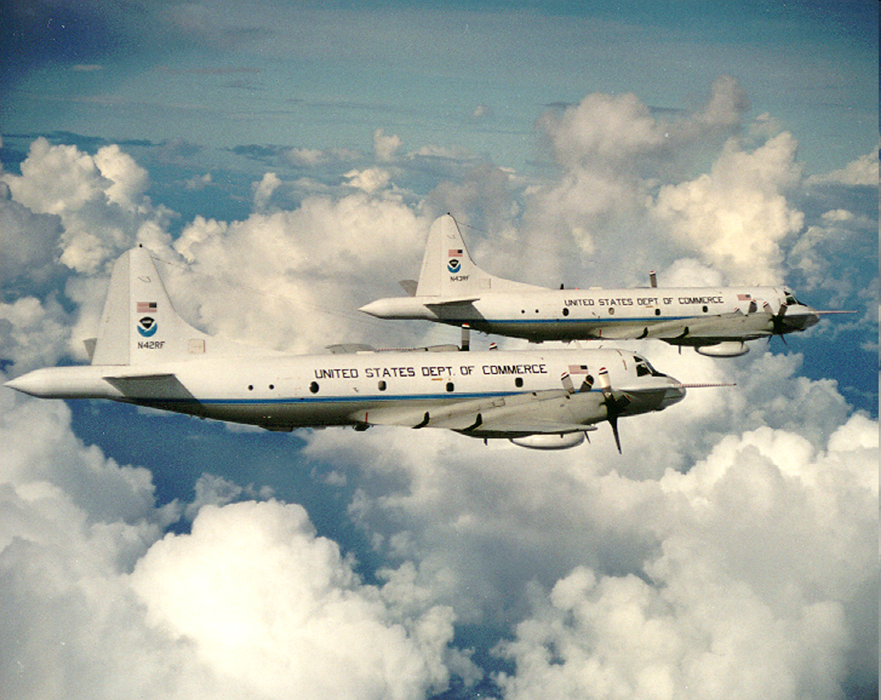
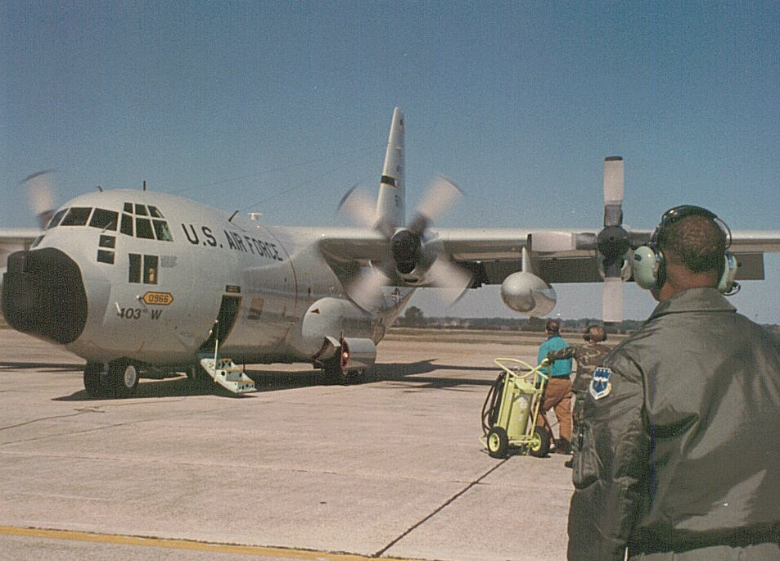
Hurricane Hunters
Two NOAA Orion-P3 Aircraft
Ten Air Force C-130 Aircraft

Slide 13
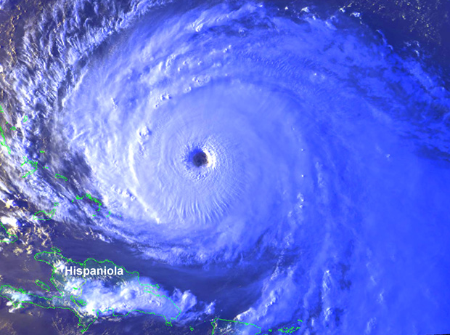
RECONNAISSANCE FLIGHT PATH
Aircraft “ALPHA” Pattern

Slide 14
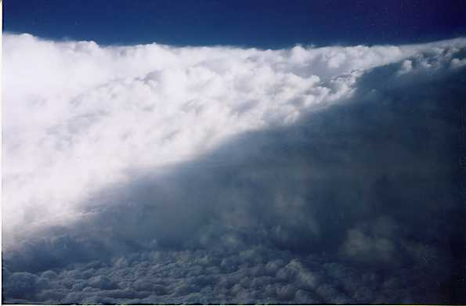
Within the Eye of Hurricane Georges
eyewall
low clouds above
sea-surface

Slide 15
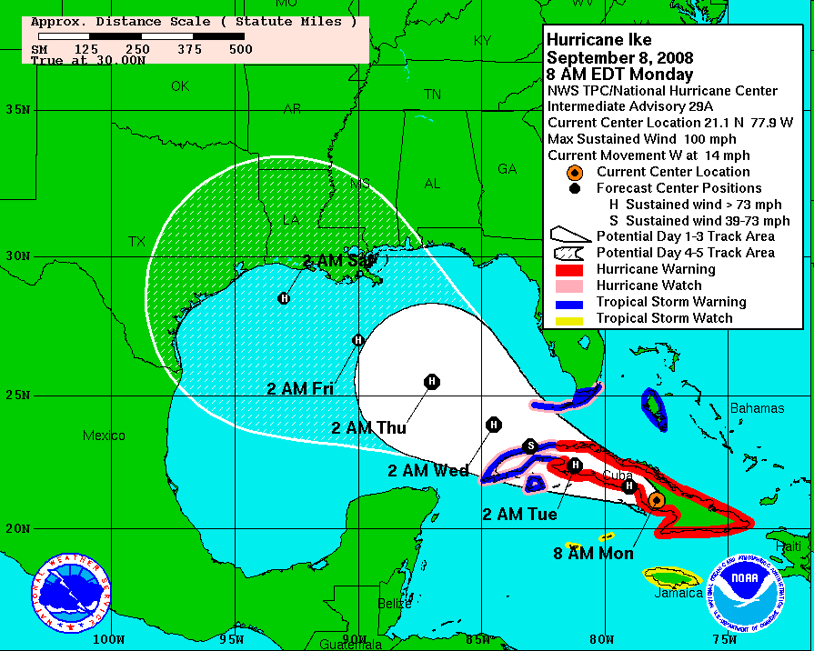
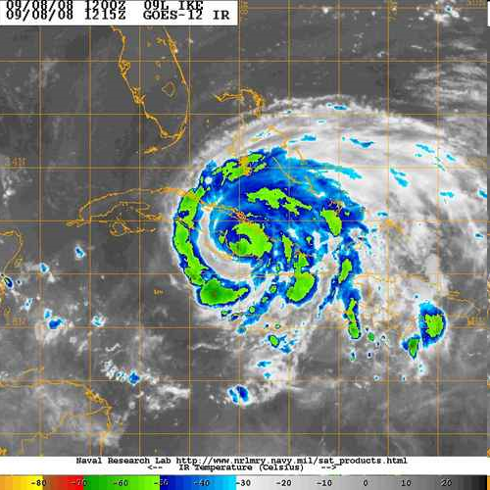
Tropical Cyclone Forecasting

Slide 16
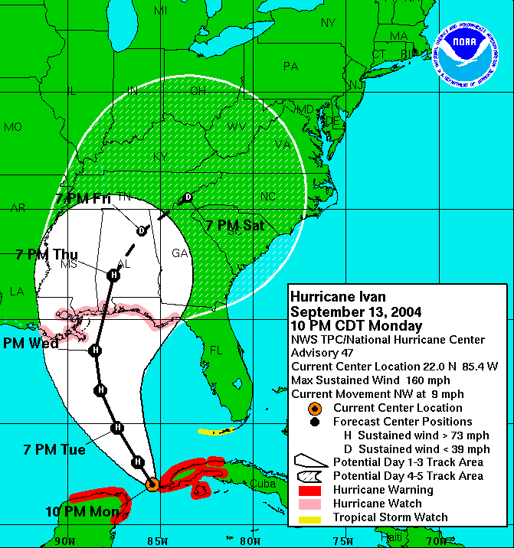
NHC Forecast Cone
Represents the probable track of the center of the tropical cyclone.
Formed by connecting circles centered on each forecast point (at 12, 24, 36 h, etc.)
Size of the circles determined so that, say, the actual storm position at 48 h will be within the 48-h circle 67% of the time.

Slide 17
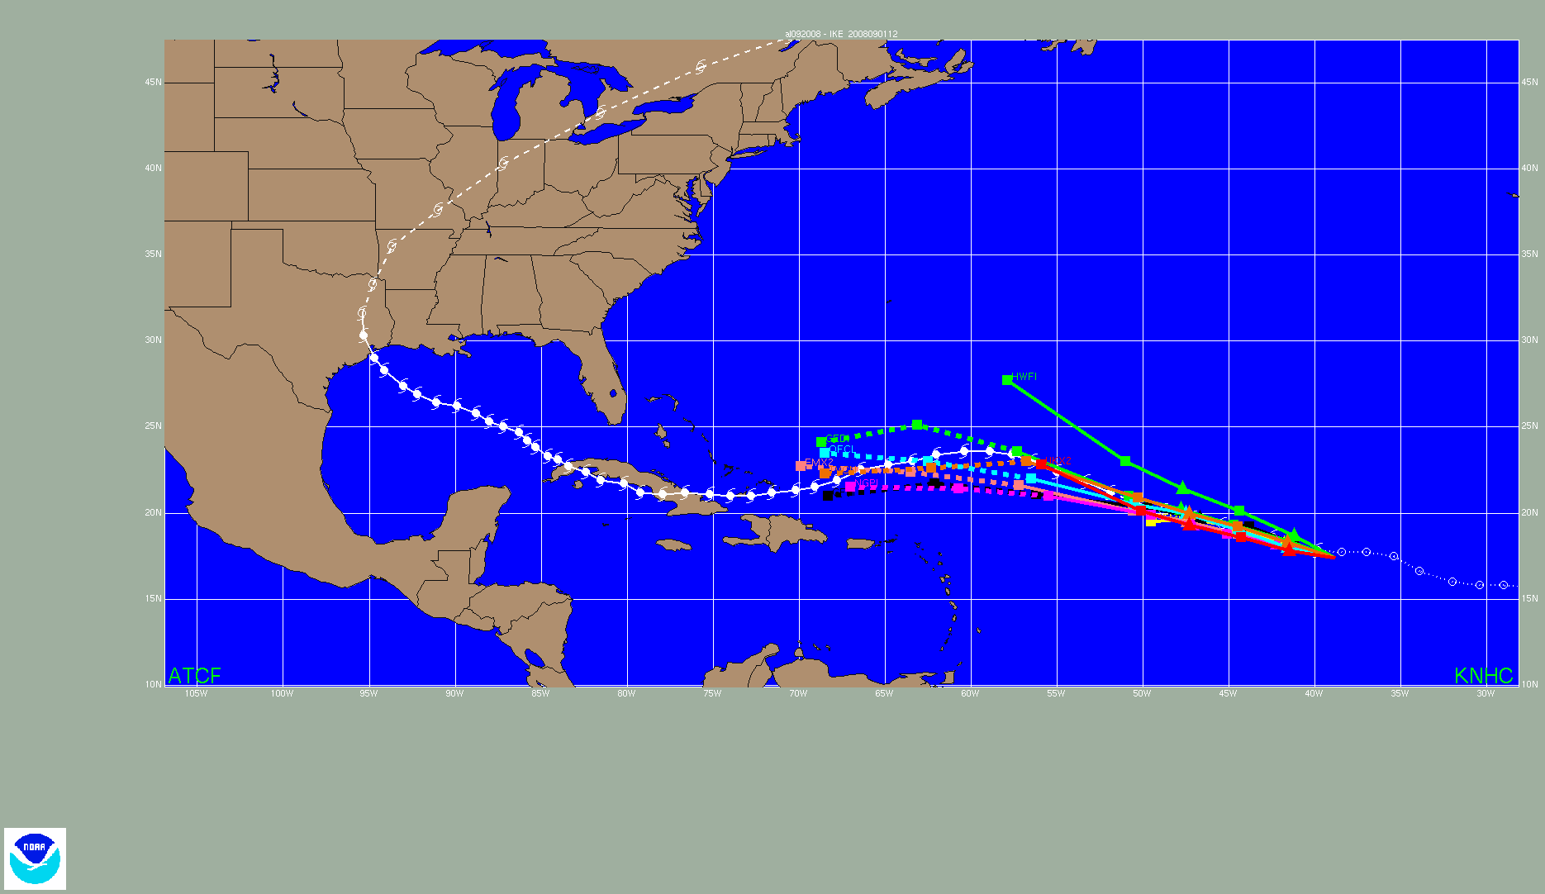
Hurricane Ike Track models
Notes:
Animation of track guidance models for Hurricane Ike.

Slide 18
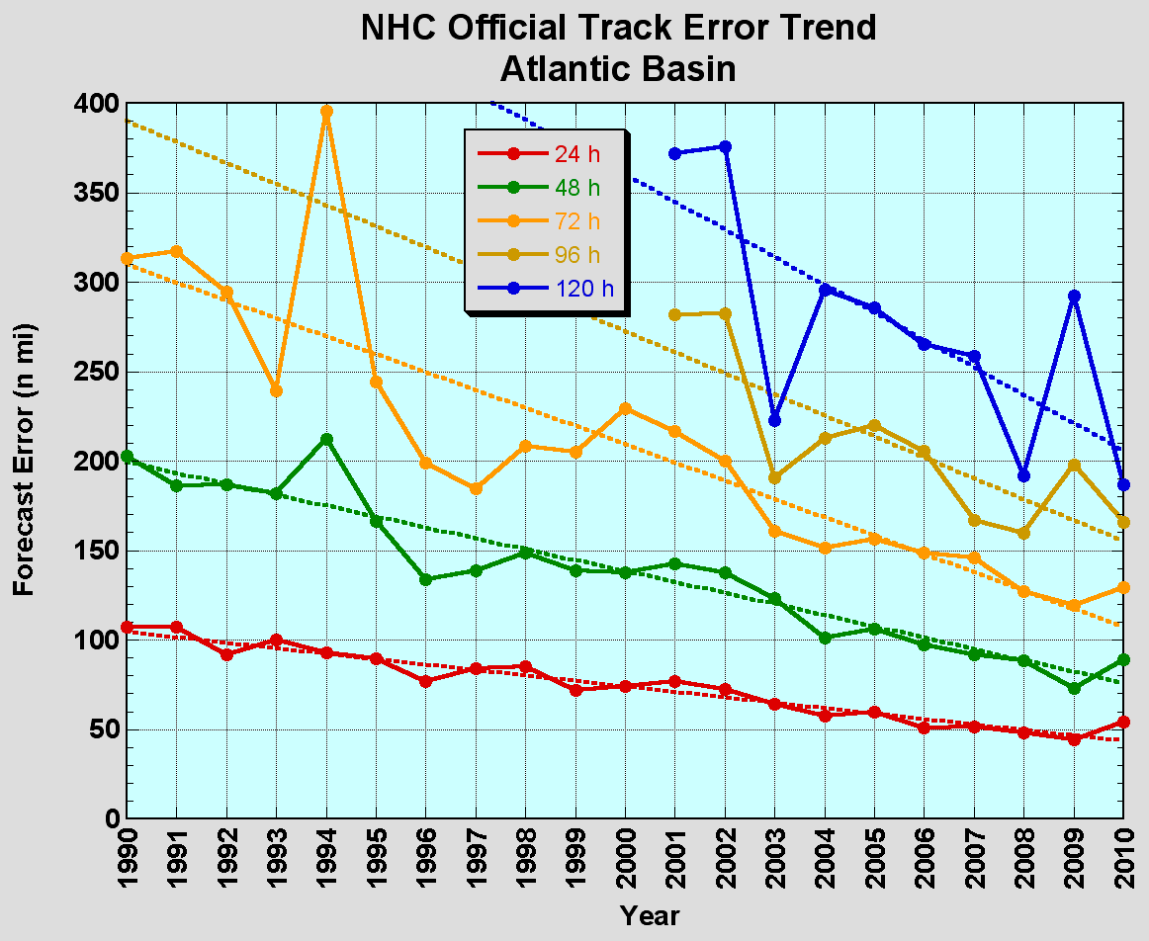
Improvements in Forecast Models and Increased Satellite Data has Led to a Large Reduction in NHC Track Errors
Errors have been cut in half over the past 15 years. 2009 was best year ever.
Notes:
18

Slide 19
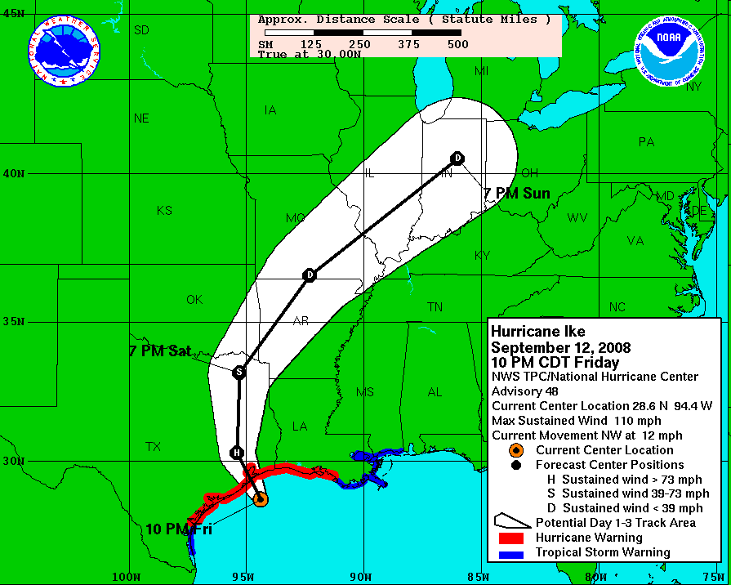
Cone versus
Size & Impact
The Cone DOES NOT denote area of impact….

Slide 20
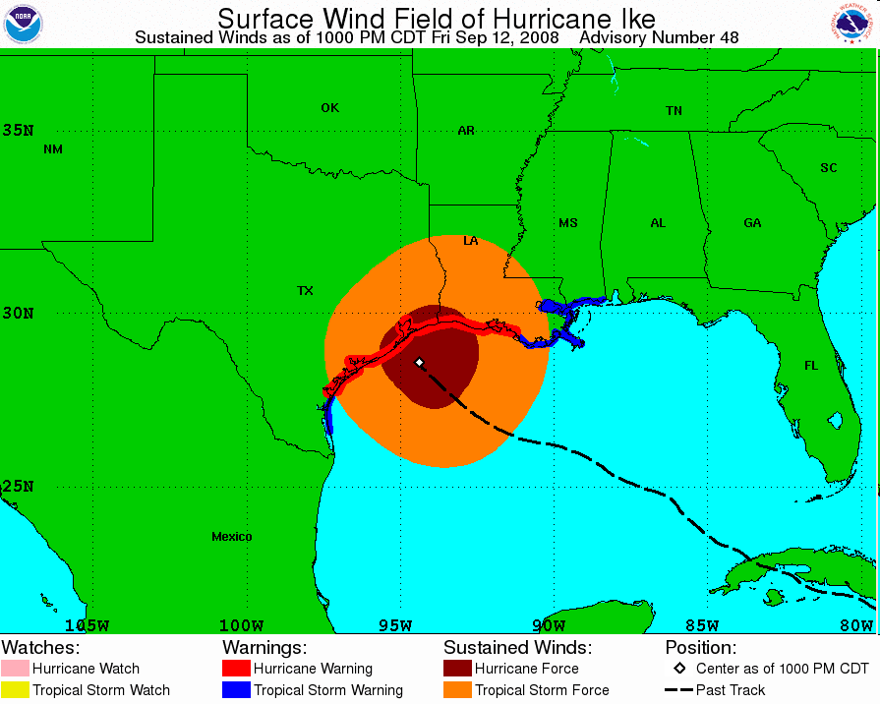
Cone versus
Size & Impact
…as Ike’s hurricane force winds demonstrate

Slide 21
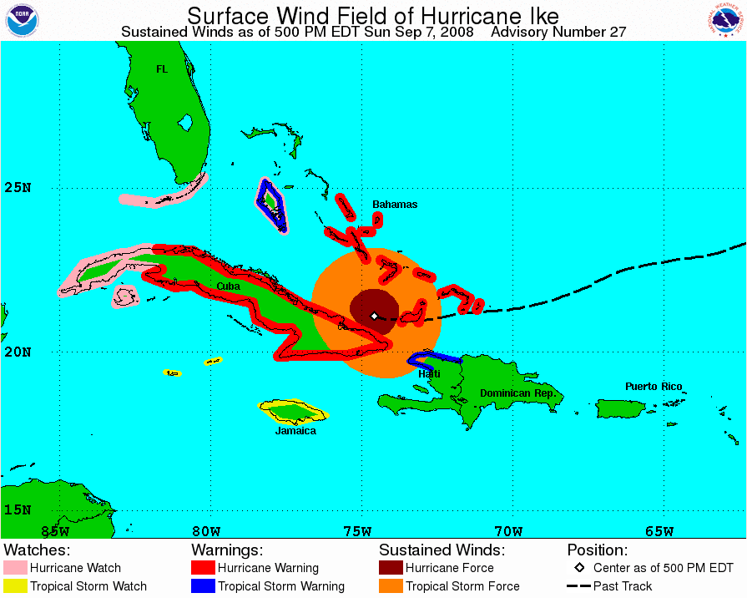
Tropical Cyclone Wind Field
became operational in 2009
Shows:
Wind field
Past track
Current
watches/
warnings

Slide 22
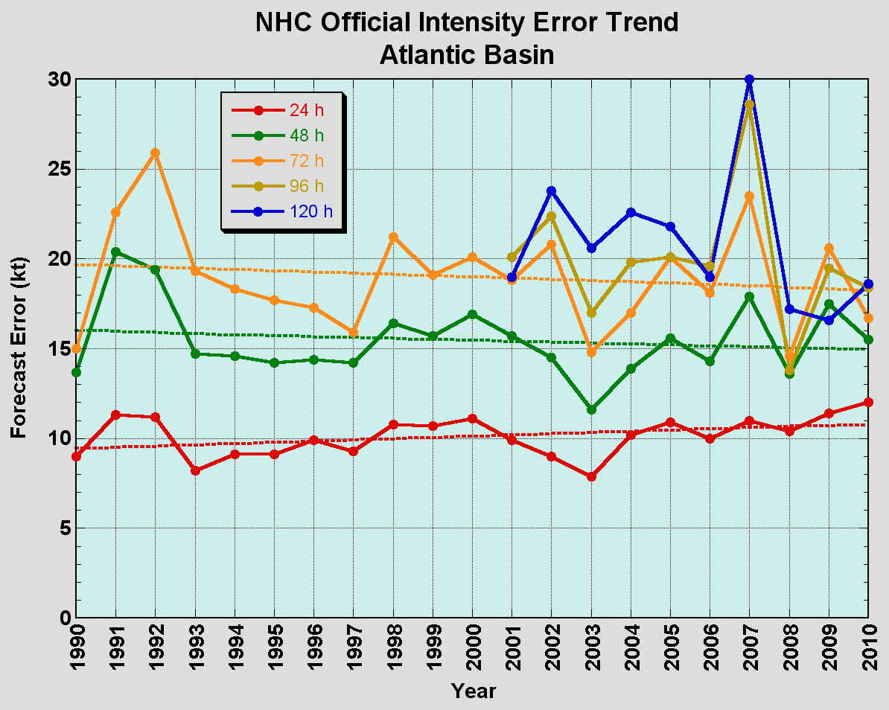
Atlantic Intensity (Wind) Error Trends
No progress with intensity.
24-48 h intensity forecasts are likely to be off by one SSHS category, and off by two SSHS categories perhaps 5-10% of the time.
Notes:
22

Slide 23
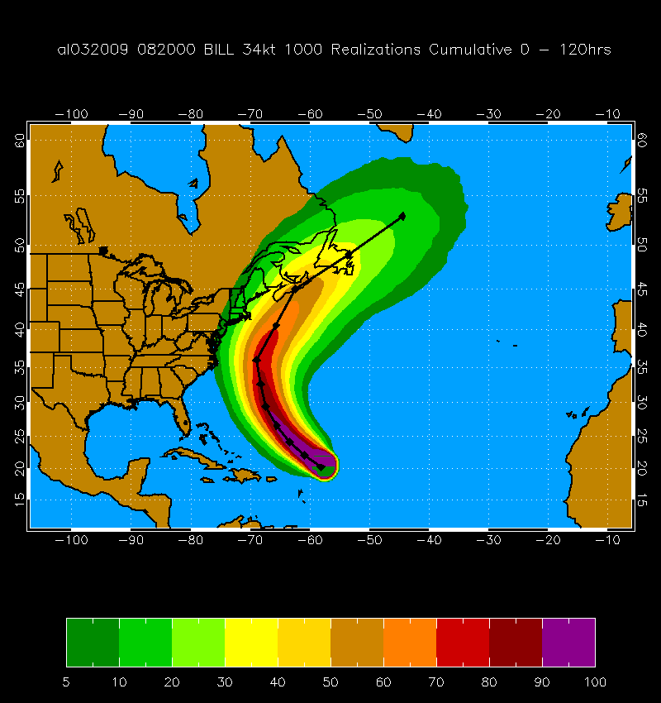
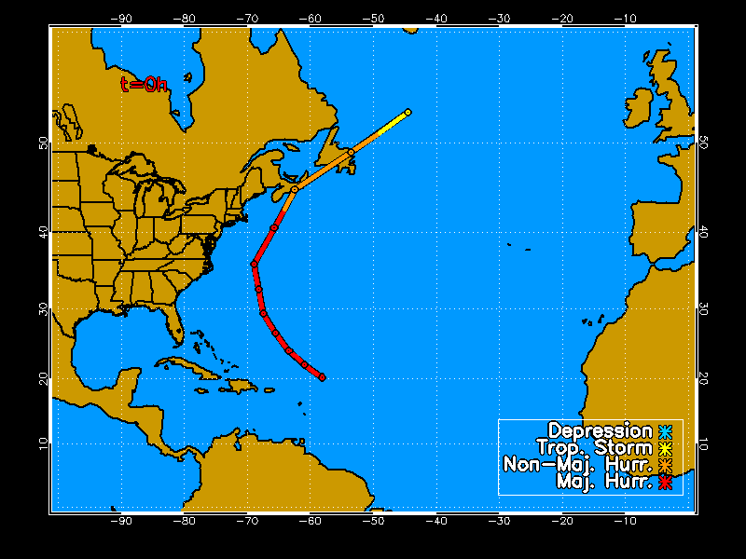
Wind Speed Probabilities
Hurricane Bill 20 Aug 2009 00 UTC
1000 Track Realizations 34 kt 0-120 h Cumulative Probabilities

Slide 24
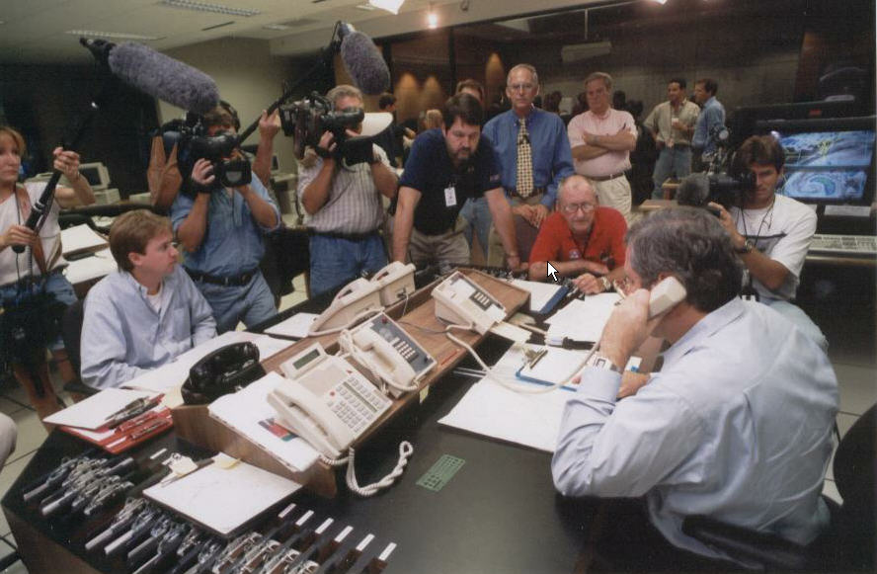
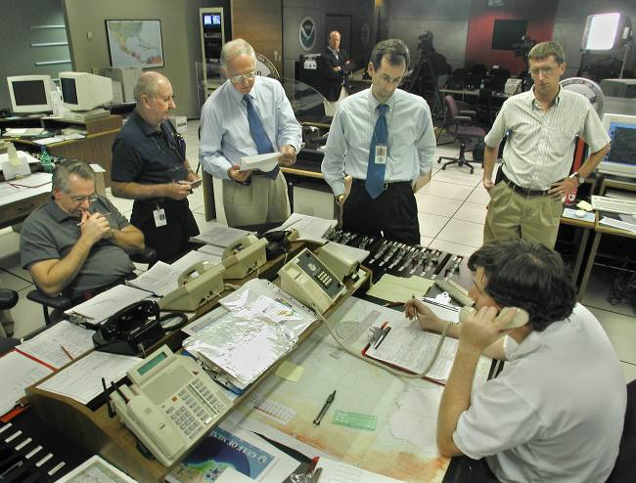
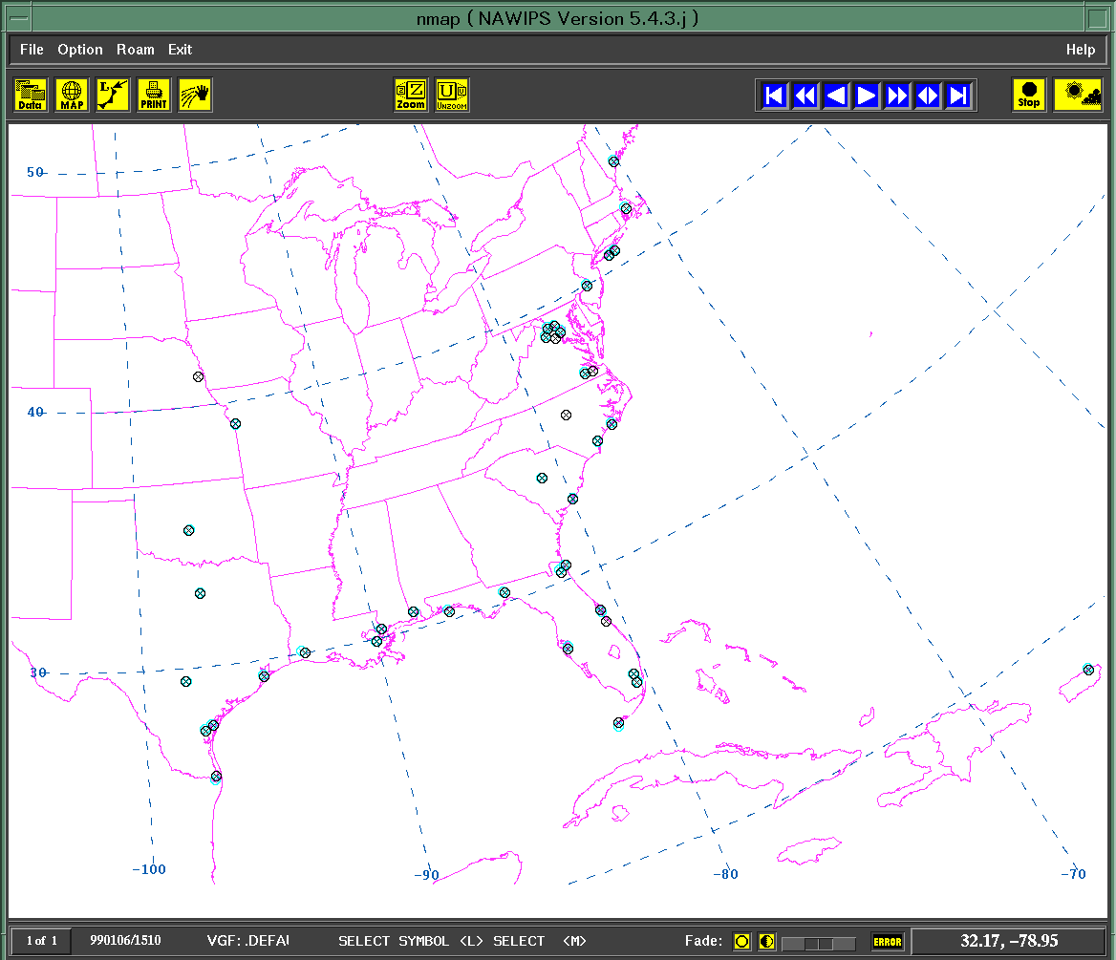
Forecast Coordination
Hurricane Hotline
  Other NWS/NCEP National Centers (HPC, OPC, SPC)
  Local NWS Offices
  DOD
  Other federal agencies
NWS
USAF
USN
Hurricane Hotline Locations
Notes:
24

Slide 25
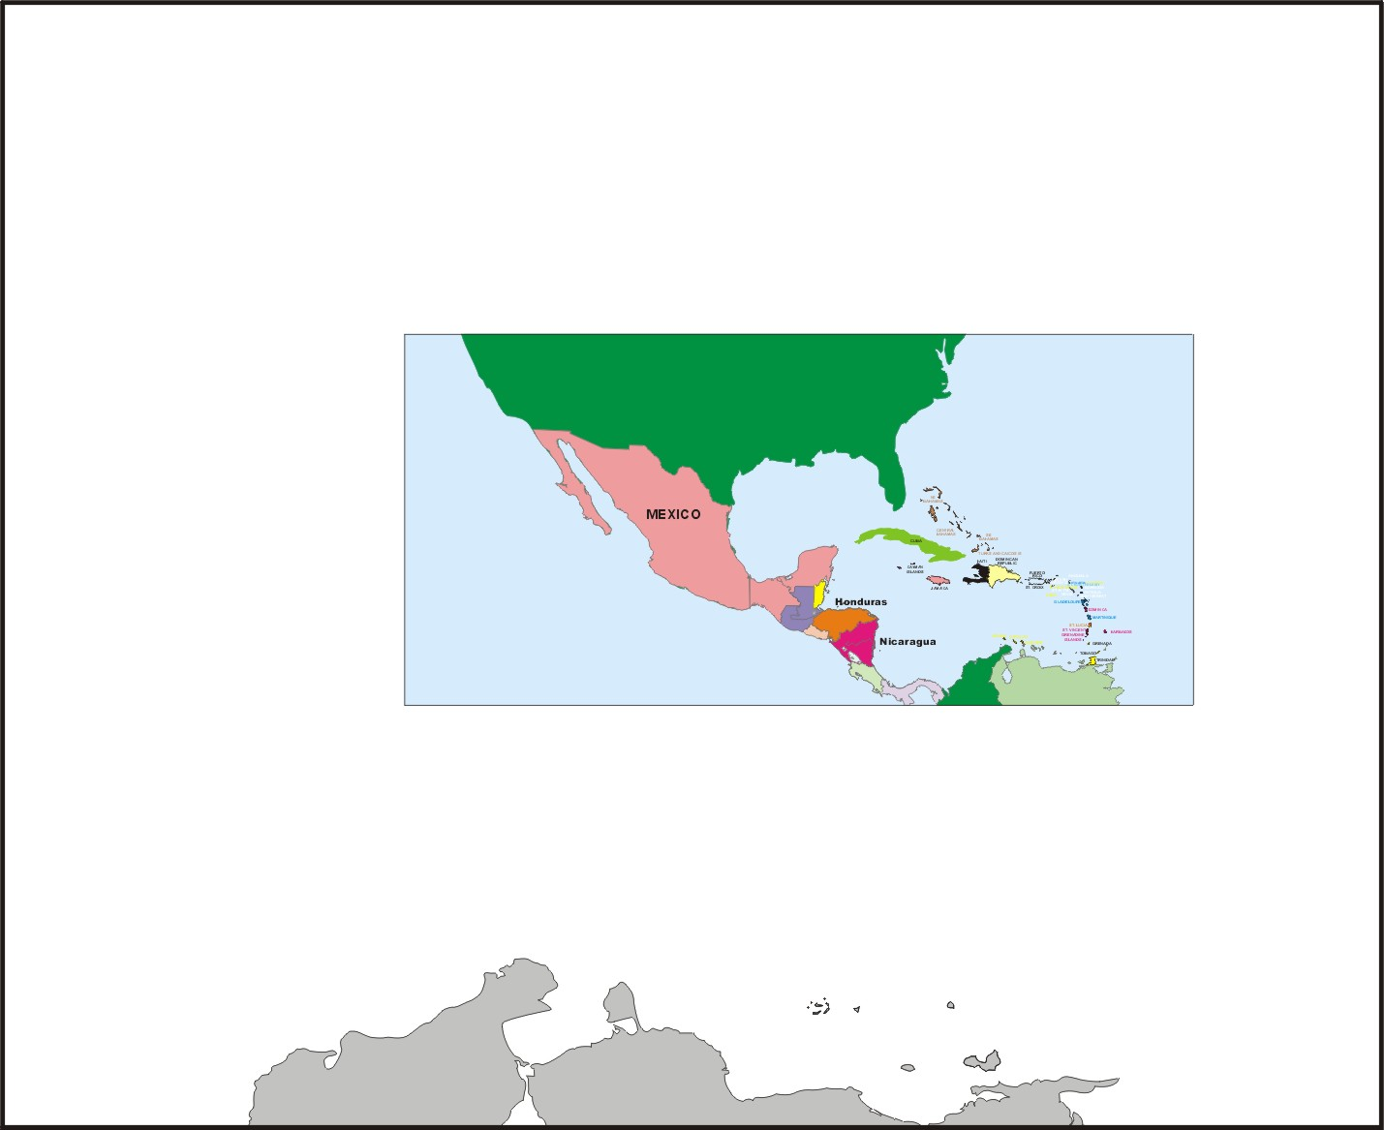
WORLD METEOROLOGICAL ORGANIZATION
Regional Association IV (RA-IV) Coordination
RSMC Miami
RSMC= Regional Specialized Meteorological Center;
RA-IV countries include Caribbean area, Central America, Mexico, Canada, and Bermuda.

Slide 26
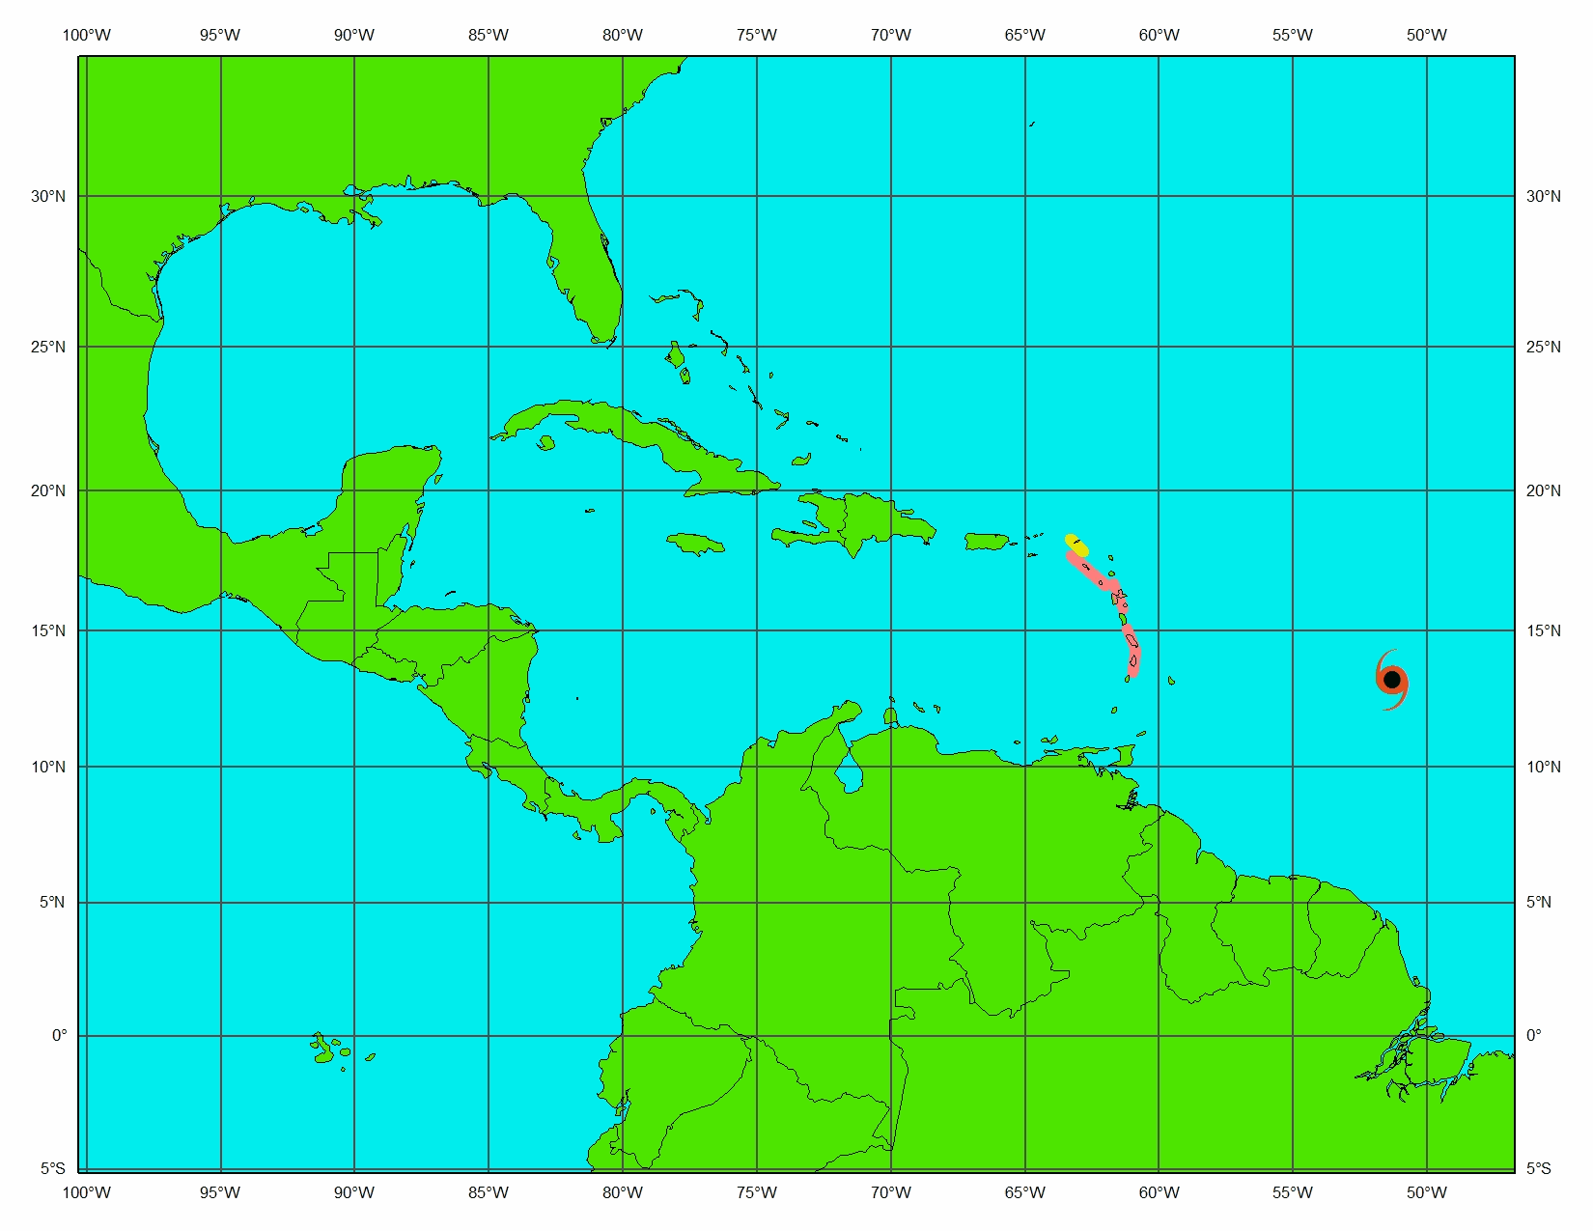
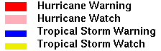
Hurricane Dean watches and warnings

Slide 27
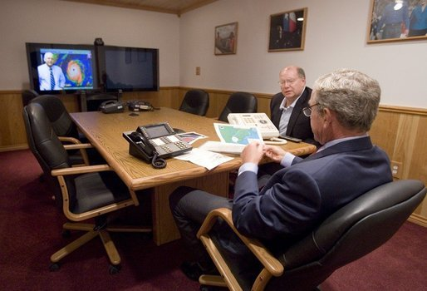
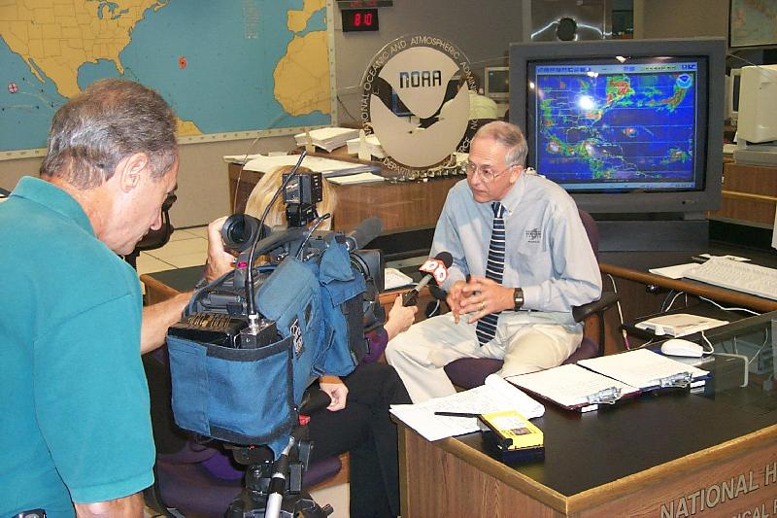
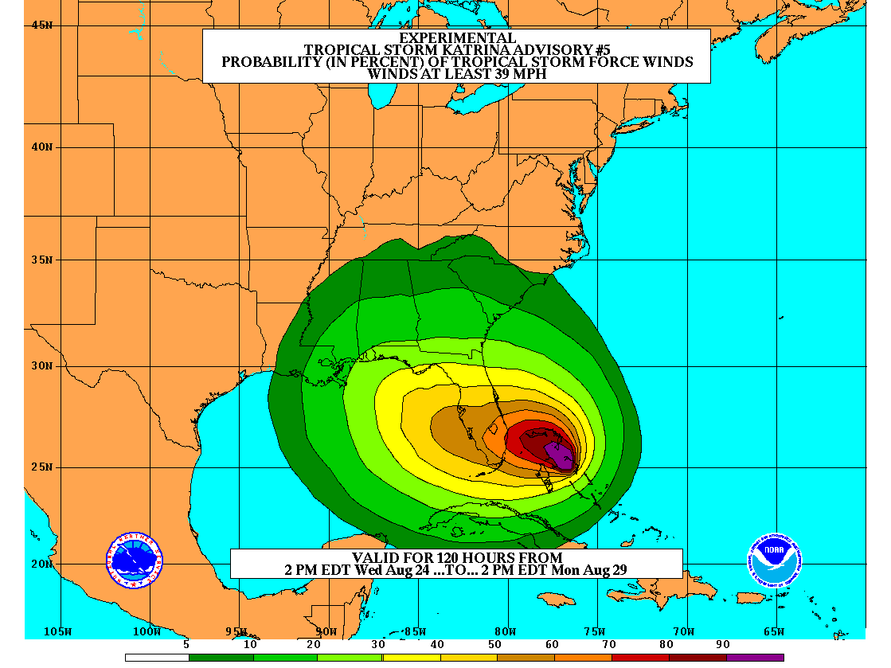
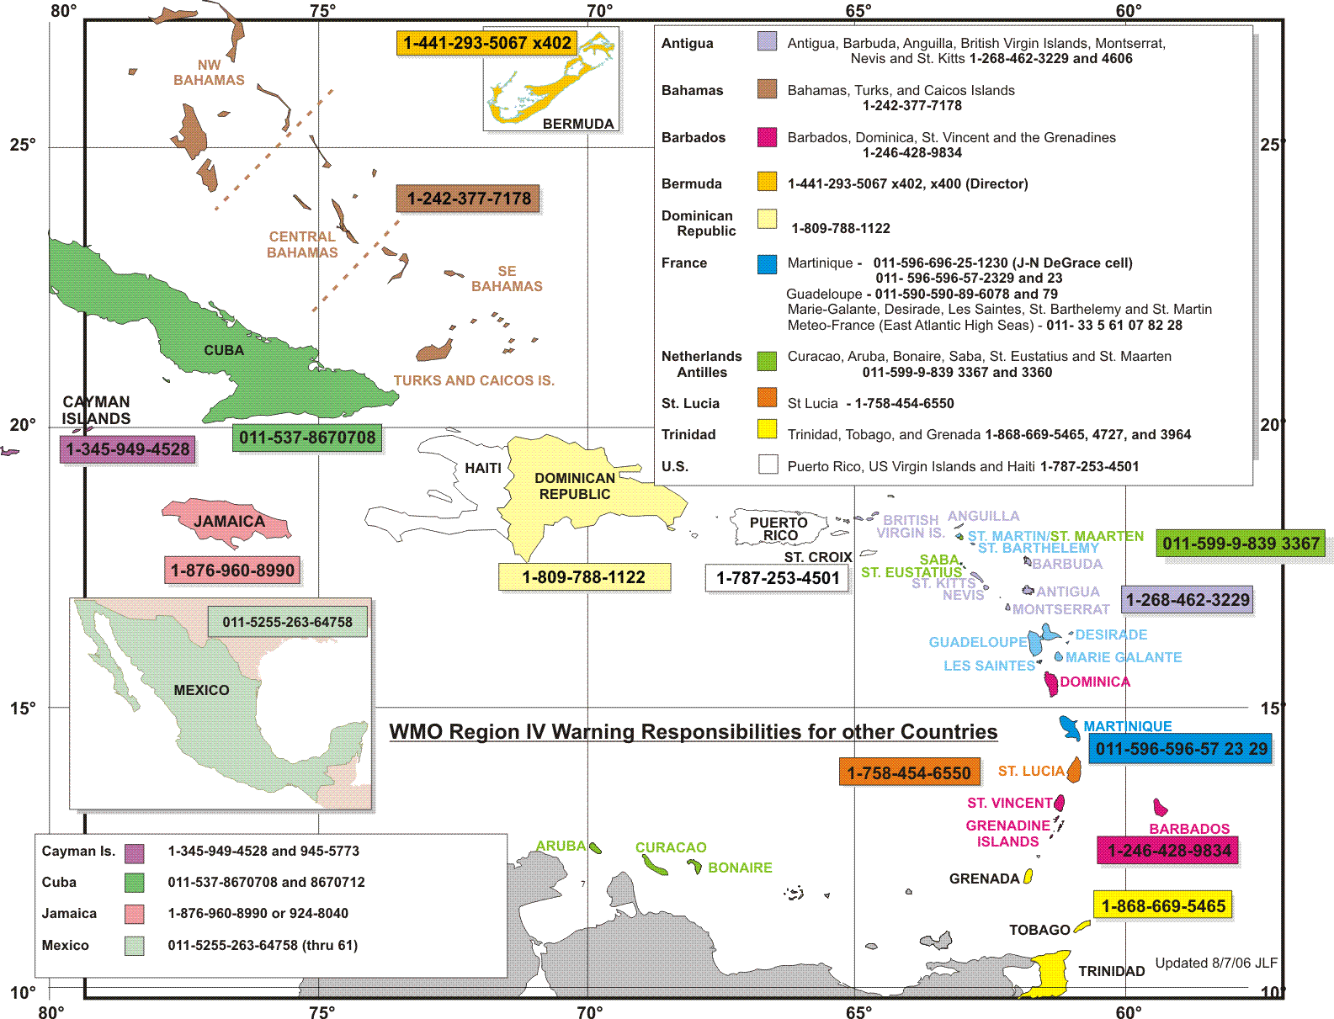
OPERATIONAL COMMUNICATIONS
WITH KEY DECISION-MAKERS
WITH THE MEDIA
White House Photo
President George W. Bush and Deputy Chief of Staff Joe Hagin, center, during a video teleconference with NHC and emergency managers
WITH THE PUBLIC
WITH INTERNATIONAL PARTNERS
Notes:
27

Slide 28
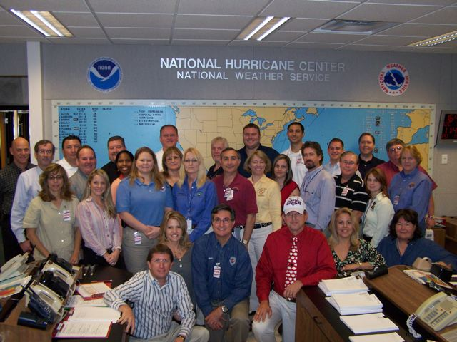
OUTREACH AND EDUCATION
National Hurricane Preparedness Week
FEMA workshop for emergency managers
Hurricane Awareness Tours
National Hurricane Conference (& others)
WMO workshop for international meteorologists
U.S. Interdepartmental Hurricane Conference
Notes:
28

Slide 29
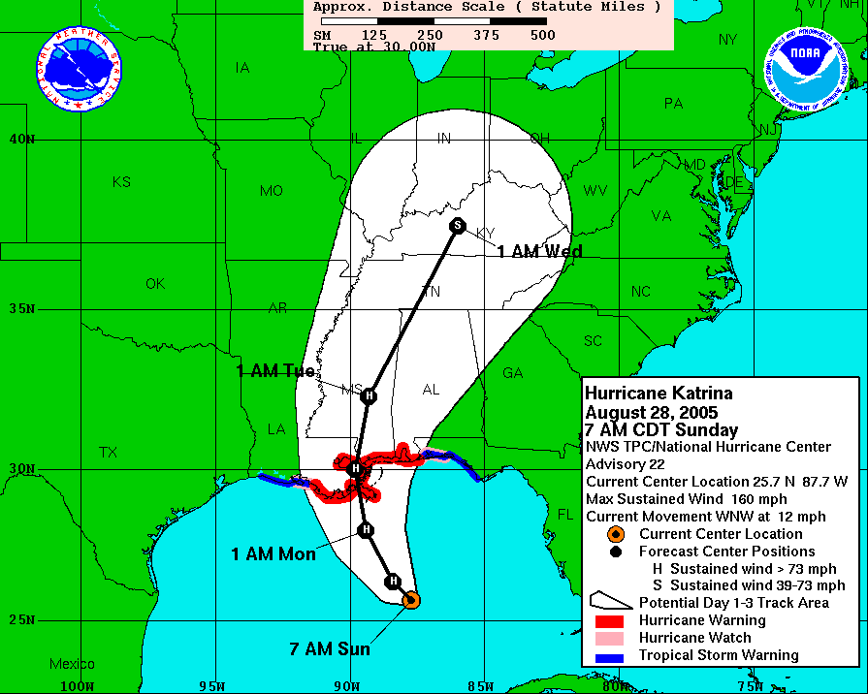
Possible Changes for 2012 and Beyond
7 Day Track and Intensity Forecasts
  Testing in 2011
Track, Intensity and Size Forecasts BEFORE Genesis
  Testing in 2011
Five Day Genesis Forecasts
  Testing in 2009-2011
Storm Surge Warnings
  Testing in 2012
Coastal County Population,
Texas to Maine
53% of the U.S. population now lives within 50 miles of the coast
Population
Year
Evacuation decisions in many cases must
be made more than 24 h before landfall
H
H
Storm Surge Warning

Slide 30
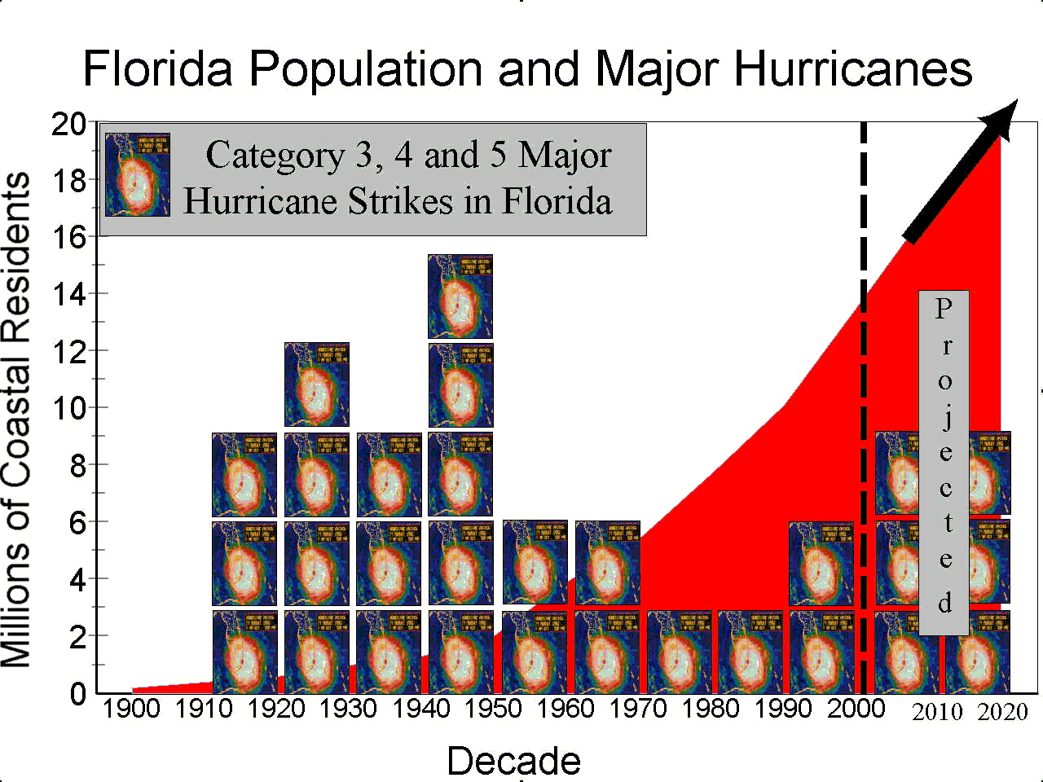

Slide 31
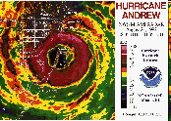
Five Major Landfalling Hurricanes in Florida – 2000-2009
Notes:
31

Slide 32
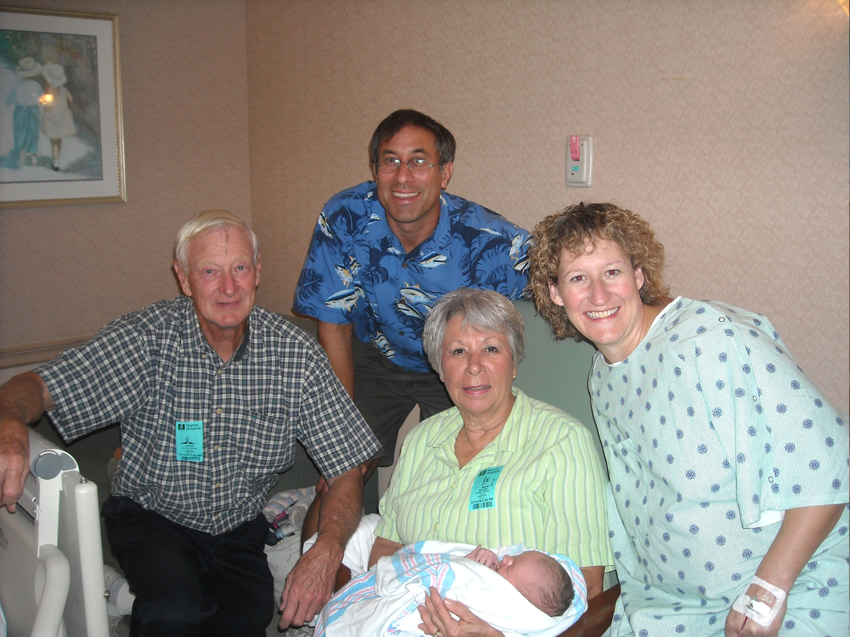

Slide 33
…”Dang, is it Hurricane Season Again, Already?”
Chris Landsea
Science and Operations Officer
National Hurricane Center
LSPAA First Friday Forum
May 6th, 2011
Notes:
33

Slide 34


NOAA’s 2010 Atlantic Hurricane Outlook
Season and May 2010 Aug 2010 Observed
Activity Type Outlook Outlook Activity Climatology
Chance Above Normal 85% 90% Very Busy! 33%
Chance Near Normal 10% 10% 33%
Chance Below Normal 5% 0% 33%
Named Storms 14-23 14-20 19 11
Hurricanes 8-14 8-12 12 6
Major Hurricanes 3-7 4-6 5 2
ACE % of Median 155-270% 170-260% 190% 100%
Notes:
34
34
117% of the median is generally above average, while

Slide 35
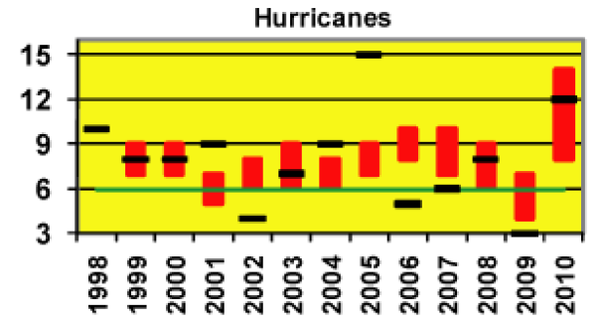
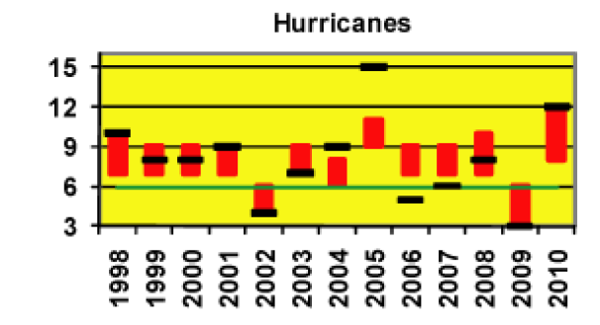
May Forecast -
May Forecast -
NOAA Seasonal Outlook
Caveats:
1) Forecasts only modestly skillful;
2) Says nothing about US landfalls
August Forecast -

Slide 36
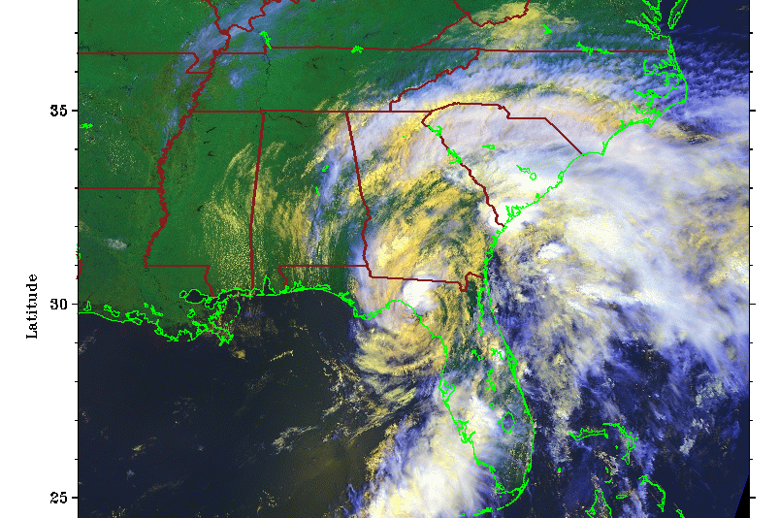
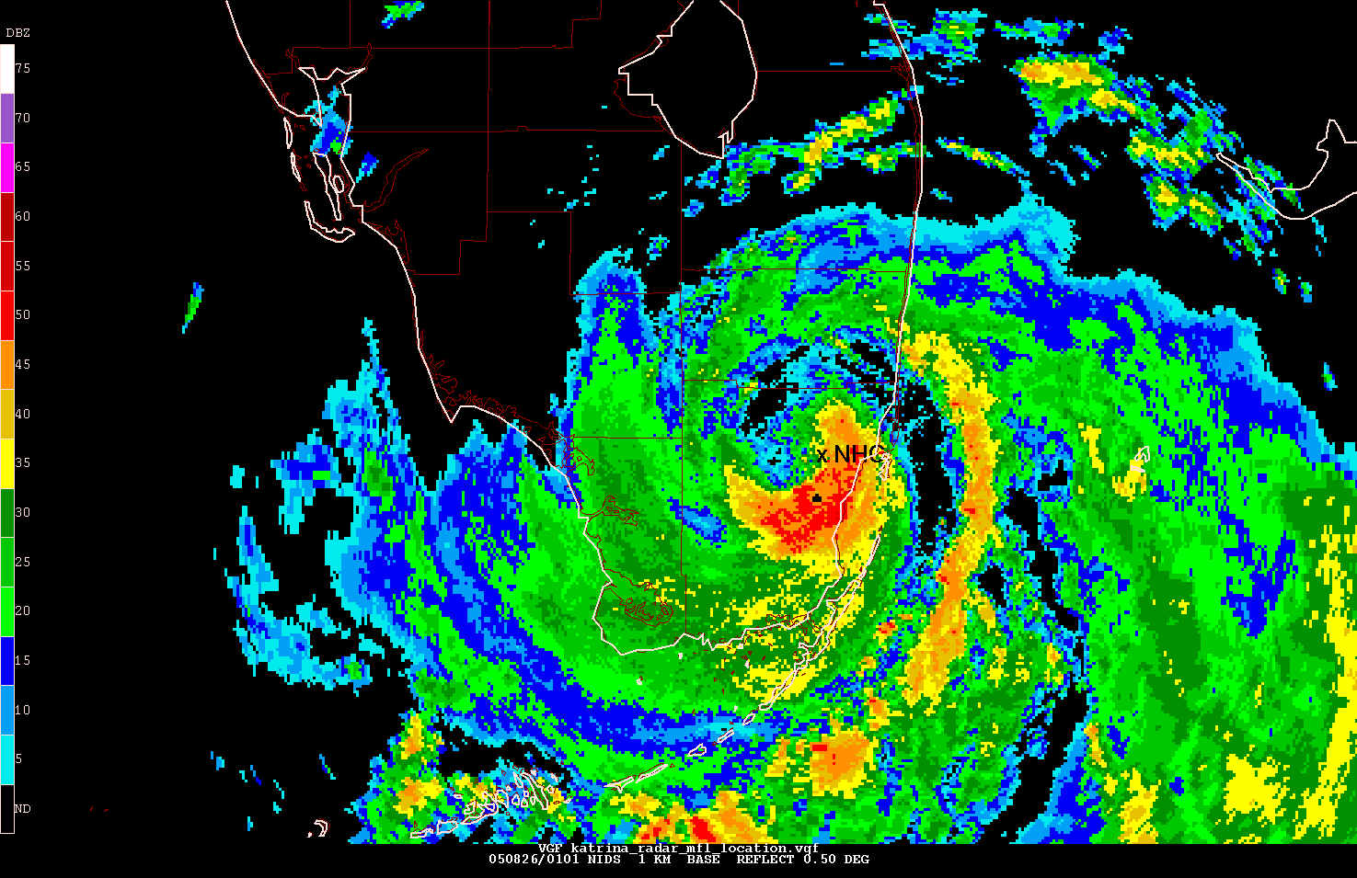
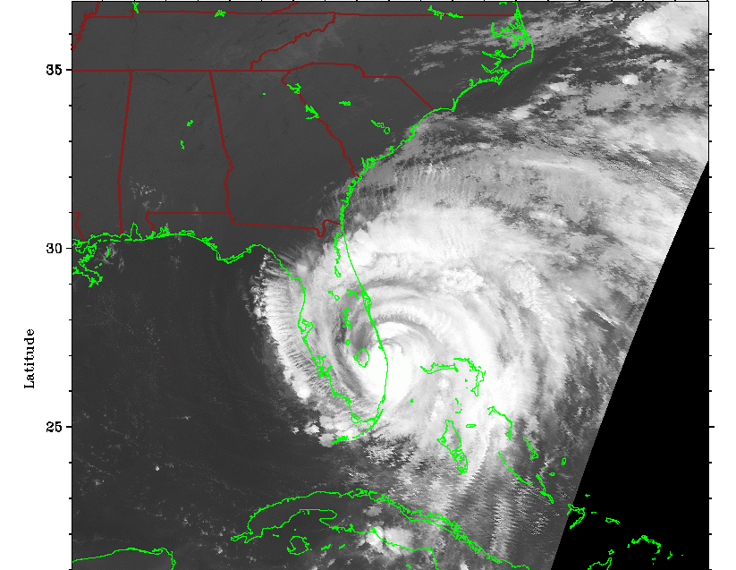
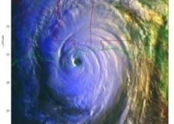
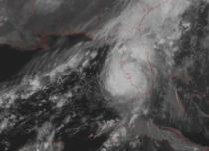
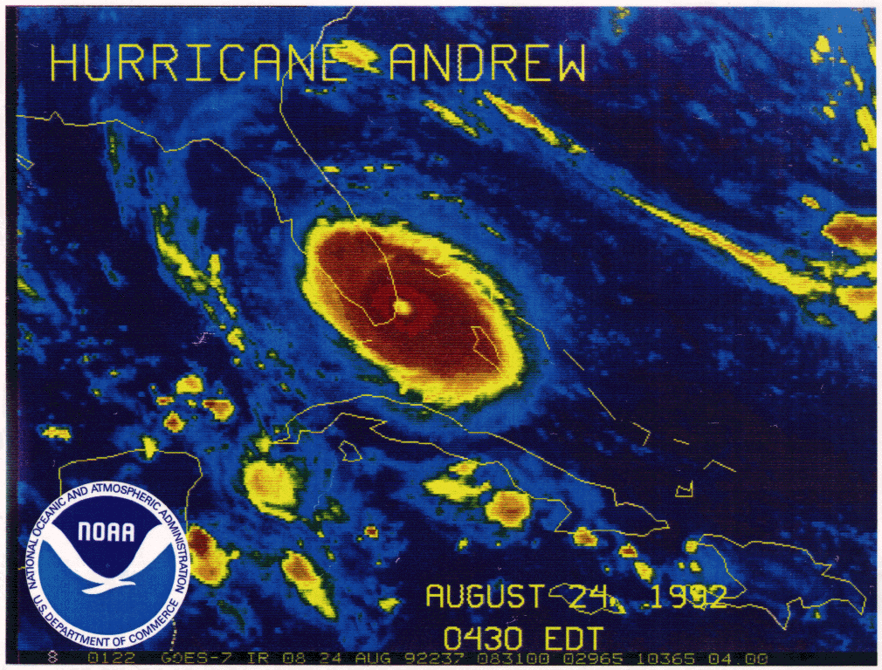
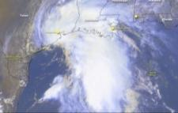
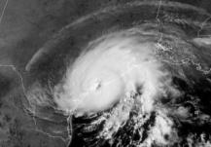




Saffir-Simpson Hurricane Scale
Categorizes hurricanes by wind speed
MAJOR HURRICANES
Tropical Storm | Category 1 | Category 2 | Category 3 | Category 4 | Category 5
39-73 mph (34-63 kt) | 74-95mph (64-82 kt) | 96-110 mph (83-95 kt) | 111-130 mph (96-113 kt) | 131-155 mph (114-135 kt) | > 155 mph (> 136 kt)
Alberto (2006) | Katrina (FL - 2005) | Frances (2004) | Katrina (LA - 2005) | Charley (2004) | Andrew (1992)
Allison (2001) | Claudette (2003) | Isabel (2003) | Wilma (FL- 2005) | Hugo (1989) | Camille (1969)
Notes:
36

Slide 37


Saffir-Simpson Hurricane Wind Scale
Surge, rainfall, and pressure fit the scale
like a square peg in a round hole
http://www.nhc.noaa.gov/aboutsshs.shtml
KATRINA (3)
IKE (2)
CHARLEY (4)
Notes:
37

Slide 38


Storm Surge Probability
became operational in 2009
available in 1-ft increments from 2 to 25 ft
run when a Hurricane Watch or Warning is in effect
Chance of surge > 2 ft
Chance of surge > 10 ft

Slide 39




Lots of problems with dynamical guidance for predicting intensity change

Slide 40




Wind Speed Probabilities
Shows the chance of a particular event occurring at a specific location

