Slide 1
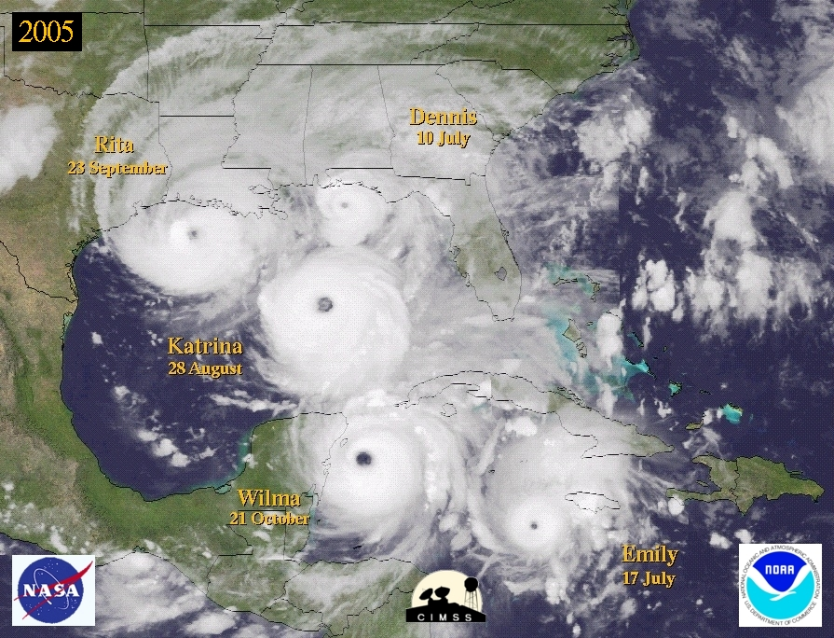
The Hurricane Database Reanalysis Project:
Revisiting Historic Hurricane
23 February, 2011
WFO Ruskin
Chris Landsea, National Hurricane Center, Miami
Many collaborators: Craig Anderson, Noel Charles, Gil Clark, Jason Dunion, Jose Fernandez-Partagas, Paul Hungerford, Charlie Neumann, Mark Zimmer, David Glenn, William Bredemeyer, Mike Chenoweth, Ryan Ellis, John Gamache, Lyle Hufstetler, Cary Mock, Donna Thomas, Lenworth Woolcock, Adrian Santiago, Cristina Carrasco, Andy Hagen, Donna Strahan, Brian Etherton, Mike Dickinson, Steve Feuer, Ramon Perez Suarez, Ricardo Prieto, and Jorge Sanchez-Sesma
Supported by the NOAA Climate Program Office and the Risk Prediction Initiative, BBSR

Slide 2
HURDAT
The National Hurricane Center maintains and updates annually the North Atlantic Basin’s Hurricane Database (HURDAT)
HURDAT provides from 1851 to 2009 for all tropical storms, subtropical storms, and hurricanes every 6 hours:
Positions (to nearest 0.1 degree latitude/longitude)
Intensity (1 min surface winds to nearest 10 kt from 1851-1885, 5 kt from 1886 onward)
Central pressure (to nearest 1 mb, when observed)
34, 50, and 64 kt wind radii maximum extent since 2004 ( by quadrant, to nearest 5 nmi)

Slide 3
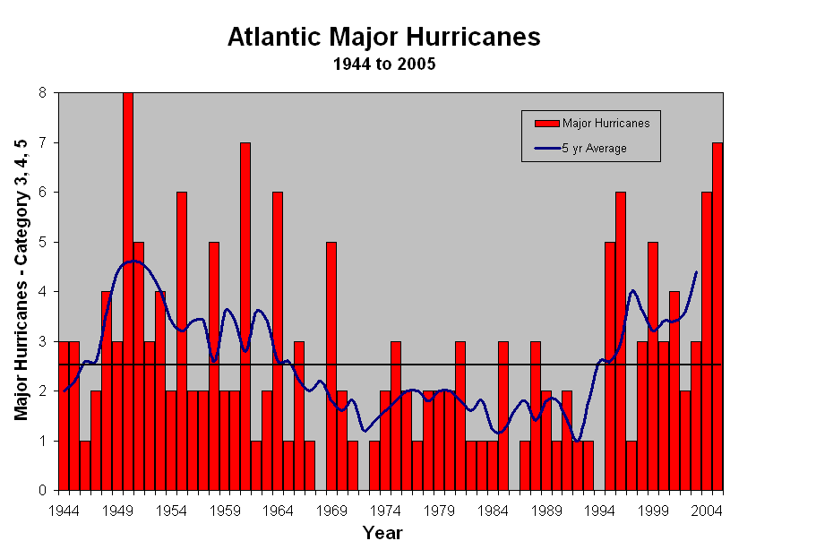
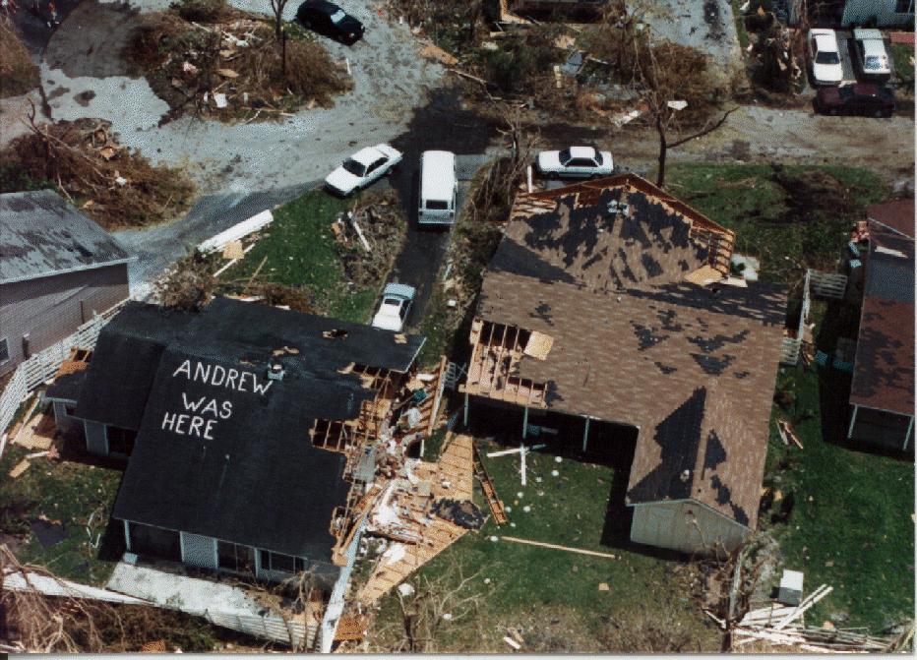
HURDAT applications:
  Validation of official and model predictions
  Climate trend assessment – long term trends, seasonal forecasts, etc.
  Building code standards and insurance rates for coastal communities
  Risk assessment for emergency managers (recurrence intervals)

Slide 4
Why revise HURDAT?
HURDAT contains many systematic and random errors
  1938 Hurricane: Cat 3 at landfall, but 85kts at last offshore position
Missing storms (in real-time)
Lack of exact hurricane landfall parameters
Advances in the understanding of hurricanes and analysis techniques
Bias in early
major hurricanes

Slide 5
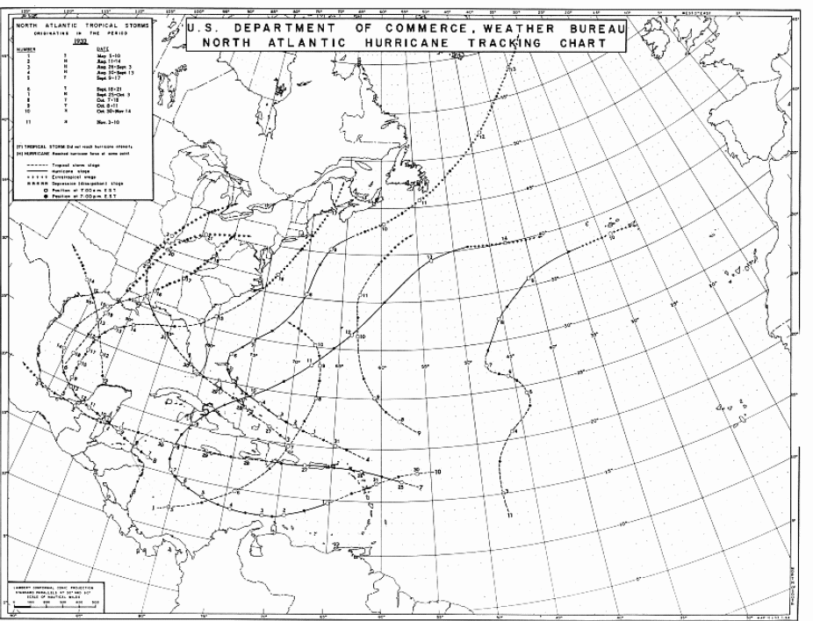
Too Rapid During
Last 6 Hours

Slide 6
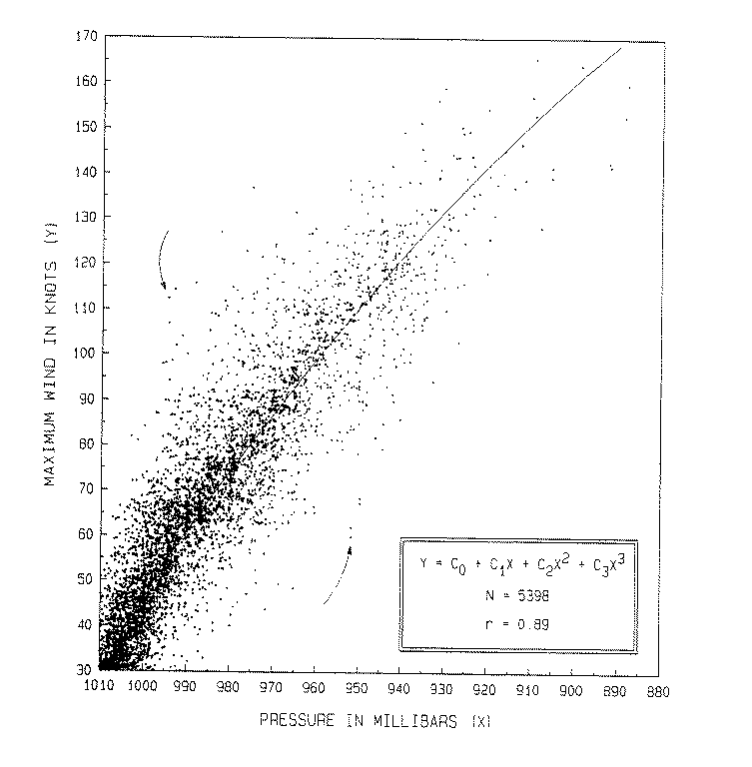
Pressure-Wind
Relationship

Slide 7
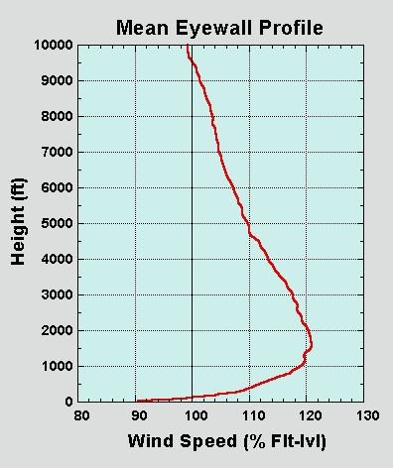
GPS Dropsondes
New understanding of hurricane
wind structure in the vertical
Franklin et al. (2002)

Slide 8
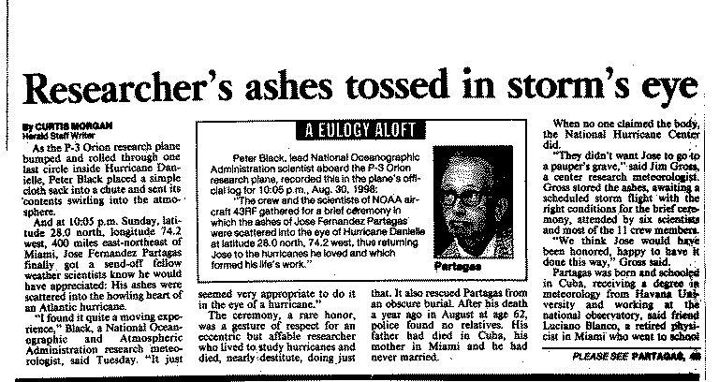
Work of Jose Partagas:
Historical Reconstruction from 1851-1910

Slide 9
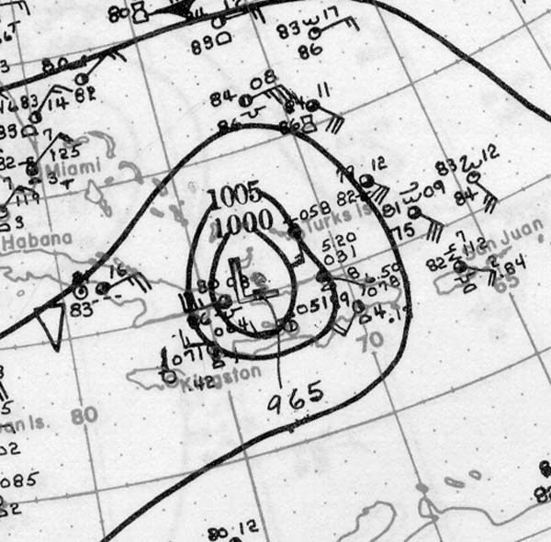
Reanalysis Data Sources for 1926 to 1930
Historical Weather Map series

Slide 10
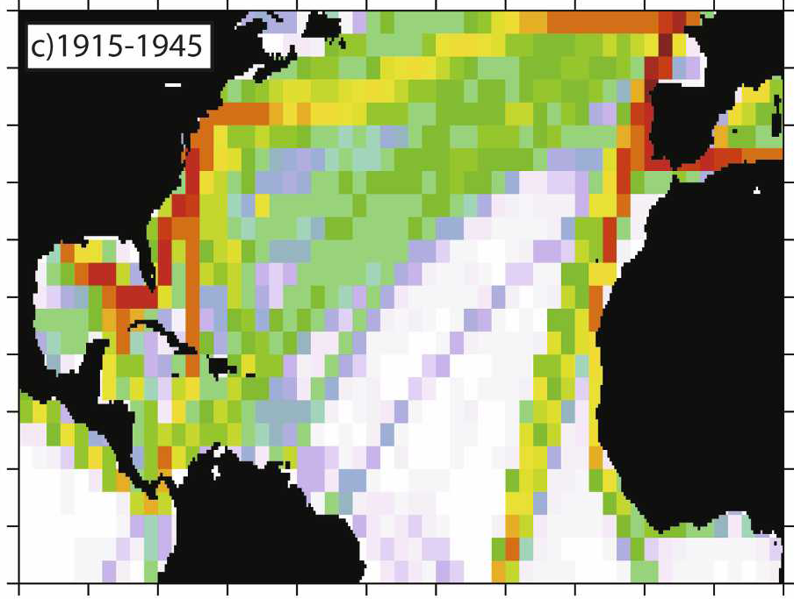
International Comprehensive Ocean-Atmosphere Dataset (ICOADS)
Notes:
10

Slide 11
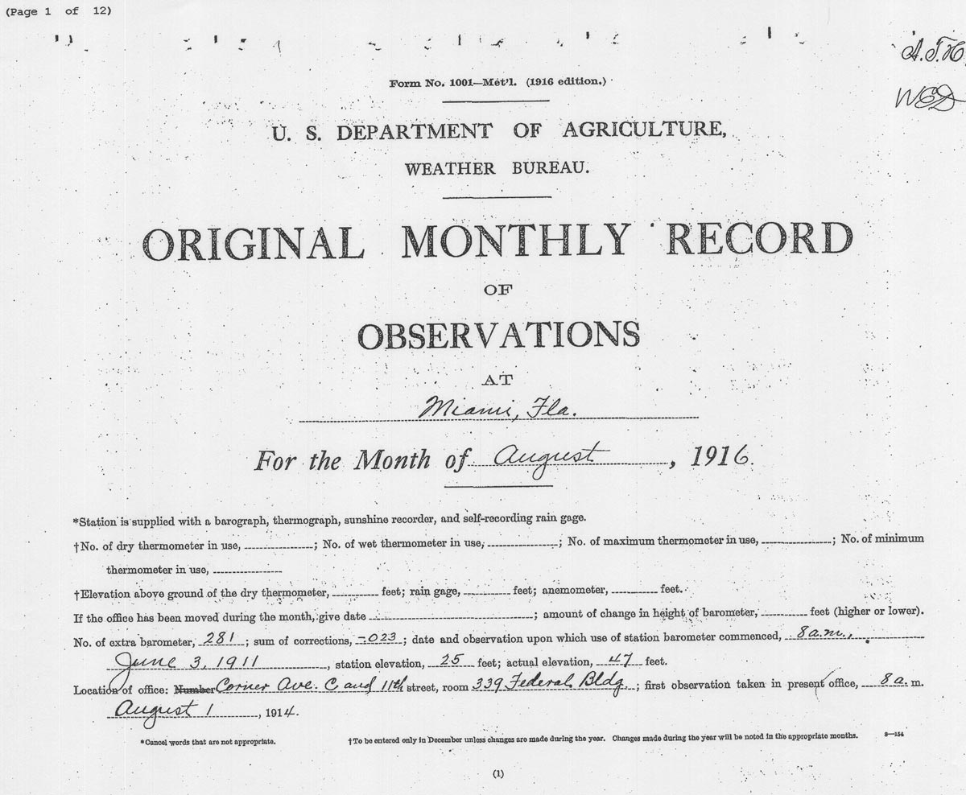
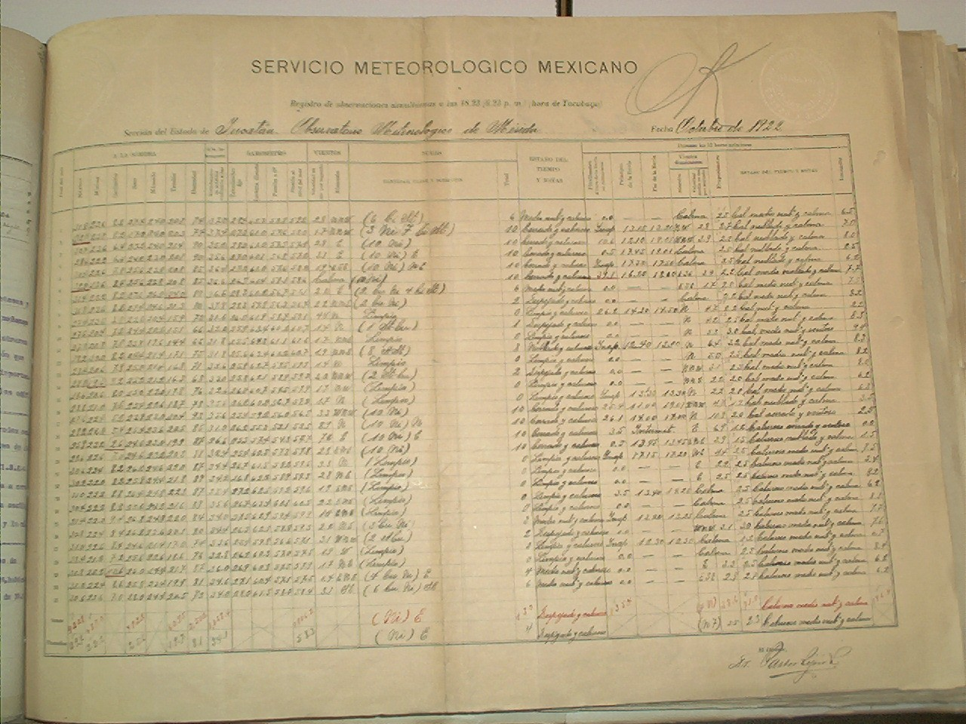
U.S. Original
Monthly Records
(NCDC - WSSRD)
Weather Observations
from Colleagues in Mexico,
Cuba and throughout
the Caribbean

Slide 12
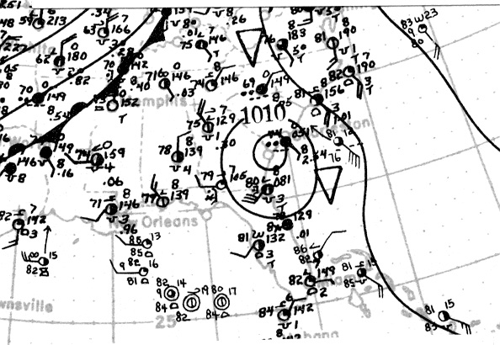
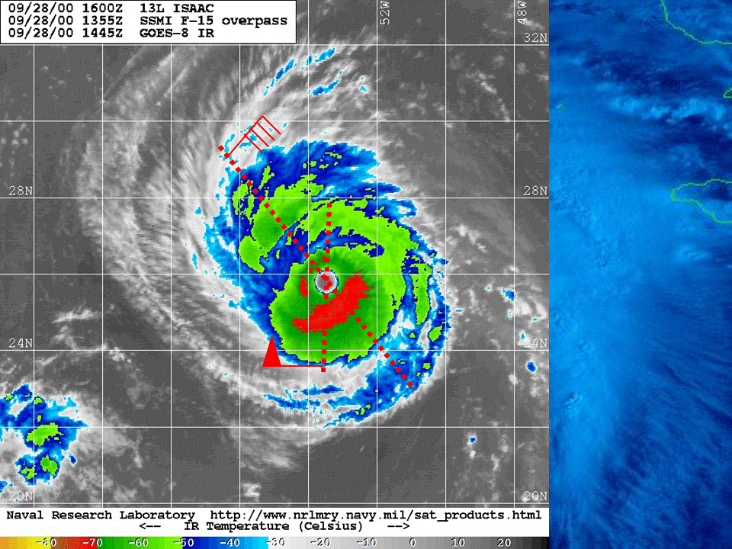
Reanalysis Steps
1) Obtain all available raw data into a single database
2) Once daily (more often in shipping lanes or near coast), conduct synoptic analysis
3) Determine track
3) Determine intensity
4) Document revisions (metadata file)

Slide 13
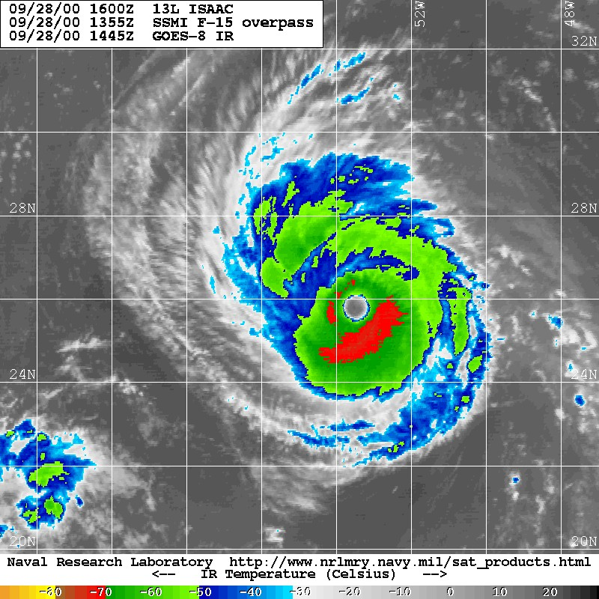
Using Ship
Observations to
Estimate the
Hurricane’s
Location

Slide 14
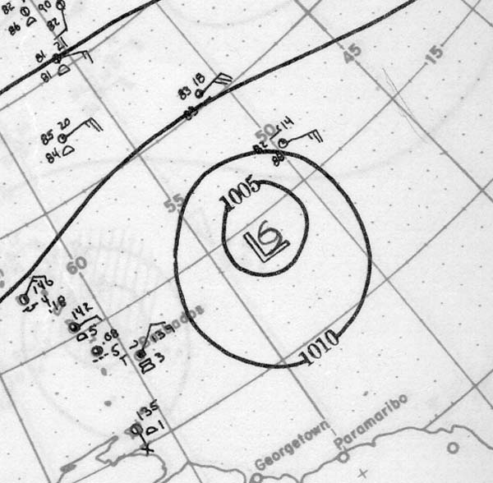
Historical Weather Maps – 11 September 1928

Slide 15
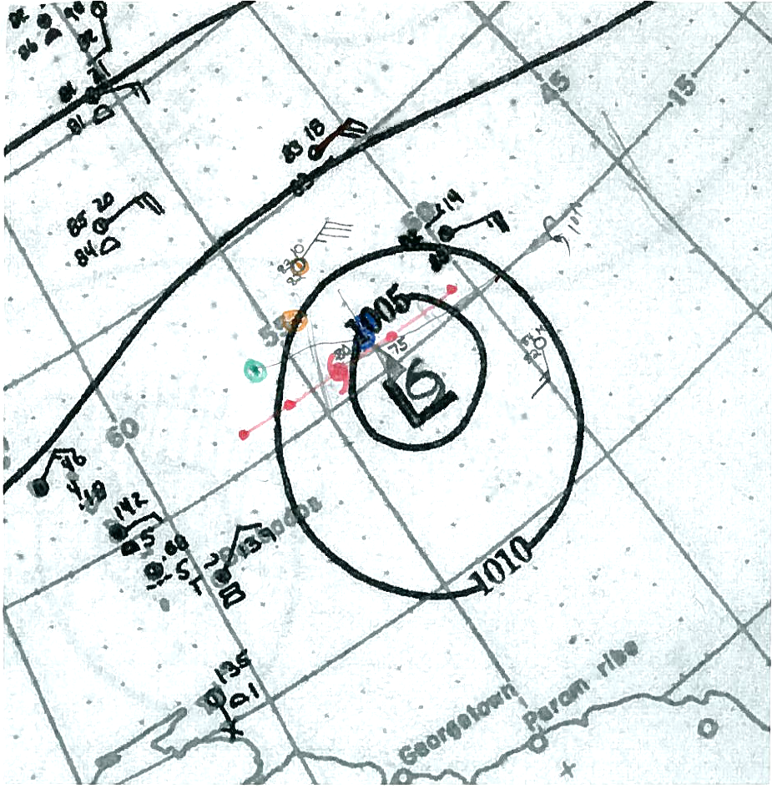
Historical Weather Maps – 11 September 1928
With COADS and additional observations

Slide 16

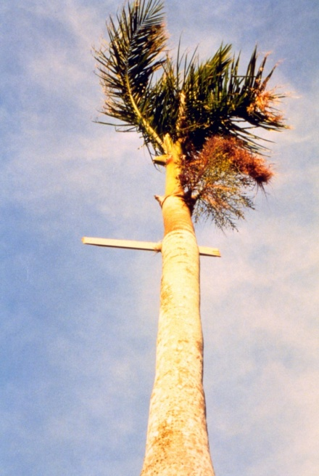
Methods for Estimating Intensity
Beaufort Scale (0-12: Calm to to Hurricane)
Anemometers – Biases in in in in in Early Instruments
Pressure-Wind Relationships
Utilizing Size (Radius of Maximum Wind) Information
Storm Surge/SLOSH runs
Wind-caused Structural Damage
Inland Wind/Pressure Decay Models

Slide 17
ATLANTIC PRESSURE-WIND RELATIONSHIPS
Utilize Brown et al. (2006)
Central South South South 25N to 25N to 25N to North
Pressure 25N 25N-Int 25N-Wea 35N 35N-Int 35N-Wea 35N
960mb 101kt 102 98 95 100 91 90
Adjustments made (+/- 5 kt) due to small/large TC, to fast/slow moving TC, and/or to high/low environmental pressure

Slide 18
Raw Data (Hurricane Force) for
1921 Tampa Bay Hurricane
1921 STORM 6 (OCTOBER) - TAMPA BAY HURRICANE
22-Oct | ~16Z | 989 |  |  |  |  | SWAN IS. | 175 | 842 |  | MWR | MIN PRESS
22-Oct | ~20Z |  | 70 | SW |  |  | SWAN IS. | 175 | 842 |  | MWR
23-Oct | ~22Z | 941 | EYE |  |  |  | SHIP | 215 | 855 |  | MWR | "VIRGINIA"
24-Oct | 8Z | 959 | 70 | E |  |  | SHIP | 240 | 852 |  | MWR | "BALTIC"
24-Oct | 23Z | 986 | 70 | E |  |  | SHIP-"EL ESTERO" | 256 | 844 |  | MWR | US033420
25-Oct | 0Z | 987 | 70 | E | 80 |  | SHIP-"EL ESTERO" | 256 | 844 |  | COA | US033420
25-Oct | 1Z |  | ~90 | SE |  |  | SHIP-"EL ESTERO" | 256 | 844 |  | MWR | US033420
25-Oct | 3Z | 943 | 0 | EYE |  |  | SHIP-"EL ESTERO" | 256 | 844 |  | MWR | MIN PRESS
25-Oct | 1130Z | 982 | 70 | E | 72 |  | SHIP | 276 | 832 |  | MWR | "TRUXILLO"
25-Oct | 13Z | 979 | 70 | E | 72 |  | SHIP | 276 | 832 |  | MWR | "TRUXILLO"
25-Oct | 1520Z | 958 | 0 | EYE |  |  | SHIP | 276 | 832 |  | MWR | "TRUXILLO"
25-Oct | 1550Z | 958 | 70 | W | 72 |  | SHIP | 276 | 832 |  | MWR | "TRUXILLO"
25-Oct | 1630Z | 959 | 70 | W |  |  | SHIP | 276 | 832 |  | MWR | "TRUXILLO"
25-Oct | 19Z | 960 |  |  |  |  | DUNEDIN | 279 | 827 |  | CLINE | MIN PRESS
25-Oct | 19Z | 965 |  |  |  |  | SAFETY HARBOR | 280 | 827 |  | CLINE | MIN PRESS
25-Oct | 1918Z |  | 59 | S |  |  | TAMPA | 280 | 825 |  | MWR | MAX WIND
25-Oct | 1918Z |  | 65 | S |  |  | TAMPA | 280 | 825 |  | MWR | EXTREME W
25-Oct | 1930Z | 958 |  |  |  |  | TARPON SPRINGS | 281 | 827 |  | CLINE | MIN PRESS
25-Oct | 2040Z | 952 |  |  |  |  | TARPON SPRINGS | 281 | 827 |  | MWR | MIN PRESS
25-Oct | 1940Z |  | 0 |  |  |  | TARPON SPRINGS | 281 | 827 |  | CLINE | EYE
25-Oct | 1945Z | 976 | 47 | S | 76 |  | TAMPA | 280 | 825 |  | MWR | MIN PRESS
26-Oct | 19Z | 991 | 70 | SW |  |  | SHIP | 275 | 785 |  | MWR | "F.D. ASCHE"
27-Oct | 12Z | 996 | 70 | NE | 70 |  | SHIP-"W.C. GORGAS" | 300 | 731 |  | COA | US034079

Slide 19
Revised “Best Track” (HURDAT) Data
for 1921 Tampa Bay Hurricane
1921/06 - 2009 REVISION:
22585 10/20/1921 M=11 6 SNBR= 523 NOT NAMED XING=1 SSS=3
22590 10/20*123 801 35 0*131 804 35 0*137 806 35 0*143 809 40 0
22590 10/20*127 801 35 0*131 804 35 0*135 806 35 0*138 809 40 0
*** *** ***
22595 10/21*148 812 45 0*153 815 50 0*158 818 50 0*162 821 55 0
22595 10/21*142 812 45 0*146 815 50 0*150 818 50 0*155 822 55 0
*** *** *** *** ***
22600 10/22*166 824 65 0*170 827 70 0*175 830 75 0*181 834 80 0
22600 10/22*160 826 65 0*165 830 70 0*170 835 75 0*176 840 80 0
*** *** *** *** *** *** *** ***

Slide 20
Metadata File for
the 1921 Tampa Bay Hurricane
The hurricane made landfall in southwest Florida with a central
pressure of 952 mb measured in Tarpon Springs at 1940-2040 UTC on the 25th.
952 mb suggests winds of 108 kt from the Gulf of Mexico pressure-wind
relationship. The new Brown et al. (2006) pressure-wind relationship suggests
103 kt from the north of 25N associations. Schwerdt et al. (1979) suggested an
environmental pressure of 1006 mb, maximum 1 min surface wind at the coast of
98 kt, suggesting a low end Category 3 hurricane. Ho et al. analyzed a
landfall position of 27.9N, 82.8W with a 952 mb central pressure and an RMW of
18 nmi. Such an RMW is close to the average value for that latitude and
central pressure (Vickery et al. 2000), thus 105 kt is chosen for intensity at
landfall, making the storm a Category 3. This is in agreement with
HURDAT, Neumann et al., and Jarrell et al. Highest observed winds for this
system from Tampa at 1918 UTC on the 25th were 59 kt, which converts to 49 kt
after adjustment. However, the landfall position from Ho et al. is too far
south given the clearcut eye passage over Tarpon Springs. A landfall position
of 28.1N 82.8W is used instead, which retains the original HURDAT position
at 18 UTC on the 25th. Peak observed winds after landfall within two hours of
the 00 and 06 UTC synoptic times on the 26th were 50 kt and 45 kt from ship
observations in the Gulf of Mexico. (Highest land based winds were 49 kt
around 00 UTC [Jacksonville] and 37 kt around 06 UTC [Charleston and
Savannah].) A run of the Kaplan-DeMaria inland decay model suggests winds of
78 and 70 kt at 00 and 06 UTC, respectively. Winds in HURDAT are reduced from
85 to 80 kt at 00 UTC and 80 to 70 kt at 06 UTC, accordingly. (The winds
could have been reduced even further; however, due to the dearth of station
data, higher winds might have possibly occurred.) For the Florida regional
breakdown, the hurricane is considered a Category 3 impact in Southwest Florida
(BFL3), a Category 2 impact in Northwest Florida (AFL2), and Category 1 impact
in Northeast Florida (DFL1) and in Southeast Florida (CFL1).

Slide 21
BEST-TRACK CHANGE COMMITTEE CHARTER
02/20/2003
Statement of Problem:
The final "best-tracks" are prepared by the National Hurricane Center (NHC) hurricane specialists at the conclusion of every Atlantic and eastern north Pacific tropical cyclone. These tracks represent the best estimate of tropical position, intensity and status every six hours during its life cycle. They are based on a comprehensive analysis of all available observational data. Once completed, these tracks are added to the historical tropical cyclone database for each basin. These files (1851 to the present for the Atlantic, 1949 to the present for the eastern north Pacific) are used at NHC for verification of forecasts and other internal applications. They are also used extensively by the research, academic and insurance communities, as well as the media and the public.
The best-track files are not static, but rather represent the best current estimates for tropical cyclone track and intensity, given the observations and science available at the time. Newly acquired observations, re-interpretation, or re-analysis may indicate changes to these tracks. Such changes must be dealt with in an organized and well-documented manner.
Vision:
To have the most accurate tropical cyclone best-tracks based on observations and sound science.
Mission:
Insure that proposed changes to the best-track files are consistent with contemporary science.
Success Criteria:
Accurate best-track files which withstand scientific scrutiny.
Scope of Authority/Limitations:
The committee will have the authority to change the best-track files.
Termination Date:
None.
Team Membership:
The tropical Prediction Center director will appoint committee members. The team will be composed of three hurricane specialists and three other TPC scientists. The team will have a standing, non-voting member, external to TPC, who will review any proposed change of U.S. landfall category of a U.S. landfalling category 4 or 5 hurricane. The team can also add a non-TPC voting member for any tropical cyclone as it sees fit. The additional temporary team member is to be selected by majority vote of the team.

Slide 22
BEST-TRACK CHANGE COMMITTEE CHARTER
02/20/2003
Statement of Problem:
The final "best-tracks" are prepared by the National Hurricane Center (NHC) hurricane specialists at the conclusion of every Atlantic and eastern north Pacific tropical cyclone. These tracks represent the best estimate of tropical position, intensity and status every six hours during its life cycle. They are based on a comprehensive analysis of all available observational data. Once completed, these tracks are added to the historical tropical cyclone database for each basin. These files (1851 to the present for the Atlantic, 1949 to the present for the eastern north Pacific) are used at NHC for verification of forecasts and other internal applications. They are also used extensively by the research, academic and insurance communities, as well as the media and the public.
The best-track files are not static, but rather represent the best current estimates for tropical cyclone track and intensity, given the observations and science available at the time. Newly acquired observations, re-interpretation, or re-analysis may indicate changes to these tracks. Such changes must be dealt with in an organized and well-documented manner.
Vision:
To have the most accurate tropical cyclone best-tracks based on observations and sound science.
Mission:
Insure that proposed changes to the best-track files are consistent with contemporary science.
Success Criteria:
Accurate best-track files which withstand scientific scrutiny.
Scope of Authority/Limitations:
The committee will have the authority to change the best-track files.
Termination Date:
None.
Team Membership:
The tropical Prediction Center director will appoint committee members. The team will be composed of three hurricane specialists and three other TPC scientists. The team will have a standing, non-voting member, external to TPC, who will review any proposed change of U.S. landfall category of a U.S. landfalling category 4 or 5 hurricane. The team can also add a non-TPC voting member for any tropical cyclone as it sees fit. The additional temporary team member is to be selected by majority vote of the team.
Minutes of the best-track change committee meeting
1921 #8: Given the west wind of 20 kt found in the HWM, it is suggested that the wind at 12Z on 10/20 be maintained at 35 kt. Please note that the observation cited in the metadata for 10/23 (27.5, 85.6) appears to be either for some other day, or the latitude is incorrect (21.5?). A major concern is the southward shift in the track at the time of Florida landfall. An extended calm is well-documented over Tarpon Springs, and the original track in fact passes directly over this area. However, the revised track is shifted considerably south of Tarpon Springs. This does not seem warranted. Further, the change in intensity to 110 kt at landfall may be a bit high. Given the fact that this was a large, late-season system that was filling as it made landfall, and given the relatively low environmental pressure, 105 kt is suggested. (post-meeting, Brian Jarvinen confirms (through Richard Pasch) that the area of landfall was Tarpon Springs, and that intensity was likely 105 kt.)

Slide 23
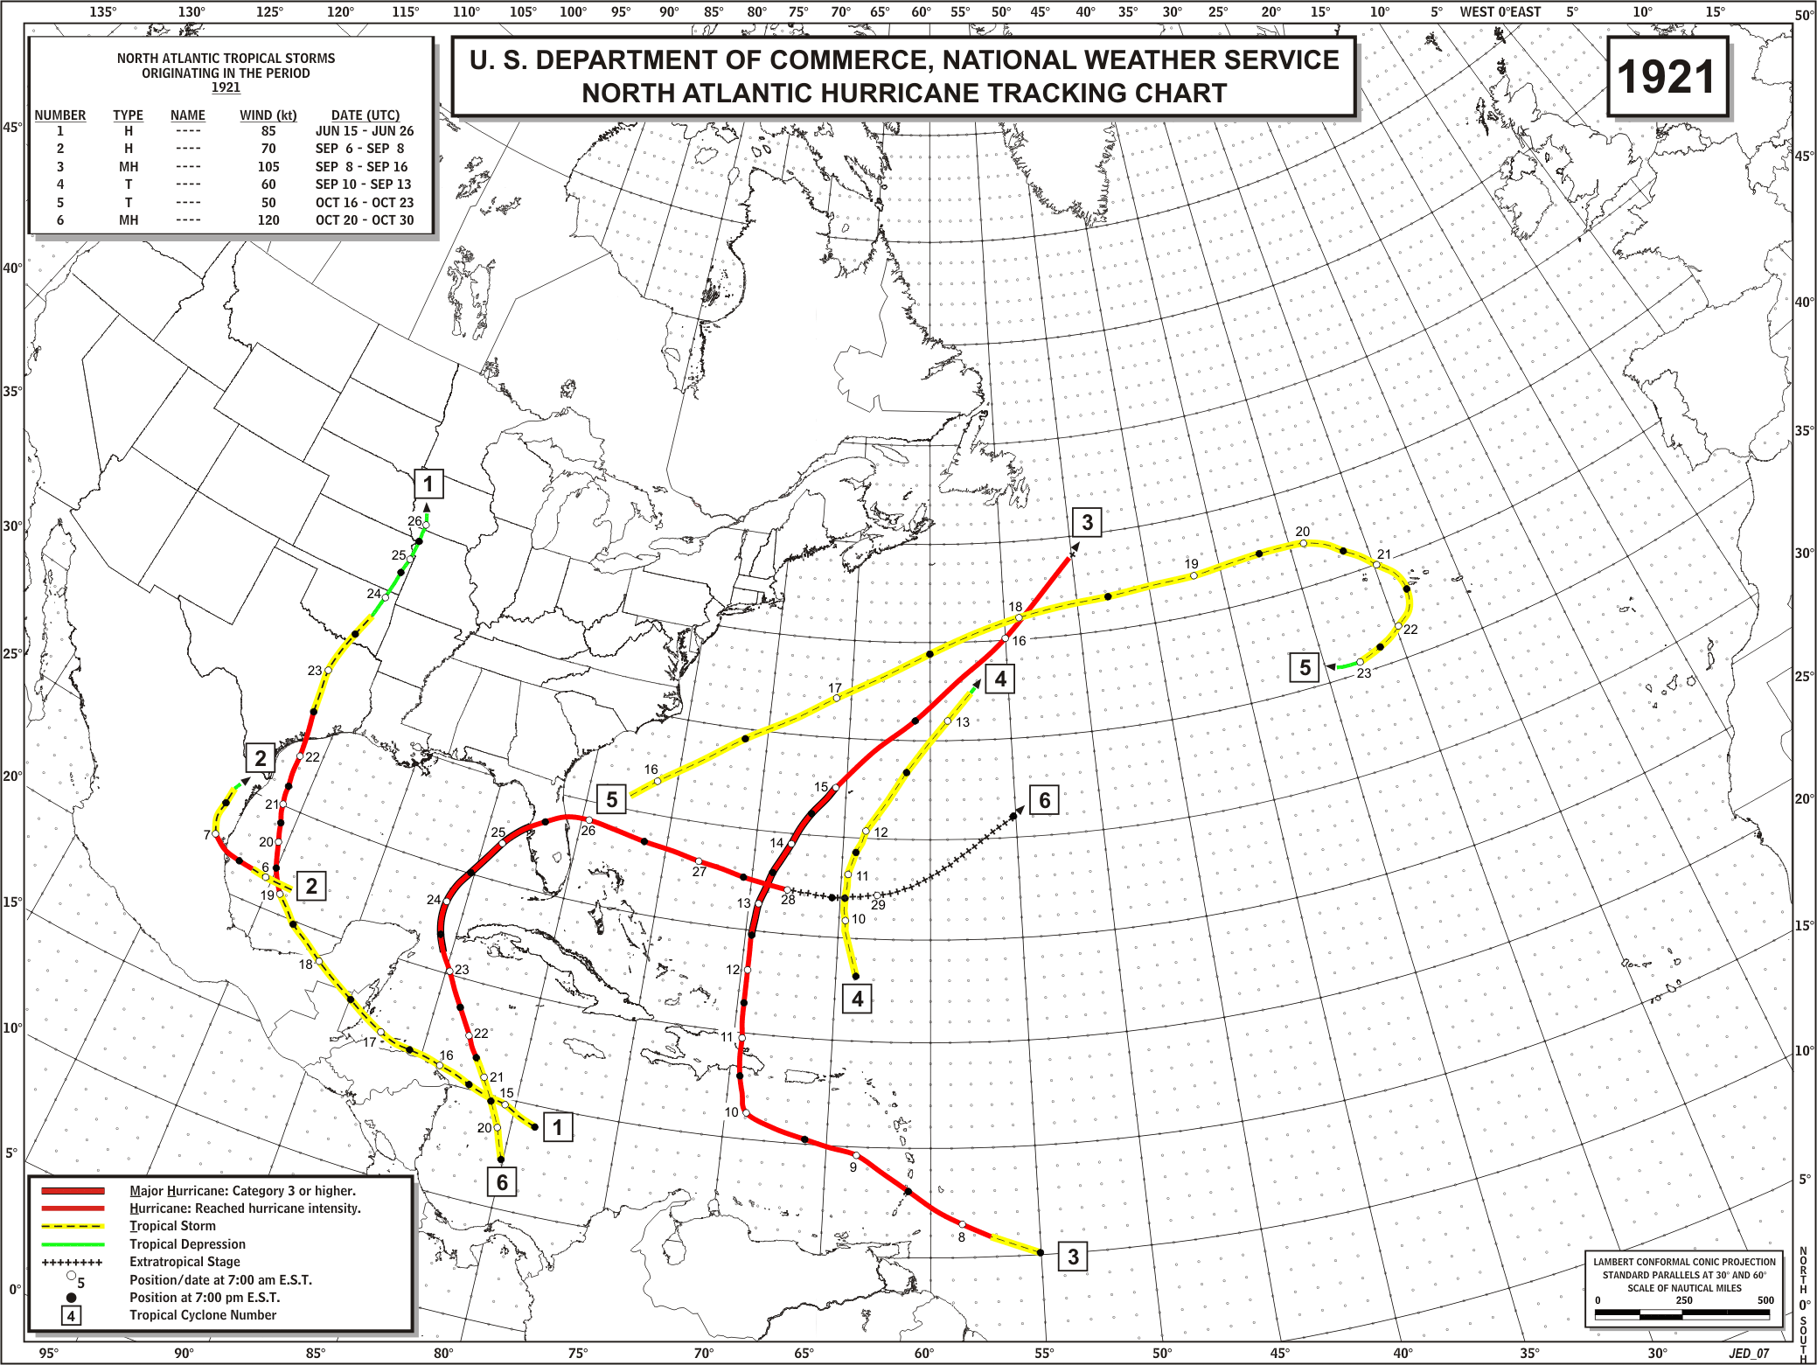
ORIGINAL

Slide 24
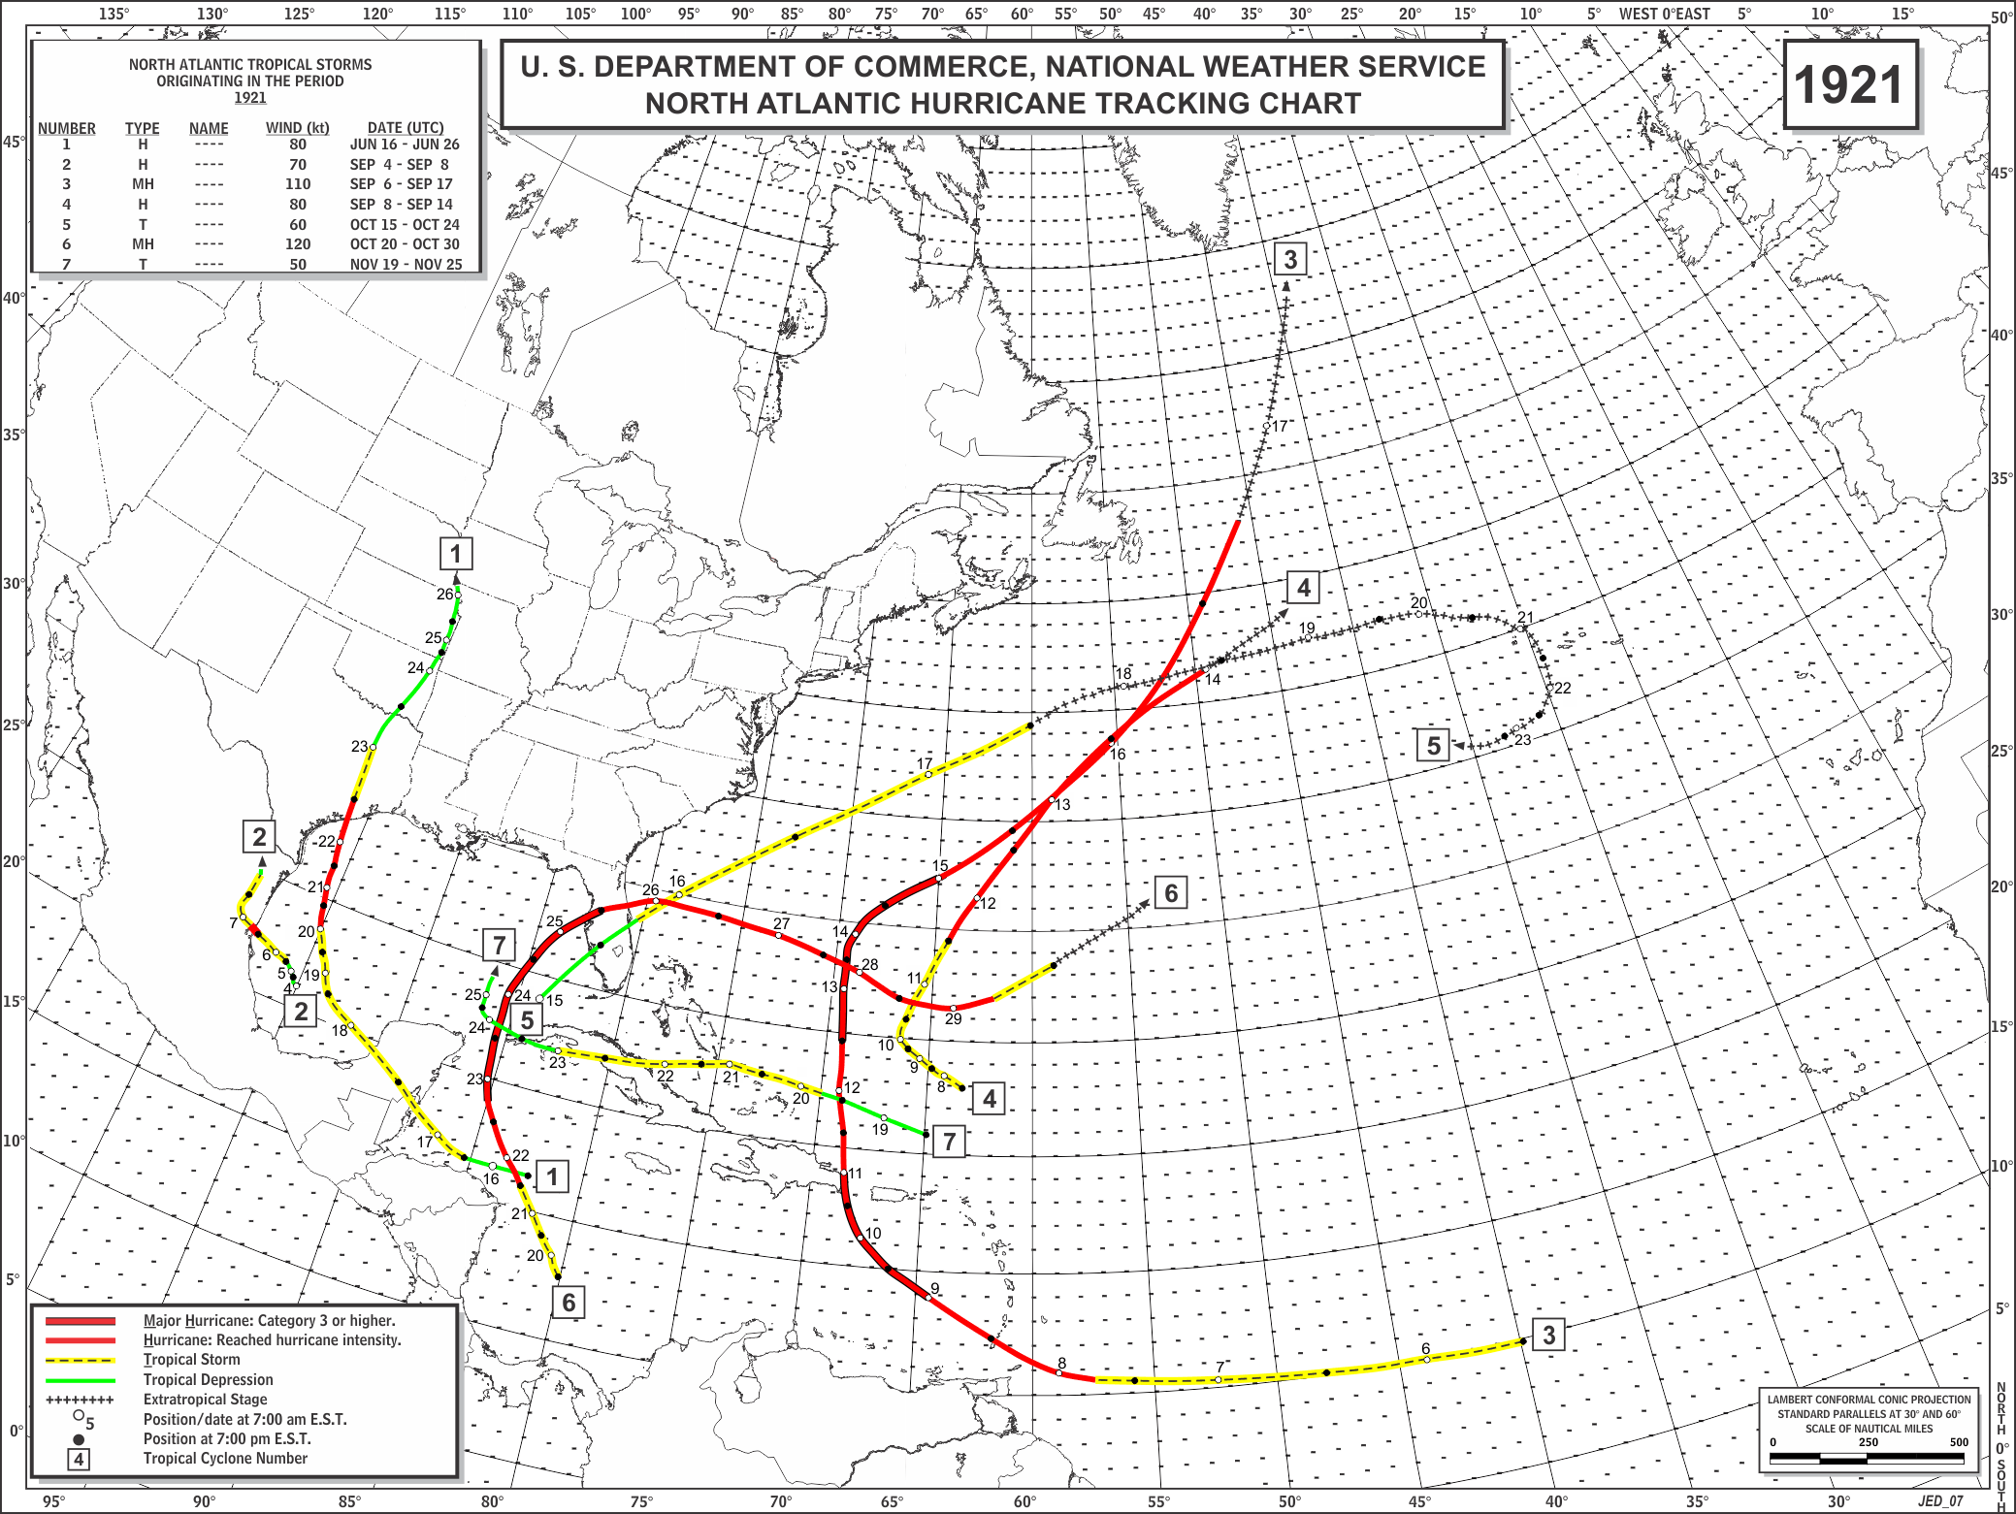
REVISED

Slide 25
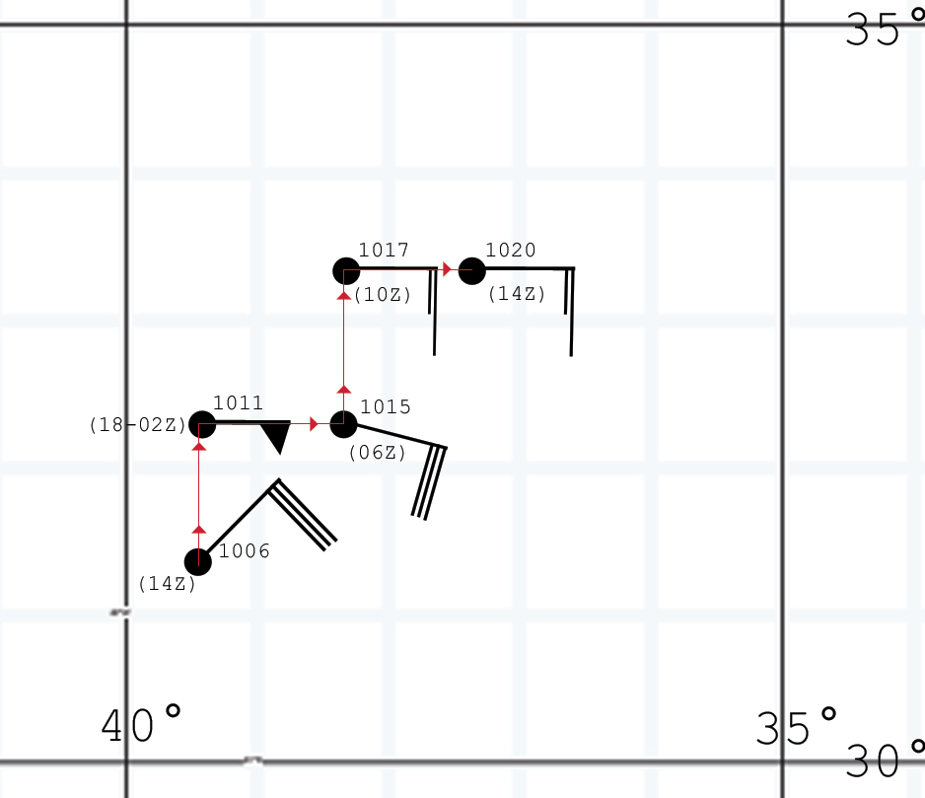
Ship Location Accuracy

Slide 26
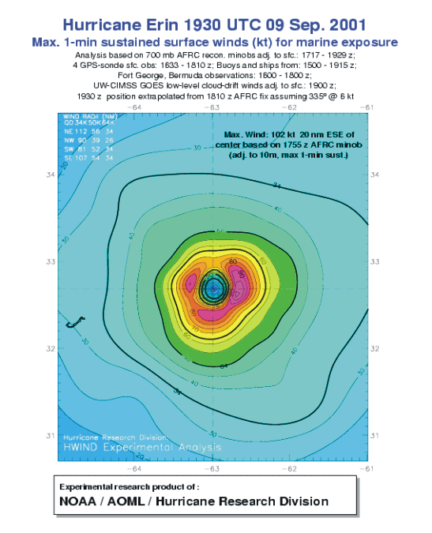
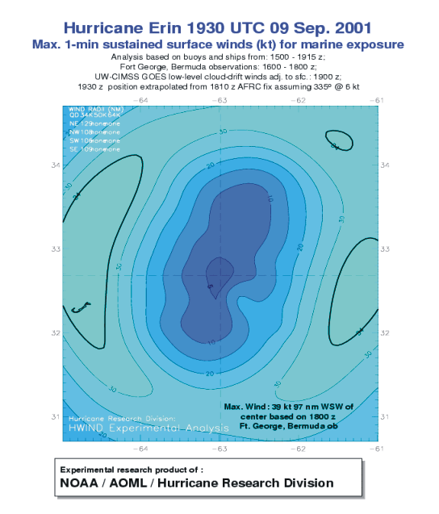
Estimating Intensity with and without Aircraft Reconnaissance
Landsea et al. (2004)

Slide 27
Estimating the intensity bias in HURDAT for 1851 to 1930 – Comparing the Peak Intensity versus U.S. Landfall Intensity
1851-1930
1980-2008
Suggests 10-15 kt LOW bias in early HURDAT

Slide 28
Estimated Errors in HURDAT – 1851 to 1930
Situation | Dates | Position error (n mi) | Intensity error (absolute) (kt) | Intensity error (bias) (kt)
Open ocean | 1851–85 | 120 | 25 | -15
 | 1886–1930 | 100 | 20 | -10
Landfall at sparsely populated area | 1851–85 | 120 | 25 | -15
 | 1886–1930 | 100 | 20 | -10
Landfall at settled area | 1851–85 | 60 | 15 | 0
 | 1886–1930 | 60 | 12 | 0

Slide 29
Accomplishments:
2000 – Added in 241 new tropical storms/hurricanes for 1851 to 1885
2002 – Reanalyzed 1992’s Hurricane Andrew
2003 – Reanalyzed 1886 to 1910 – Revised all existing 194 systems,
added 23 new tropical cyclones, removing one system (in
1891), some changes in 1851-1886 including removing one
tropical cyclone (in 1885)
2005 – Reanalyzed 1911 to 1914 – Revised all 15 existing systems,
added 5 new tropical cyclones.
2008 – Reanalyzed 1915 to 1920 – Revised all 34 existing systems,
added 8 new tropical cyclones, removed one system (in 1916)
2009 – Reanalyzed 1921 to 1925 – Revised all 27 existing tropical
cyclones, added in 10 new tropical cyclones, removed one
system (in 1923)
2010 – Reanalyzed 1926 to 1930 – All 29 revised, 4 new TCs.
Overall: Revised 299 existing tropical cyclones, added 291 new
systems, removed 4 tropical cyclones

Slide 30
West Florida Peninsula (Fort Myers to Cedar Key) Hurricanes (since 1851, reliable since 1900):
Category 4s
2004-Charley
Category 3s
1873, 1896, 1921, (1926), (1928), 1944, 1950-Easy, 1960-Donna
Category 2s
1878, 1888, 1894, 1910, 1935, (1941), (1947), 1968-Gladys
Category 1s
1852, 1871, 1874, 1880, 1882, 1886, (1888), 1925, 1945, 1946, (2004-Frances), (2004-Jeanne)

Slide 31
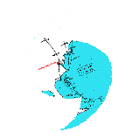
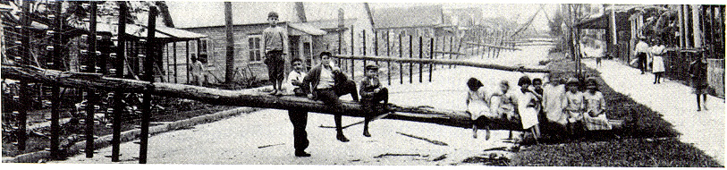
Atlantic Hurricane Database Re-Analysis Project
http://www.aoml.noaa.gov/hrd/data_sub/re_anal.html
1851 through 1930 changes accepted and officially adopted by NHC Best Track Change Committee.
1931-1953 have been preliminarily reanalyzed.
Remainder of 20th Century will be reanalyzed.
RE-ANALYSES NEED TO BE CONDUCTED GLOBALLY!!!
"Florida's Hurricane History"

Slide 32
The Hurricane Database Reanalysis Project:
Revisiting Historic Hurricane
23 February, 2011
WFO Ruskin
Chris Landsea, National Hurricane Center, Miami
Many collaborators: Craig Anderson, Noel Charles, Gil Clark, Jason Dunion, Jose Fernandez-Partagas, Paul Hungerford, Charlie Neumann, Mark Zimmer, David Glenn, William Bredemeyer, Mike Chenoweth, Ryan Ellis, John Gamache, Lyle Hufstetler, Cary Mock, Donna Thomas, Lenworth Woolcock, Adrian Santiago, Cristina Carrasco, Andy Hagen, Donna Strahan, Brian Etherton, Mike Dickinson, Steve Feuer, Ramon Perez Suarez, Ricardo Prieto, and Jorge Sanchez-Sesma
Supported by the NOAA Climate Program Office and the Risk Prediction Initiative, BBSR

Slide 33
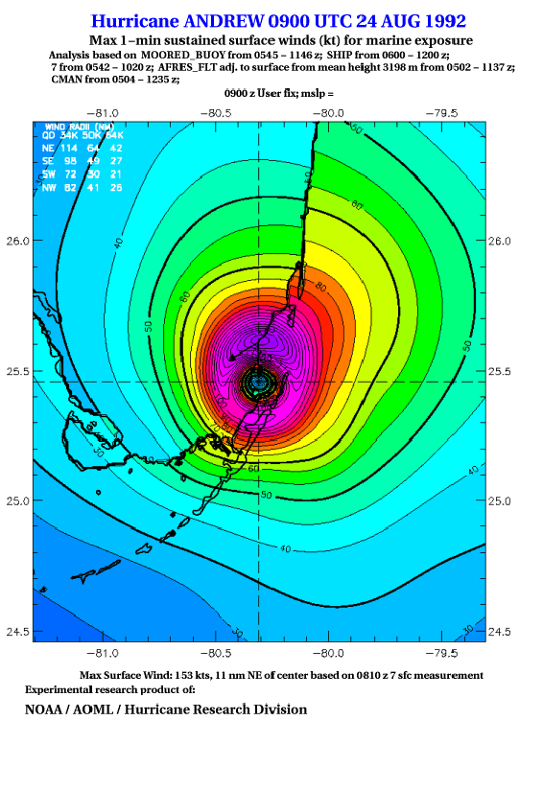
Hurricane Andrew
Re-analysis:
New H*Wind Method -
153 kt (94% of flight level)
NHC Method –
146 kt (90% of flight level)

Slide 34
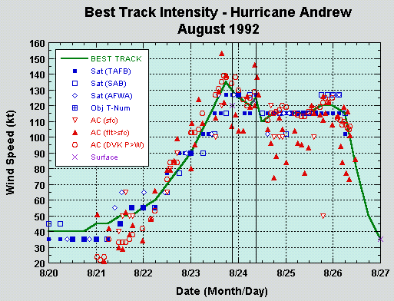
Revised
Best Track

Slide 35
12 U.S. Major Hurricanes
Six Category-3 hurricanes that impacted New York and New England:
1938 Storm 4 (Unnamed)
1944 Storm 7 (Unnamed)
1954 Storm 3 (Carol)
1954 Storm 5 (Edna)
1960 Storm 5 (Donna)
1985 Storm 7 (Gloria)
Six U.S. major hurricanes with large discrepancies between HURDAT and U.S. landfall assignment:
1915 Storm 5 (Unnamed)
1919 Storm 2 (Unnamed)
1934 Storm 2 (Unnamed)
1945 Storm 5 (Unnamed)
1947 Storm 4 (Unnamed)
1954 Storm 9 (Hazel)

Slide 36
HURDAT
The National Hurricane Center maintains and updates annually the North Atlantic Basin’s Hurricane Database (HURDAT)
HURDAT applications:
  Climate trend assessment – long term trends, seasonal forecasts, etc.
  Building code standards and insurance rates for coastal communities
  Risk assessment for emergency managers (recurrence intervals)

Slide 37
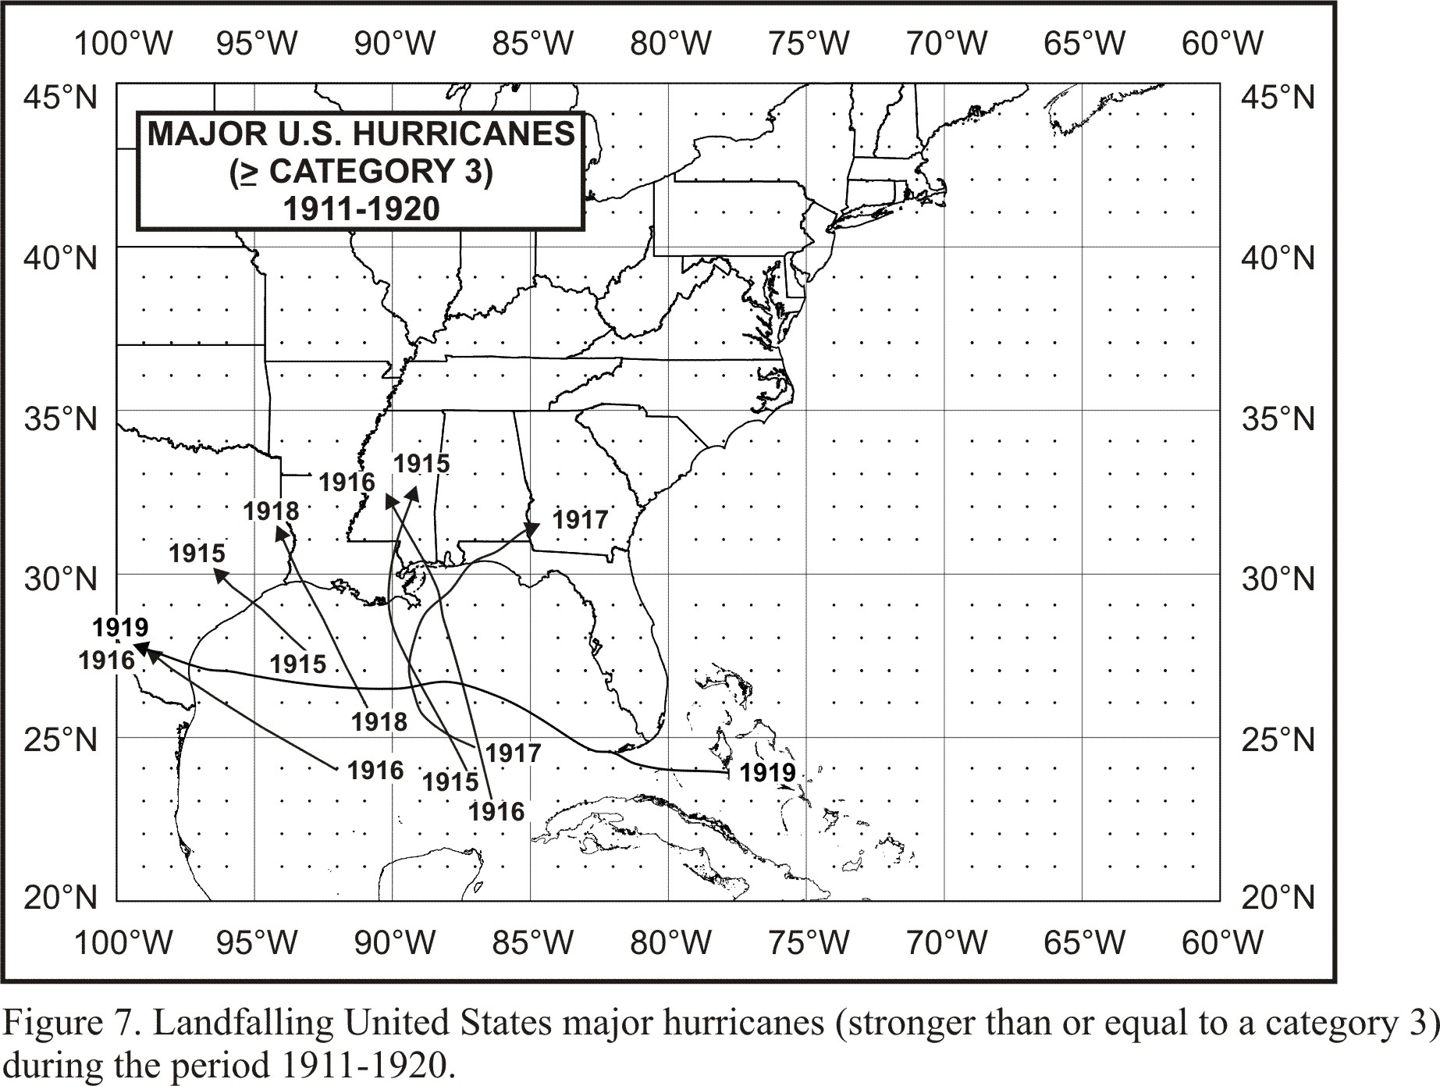
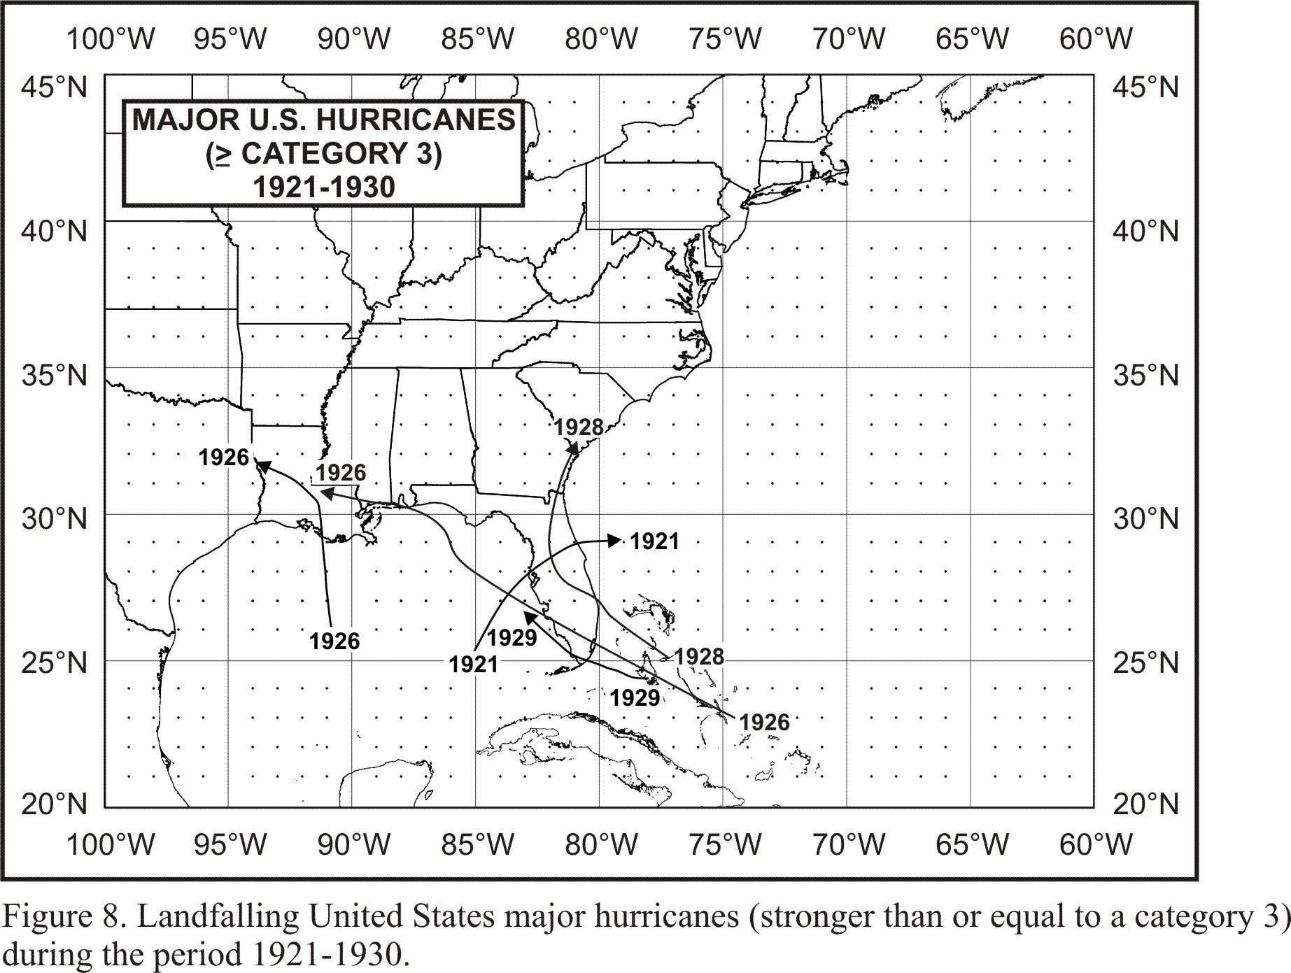
US Major
Hurricanes

Slide 38
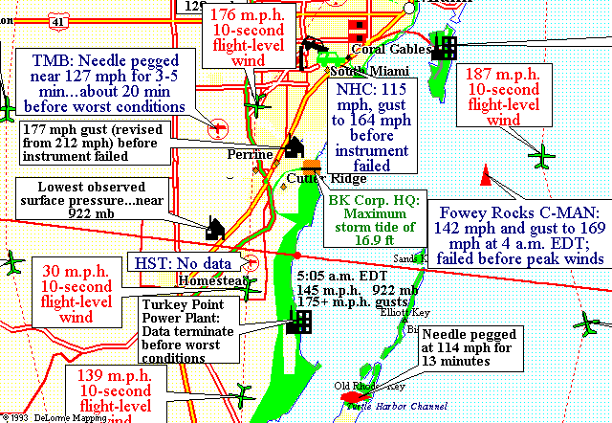

Slide 39
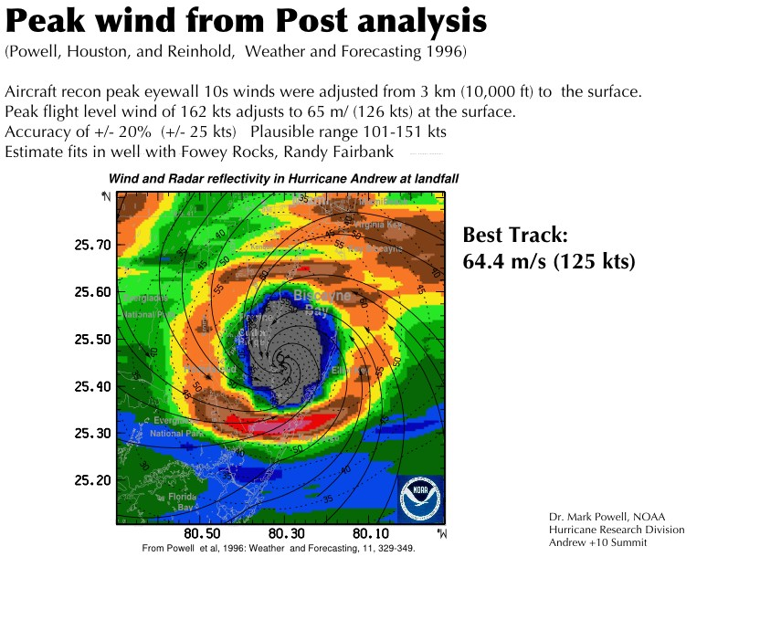
In the early 1990’s, reduction factors used by NHC ranged from 75%-90% of the flight-level wind.
Powell and Black (1990) concluded 63-73% for 700mb to surface reduction factor, but had few eyewall high-wind cases.

Slide 40

EYEWALL SCHEMATIC
WARM CORE
EYEWALL
a
AIRCRAFT TRACK
b
10,000 ft
EYE
100
90
80
70
5,000 ft
1,500 ft
HRD Methodology
1) flight-level MBL
2) MBL 10 m

Slide 41
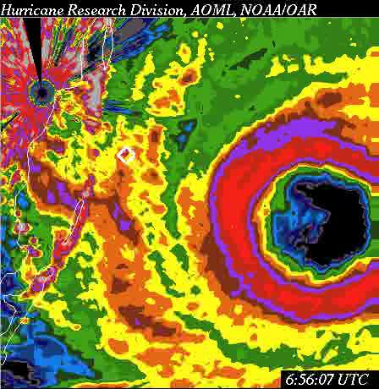
Some New Hurricane Andrew Data:
Radar Feature Tracking

Slide 42
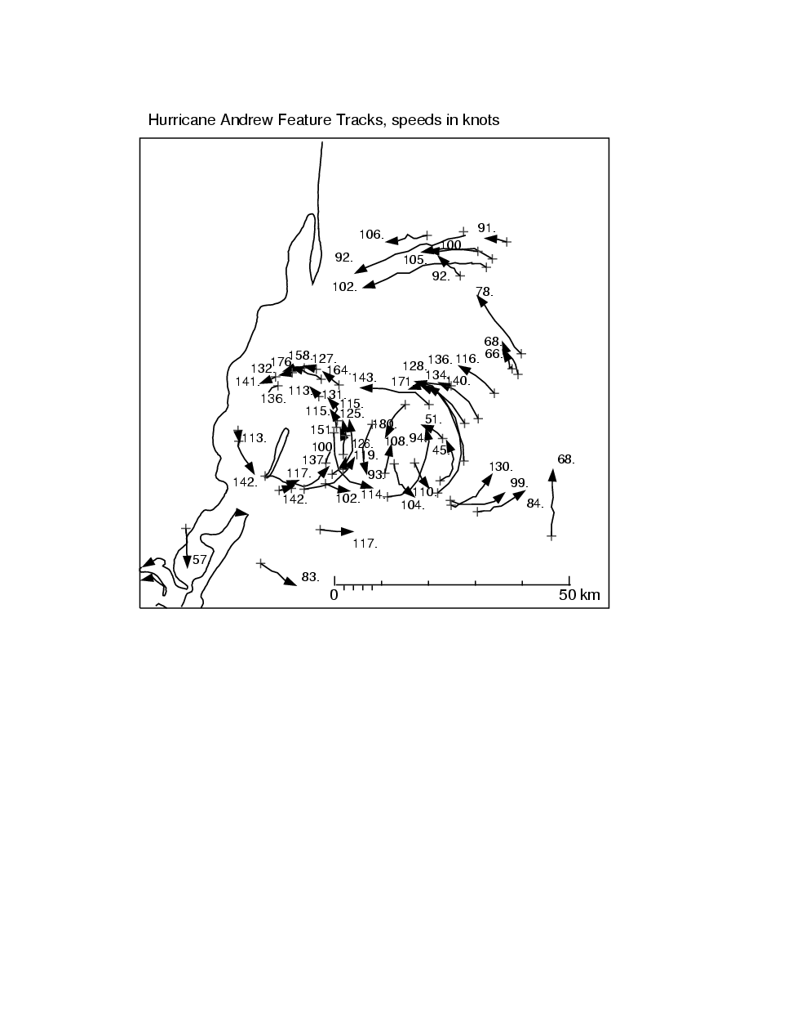
Hurricane Andrew Feature Tracks (kt)
Hurricane Andrew
Re-analysis:
New H*Wind Method -
148 kt (85% adjustment)
NHC Method –
143 kt (82% adjustment)

Slide 43
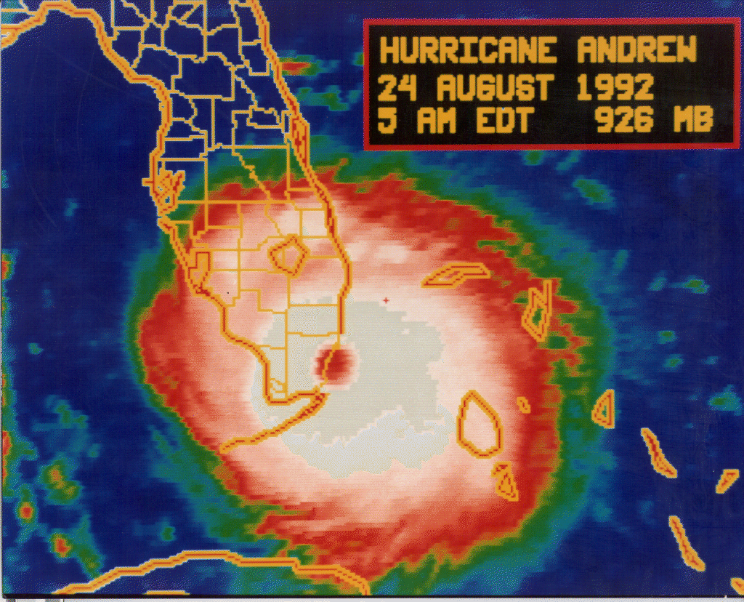
Hurricane Andrew -
Satellite Dvorak Estimates
127 kt/935 mb

Slide 44
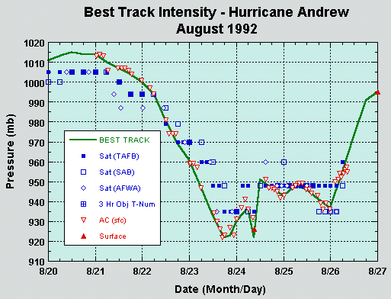

Slide 45
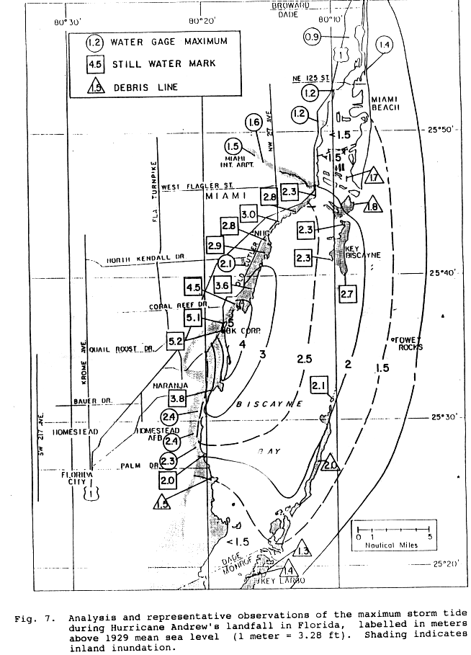
Hurricane Andrew’s
Storm Surge
And
SLOSH Runs

Slide 46
Structural Damage
Surveys of Hurricane Andrew

Slide 47
The Re-analysis
of Hurricane Andrew (1992)
Flight-level wind to sfc extrapolation 145 kt(+10)
Feature tracking from the Miami radar 145 kt (+15)
Pressure-wind relationships 145 kt (+20)
Satellite intensity estimates 145 kt (+20)
Storm surge and SLOSH implications 145 kt (+25)
Structural damage survey estimates 135 kt (+30)

Slide 48
CAVEATS
Pros and Cons on the conclusion of
Andrew being 145 kt (Category 5) at landfall
Pros – it might have been stronger
Air Force may have missed peak wind
Adjustment may be conservative
a. GPS drop interpolation to 10m
b. Ratio may increase further for extreme winds
c. Ratio increases with strong convection/vertical motions
Andrew was deepening
Cons – it might have been weaker
Adjustment not consistent with surface obs
Biscayne Bay roughness length increase

Slide 49
IMPLICATIONS OF ANDREW’S RECLASSIFICATION
Because of this reclassification, the return period of catastrophic hurricanes like Andrew increases from about 15 years to about 50 years for south Florida. Thus the risk from “Andrew-like” hurricanes here is significantly LESS than previously estimated.
Original Assessment –
“Andrew-like” hurricanes
(i.e., Category 4 or 5):
1919 Key West hurricane
1926 Great Miami hurricane
1928 Lake Okeechobee hurricane
1935 Labor Day hurricane
1947 Broward hurricane
1960 Donna
1992 Andrew
Revised Assessment –
“Andrew-like” hurricanes
(i.e., Category 5 only):
1935 Labor Day hurricane
1992 Andrew

Slide 50
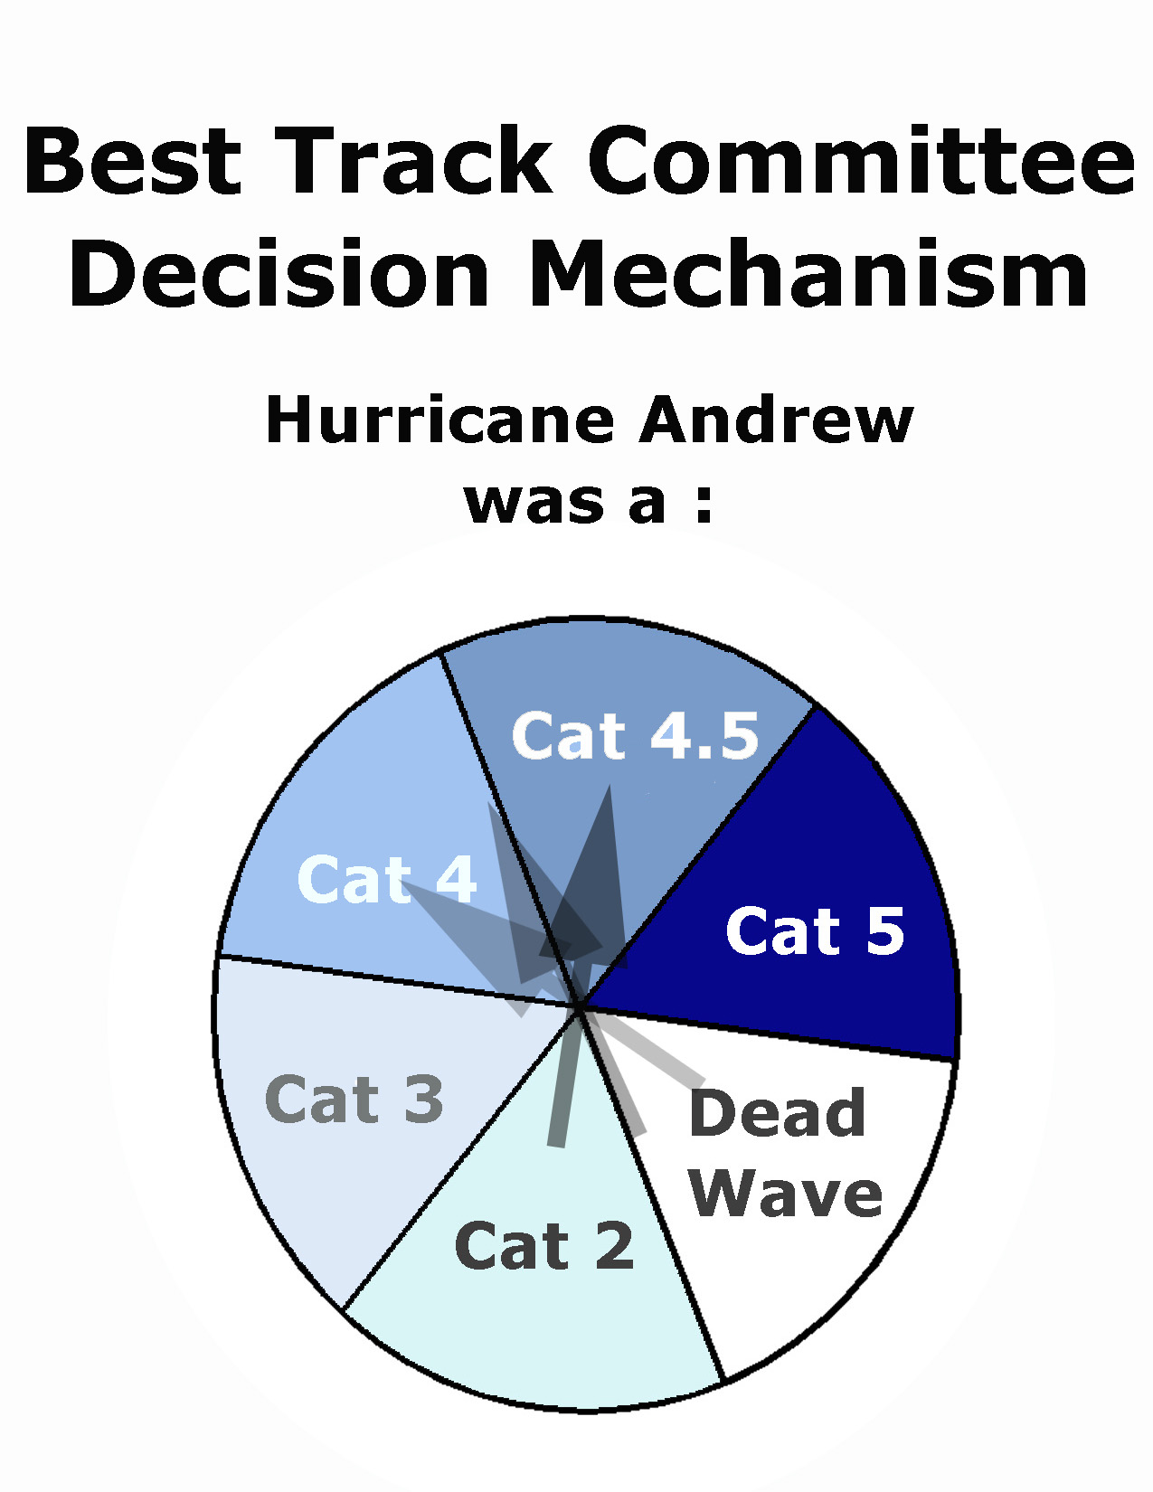
http://www.aoml.noaa.gov/
hrd/hurdat/andrew.html

Slide 51
Powell: “I disagree with the estimate of
Andrew as a Cat 5 storm during any point of
its history when over shallow water or land…
I believe that Andrew’s wind speeds were …
132 +/- 26 kt”
106
132
158
Cat. 3---
---------Category 4----------
---------Category 5----------
114
136
Given these uncertainty ranges, Powell’s intensity
estimate for Andrew gives it about a 40% chance
of being a Category 5 at landfall.

Slide 52
AVERAGE OF 357 GPS DROPSONDE PROFILES IN THE HURRICANE EYEWALL.
ON AVERAGE, THE SURFACE WIND IS 90% OF THE WIND AT 700 MB AIRCRAFT RECONNAISSANCE LEVELS (75-80% AT LOWER ALTITUDES).
Franklin et al. (2002)

Slide 53
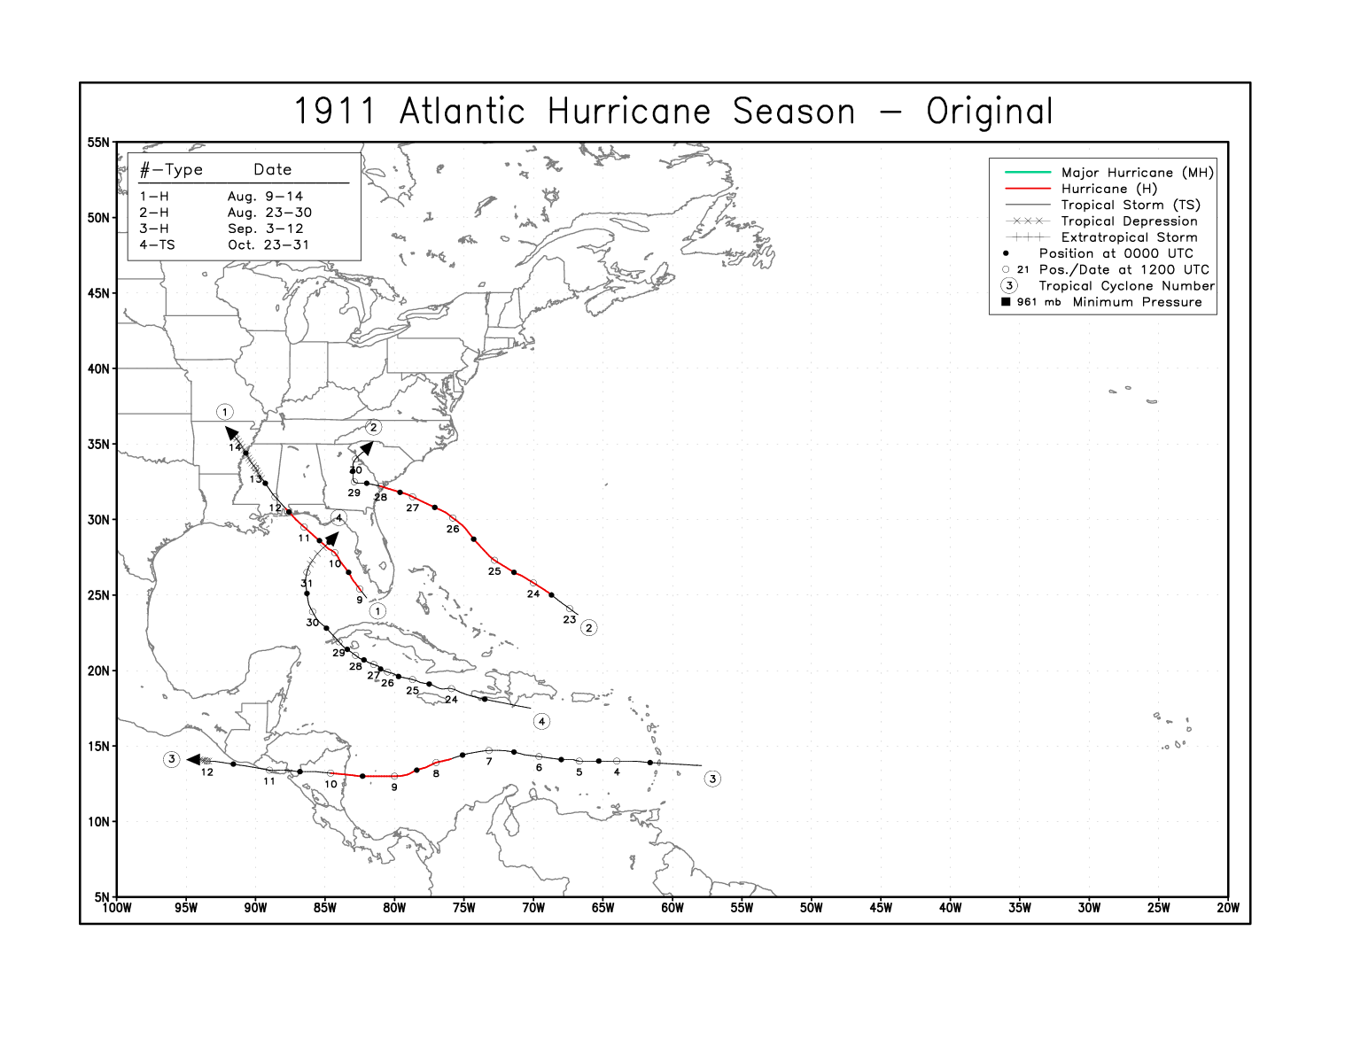

Slide 54
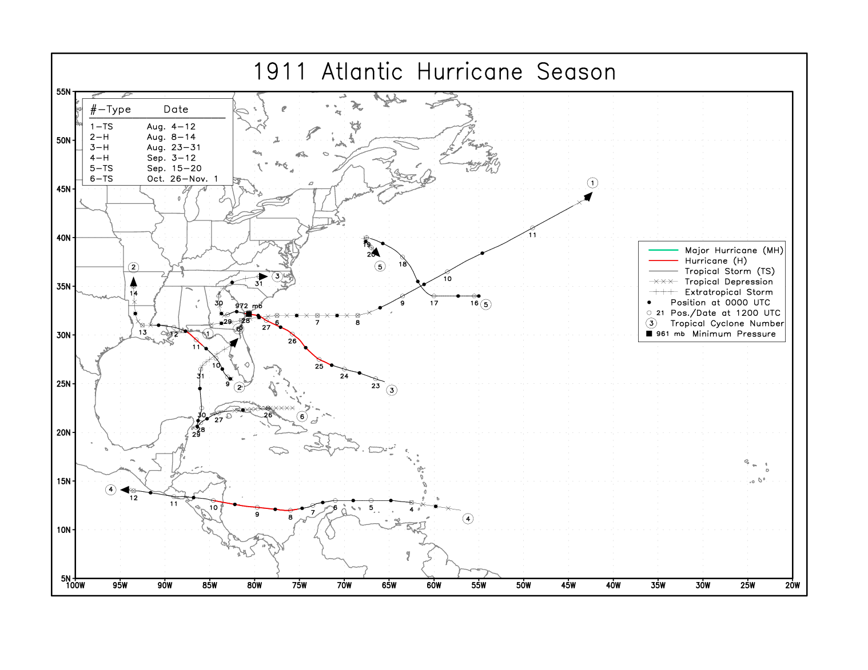

Slide 55
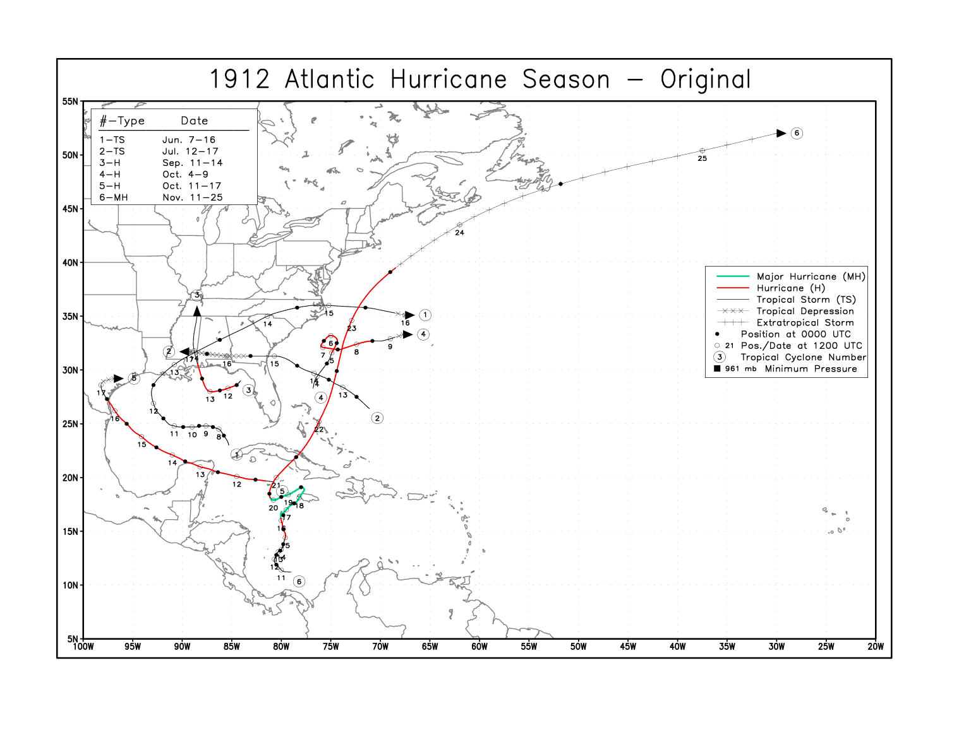

Slide 56
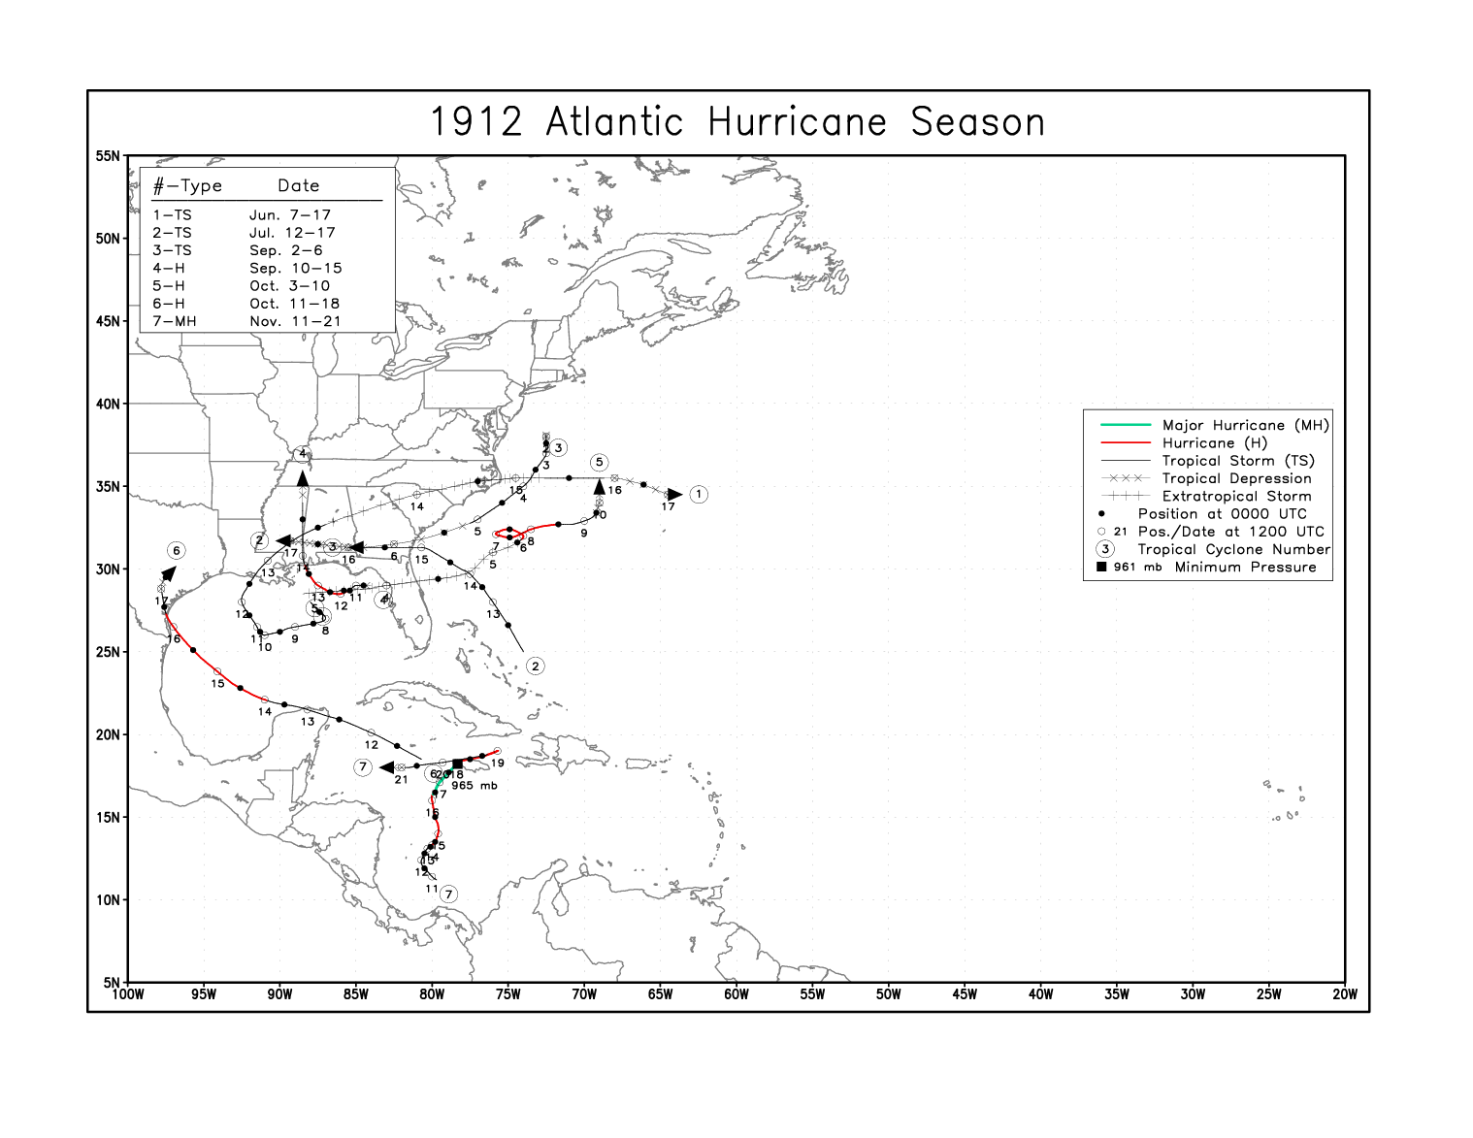

Slide 57
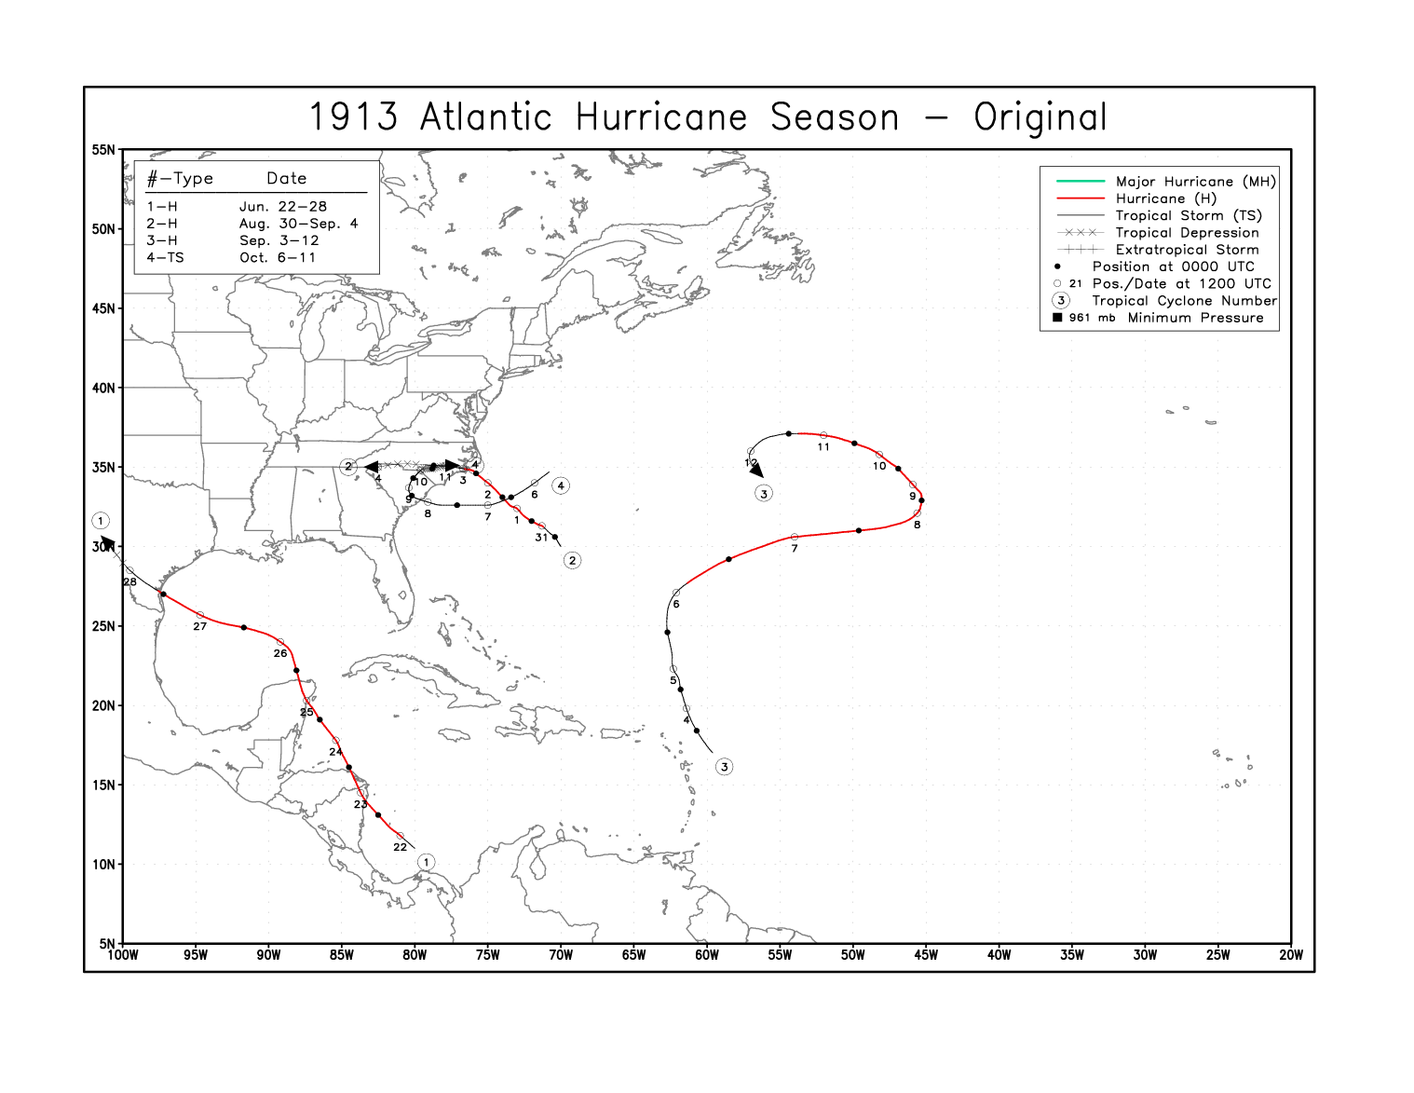

Slide 58
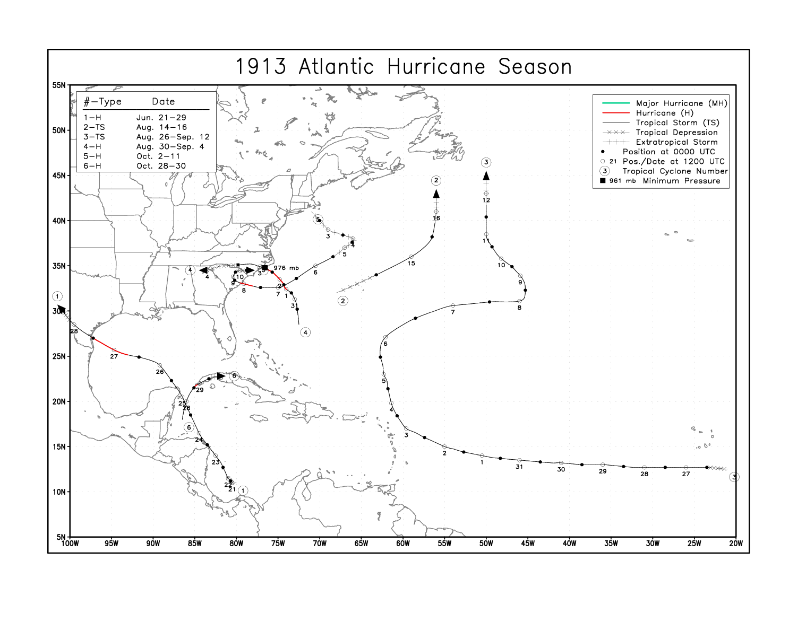

Slide 59
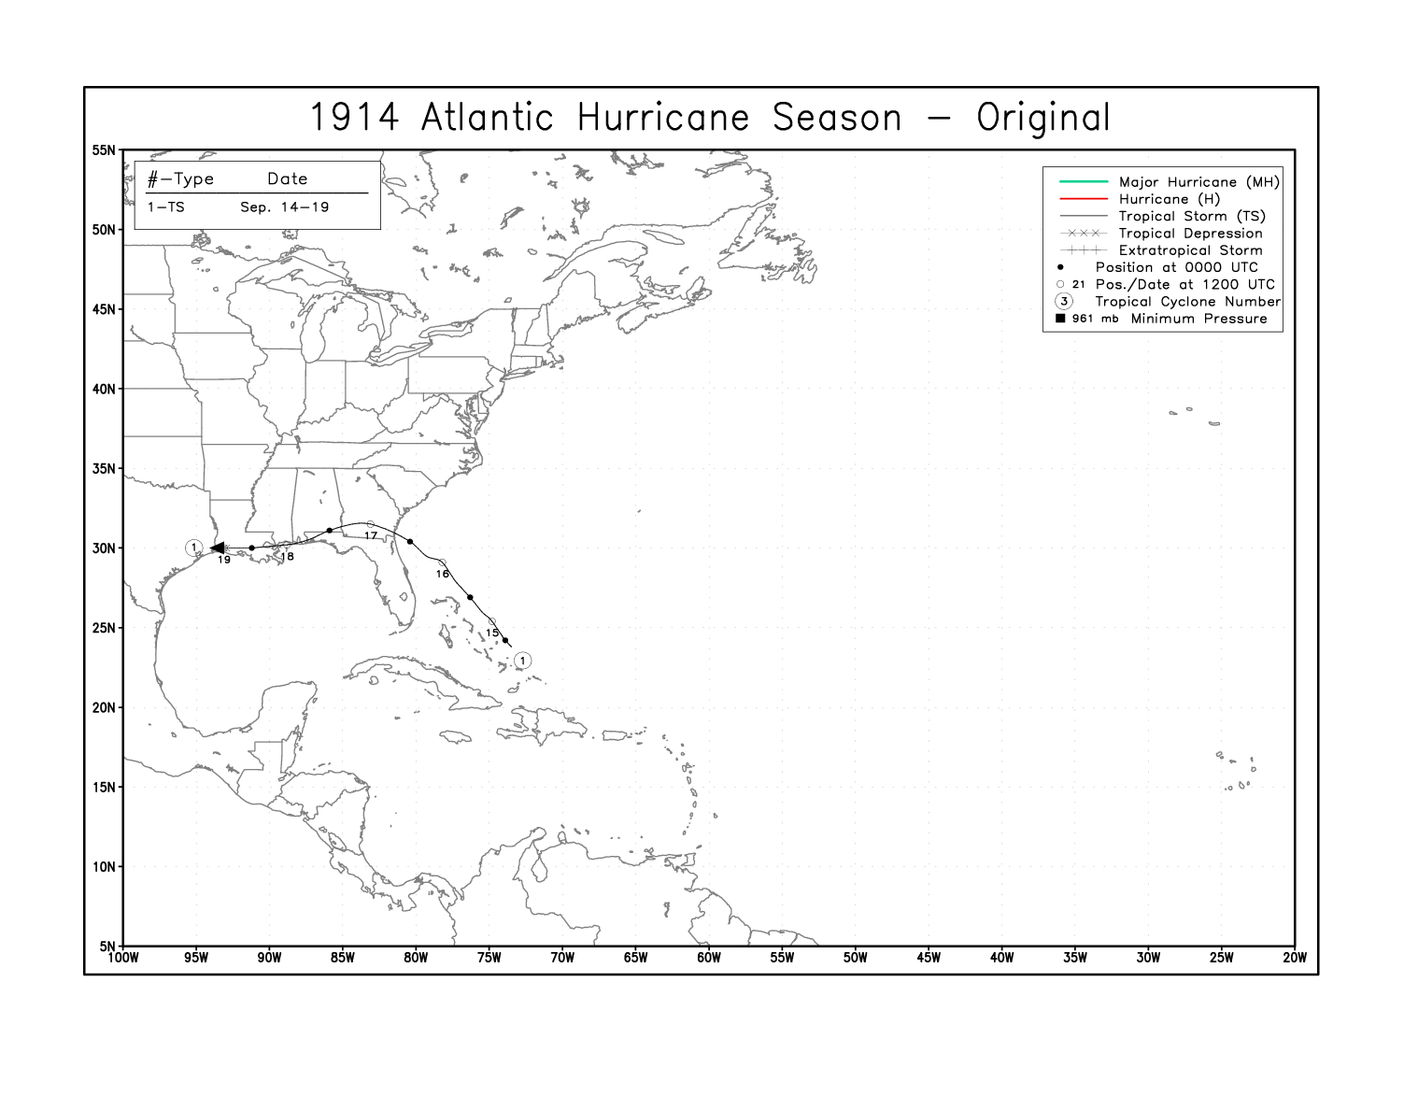

Slide 60
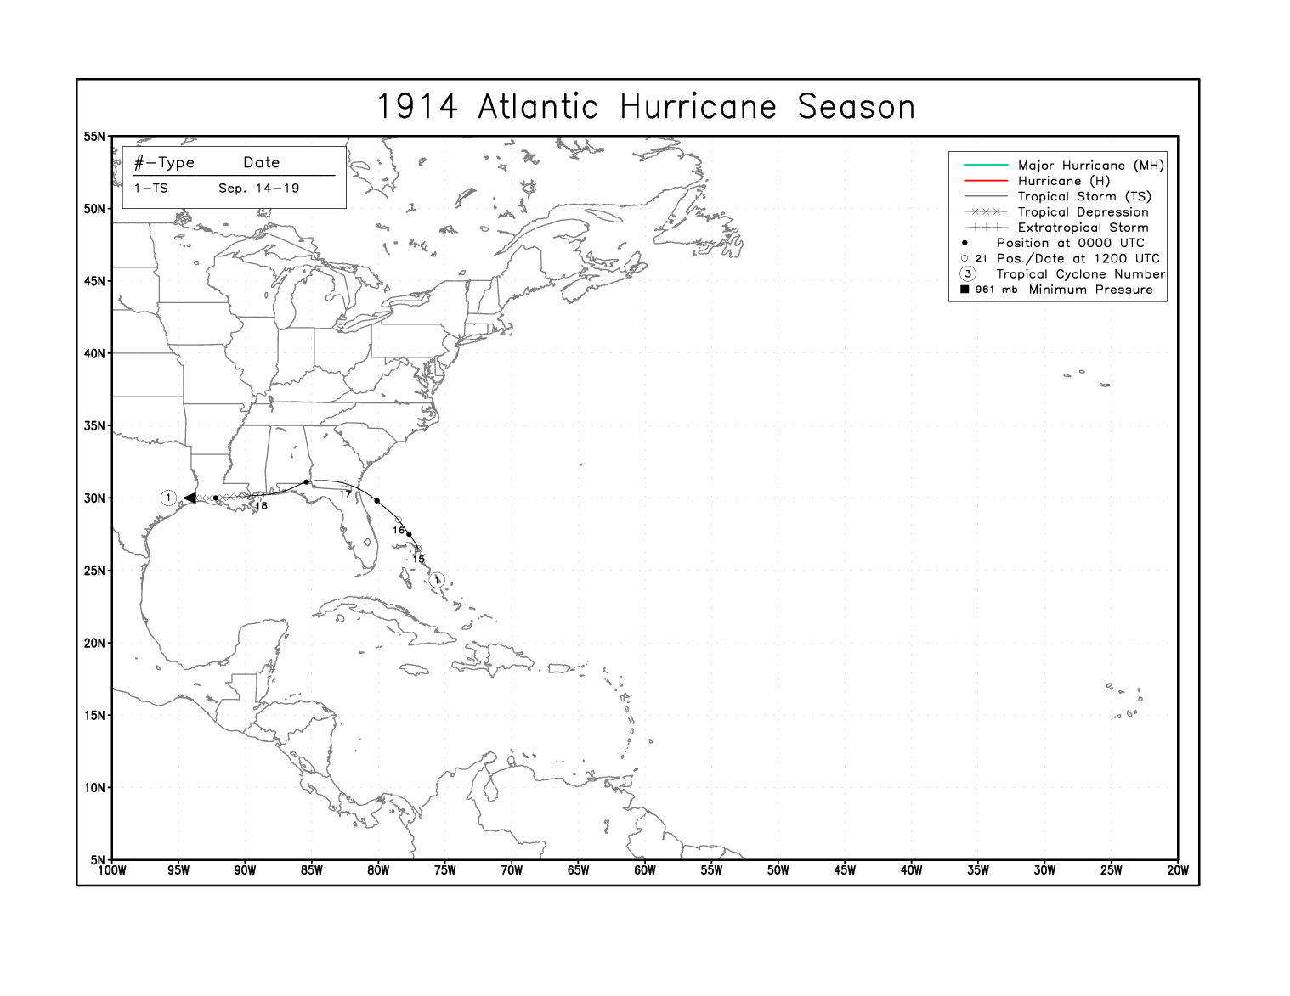

Slide 61
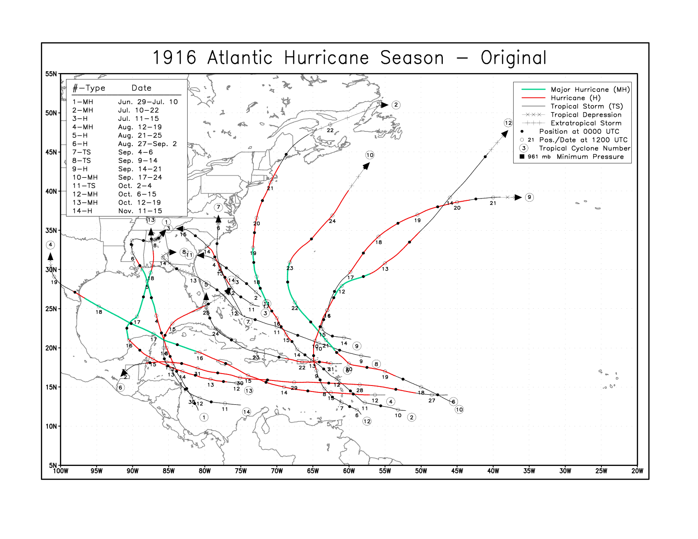

Slide 62
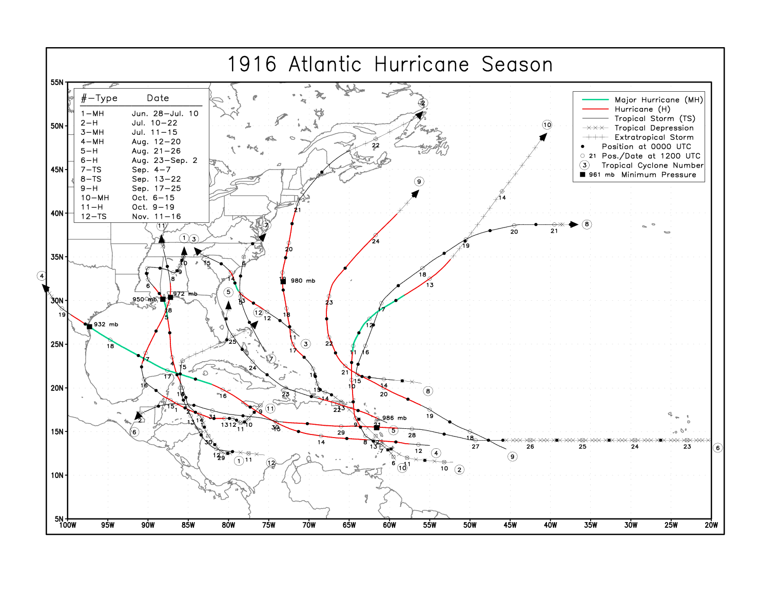

Slide 63
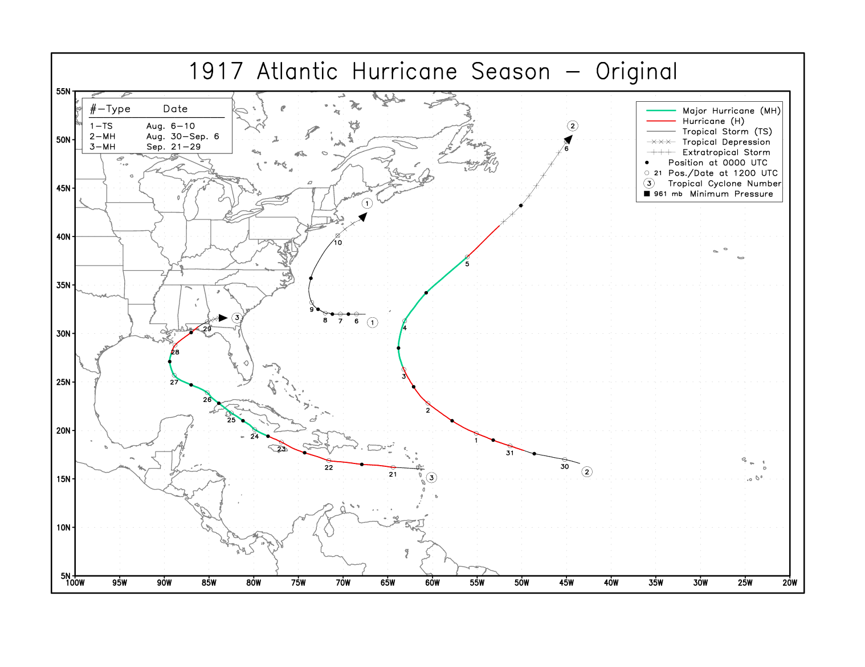

Slide 64
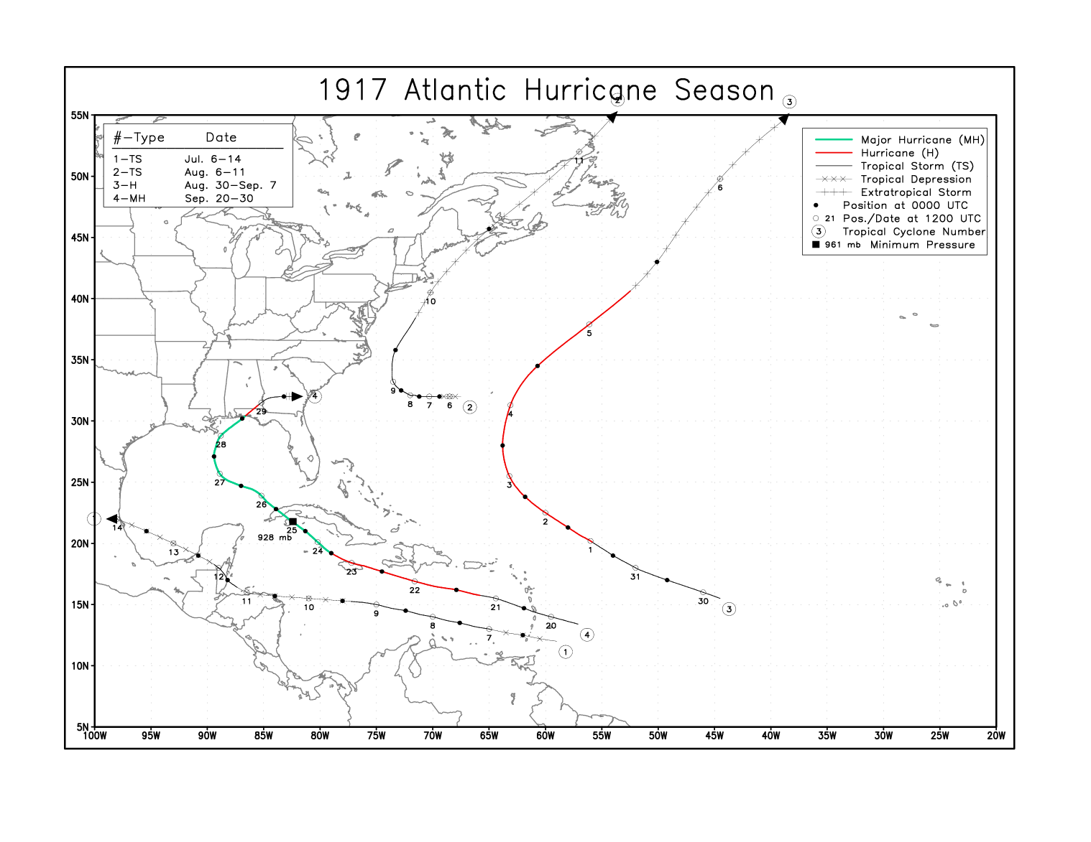

Slide 65
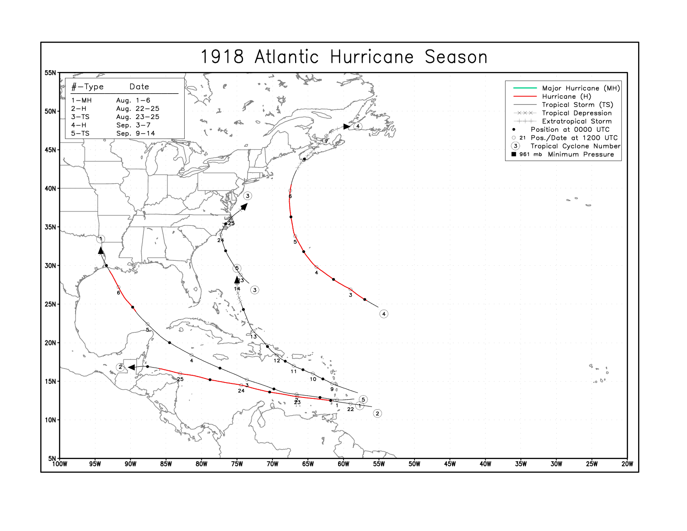

Slide 66
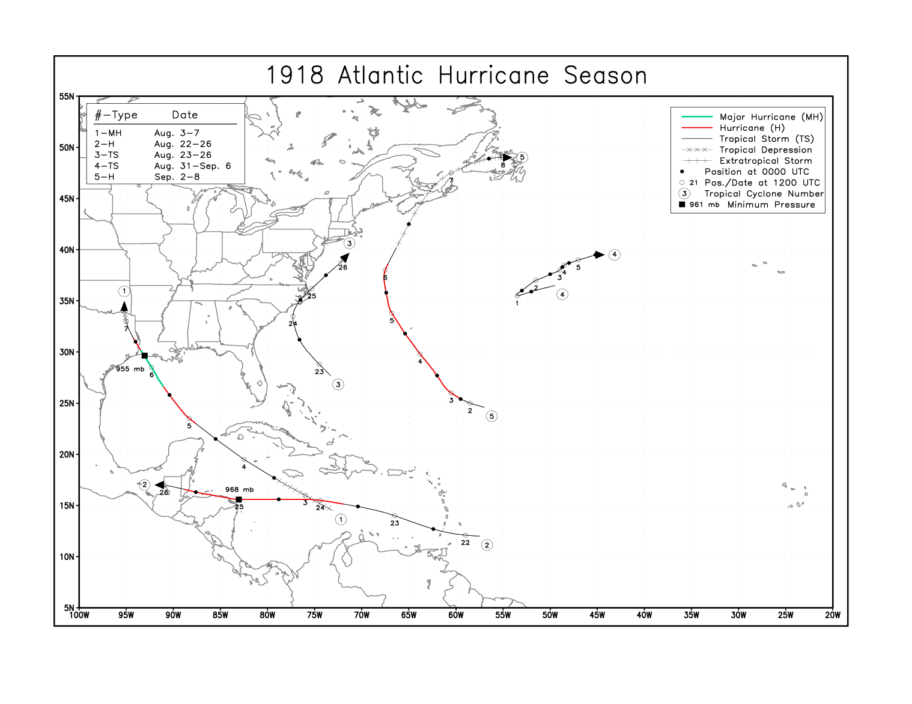

Slide 67


Slide 68


Slide 69


Slide 70


Slide 71


Slide 72


Slide 73


Slide 74


Slide 75


Slide 76


Slide 77


Slide 78


Slide 79


Slide 80


Slide 81

Incorrect
intensity
and location
at landfall

Slide 82
Saffir-simpson scale
Category Windspeed Pressure
1 64-82 kt > 980 mb
2 83-95 979-965
3 96-113 964-945
4 114-135 944-920
5 135+ < 920
For U.S. Hurricane Landfalls:
HURDAT – Basinwide in late 1960s by Neumann and Hope
Saffir-Simpson Categorization – By Taylor and Hebert in mid-1970s, primarily by central pressure

Slide 83


Monthly Weather Review

Slide 84

Monthly Weather Review

Slide 85

Monthly Weather Review

Slide 86

Raw Station Observations also obtained from Colleagues in Mexico, Cuba and throughout the Caribbean

Slide 87

Information resources at the Institute of Meteorology, Havana, Cuba

Slide 88

Atlantic Major Hurricanes
Bias-removed
Landsea (1993)

Slide 89

Historical Weather Maps
The example to the right is an
annotated Historical Weather
Map. Some raw data are gathered from the HWM but it is mainly used as the synoptic background for plotting all raw data from the sources of COADS, MWR, OMR, and other historical reports.
Observations are plotted for the time interval 10-14Z to maximize data near the synoptic time.

Slide 90
Radius of Maximum Wind (RMW)
Vickery et al. (2001) derived an equation for the radius of maximum winds (RMW) of north Atlantic tropical cyclones expressed in terms of central pressure (P_{o}), environmental pressure (P_{n}), and latitude (L):
ln(RMW) = 2.363 – 0.00005086*( Po - Pn)2 + 0.0394899*(L)
RWM of 25 to 50 percent less than climatology had an increase of about 5 kt while systems that had extremely smaller RMW (greater than 50 percent) were strengthened by 10 kt.

Slide 91
Anemometer Bias
Prior to the mid-1920’s, Robinson 4-cup anemometers were used that generally overestimated winds speeds greater than 30 knots (Fergusson and Covert, 1924).
For example, a minimal hurricane force wind of 64 kt reduces to 50 kt after bias correction.
Most anemometers were compromised or destroyed before sampling the highest winds.

Slide 92

Storm Surge

Slide 93

Surveys of Wind-caused Damage

Slide 94
Kaplan and DeMaria (1995):
Inland Wind Decay Model
The Inland Wind Decay Model was used to determine the best track after landfalling tropical cyclones.
Only used in the absence of observed winds.
Designed for landfalling tropical cyclones over the southeastern U.S. where nearly all the regions within 150 nmi of the coast have elevations less than 650 ft.
Not applicable for higher terrains such as Cuba, Hispaniola, and Mexico.
Notes:
30% decay in higher terrains

Slide 95


Accurate Environmental Forecasting’s RealTrack model system
Features
Derived from the operational GFDL system
High-resolution boundary layer
(8 levels below 1000 meters)
High-resolution terrain and land-use datasets
High-resolution output in space and time
Able to control storm track, intensity, and broad storm characteristics
Model domain “moves” with the tropical cyclone
Model input based on original and revised HURDAT

Slide 96


1938: BEFORE RE-ANALYSIS
TWO BIG DISCREPANCIES IN HURDAT:
OFFICIALLY LISTED AS CATEGORY 3, BUT HURDAT WINDS INDICATE CATEGORY 2
LISTED AS EXTRATROPICAL, BUT CONSIDERED A HURRICANE AT LANDFALL
ORIGINAL CATEGORIES EXPERIENCED BY STATE:
NEW YORK: CAT 3
CONNECTICUT: CAT 3
RHODE ISLAND: CAT 3
MASSACHUSETTS: CAT 3
TOO FAST

Slide 97

1938: AFTER RE-ANALYSIS
EXTRATROPICAL AFTER LANDFALL
WINDS AT LANDFALL RE-ANALYZED AT 105 KT
REVISED CATEGORIES EXPERIENCED BY STATE:
NEW YORK: CAT 3
CONNECTICUT: CAT 3
RHODE ISLAND: CAT 3
MASSACHUSETTS: CAT 2
“STAIR STEP” TO TRACK
FAST SPEED REDUCED

Slide 98


Galveston 1900 - 1
How many direct measurements/estimates of strongest winds and/or central pressure?
Carol 1954 - 7
Wilma -280

Slide 99
Beaufort Scale
Beaufort Number | Knots | Description | Specifications at Sea
0 | < 1 | Calm | Sea like a mirror
1 | 1-3 | Light air | Ripples with the appearance of scales are formed, but without foam crest
2 | 4-6 | Light breeze | Small wavelets, still short but more pronounced; crests have a glassy appearance and do not break
3 | 7-10 | Gentle breeze | Large wavelets; crests begin to break; foam of glassy appearance; perhaps scattered white horses
4 | 11-16 | Moderate breeze | Small waves, becoming longer; fairly frequent white horses
5 | 17-21 | Fresh breeze | Moderate waves, taking a more pronounced long form; many white horses are formed (chance of some spray)
6 | 22-27 | Strong breeze | Large waves begin to form; the white foam crests are more extensive everywhere (probably some spray)
7 | 28-33 | Near gale | Sea heaps up and white foam from breaking waves begins to be blown in streaks in the direction of the wind
8 | 34-40 | Gale | Moderately high waves of greater length; edges of crests begin to break into spindrift; foam is blown in well-marked streaks along the direction of the wind
9 | 41-47 | Strong gale | High waves; dense streaks of foam along the direction of the wind; crests of waves begin to topple, tumble, and roll over; spray may affect visibility
10 | 48-55 | Storm | Very high waves with long overhanging crests; the resulting foam, in great patches, is blown in dense white streaks along the direction of the wind; on the whole, the surface of the sea takes on a white appearance; the tumbling of the sea becomes heavy and shock-like; visibility affected
11 | 56-63 | Violent storm | Exceptionally high waves (small and medium-sized ships might be for a time lost to view behind the waves); the sea completely covered with long white patches of foam lying along the direction of the wind; everywhere the edges of wave crests are blown into froth; visibility affected
12 | > 63 | Hurricane | The air is filled with foam and spray; sea completely white with driving spray; visibility very seriously affected
Source: Fitzpatrick, 1999

Slide 100
ATLANTIC PRESSURE-WIND RELATIONSHIPS
1) GLFMEX Vmax(kt)=10.627*(1013-p)**0.5640 n =664; r=0.991
2) <25N Vmax(kt)=12.016*(1013-p)**0.5337 n =1033; r=0.994
3) 25-35N Vmax(kt)=14.172*(1013-p)**0.4778 n =922; r=0.996
4) 35-45N Vmax(kt)=16.086*(1013-p)**0.4333 n =492; r=0.974
5)For Kraft Vmax(kt)=14.000*(1013-p)**0.5000 n =13; r= ??
P(MB) GLFMEX <25N 25-35N 35-45N KRAFT P(MB) P(IN)
960 100 100 94 90 102 960 28.35
Hurricanes with a small Radius of Maximum Winds (RMW) will typically have stronger winds than a system with the same central pressure but larger RMW.

Slide 101

COMPREHENSIVE
PRESSURE-WIND RELATIONSHIP
MAXIMUM WIND = 18.633
  14.960xSIZE
  0.755xLATITUDE
  0.518x(ENV.-CENTRAL PRESSURE)
  +9.738x(ENV.-CENTRAL PRESSURE)**0.5
  +1.5(SPEED)**0.63
For example, a small RMW TC with a central pressure of 963 mb in the lower latitudes (with average environmental pressure and translational velocity) would suggest a windspeed of 100 kt, while a large RMW TC with a central pressure of 948 mb in high latitude would also suggest also a maximum wind of 100 kt.
Knaff and Zehr (2007)

Slide 102
Hurricane Observational Milestones
Year | Observation Network (Source: Fitzpatrick, 1999)
1800s | Ship Logs
1845 | First telegraph line complete from Washington to Boston
1846 | The invention of the cup anemometer by Robinson
1870 | Smithsonian Institute volunteer weather observer network started in the U.S.
1875 | First hurricane prediction system started by Benito Vines in Cuba
1890 | U.S. weather service transferred to civilian agency - U.S. Weather Bureau
1898 | U.S. Weather Bureau established observation stations throughout Caribbean
1905 | First use of the radio to transmit weather observations from shipping vessels
1940s | Beginning of regular aircraft reconnaissance for tropical cyclone observation
1960s | Satellite observations used for tropical cyclone detection and observation
From the period 1886 to 1930, the original HURDAT was created from a once daily 12 GMT track and intensity estimate. The 00, 06, and 18 GMT track and intensity estimates were interpolated from two day’s 12 GMT estimates.
Problematic for storms undergoing rapid intensification or rapid decay.
Notes:
Rapid intensification and rapid decay

Slide 103
Changes to U.S. Landfalling Hurricanes
#-Year Original Revised #-Year Original Revised
2-1911 AFL1,AL1 AFL1,AL1 1-1921 BTX2 BTX1,CTX1
3-1911 GA2,SC2 SC2, GA1 7-1921 BFL3,DFL2 BFL3,AFL2,DFL1
4-1912 AL1 AL1,AFL1 5-1923 LA1 LA1
6-1912 ATX1 ATX2 2-1924 TS NC1
1-1913 ATX1 ATX1 4-1924 AFL1 AFL1
4-1913 NC1 NC1 8-1924 BFL1 BFL2,CFL1
5-1913 TS SC1 2-1925 BFL1 ET
2-1915 CTX4 CTX4,BTX1 1-1926 DFL2 DFL2
4-1915 AFL1 AFL1 3-1926 LA3 LA3
6-1915 LA4 LA3,MS1 7-1926 CFL4,BFL3, CFL4,BFL3,
1-1916 MS3,AL3 MS3,AL3,AFL2 AFL3,AL3 AFL3,AL3,MS1
2-1916 MA1 TS 1-1928 CFL2 CFL2
3-1916 SC1 SC2 4-1928 CFL4,DFL2, CFL4,BFL3,AFL1,
4-1916 ATX3 ATX4 GA1,SC1 DFL1,GA1,SC1
11-1916 AL2,AFL2 AL2,AFL2 1-1929 BTX1 BTX1
12-1916 BFL1 ET 2-1929 CFL3,AFL2 CFL3,BFL2,AFL1
3-1917 AFL3 AFL3,LA2,AL1
1-1918 LA3 LA3,CTX1
2-1919 BFL4,ATX4 BFL4,CFL2,ATX3,BTX3
2-1920 LA2 LA2
3-1920 NC1 TS
Overall changes: 6 up 1 Category, 23 same, 6 down 1 Category

Slide 104


1938 New England Hurricane
Original HURDAT
Revised HURDAT
Original HURDAT: Cat 3 in NY, CT, RI, MA
HURDAT shows the last point before landfall was 85 kt and the first landfall point of 70 kt
AEF footprint analysis shows only Cat 1 in NY, CT, RI, and MA
Revised HURDAT: Cat 3 in NY, CT, RI and Cat 2 in MA
HURDAT revised - last point before NY landfall was 105 kt and CT landfall was 100 kt
AEF footprint analysis shows Cat 3 NY, CT, RI and Cat 2 in MA

