Slide 1
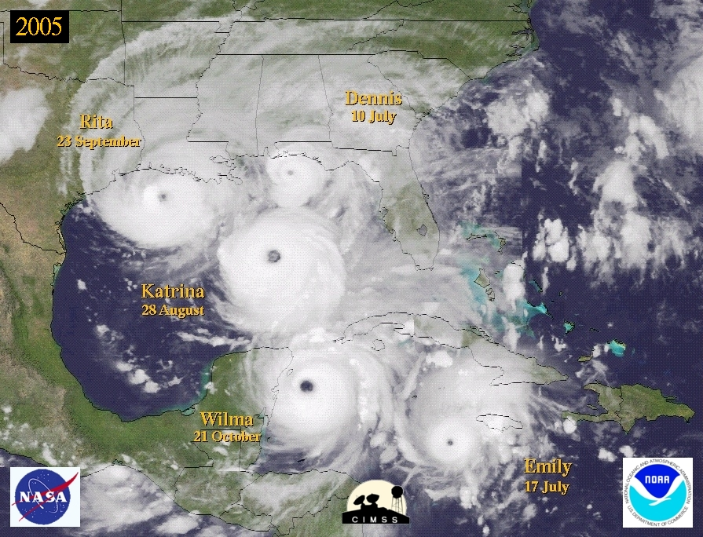

The Atlantic Hurricane Database Reanalysis
October 2012
NOAA Climate Diagnostics and Prediction Workshop
Chris Landsea, National Hurricane Center, Miami, USA
Supported by the NOAA Climate Program Office

Slide 2
HURDAT
The National Hurricane Center maintains and updates annually the North Atlantic Basin’s Hurricane Database (HURDAT)
HURDAT provides from 1851 to 2011 for all tropical storms, subtropical storms, and hurricanes every 6 hours:
Positions (to nearest 0.1 degree latitude/longitude)
Intensity (1 min surface winds to nearest 10 kt from 1851-1885, 5 kt from 1886 onward)
Central pressure (to nearest 1 mb, when observed)
34, 50, and 64 kt wind radii maximum extent since 2004 (by quadrant, to nearest 10 nmi)

Slide 3
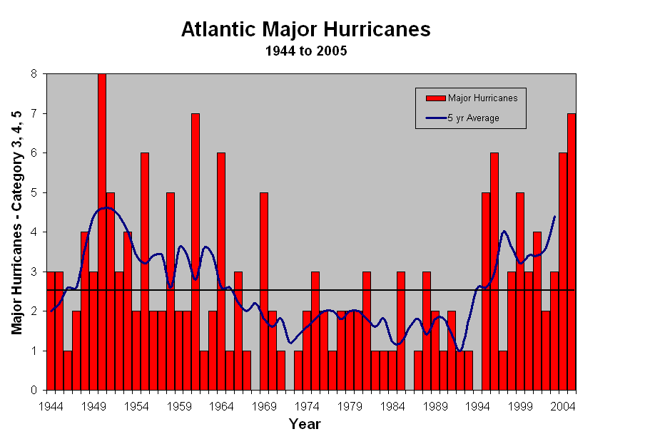
HURDAT applications:
  Validation of official and model predictions
  Climate trend assessment – long term trends, seasonal forecasts, etc.
  Building code standards and insurance rates for coastal communities
  Risk assessment for emergency managers (recurrence intervals)

Slide 4
Why revise HURDAT?
HURDAT contains many systematic and random errors
  1938 Hurricane: Cat 3 at landfall, but 85kts at last offshore position
“Missing storms”
Lack of exact hurricane landfall parameters
Advances in the understanding of hurricanes and analysis techniques
Bias in early
major hurricanes

Slide 5
How is the reanalysis conducted?
Search through all data sources to find all info/data that exist on storms
Place all raw data into a single database
Conduct synoptic analyses 1 to 4 times daily by plotting all observations (i.e. wind, pressure, etc.) on surface maps
Determine track and intensity
Document revisions (metadata file)
After TCs for a year are reanalyzed, a search is conducted for missing storms

Slide 6
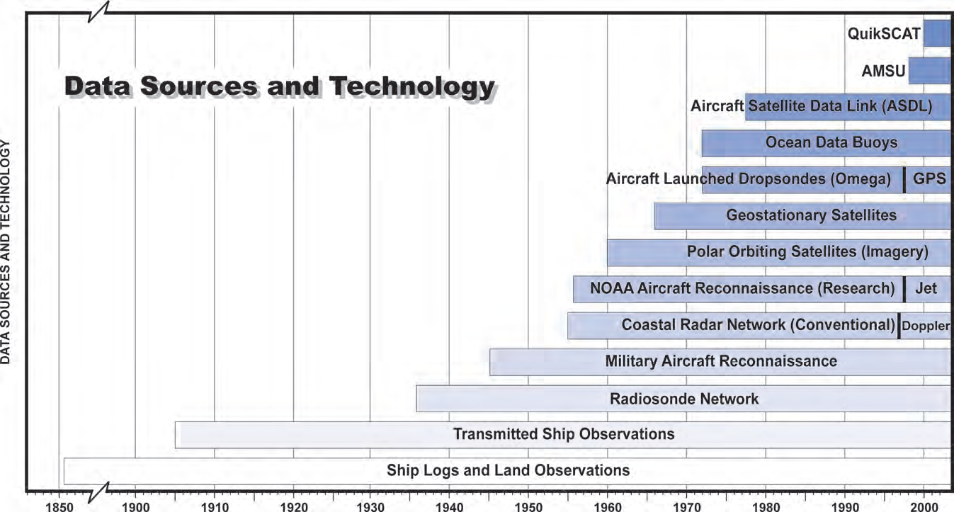
Observation Capabilities:
Huge Improvements over Time

Slide 7
Work of Jose Partagas:
Historical Reconstruction from 1851-1910

Slide 8
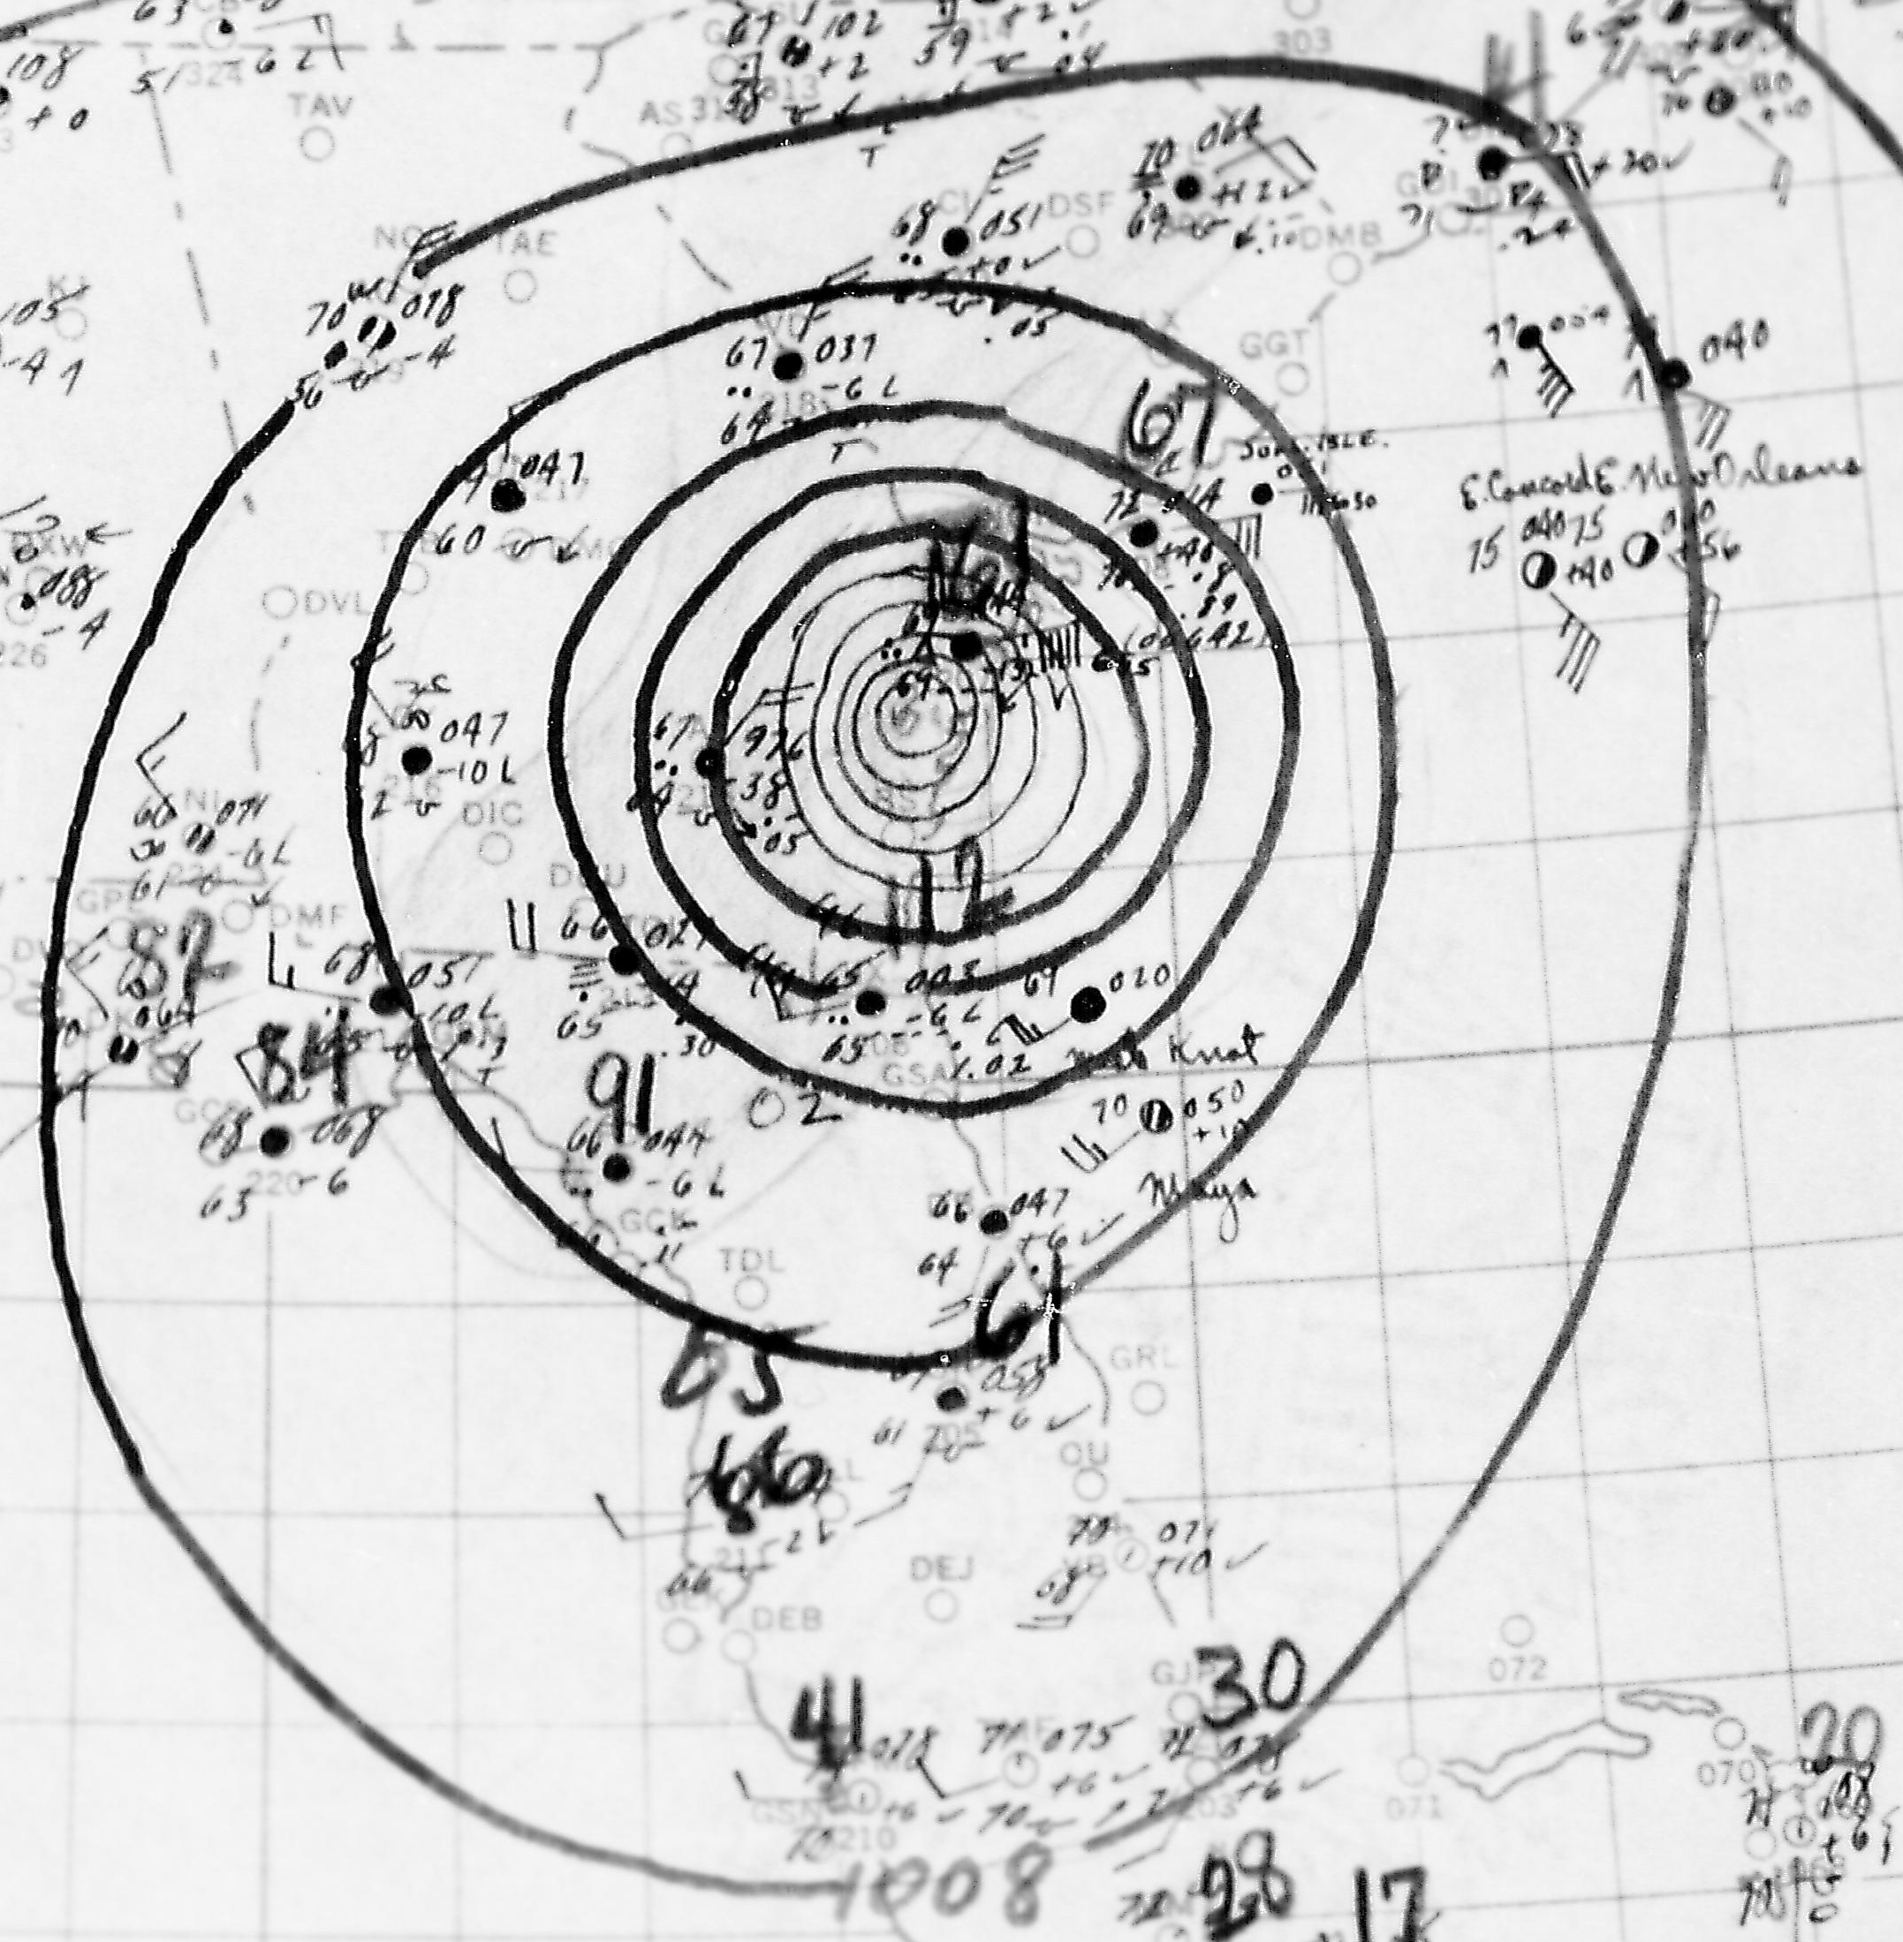
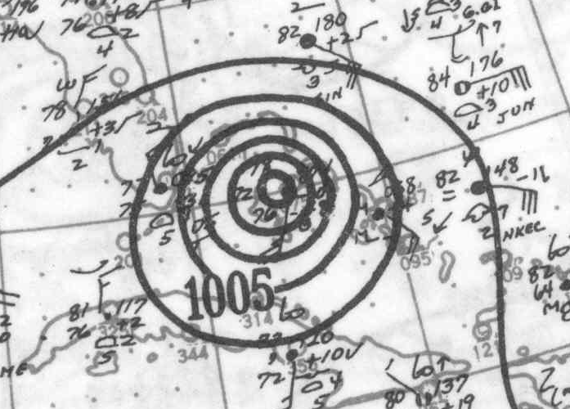
Data Sources
Microfilm
Historical Weather Maps
1947 Storm 8
1949 Storm 2

Slide 9
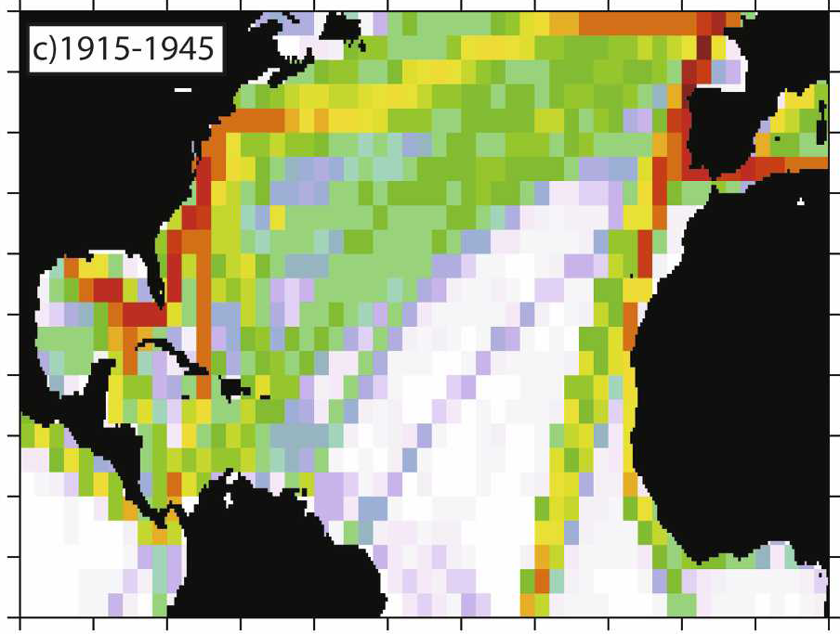
International Comprehensive Ocean-Atmosphere Dataset (ICOADS)
Notes:
9

Slide 10
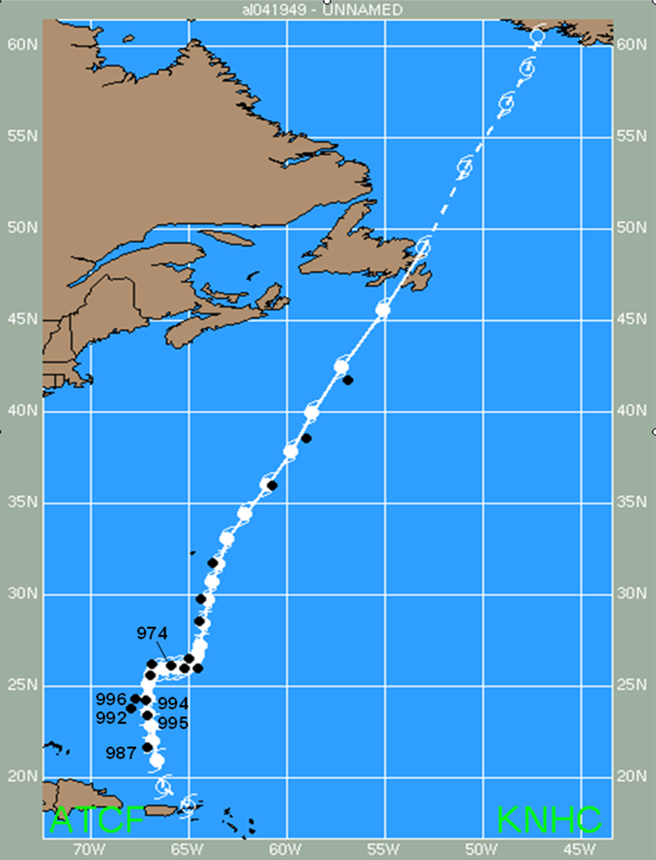
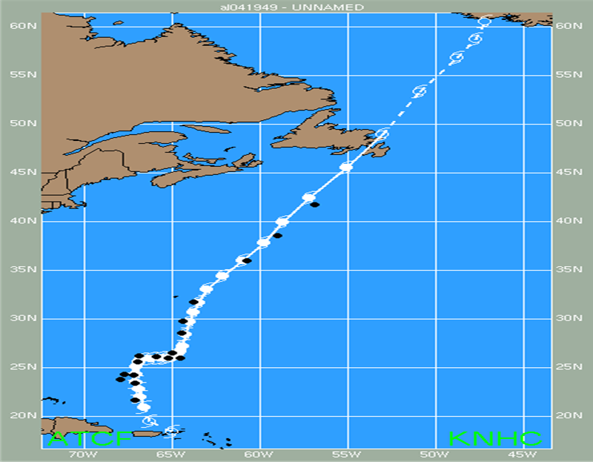

Hurricane Aircraft Reconnaissance in late 1940s and early 1950s:
U.S. Navy’s PB4Y2
Notes:
10
10

Slide 11
U.S. Navy’s PB4Y2:
No night flights
No central pressure for major hurricanes
Notes:
11
11

Slide 12
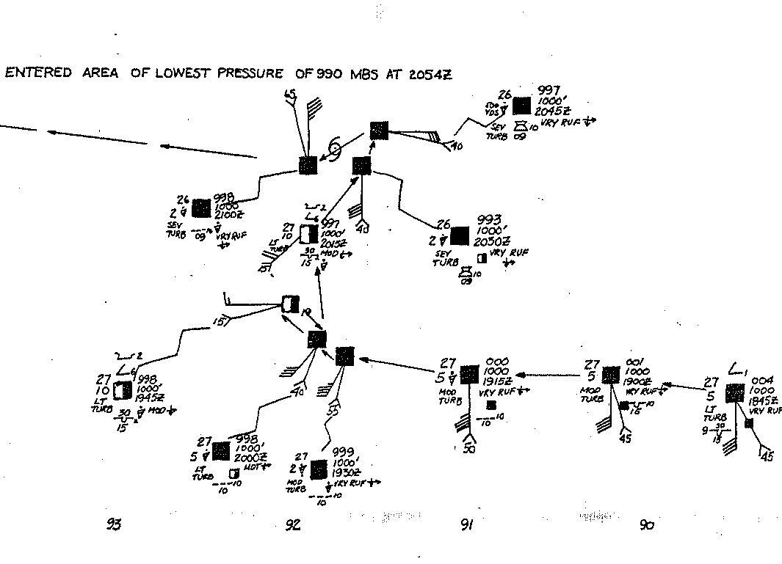
Aircraft Reconnaissance Penetration: 1948 Storm 5

Slide 13
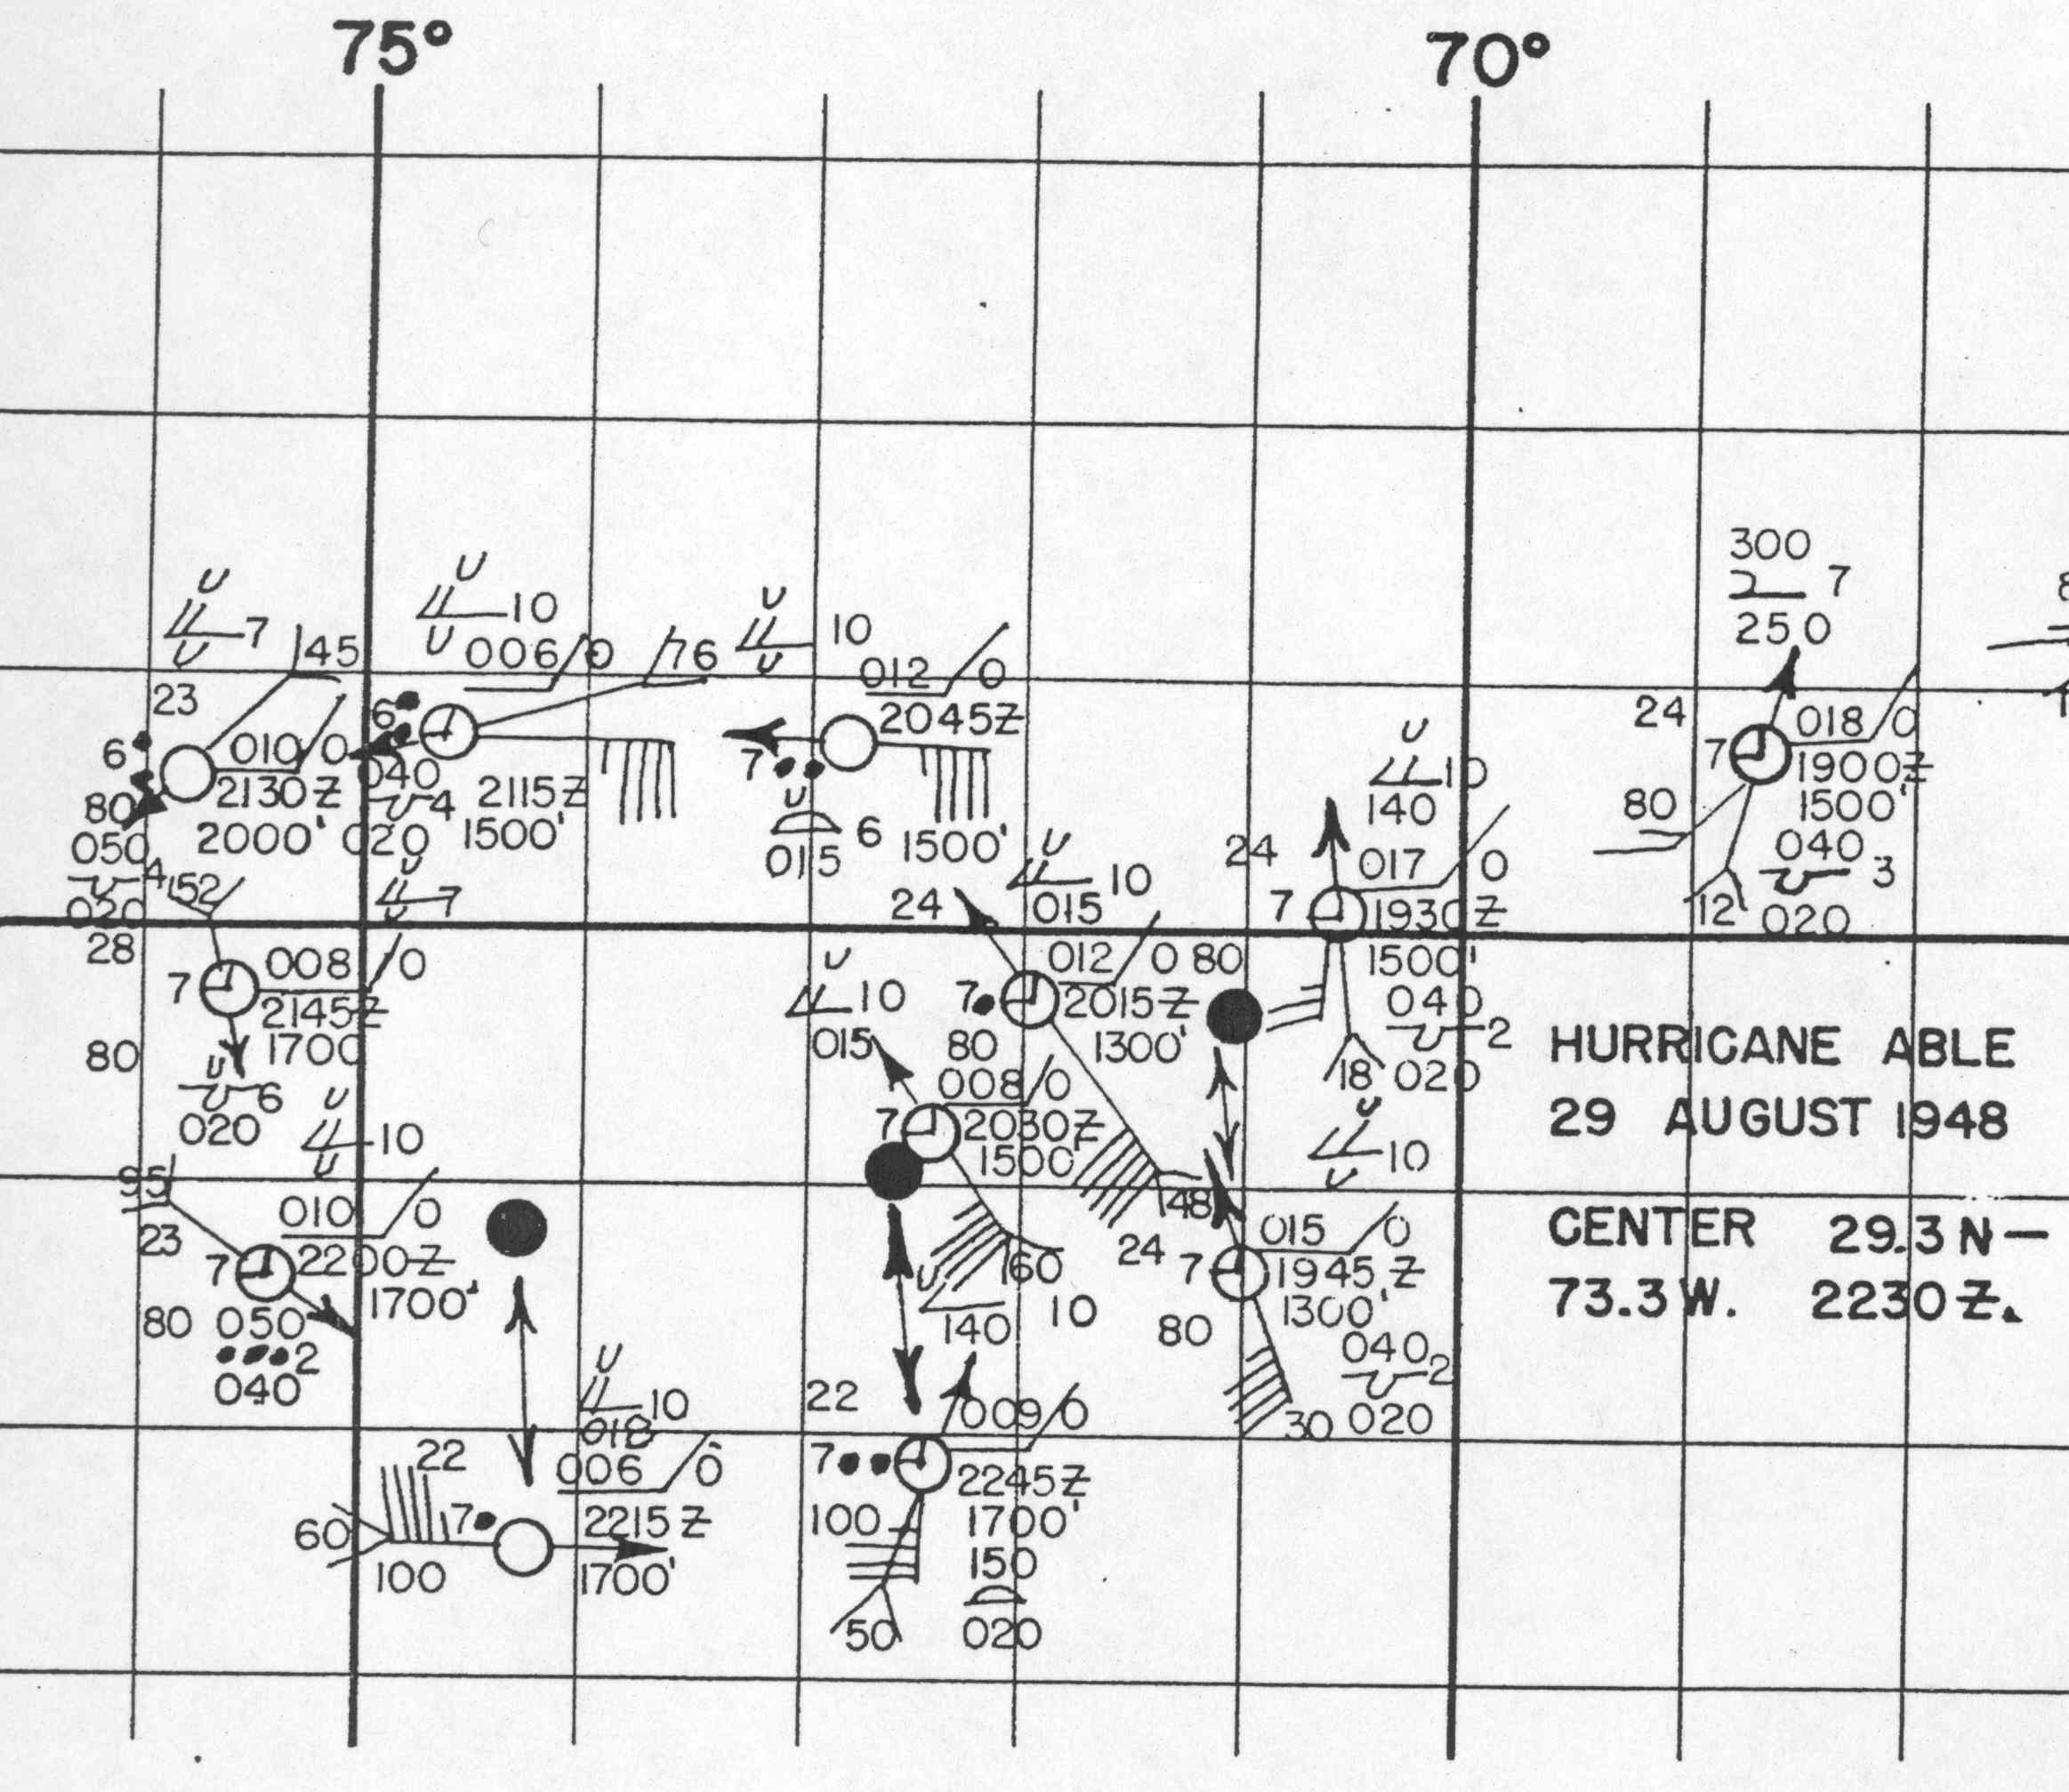

Flight track 1948 Storm 3 – August 29th
Circumnavigation - typical technique for intense hurricanes
32 N
Given aircraft fix position
30 N
28 N
76 W
74 W
72 W
70 W

Slide 14
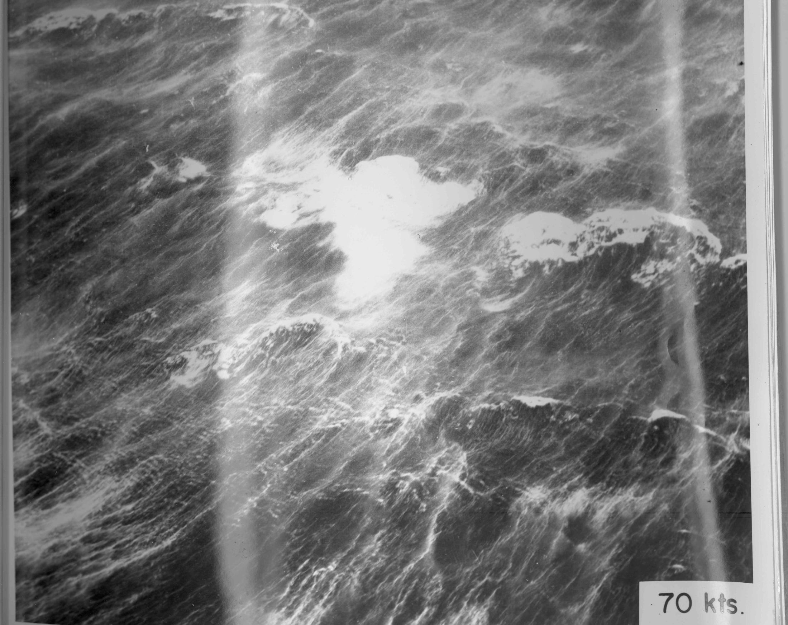
Neumann 1952

Slide 15
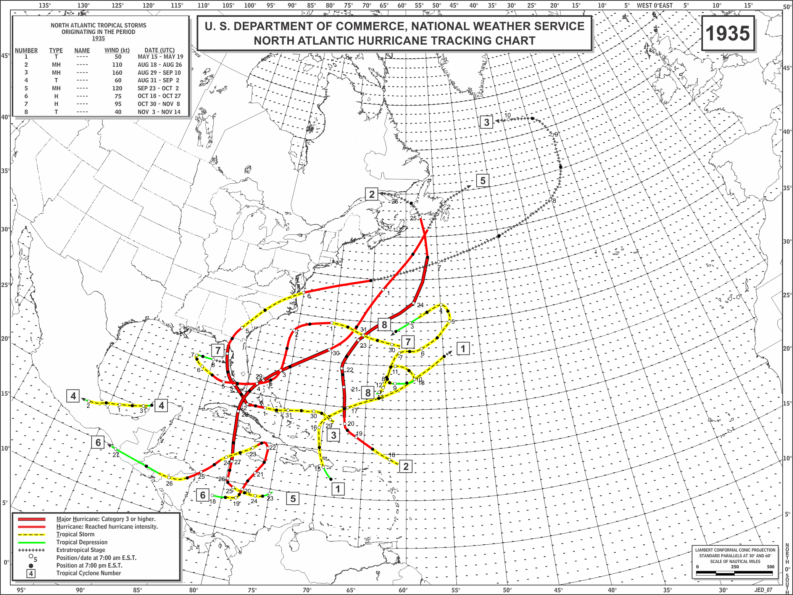
Reanalysis Products
Raw Data
“Best Track” Data
22-Oct | ~16Z | 989 |  |  |  |  | SWAN IS. | 175 | 842
22-Oct | ~20Z |  | 70 | SW |  |  | SWAN IS. | 175 | 842
23-Oct | ~22Z | 941 | EYE |  |  |  | SHIP | 215 | 855
24-Oct | 8Z | 959 | 70 | E |  |  | SHIP | 240 | 852
22590 10/20*123 801 35 0*131 804 35 0*137 806 35 0*143 809 40 0
Metadata
The hurricane made landfall in southwest Florida with a central
pressure of 952 mb measured in Tarpon Springs at 1940-2040 UTC on the 25th.
952 mb suggests winds of 108 kt from the Gulf of Mexico pressure-wind
relationship. The new Brown et al. (2006) pressure-wind relationship suggests
103 kt from the north of 25N associations. Schwerdt et al. (1979) suggested an
Track Maps
Comments by/Replies to Best Track Change Committee
1921 #8: Given the west wind of 20 kt found in the HWM, it is suggested that the wind at 12Z on 10/20 be maintained at 35 kt. Please note that the observation cited in the metadata for 10/23 (27.5, 85.6) appears to be either for some other day, or the latitude is incorrect (21.5?). A major

Slide 16
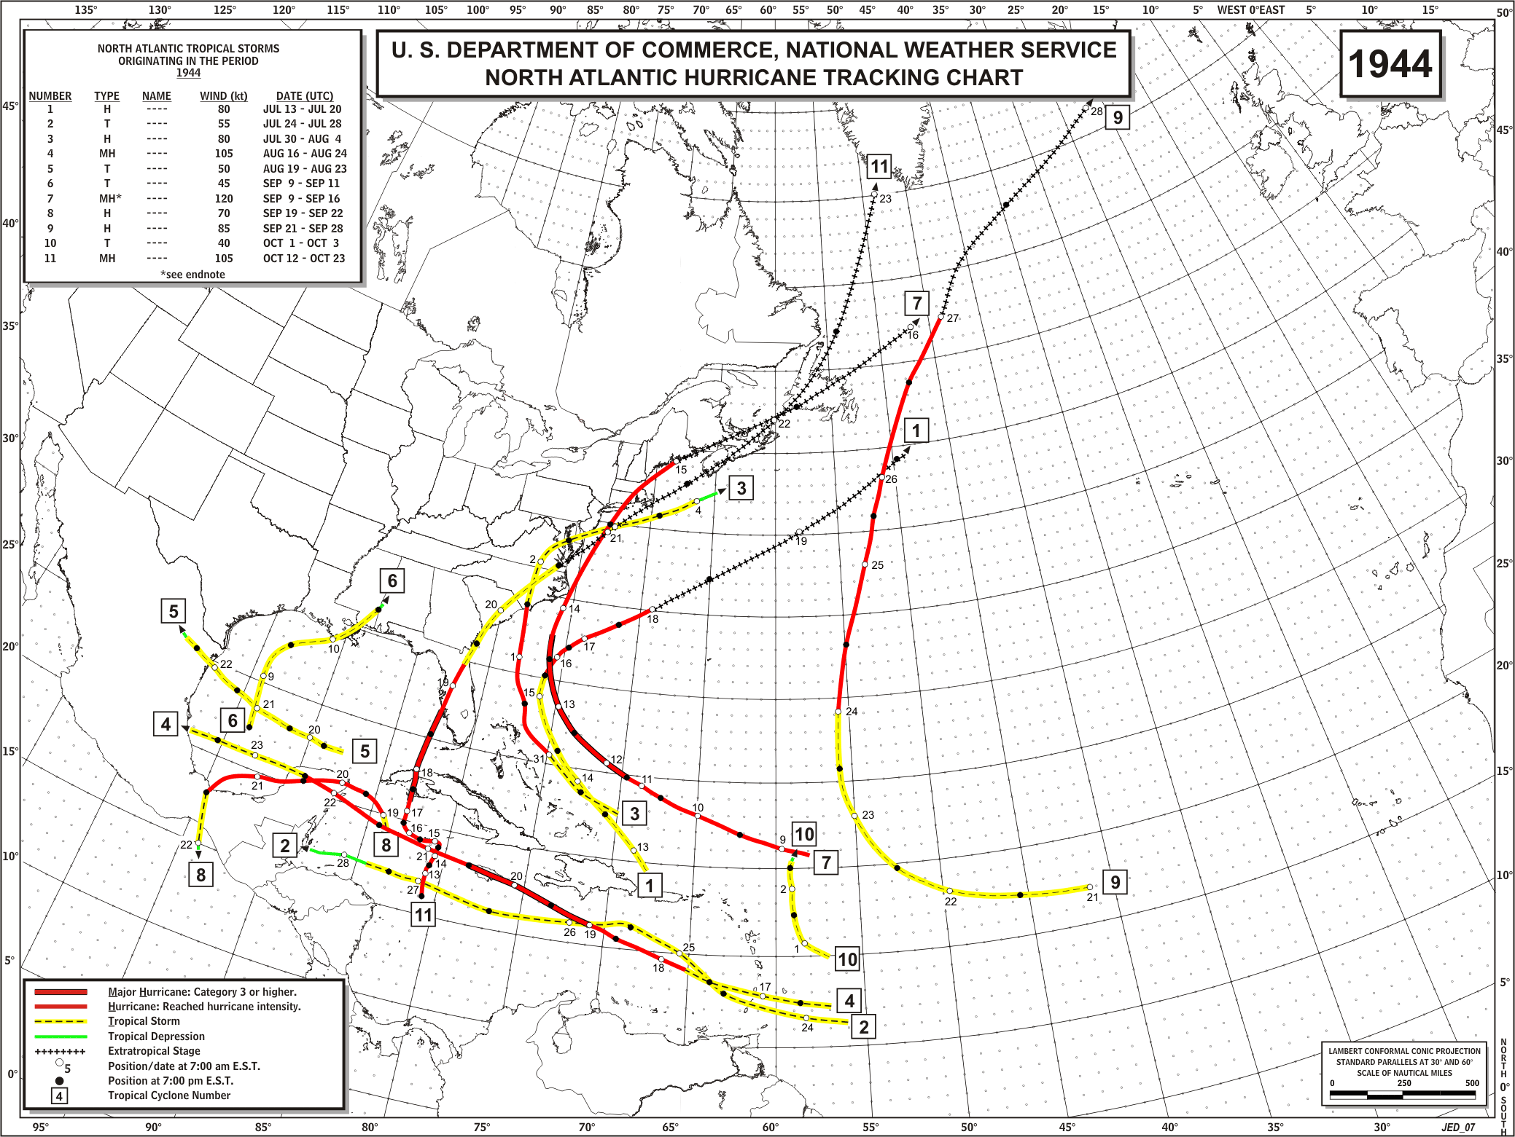
Original

Slide 17
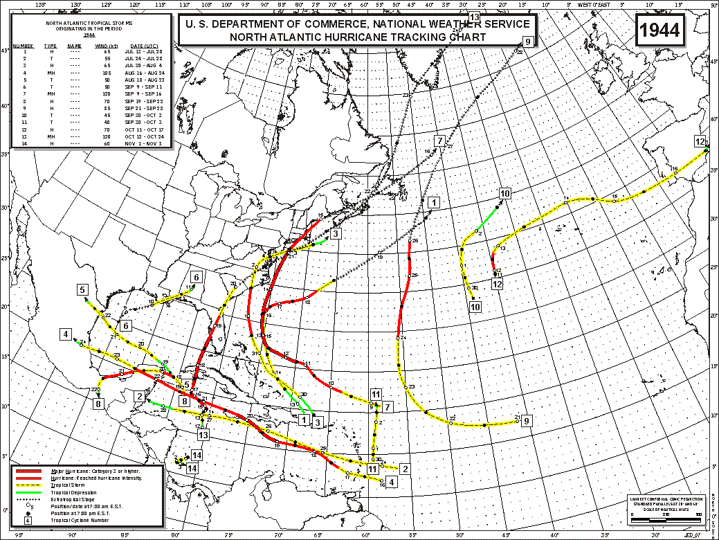
Revised

Slide 18
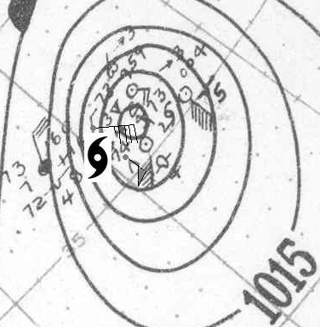
1944 missing hurricane found
New to HURDAT:
31895 10/11/1944 M= 7 12 SNBR= 707 NOT NAMED XING=0
31896 10/11*355 400 35 0*355 400 35 0*355 400 40 0*355 400 45 0*
31897 10/12*356 400 50 0*357 400 60 0*360 400 70 0*366 400 70 0*
31898 10/13*375 399 70 0*383 395 60 0*390 385 50 0*397 365 50 0*
31899 10/14*404 335 45 0*410 295 45 0*415 255 45 0*412 230 45 0*
31899 10/15*405 210 45 0*397 195 50 0*390 180 55 0*385 160 55 0*
31899 10/16*382 130 50 0*381 100 50 0*380 70 45 0*380 40 35 0*
31899 10/17*380 10 30 0* 0 0 0 0* 0 0 0 0* 0 0 0 0*
31960 HR
Key observations:
Oct 12, 1944 HWM

Slide 19
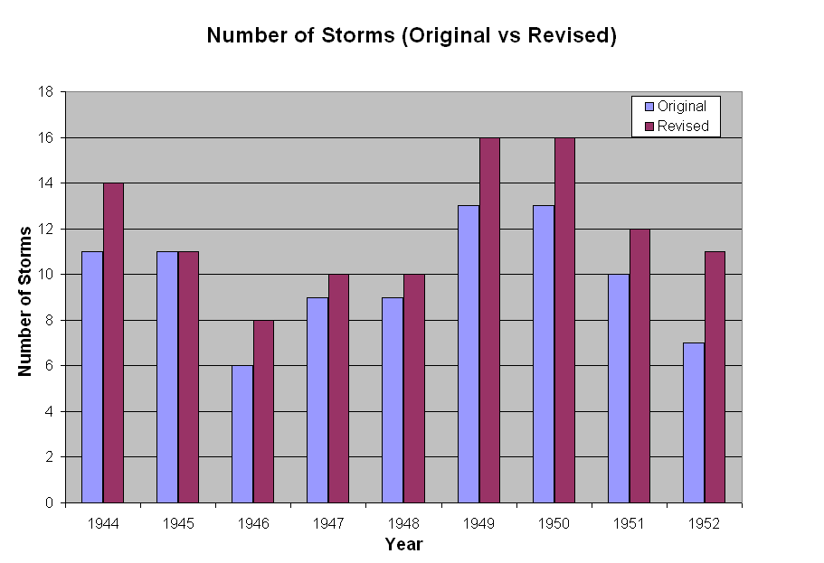
Tropical storms and hurricanes
Revised (avg = 12.0)
Original (avg = 9.9)

Slide 20

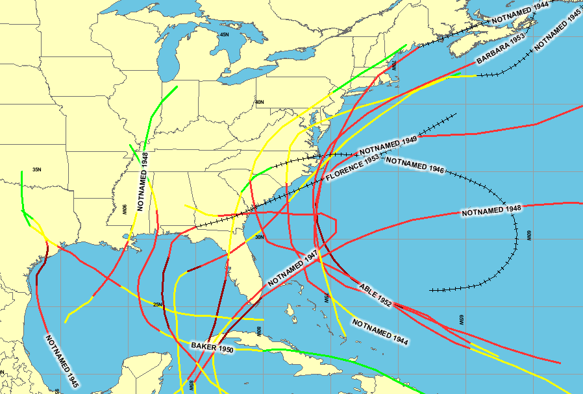
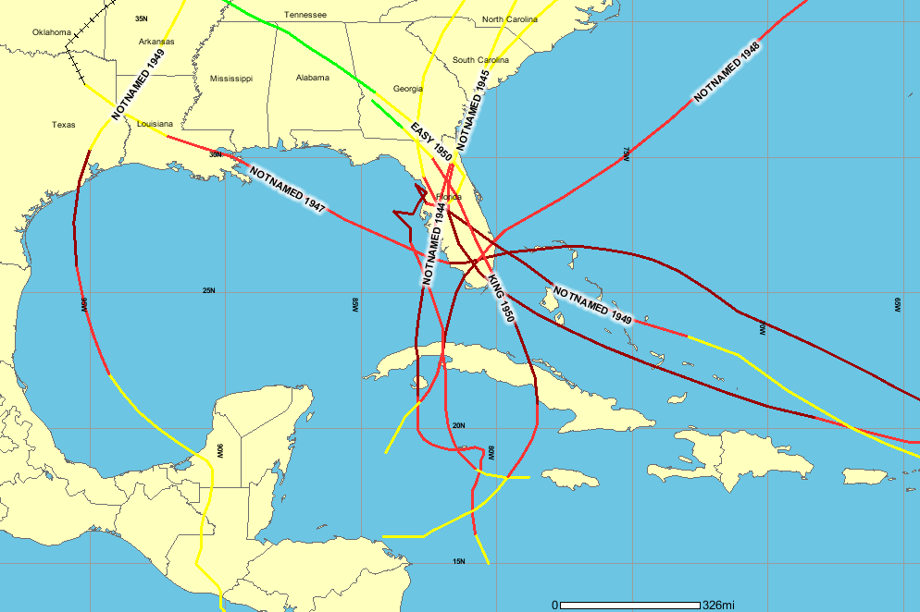
US Cat 1&2 Hurricanes (1944-1953)
1944-1953:
6 up 1 Category
2 down 1 Category
15 unchanged
US Major Hurricanes (1944-1953)

Slide 22
Accomplishments:
2000 – Added in 241 new TCs for 1851 to 1885
2002 – Reanalyzed 1992’s Hurricane Andrew
2003 – Reanalyzed 1886 to 1910 – Revised all existing 194 TCs,
added 23 new TCs, removing one TC
2005 – Reanalyzed 1911 to 1914 – Revised all 15 existing TCs,
added 5 new TCs.
2008 – Reanalyzed 1915 to 1920 – Revised all 34 existing TCs,
added 8 new TCs, removed one TC
2009 – Reanalyzed 1921 to 1925 – Revised all 27 existing TCs,
added in 10 new TCs, removed one TC
2010 – Reanalyzed 1926 to 1930 – All 29 TCs revised, 4 new TCs
2012 – Reanalyzed 1931 to 1935 – All 58 TCs revised, 15 new TCs,
4 removed TCs
2012 – Have submitted 1936 to 1954 reanalyses for consideration
Overall: Revised 357 existing tropical cyclones, added 316 new
systems, removed 8 tropical cyclones
http://www.aoml.noaa.gov/hrd/data_sub/re_anal.html

Slide 23
The Atlantic Hurricane Database Reanalysis
October 2012
NOAA Climate Diagnostics and Prediction Workshop
Chris Landsea, National Hurricane Center, Miami, USA
Supported by the NOAA Climate Program Office

Slide 24
Reanalysis of NW Pacific Typhoon Database
Shifts in Typhoon Tracks over the western North Pacific during the 20th century based on the recovery of historical data
Hisayuki Kubota, Research Institute for Global Change/ Japan Agency for Marine-Earth Science and Technology, Yokosuka, Japan; and J. C. L. Chan, J. Matsumoto, and E. Ginn – American Meteorological Society Hurricanes and Tropical Meteorology Conference, April 2012

Slide 25
Revised HURDAT average position errors
1851-1920 numbers from Landsea et al. 2004, Landsea et al. 2008. Late 1990s and late 2000s estimates from Landsea 2012
Revised HURDAT average intensity errors

Slide 26
Revised HURDAT intensity biases
1851-1920 numbers from Landsea et al. 2004, Landsea et al. 2008. Late 1990s and late 2000s estimates from Landsea 2012

Slide 27
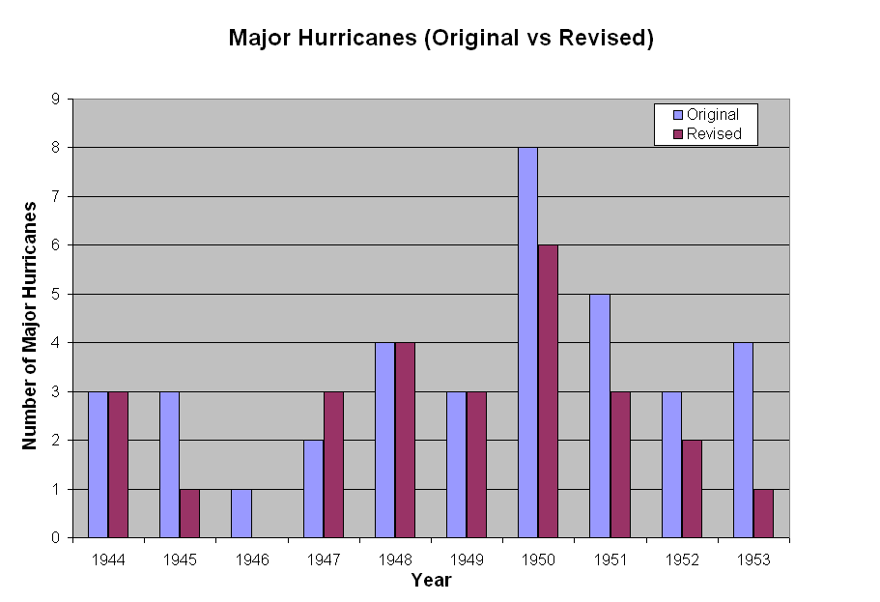
Major hurricanes
Original (avg = 3.6)
Revised (avg = 2.6)

Slide 28
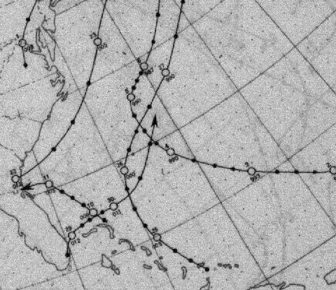
More data Sources
COADS Ship Observations
Other useful data sources
MWR Tracks of Lows
Monthly Weather Review (MWR) post-season summary articles
Navy, Army-Air Force, and Air Weather Service post-season hurricane summaries: These focus on aircraft reconnaissance
Original Monthly Records and Climatological Data Summaries of U.S. coastal station observations
Several publications on case studies of Atlantic hurricanes

Slide 29
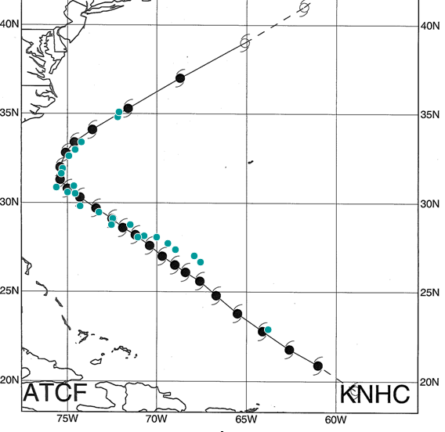
Track analysis methodology
(with abundant recon fixes)
All center fixes compiled
Fixes plotted and interpolated to 6-hourly positions
Ship and station data plotted against aircraft data
Final revised positions are a consensus of all data
When lack of data, significant changes are not implemented

Slide 30
Intensity analysis tools
Ship, coastal stations, aircraft reconnaissance data
Brown et al. (2006) pressure-wind relationships
Vickery et al. (2000) climatological RMW values
Kaplan and DeMaria (1995) inland decay model
Schloemer (1954) equation
  Calculates central pressure given
  a peripheral pressure measurement
Ho et al. (1987) inland pressure decay model
  Estimates landfall central pressure based on a post-landfall central pressure measurement
Neumann model from Schwerdt et al. (1979)
  Calculates extent of hurricane force winds
Franklin et al. (2003) flight-level to sfc wind

