Slide 1
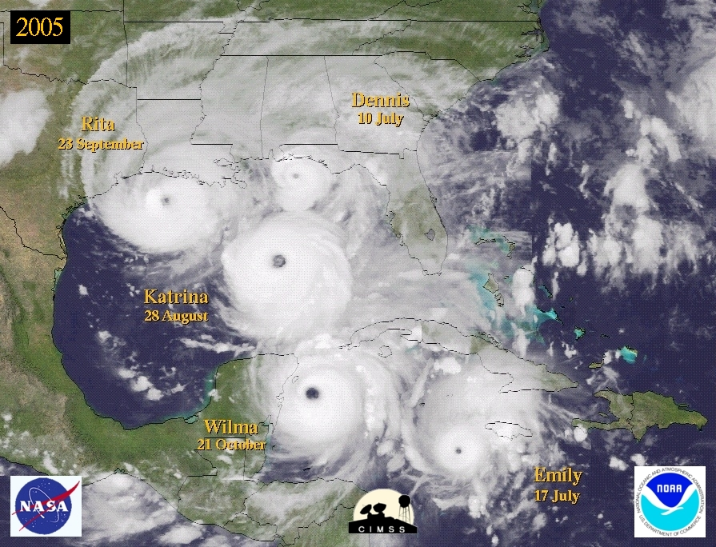
A Reanalysis of the 1926-1930 Atlantic Hurricane Database
10 February, 2011
HRD Science Meeting
Chris Landsea, National Hurricane Center
Co-authors: David Glenn (1927, 1928), Mike Chenoweth, Andrew Hagen (1926, 1927, 1930), Steve Feuer (1926), Ramon Perez, Jamese Sims (1926), and Nick Anderson (1930)
Thanks also to: Charlie Neumann, Colin McAdie, Joan David, Sandy Delgado, Lyle Huftstetler, Neal Dorst, and Best Track Change Committee (Jack Beven – chair, Eric Blake, Richard Pasch, Todd Kimberlain, Gladys Rubio, and Eric Uhlhorn)
Supported by the NOAA Climate Program Office

Slide 2
Why revise HURDAT?
HURDAT contains many systematic and random errors
  1938 Hurricane: Cat 3 at landfall, but 85kts at last offshore position
Missing storms (in real-time)
Lack of exact hurricane landfall parameters
Advances in the understanding of hurricanes and analysis techniques
Bias in early
major hurricanes

Slide 3
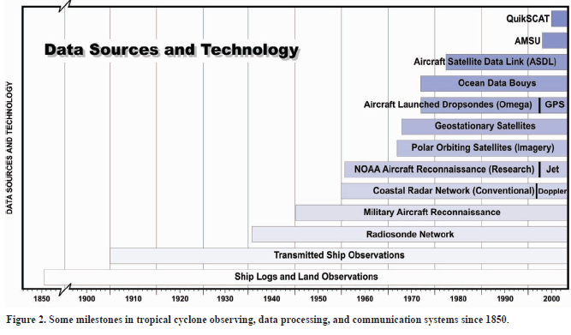
Hurricane Observational Milestones
1926-1930
From the period 1886 to 1930, the original HURDAT was created from a once daily 12 UTC track and intensity estimate. The 00, 06, and 18 UTC track and intensity estimates were interpolated from the once a day’s 12 UTC estimate.
Notes:
Rapid intensification and rapid decay

Slide 4
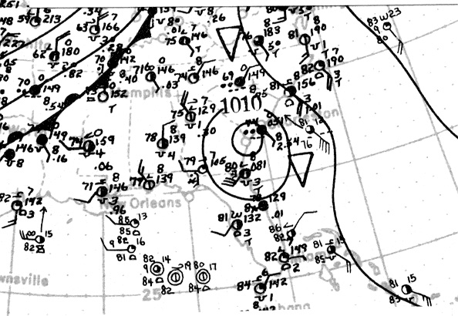
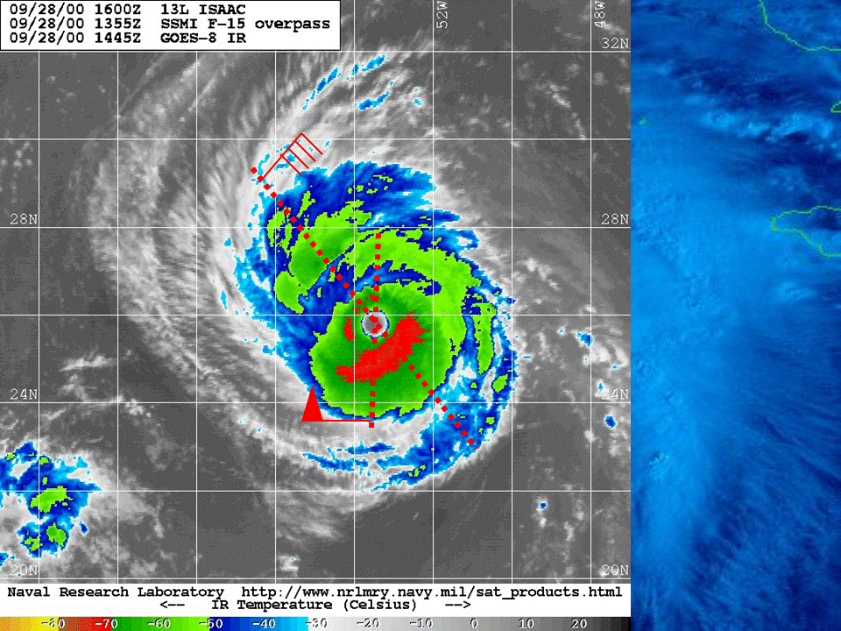
Reanalysis Steps
1) Obtain all available raw data into a single database
2) Once daily (more often in shipping lanes or near coast), conduct synoptic analysis
3) Determine track
3) Determine intensity
4) Document revisions (metadata file)

Slide 5
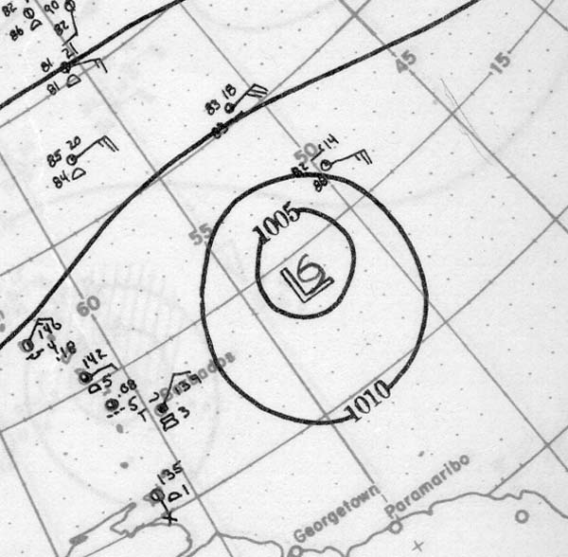
Historical Weather Maps – 11 September 1928

Slide 6
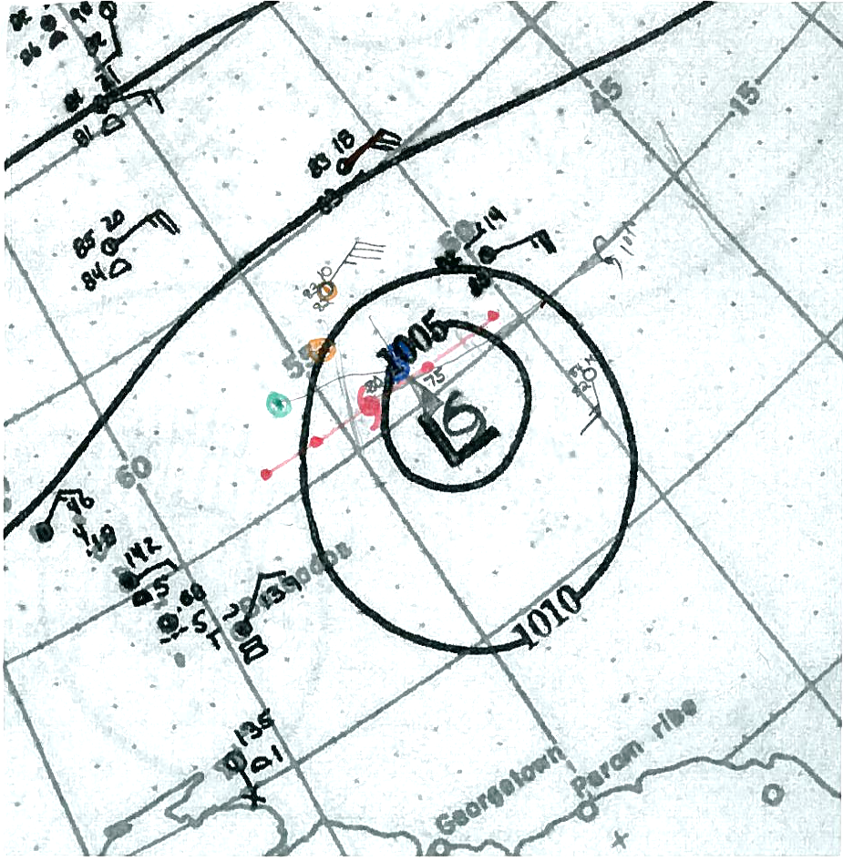
Historical Weather Maps – 11 September 1928
With COADS and additional observations

Slide 7
Raw Data (Hurricane-force) for
1928 San Felipe/Lake Okeechobee Hurricane
Day | OBS | PRES | WIND | DIR | TEMP | LOCATION | LAT | LON | SOURCE | SHIP NAME/ID | COMMENTS
1928 STORM 4 (SEPTEMBER)
12-Sep | 16Z | 973 |  |  |  | POINTE A' PITRE, GUAD. | 162 | 615 | MWR
12-Sep | 17Z | 946 |  |  |  | POINTE A' PITRE, GUAD. | 162 | 615 | MWR
12-Sep | 1730Z | 940 |  |  |  | AGRONOMIQUE, GUAD. | 162 | 615 | NCDC
12-Sep | 18Z | 940 | 0 |  |  | POINTE A' PITRE, GUAD. | 162 | 615 | MWR |  | Eye
Revised “Best Track” (HURDAT) Data
24780 09/06* 0 0 0 0* 0 0 0 0*137 204 35 0*138 221 35 0
24780 09/06*142 170 30 0*141 185 30 0*140 200 35 0*138 216 40 0
*** *** ** *** *** ** *** *** *** **
Metadata File
The hurricane next made landfall in Southeast Florida around 00 UTC on the 17th of September at 26.7N 80.0W. A 929 mb pressure reading was observed at 00 UTC on the 17th from the AT&T Company office in West Palm Beach and this is what is utilized in HURDAT and also what has been accepted as the central pressure in Jarrell et al.
Best Track Change Committee Comments and Replies to the Comments
1. The 50 kt observation on 7 September is a south wind (presumably east of the center), which suggest the possibility that the winds were stronger north of the center. Please consider revising the intensities for this and subsequent days.
[Agreed.]

Slide 8
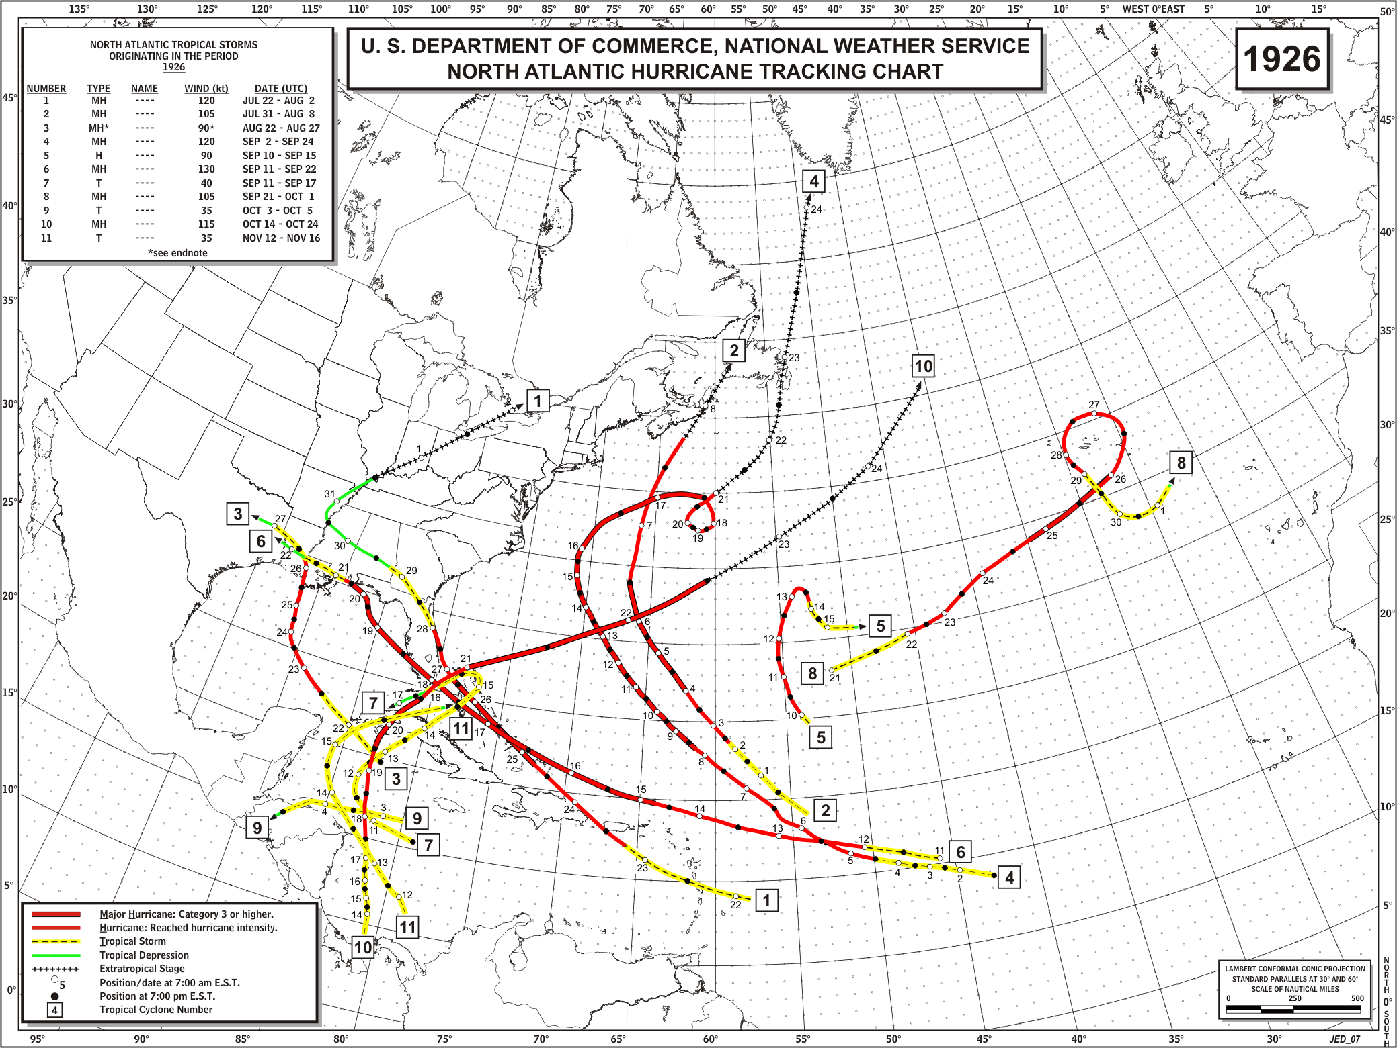
ORIGINAL

Slide 9
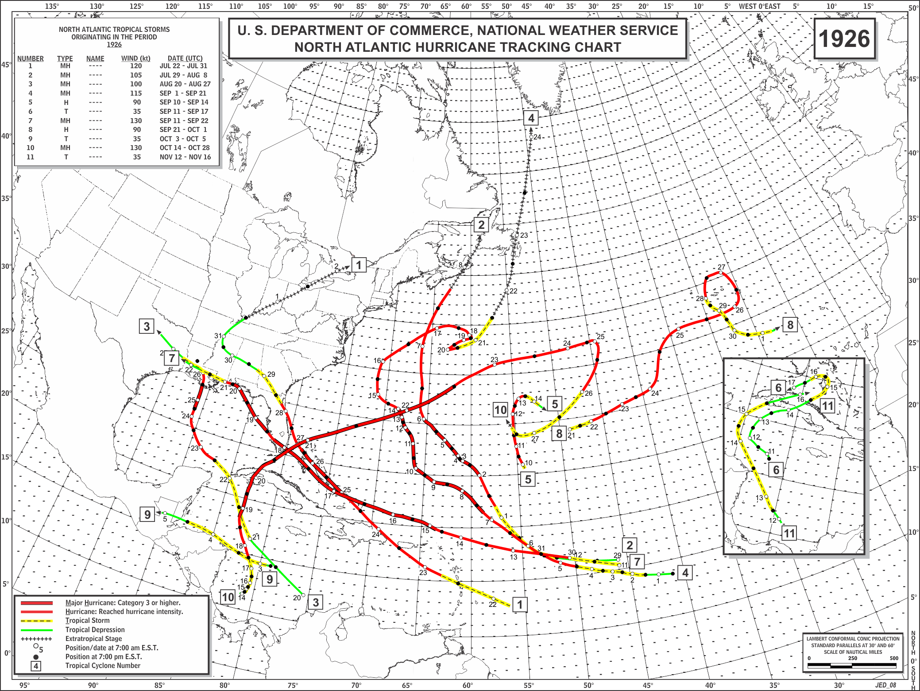
REVISED

Slide 10
Highlights for the Atlantic hurricane
database reanalysis project - 1926 to 1930:
A) Track alterations (primarily minor) were implemented for all TCs;
B) Intensity changes (primarily major) were incorporated into all TCs, either toward stronger or weaker winds;
C) 4 new TCs were discovered and added into HURDAT;
D) 8 continental U.S. hurricanes were identified, one more than originally listed in HURDAT. No changes to peak Saffir-Simpson category for major U.S. hurricanes;
E) 6 major hurricanes struck other countries;
F) There still exists significant uncertainty in TC tracks, significant undercounts in TC frequency, and significant underestimation of TC intensity and duration.

Slide 11
A Reanalysis of the 1926-1930 Atlantic Hurricane Database
20 January, 2011
NHC Brown Bag Seminar
Chris Landsea, National Hurricane Center
Co-authors: David Glenn (1927, 1928), Mike Chenoweth, Andrew Hagen (1926, 1927, 1930), Steve Feuer (1926), Ramon Perez, Jamese Sims (1926), and Nick Anderson (1930)
Thanks also to: Charlie Neumann, Colin McAdie, Joan David, Sandy Delgado, Lyle Huftstetler, Neal Dorst, and Best Track Change Committee (Jack Beven – chair, Eric Blake, Richard Pasch, Todd Kimberlain, Gladys Rubio, and Eric Uhlhorn)
Supported by the NOAA Climate Program Office

Slide 12
HURDAT
The National Hurricane Center maintains and updates annually the North Atlantic Basin’s Hurricane Database (HURDAT)
HURDAT provides from 1851 to 2009 for all tropical storms, subtropical storms, and hurricanes every 6 hours:
Positions (to nearest 0.1 degree latitude/longitude)
Intensity (1 min surface winds to nearest 10 kt from 1851-1885, 5 kt from 1886 onward)
Central pressure (to nearest 1 mb, when observed)
34, 50, and 64 kt wind radii maximum extent since 2004 ( by quadrant, to nearest 5 nmi)

Slide 13
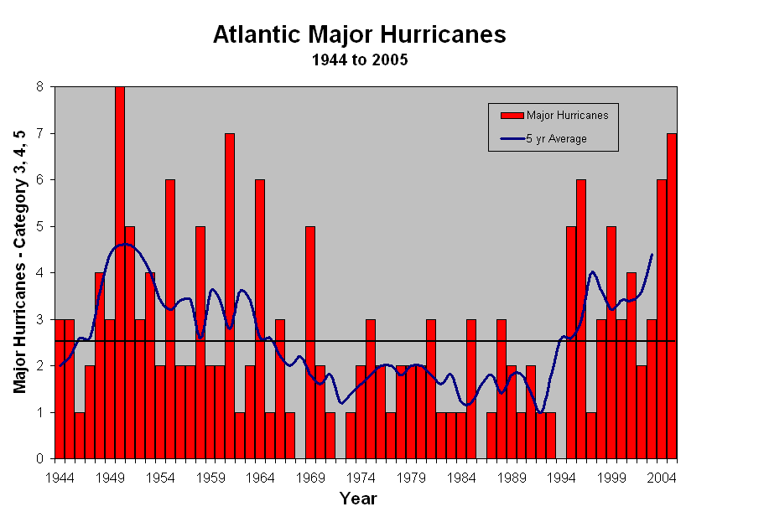
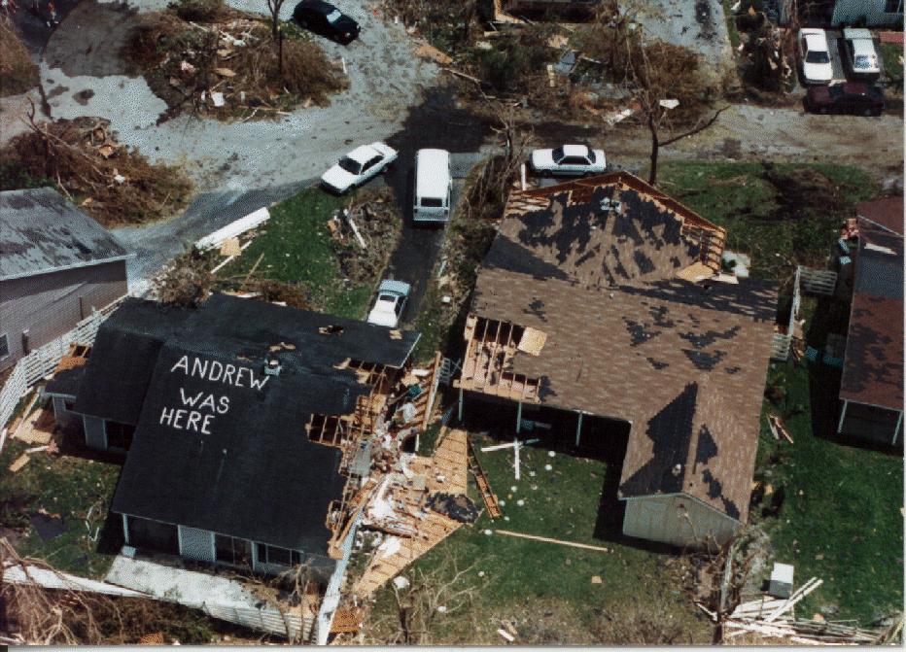
HURDAT applications:
  Validation of official and model predictions
  Climate trend assessment – long term trends, seasonal forecasts, etc.
  Building code standards and insurance rates for coastal communities
  Risk assessment for emergency managers (recurrence intervals)

Slide 14
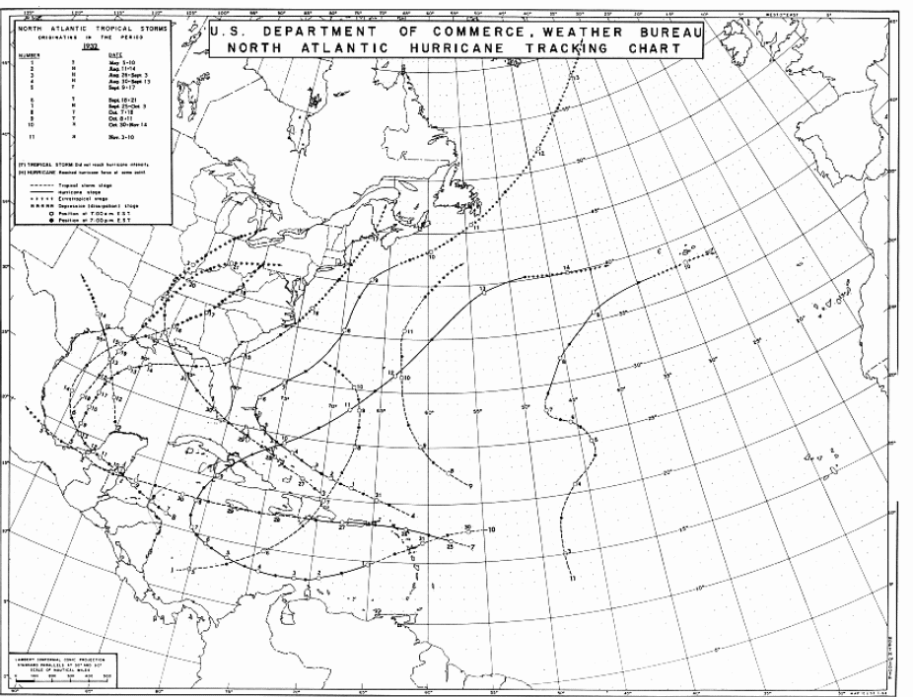
Too Rapid During
Last 6 Hours

Slide 15
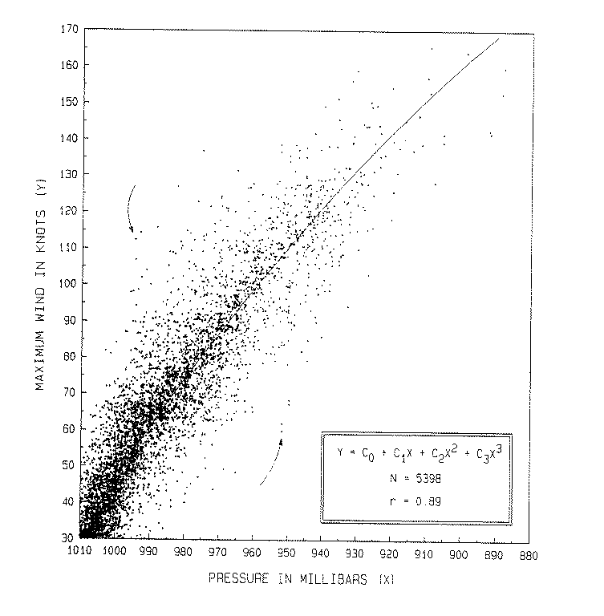
Pressure-Wind
Relationship

Slide 16
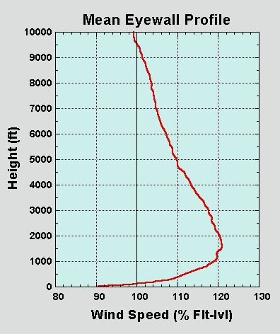
GPS Dropsondes
New understanding of hurricane
wind structure in the vertical
Franklin et al. (2002)

Slide 17
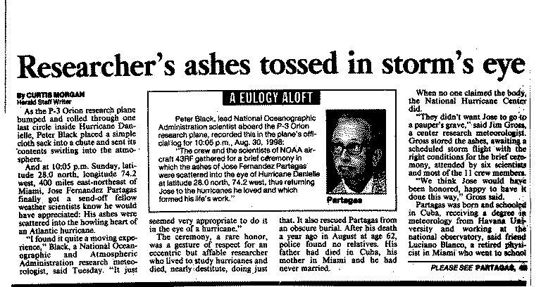
Work of Jose Partagas:
Historical Reconstruction from 1851-1910

Slide 18
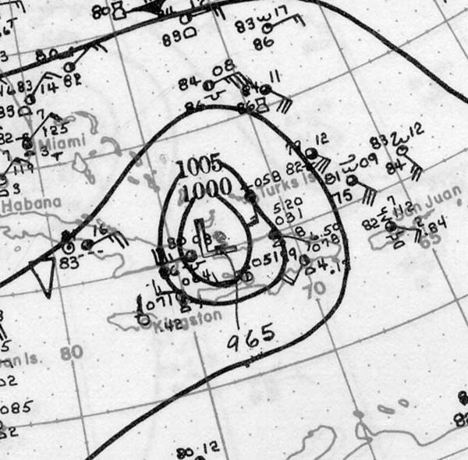
Reanalysis Data Sources for 1926 to 1930
Historical Weather Map series

Slide 19
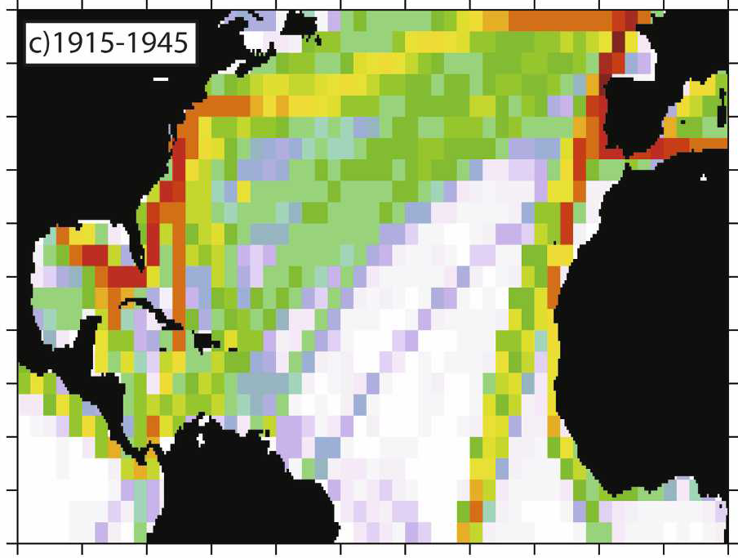
Comprehensive Ocean-Atmosphere Dataset (COADS)
Notes:
19

Slide 20
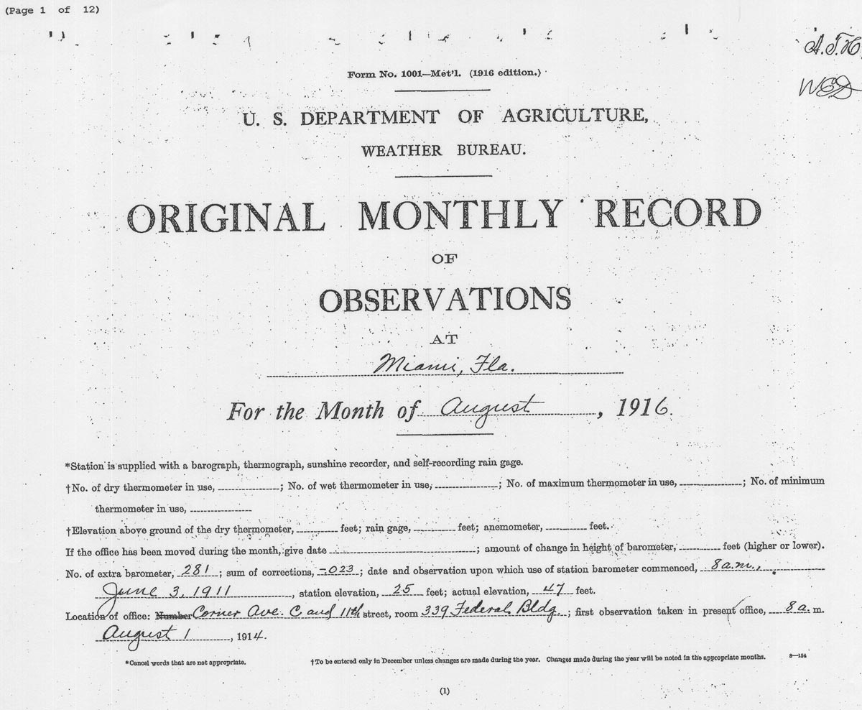
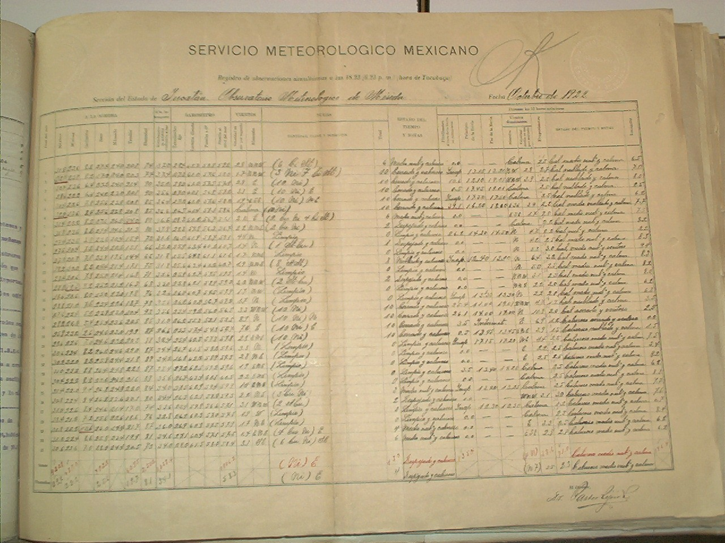
U.S. Original
Monthly Records
(NCDC - EDADS)
Weather Observations
from Colleagues in Mexico,
Cuba and throughout
the Caribbean

Slide 21
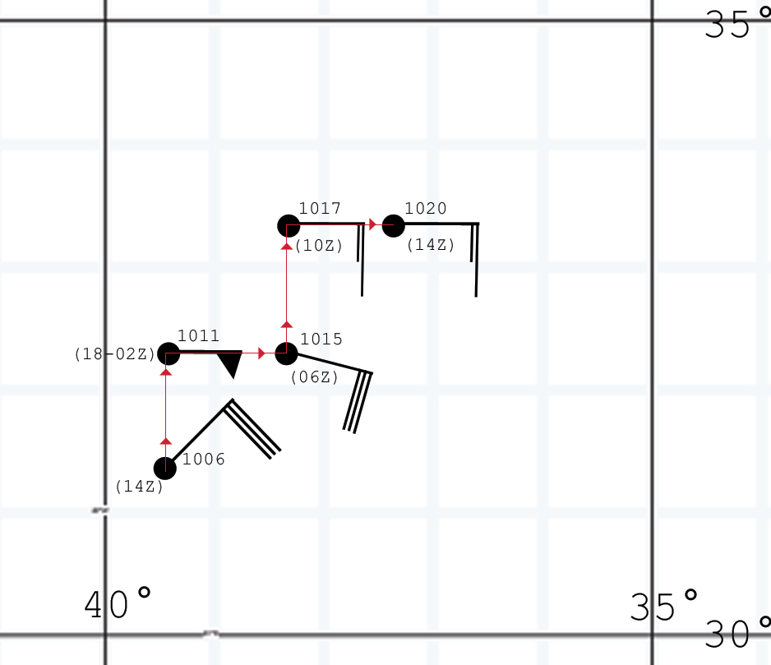
Ship Location Accuracy

Slide 22

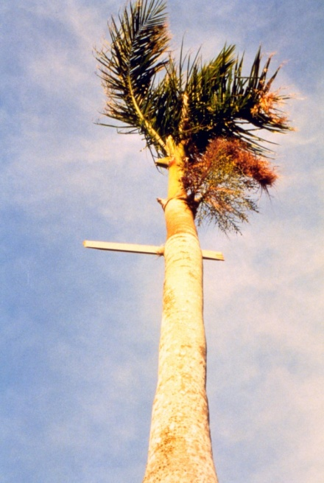
Methods for Estimating Intensity
Beaufort Scale (0-12: Calm to to Hurricane)
Anemometers – Biases in in in in in Early Instruments
Pressure-Wind Relationships
Utilizing Size (Radius of Maximum Wind) Information
Storm Surge/SLOSH runs
Wind-caused Structural Damage
Inland Wind/Pressure Decay Models

Slide 23
ATLANTIC PRESSURE-WIND RELATIONSHIPS
Utilize Brown et al. (2006)
Central South South South 25N to 25N to 25N to North
Pressure 25N 25N-Int 25N-Wea 35N 35N-Int 35N-Wea 35N
960mb 101kt 102 98 95 100 91 90
Adjustments made (+/- 5 kt) due to small/large TC, to fast/slow moving TC, and/or to high/low environmental pressure

Slide 24
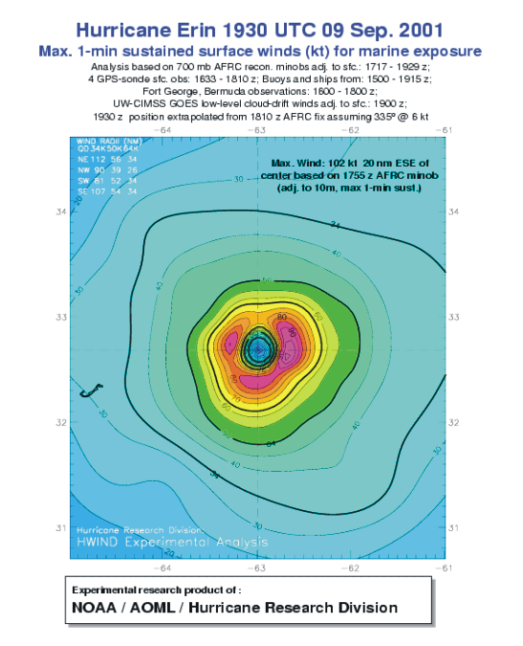
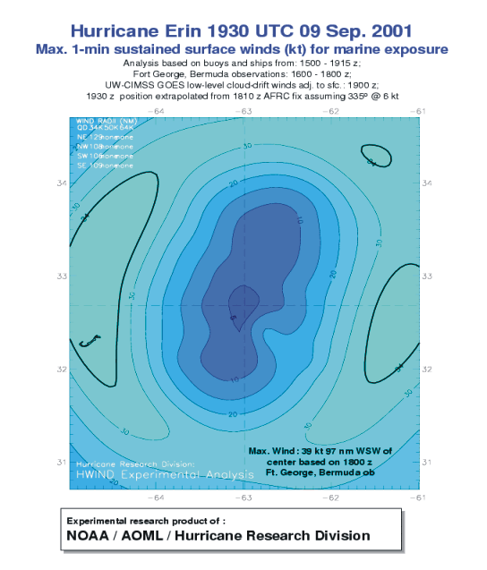
Estimating Intensity with and without Aircraft Reconnaissance
Landsea et al. (2004)

Slide 25
Estimating the intensity bias in HURDAT for 1851 to 1930 – Comparing the Peak Intensity versus U.S. Landfall Intensity
1851-1930
1980-2008
Suggests 10-15 kt LOW bias in early HURDAT

Slide 26
Estimated Errors in HURDAT – 1851 to 1930
Situation | Dates | Position error (n mi) | Intensity error (absolute) (kt) | Intensity error (bias) (kt)
Open ocean | 1851–85 | 120 | 25 | -15
 | 1886–1930 | 100 | 20 | -10
Landfall at sparsely populated area | 1851–85 | 120 | 25 | -15
 | 1886–1930 | 100 | 20 | -10
Landfall at settled area | 1851–85 | 60 | 15 | 0
 | 1886–1930 | 60 | 12 | 0

Slide 27
Raw Data (Hurricane-force) for
1928 San Felipe/Lake Okeechobee Hurricane
Day | OBS | PRES | WIND | DIR | TEMP | LOCATION | LAT | LON | SOURCE | SHIP NAME/ID | COMMENTS
1928 STORM 4 (SEPTEMBER)
12-Sep | 16Z | 973 |  |  |  | POINTE A' PITRE, GUAD. | 162 | 615 | MWR
12-Sep | 17Z | 946 |  |  |  | POINTE A' PITRE, GUAD. | 162 | 615 | MWR
12-Sep | 1730Z | 940 |  |  |  | AGRONOMIQUE, GUAD. | 162 | 615 | NCDC
12-Sep | 18Z | 940 | 0 |  |  | POINTE A' PITRE, GUAD. | 162 | 615 | MWR |  | Eye
12-Sep | 18Z | 940 | 0 |  |  | AGRONOMIQUE, GUAD. | 162 | 615 | NCDC |  | Eye
12-Sep | 1830Z | 940 |  | S |  | AGRONOMIQUE, GUAD. | 162 | 615 | NCDC
12-Sep | 19Z | 944 |  |  |  | POINTE A' PITRE, GUAD. | 162 | 615 | MWR
12-Sep | 20Z | 964 |  |  |  | POINTE A' PITRE, GUAD. | 162 | 615 | MWR
12-Sep | 2230Z | 955 |  |  |  | MARTINIQUE | 146 | 611 | CHEN |  | Min-P
13-Sep | 12Z | 976 |  |  |  | SHIP | 176 | 652 | MWR | "MATURA"
13-Sep | 13Z | 960 |  |  |  | SHIP | 176 | 652 | MWR | "MATURA"
13-Sep | 13Z | 1001 | 65 | E | 77 | SAN JUAN | 185 | 660 | MWR
13-Sep | 14Z |  | 78 | N/A |  | ST. THOMAS | 184 | 649 | MWR |  | MAX WIND
13-Sep | 14Z | 1000 | 70 | NE | 77 | SAN JUAN | 185 | 660 | MWR
13-Sep | 15Z | 931 | Calm |  |  | SHIP | 176 | 652 | MWR | "MATURA" | Eye
13-Sep | 15Z | 997 | 122 | NE | 78 | SAN JUAN | 185 | 660 | MWR
13-Sep | 16Z | 945 |  |  |  | SHIP | 176 | 652 | MWR | "MATURA"
13-Sep | 16Z | 990 | 130 | NE | 78 | SAN JUAN | 185 | 660 | MWR
13-Sep | 17Z | 963 |  |  |  | SHIP | 176 | 652 | MWR | "MATURA"
13-Sep | 17Z | 986 | 130 | NE | 78 | SAN JUAN | 185 | 660 | MWR
13-Sep | 17Z | 990 | 70 | ENE |  | SHIP-"HENRY HOLMES" | 183 | 649 | MWR | UK036719 | Min-P
13-Sep | 1750Z | 949 |  |  |  | HUMACAO, P.R. | 182 | 660 | MWR |  | MIN PRESS
13-Sep | 18Z | 975 |  |  |  | SHIP | 176 | 652 | MWR | "MATURA"
13-Sep | 18Z | 976 | 139 | NE | 78 | SAN JUAN | 185 | 660 | MWR
13-Sep | 18Z | 998 | 70 | NNE |  | MAYAGUEZ | 182 | 672 | NCDC | PORTO PIER
13-Sep | 1830Z | 976 |  |  |  | SAN JUAN | 185 | 660 | MWR |  | MIN PRESS
13-Sep | 1830Z | 936 |  |  |  | GUAYAMA, P.R. | 180 | 662 | MWR |  | MIN PRESS
13-Sep | 19Z | 980 |  | NE | 80 | SAN JUAN | 185 | 660 | MWR
13-Sep | 19Z | 995 | 70 | NNE |  | MAYAGUEZ | 182 | 672 | NCDC | PORTO PIER
13-Sep | 1930Z | 974 |  |  |  | ARECIBO, P.R. | 185 | 668 | MWR |  | MIN PRESS
13-Sep | 20Z | 983 | 96 | E | 78 | SAN JUAN | 185 | 660 | MWR
13-Sep | 20Z | 989 | 70 | N |  | SHIP | 182 | 672 | NCDC | "MONTOSA"
13-Sep | 20Z | 989 | 70 | NNE |  | MAYAGUEZ | 182 | 672 | NCDC | PORTO PIER
13-Sep | 2030Z | 957 |  |  |  | PONCE, P.R. | 180 | 666 | MWR |  | MIN PRESS
13-Sep | 21Z | 986 | 78 | E | 77 | SAN JUAN | 185 | 660 | MWR
13-Sep | 21Z | 980 |  | N | 78 | HORMIGUEROS, P.R. | 182 | 671 | NCDC
13-Sep | 21Z | 987 | 70 | NNE |  | MAYAGUEZ | 182 | 672 | NCDC | PORTO PIER
13-Sep | 22Z | 952 |  |  |  | LARES, P.R. | 183 | 669 | COLON |  | MIN PRESS
13-Sep | 22Z | 971 |  | NW | 77 | HORMIGUEROS, P.R. | 182 | 671 | NCDC
13-Sep | 22Z | 977 | 70 | N |  | MAYAGUEZ | 182 | 672 | NCDC | PORTO PIER
13-Sep | 23Z | 965 |  | NW | 77 | HORMIGUEROS, P.R. | 182 | 671 | NCDC
13-Sep | 23Z | 972 | 70 | N |  | MAYAGUEZ | 182 | 672 | NCDC | PORTO PIER
13-Sep | N/A |  | 70 | E |  | SHIP | 205 | 666 | MWR | "PONCE" | Max-W
14-Sep | 0Z | 968 |  |  |  | MAYAGUEZ | 182 | 672 | MWR |  | MIN PRESS
14-Sep | 0Z | 964 |  |  | 78 | HORMIGUEROS, P.R. | 182 | 671 | NCDC |  | Min-P
14-Sep | 0Z | 970 | 70 | ENE |  | SHIP | 182 | 672 | NCDC | "MONTOSA"
14-Sep | 0Z | 970 | 70 | N |  | MAYAGUEZ | 182 | 672 | NCDC | PORTO PIER
14-Sep | 0Z | 964 |  |  |  | CABO ROJO, P.R. | 181 | 672 | COLON |  | MIN PRESS
14-Sep | 0030Z | 970 | 50 | ENE |  | MAYAGUEZ | 182 | 672 | NCDC | PORTO PIER

Slide 28
Revised “Best Track” (HURDAT) Data
for 1928 San Felipe/Lake Okeechobee Hurricane
1928/04 – 2010 REVISIONS:
24775 09/06/1928 M=15 4 SNBR= 553 NOT NAMED XING=1 SSS=4
24775 09/06/1928 M=16 4 SNBR= 553 NOT NAMED XING=1 SSS=4
**
24780 09/06* 0 0 0 0* 0 0 0 0*137 204 35 0*138 221 35 0
24780 09/06*142 170 30 0*141 185 30 0*140 200 35 0*138 216 40 0
*** *** ** *** *** ** *** *** *** **
24785 09/07*139 239 35 0*140 257 35 0*141 275 35 0*142 294 35 0
24785 09/07*137 232 45 0*136 248 50 0*135 265 55 0*135 282 60 0
*** *** ** *** *** ** *** *** ** *** *** **
24790 09/08*144 315 35 0*146 335 40 0*147 352 40 0*148 367 40 0
24790 09/08*135 300 60 0*136 317 60 0*137 335 60 0*138 352 60 0
*** *** ** *** *** ** *** *** ** *** *** **

Slide 29
Metadata File for
the 1928 San Felipe/Lake Okeechobee Hurricane
The hurricane next made landfall in Southeast Florida around 00 UTC on the 17th of September at 26.7N 80.0W. A 929 mb pressure reading was observed at 00 UTC on the 17th from the AT&T Company office in West Palm Beach and this is what is utilized in HURDAT and also what has been accepted as the central pressure in Jarrell et al. However, Ho et al. (and Schwerdt et al. previously) had used a 935 mb reading from the West Palm Beach Everglades Drainage District Office, as the basis for a 935 mb central pressure at landfall. Given that the pressure readings may vary based upon a true calibration as well as relative location to the exact eye center, the 929 mb value is retained as the central pressure at landfall for this hurricane. 929 mb suggests 124 kt [131 kt] from the north of 25N [south of 25N] Brown et al. pressure-wind relationship. The hurricane was rather large in size (325 nmi radius of closed isobar and RMW of 25 nmi – compared with 15 nmi from climatology for this landfall latitude and central pressure [Vickery et al. 2001]). (Ho et al. had estimated a 28 nm RMW. However, after reviewing all available observations, it appears that this was somewhat too large. Our best estimate of the RMW is 25 nm, plus/minus 5 nm.) The environmental pressures were somewhat low, with an outer closed isobar of 1009 mb. The translational velocity was moderate at about 13 kt at landfall. Taking an average of the pressure-wind relationship for south and north of 25N gives 128 kt. Accounting for the large size and low environmental pressures would indicate a maximum 1-min wind of about 125 kt at landfall in southeast Florida, making this a US Category 4 hurricane. This is a 5 kt reduction from what was in HURDAT originally. Peak observed winds after landfall were 60 kt within 2 hr of 06 UTC on the 17th, 70 kt at 12 UTC, and 42 kt at 18 UTC, though the available observations were extremely sparse (the 60 and 70 kt reports were actually ship reports though the hurricane was overland). A run of the Kaplan and DeMaria inland-decay model suggests winds of 74 kt at 06 UTC, 58 kt at 12 UTC, and 48 kt at 18 UTC. Because of the large size of the hurricane and that it was likely intensifying right up until landfall, winds are chosen for HURDAT after landfall substantially higher than the inland-decay model would suggest: 100 kt at 06 UTC, 85 kt at 12 UTC, and 75 kt at 18 UTC. These values are reduced from that originally shown in HURDAT by 15, 25, and 15 kt, respectively. Based upon these analyzed winds, SW Florida was impacted by Category 3 hurricane winds and NW Florida was impacted by Category 1 hurricane winds. Neither region was included in the hurricane state impact summary in HURDAT previously. The hurricane recurved over the Florida peninsula late on the 17th and early on the 18th and the center passed just east of Jacksonville. Jacksonville’s 17 kt NW concurrent with 979 mb minimum pressure at 0750 UTC on the 18th suggests a central pressure of 977 mb (which is now included into HURDAT at 06 UTC). This central pressure suggests winds of 76 kt from the north of 25N pressure-wind relationship (73 kt for filling cyclones). Given that the maximum winds were still over land at 06 UTC, the intensity at this time analyzed to be 65 kt, down from 75 kt originally. (It is noted that pressures were estimated every 12 hours into HURDAT after landfall [955 mb at 12 UTC on the 17th, 974 mb at 00 UTC on the 18th, etc.]. However, none of these are based upon any direct observations as can be determined. These are now removed from HURDAT.)

Slide 30
Storm #4, 1928 (The San Felipe/Lake Okeechobee Hurricane) Best Track Change Committee Comments and Replies to the Comments
Comments on the proposed revisions to the 1928 Hurricane Season from the Best Track Change Committee are in regular font. [Replies to the Committee are indented and boldface. – Chris Landsea – June 2010]
Storm #4, 1928:
1. The 50 kt observation on 7 September is a south wind (presumably east of the center), which suggest the possibility that the winds were stronger north of the center. Please consider revising the intensities for this and subsequent days.
[Agreed.]
2. Does the available data justify the small kinks shown in the track on 12 and 14 September (especially the one that brought the center close to the north coast of Hispaniola?) If not, please consider smoothing the kinks out.
[Observations do confirm a modest turn of the hurricane toward the west-northwest beginning around 00 UTC 13th. Agreed to smooth the kink around 12 UTC on the 14th, as there is limited inner core data.]

Slide 31
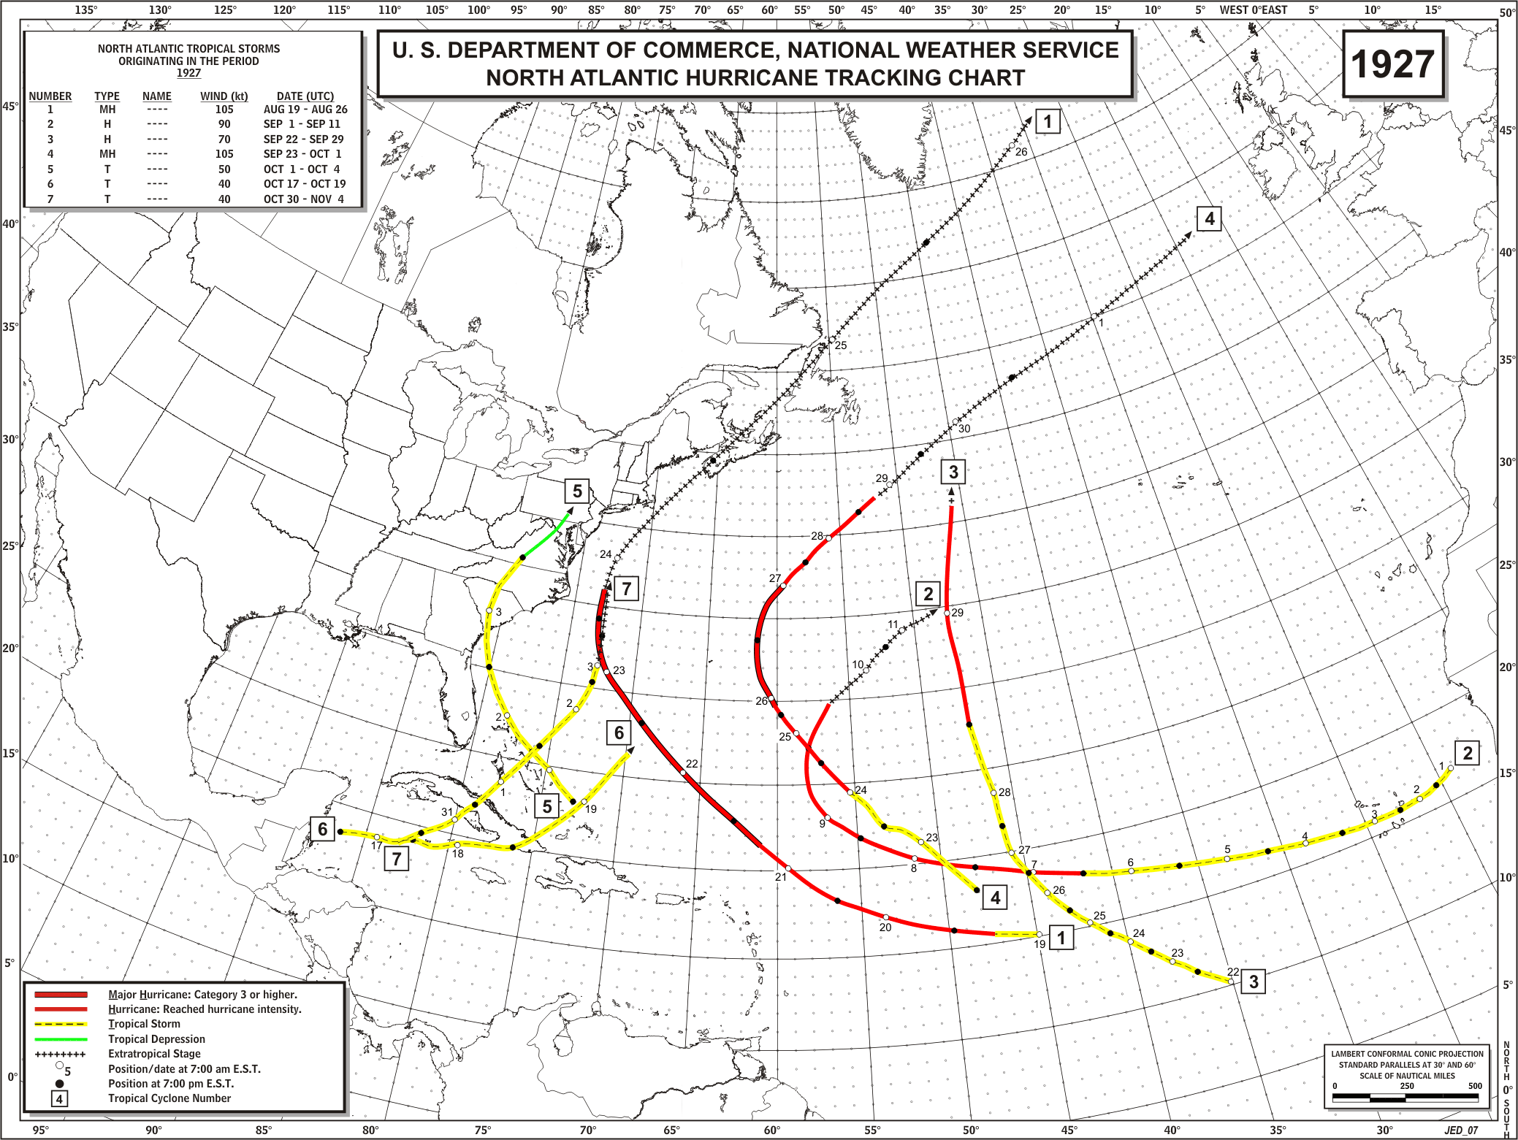
ORIGINAL

Slide 32
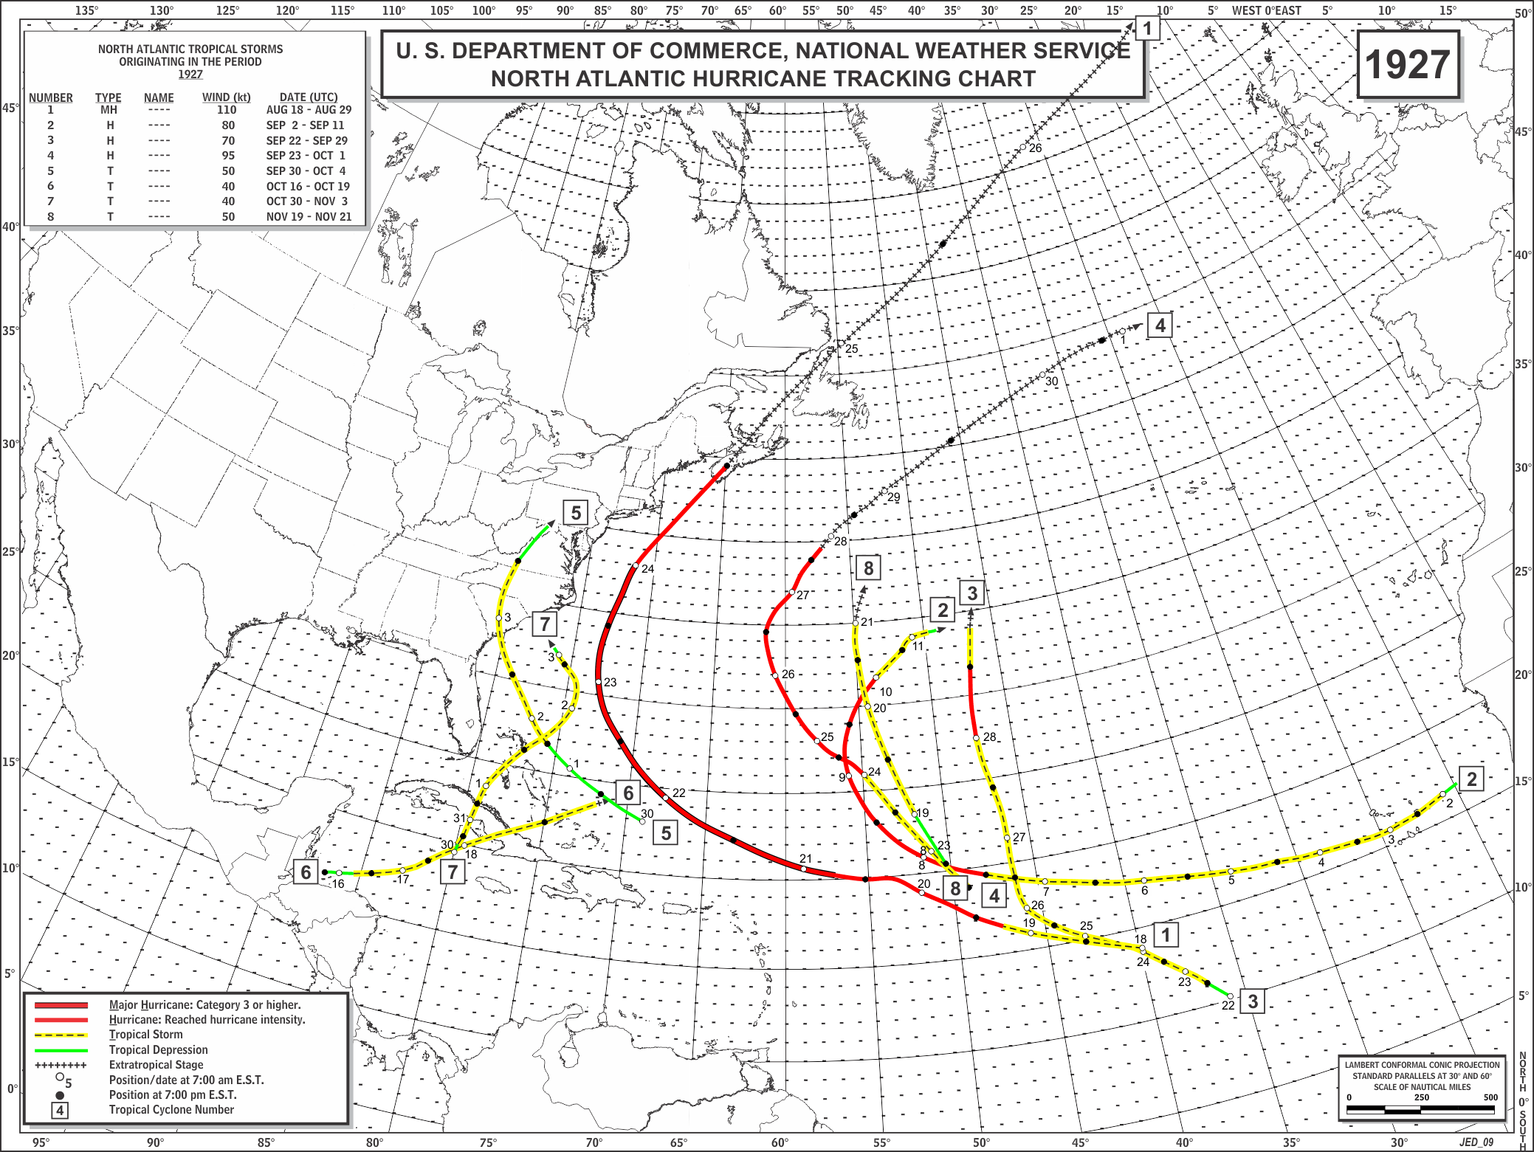
REVISED

Slide 33
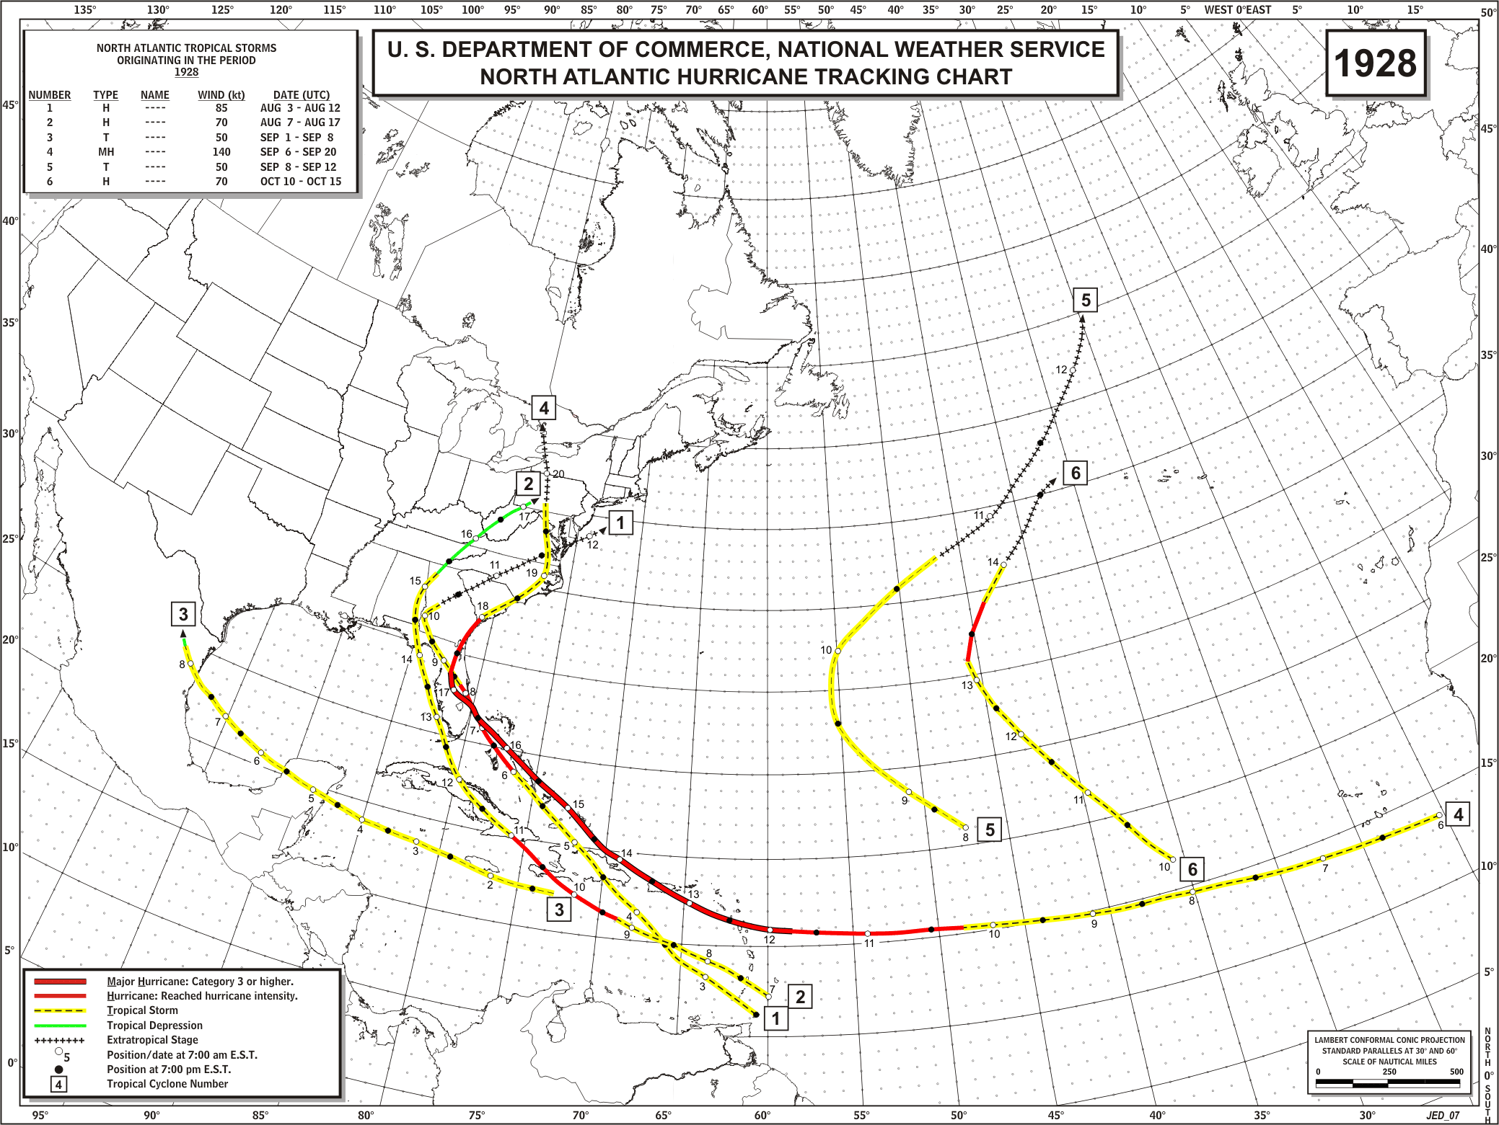
ORIGINAL

Slide 34
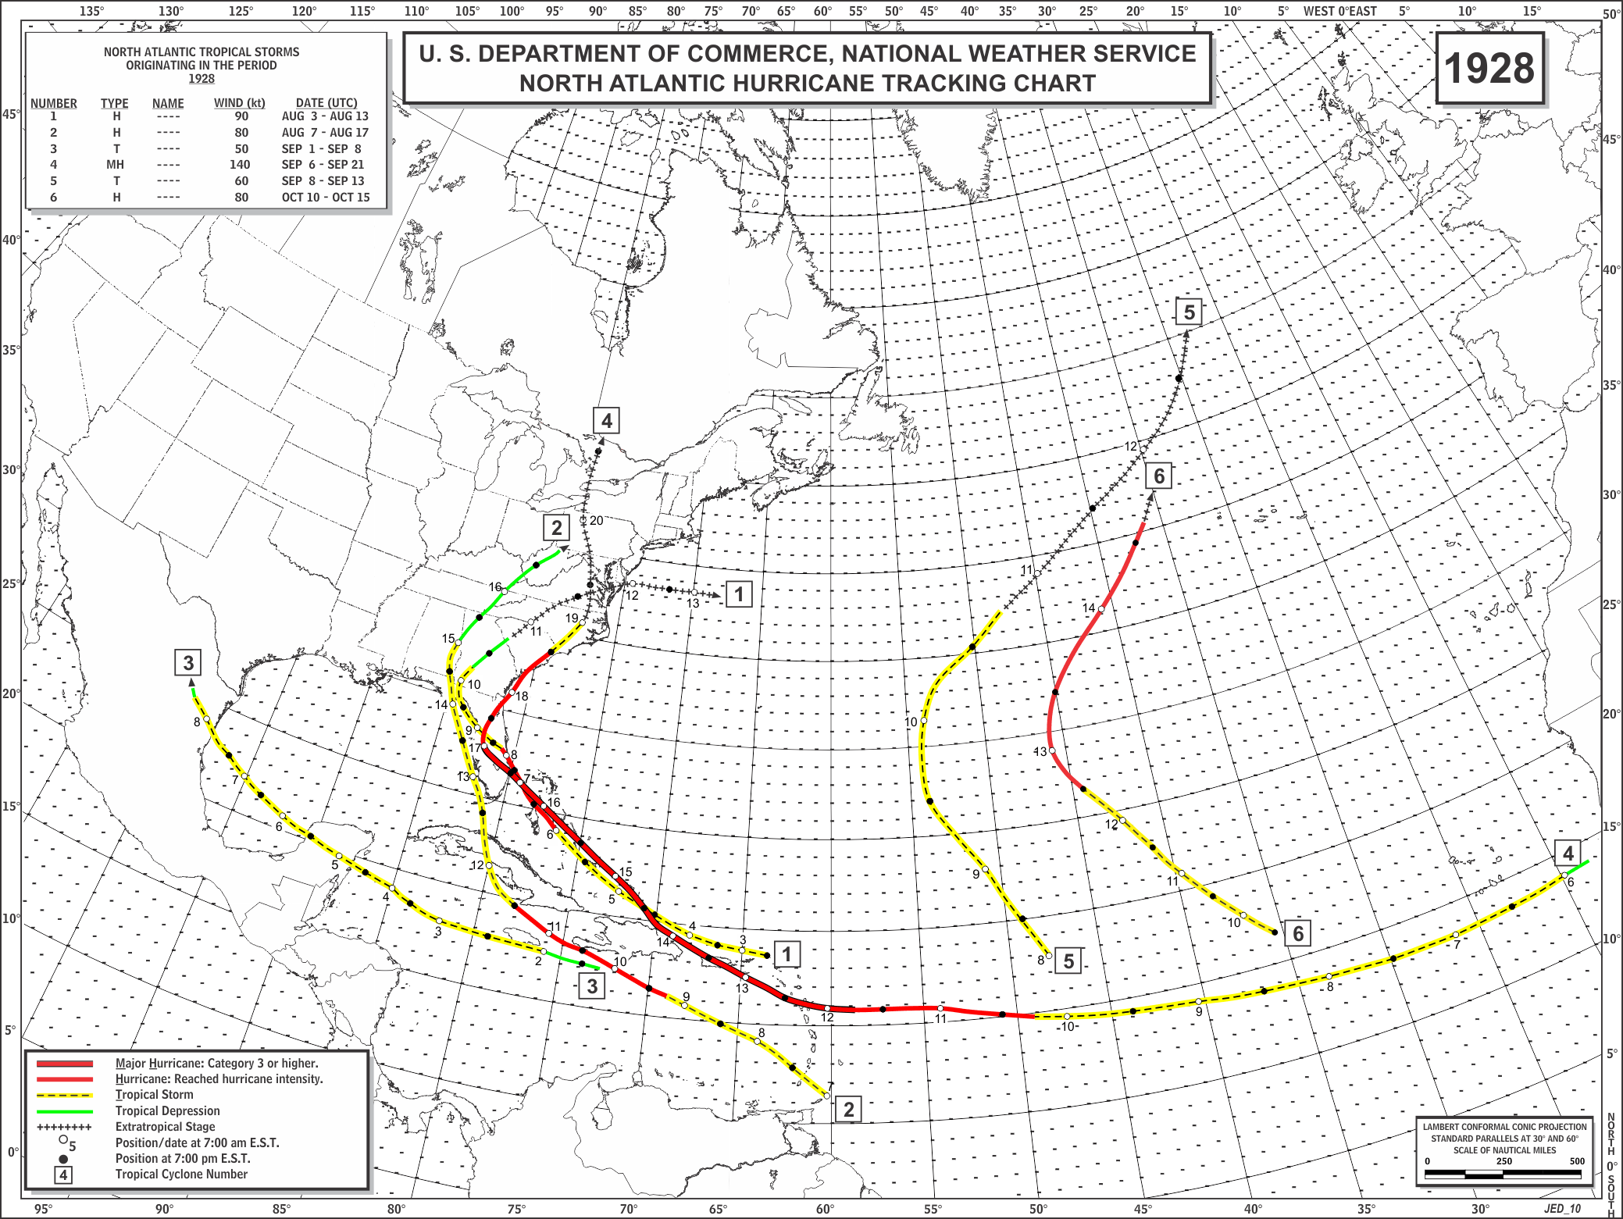
REVISED

Slide 35
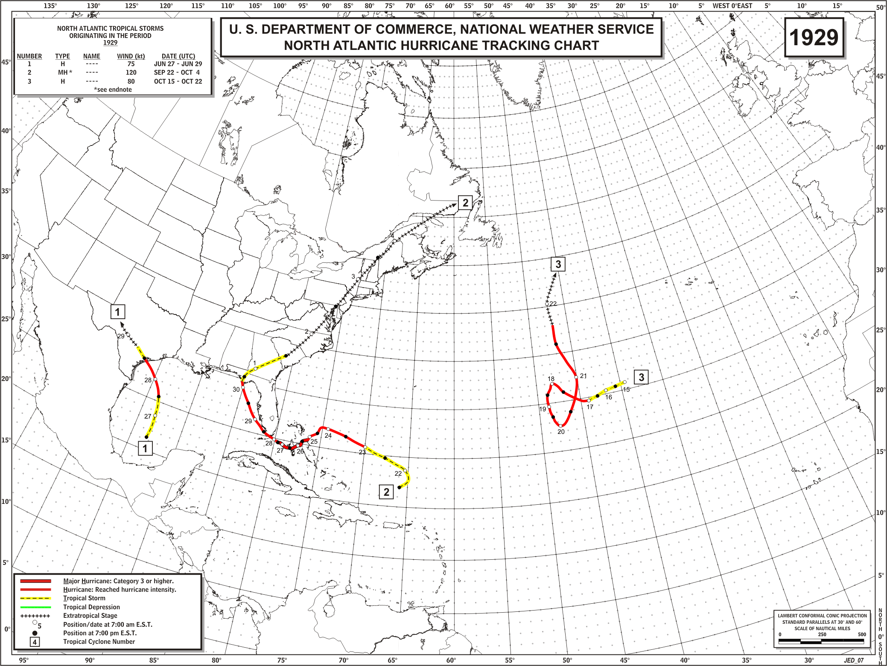
ORIGINAL

Slide 36
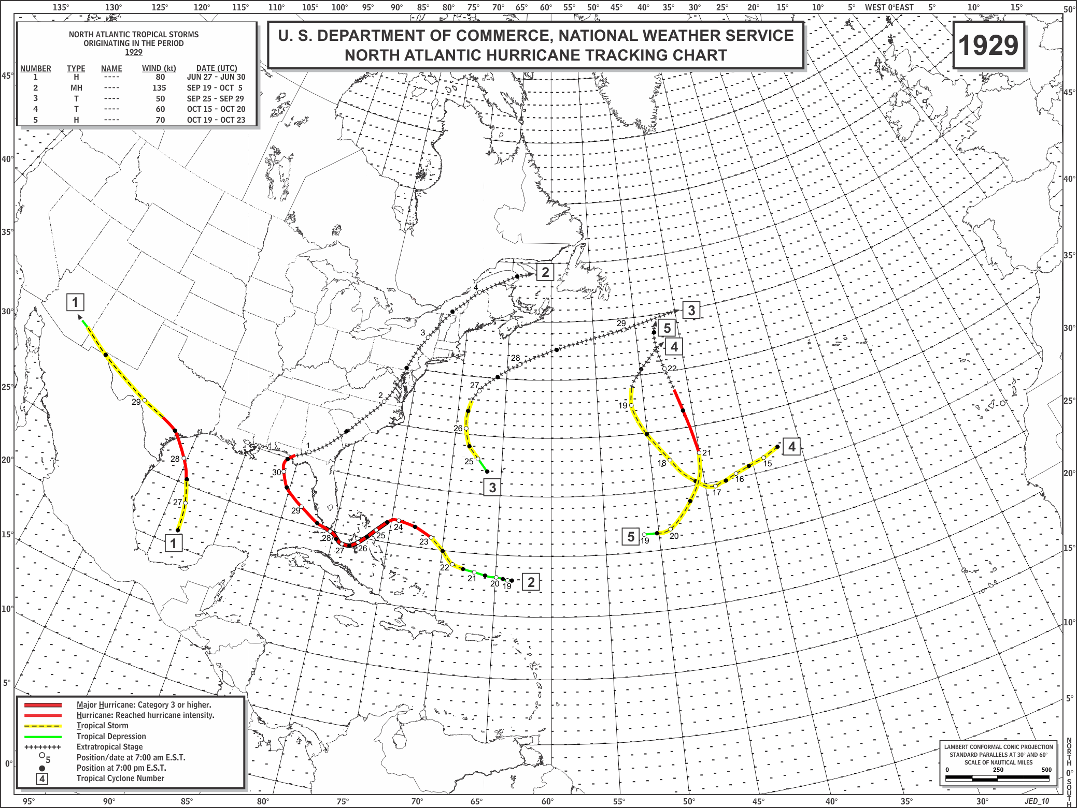
REVISED

Slide 37
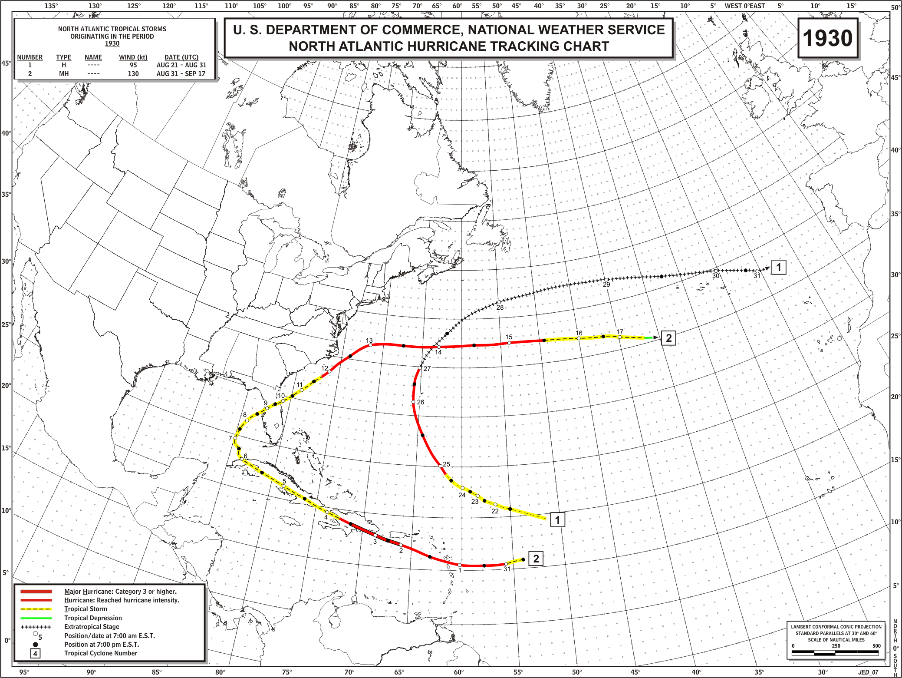
ORIGINAL

Slide 38
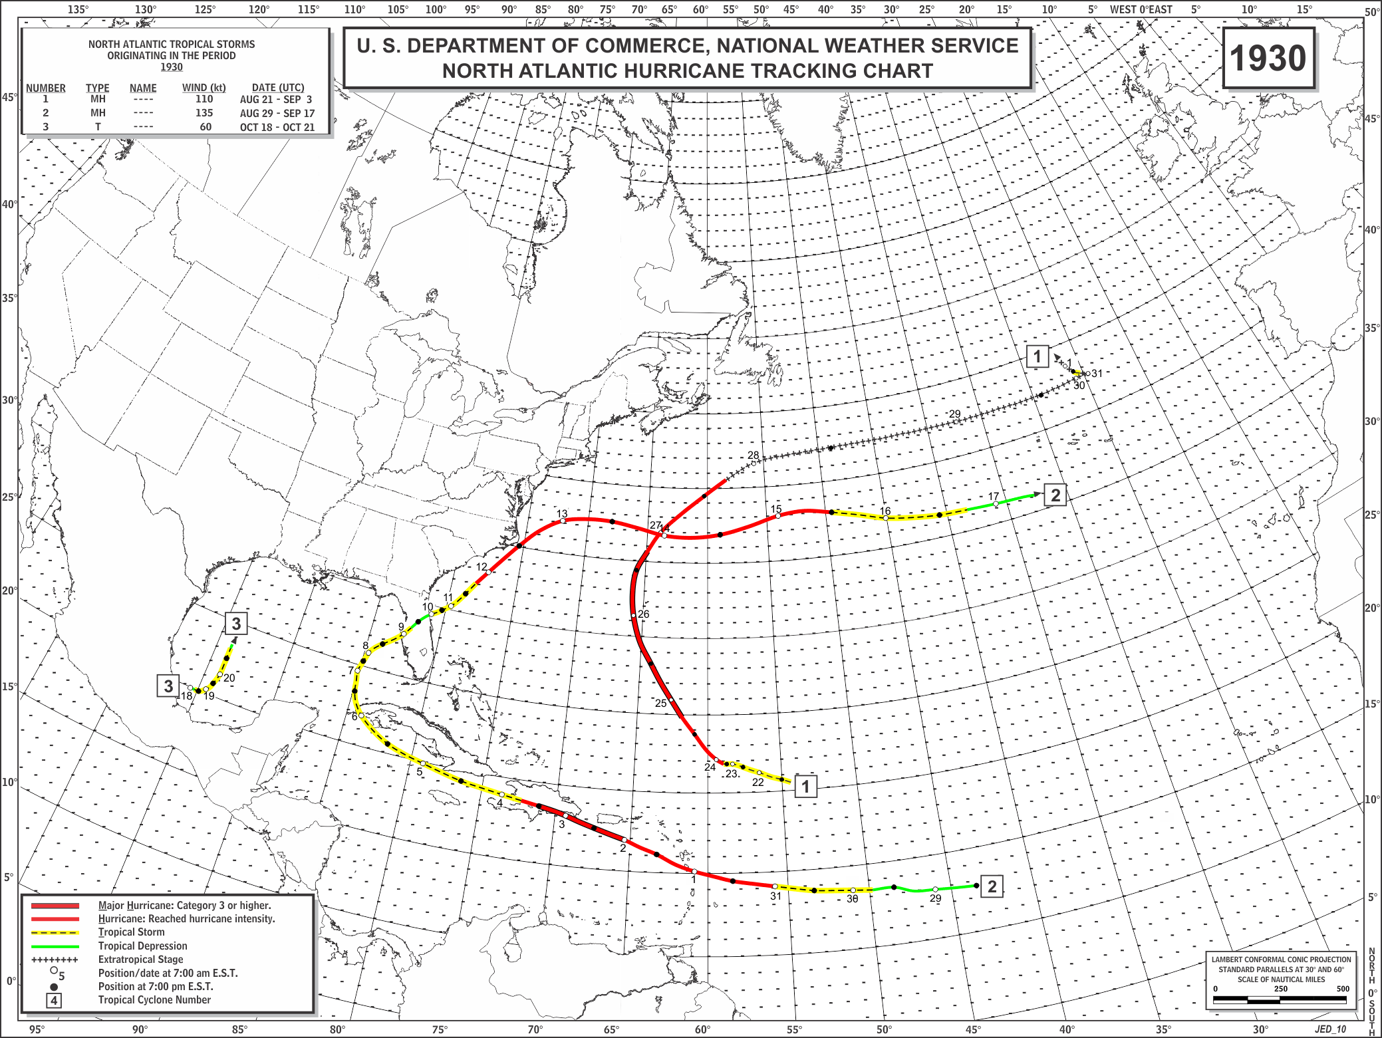
REVISED

Slide 39
U.S. Hurricanes – 1926 to 1930
#/Date Time Lat Lon Max SSHWS RMW Central OCI Size States Original
Winds Pressure Affected Assessment
(kt) (nm) (mb) (mb) (nm)
---------------------------------------------------------------------------------------------------
1-7/28/1926 1000Z 29.0N 80.8W 90 2 15 967 1014 300 DFL2,CFL1 DFL2
3-8/25/1926 2300Z 29.2N 90.9W 100 3 20 955 1012 275 LA3 LA3
7-9/18/1926 1200Z 25.7N 80.3W 125 4 20 930 1008 325 CFL4,BFL3 CFL4,BFL3
7-9/20/1926 2200Z 30.3N 87.5W 100 3 15 955 1008 225 AFL3,AL3,MS1 AFL3,AL3
10-10/21/1926* 0300Z 25.0N 80.3W 75 1 20 949 1009 300 BFL1,CFL1 (None)
None - 1927
1-8/8/1928 0700Z 27.3N 80.2W 85 2 10 977 1014 150 CFL2 CFL2
4-9/17/1928 0000Z 26.7N 80.0W 125 4 30 929 1009 275 CFL4,BFL3, CFL4, DFL2
AFL1,DFL1
4-9/18/1928 1900Z 32.5N 80.3W 75 1 35 976 1008 350 GA1,SC1 GA1,SC1
1-6/28/1929 2100Z 28.3N 96.4W 80 1 10 982 1007 150 BTX1 BTX1
2-9/28/1929 1300Z 25.0N 80.5W 100 3 30 948 1008 300 BFL3, CFL3 CFL3
2-10/1/1929 0400Z 30.2N 85.7W 70 1 --- 975 1011 400 AFL1 AFL2
None - 1930

Slide 40
Non-Continental U.S. Major Hurricanes – 1926 to 1930
#/Date Name Location Max SSHWS Central Original
Winds Pressure Winds
------------------------------------------------------------------------------
1-7/26/1926 ------ Bahamas 120 4 (938) 120
7-9/17/1926 ------ Bahamas 130 4 (926) 130
10-10/20/1926 ------ Cuba 130 4 934 105
10-10/21/1926 ------ Bahamas 110 3 (948) 100
10-10/22/1926 ------ Bermuda 105 3 962 115
1927 - None
4-9/12/1928 ------ Guadelope 120 4 940 110
4-9/13/1928 San Felipe Puerto Rico 140 5 931 140
4-9/15/1928 ------ Bahamas 135 4 (920) 135
2-9/26/1929 ------ Bahamas 125 4 936 125
2-9/3/1930 ------ Dominican Republic 135 4 933 130

Slide 41
Original/revised Atlantic basin statistics – 1926 to 1930
Year | Tropical Storms & Hurricanes | Hurricanes | Major Hurricanes | ACE
1926 | 11/11 | 8/8 | 6/6 | 222/230
1927 | 7/8 | 4/4 | 2/1 | 56/56
1928 | 6/6 | 4/4 | 1/1 | 75/83
1929 | 3/5 | 3/3 | 1/1 | 43/48
1930 | 2/3 | 2/2 | 1/2 | 39/50

Slide 42
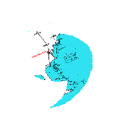
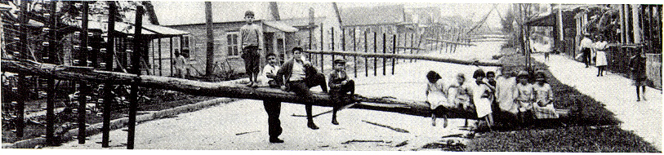
Atlantic Hurricane Database Re-Analysis Project
http://www.aoml.noaa.gov/hrd/data_sub/re_anal.html
1851 through 1930 changes accepted and officially adopted by Best Track Change Committee
1944-1951 have been submitted to the BTCC
1931-1943, 1952-53 have been preliminarily reanalyzed
1954-onward being reanalyzed currently
RE-ANALYSES NEED TO BE CONDUCTED IN THE NORTHEAST PACIFIC AND GLOBALLY!!!
"Florida's Hurricane History"

