Slide 1
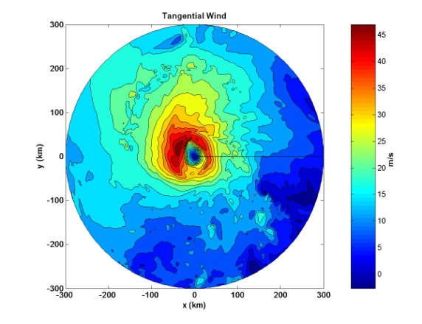
Assessing Gap Limits for Fourier Decomposition of Doppler Data Sylvie Lorsolo and Altuğ Aksoy
Motivation
For a better understanding of processes impacting hurricane intensity, investigate axisymmetric and asymmetric structure of the wind field ➔ Need for Fourier decomposition
Best Case Scenario
Observational Doppler Data
Lee et al. (2000) for GBVTD-retrieved tangential winds:
gap > 60°, n> 2 and higher not computed
gap > 90°, n= 1 and higher not computed gap > 180° no Fourier decomposition

Slide 2
Monte Carlo Experiment
Create Field
6 configurations
- n=0 dominant
- n=1 dominant
- n=2 dominant
- n equal
-n=0,1 dominant
-n=1,2 dominant
In addition
3 noise levels
Signal randomization
30 random signals for each config
Gap introduction
Max gap size:180°
- 1 gap:
1°-180°
- 2 gaps:
1°-90°
-3 gaps:
1°-60°
-4 gaps:
1°-45°
-5 gaps:
1°-36°
Gap randomization
100 random possible locations of gaps in the field
Filling
Simple filling of the gaps by generating linearly spaced data between the last good data points
Evaluation
Wavenumber decomposition and comparison with wavenumbers from original field

Slide 3
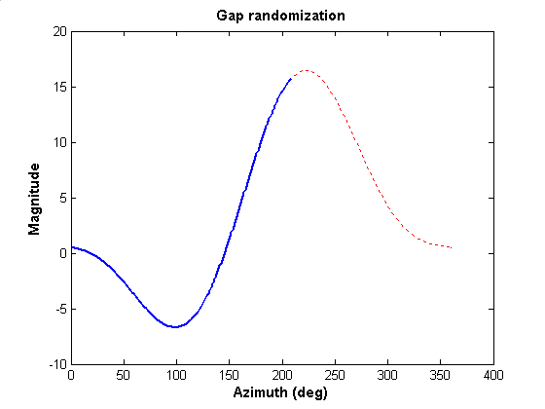
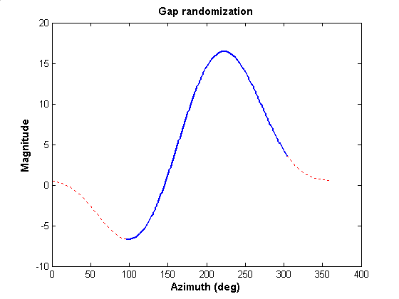
Example
Number of gaps = 1
Gap size = 150°
Signal configuration: n = 1 dominant
Noise level = 0

Slide 4
How to evaluate the retrieved signals ?

Slide 5
Evaluation of Fourier Decomposition
r ≈0.67: 0% of amplitude error
80° phase shift
r ≈0.67: 60% of amplitude error
140° phase shift
r_threshold = 0.1
➔ At least 80% of magnitude resolved and less than 20° phase shift

Slide 6
Evaluation of Fourier Decomposition

