Slide 1
CHOICE OF PBL SCHEME FOR HIGH RESOLUTION HWRF: GFS –VS- MYJ
Bao et al., 2010
(under preparation)
HRD science meeting presentation

Slide 2
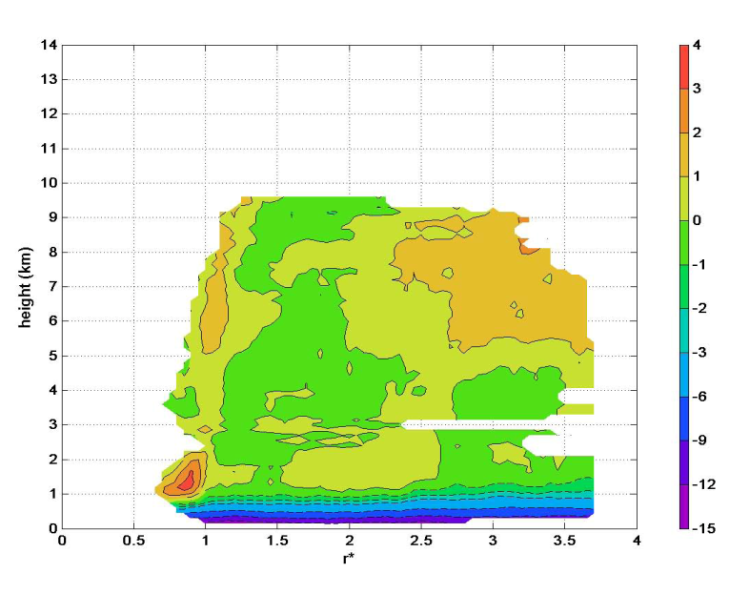
Radial Velocity from Composite Storm

Slide 3
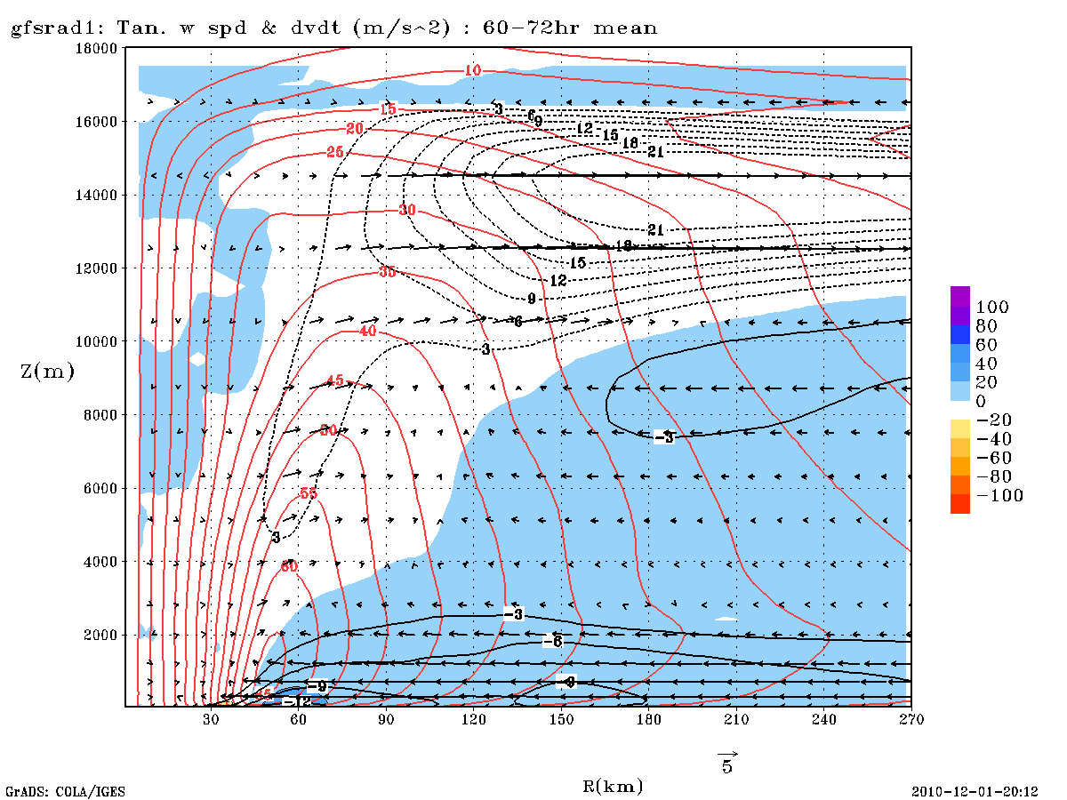
GFS BL Scheme: 60-72 hr mean of u,v and dv/dt

Slide 4
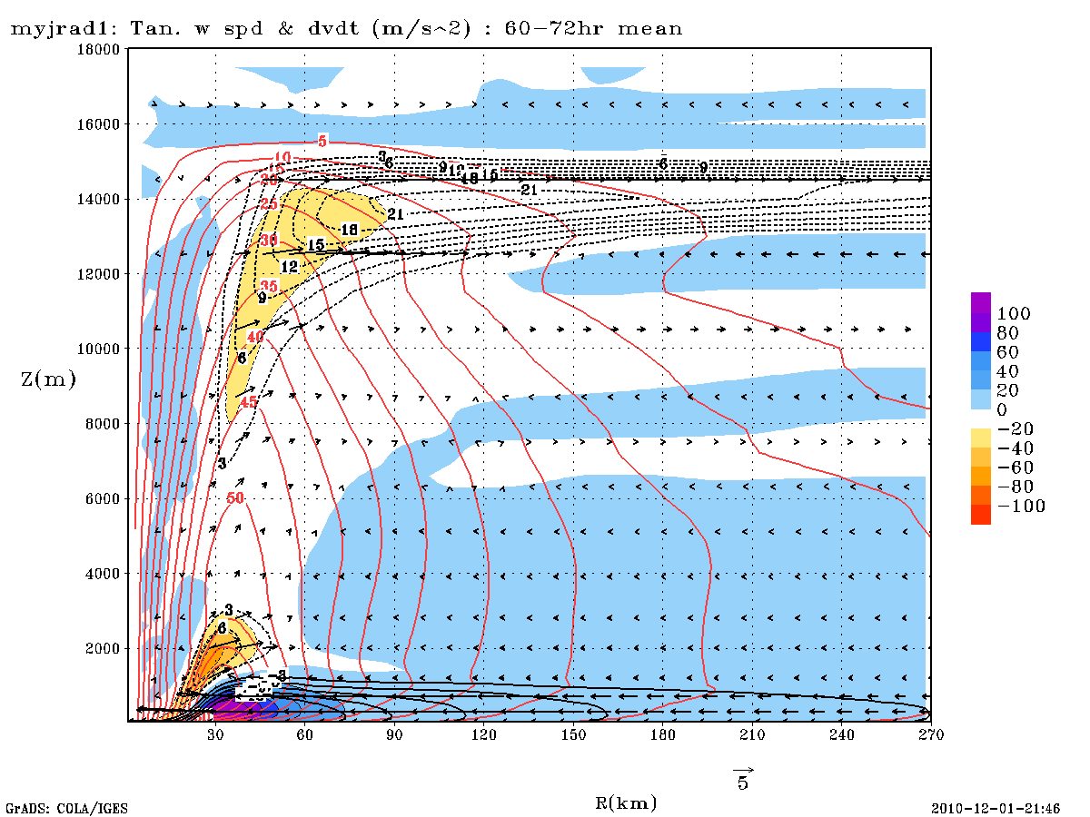
MYJ BL Scheme: 60-72 hr mean of u,v and dv/dt

Slide 5
