Slide 1
Airborne datasets useful for model diagnostics
Two primary uses for airborne datasets:
Quick-look assessments of model forecasts for a specific case
Comprehensive analyses in a composite framework for assessment of systematic biases

Slide 2
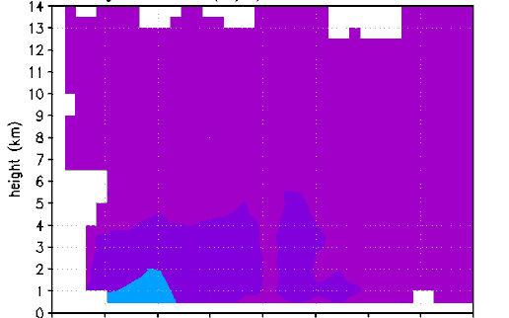
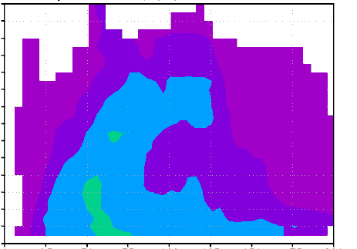
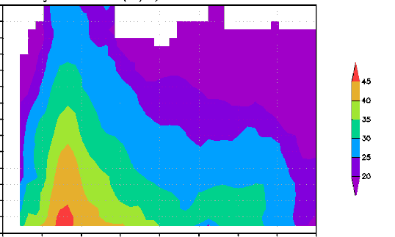
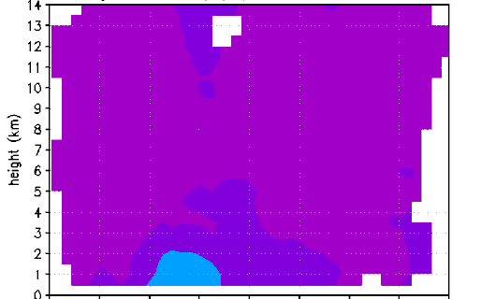
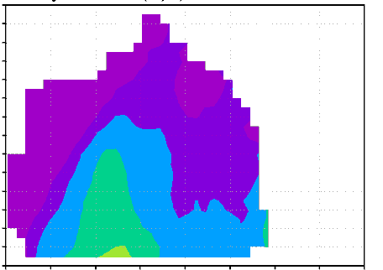
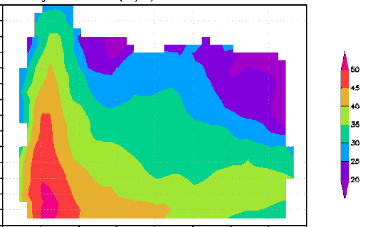
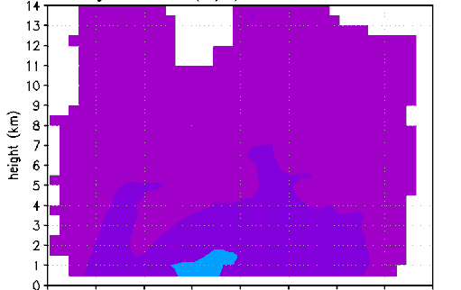
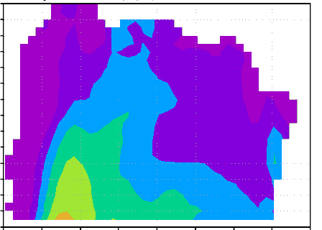
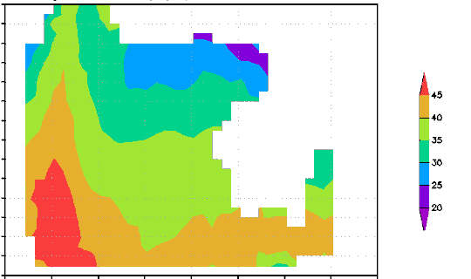
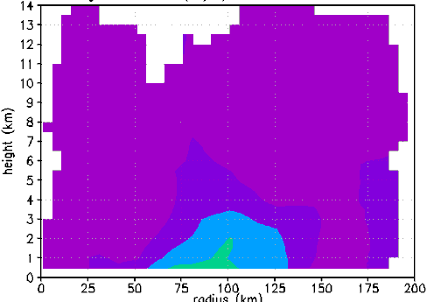
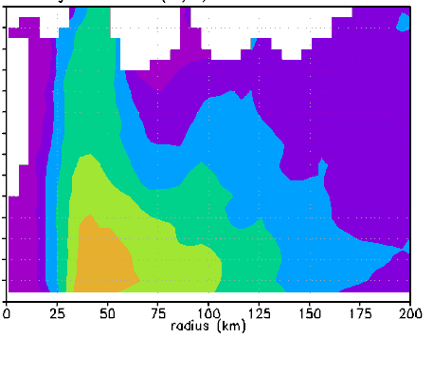
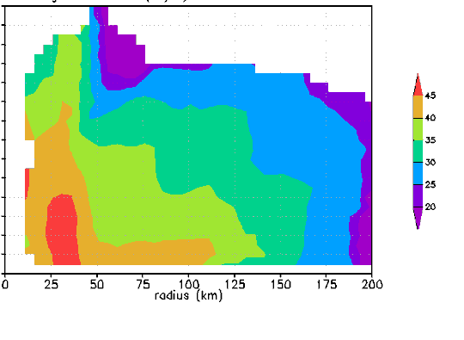
Quick-look assessments
Evolution of axisymmetric tangential wind (shaded, m/s) during RI
21:44Z Aug 28
21:00Z Aug 29
13:40Z Aug 30
23:03Z Aug 28
22:13Z Aug 29
21:23Z Aug 30
09:39Z Aug 29
00:44Z Aug 30
22:31Z Aug 30
11:58Z Aug 29
11:17Z Aug 30
23:33Z Aug 30

Slide 3
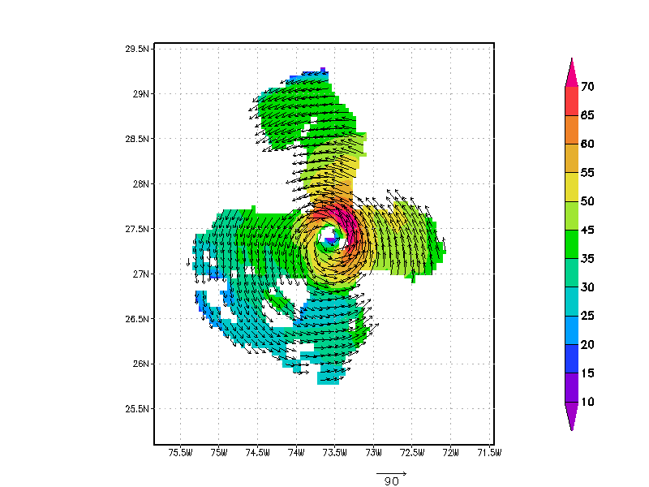
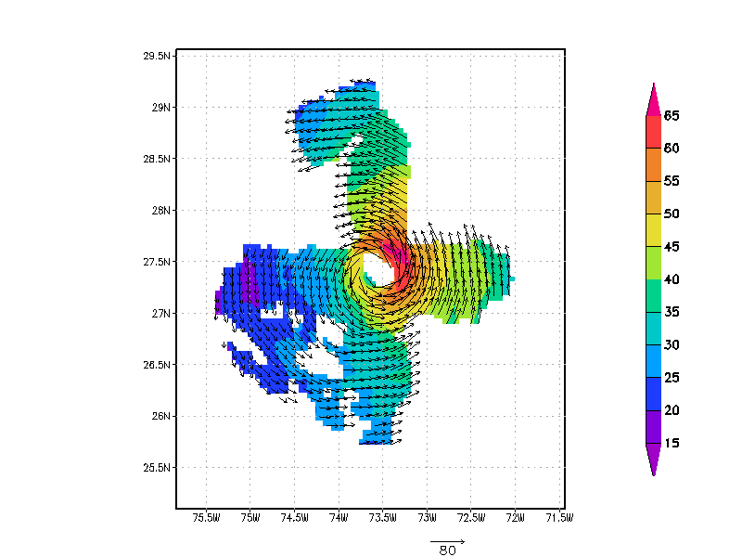
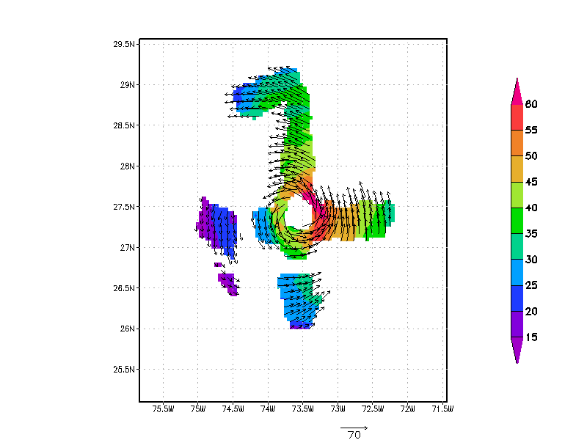
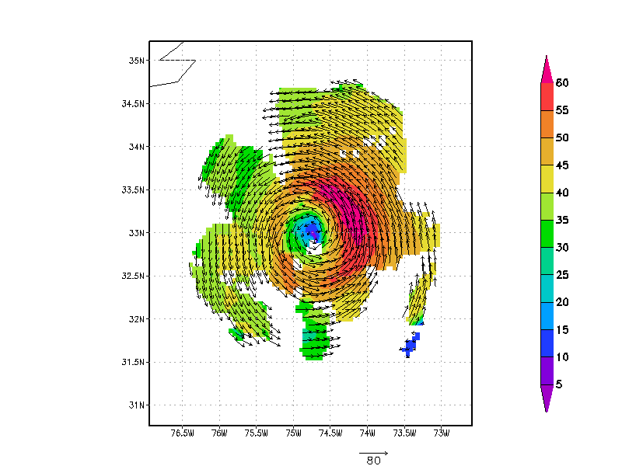
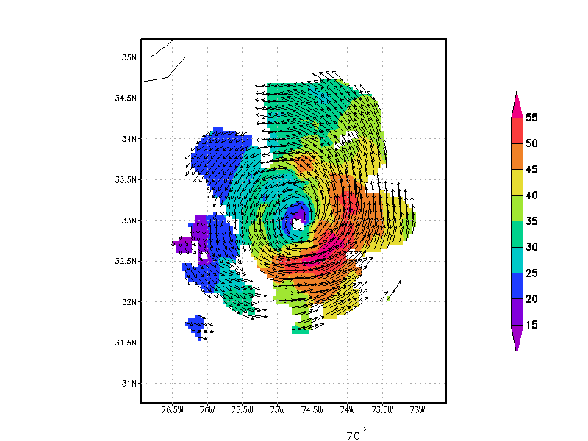
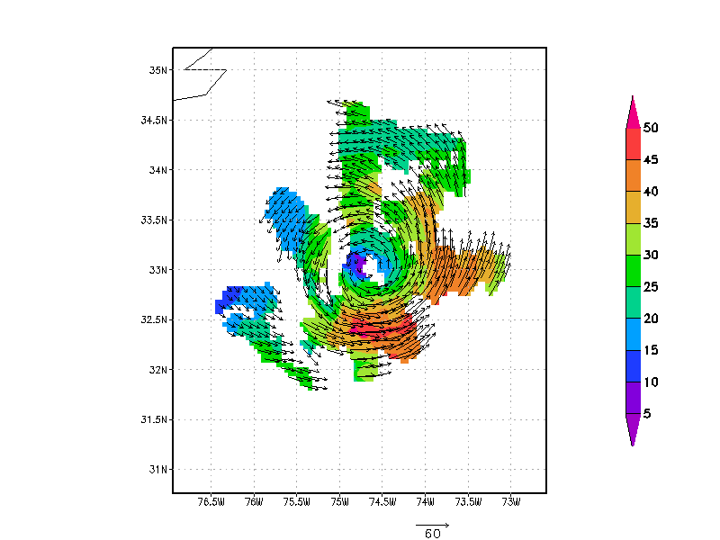
Quick-look assessments
Asymmetries of wind speed (shaded, m/s) from 1-9 km altitude
1 km
5 km
9 km
0114Z
Sept 2
1 km
5 km
9 km
2343Z
Sept 2

Slide 4
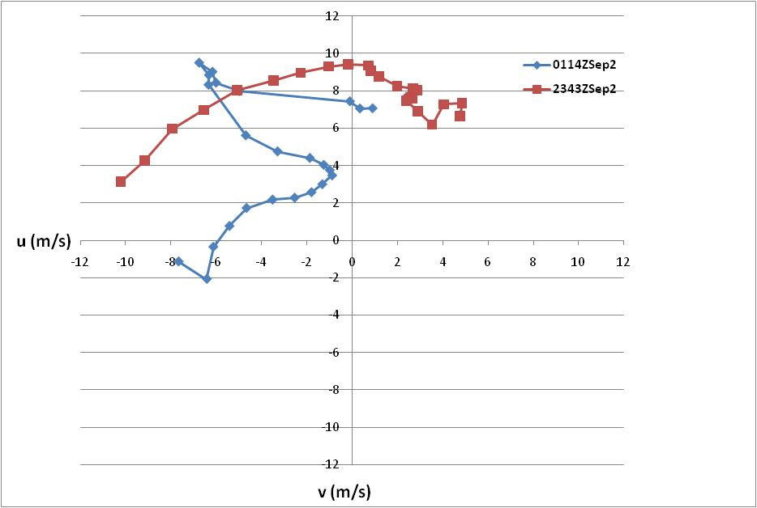
Quick-look assessments
Hodographs of Doppler-derived environmental winds (m/s) from 0.5-12 km altitude
9
3
5
10
4
6
7
8
11
11
9
8
2
12
10
12
7
6
1
5
3
4
2
1

Slide 5
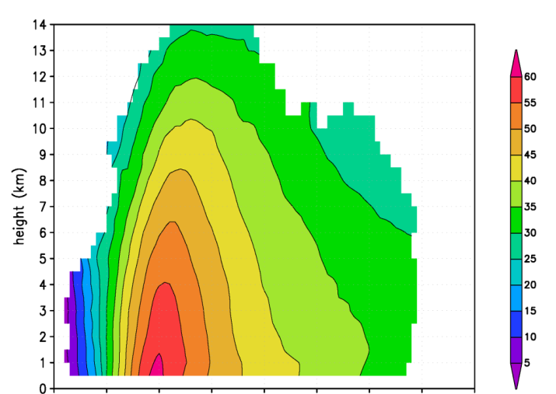
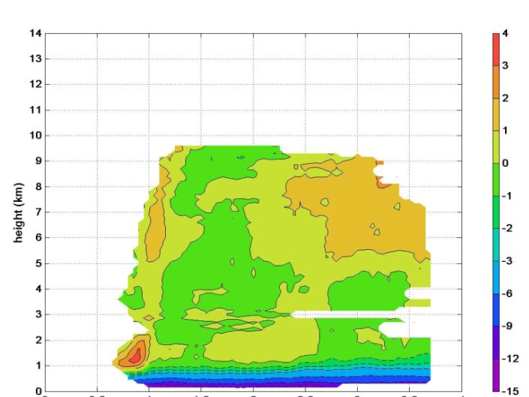
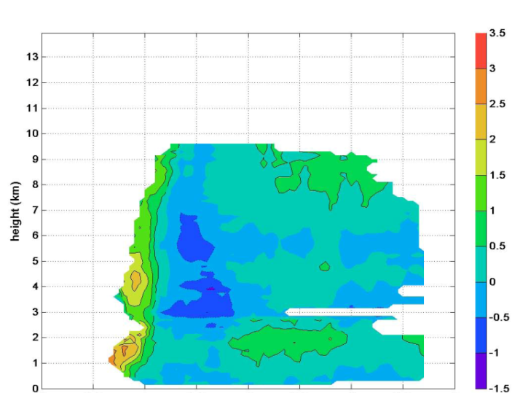
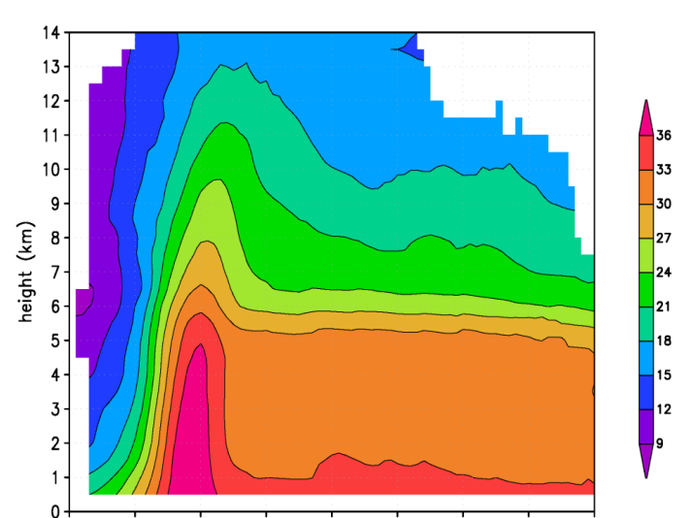
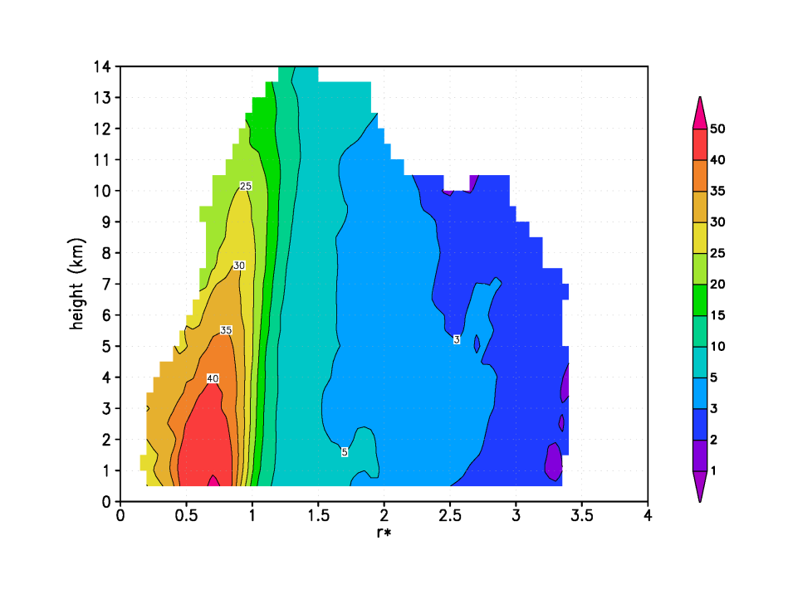
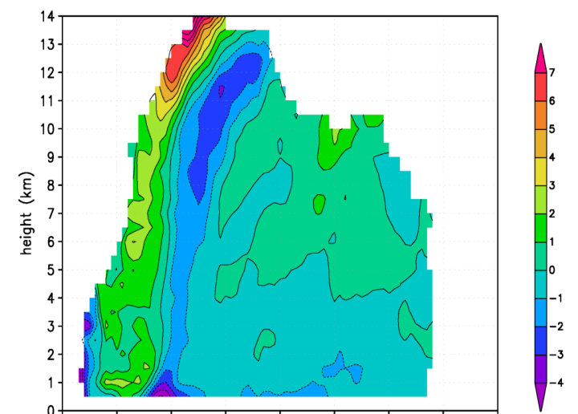
Composite analyses for model biases
Airborne Doppler composites from 40 radial penetrations in 8 different hurricanes
tangential wind (m/s)
radial wind (m/s)
vertical wind (m/s)
0
0.5
1
1.5
2
2.5
3
3.5
4
0
0.5
1
1.5
2
2.5
3
3.5
4
0
0.5
1
1.5
2
2.5
3
3.5
4
r/RMW
r/RMW
r/RMW
reflectivity (dBZ)
vorticity (x 10⁻⁴ s⁻¹)
divergence (x 10⁻⁴ s⁻¹)
0
0.5
1
1.5
2
2.5
3
3.5
4
0
0.5
1
1.5
2
2.5
3
3.5
4
0
0.5
1
1.5
2
2.5
3
3.5
4
r/RMW
r/RMW
r/RMW

Slide 6
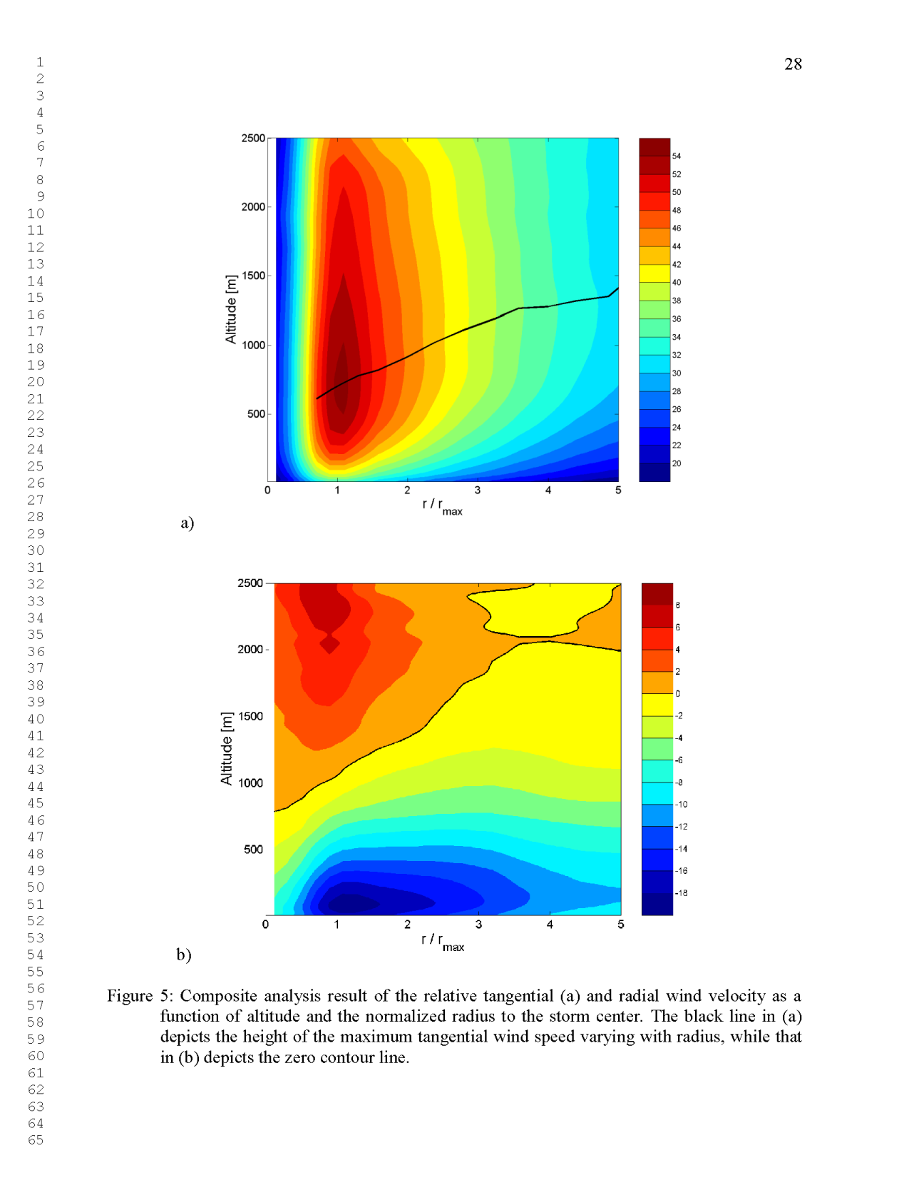
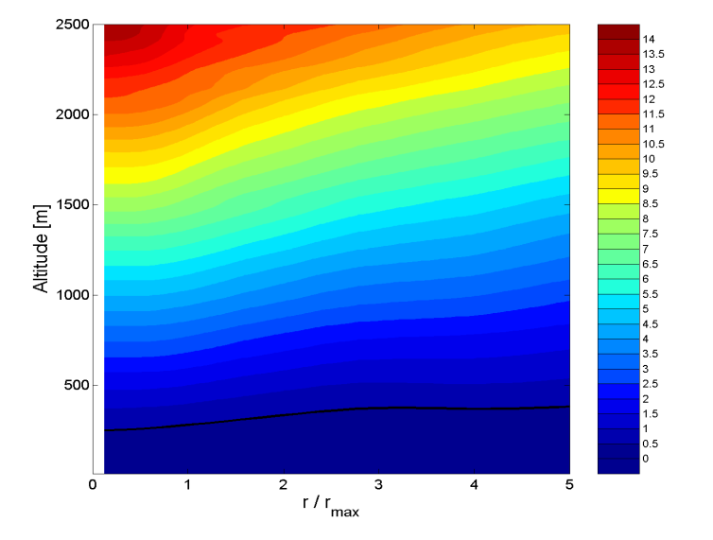
Composite analyses for model biases
Boundary-layer height using 3 different definitions derived from GPS dropsonde composites
from 2231 drops from 13 different hurricanes
Level of peak wind
Inflow-layer depth
Mixed-layer depth
tangential wind (m/s)
radial wind (m/s)
virtual potential temperature (K)
(difference between Ө_{v} and average Ө_{v} in lowest 150 m)

