Slide 1
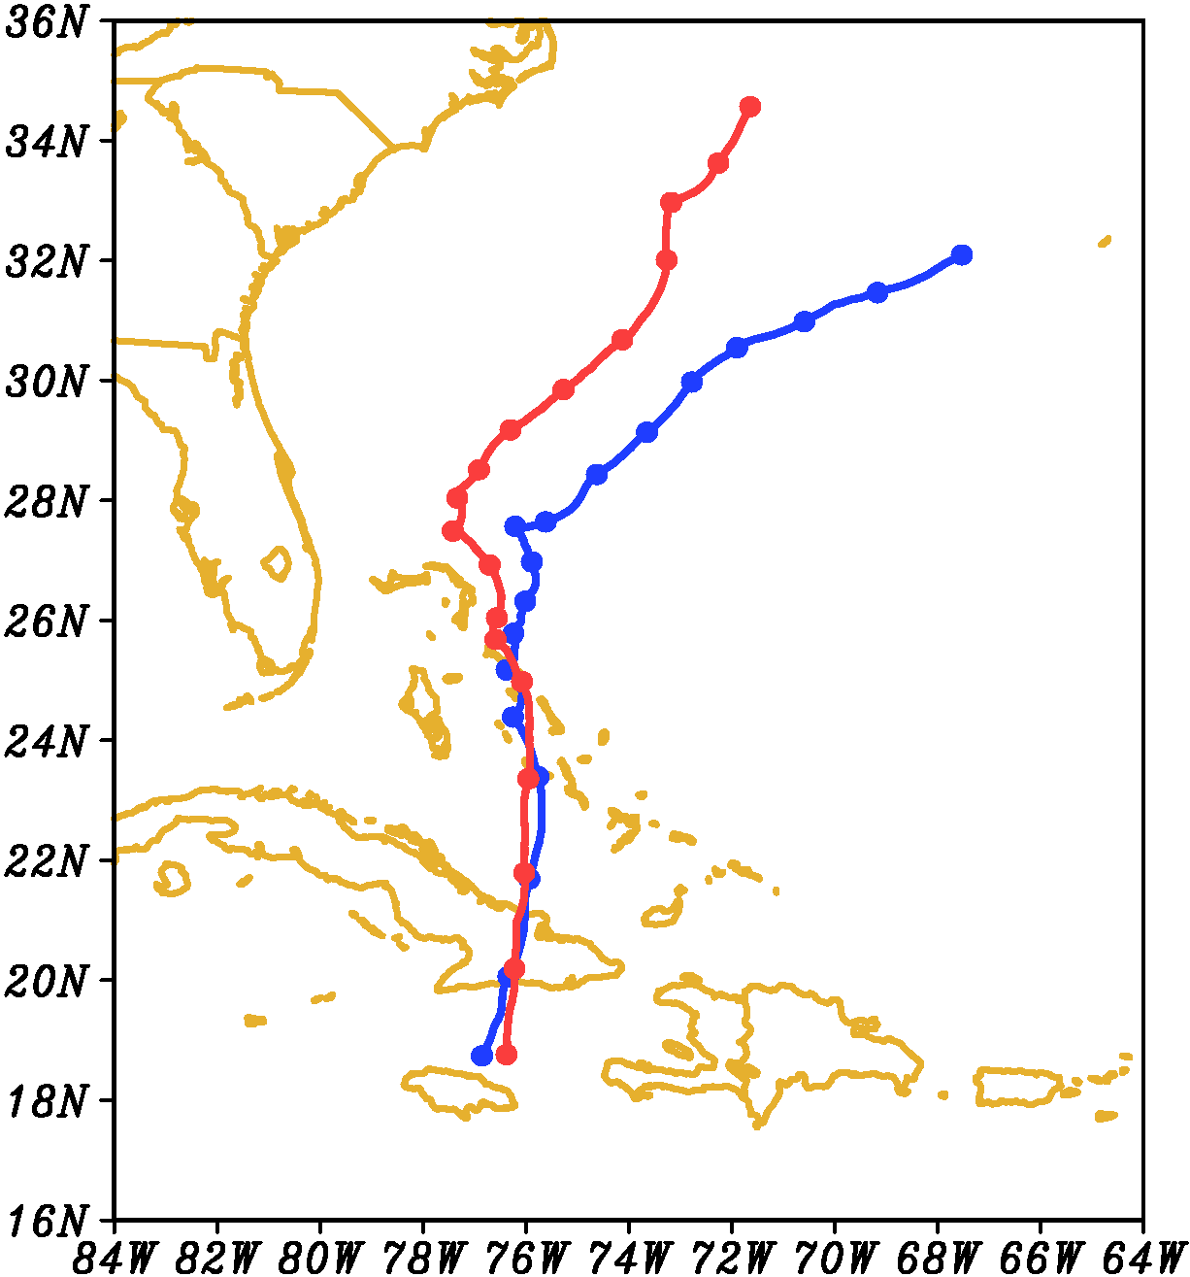
96 h
96 h
72 h
72 h
48 h
48 h
24 h
24 h
00:00OCT25

Slide 2
18 h
00:00OCT25

Slide 4
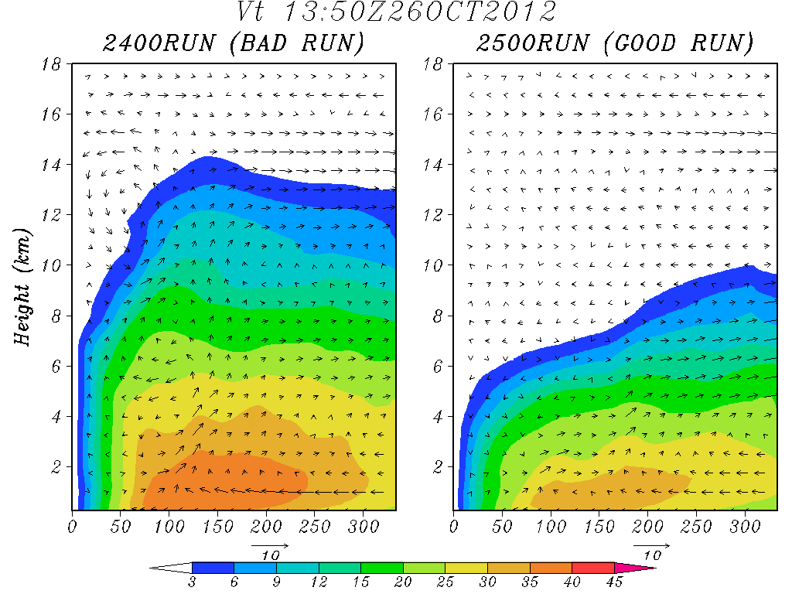

Slide 5
