Slide 1
Idealized Simulations: 27:09:03 –vs- 18:06:02
HRD/PSD HWRF Team
Work in progress

Slide 2
Time History: Peak 10-m wind and MSLP

Slide 3
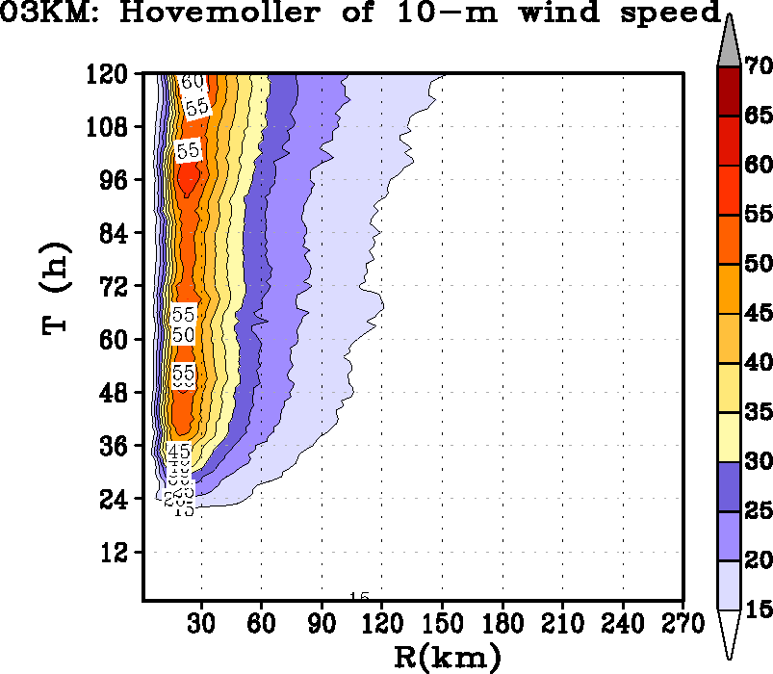
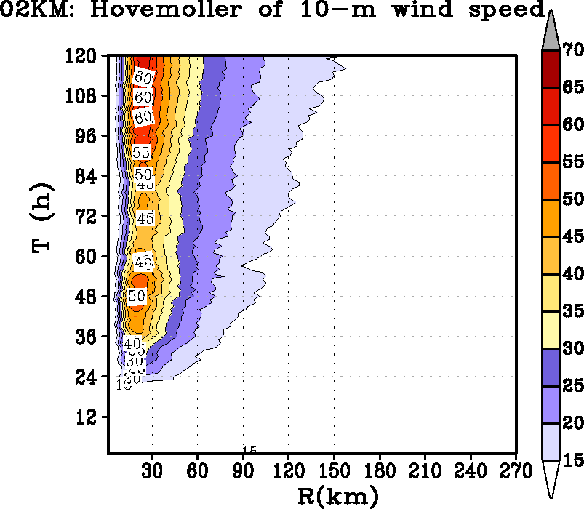
Size

Slide 4
Properties of the updrafts

Slide 5
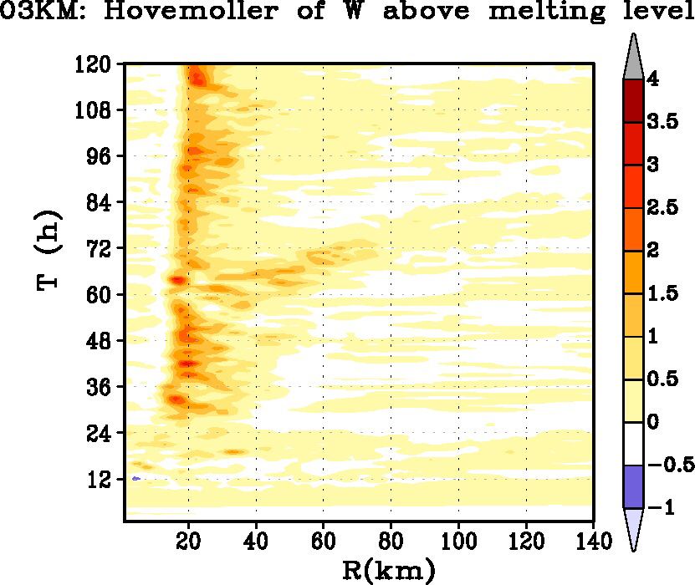
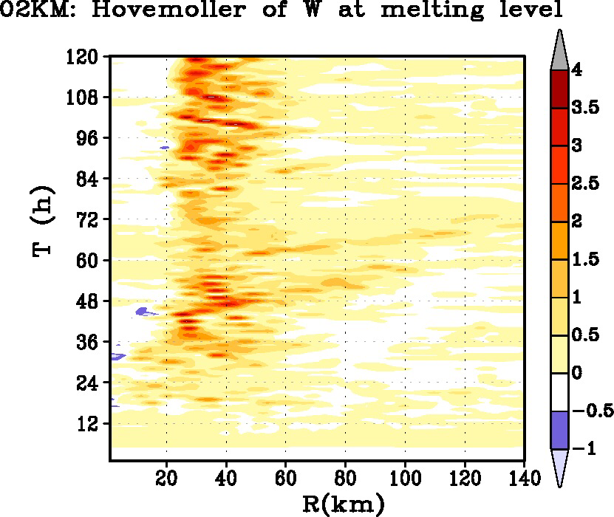
Improved structure ?

Slide 6
Secondary Circulation
Still not there with ERC ? PBL, MP or IC ?

