Slide 1



The NOAA-HWRF Modeling System: Advancements, Promises and Challenges in Tropical Cyclone Structure and Intensity Predictions
Sundararaman G. Gopalakrishnan (Gopal)
NOAA/AOML/HRD, Miami
Vijay Tallapragada
NOAA/NCEP/EMC, Washington DC
NOAA Science Day, 12 Sept, 2012
Acknowledgements :
Frank Marks, NOAA/AOML/HRD, Miami, FL
Robert Atlas, NOAA/AOML, Miami, FL
Bill Lapenta, NOAA/NCEP/EMC, Washington, DC
Notes:
Hurricane Bill: HWRF Equivalent of GOES-East Imager 10.7 micro m
1

Slide 2
HFIP-HWRF TIGER TEAM
NOAA/NCEP/EMC Teams
NOAA/AOML/HRD Modeling Teams
Dr.Vijay Tallapragada (Team Lead)
Dr.Young Kwon
Dr.Qingfu Liu
Dr.Zhan Zhang
Dr.Sam Trahan
Dr.Weiguo Wang
Dr.Chanh Kieu
Dr.Mingjing Tong
Dr.In-Hyuk Kwon
Dr.S. G. Gopalakrishnan (Lead)
Dr. Xuejin Zhang
Dr.Thiago Quirino
Dr.Jun Zhang
Lisa Bucci
Dr. Kevin Yeh
Stanley Goldenberg
NOAA/ESRL Modeling Teams
Dr.Jian-Wen.Bao
S.A.Michelson
DTC: code support and management
NOAA/NHC: important inputs and suggestions
2
Capacity Building for NOAA

Slide 3
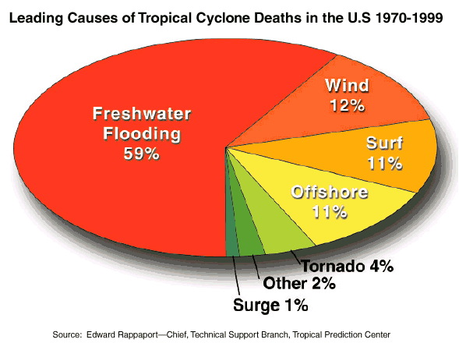

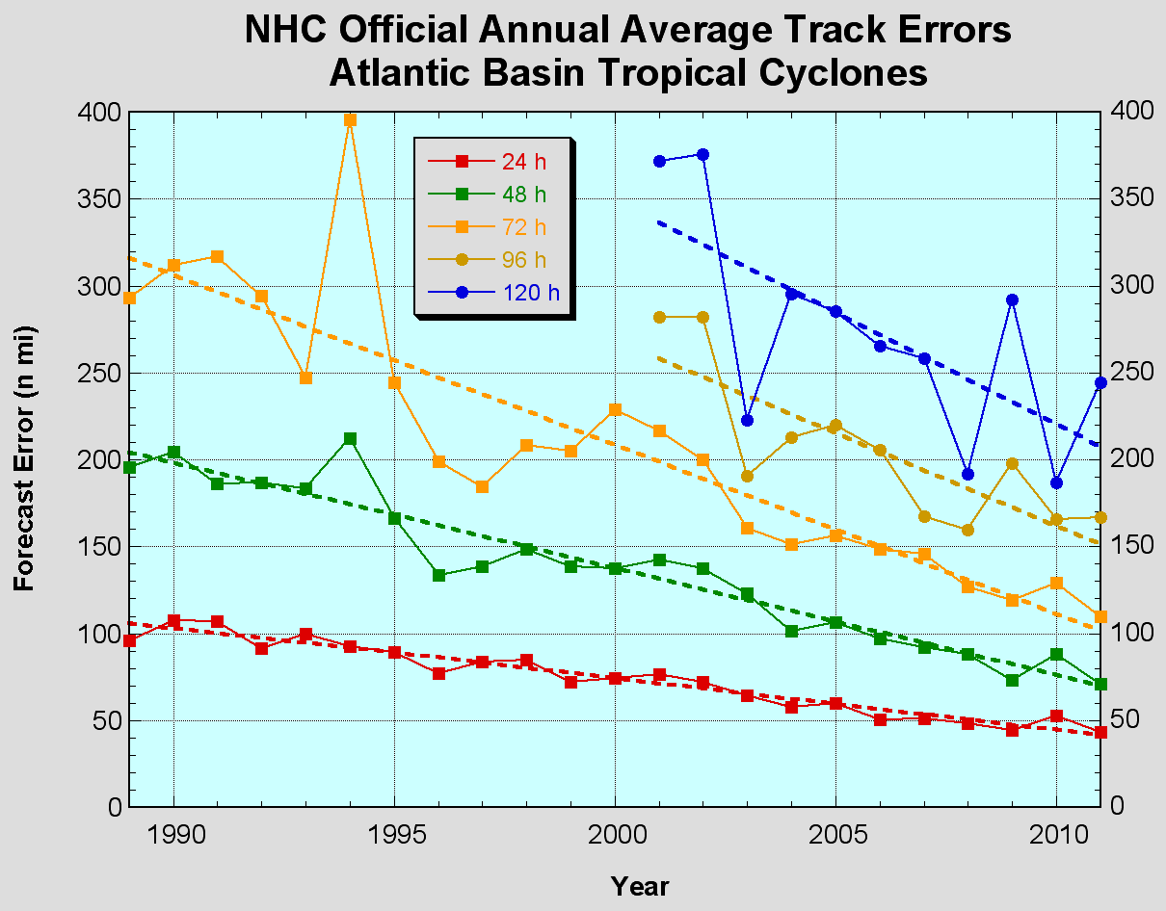
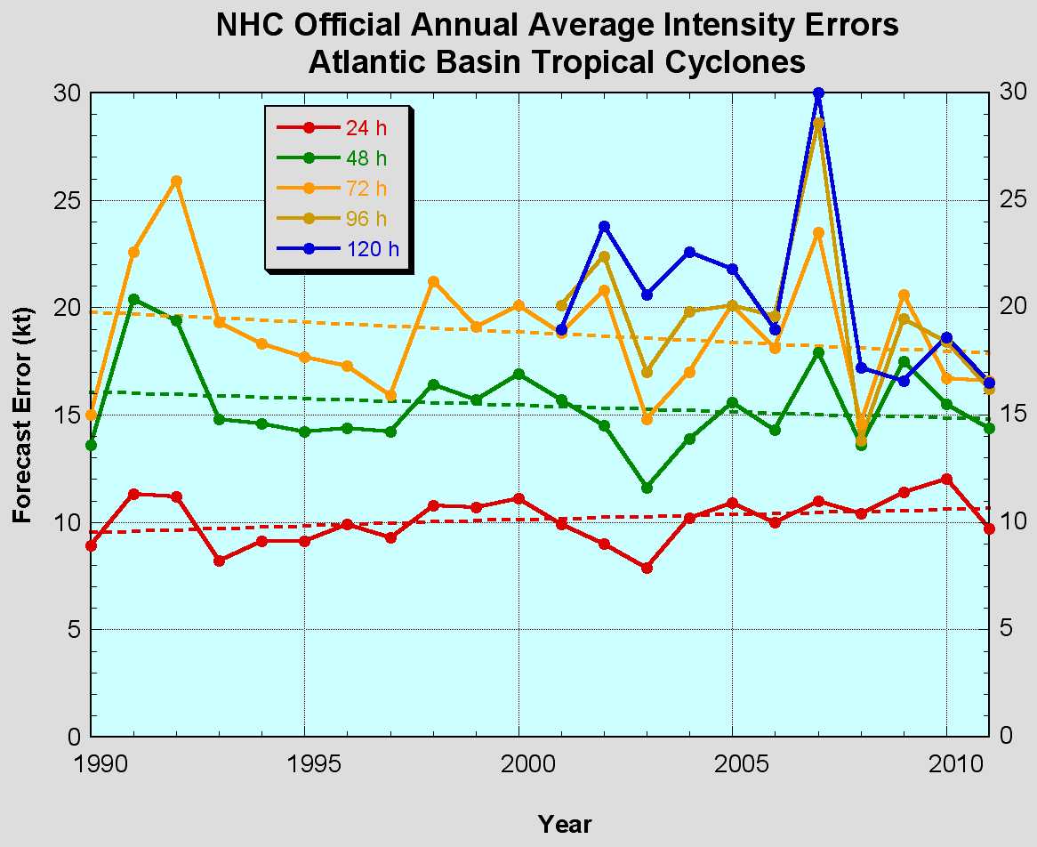
TRACK AND INTENSITY FORECASTING:
STATE-OF-THE-ART
The Good – Improved track predictions
The Bad – Wind Intensity no real gains
Errors cut in half past 15 years
Need for an immediate focus!
http://www.nhc.noaa.gov/verification/verify5.shtml
Size and Intensity
No established metrics to evaluate/verify rainfall and size
-Both of which are important at landfall
Notes:
Images from: http://www.nhc.noaa.gov/verification/verify5.shtml

Slide 4
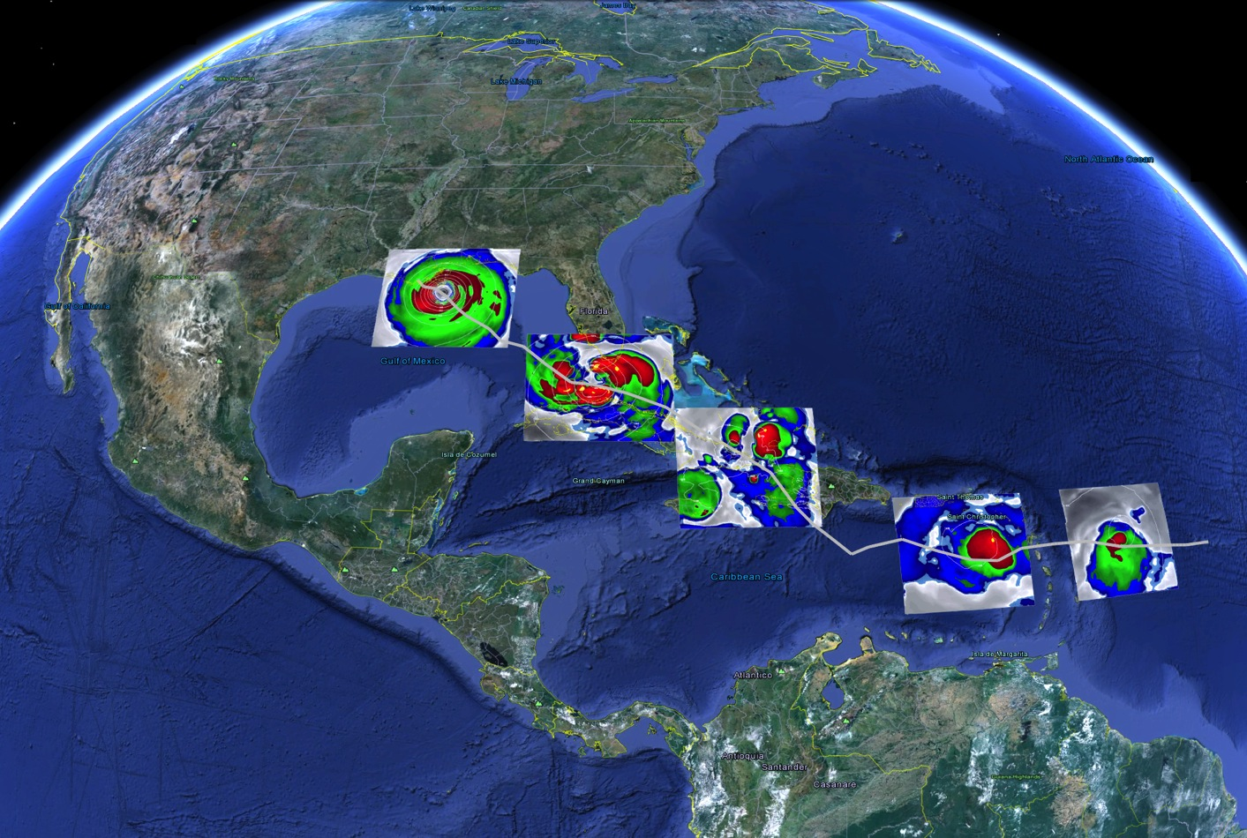

THE INTENSIFICATION PROBLEM:
MULTISCALE INTERACTIONS
AOML/HRD – NCEP/EMC
What it takes to forecast a Tropical Cyclone (TC)
1.Higher Resolution for resolving convection & terrain
2. Model Physics valid for higher resolution
3. Improved representation of initial conditions
4. Advanced understanding of the TCs (observations)
Warmer sea surface temperatures and no shear
Vortex tilt, dry air, and size of the storm
Terrain interactions
Northerly shear and dry air impedes the development of circulation
Enhanced Water Vapor Equivalents obtained from HWRF in the Life cycle of Hurricane Isaac

Slide 5
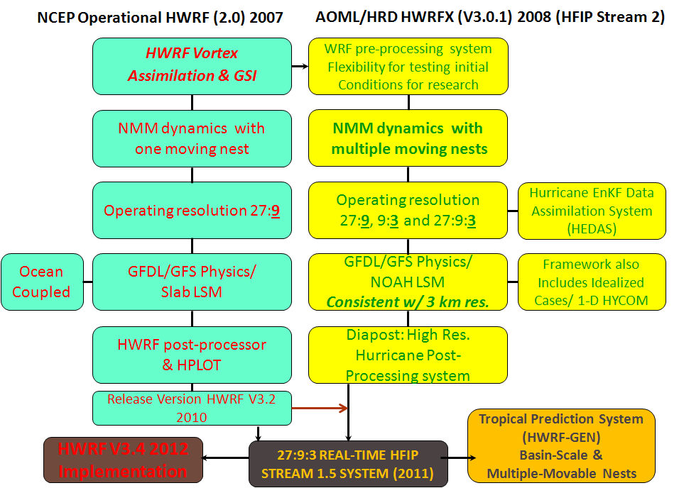
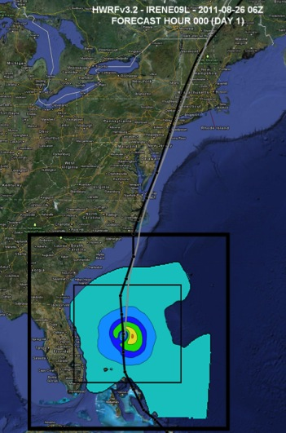
IMPROVING STRUCTURE AND INTENSITY PREDICTIONS:
THE HIGH RESOLUTION HWRF SYSTEM
AOML and their partners at NCEP are creating a high resolution HWRF model to address NOAA’s immediate and future operational needs
Successful O2R and R2O transitions under the directions of the HFIP
“A major accomplishment was the development of a third nest, at 3 km resolution, to cover the inner core and most of the surrounding circulation of the storm. This would make the HWRF model the highest resolution hurricane model ever implemented for operations in the National Weather Services”… Richard Pasch, NHC.
Advances

Slide 6



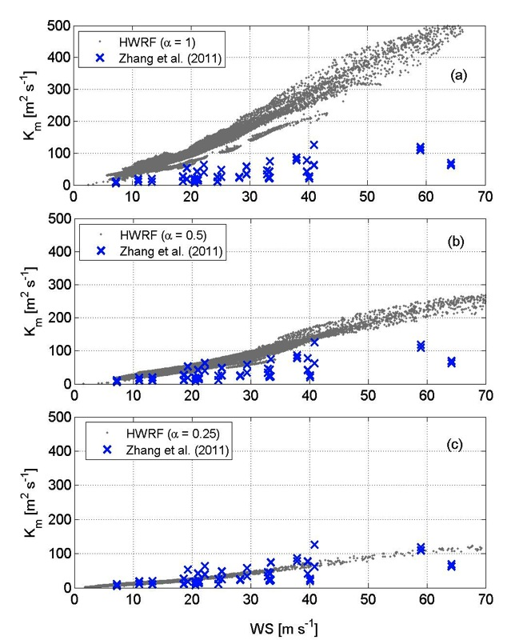
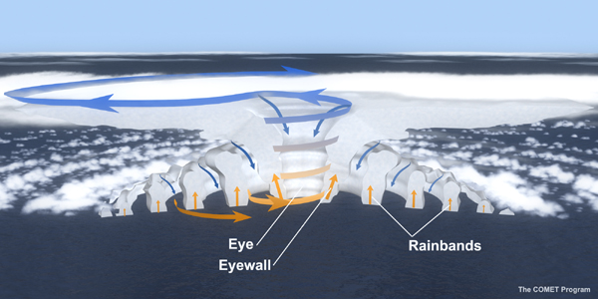

The NOAA G-IV
above and around
the hurricane
IMPROVING STRUCTURE AND INTENSITY PREDICTIONS:
USE OF P3s IN IMPROVING HWRF PHYSICS
The NOAA P-3
samples inside
the hurricane
Radiation
outflow
outflow
Microphysics
HWRF
observations
1 km
Inflow
Boundary Layer: Km/Kh
Inflow
Surface layer: Cd and Ch
SST/Waves/Sea-Spray
Improved observation-based Surface and Boundary Layer physics in the High Resolution HWRF
Findings: Stronger inflow and smaller matured storms consistent with observations
Gopalakrishnan, S. G., F. Marks, Jr, J. A. Zhang, X. Zhang, J. Bao, and V. Tallapragada, 2012: A study of the impacts of vertical diffusion on the structure and intensity of tropical cyclones using the high resolution HWRF system. J.Atmos.Sci (in press)
Advances

Slide 7
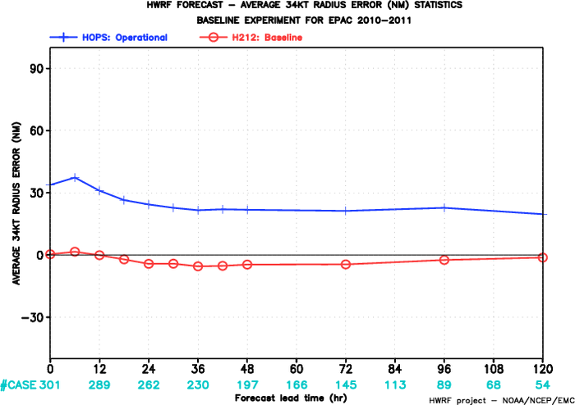
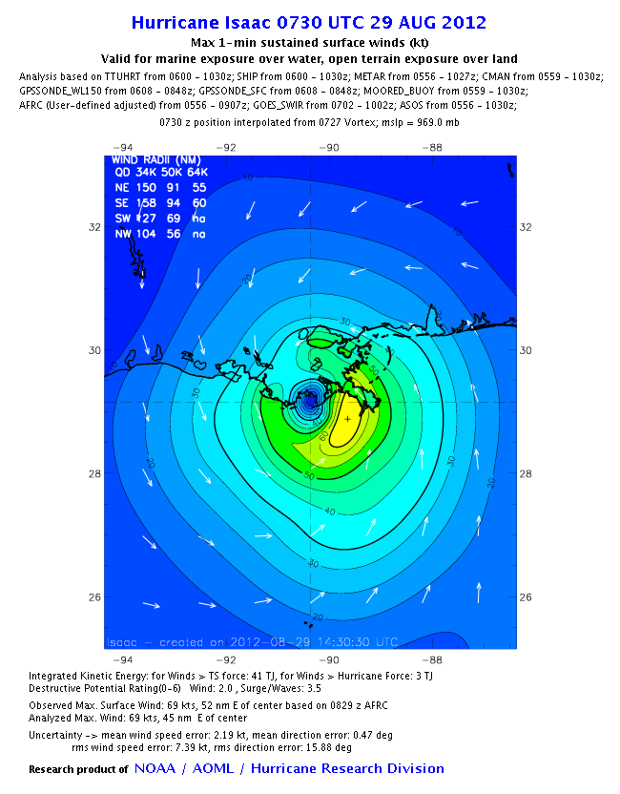
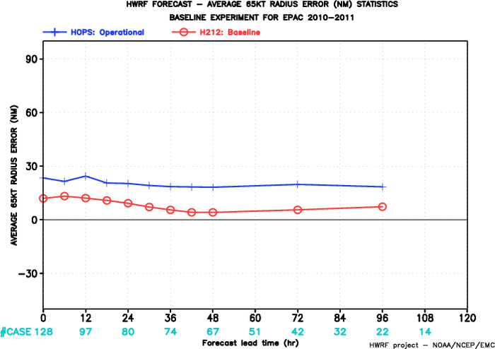
WIND RADII PREDICTIONS:
SIGNIFICANT GAINS WITH RESOLUTION AND PHYSICS
EPAC: Mean 34-kt Radius Error
9km HWRF
Radius
Of 34 kt
winds
3km HWRF
Radius
Of Maximum
winds
EPAC: Mean 65-kt Radius Error
NOAA-H*Wind Analysis
9km HWRF
Size Matters!
(e.g. storm surge)
3km HWRF
Promises
Notes:
7

Slide 8
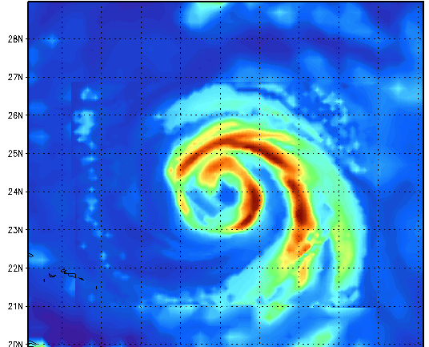
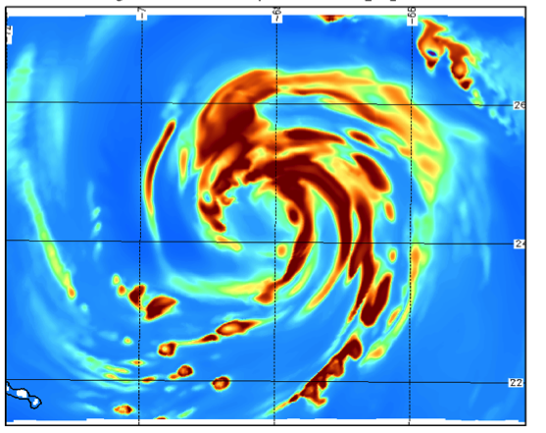
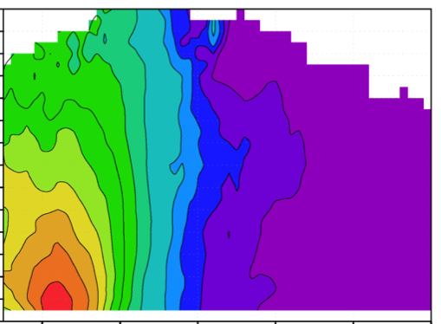
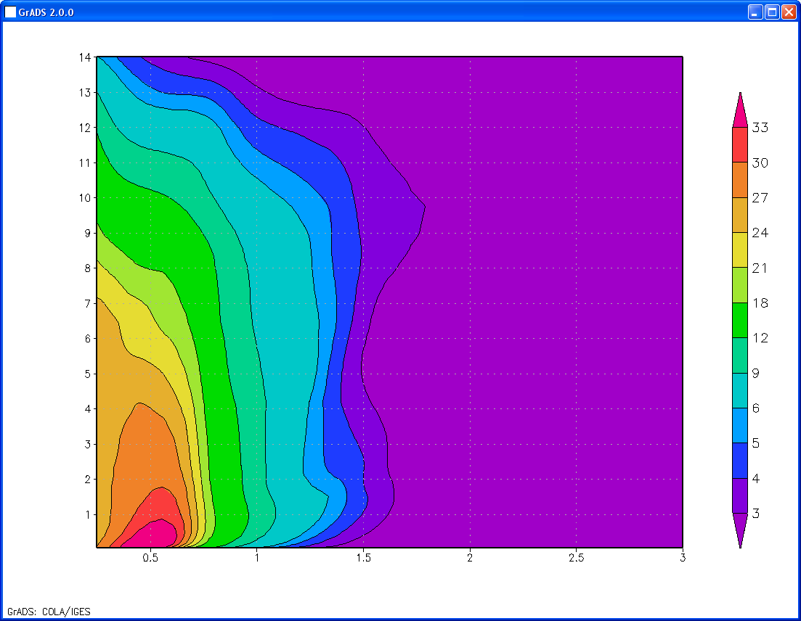
STRUCTURE PREDICTIONS:
SIGNIFICANT GAINS WITH RESOLUTION AND PHYSICS
9 km HWRF: Hurricane Katia
3 km HWRF
Hurricane Katia
14
14
13
13
12
12
33
11
Rogers et al 2012, MWR
11
30
10
10
27
height (km)
9
height (km)
9
24
8
8
21
7
7
18
6
6
12
5
5
9
4
Doppler Composites
4
6
3
3
3 km HWRF
Hurricane Earl
5
2
2
4
1
1
3
0
0.5
1
1.5
2
2.5
3
0
0.5
1
1.5
2
2.5
3
r/RMW
r/RMW
Promises

Slide 9
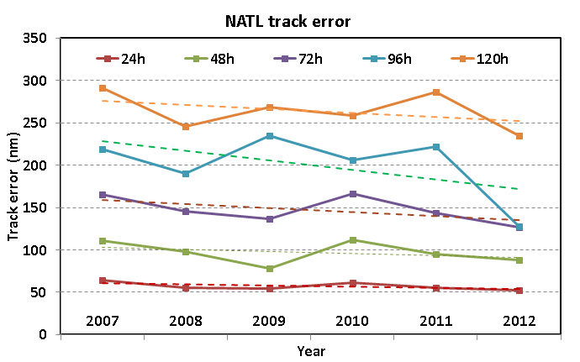
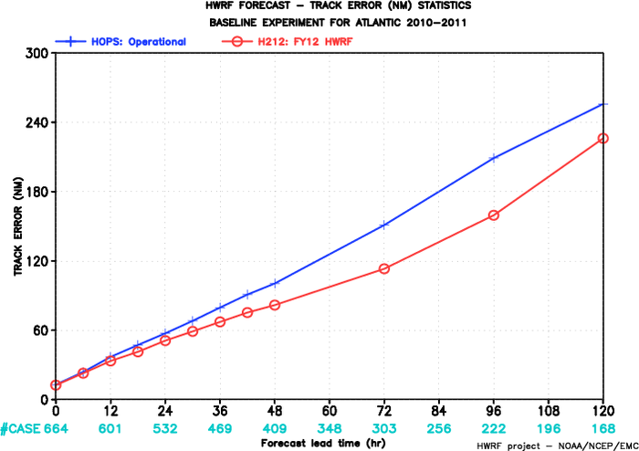
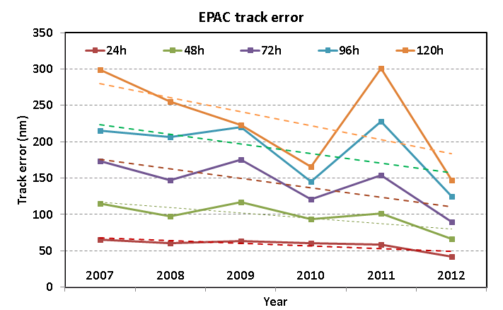
TRACK PREDICTIONS:
SIGNIFICANT GAINS WITH RESOLUTION AND PHYSICS
Atlantic Basin
9-km HWRF
3-km HWRF
Retrospective runs of 3km HWRF from 2010-2011 seasons show 10-25% reduction in track errors
Promises

Slide 10
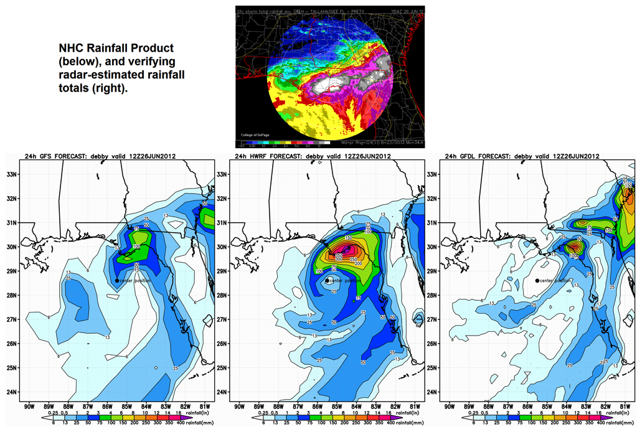
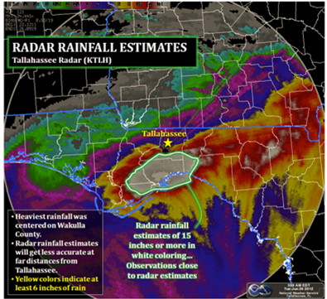
RAINFALL PREDICTIONS:
SIGNIFICANT GAINS WITH RESOLUTION AND PHYSICS
GFS
HWRF
GFDL
Promises

Slide 11
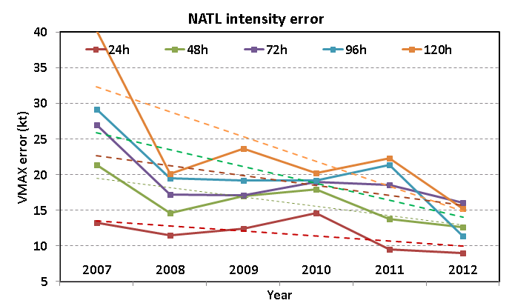
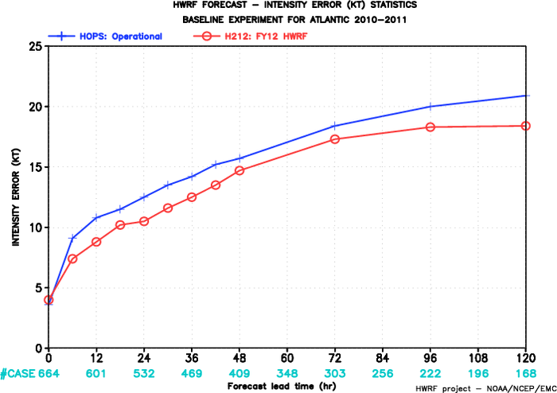
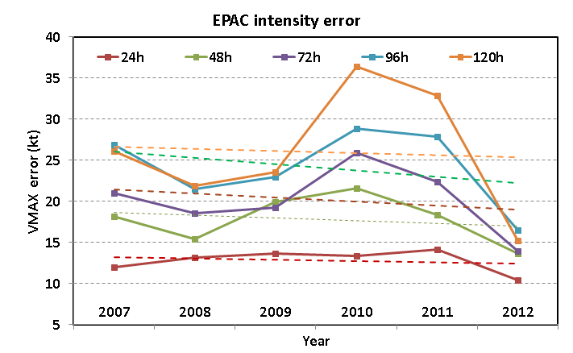
WIND INTENSITY PREDICTIONS:
PROMISES & CHALLENGES
Atlantic Basin
9-km HWRF
3-km HWRF
Retrospective runs of 3km HWRF from 2010-2011 seasons show only 5-15% reduction in wind intensity errors
Challenges

Slide 12
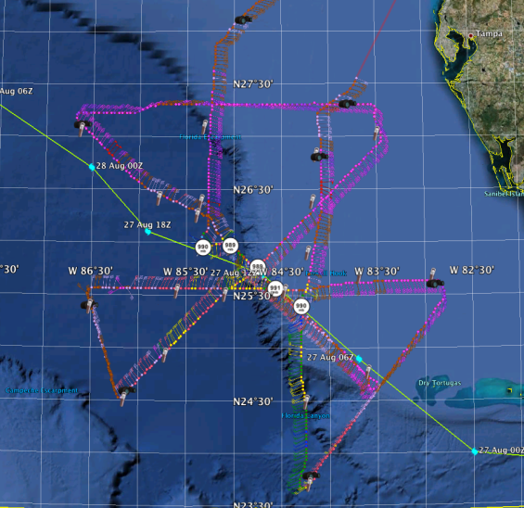
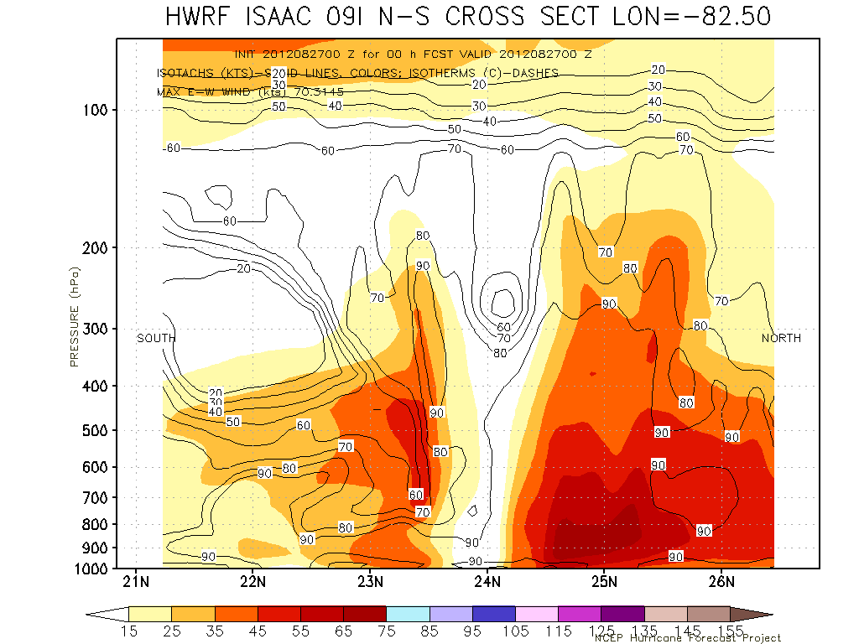
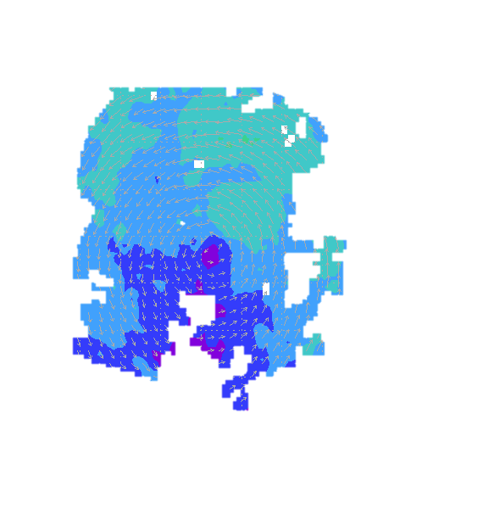
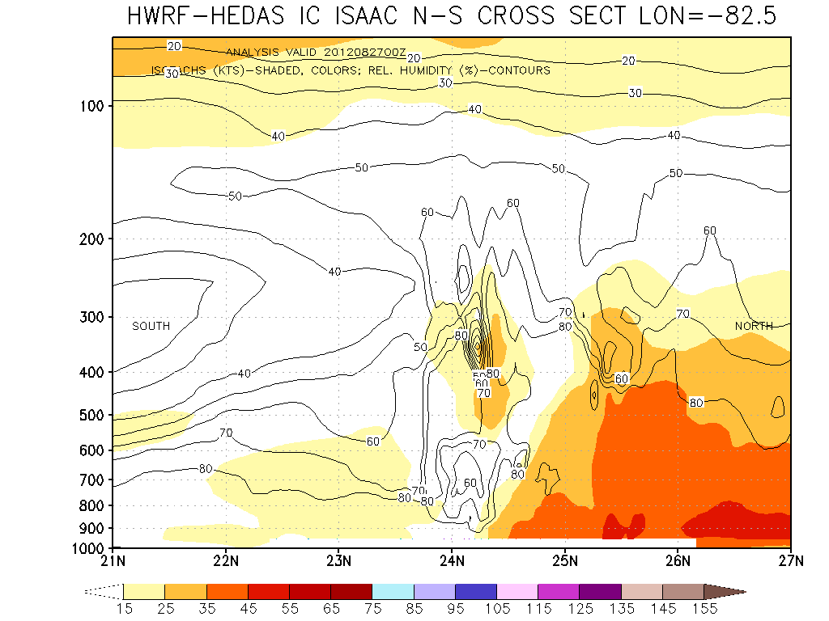
The NOAA G-IV
above and around
the hurricane
IMPACT OF AIRCRAFT OBSERVATIONS ON HWRF FORECAST
IMPROVING STORM STRUCTURE AT INITIAL TIME
The NOAA P-3
samples inside
the hurricane
The Hurricane Research Division of NOAA/AOML has developed a state-of the-art inner core data assimilation system for HWRF (HEDAS)
[Runs in real time under HFIP]
ISAAC Initial vortex (wind)
Operational HWRF (No Data Assimilation)
ISAAC (2012): Intensity Errors (kt)
Hours | 12 | 24 | 36 | 48
Operational HWRF | 13 | 16 | 26 | 26
With P3 Data | 8 | 3 | 9 | 20
Cases | 9 | 7 | 5 | 3
ISAAC Initial vortex (wind)
with assimilation of observations
Dry and
Sheared
vortex
Aksoy, A., S. Lorsolo, T. Vukicevic, K. Sellwood, S. Aberson, and F. Zhang, 2012: The HWRF Hurricane Ensemble Data Assimilation System (HEDAS) for highresolution data: The impact of airborne Doppler radar observations in an OSSE. Mon. Wea. Rev (in press).
Challenges

Slide 13
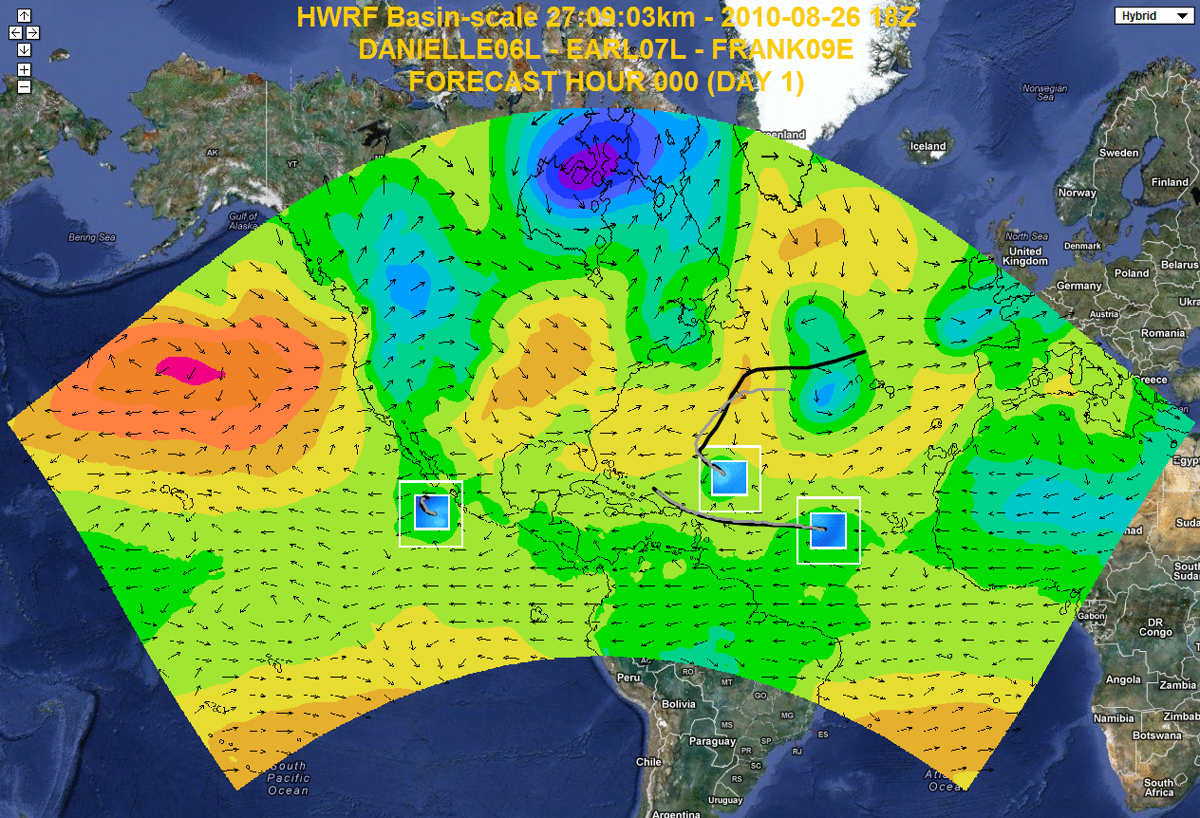
NEXT GENERATION EFFORT:
THE BASIN SCALE 3-KM HWRF
Multiple high resolution nest
Storm storm interactions
Genesis products
Daily Tropical Outlook (Tropical Waves)
Computational efficiency
Efficient for Data Assimilation
Website at AOML: https://storm.aoml.noaa.gov/realtime
Notes:
Independent DA system including vortex scale DA
Genesis
Track forecast
Local application
Drive local-scale model
Website at AOML: https://storm.aoml.noaa.gov/realtime
13

Slide 14
PROMISES AND CHALLENGES
Will further physics advancements improve forecasts?
Will the Tail Doppler Radar data (P3s) improve the predictions of 10-m wind for the HWRF system?
Will the HWRF tropical prediction system improve track and intensity forecasting
Is the 10-m wind sufficient to depict intensification process in tropical storms ?
Limits of predictability of TCs ?

Slide 15
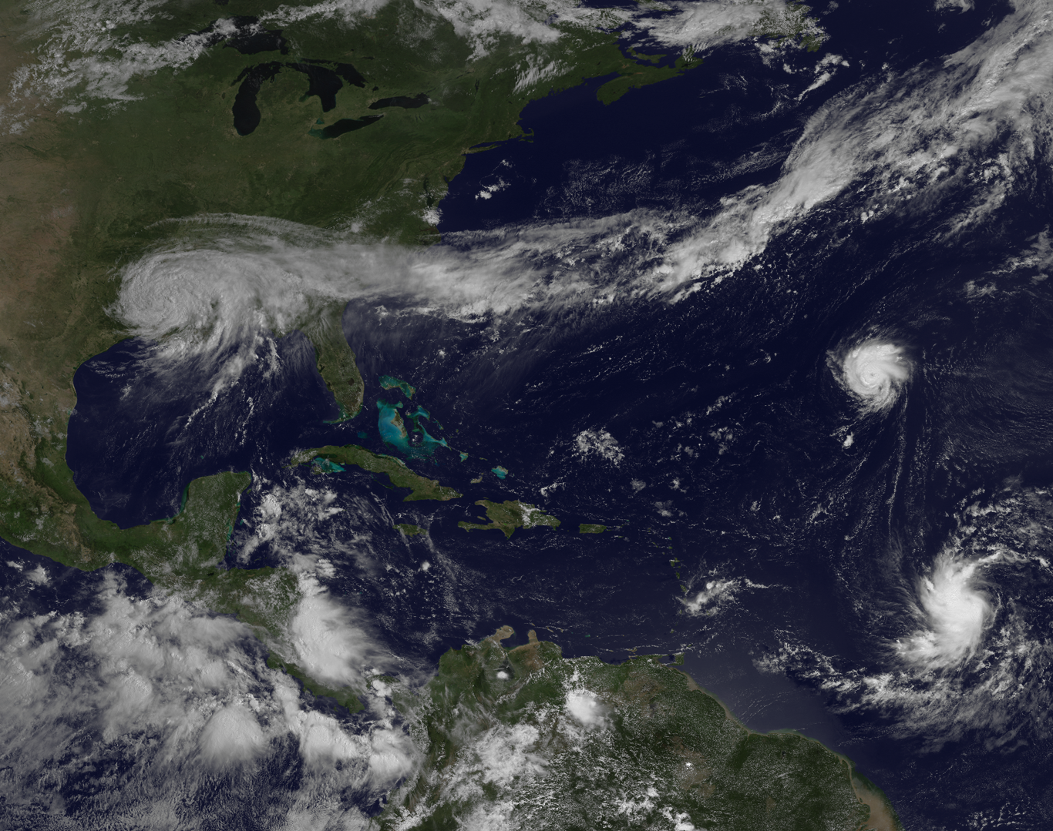
Questions ?
Notes:
15

Slide 16



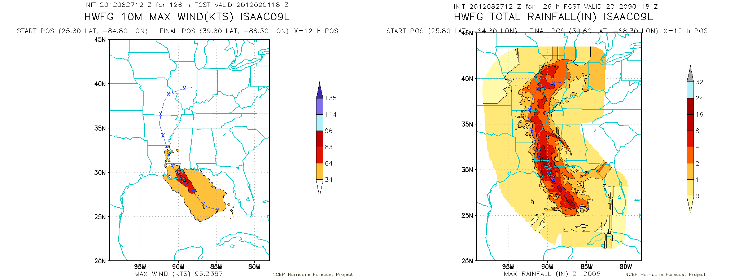
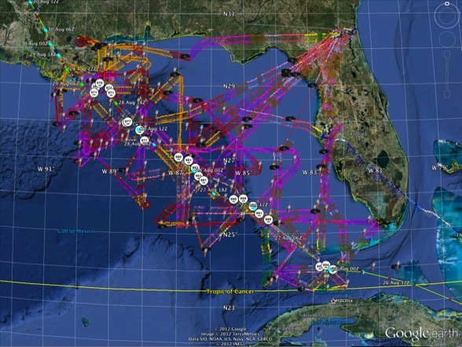
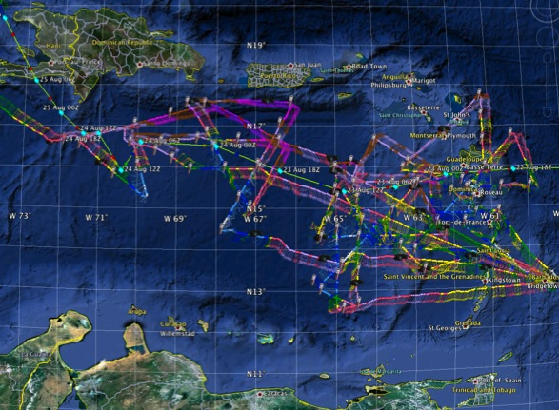
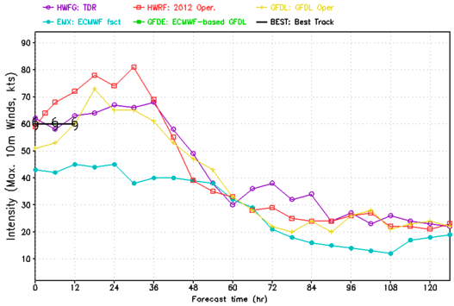
The NOAA G-IV
above and around
the hurricane
IFEX 2012: ISAAC:
IMPROVED INITIAL CONDITIONS & IMPROVED HWRF
The NOAA P-3
samples inside
the hurricane
HWRF/GSI
20120827 12UTC
4 P-3 Flights
22 August – 24 August 2011
Data Assimilation
is used
to integrate airborne
observations
into forecast
5 P-3 Flights
26 August – 28 August 2011
4 missions from 22-24 Aug 2012 and 5 missions from 26-28 Aug 2012 at 12 h Doppler sampling (HEDAS/GSI) & 6 G-IV missions
Sampled Isaac as a tropical storm to hurricane at landfall
HWRF/GSI
20120827 12UTC
Aberson, Aksoy, Gamache, Gopal (AOML/HRD), Tong (EMC)
Notes:
Map shows flight tracks for all of the NOAA missions (color coded are the flight level winds for the P-3 missions, dropsonde symbols denote G-IV patterns)
Flight track plots courtesy of Tropical Atlantic - http://tropicalatlantic.com/recon/
Model data available at: http://storm.aoml.noaa.gov/realtime

Slide 17
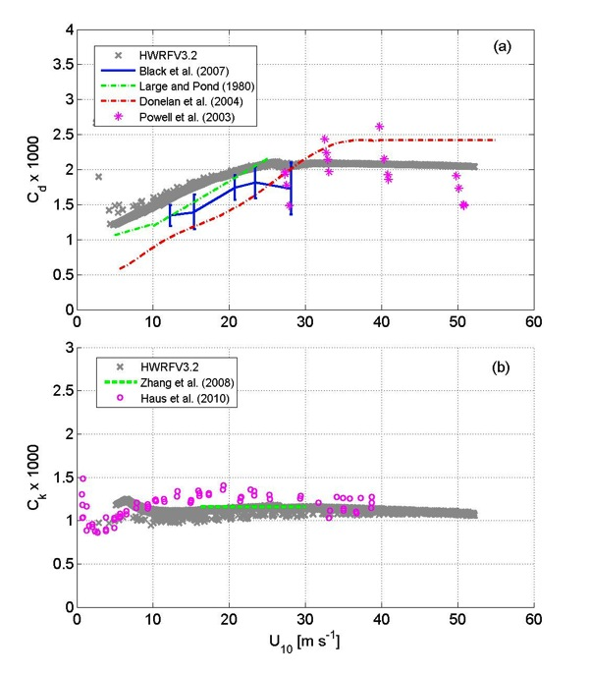
The NOAA G-IV
above and around
the hurricane
IMPROVING STRUCTURE AND INTENSITY PREDICTIONS:
USE OF P3s & G4s IN IMPROVING HWRF PHYSICS
The NOAA P-3
samples inside
the hurricane
observations
Radiation
HWRF
outflow
outflow
Microphysics
1 km
Inflow
Boundary Layer: Km/Kh
Inflow
observations
HWRF
Surface layer: Cd and Ch
SST/Waves/Sea-Spray
Improved observation based surface layer physics in the High Resolution HWRF
1.Drennan, W. M., J. A. Zhang, J. R. French, and P. G. Black, 2007.Turbulent Fluxes in the Hurricane Boundary Layer, II. Latent Heat Flux., J. Atmos. Sci., 64, 1103-1115
2.Mark D. Powell, Peter J. Vickery and Timothy A. Reinhold, 2003: Reduced drag coefficient for high wind speeds in tropical cyclones, Nature , 422 279-283
Advances

Slide 18



The NOAA G-IV
above and around
the hurricane
IMPROVING STRUCTURE AND INTENSITY PREDICTIONS:
USE OF P3s IN IMPROVING HWRF PHYSICS
The NOAA P-3
samples inside
the hurricane
Improved observation-based Boundary Layer physics in the High Resolution HWRF
Findings: Stronger inflow and smaller matured storms
Impacts of vertical diffusion on the storm size
HWRF
observations
Gopalakrishnan, S. G., F. Marks, Jr, J. A. Zhang, X. Zhang, J. Bao, and V. Tallapragada, 2012: A study of the impacts of vertical diffusion on the structure and intensity of tropical cyclones using the high resolution HWRF system. J.Atmos.Sci (in press)
Advances

Slide 19
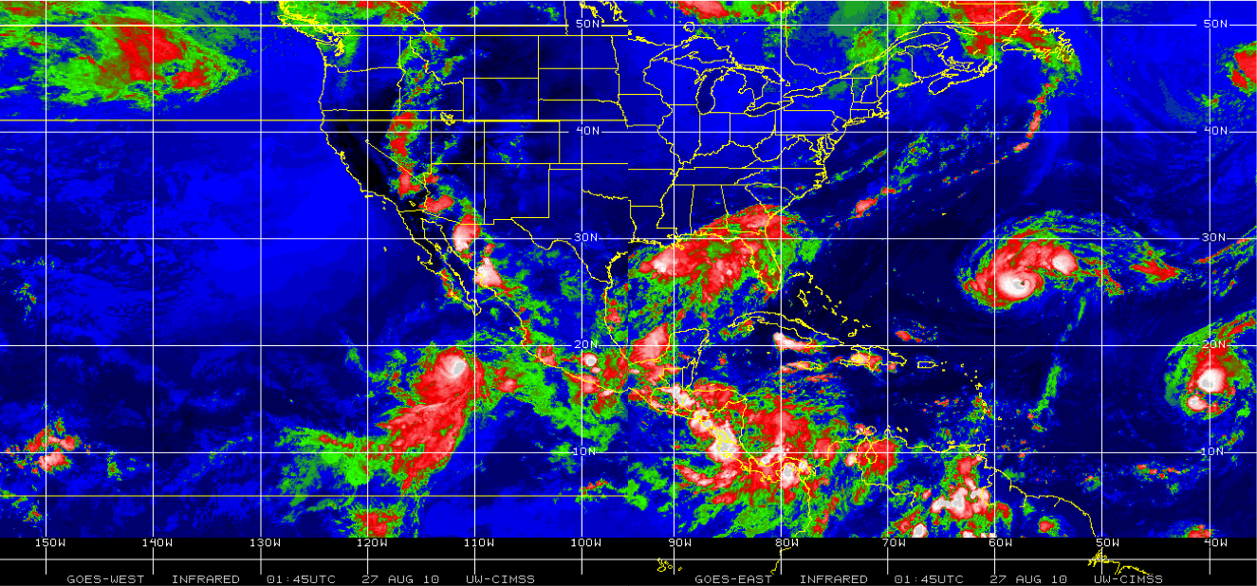
A BUSY DAY IN THE TROPICS:
IMPROVING TROPICAL WEATHER
 | 1+ storm days | 2+ storm days | 3+ storm days | 4+ storm days | Total storm days
ATL | 87.4(57.6%) | 31.3(35.8%) | 9.6(11.1%) | 1.4(1.6%) | 151.8
EP | 77.8(48.0%) | 25.5(32.8%) | 5.4(6.2%) | 0.3(0.4%) | 161.9
ATL+EP | 124.7(65.1%) | 66.2(53.1%) | 31.1(35.6%) | 10.9(8.8%) | 191.6
Danielle
Frank
Earl
Danielle, Earl (2010, Atlantic Basin); Frank (2010, East Pacific)
Challenges

