Slide 1
Update on the NGGPS/R2O: SOW and Milestones
TEAM MEMBERS
Sundararaman G. Gopalakrishnan (Gopal), Thiago Quirino, Steven Diaz, Javier.Delgado
NOAA/AOML/HRD, Miami, FL
In collaboration with:
Meso-Scale Modeling Group, EMC/NCEP, College Park, MD
Acknowledgements
Vijay Tallapragada, Frank Marks, Qingfu Liu, Fred Toepfer, ESMF team
Presented at the NGGPS Meeting, January 22, 2016
Notes:
Thanks are due to motivational leadership from Tim. We never had dedicated resources for this project. In my opinion this project had two bail outs with HPC. During the developmental stages when jet was offered. Secondly for testing in Theia. Thanks are Due to Fred and Bob Atlas. Thanks are also due to Frank and Geoff. They were gracious to have some of the FTEs involved in this effort.

Slide 2
Project Milestones
Project Statement: “AOML will develop, test and evaluate a generic nesting capability in the NEMS framework that can be adopted by NGGPS choice of global modeling system for hurricane and severe weather applications. AOML will also evaluate and test storm initialization and verify scalability and computational efficiency in nesting applications. Model development will be conducted in the EMC SVN based code repositories and use the commonly adopted ESMF tools in the NEMS framework.”
Milestones | Completed
Transition HIWPP funded developments to repository: Develop a Hurricane NMMB Subversion Repository Idealized TC framework for NMMB Multi-storm initialization for NMMB | April 2015 July 2015 January 2016
Determine the scalability and efficiency of the NMMB model | September 2015
Develop a “generalized nesting framework” for NEMS | On-going progress

Slide 3
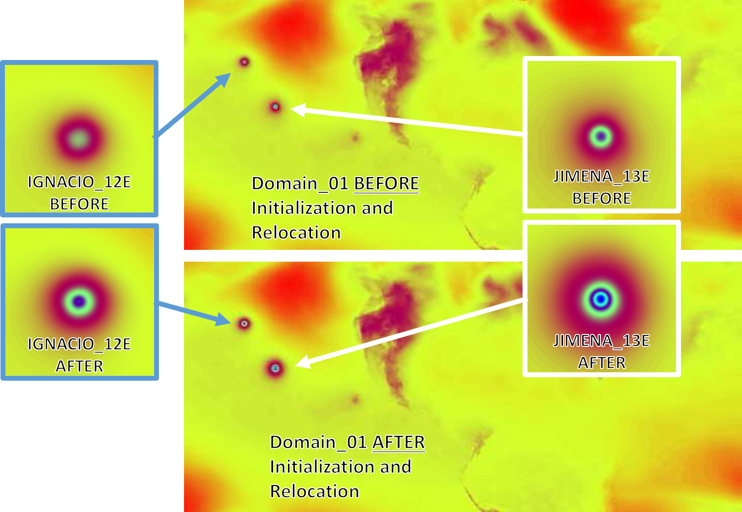
Transition Multi-Storm Initialization to NMMB (Jan. 2016)
Project Statement: “Test and evaluate the Basin-scale HWRF’s multi-storm initialization capabilities in the NMMB/NEMS framework and assess potential for demonstrating the initialization real-time in FY16 and implementing it in FY17.”
2015-09-03 00Z, MSLP Before Initialization
GFS cold-start
GFS cold-start
IGNACIO12E
JIMENA13E
After initialization and relocation
After initialization and relocation
2015-09-03 00Z, MSLP After Initialization
SVN Repository path: https://svnemc.ncep.noaa.gov/projects/hnmmb/trunk/sorc/util/vortex_init_b

Slide 4
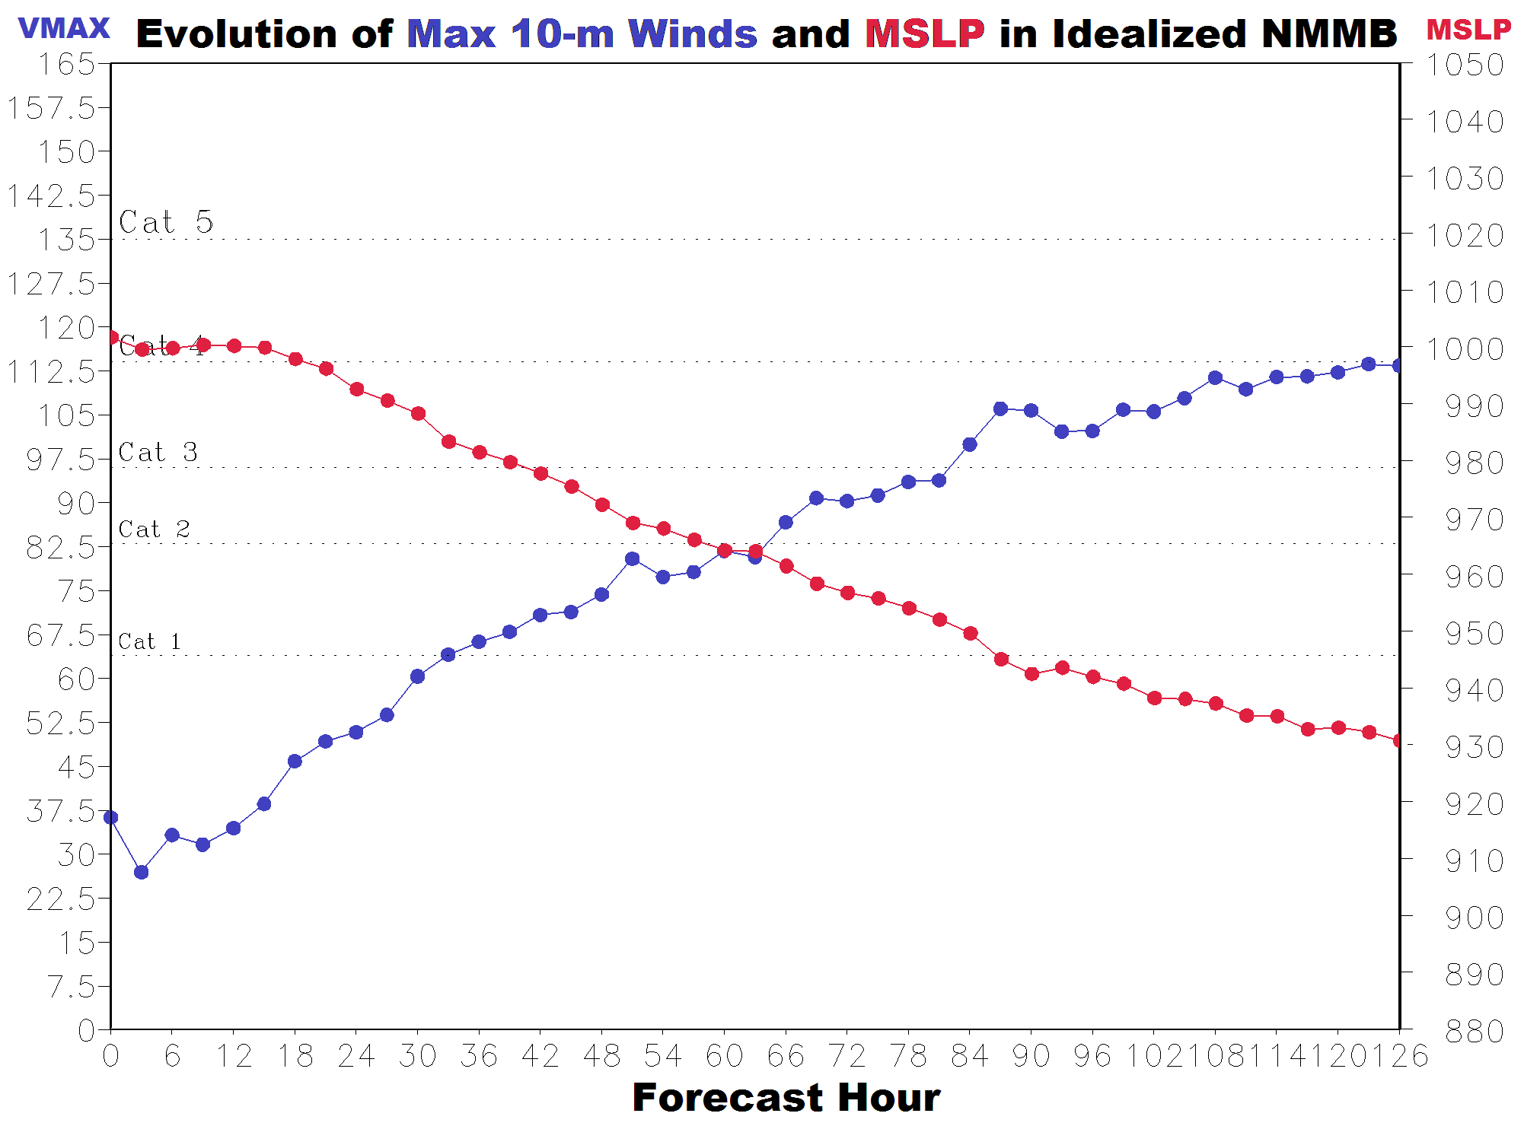
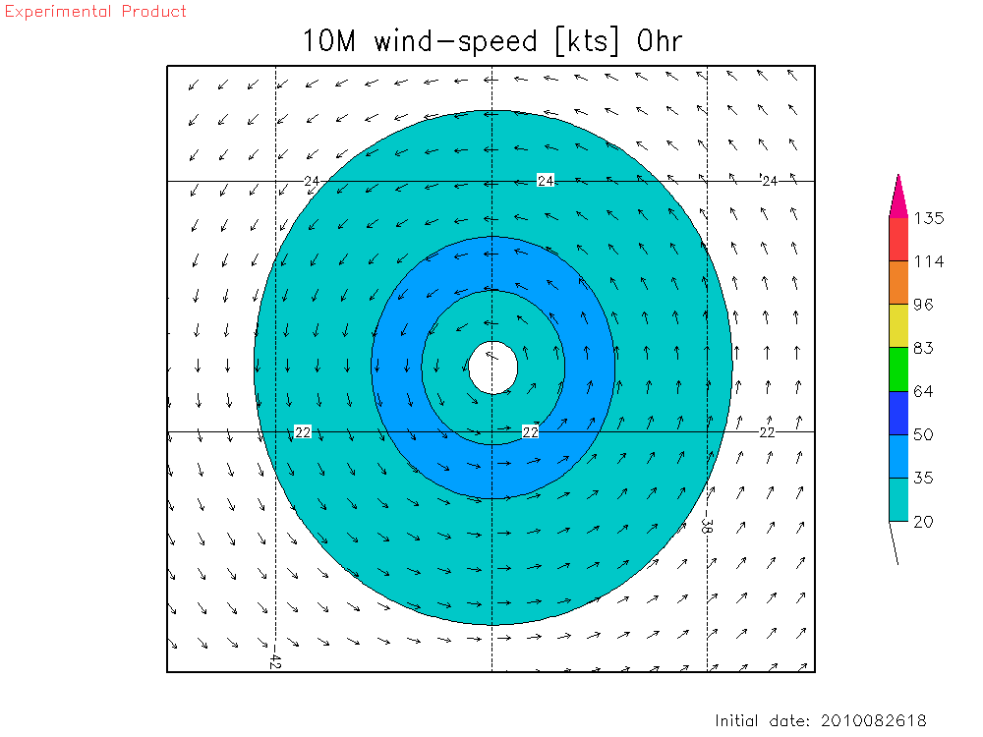
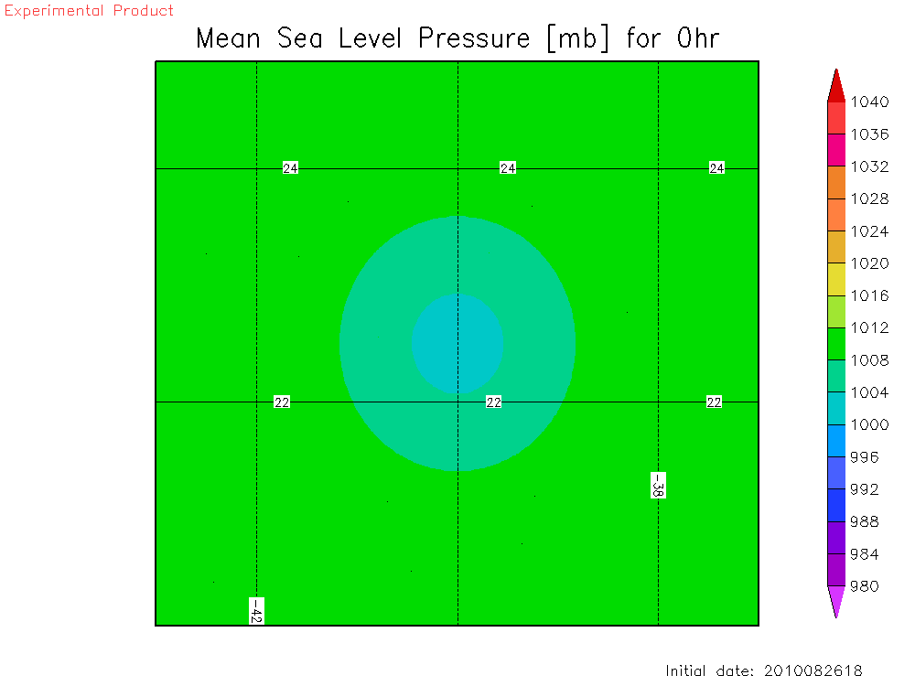
Transition Idealized TC Framework for NMMB (July 2015)
Project Statement: “Work with EMC to develop a Hurricane NMMB Subversion repository and transition HIWPP funded upgrades to the repository. These upgrades include ports of the HWRF nest movement algorithm and idealized tropical cyclone framework to the NMMB/NEMS model. They will be used to evaluate the performance of the freestanding, generalized nesting capability to be developed by HRD.”
27:09:03km Resolution with HWRF Physics
Initial Idealized TC: VMAX=39kts RMW=90km SST=302K
Knots
Millibars
SVN Repository path: https://svnemc.ncep.noaa.gov/projects/hnmmb/branches/{nmmb_init,nems}
Notes:
Such a Tropical Prediction system may be very useful for several down stream applications as well: Easy cycling, Satellite DA, Genesis and inland applications.

Slide 5
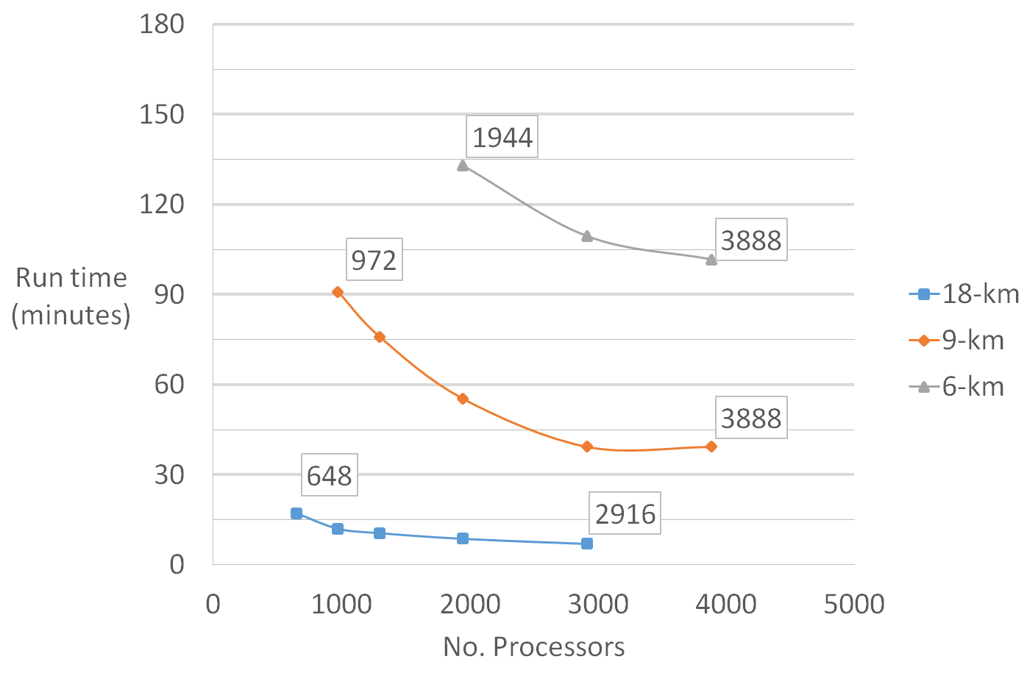
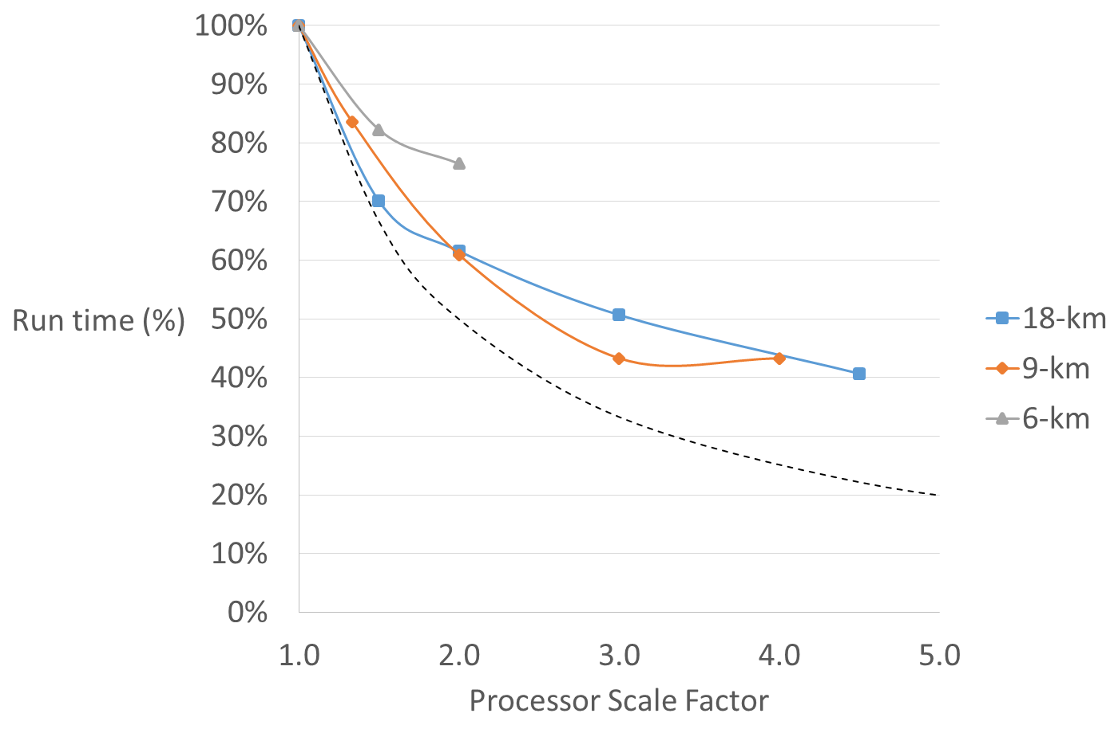
Evaluation of the Scalability of the NMMB Model (Sept 2015)
Project Statement: “Determine the efficiency and scalability of NMMB/NEMS with two-way interactive nests through testing the computational efficiency of the generation technique NMMB uses in the NEMS framework (distributing the MPI ranks to multiple domains, allowing for simultaneous integration) when configured with multiple for two-way interactive nests.”
Evaluated both single and multi-domain, 1-way and 2-way interactive, with varying resolution NMMB configurations
Scalability is limited by tile-size (i.e. cannot get rid of halo points)
Model stops scaling as grid size approaches ~ 12 to 16 grid points along X and Y directions
Communication costs overwhelm computational costs as more processors are added
Recommendation: Model runtime can be reduced by implementing parallel integration of parent and nested domains via extrapolated (e.g. FV3) or constant (e.g. HWRF) nest BCs
Example: Single-domain scalability results (varying resolutions):
Deviations from ideal curve due to minimum halo size
Notes:
Such a Tropical Prediction system may be very useful for several down stream applications as well: Easy cycling, Satellite DA, Genesis and inland applications.

Slide 6
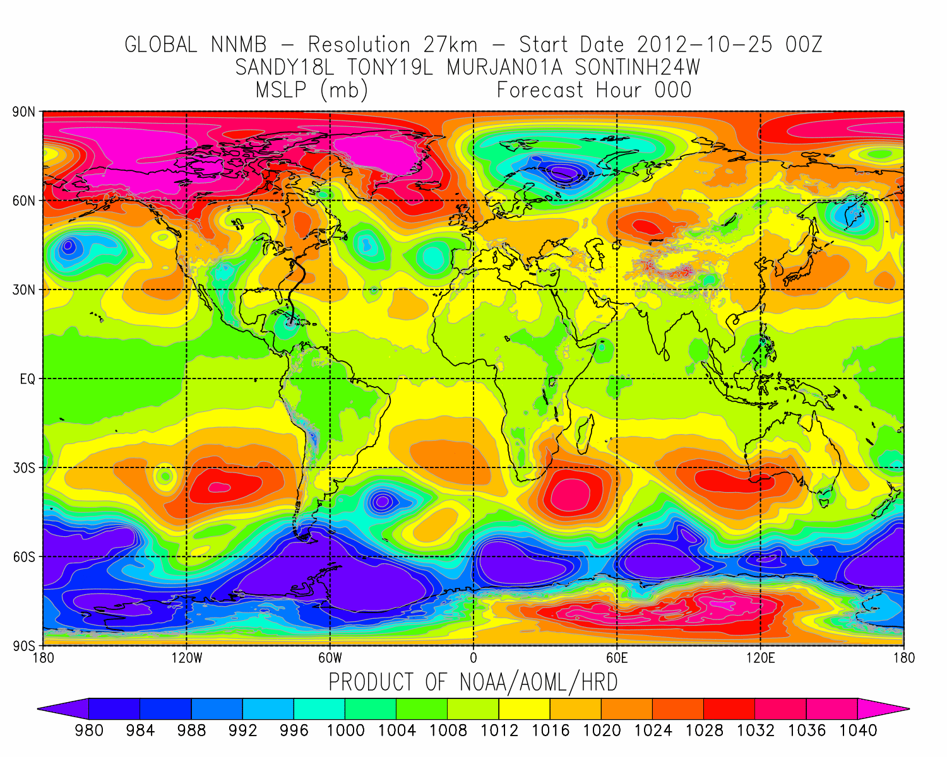
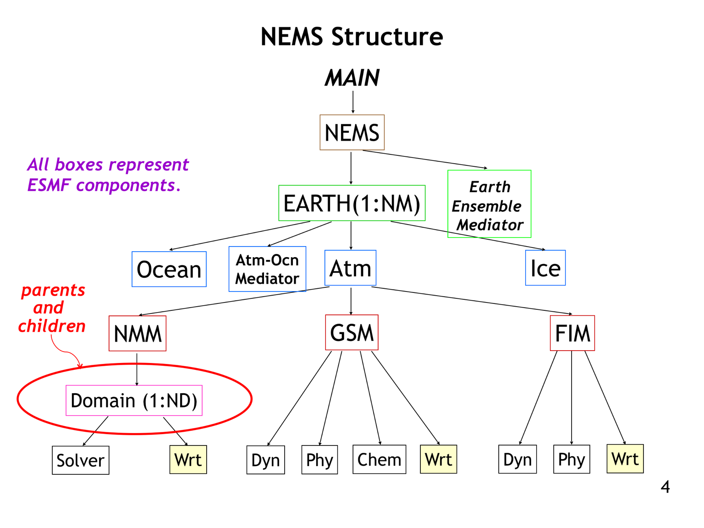
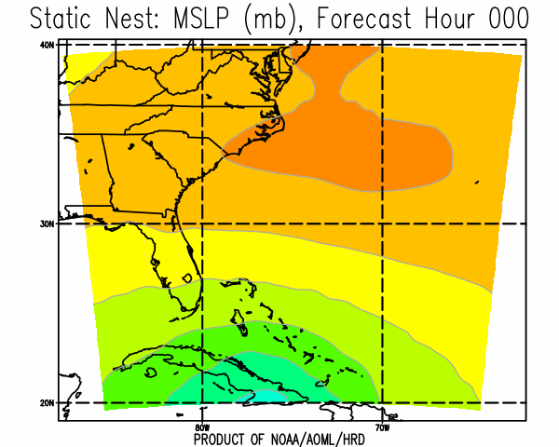
Next Generation Generalized Nesting Framework (On-going)
Project Statement: “The current nesting techniques in HWRF and NMMB are based on the projection center of the parent grid, limiting their applications to a confined region in the tropics, and limiting their ability to scale well at higher resolutions and pole-ward locations. A generalized nesting technique that can work independent of the parent model’s grid structure as well as map projections will advance the state-of-the-art in nesting techniques (one-way as well as two-way). AOML will develop a generic nesting capability applicable to and not reliant on any particular grid system and/or projection.”
NGGNF addresses the shortcomings of the current generation of nesting technology
NGGNF is the equivalent of “NUOPC for nesting”. While NUOPC is a physics interface, NGGNF is a dynamic interface that requires not only coupling but also several other numerical transformations across the interface. The layer should be close to dynamic solver instead of residing in the physics layer.
Offers a high degree of portability and abstraction
A complete, stand-alone nesting algorithm
Built into NEMS framework
No dependence on dynamical core, grid shape, grid projection, or vertical coordinate
Supports heterogeneous inter-model interaction via ESMF
Supports interaction between models built within and outside of NEMS
Offers advanced inter-domain interaction features
Nests can interact with scale spanning resolution of the parent domain
Nests can move across domain edges and poles without distortions
Supports sequential/parallel, 1 and 2-way interactive, domain integration
Offers novel features
Generalized IO: eliminates custom model IO code and performs post-processing
NEMS Framework
Model 1
Current Framework (2016)
Model 2
Model 2
Example of Core, Grid, and Projection Independent, dynamical (up/)downscaling using and advancing ESMF re-gridding
SVN Repository path: https://svnemc.ncep.noaa.gov/projects/hnmmb/branches/AOML-HRD/NGGNF
Notes:
Such a Tropical Prediction system may be very useful for several down stream applications as well: Easy cycling, Satellite DA, Genesis and inland applications.

Slide 7
Path Forward: Future Research & Developments
In 2016:
Complete the implementation of a working version of NGGNF that supports static nests:
Complete the implementation of subroutines in the NGGNF public API.
Complete implementation of a programmable interface for user specifications of boundary update and feedback regions, frequency of parent-child domain interaction, and boundary time tendency approximation scheme for 1-way and 2-way interaction strategies.
Complete support for hydrostatic adjustment between domains having different vertical coordinates.
Complete support for horizontal projection adjustment of vector variables for domains having grids with different horizontal projections.
Complete support for constant, interpolated, and extrapolated nested domain BCs update schemes to support parallel integration of parent and nested domains under 1-way and 2-way interaction
Advance ESMF by implementing support for multi-tiled models into NGGNF using ESMF gridded fields instead of ESMF meshes with the goal of support conservative horizontal re-gridding schemes.
Optimize code in order to minimize the costly generation of ESMF re-gridding weights for multiple grids.
Write utility functions to support wrapping of custom model fields as Fortran arrays into ESMF fields.
In 2017 & 2018:
Add support for moving nests into NGGNF:
Generalized terrain: Add support for efficient, real-time interpolation of terrain data during nest motion to accommodate for the changing properties of moving grids having independent projections.
Generalized storm tracking algorithm: Port the latest HWRF storm tracking algorithm into NGGNF. Nested domains without children will track the center of their respective storms and nested domains with children will track the center of their respective children domains.
Generalized IO: Implement data transfer, post-processing, and output functionalities into NGGNF to eliminate the need for custom model IO. Add support for NEMSIO, PNETCDF, and GRIB formats. Generate output grids in both regular lat-lon and cylindrical projections. Add domain merging capabilities into NGGNF.

Slide 8
Questions?

