Slide 1
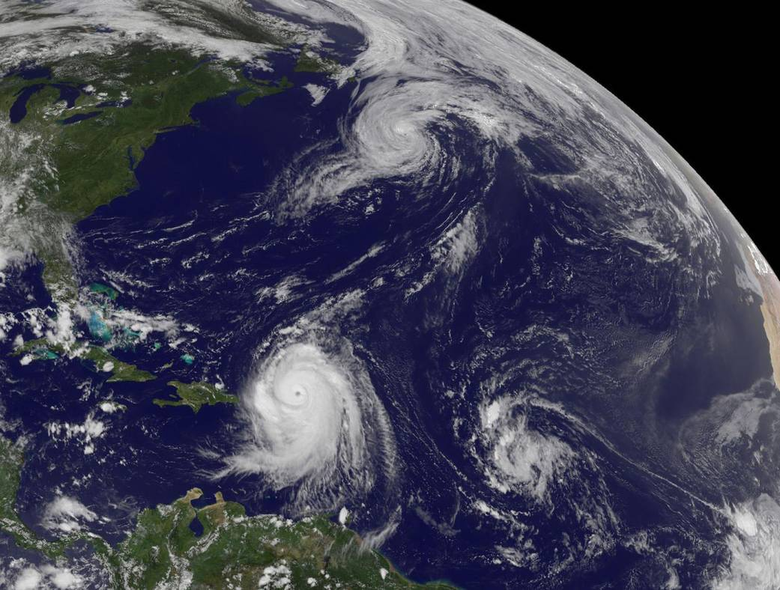







Advances and Challenges in Tropical Cyclone Track, Structure and Intensity Predictions
A Generalized, Model-Core Independent Nesting Technique: Services to Support the Research to Operations (NGGPS) Initiative
Dannielle
Sundararaman Gopalakrishnan (gopal)
Thiago quirino and frank marks
NOAA/AOML/Hurricane Research Division, Miami, FL, USA
Sundararaman gopalakrishnan (gopal)
noaa/aoml/Hurricane research division, Miami, FL, USA
Earl
Acknowledgements: Fred Toepfer, Timothy Schneider, Thomas black, vijay tallapragada and robert atlas
Fiona
Presented at the Shanghai Typhoon Institute, CMA, December 2016
AOML NGGPS Review

Slide 2
Objectives
Under R2O in FY15, AOML plans to further advance the capabilities, accuracies and reliability of numerical forecasting (especially regional severe weather and, in particular, hurricanes) through development, evaluation and testing of nesting techniques. The current nesting techniques in HWRF and NMMB are based on the projection center of the parent grid, limiting their applications to a confined region in the tropics, and limiting their ability to scale well at higher resolutions and pole-ward locations. A generalized nesting technique that can work independent of the parent model’s grid structure as well as map projections will advance the state-of-the-art in nesting techniques (one-way as well as two-way). AOML will develop a generic nesting capability applicable to and not reliant on any particular grid system and/or projection.

Slide 3
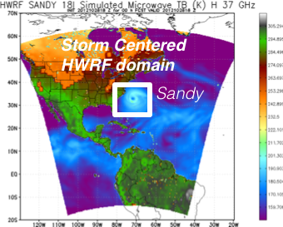
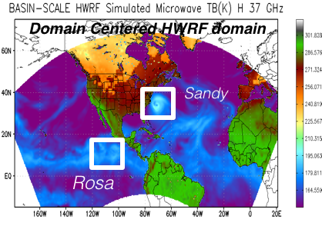
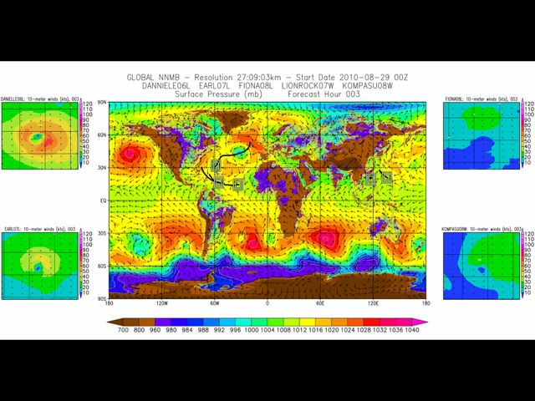


AOML: High Resolution NWP for Improving Hurricane Forecasting
Highlights of our R&D
2012: 3-km storm centric version of HWRF was developed and transitioned to operations along with PBL physics and idealized framework appropriate for TC predictions.
2015: Domain centric multi-nested basin scale HWRF was transitioned to Developmental Testbed Center and is a part of HWRF community release.
2015: For the first time a global model configuration of the NMMB/NEMS with multiple moving nests was successfully run at 3-km resolution under the HIWPP*
2017: Generalized, Model-Core Independent Nesting Technique will be complete within the NEMS framework.
*HIWPP: Joint partnership between EMC and AOML
http://hwrf.aoml.noaa.gov/

Slide 4
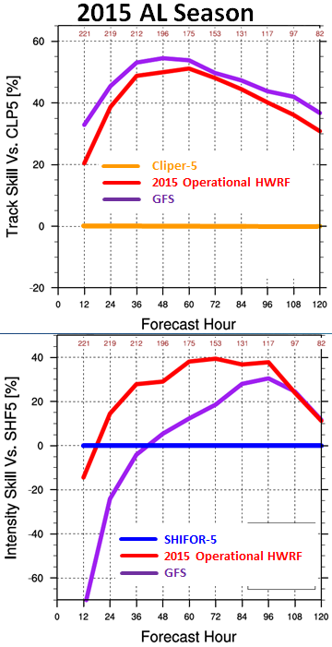
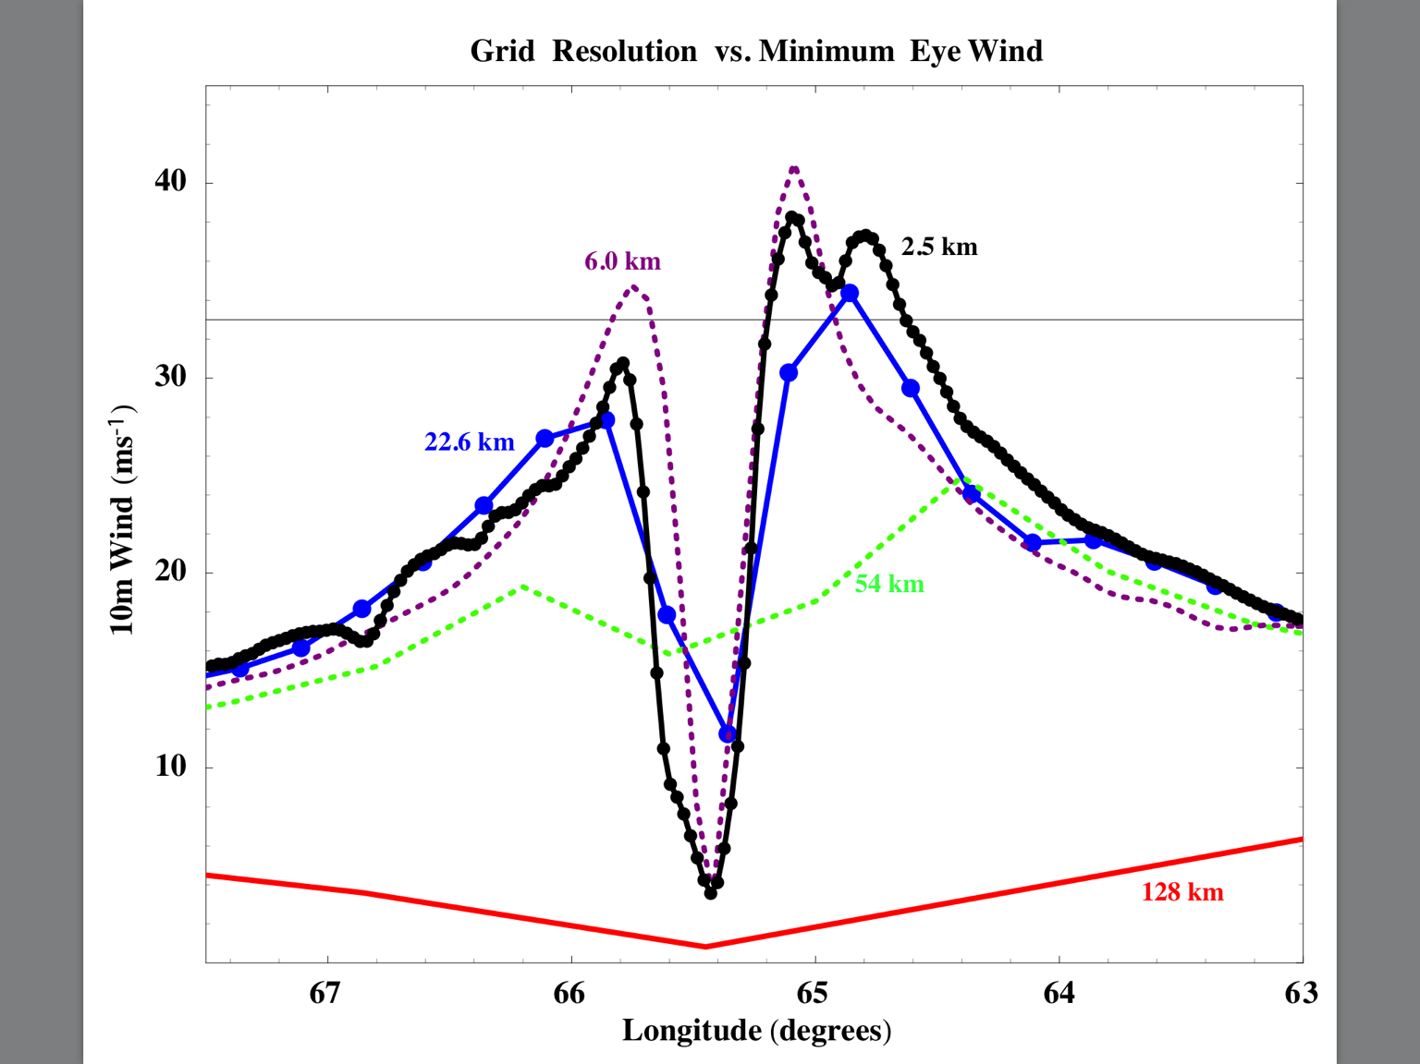
Motivation: Nesting for Global Model
NMMB: Impact of global model resolution on prediction of the inner core structure of Hurricane Earl (2010)
Importance of 1-3 km horizontal resolution for hurricane forecasting

Slide 5
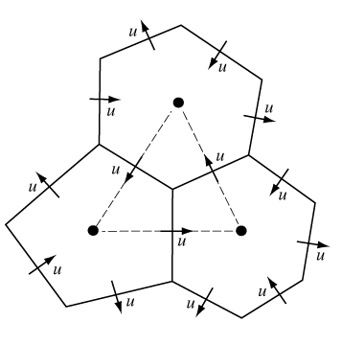
High Resolution: Grid Refinement Technique
Adaptive Grid Refinement Technique
Gopalakrishnan, et al., 2002: An Operational Multiscale Hurricane Forecasting System. Mon. Wea. Rev., 130, 1830–1847.
Seamless across the boundaries
Core dependent technology
Viable options: running Global models for individual applications (e.g. tropical belt, severe weather etc.) or global model at uniform 3 km resolution
Can we afford testing convective scale global models for hurricane forecasting and severe weather in the next 3-5 years ?
Pros: Seamless across the boundaries
Corns: Core dependent
Corns: Speed limitations
Corns: Not easy to parallelize
Corns: 5-6 years of dedicated developments ($$$)

Slide 6

High Resolution: Mesh Refinement and Nesting Technique
Grid Nesting
Lucas M. Harris and Shian-Jiann Lin, 2013: A Two-Way Nested Global-Regional Dynamical Core on the Cubed-Sphere Grid. Mon. Wea. Rev., 141, 283–306.
Proved Seamless across scale
Core dependent
Moving nest possible but needs development

Slide 7
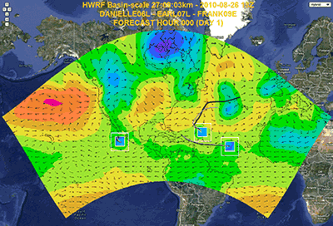
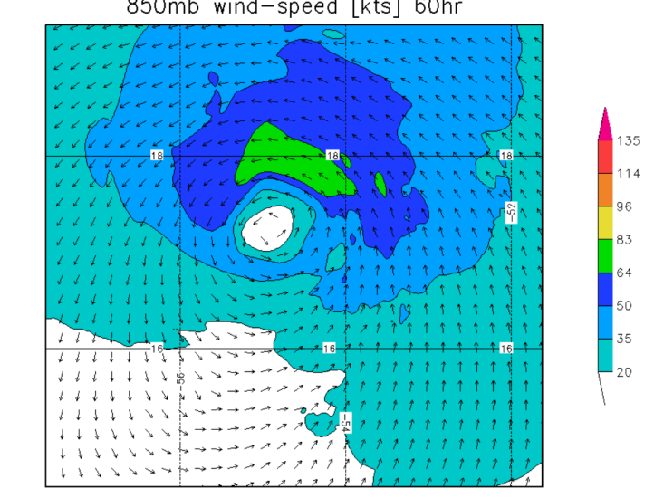
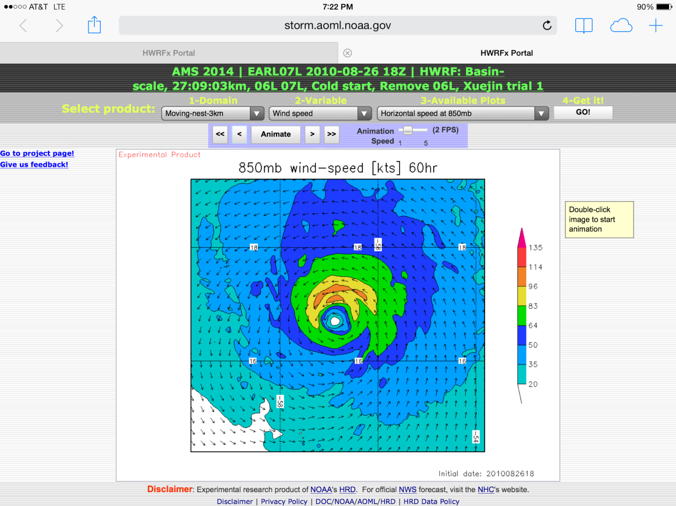
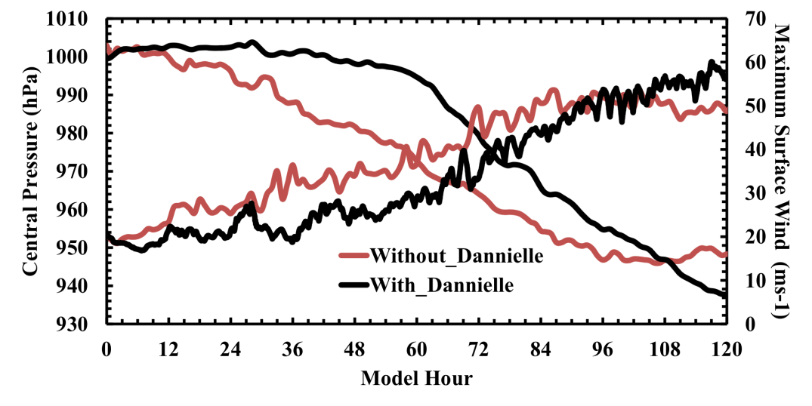
HWRF Nesting: Importance of Storm-Storm Interactions
Mass consistent at the boundaries
Easy to extend to any Global Model
But Core dependent
Earl with Danielle Interactions
Proof of seamless prediction: Shear vortex interactions during RI in Hurricane Earl (2010)
Perfect Forecast
Earl W/O Danielle interactions

Slide 8
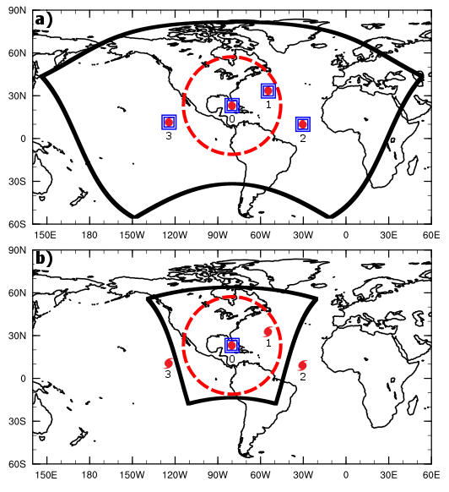
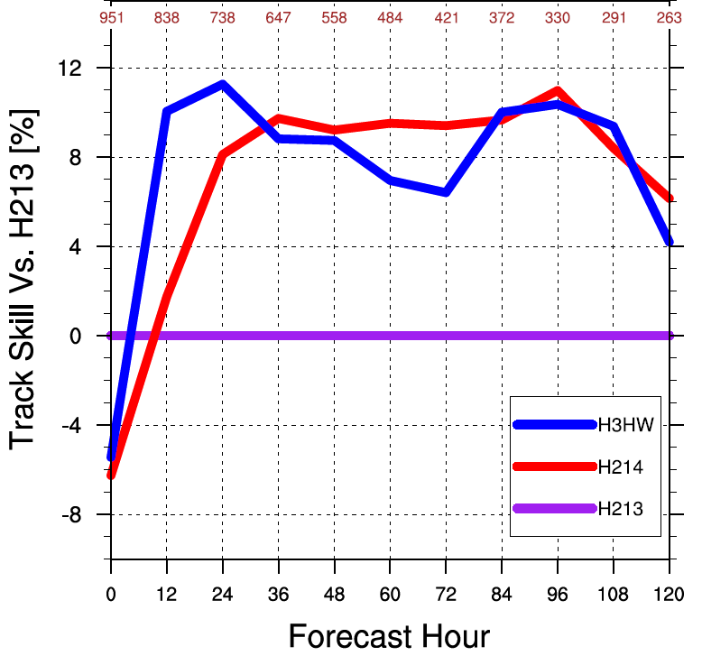
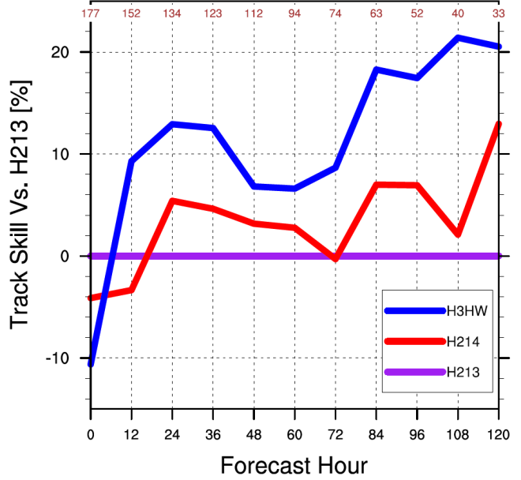
HWRF Nesting: Importance of Far-Field TCs
Operational HWRF domain
2013 Basin-Scale HWRF
2014 Operational HWRF
2013 Operational HWRF
2011-2013 sample
Stratified by TCs outside Operational domain
Basin-Scale HWRF domain
2013 Basin-Scale HWRF
2014 Operational HWRF
2013 Operational HWRF
2011-2013 sample

Slide 9
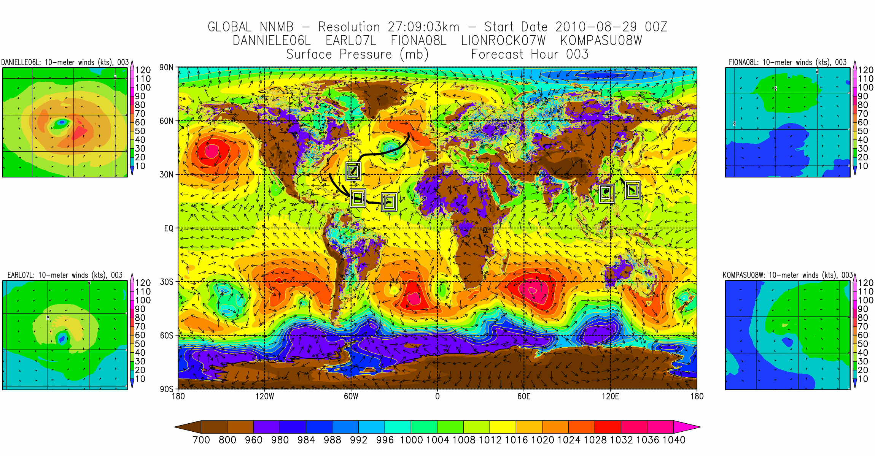
A Global Tropical Prediction System

Slide 10
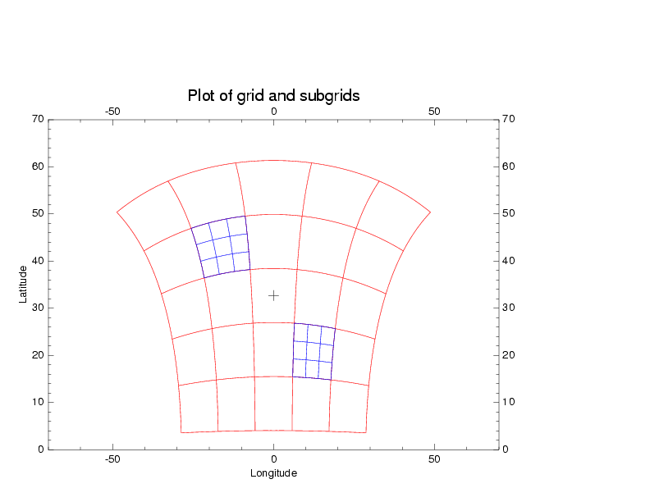
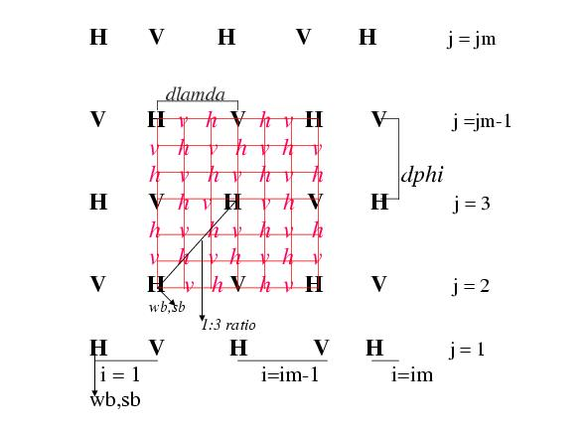
The Traditional Design of Nesting Technologies
  Traditional Nesting Technologies are built with specific models in mind:
  Design and implementation are core-specific
    Deeply interwoven dynamics and nesting code
    Core-specific nesting communication/data-interpolation codes
    Complex surgery required to extract nesting related functionalities into a separate package
  Model grid projection dependence
    Core-specific projection adjustment routines for interpolation of vector variables
    Nested grids must coincide with parent grids, leading to distortions
    Hard-coded support for only specific parent-to-nest resolution ratios
  Model grid geometry dependence
    Interpolation codes support specific grid types: NMM E-grid vs. NMMB B-grid vs. cubed-sphere
    No support for interaction between single-tile/multi-tile grids or complex unstructured grids
  Model vertical coordinate dependence
    Core-specific mass-adjustment routines
  Under utilization of ESMF standards to facilitate inter-model interactions
    Core-specific representation of NWP model data fields
    Core-specific parent-nest data interpolation codes
    No built-in support for inter-model interaction
Projection dependence in HWRF nesting
Grid point coincidence for 2 way nesting in HWRF

Slide 11
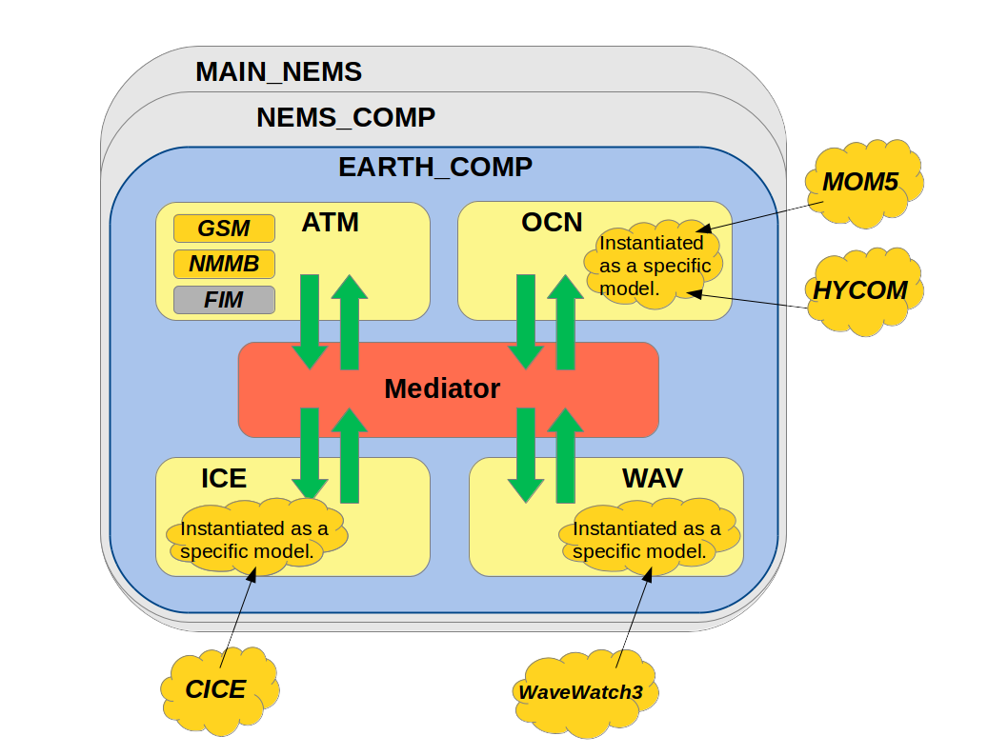
The “Next Generation Generalized Nesting Framework” (NGGNF)
NGGNF can be considered as a subset of the “Coupled NEMS” project. While “Coupled NEMS” focuses on coupling various earth system models through surface interactions, NGGNF is a dynamic interface for nesting that couples one or more atmospheric models at the dynamic level by providing several required numerical transformations across the interface, including 3D interpolations.
NGGNF addresses the shortcomings of the current generation of nesting technology:
  Offers a high degree of portability and abstraction
    A complete, stand-alone nesting algorithm
    Built into NEMS framework
    No dependence on dynamical core, grid shape, grid projection, or vertical coordinate
  Offers advanced inter-domain interaction features
    Nests can interact with scale spanning resolution of the parent domain
    Nests can move across domain edges and poles without distortions
    Supports sequential/parallel, 1 and 2-way interactive, domain integration
  Offers novel features
    Generalized IO: eliminates custom model IO code and performs post-processing
The Coupled NEMS Project
NGGNF
Architecture of the NEMS NUOPC “mediator” with the NGGNF dynamic layer

Slide 12
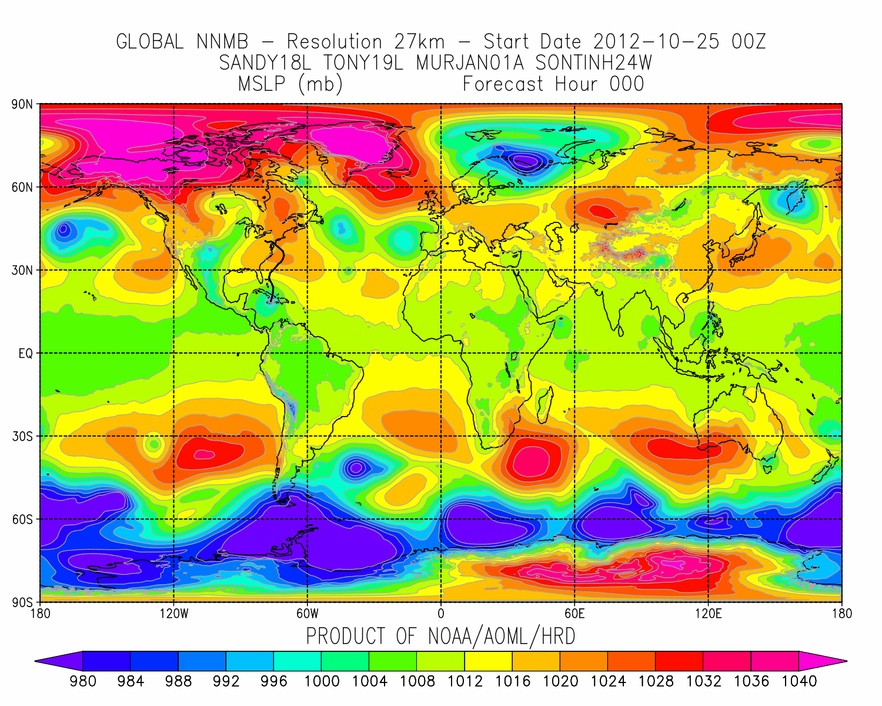
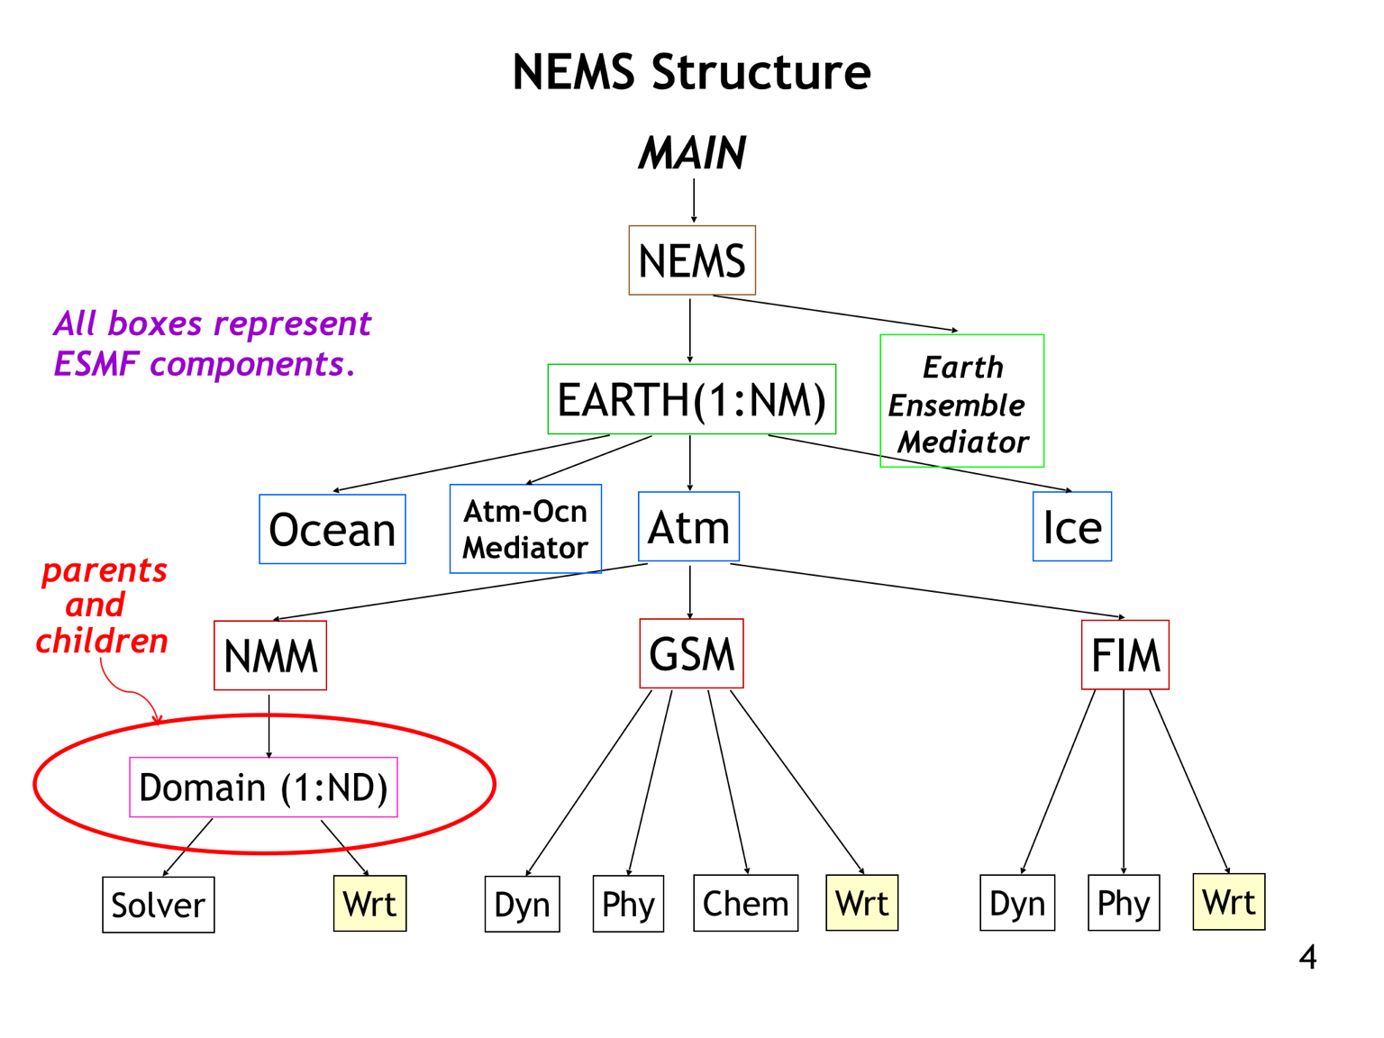
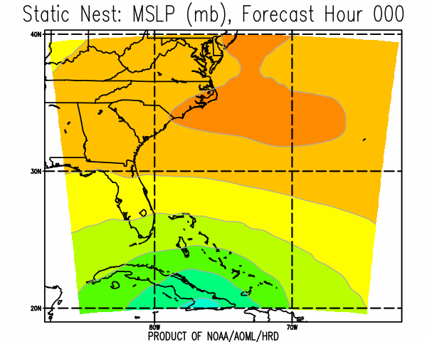
NGGPS: Building framework for next generation nesting
Next Generation Global Model is expected to be run at about 8-10-km resolution.
AOML is building the Next Generation Nesting Framework (NGGNF) within NEMS to advance global-2-local scale modeling for hurricanes.
NGGNF is an advanced framework that will allow multiple heterogeneous numerical models, both inside and outside of NEMS, to be coupled together into a high-resolution prediction system.
NEMS Framework
Model 1
Current Framework (2016)
Model 2
Example of Core, Grid, and Projection Independent, dynamical (up/)downscaling using and advancing ESMF re-gridding
Model 2
Notes:
AOML is building a generalized nesting framework within NEMS to advance global-2-local scale modeling for hurricanes.
The Next Generation Generalized Nesting Framework (NGGNF) is an advanced framework within NEMS that will allow multiple heterogeneous numerical models, both inside and outside of NEMS, to be coupled together into a high-resolution prediction system.
To ensure portability of this framework, we have adopted ESMF at core of our developments
We are advancing all of the re-gridding capabilities needed to couple heterogeneous models having different grids, projections, and number of levels.

Slide 13
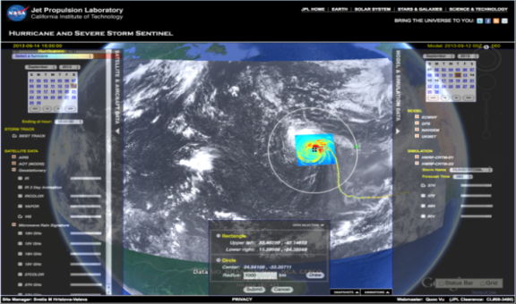
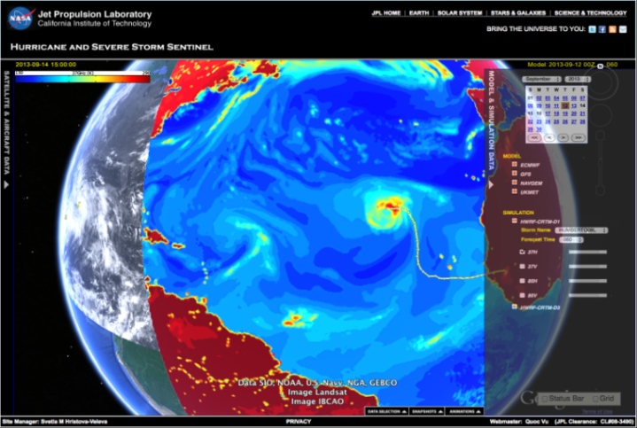
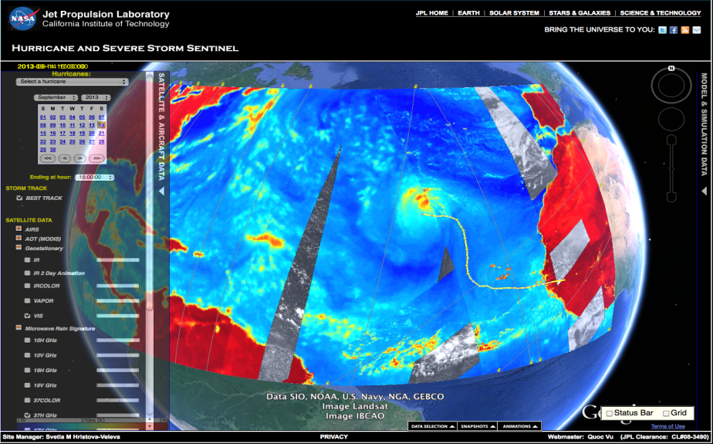
Summary and Conclusions
HWRF
In a year NOAA will be running NGGPS at 8-10 km resolution. The generalized, core independent nesting approach proposed here may be useful to test the model at cloud permitting resolutions (1-3 km) rapidly.
From the 1st year of funding we have created a capacity and proved that generalized, and even core independent nesting is possible within NEMS framework and could be potentially used for creating siblings at 1-3 km resolution from NGGPS. We need continued support for maintaining this capacity.
Key to further improving TC predictions may lie in modeling the multi scale interactions better – requires Global domain with 2-way interactive, high resolution nests at 1-3 km horizontal resolution
Significant research and developments may be required for advancing high resolution global model with nests.
Sustained partnership between NOAA research and operations and other agencies and universities hold the key to our future success.
BASIN HWRF
Global Nest (Research)
High Impact Weather Prediction Project
Notes:
Picture shows Satellite equivalents from model and future Tropical Prediction system

