Slide 1
Hurricane Maria
COAMPS-TC Forecasts Evaluation
and Multi-Model Comparison
Yi Jin, James Doyle, Jon Moskaitis, Hao Jin, Rich Hodur
(for HRD Modeling Meeting Oct 20 2011)
Notes:
For other TCs the move north, COAMPS-TC does fine with the tracks!

Slide 2
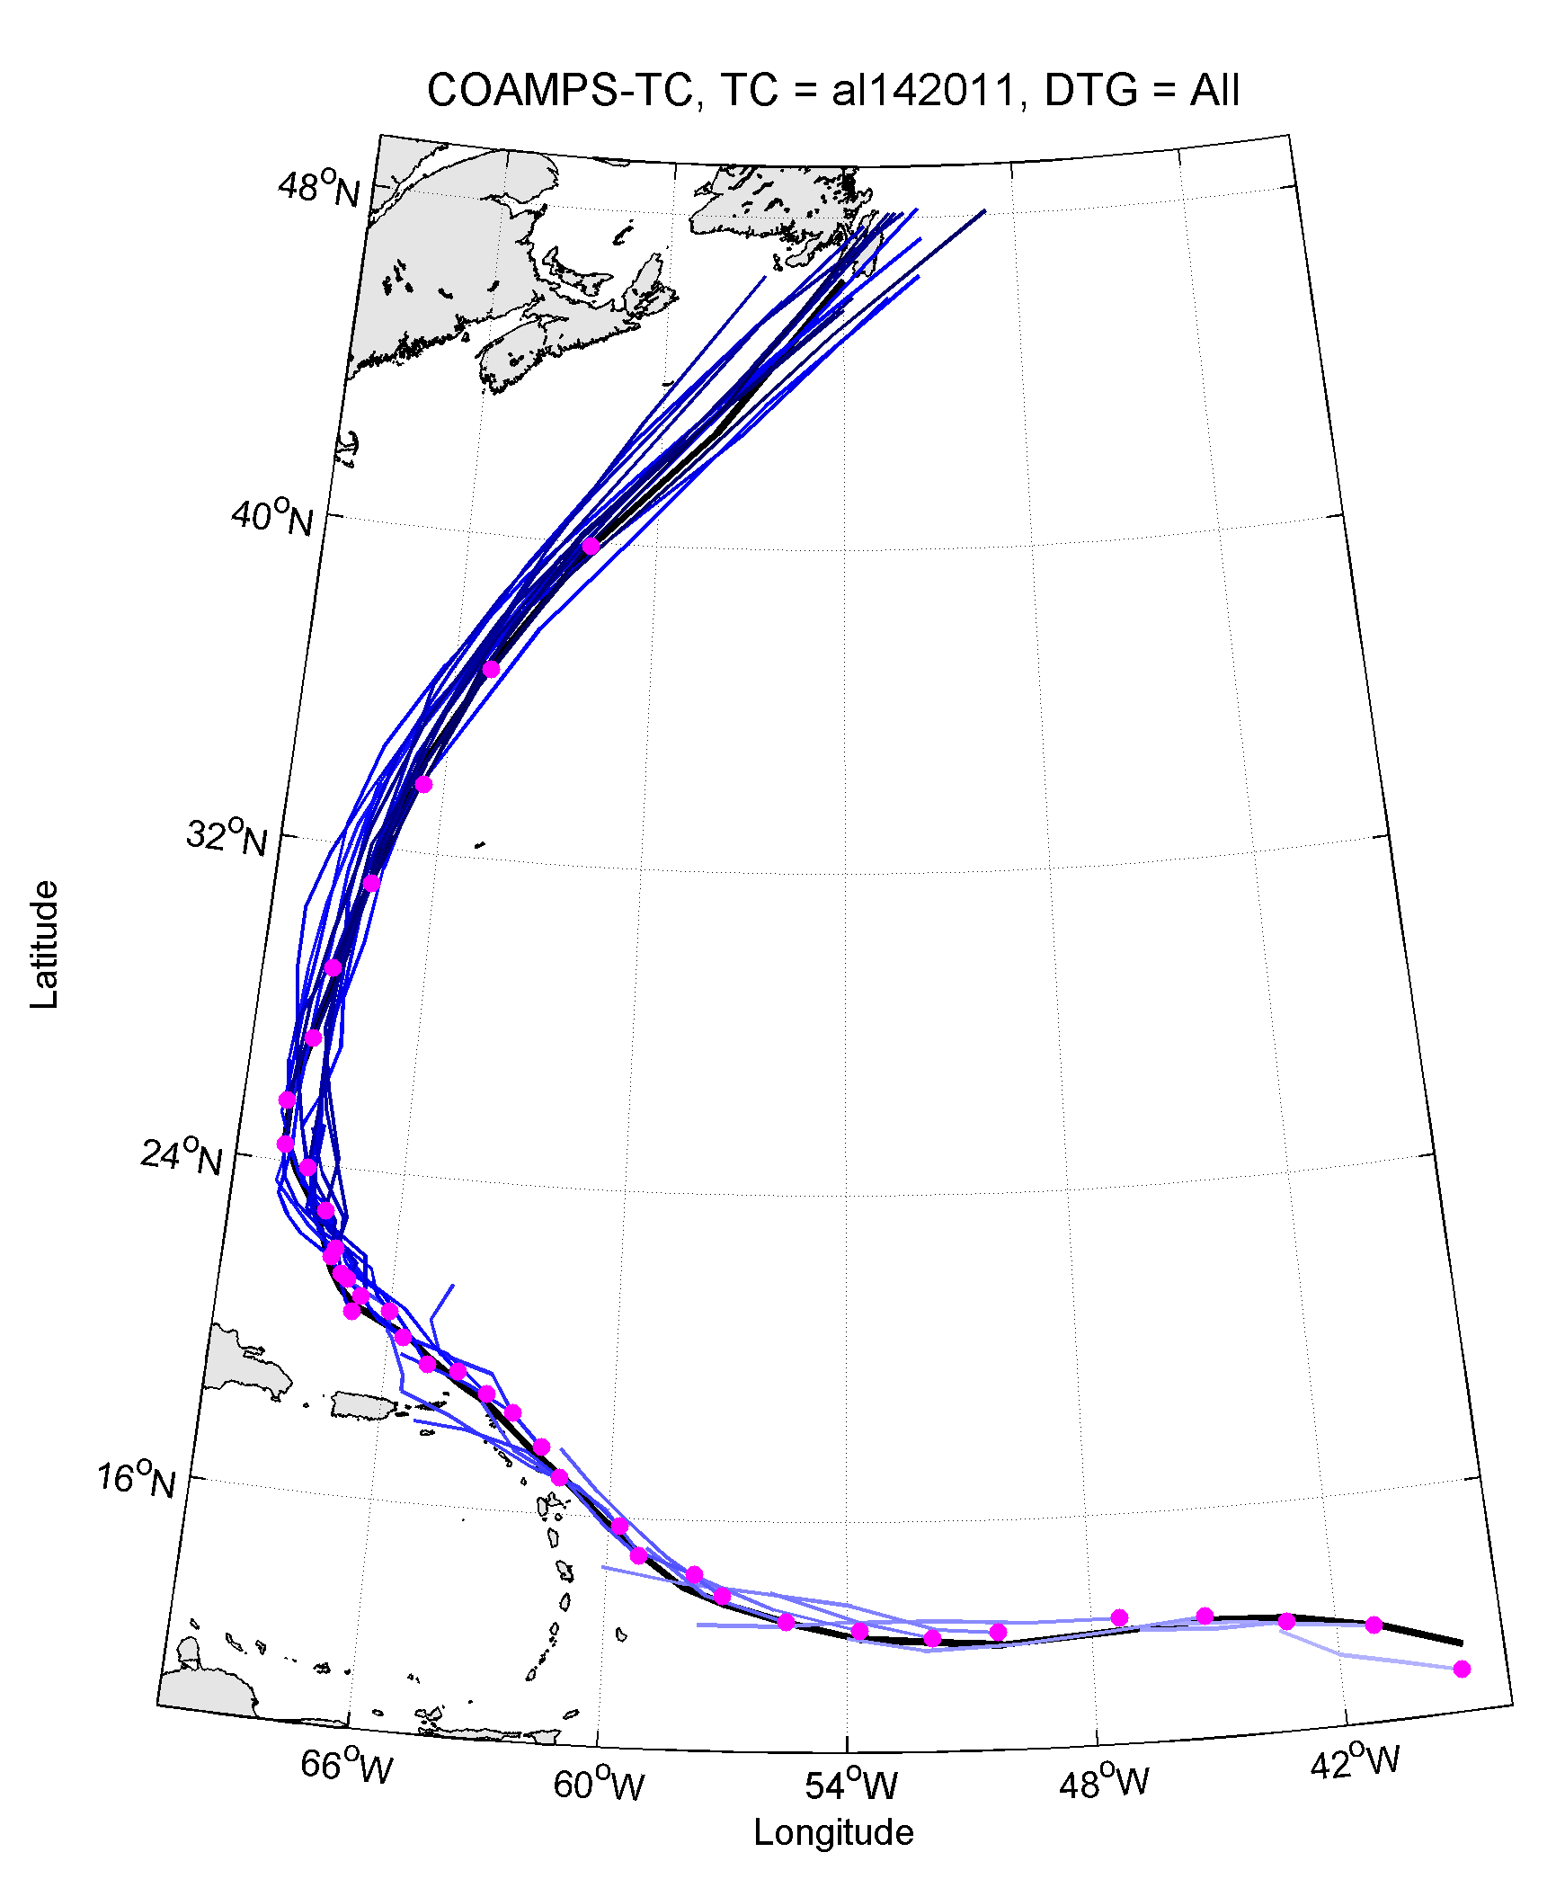
Hurricane Maria
COAMPS-TC Track Error Statistics
Notes:
For other TCs the move north, COAMPS-TC does fine with the tracks!
2

Slide 3
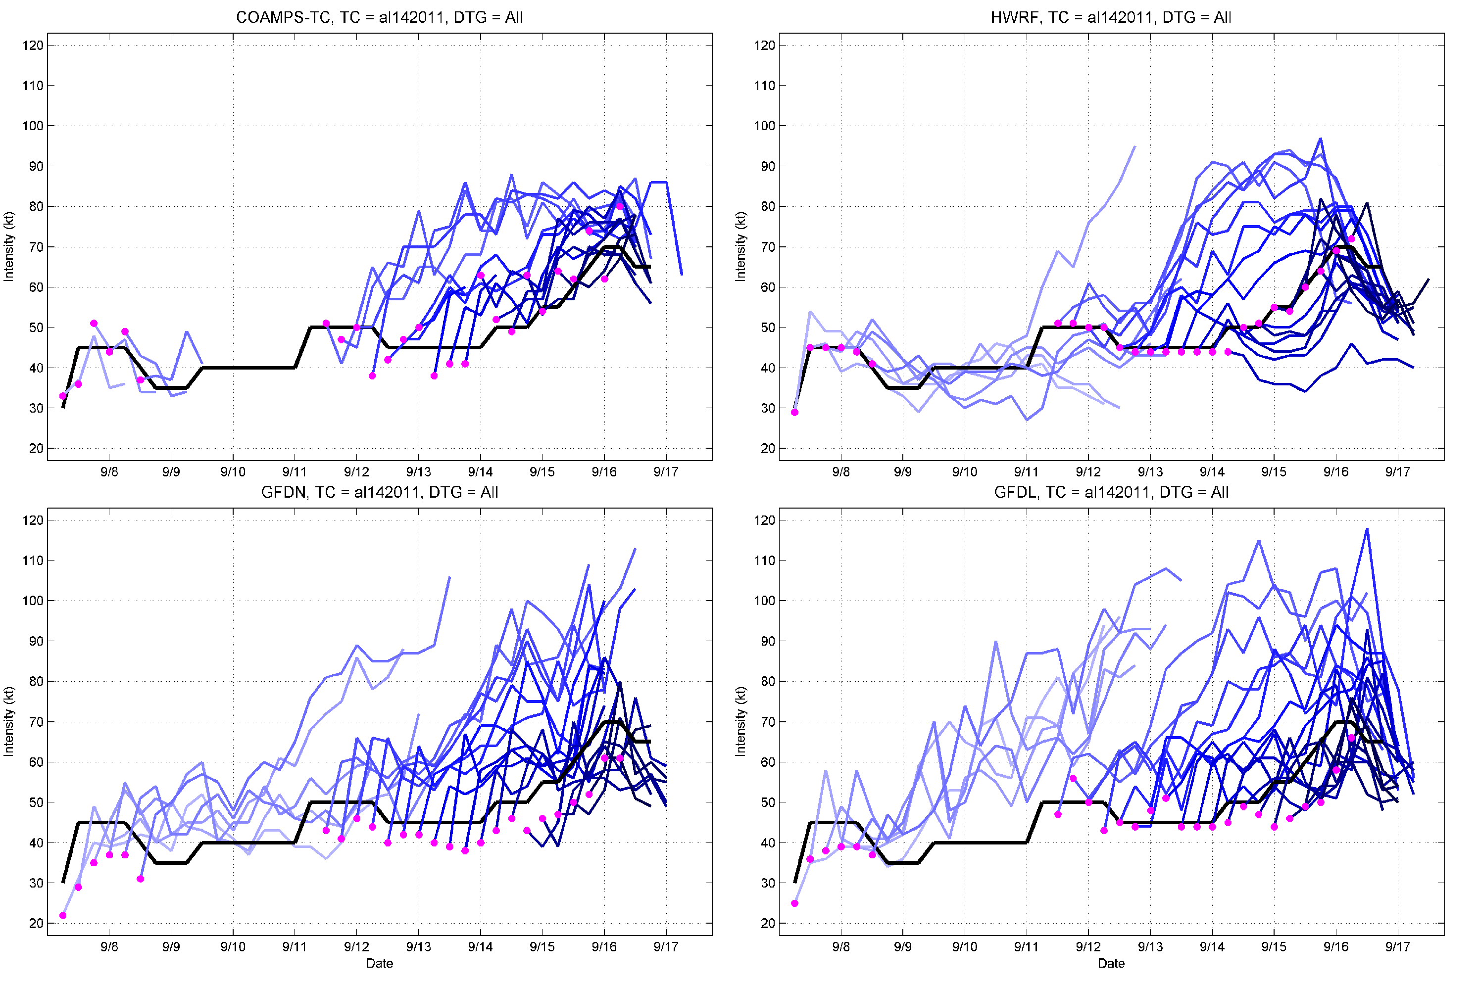
Hurricane Maria
COAMPS-TC Intensity
Notes:
Maria: Kept the storm weak early on … coupled with tracker problems, that’s why early forecasts do not extend very far. Later in the storm’s life, we were not so aggressive intensifying it

Slide 4
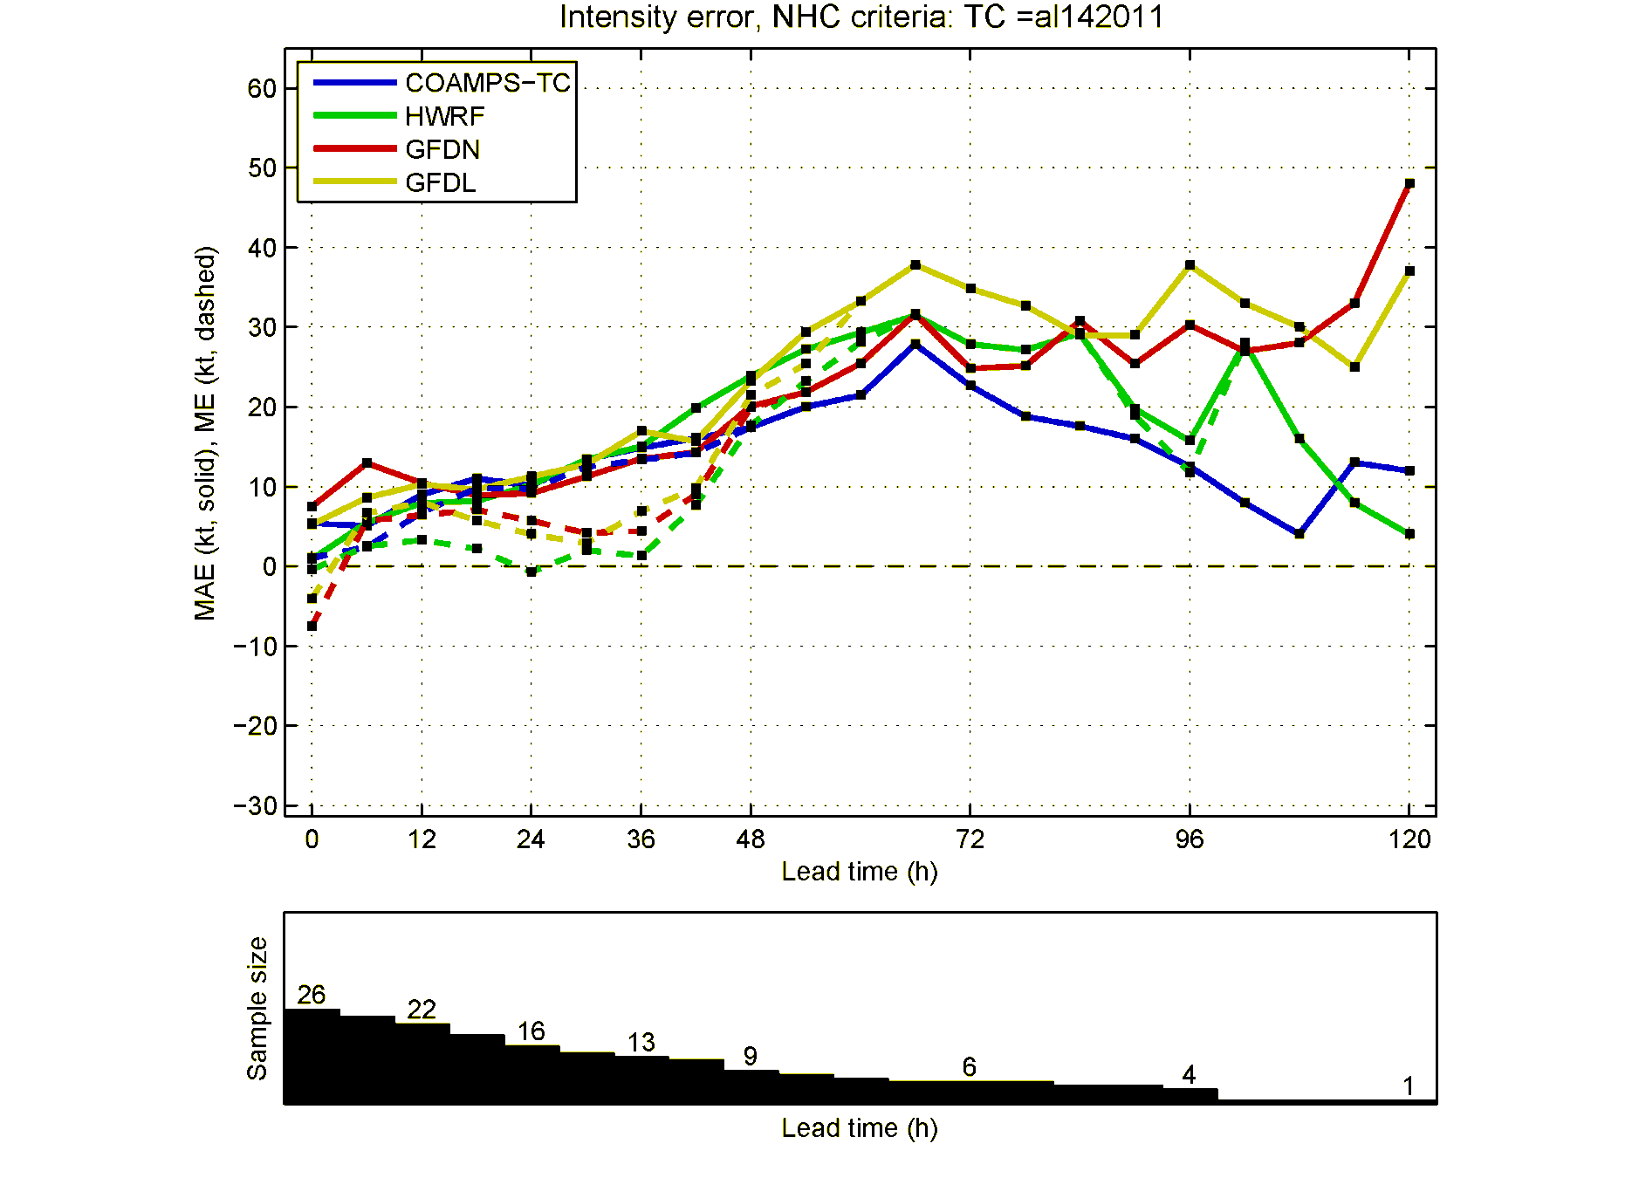
Hurricane Maria
Intensity Statistics
Notes:
Maria: Kept the storm weak early on … coupled with tracker problems, that’s why early forecasts do not extend very far. Later in the storm’s life, we were not so aggressive intensifying it

Slide 5
Hurricane Maria
Vertical Shear Comparisons
COAMPS-TC
(Courtesy of Brian McNoldy)
COAMPS-TC has slightly higher shear (by 5kt) during 13-14 Sept.
Notes:
Maria: Kept the storm weak early on … coupled with tracker problems, that’s why early forecasts do not extend very far. Later in the storm’s life, we were not so aggressive intensifying it
5

Slide 6
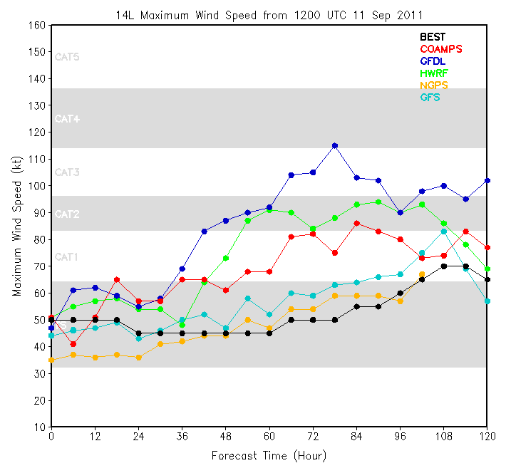
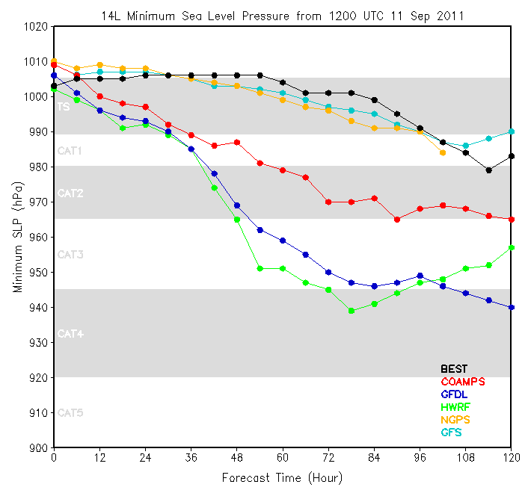
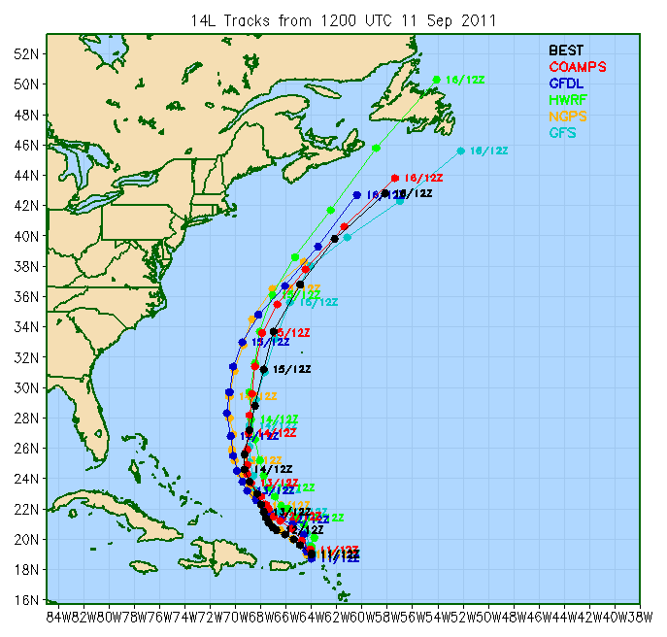
Hurricane Maria
Intensity for run initialized 1200 11 Sept. 2011
The three regional models over-predict the storm intensity.
COAMPS-TC intensified the storm to CAT1, whereas GFDL to CAT3, and HWRF is between (CAT2).
Most difference is seen in the SLP fields
Notes:
Maria: Kept the storm weak early on … coupled with tracker problems, that’s why early forecasts do not extend very far. Later in the storm’s life, we were not so aggressive intensifying it
6

Slide 7
Hurricane Maria
2011091112 Environment - shear
COAMPS-TC has slightly larger shear than the other two models for the first 84 hours.
HWRF has a rapid increase in the shear over the last 24 h, corresponding to the weakening in the storm intensity.
Notes:
Maria: Kept the storm weak early on … coupled with tracker problems, that’s why early forecasts do not extend very far. Later in the storm’s life, we were not so aggressive intensifying it
7

Slide 8
Hurricane Maria
2011091112 Environent - SST
30
29
28
27
SST (ºC)
26
25
24
23
22
21
COAMPS-TC has somewhat lower SST (0.5-1 C) than the other two models for the first 72 hours.
Over the last 12 h, SST cools rapidly for all three models.
Notes:
Maria: Kept the storm weak early on … coupled with tracker problems, that’s why early forecasts do not extend very far. Later in the storm’s life, we were not so aggressive intensifying it
8

Slide 9
Hurricane Maria
2011091112 Environent – 500 hPa Temperature
12
10
8
6
Temperature (ºC)
4
2
0
COAMPS-TC is slightly cooler at 500 hPa than the other two models for the first 96 hours.
GFDL is the warmest at this level.
Notes:
Maria: Kept the storm weak early on … coupled with tracker problems, that’s why early forecasts do not extend very far. Later in the storm’s life, we were not so aggressive intensifying it
9

Slide 10
Hurricane Maria
2011091112 Environent – 200 hPa divergence
Divergence (10⁻⁷ s⁻¹)
COAMPS-TC has much reduced divergence at 200 hPa than the other two models during the first 72 h.
Notes:
Maria: Kept the storm weak early on … coupled with tracker problems, that’s why early forecasts do not extend very far. Later in the storm’s life, we were not so aggressive intensifying it
10

Slide 11
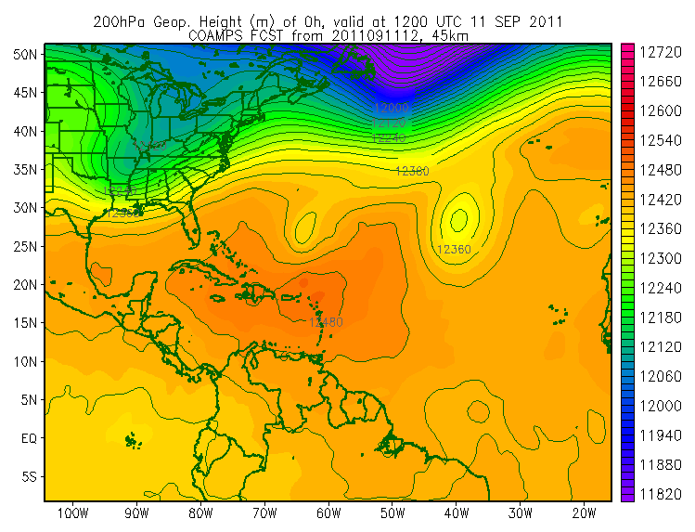
Hurricane Maria
2011091112 200-hPa Geop. Height
An upper level low exists north of Maria for the first 2 days of the simulations. This short-wave disturbance also existed in the satellite track-wind analysis for the same period.
Notes:
Maria: Kept the storm weak early on … coupled with tracker problems, that’s why early forecasts do not extend very far. Later in the storm’s life, we were not so aggressive intensifying it
11

Slide 12
Hurricane Maria
Summary
COAMPS-TC over-intensified Maria, although to a lesser extent compared to HWRF/GFDL.
Vertical shear is similar between the three models during the intensification period.
COAMPS-TC SST is about 0.5-1 ºC lower than HWRF/GFDL.
COAMPS-TC has much small upper-level divergence.
COAMPS-TC captured well the low pressure center north of the storm.
Further research is needed (e.g., vertical distribution of divergence, temperature)
Notes:
Maria: Kept the storm weak early on … coupled with tracker problems, that’s why early forecasts do not extend very far. Later in the storm’s life, we were not so aggressive intensifying it
12

