Slide 1
Analysis on the Hurricane Maria with a new diagnostic tool
In-Hyuk Kwon, Young Kwon, Eric Aligo, and Vijay Tallapragada
OCT 20 2011

Slide 2
New Hurricane Diagnostic Tool
Plotting Tropical cyclone structure and environment from the HWRF output in vertical pressure coordinate
Useful to diagnose the hurricane motion and intensity change
Diagnos_d01: diagnose HWRF parent domain
Diagnos_d02: diagnose HWRF nest domain
Plotting Horizontal fields, cross sections, and azimuthal averaged figures: Storm centers are determined at each level
Diagnos_total: Overview of the hurricane structure

Slide 3
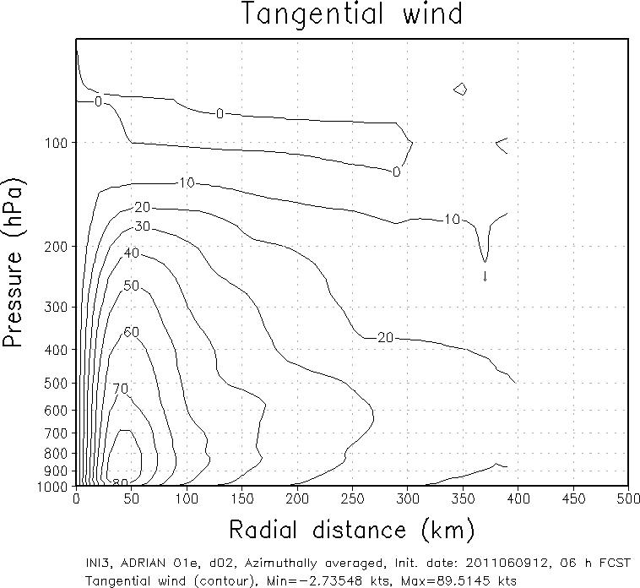
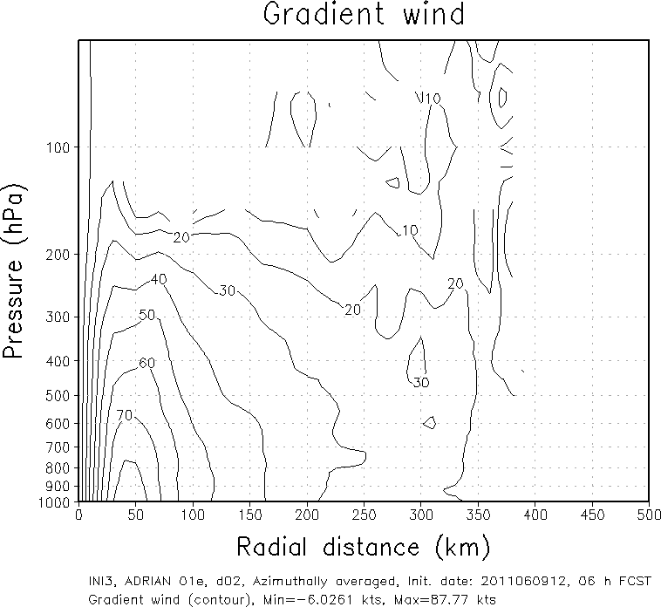
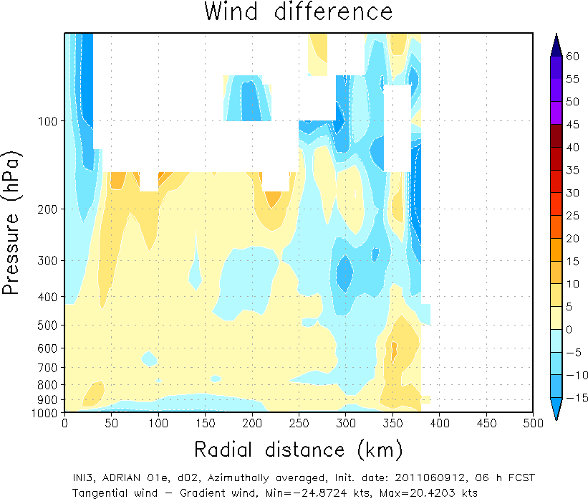
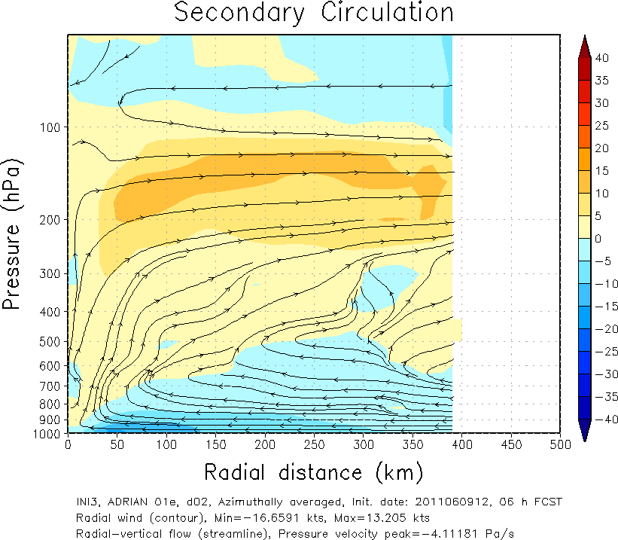
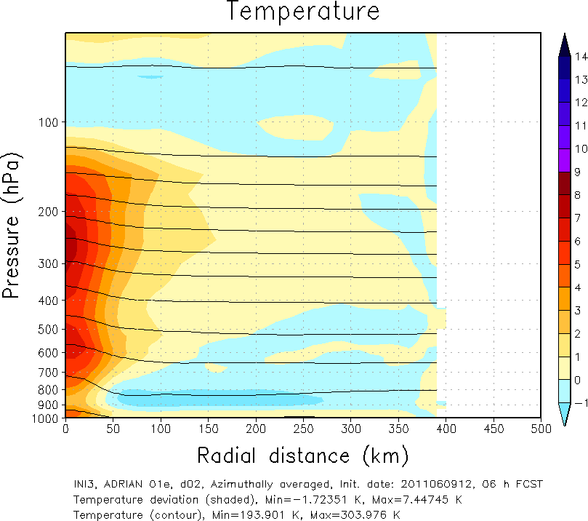
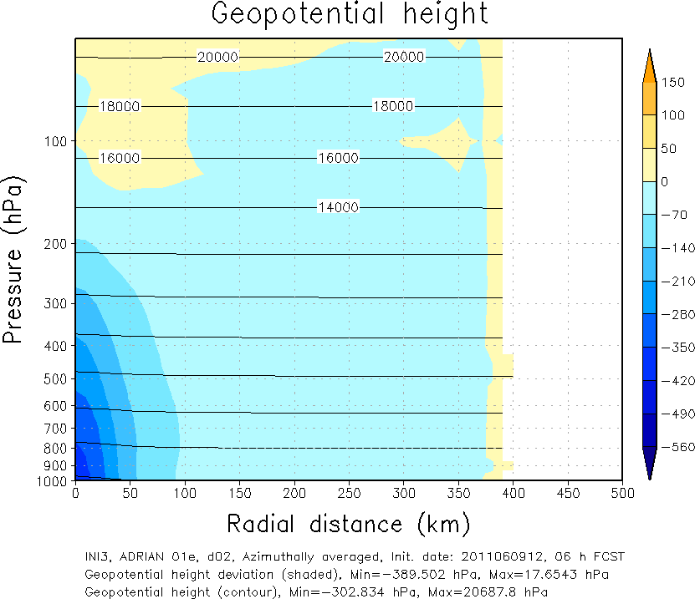
Azimuthal averaged structure
Adrian 2011060912 06h forecast

Slide 4
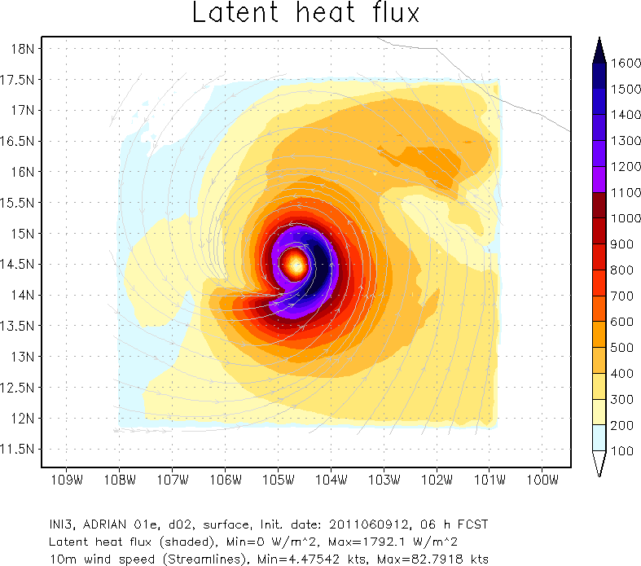
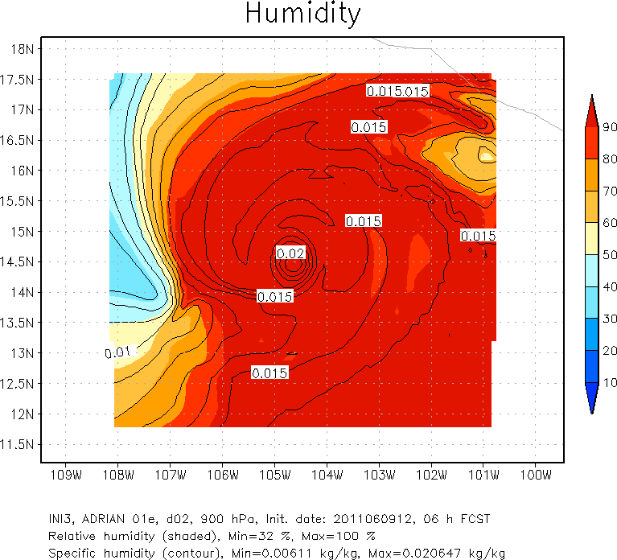
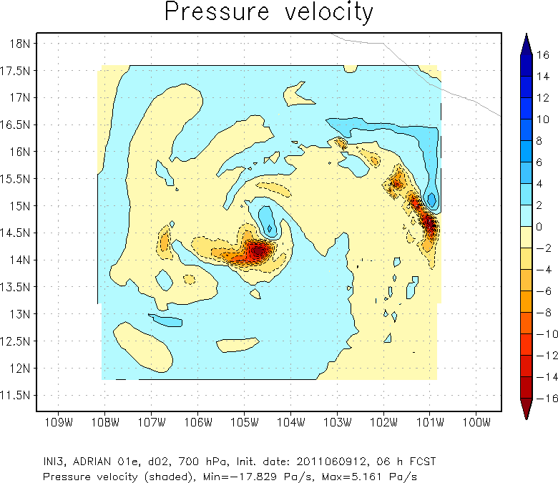
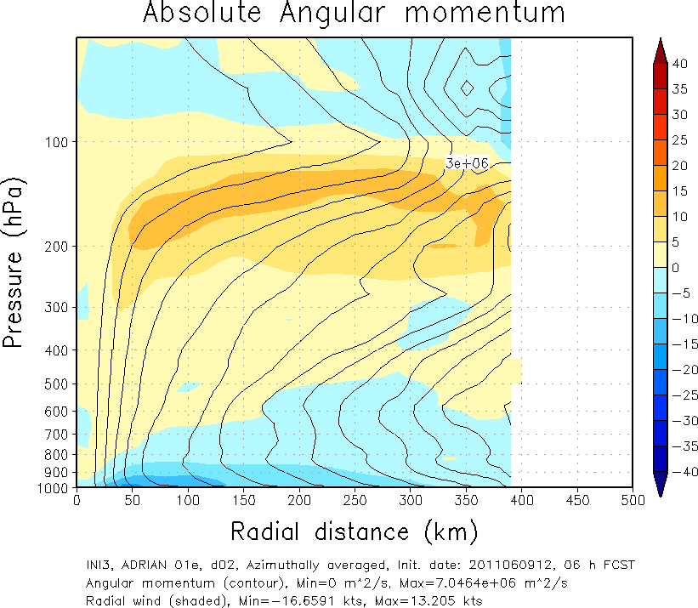
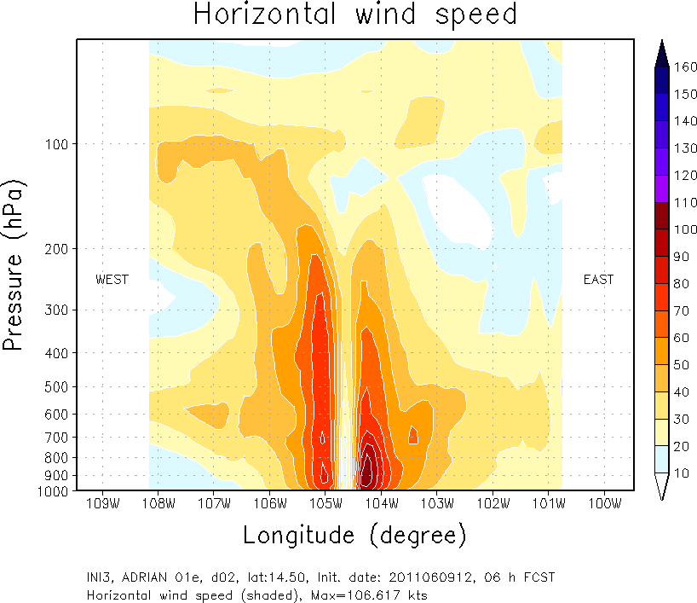
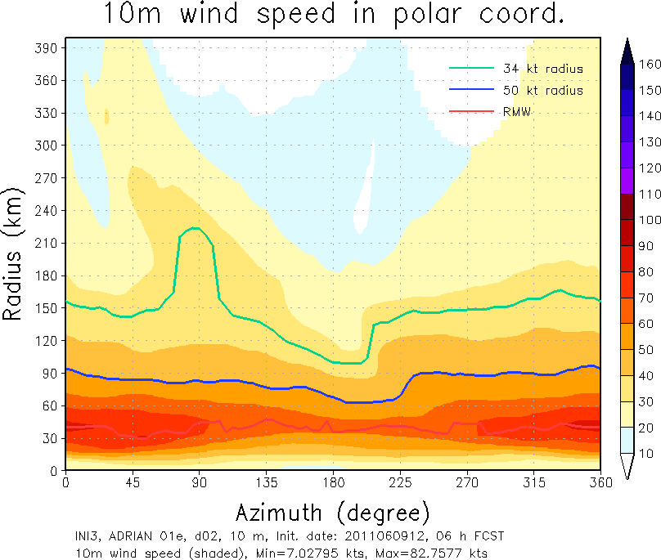
Horizontal structure
ETC.

Slide 5
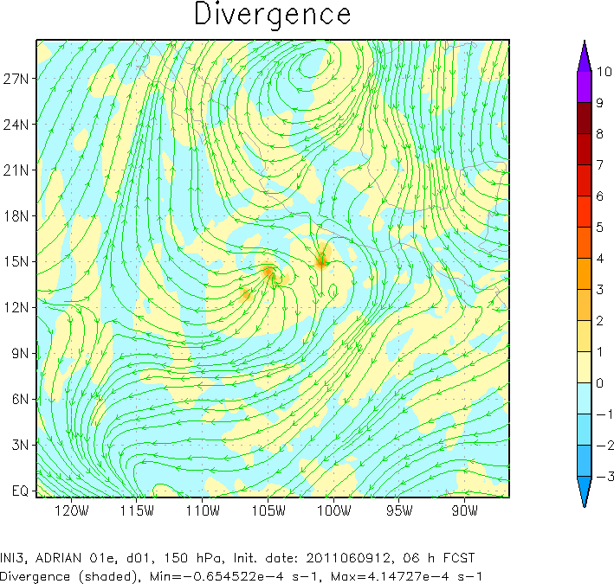
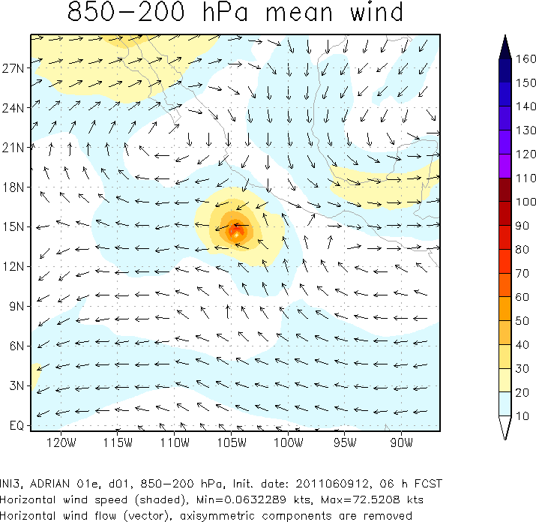
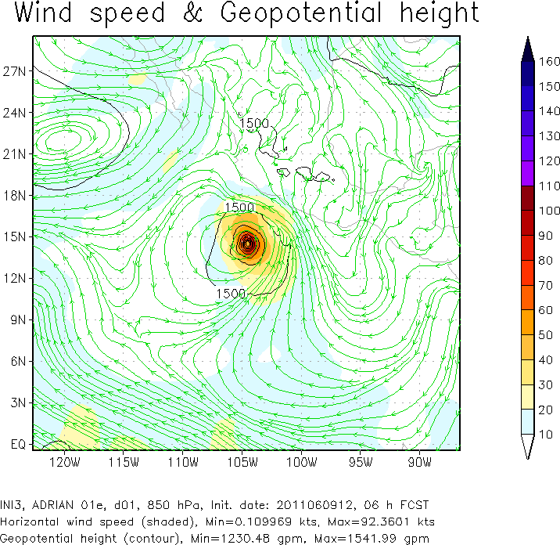
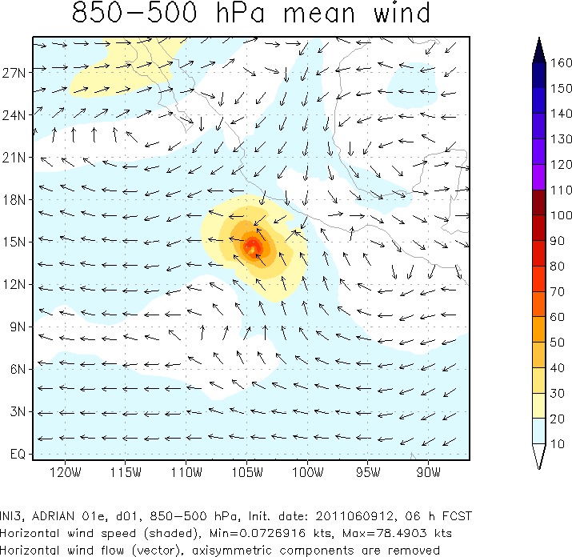
Plotting the parent domain

Slide 6
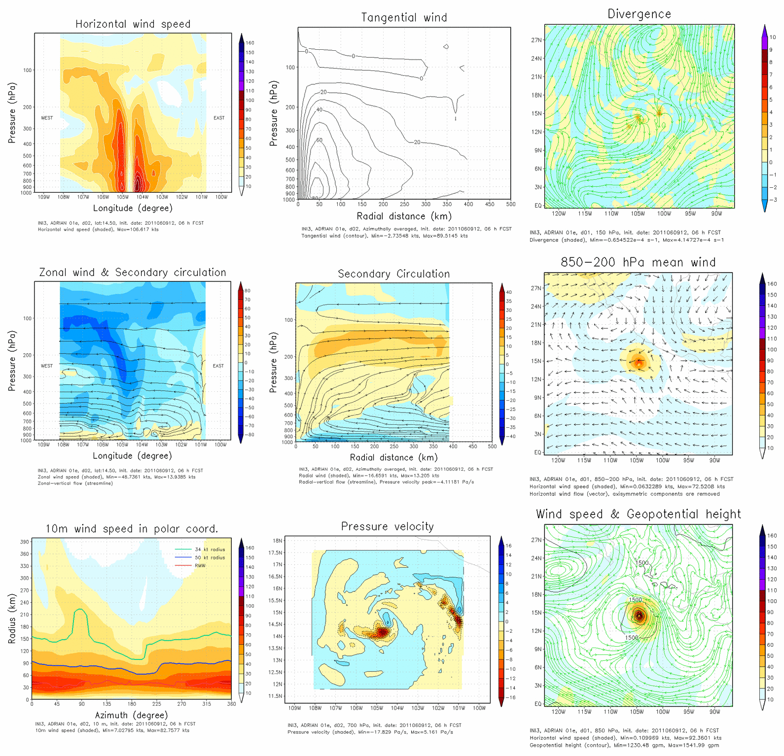
Total figure #1

Slide 7
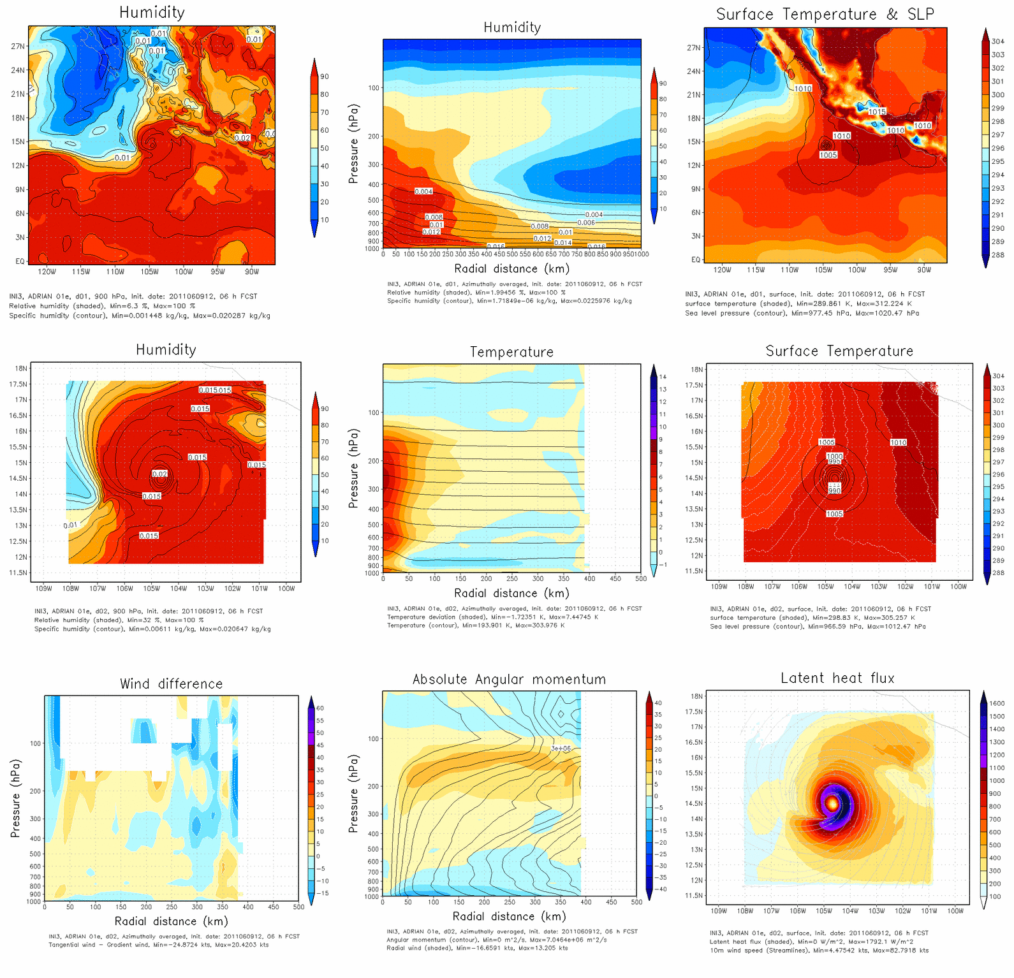
Total figure #2

Slide 8
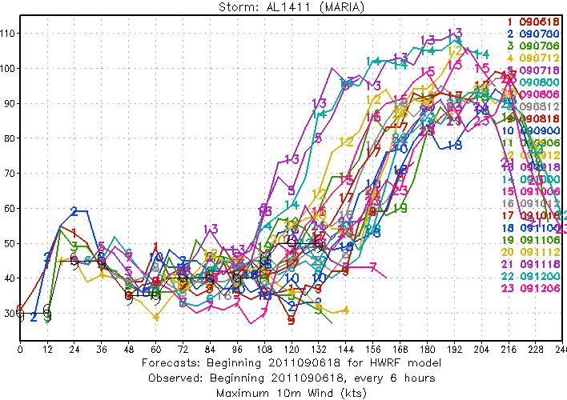
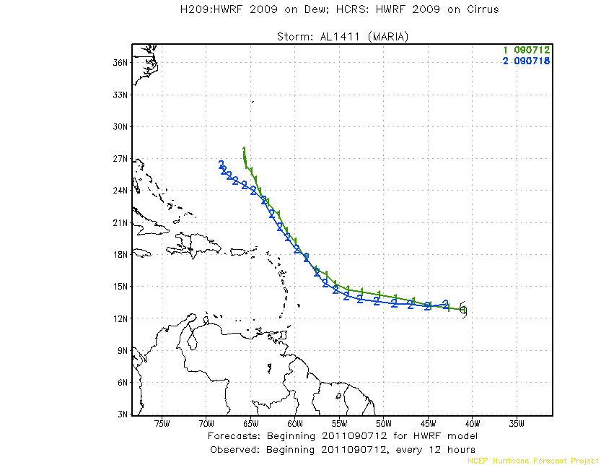
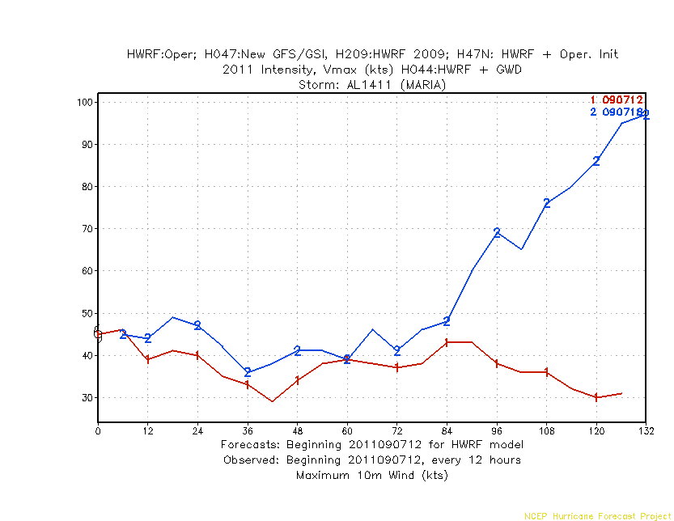
Analysis on the Hurricane Maria
developing
Non developing

Slide 9
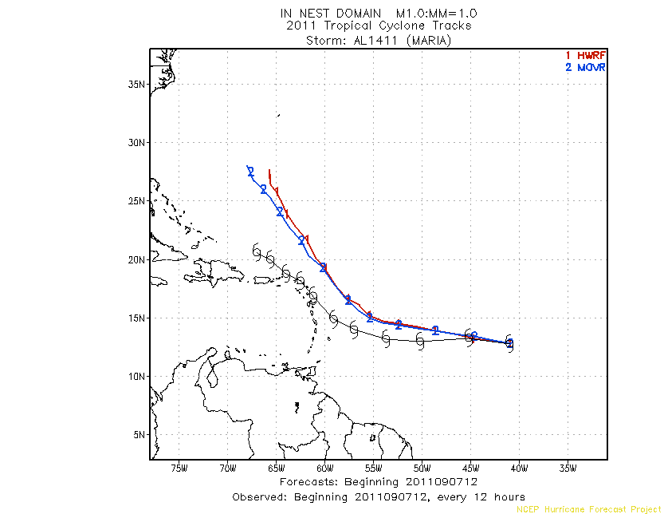
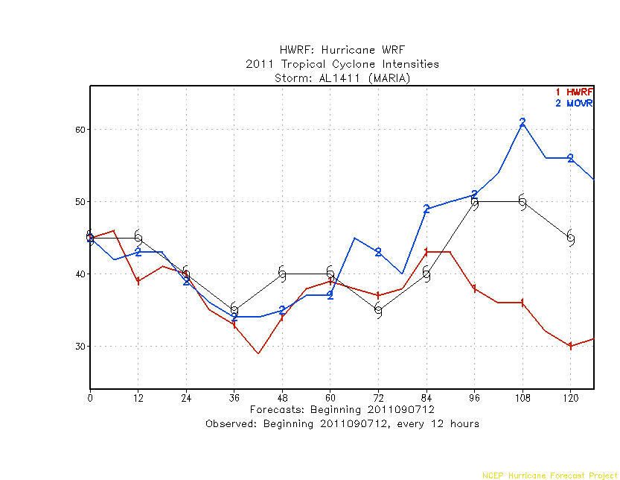
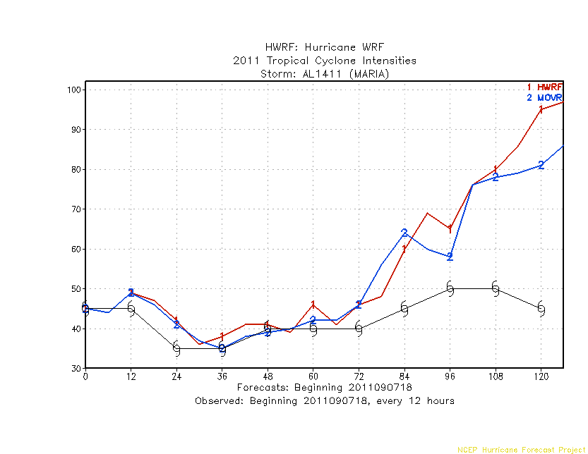
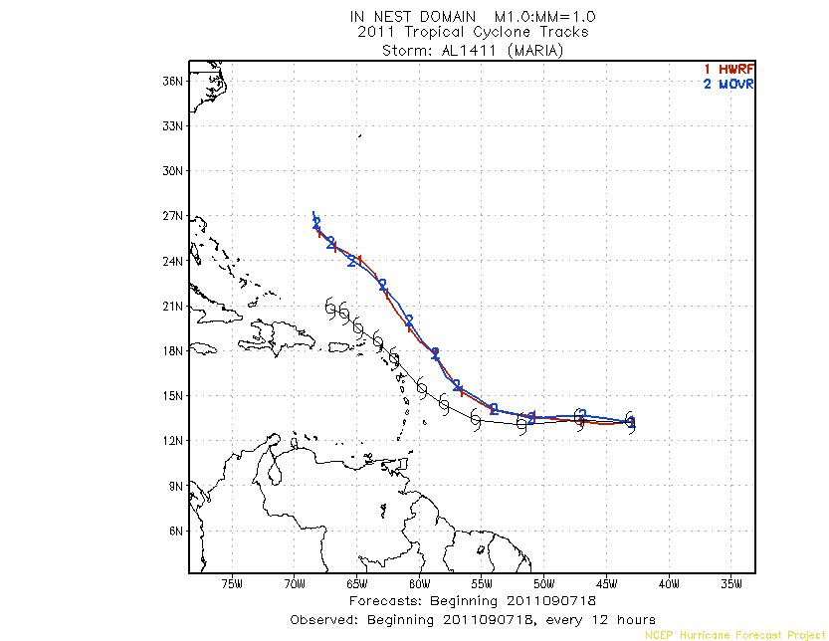

Slide 10
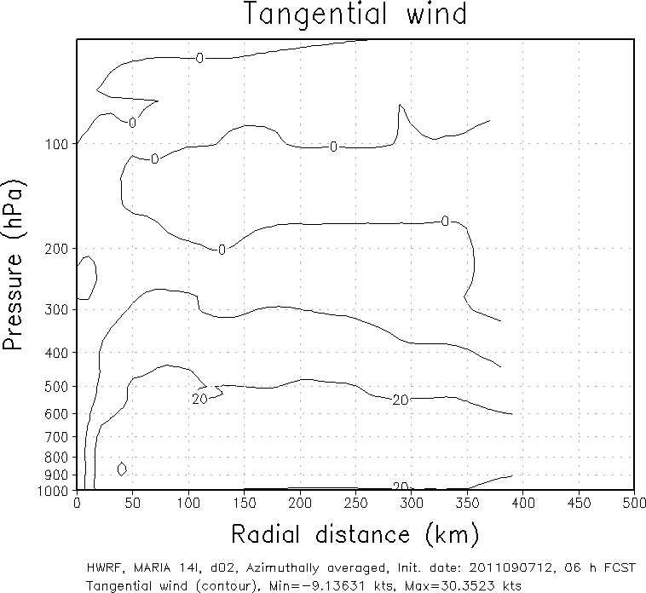
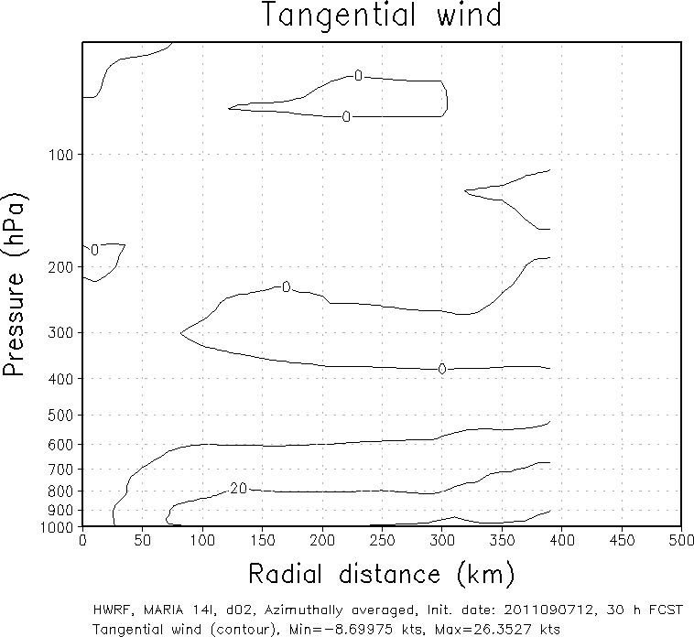
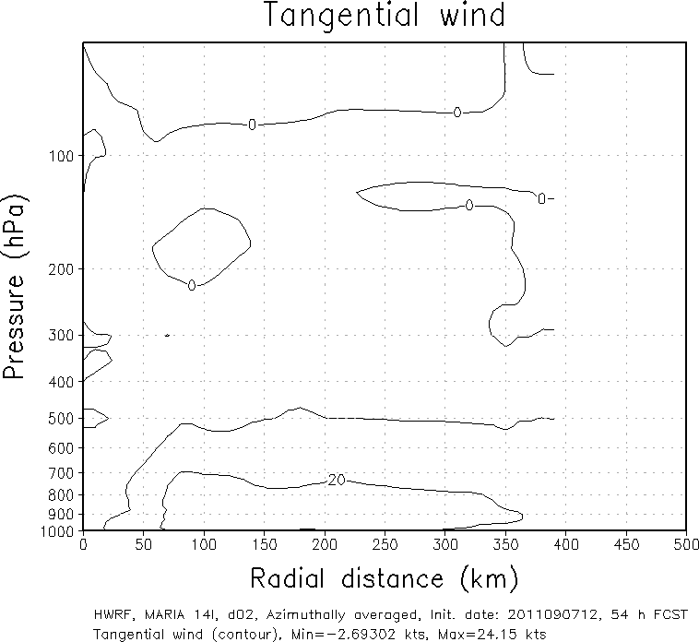
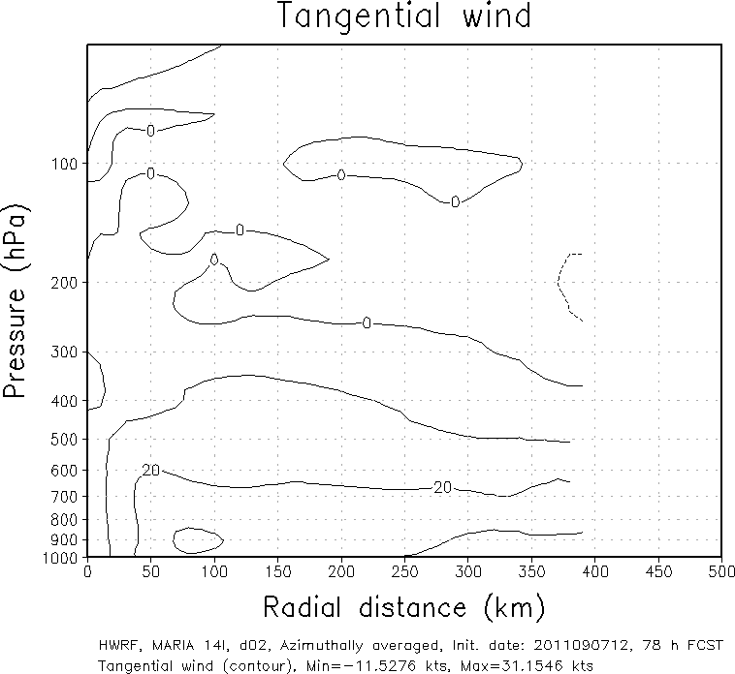
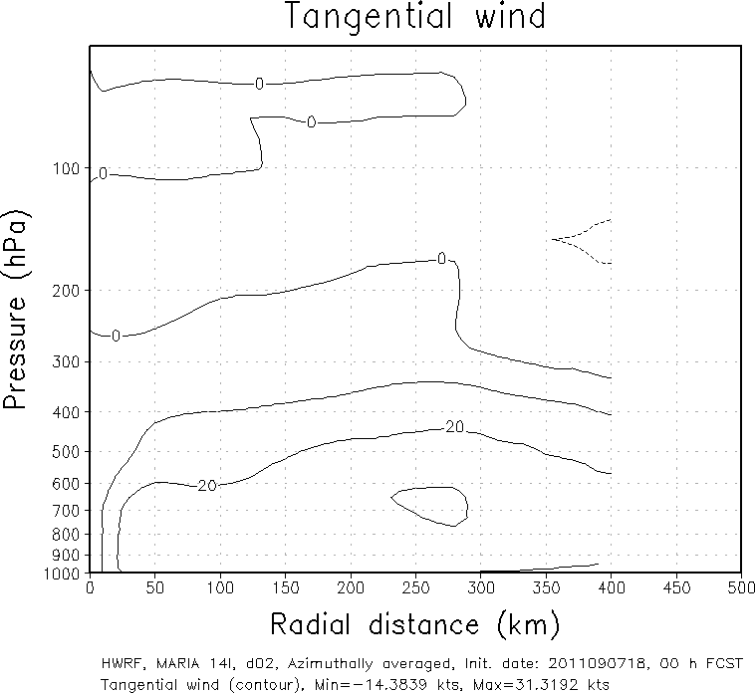
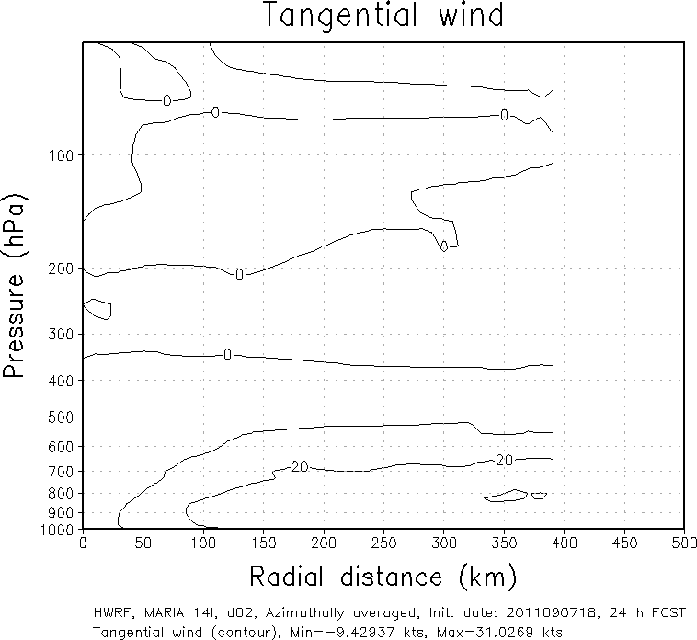
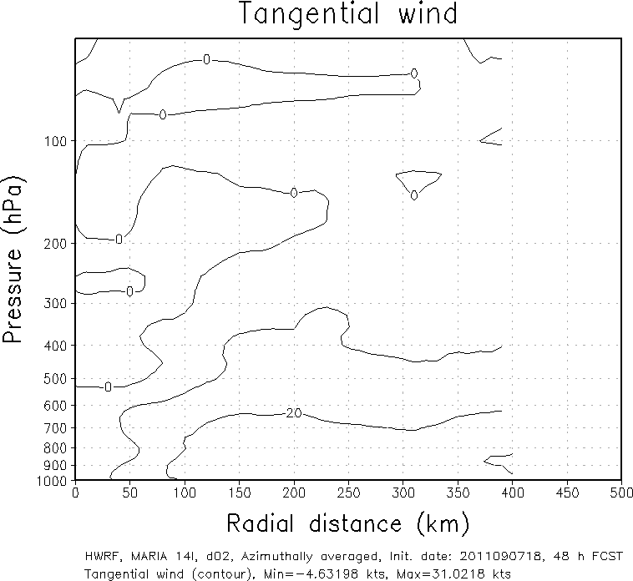
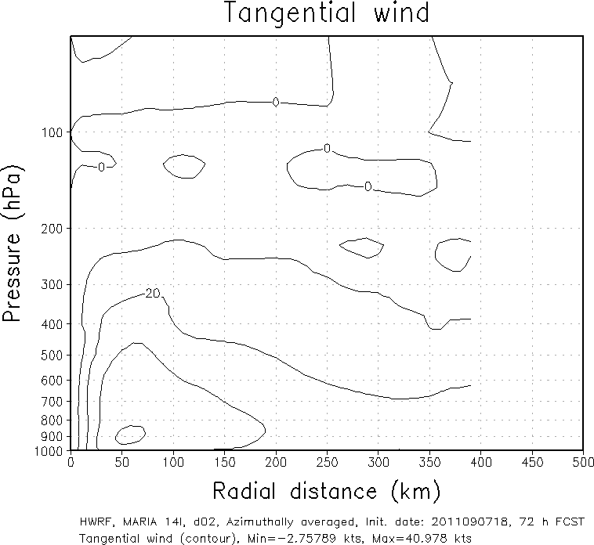
Initial time: 2011090712
24hr
48hr
72hr
Initial time: 2011090718
Stronger Storm
Larger Initial Storm Size
2011090718
2011090818
2011090918
2011091018
10

Slide 11
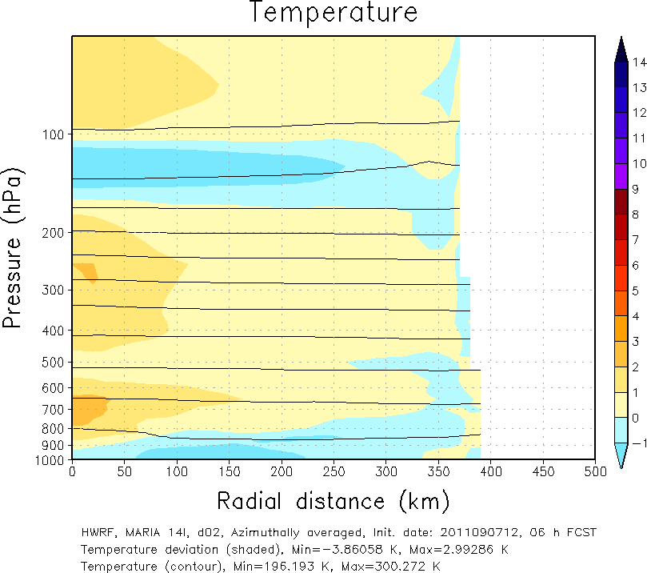
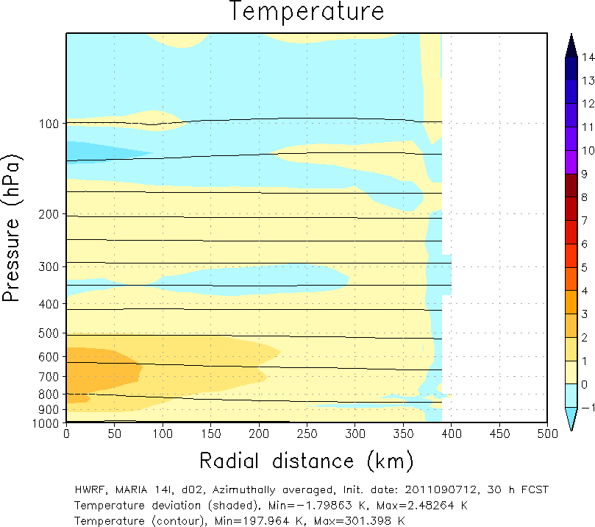
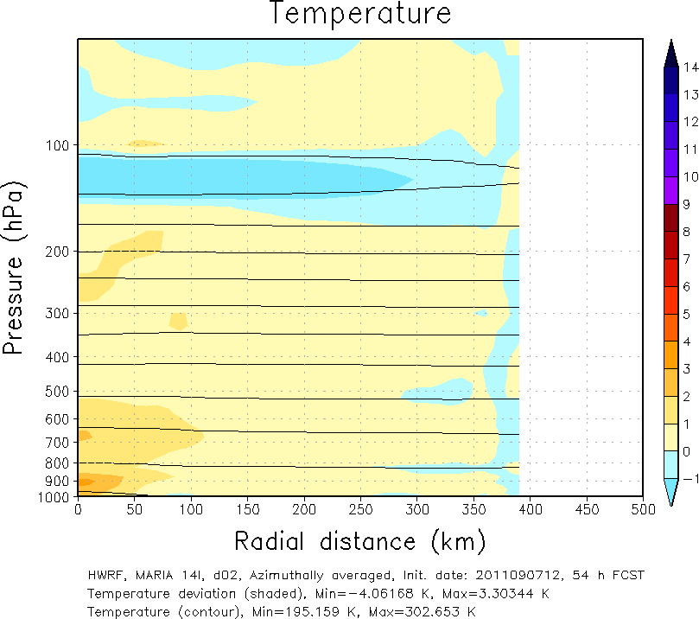
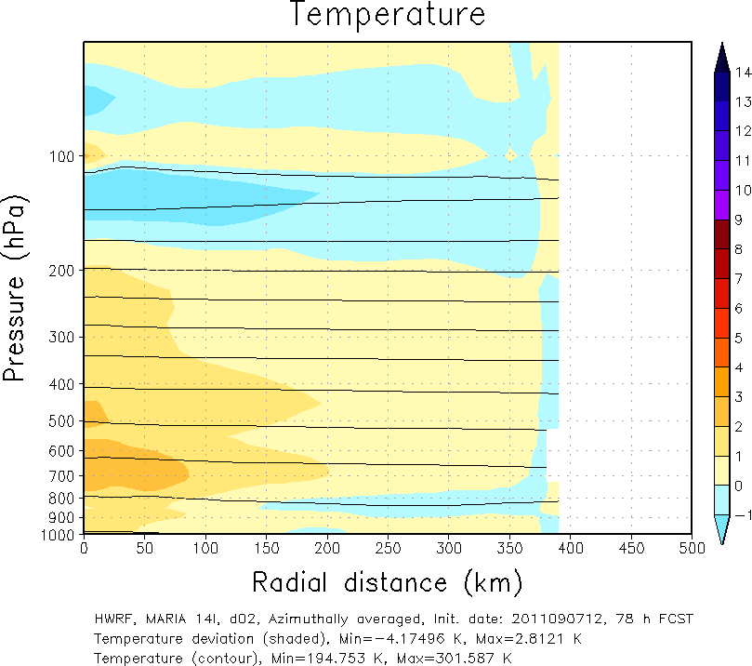
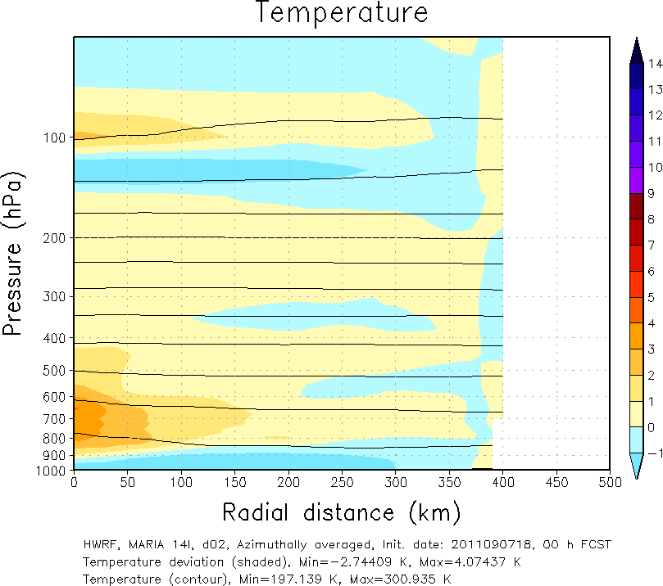
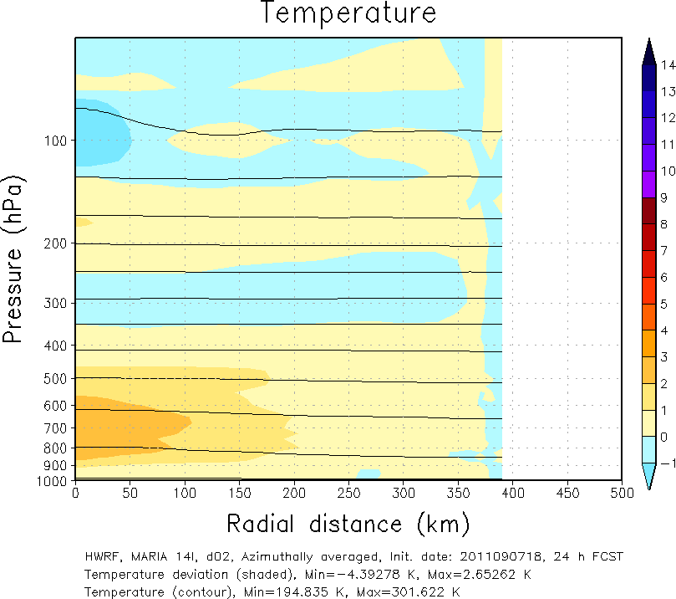
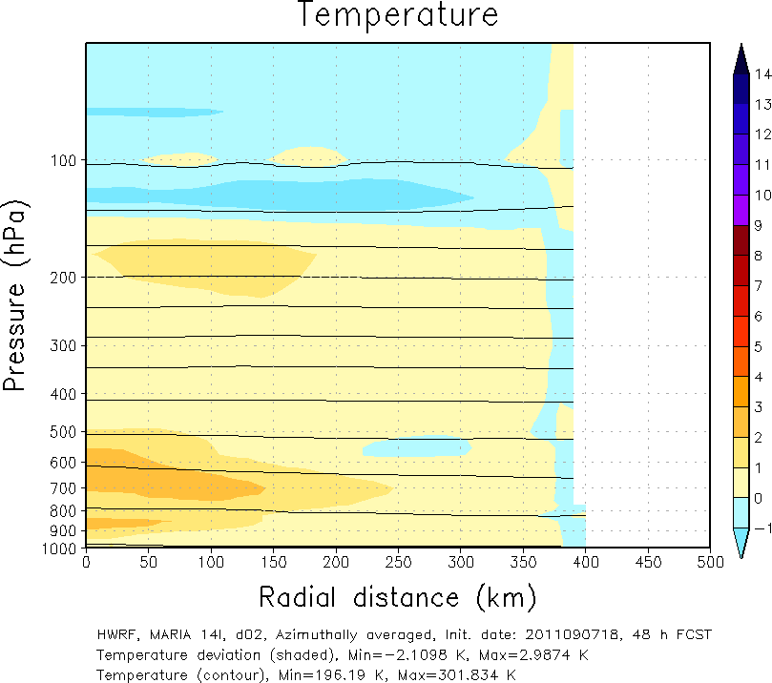
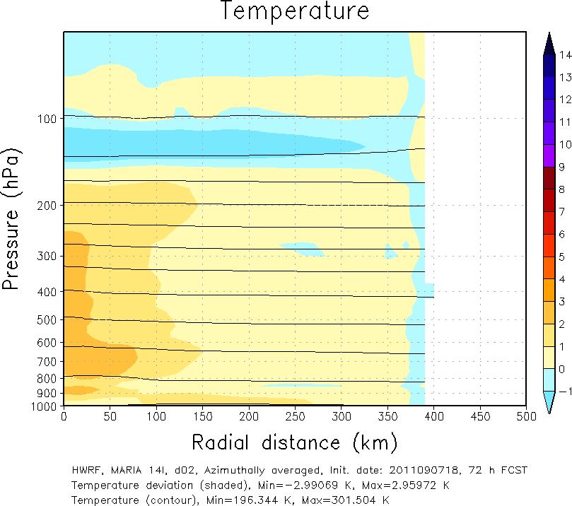
Initial time: 2011090712
24hr
48hr
72hr
Initial time: 2011090718
2011090718
2011090818
2011090918
2011091018
11

Slide 12
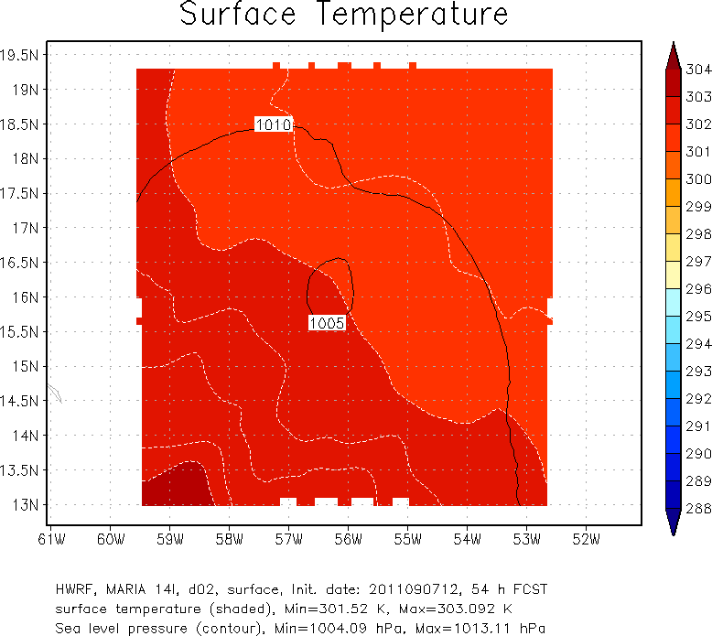
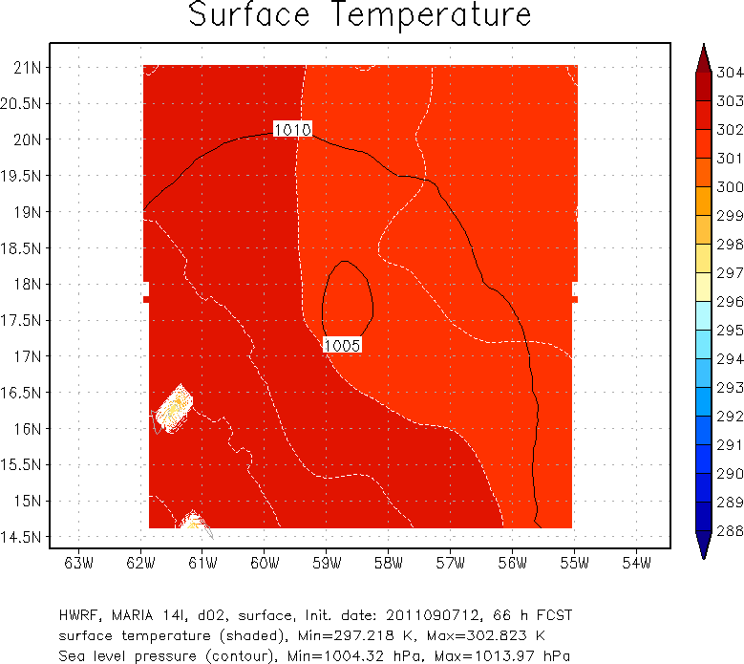
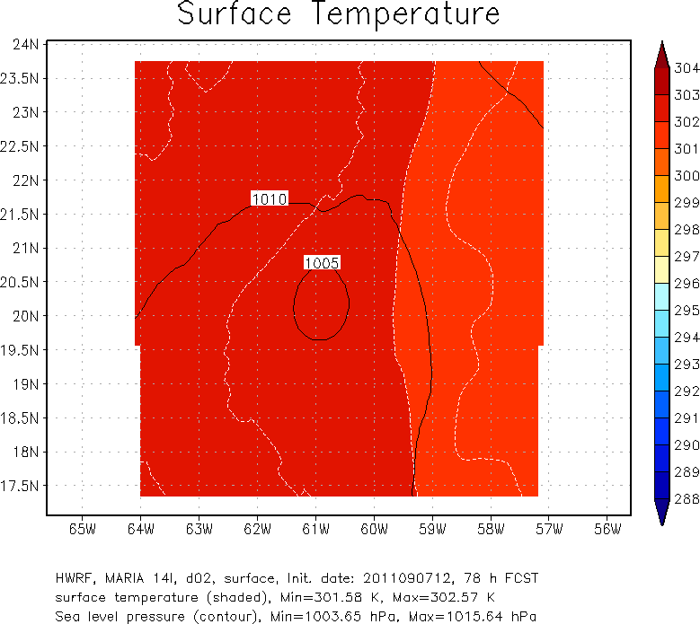
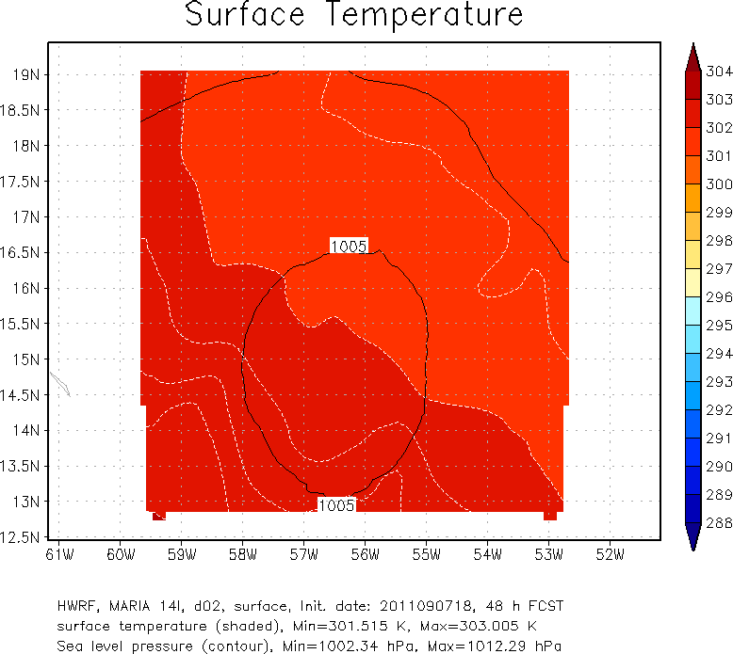
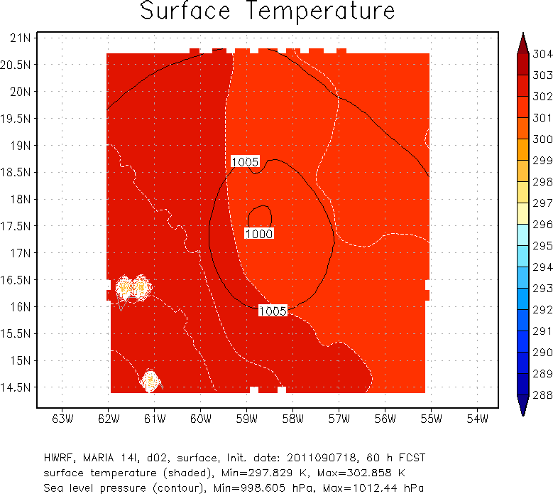
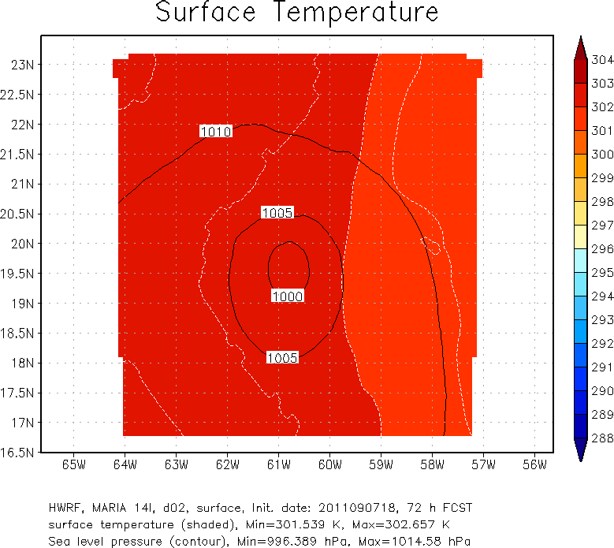
Surface temperature – No Big Impact
Initial time: 2011090712
54hr
66hr
78hr
Initial time: 2011090718
48hr
60hr
72hr
2011090918
2011091006
2011091018

Slide 13
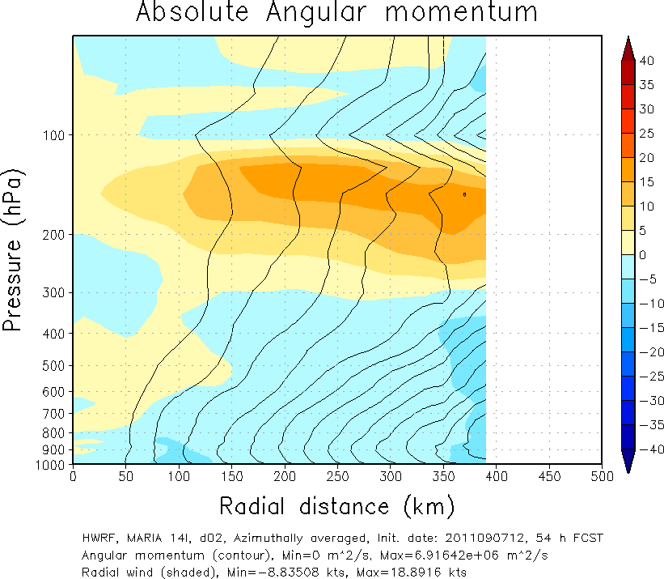
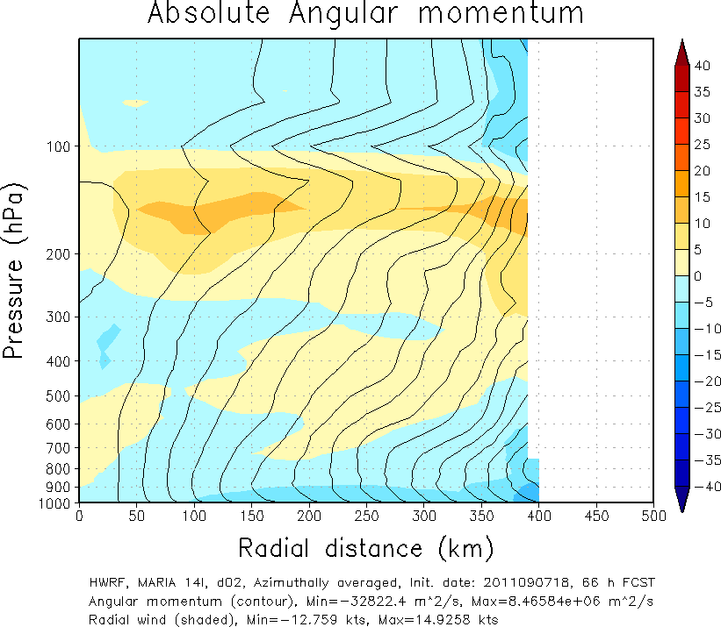
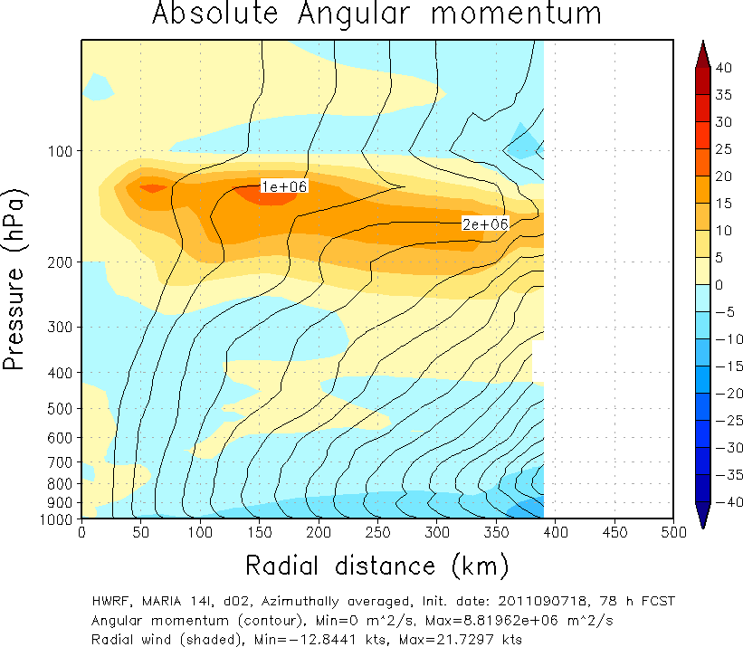



Absolute angular momentum
Initial time: 2011090712
54hr
66hr
78hr
Maximum: 6.91
Initial time: 2011090718
48hr
60hr
72hr
Maximum: 9.49
2011090918
2011091006
2011091018

Slide 14




Size correction in the TC initialization (could be related to use of ROCI)
Maria04L.2011090718_00h: INI6 - new initialization
Shrunken
Maria04L.2011090712_06h: HWRF
 | TCVITALS
V_{max} | 23 m/s (45knots)
R_{max} | 74 km
ROCI | 324 km (1012hPa)
R₃₄ | 93, -999, -999, 93 km
: First guess
Maria04L.2011090718_00h: HWRF
Extended

Slide 15









Tangential wind
Initial time: 2011090718
HWRF
INI6
81h forecast
84h forecast
87h forecast
90h forecast

Slide 16








Secondary circulation
Initial time: 2011090718
HWRF
INI6
81h forecast
84h forecast
87h forecast
90h forecast
16

Slide 17


Composite storm analysis
Non developing
Strom list: maximum wind speed of 40~50 kts
Non developing: 2011090618 _60h
Non developing: 2011090700 _66h
Non developing: 2011090706 _78h
Non developing: 2011090712 _84h
Non developing: 2011090800 _72h
Non developing: 2011090806 _90h
Developing: 2011090718 _66h
Developing: 2011090812 _96h
Developing: 2011090818 _90h
Developing: 2011090900 _78h
Developing: 2011090906 _48h
Developing: 2011090912 _36h
Developing: 2011090918 _30h
Developing

Slide 18




Surface wind
Non developing
Developing
-12h
Target date
+ 12h

Slide 19






Tangential wind
Non developing
Developing
-12h
Target date
+ 12h

Slide 20






Temperature anomaly
Non developing
Developing
-12h
Target date
+ 12h

Slide 21






Secondary circulation
Non developing
Could be due to asymmetric structure???
Developing
-12h
Target date
+ 12h

Slide 22






Vertical wind shear
Non developing
Developing
-12h
Target date
+ 12h

Slide 23






Absolute angular momentum
Non developing
Developing
-12h
Target date
+ 12h

Slide 24






Radial angular momentum advection
Non developing
Developing
-12h
Target date
+ 12h

Slide 25






Humidity
Non developing
Developing
-12h
Target date
+ 12h

Slide 26






Radial moisture flux convergence
Non developing
Developing
-12h
Target date
+ 12h

Slide 27
Summary
Large storm size
  Bigger Absolute angular momentum
  Bigger humidity advection
  Bigger latent heat flux area
Vertical wind shear
  Distract the secondary circulation
  Suppress a vertical expanding of storm structure
  Low level warm core center

Slide 28

Time series of the correlation between the HWRF Vmax errors and absolute track errors for Maria (2011) each forecast cycle. The correlation is computed at each lead time by using the entire 44 cycles.
Issue: Correlation is mostly negative for the entire range of lead times. That means the larger the track errors are, the lesser intensity errors would be? (the HWRF model has some internal inconsistencies, or serial bias correlation for one case, … ????)

