Slide 1
Hurricane Maria: HWRF Forecasts and Model Diagnostics on the Vortex Scale
David Zelinsky and Wallace Hogsett
NHC

Slide 2
Part I: Satellite Observations of Maria: Comparing HWRF to reality

Slide 3
Overview: What actually happened
6 stages of Maria from a satellite perspective:
Loosely organized convection (pre depression/depression stage, 05/0000 – 09/1800)
Development of first band-like feature (09/1800 – 11/0000)
Band becomes disorganized, convection is more blob-like, and sheared (11/0000 – 13/1200)
Re-organization of convection into a band which begins to slowly wrap around the center (13/1200 – 15/0600)
Band wraps around the west semicircle and an eye feature briefly develops (15/0600 – 16/0000)
ET and dissipation (16/0000 – 17/0000)

Slide 4
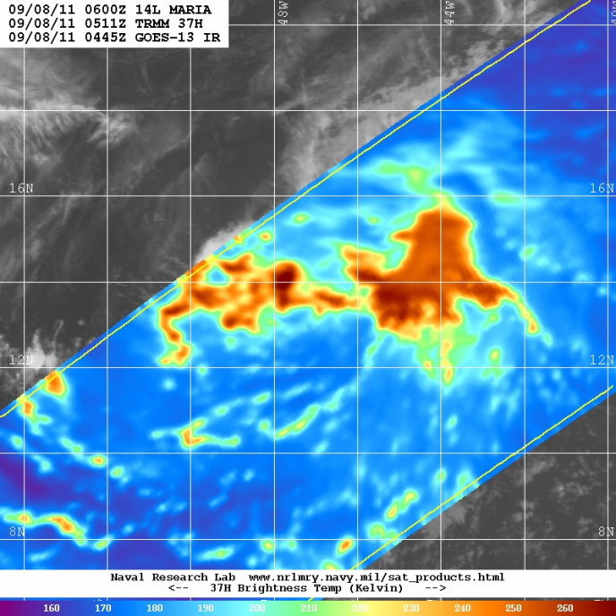
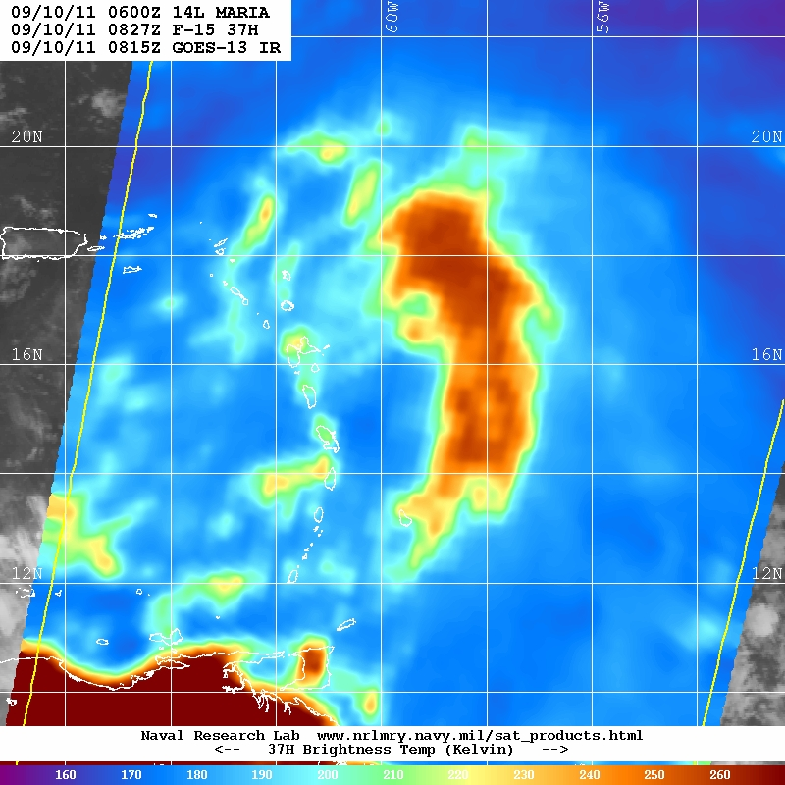
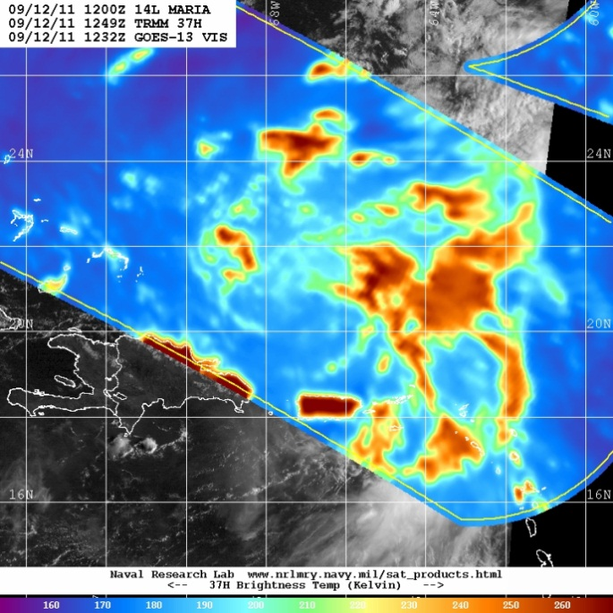
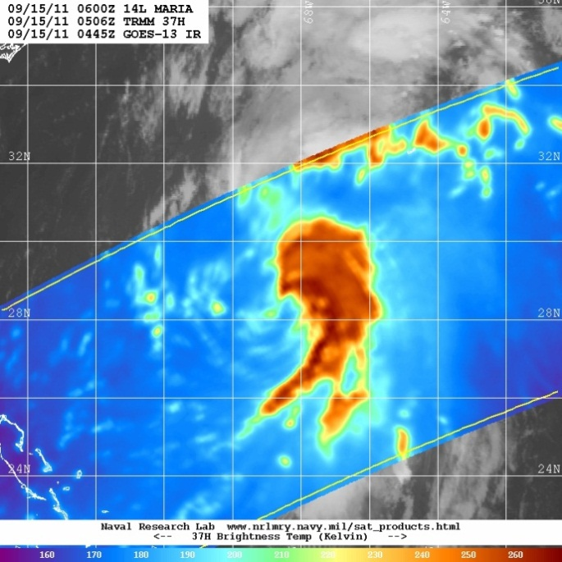
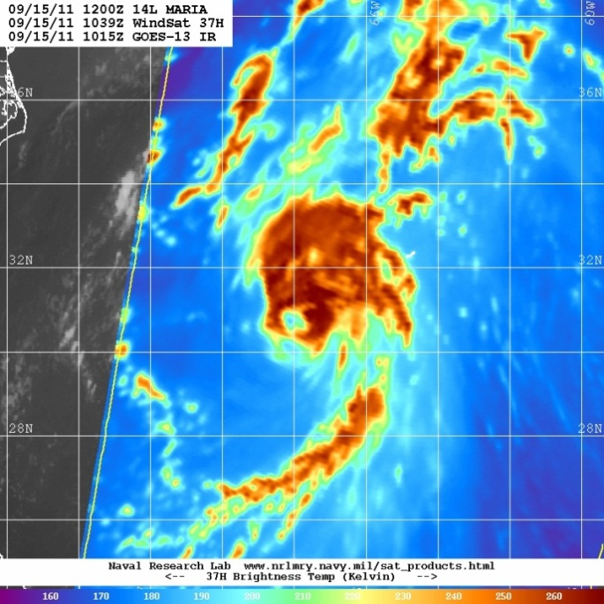
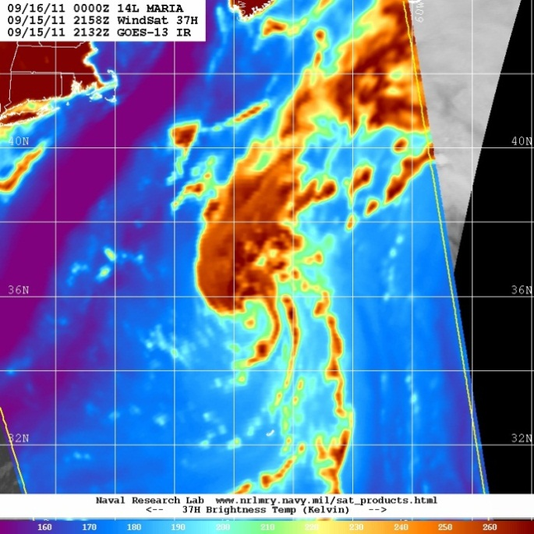
37GHz
1)
05/00 – 09/18
2)
09/18 – 11/00
3)
11/00 – 13/12
4)
13/12 – 15/06
5)
15/06 – 16/00
6)
16/00 – 17/00

Slide 5
Overview: What HWRF predicted
Operational HWRF:
Every run from 08/1200 – 13/0600 involves the wrapping of bands around the center, resulting in the formation of an eye-like feature (timing varies)
Not a single run after 13/0600 forecasts the development of an eye-like feature
Experimental HWRF:
Lots of run-to-run variability
All runs from 08/1200 – 15/1800 depict the wrapping of bands around the center, sometimes resulting in the formation of an eye-like feature

Slide 6
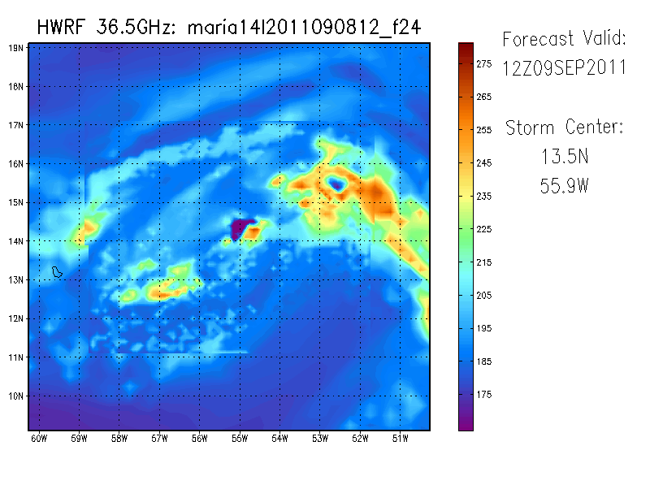
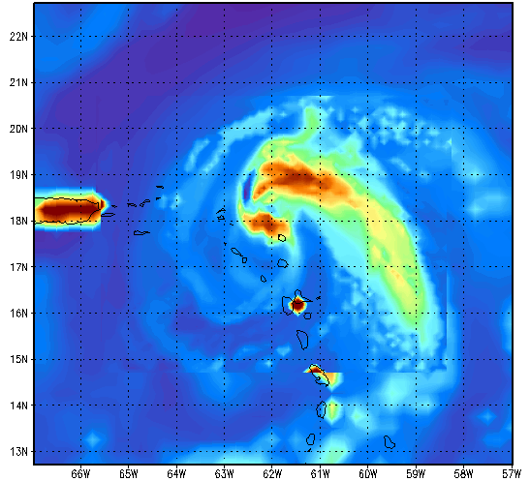
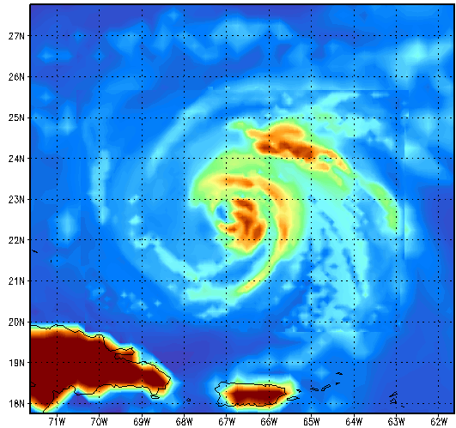
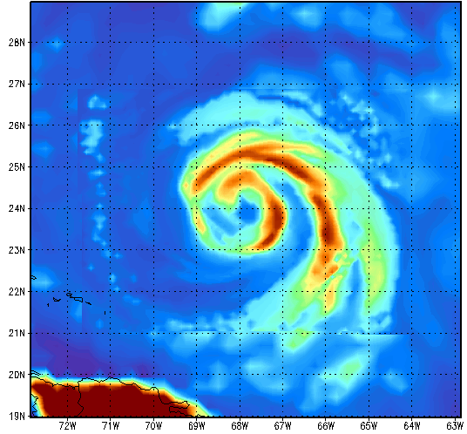
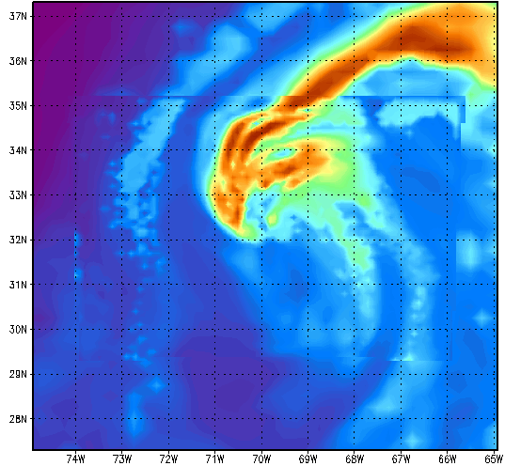
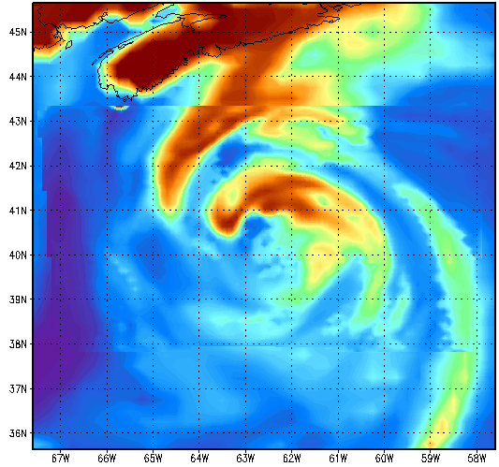
Operational HWRF: 36.5 GHz 24-hr forecasts
1)
05/00 – 09/18
2)
09/18 – 11/00
3)
11/00 – 13/12
Valid: 2011090912
Valid: 2011091012
Valid: 2011090912
Valid: 2011091300
4)
13/12 – 15/06
5)
15/06 – 16/00
6)
16/00 – 17/00
Valid: 2011091400
Valid: 2011091400
Valid: 2011091512
Valid: 2011091606

Slide 7
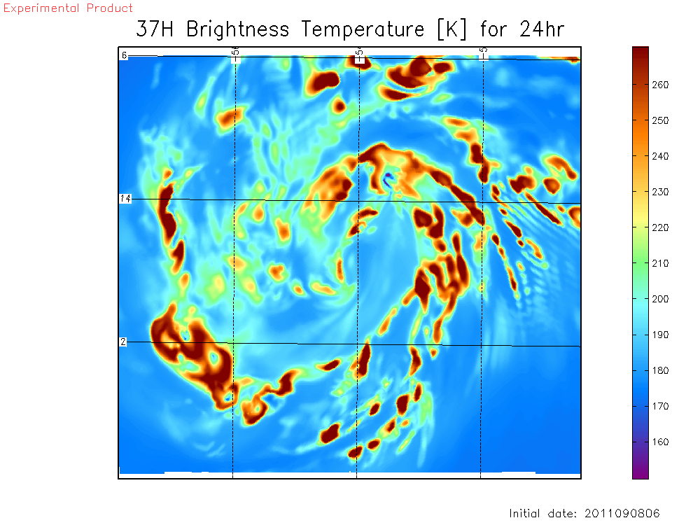
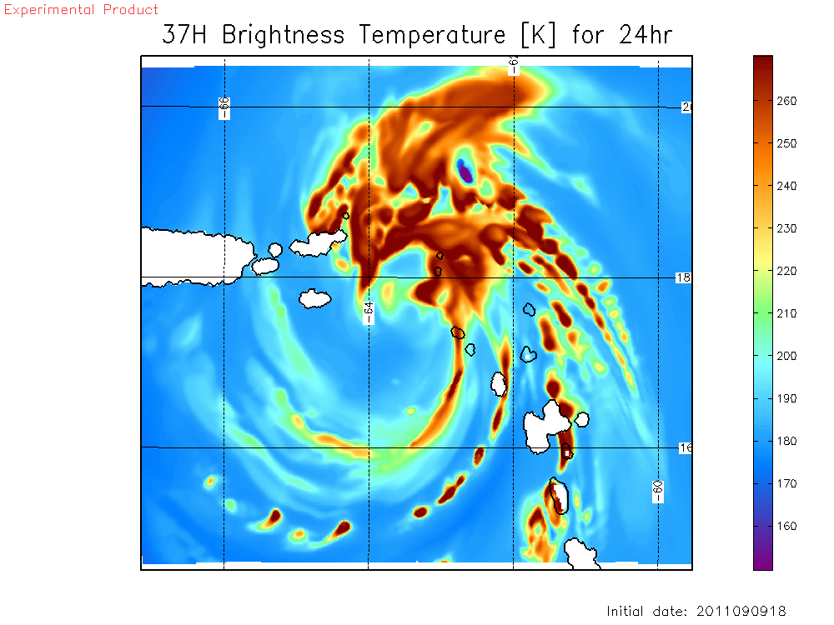
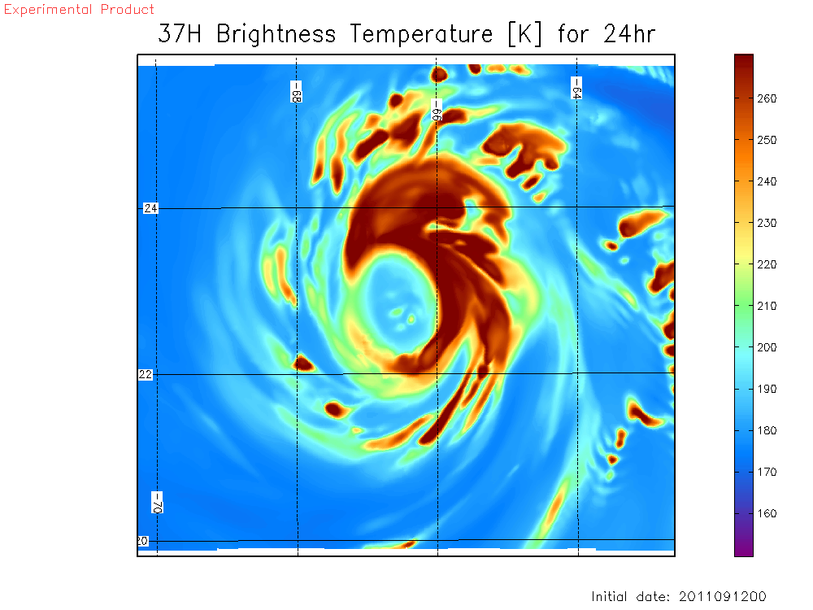
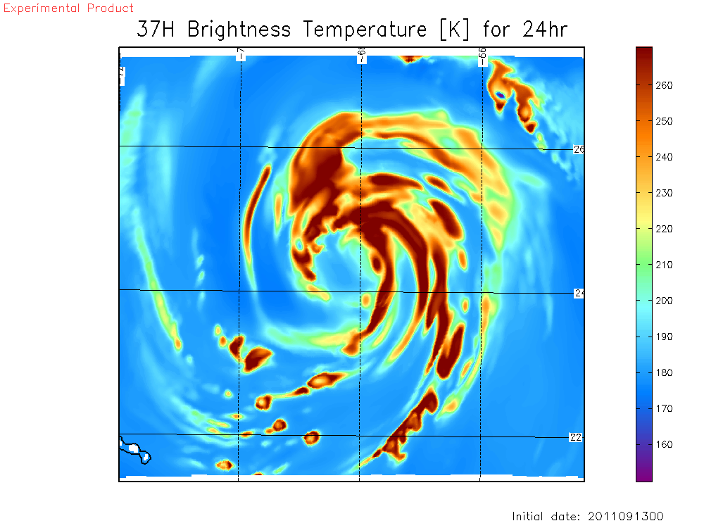
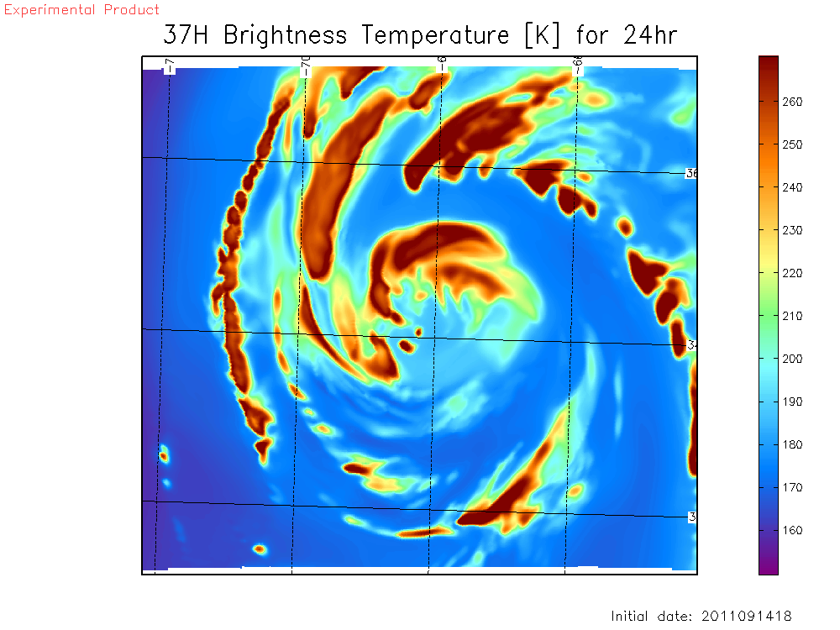
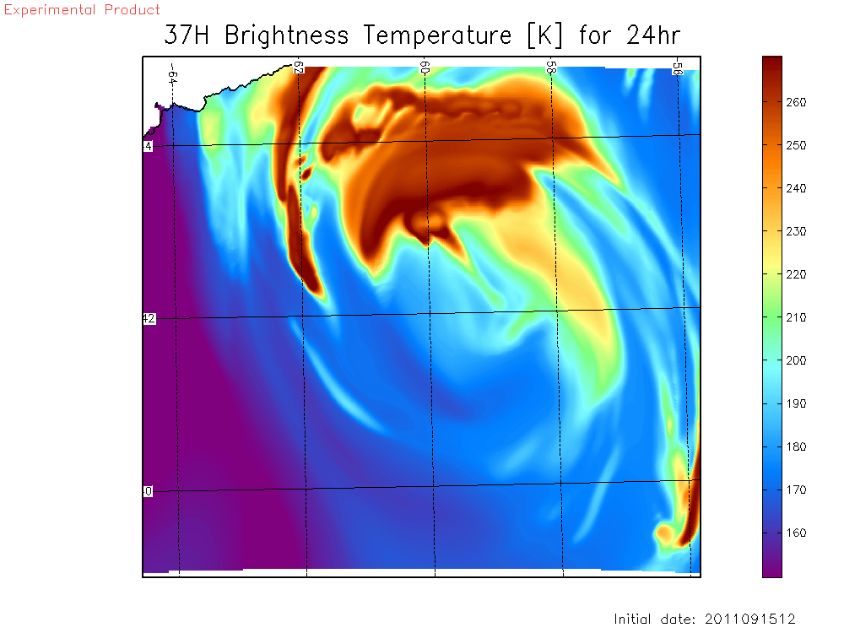
Experimental HWRF: 37 GHz 24-hr forecasts
1)
05/00 – 09/18
2)
09/18 – 11/00
3)
11/00 – 13/12
Valid: 2011090906
Valid: 2011091018
Valid: 2011091300
4)
13/12 – 15/06
5)
15/06 – 16/00
6)
16/00 – 17/00
Valid: 2011091400
Valid: 2011091518
Valid: 2011091612

Slide 8
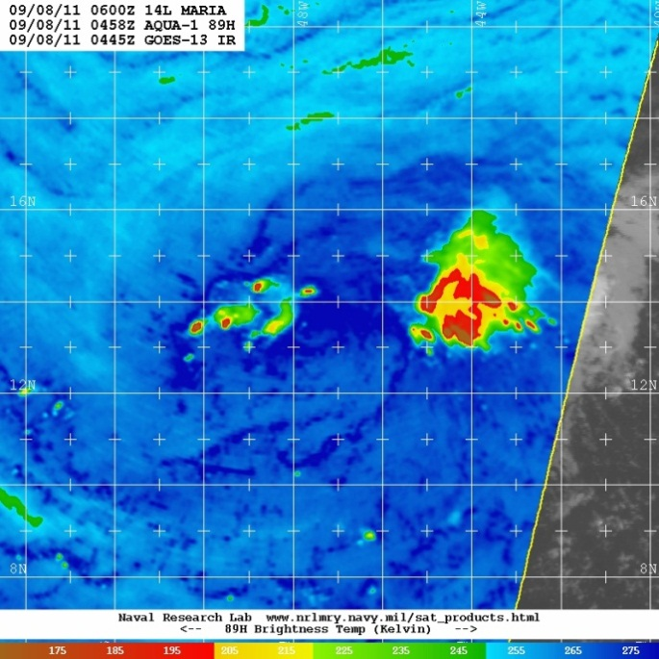
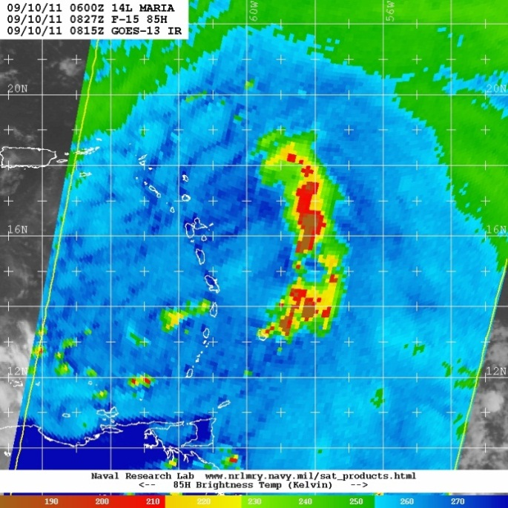
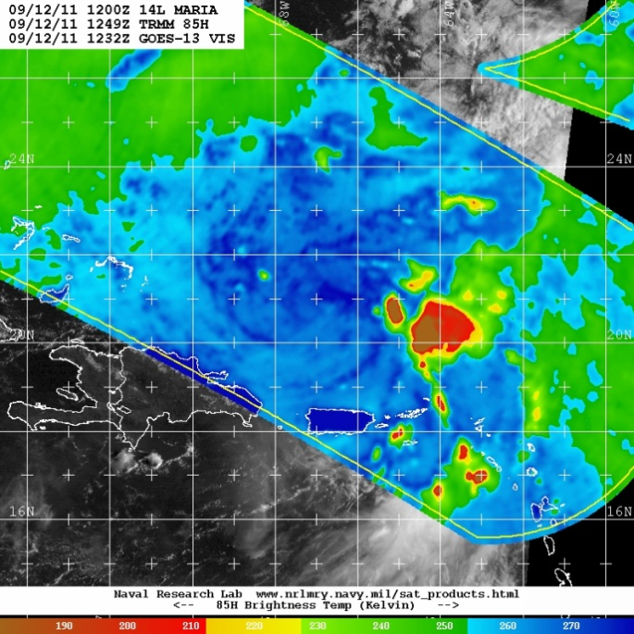
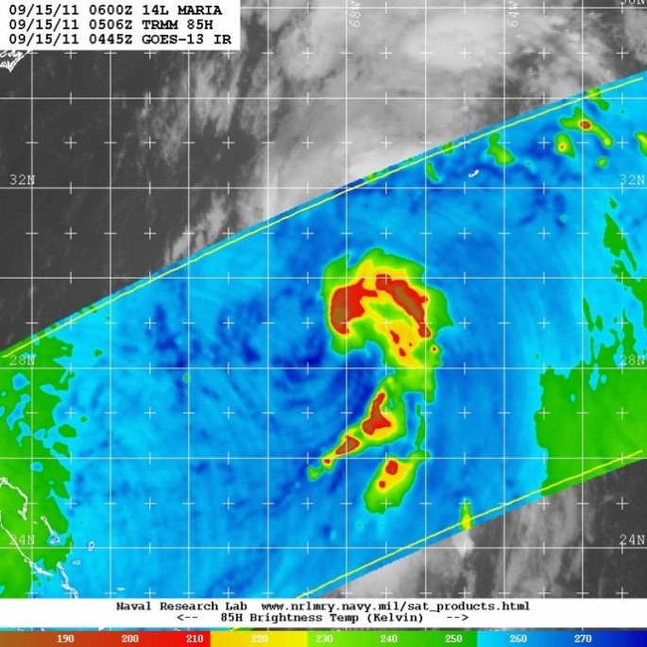
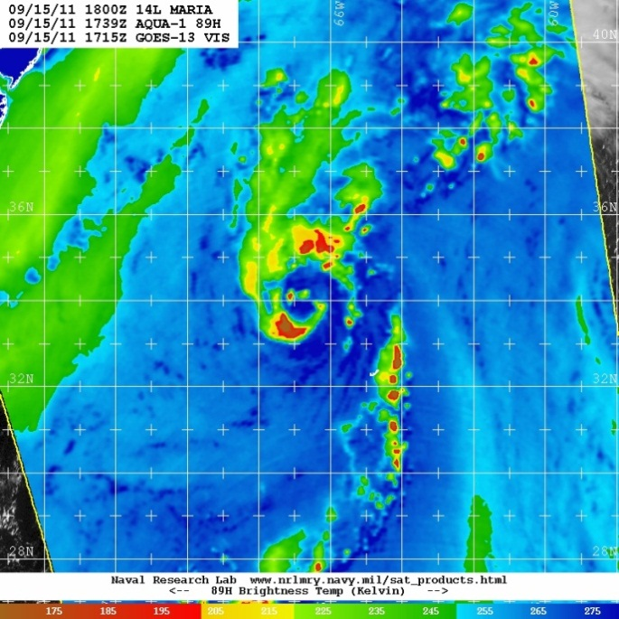
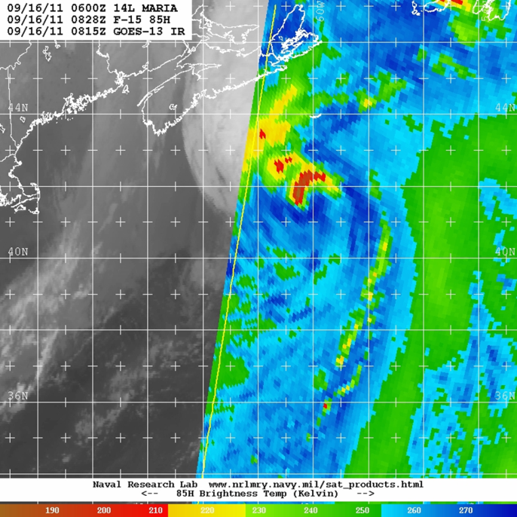
85/89 GHz
1)
05/00 – 09/18
2)
09/18 – 11/00
3)
11/00 – 13/12
4)
13/12 – 15/06
5)
15/06 – 16/00
6)
16/00 – 17/00

Slide 9
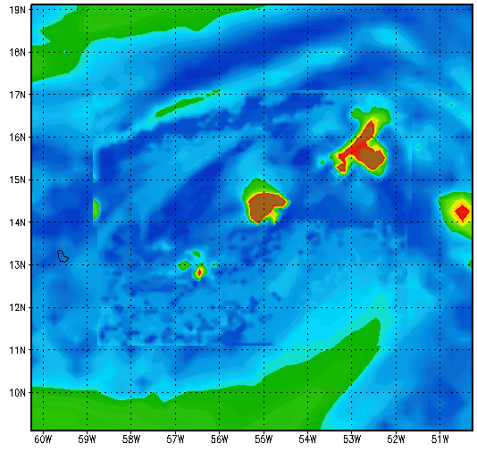
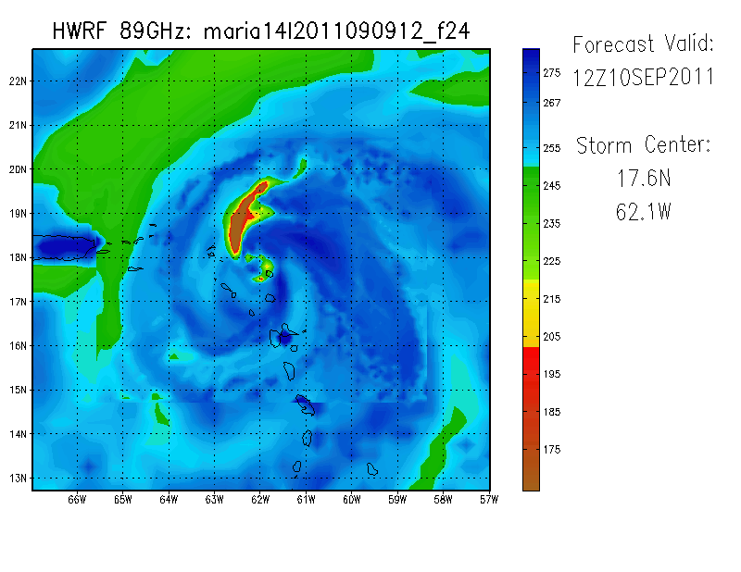
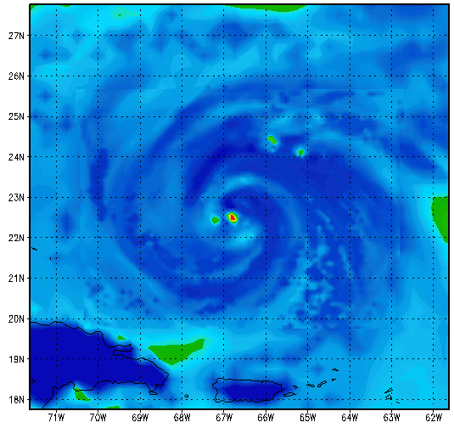
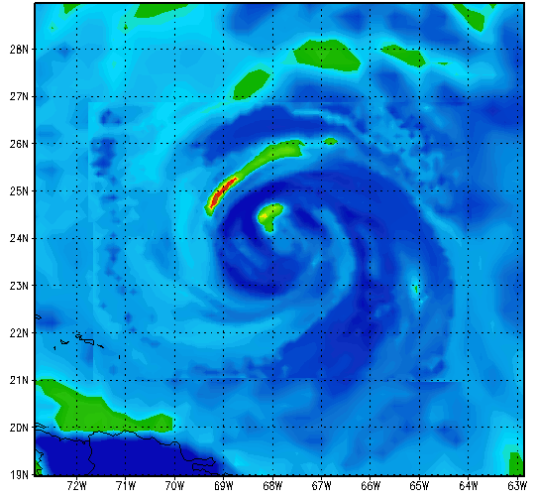
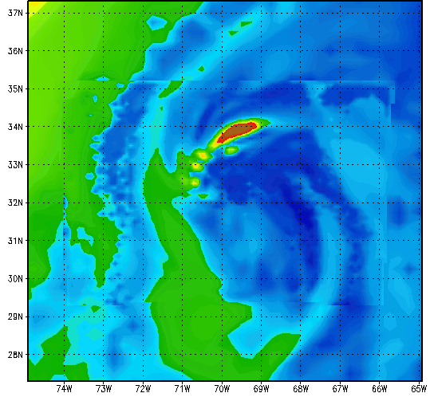
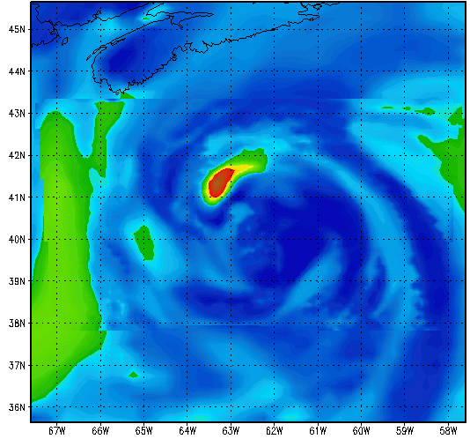
Operational HWRF: 89 GHz 24-hr forecasts
1)
05/00 – 09/18
2)
09/18 – 11/00
3)
11/00 – 13/12
Valid: 2011090912
Valid: 2011091012
Valid: 2011091300
4)
13/12 – 15/06
5)
15/06 – 16/00
6)
16/00 – 17/00
Valid: 2011091400
Valid: 2011091512
Valid: 2011091606

Slide 10
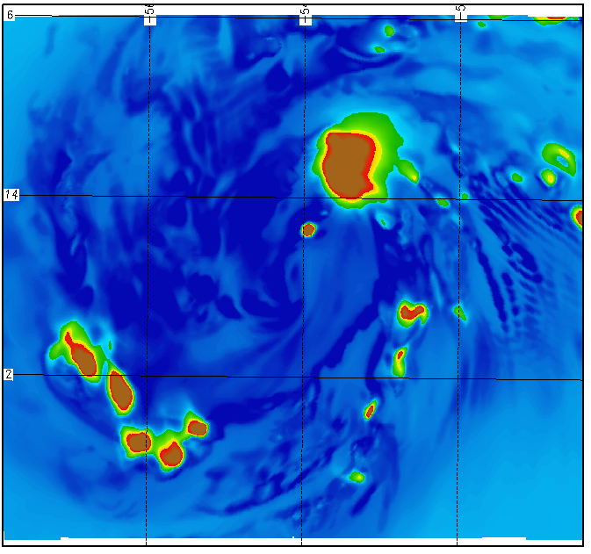
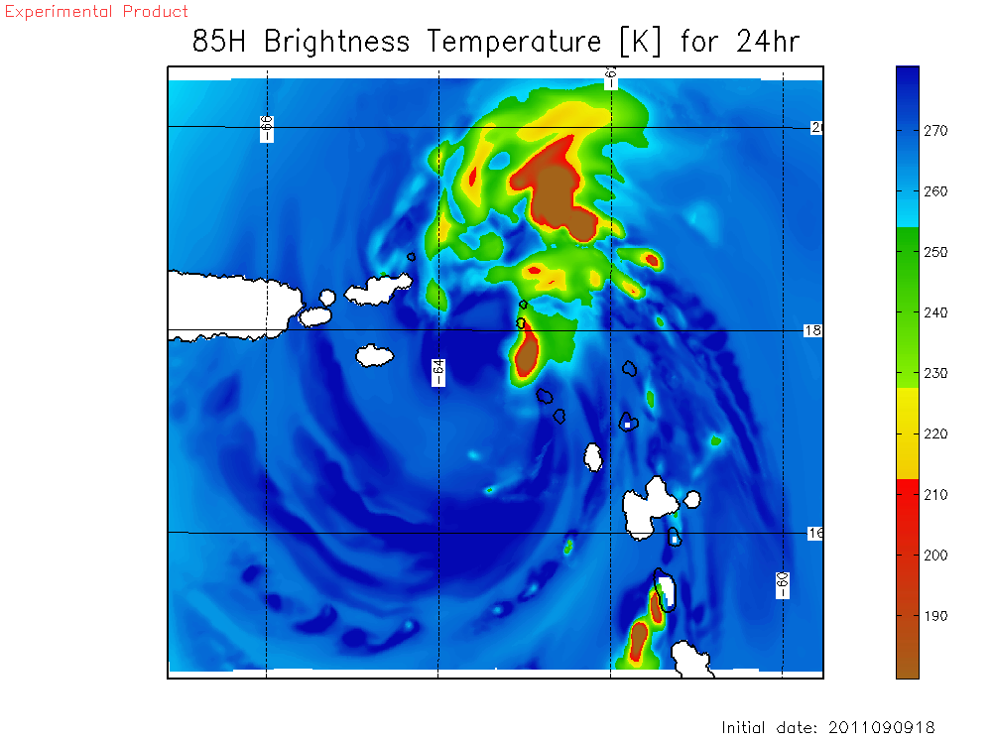
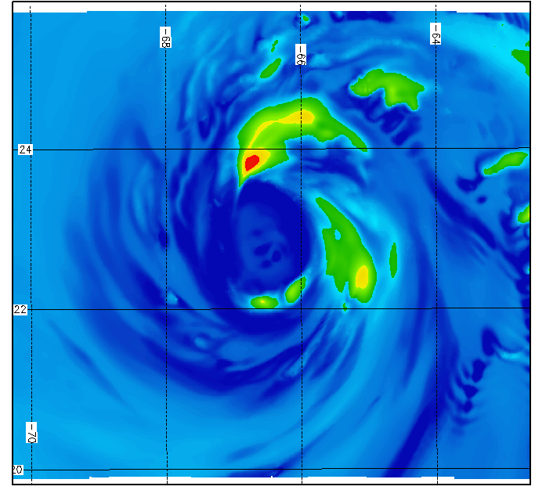
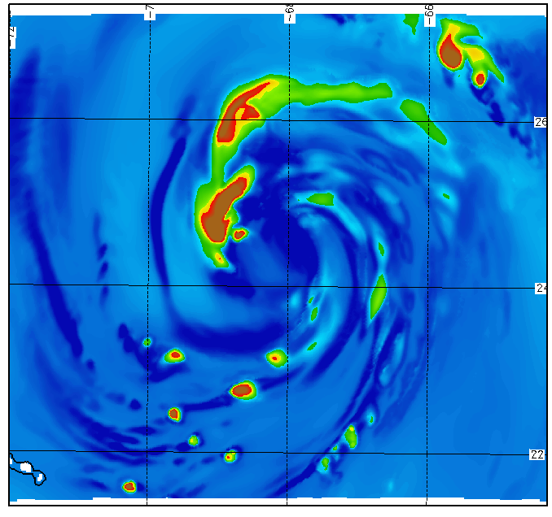
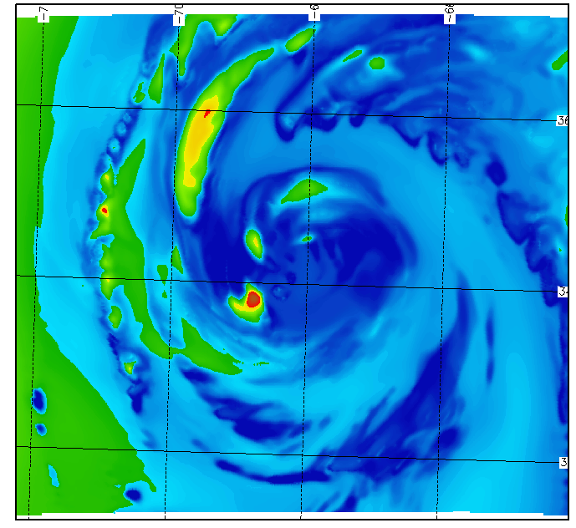
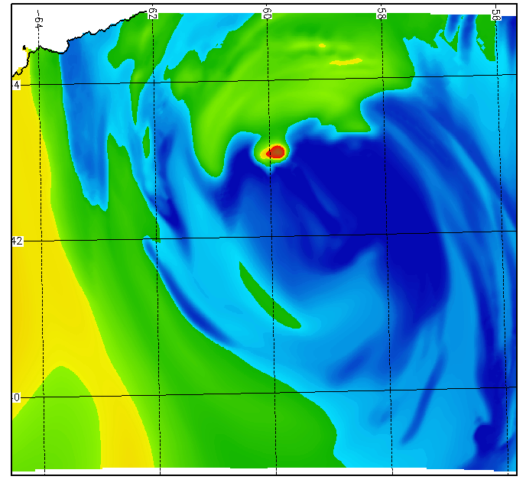
Experimental HWRF: 85 GHz 24-hr forecasts
1)
05/00 – 09/18
2)
09/18 – 11/00
3)
11/00 – 13/12
Valid: 2011090912
Valid: 2011091012
Valid: 2011091300
4)
13/12 – 15/06
5)
15/06 – 16/00
6)
16/00 – 17/00
Valid: 2011091400
Valid: 2011091512
Valid: 2011091606

Slide 11
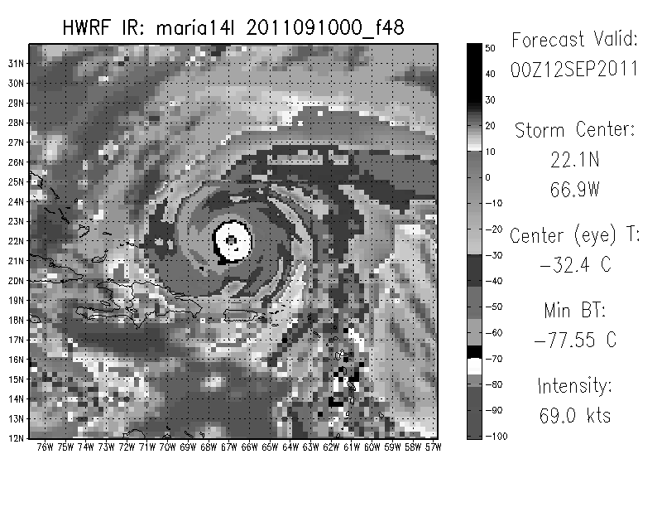
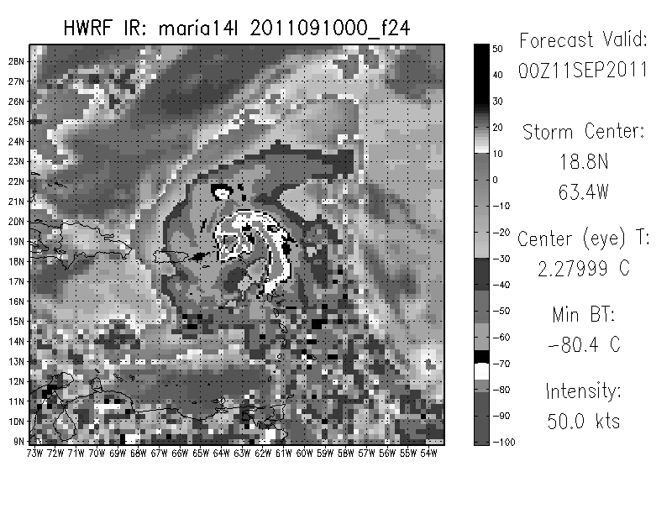
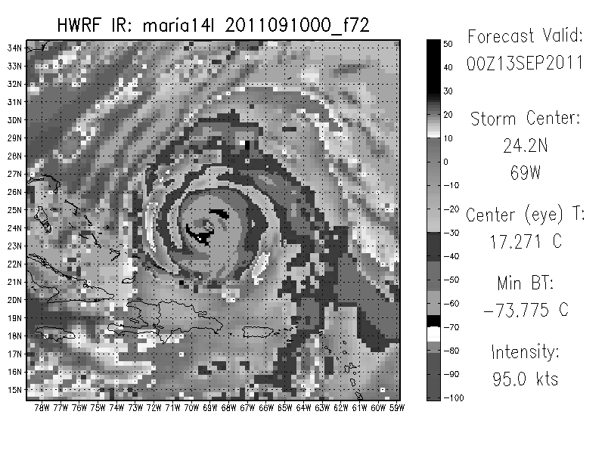
Summary and Implications
HWRF produced unrealistically symmetric structure by f24
This is likely directly related to the intensity of the modeled storm in forecasts
The forecast structure at 24 hours
may lead to poor
48+ hour forecasts

Slide 12
Next Steps
Objectively compare IR cloud patterns using Dvorak
Investigate possible disconnect between IR/37GHz and 89GHz for operational HWRF
Why did HWRF produce this structure?

Slide 13
Part II: Forecast Implications of HWRF ICs

Slide 14
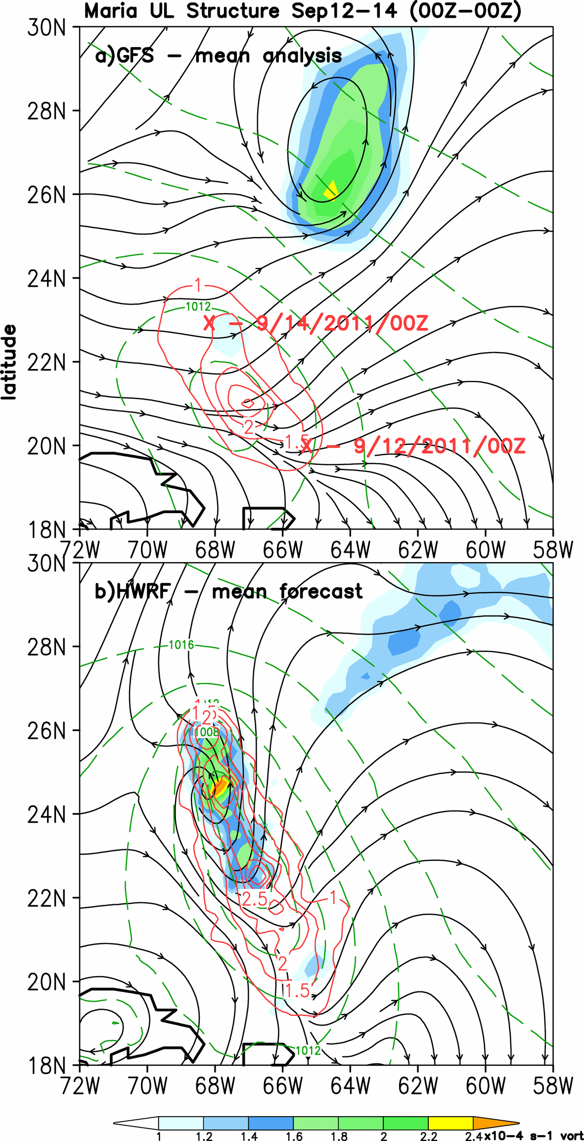
Maria – 12-14 Sep
The mean synoptic pattern consisted of an upper-level low north of Maria and associated westerly flow above Maria.
The GFS analyzed:
A persistent 200mb low,
200mb westerlies above Maria
The 12Sep00Z HWRF forecasted:
200mb upper low dissipation,
Southerlies extending north of Maria,
Maria to a hurricane with deep vortex
Why does HWRF overintensify Maria?
Left: 48h-mean 200mb vorticity (shaded), 200mb streamlines, 850mb vorticity (contoured, red), and MSLP (contoured, green), from the GFS analysis (top) and the 12Sep00Z (f00-f48) HWRF forecast.

Slide 15
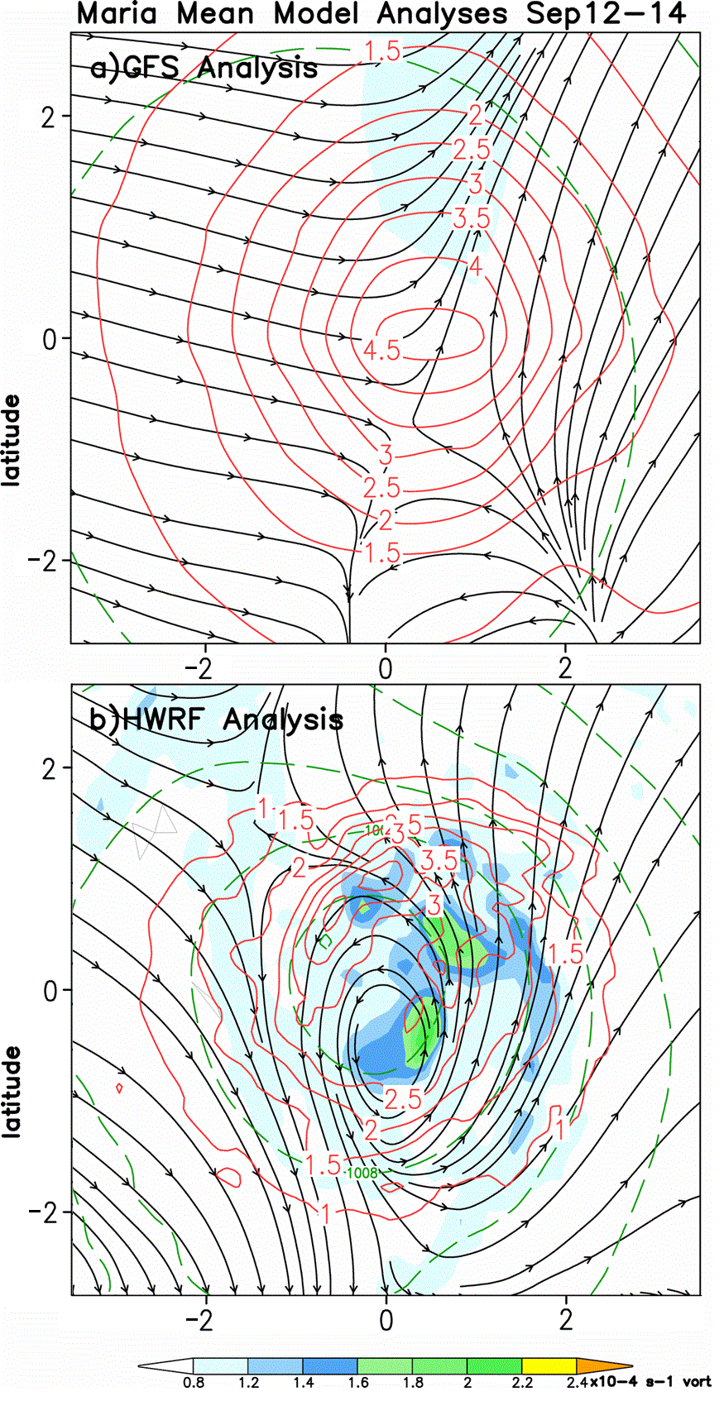
Mean analyses 12-14 Sep
Before looking into the forecast fields, here we analyze the mean vortex structure in the GFS (top) and HWRF (bottom) .
The mean GFS analysis depicts:
Confluent 200mb flow above the LLC,
No closed 200mb vortex
The mean HWRF analysis depicts:
Closed 200mb vortex directly above the LLC,
Well-defined outflow pattern north and east of Maria
LLC
LLC
Left: 200mb vorticity (shaded), 200mb streamlines, and 850mb vorticity (contoured), averaged over nine model analyses (00Z 12 Sep – 00Z 14 Sep 2011).

Slide 16
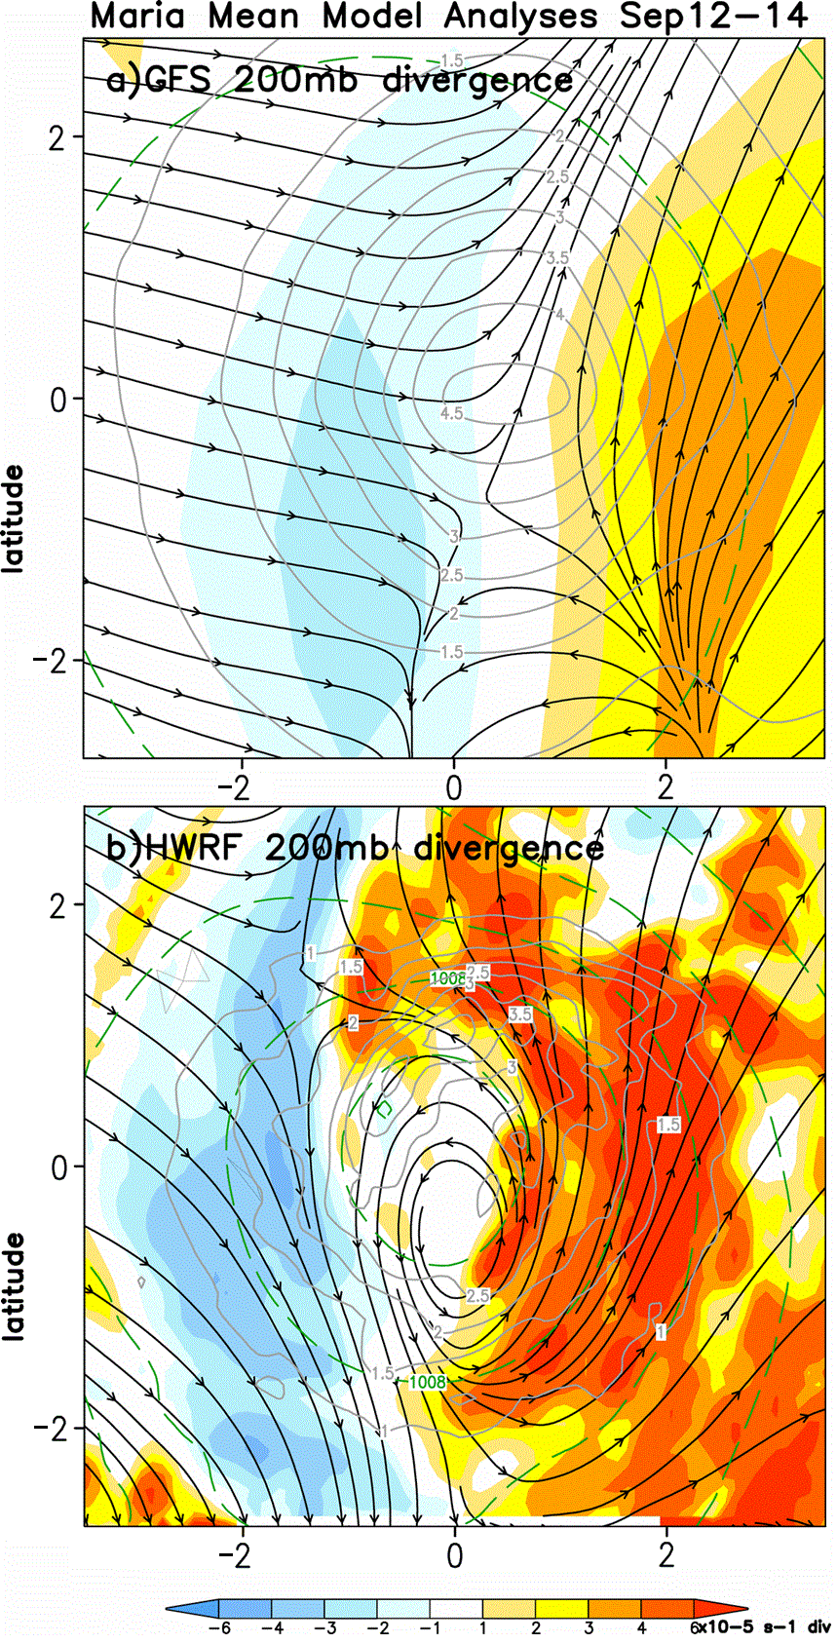
Mean analyses 12-14Sep
Consistent with satellite observations, the GFS shows upper-level divergence exclusively east of Maria.
HWRF analyses, on the other hand, depict upper-level divergence very near the center, in a pattern suggestive of spiral bands.
This may lead to convection early in the HWRF simulations that is too strong and too organized.
What impacts might this have on the forecasts?
Left: 200mb divergence (shaded), 200mb streamlines, and 850mb vorticity (contoured), averaged over nine model analyses (00Z 12 Sep – 00Z 14 Sep 2011).

Slide 17
Rainfall Forecast Verification
HWRF predicts precipitation northeast of Maria during the first 24-h of the forecast.
Satellite rainfall estimate shows almost all rain fell southeast of Maria.
This error is consistent with the initialized UL too-strong divergence.
How does the precip error impact the large-scale flow near Maria?
little precip observed NE of Maria
Left: 24-hour precipitation totals from the HWRF forecast beginning 00Z 12 Sep, and the verifying satellite precipitation analysis from the NRL-Blend product.

Slide 18
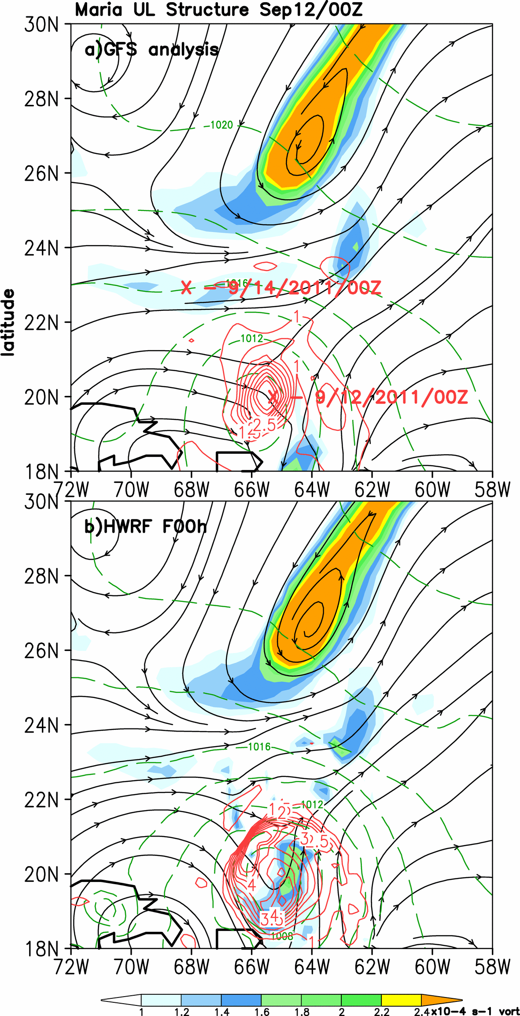
f00
We begin at the analysis time, when the
HWRF and GFS large-scale agree well, with the 200mb low analyzed similarly.
The primary differences are at the vortex scale: the 200mb vorticity is stronger in HWRF than GFS analysis, and the low-level vortex is larger.
Overall the synoptic analyses are similar, and the largest differences occur at the vortex-scale.
Left: 200mb vorticity (shaded), 200mb streamlines, 850mb vorticity (contoured, red), and MSLP (contoured, green), from the GFS analysis (top) and the 12Sep00Z HWRF forecast (f00).

Slide 19
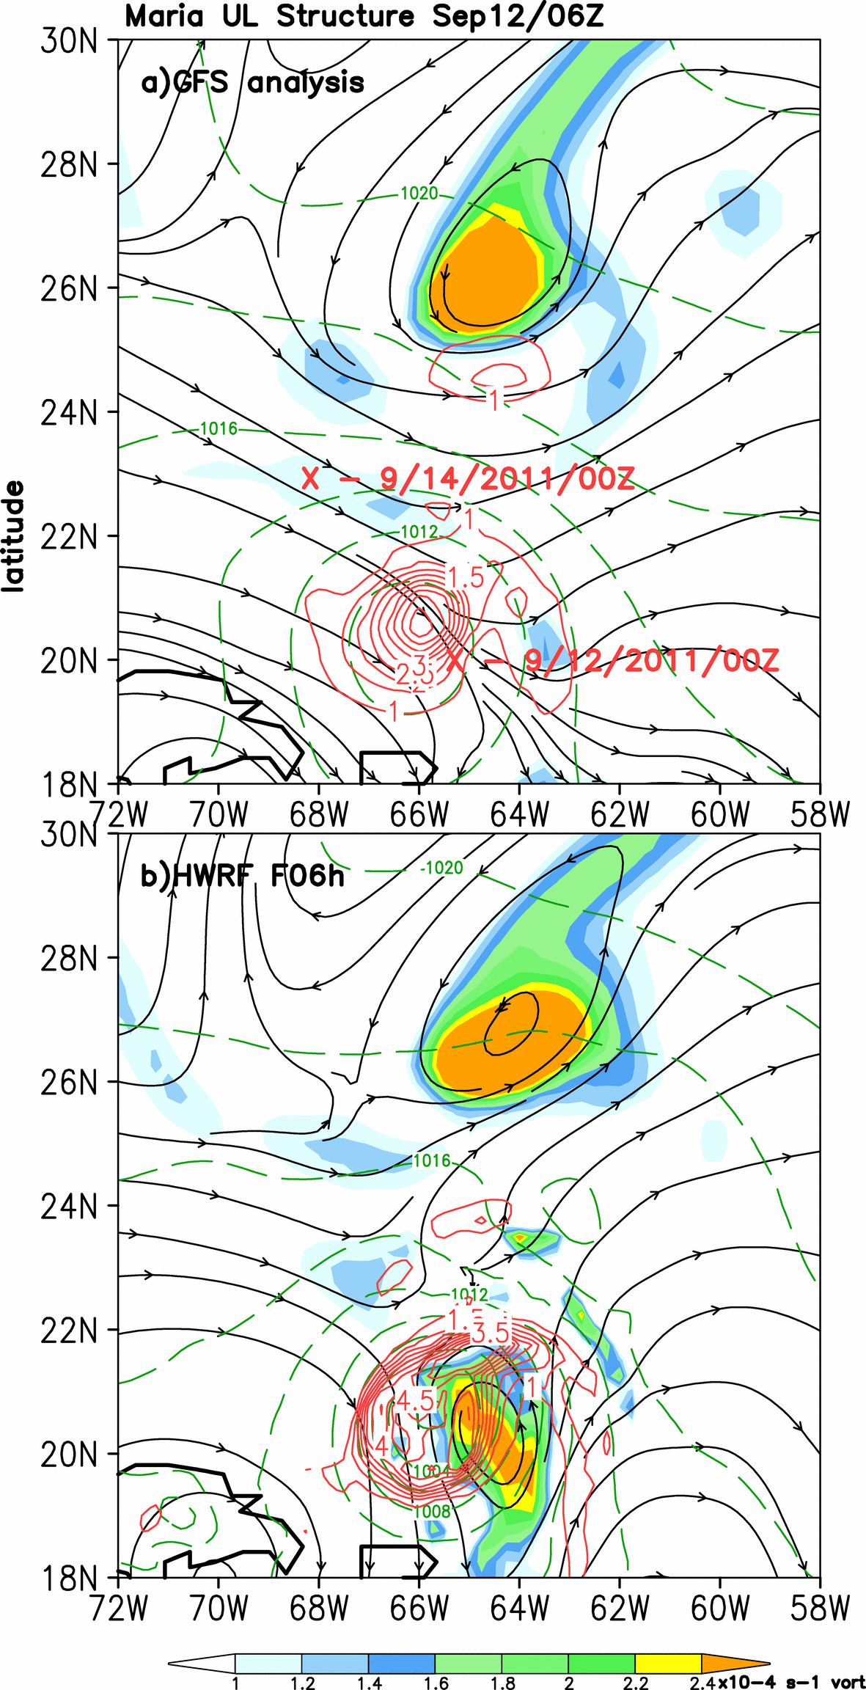
f06
Large scale remains similar, except near Maria.
GFS analysis continues to show westerly 200mb flow above Maria.
HWRF develops an intense closed 200mb circulation, associated with a band of deep convection, above 850mb vortex.
Left: 200mb vorticity (shaded), 200mb streamlines, 850mb vorticity (contoured, red), and MSLP (contoured, green), from the GFS analysis (top) and the 12Sep00Z HWRF forecast (f06).

Slide 20
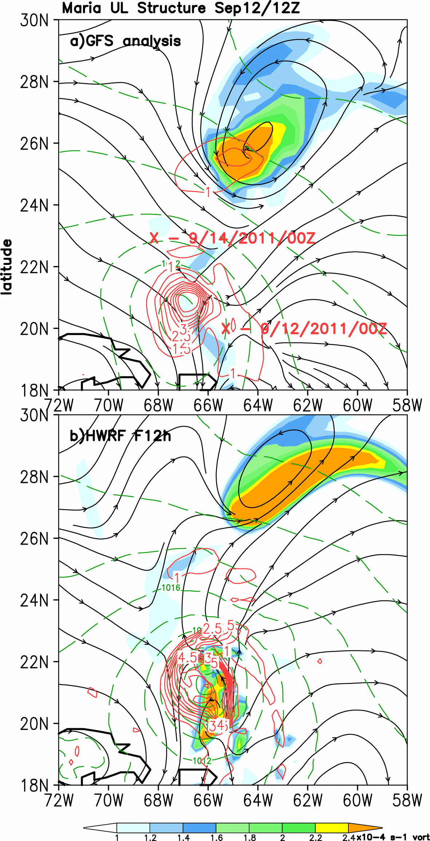
f12
HWRF large-scale begin to deform, with strong southerlies north of Maria likely associated with outflow from continuing intense convection.
In the HWRF, southerly outflow north of Maria is beginning to impinge on the west side of the HWRF upper low.
Left: 200mb vorticity (shaded), 200mb streamlines, 850mb vorticity (contoured, red), and MSLP (contoured, green), from the GFS analysis (top) and the 12Sep00Z HWRF forecast (f12).

Slide 21
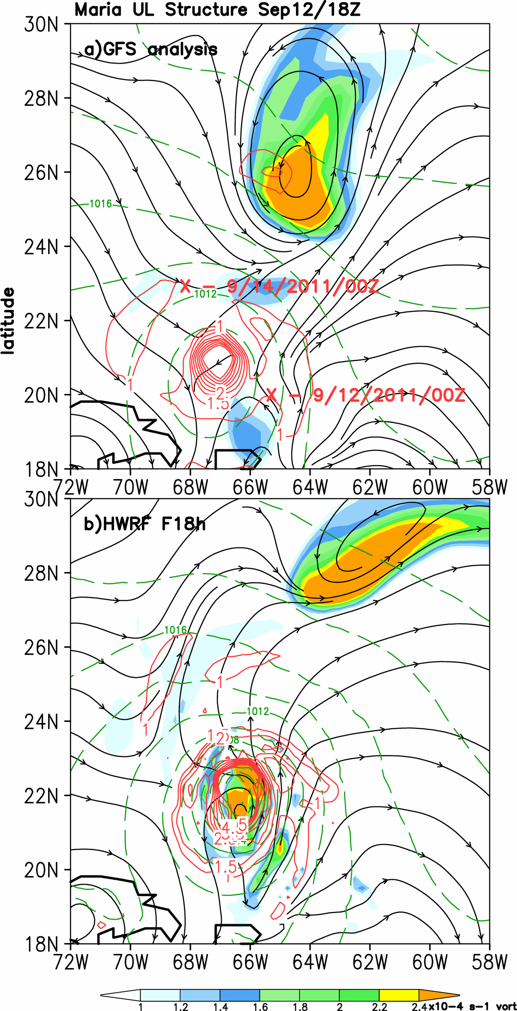
f18
GFS upper low remains stationary, but the HWRF upper low begins to eject as anticyclonic outflow intensifies north of Maria.
The intense 200mb vortex associated with simulated Maria is now directly above the low-level center. HWRF surface pressures are beginning to fall rapidly (5mb/6hrs).
Left: 200mb vorticity (shaded), 200mb streamlines, 850mb vorticity (contoured, red), and MSLP (contoured, green), from the GFS analysis (top) and the 12Sep00Z HWRF forecast (f18).

Slide 22
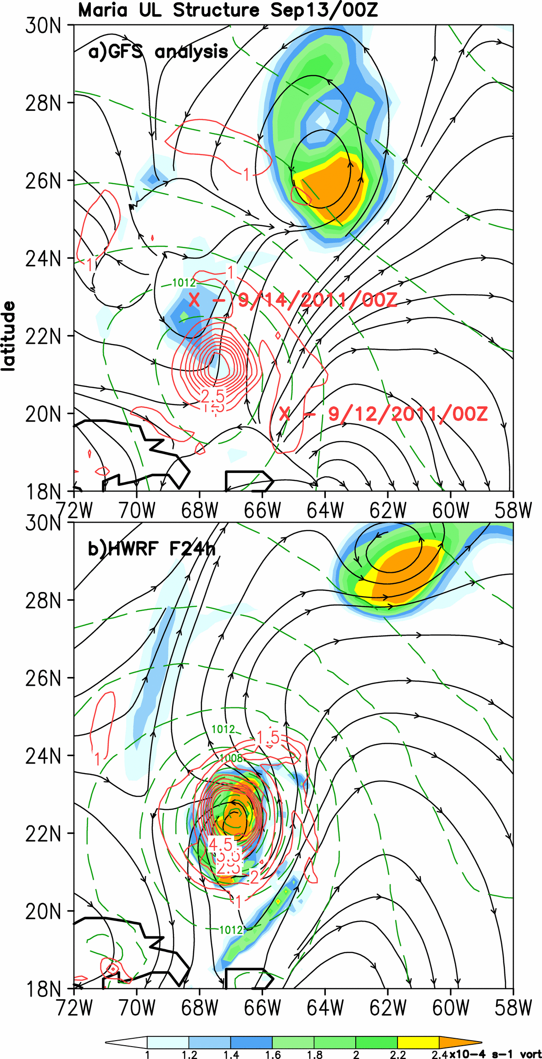
f24
GFS suggests that westerly 200mb flow continues to impact the western portion of Maria.
HWRF Maria begins RI, as upper low ejects and 200mb outflow pattern becomes better-defined.
Summary: HWRF quickly distorts the large-scale flow, as a large area of deep convection develops east of the center and wraps around the north side.
Left: 200mb vorticity (shaded), 200mb streamlines, 850mb vorticity (contoured, red), and MSLP (contoured, green), from the GFS analysis (top) and the 12Sep00Z HWRF forecast (f24).

Slide 23
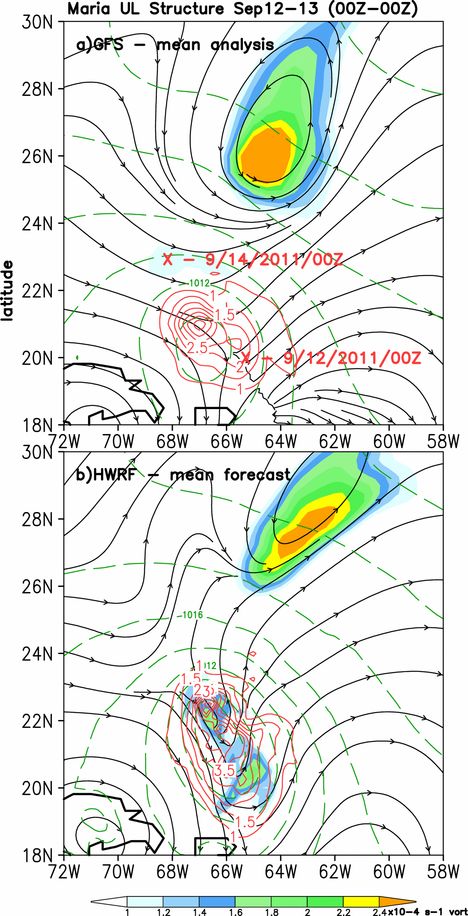
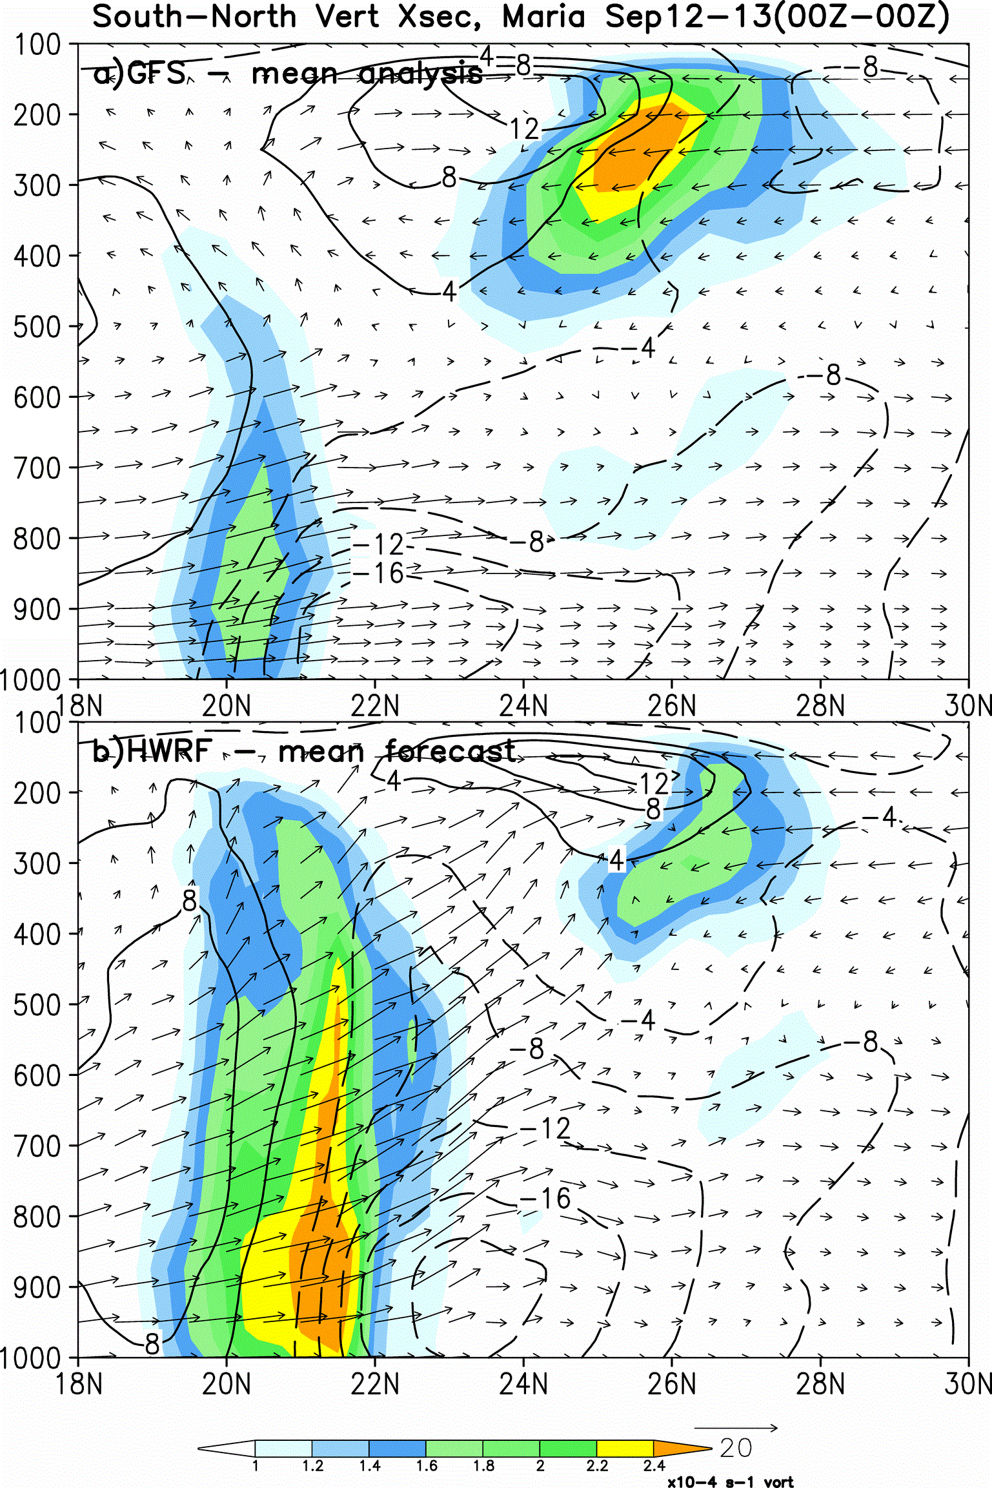
Large scale vertical structure
N
S
S N
N
S
Deep southerlies impinge on 200mb low.
Above: S-N vertical cross sections of 24h-mean absolute vorticity (shaded), in-plane wind vectors (w enhanced by factor of 10), and zonal wind (contoured, ms⁻¹), from the GFS analysis (top) and the 12Sep00Z HWRF forecast (f00-f24).

Slide 24
Summary and Implications
HWRF likely overintensified Maria because:
Initial HWRF vortex was too deep and too divergent in the upper-levels;
Convection was thus too deep/strong and overly “organized” early in the forecast period;
Extreme UL outflow played a role in ejecting the upper low, thus providing a favorable environment for intensification earlier than observed.
*It appears that intensity forecast errors can be traced back to the initialization*

Slide 25
Recommendations
Consider moving toward an exclusively real-data based initialization ASAP.
Re-evaluate the use of cycling, which may not be appropriate when forecast errors arise quickly.

