Slide 1
Revision of the PBL height definition in the HWRF operational PBL scheme
Young Kwon, Weiguo Wang and Jongil Han

Slide 2

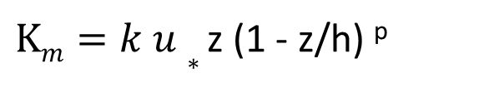
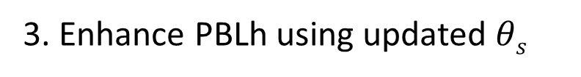
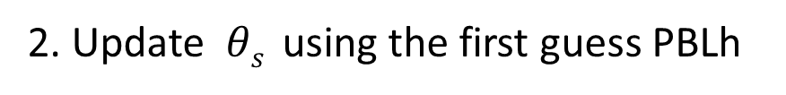
Procedures in the operational HWRF
PBL scheme
1. First guess PBL height
PBL$h=Ric \frac{θva |U\left(h\right)−U(0)|2}{g(θv\left(h\right)−θs)}$
2. Update $θs$ using the first guess PBLh
3. Enhance PBLh using updated $θs$
4. Momentum diffusivity (K_{m}) is calculated under PBLh
$Km=k u∗$ z (1 - z/h) ^{p}
5. Moist diffusivity (K_{t}) is calculated using Prandtl number

Slide 3
Richardson number:
A parameter indicating the degree of turbulent of a fluid
Bigger: fluid is more likely laminar
Smaller: fluid is more likely turbulent
Critical Richardson number: A number determining a fluid is turbulent or not. When the Richardson number of a fluid is smaller than this critical value, the fluid is regarded as turbulent.

Slide 4
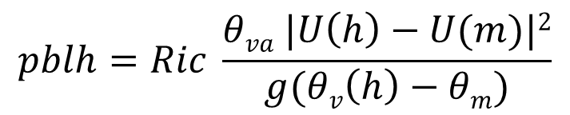
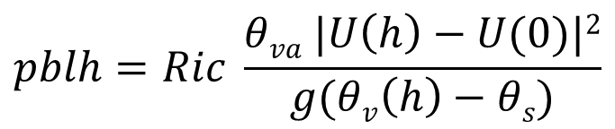
Revise PBL Height calculation in the operational HWRF (Wang)
Current scheme
Z
PBL top
R_{b} = f(h,surface)
Surface bulk Richardson number
Cal Ri #
$$pblh=Ric \frac{θva |U\left(h\right)−U(0)|2}{g(θv\left(h\right)−θs)}$$
0
Z
Revised method (Pleim,2006)
PBL top
R_{b} = f(h, mixed layer, first layer)
two-layer bulk Richardson number
ML top
$$pblh=Ric \frac{θva |U\left(h\right)−U(m)|2}{g(θv\left(h\right)−θm)}$$
Cal Ri #
0

Slide 5
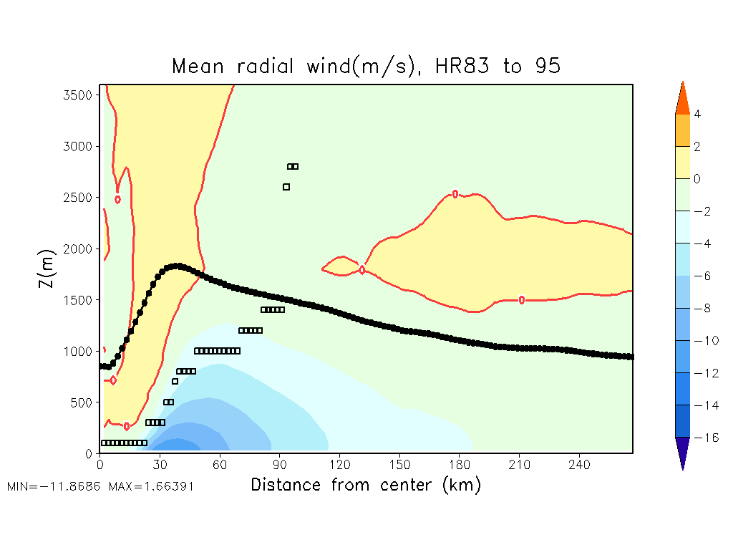
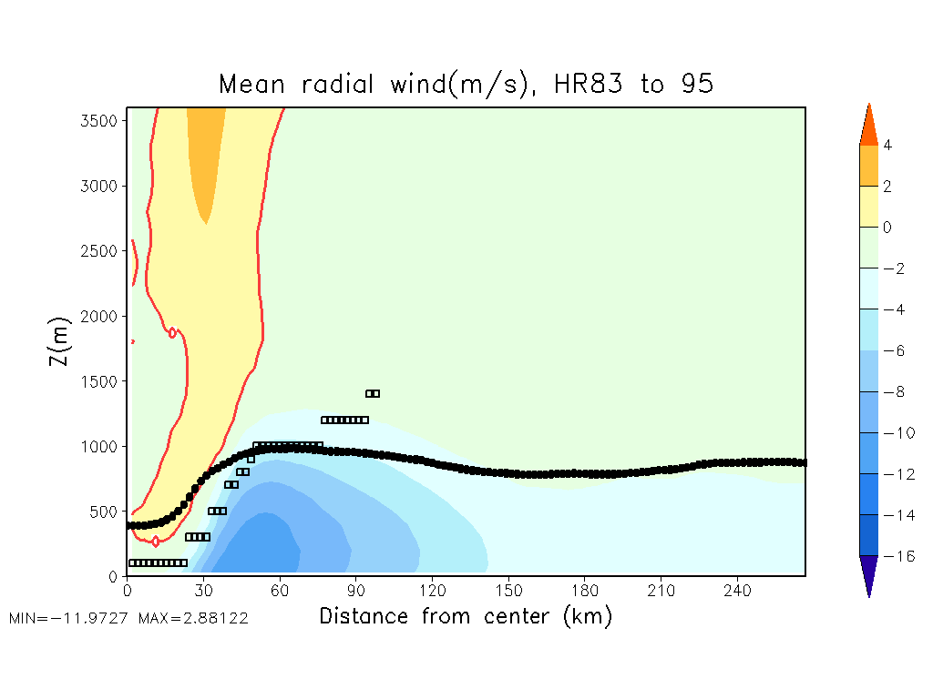
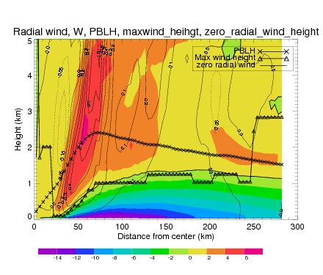
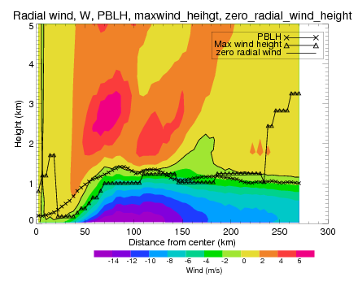
HWRF-OPERATION
NEW PBL-H&K
Ideal
PBLH
Max Wind H
Real
EARL
F24
PBL
Inflow H
Inflow H
PBL

Slide 6
However, it has been noted that GFS PBL scheme tends to underestimate the PBL height under certain conditions although the PBL height is overestimated in hurricane conditions.
As a result, the usage of two-layer Richardson number may cause more underestimation of PBL height despite of better representation of hurricane PBL.
Vickers and Mahrt (2004) suggested that it produced better results by using various critical Richardson number depended on surface Rossby number (R_{o}) with keeping surface bulk Richardson number.

Slide 7
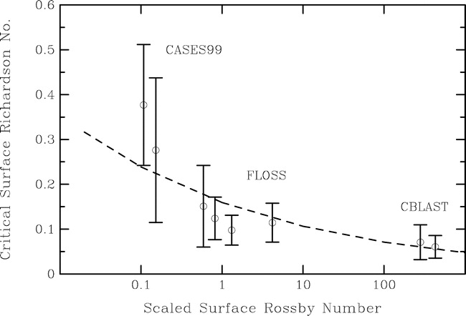
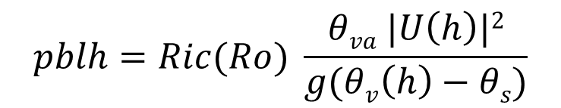
Using the surface bulk Ri fo PBL height but Ric is not a constant
$$pblh=Ric(Ro) \frac{θva |U\left(h\right)|2}{g(θv\left(h\right)−θs)}$$
Hurricane environment
Vickers and Mahrt (2004)

Slide 8

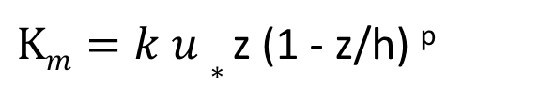

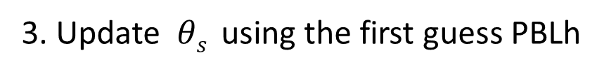
Procedures in the newly proposed HWRF
PBL scheme
1. Calculate critical Richardson number
2. First guess PBL height
PBL$h=Ric \frac{θva |U\left(h\right)−U(0)|2}{g(θv\left(h\right)−θs)}$
3. Update $θs$ using the first guess PBLh
4. Update PBLh using updated $θs$
5. Momentum diffusivity (K_{m}) is calculated under PBLh
$Km=k u∗$ z (1 - z/h) ^{p}
6. Moist diffusivity (K_{t}) is calculated using Prandtl number

Slide 9

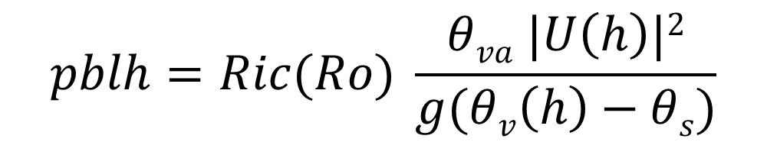
surface Rossby number (R_{o})
~ 30/(10⁻⁴ * 10⁻²) ~ 3.0E+7
R_{ic} = 0.16(10⁻⁷R_{o})^{−0.18}
0.16* 30^{-0.18} ~ 0.087
$$pblh=Ric(Ro) \frac{θva |U\left(h\right)|2}{g(θv\left(h\right)−θs)}$$

Slide 10
Plans
Test both two-layer Richardson number based method and variable critical Richardson number method in the current HWRF operational PBL scheme.
Conduct in idealized case and real case in order to examine the effect of the revised PBL scheme
The scheme which produces better results would be considered as 2013 upgrade

Slide 11
Pros/cons of the operational HWRF PBL scheme
1) Pros:
Known to be beneficial to hurricane track forecast
Appropriate to buoyancy dominant boundary layer
2) Cons:
Overestimate PBL height in shear dominant boundary layer
Too strong vertical mixing compare to observation

