Slide 1
Schematic of hurricane microphysics
Investigations into the HWRF Microphysics
Robert A. Black, Gopal, and Brad Ferrier
Figure 15 from Black and Hallett, 1999 JAS
Hurricane microphysics changes rapidly through the eyewall, from a narrow region dominated by graupel, to a stratiform area outside full of snow.

Slide 2
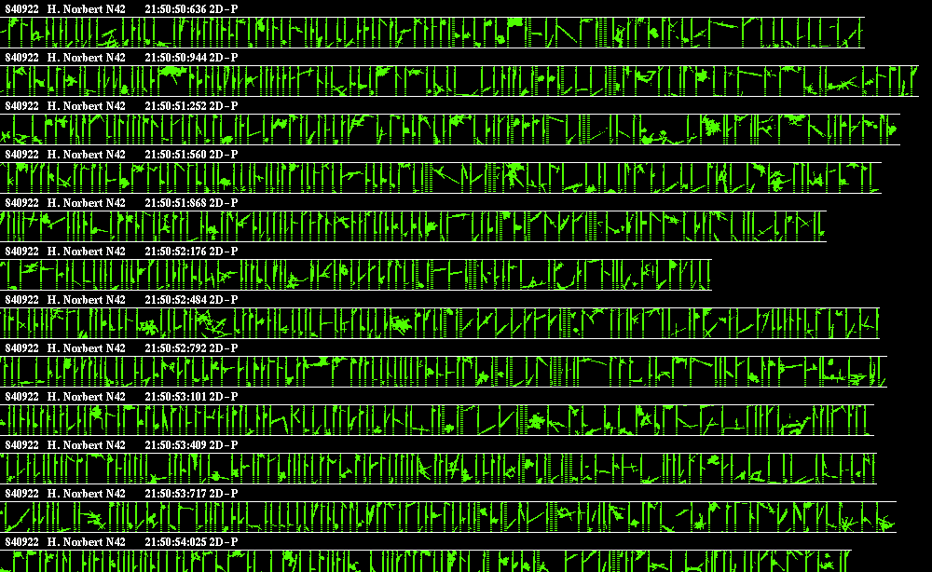
Just one example: Stratiform ice
This example is from H. Norbert (1984). The precipitation species traced by the Ferrier microphysics include rain, unrimed ice, lightly rimed snow, heavily rimed snow, graupel, and frozen drops.

Slide 3
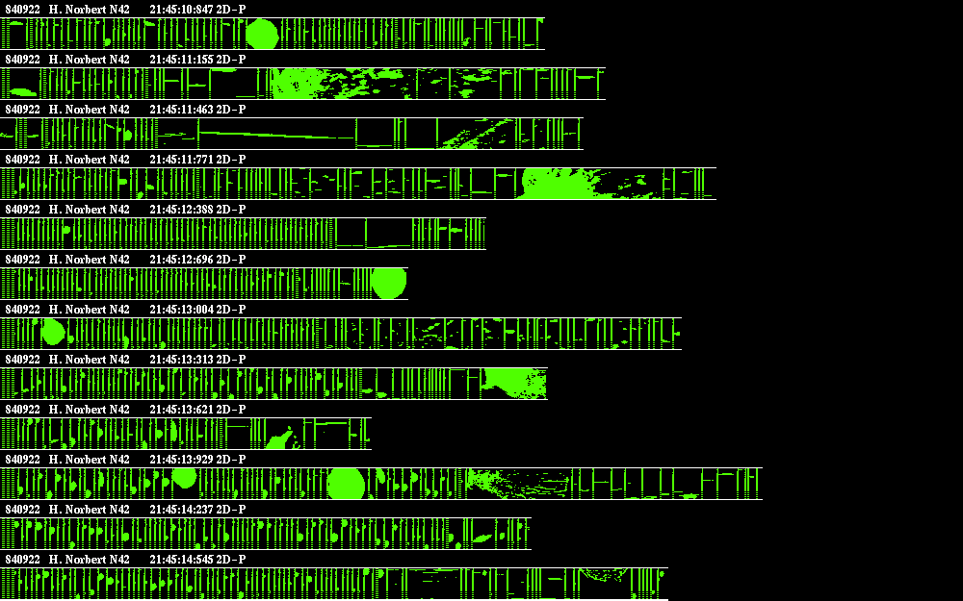
This is convective area ice
Data from H. Norbert (1984). Note the presence of 4-6 mm diameter graupel. Flight at 6.0 km MSL

Slide 4
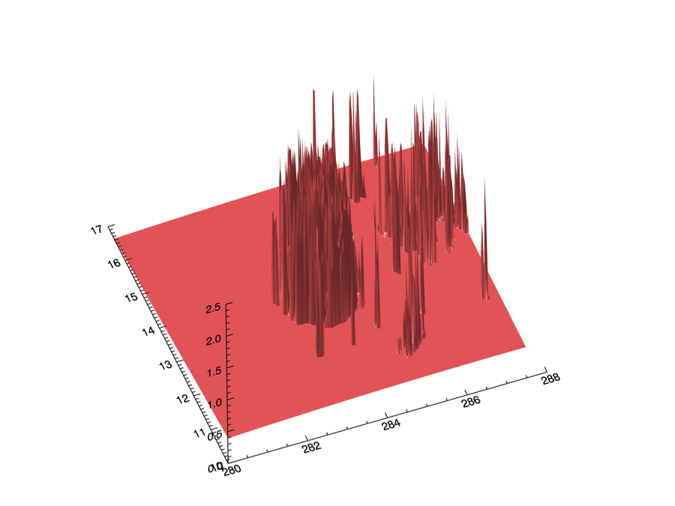
This is the 3-D distribution of “Heavy rimed ice”
Data are from 6 km elevation, as the ice obs. This package treats all necessary species for hurricanes, yet is simple to use. Our purpose is to improve the Ferrier microphysics based on observations in the operational HWRF. This is a work in progress.

Slide 5
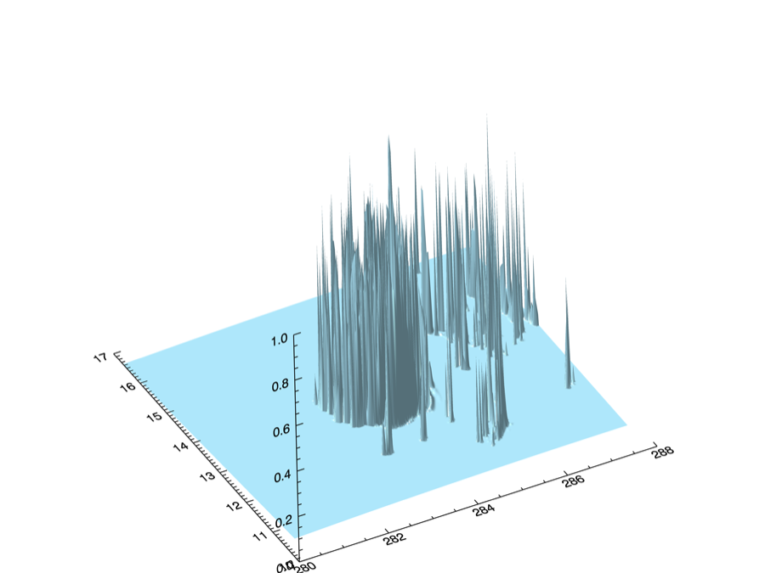
This is HWRF “Lightly rimed” snow
Model species descriptions bear little relation to the actual particles. This plot is also from the Idealized case at the 6 km level).

Slide 6
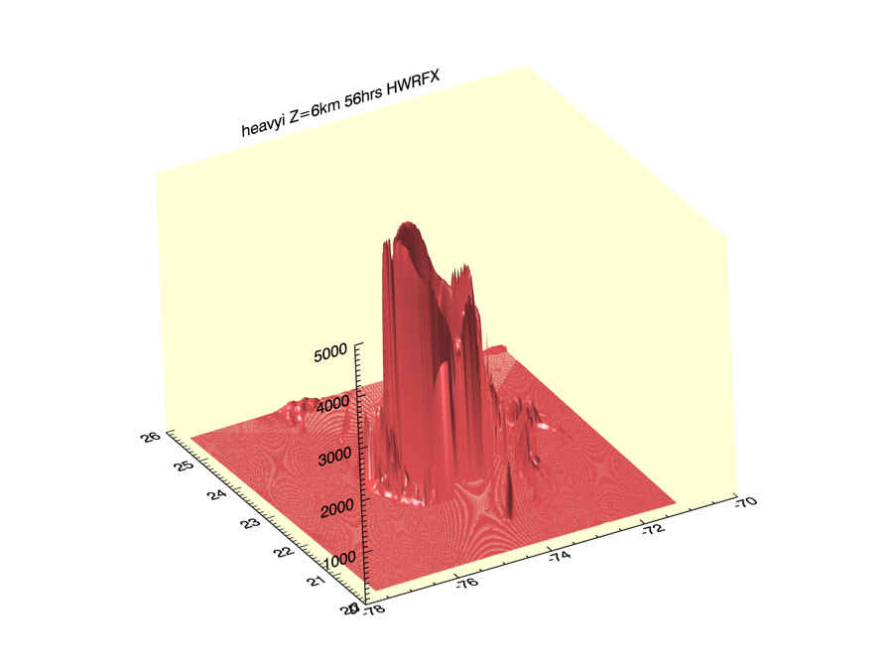
Heavy rimed ice from Irene (2011) simulation
The modeled storm makes little difference to this problem, so I’ll focus on the Idealized case, which is well-documented. Other “real” cases will follow in time.

Slide 7
HWRF rain distribution with Observations
Rain distribution is better than the ice, but not by that much. Notice the shape of the distributions – Real data is more peaked, and gaussian than HWRF. The HWRF rain distributions vary little with elevation

Slide 8
A first comparison between Model and reality
The 2D-P ice data had quality problems H. Tina (1992). The other ice plot comes from H. Norbert (1984) Those data are high quality. There are many more quality ice cases to be resurrected, and many other species tracked by the Ferrier microphysics scheme, so this is not the end of this story.

Slide 9
Where do I go from here?
Re-creating the (very old) ice data cases from the early 1980’s (a time consuming process, but less so than it was the first time).
Will be producing more runs of HWRF-Idealized case with other microphysics packages (already did this for one case)
Creating ice water content exponential fits for Stratiform and Convective areas (they are very different because of a very different particle mix).
Keeping with well-documented Idealized case (Real cases coming soon.)
Working with Dr. Brad Ferrier to alter the HWRF microphysics with this new information for testing.
Determining the impact of these changes on HWRF intensity forecasts.

