Slide 1
How vertical wind shear ended Jangmi’s (2008) intensification
Levi Thatcher, Zhaoxia Pu
Department of Atmospheric Sciences
University of Utah
HRD Modeling Group Meeting
19 May 2011

Slide 2
Motivation
Recall slow improvement in TC intensity forecasting. Only 1.1%/yr (Rogers et al. 2006).
Vertical wind shear appears to be one of major inhibitors of TC intensity.
Mechanisms of shear’s effects are little understood.

Slide 3
Various explanations of mechanism
Frank and Ritchie (2001) described shear as venting TCs of their upper-level warm core.
DeMaria (1996) saw shear as causing a tilt-induced midlevel warming, stabilization, and weakening.
We simulated Typhoon Jangmi (2008) to determine which mechanism actually occurred in this storm.

Slide 4
Simulation and Results
IC/BCs: FNL
Res: 3km
Cu: Explicit and Grell-Devenyi
PBL: Yonsei
Phys: Lin
Radiation: Dudhia and RRTM
Rapid deepening is well represented
Simulated MSLP of 926hPa is reached;
timing well aligns with that of best track

Slide 5
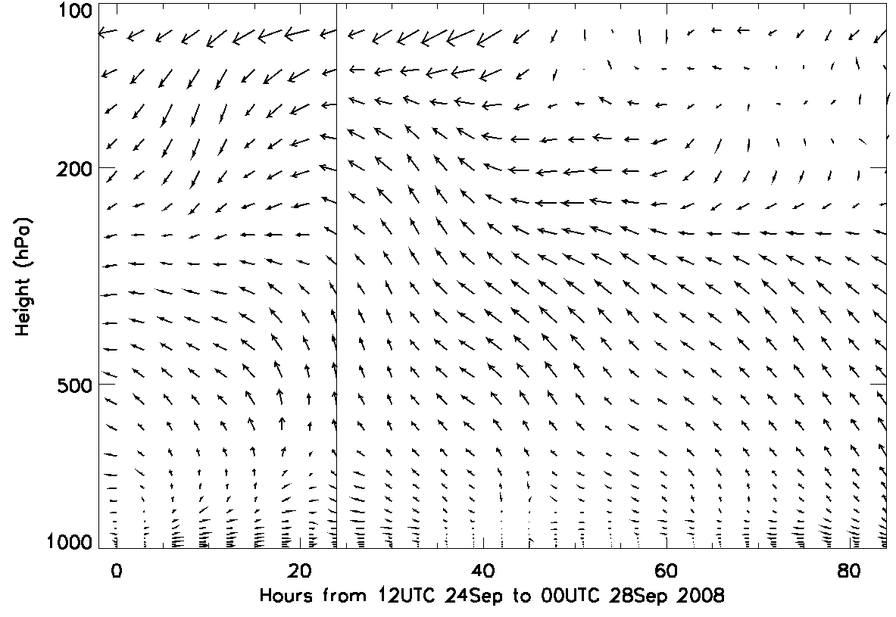
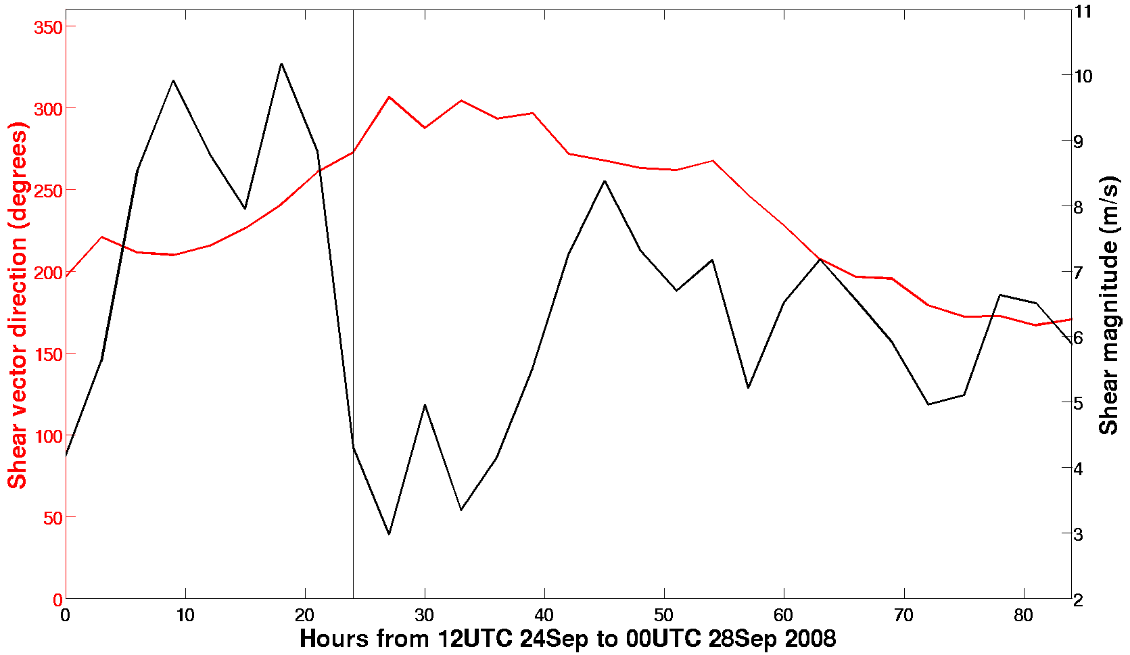
Wind profile and shear
Towards end of simulation, the upper-level winds decouple from lower-levels. This is seen in elevated shear values.
While not the highest shear value, we focus on time around 60hr, as that provides cleanest example of shear’s effects.

Slide 6
Shear episode’s effect on structure
21UTC
26th
00UTC
27th
Height
Height
03UTC
27th
06UTC
27th
South Distance from TC center (km) North
South Distance from TC center (km) North
Notice the descent and enhancement of south wall radial fluxing at 06 UTC

Slide 7
Resultant flux of 150-350hPa theta
21UTC
26th
00UTC
27th
03UTC
27th
06UTC
27th
Notice eruption of southward theta as northerly shear strengthens (at 06Z)

Slide 8
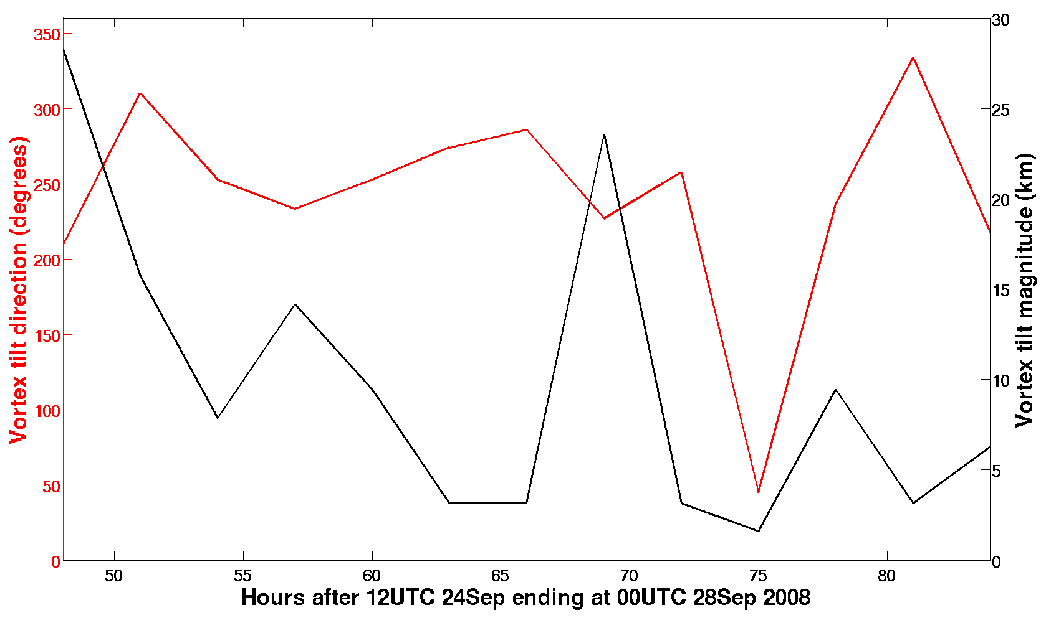
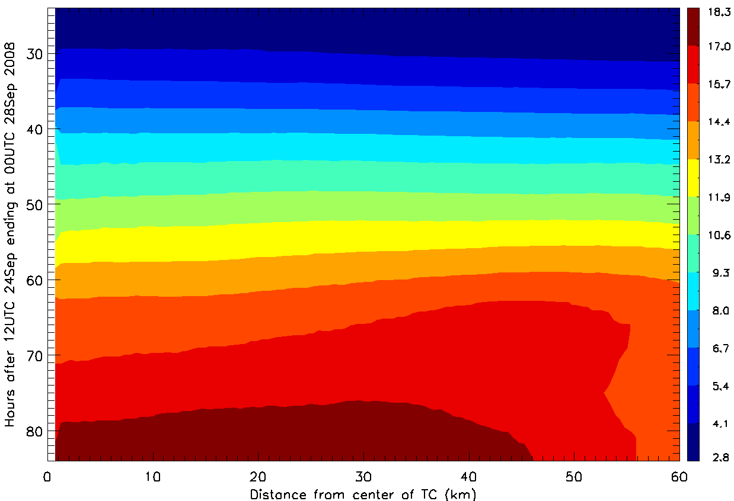
Warm core behavior and tilting
400-600hPa theta anomalies
Vortex tilt
150-350hPa theta anomalies
Shear-induced tilt temporarily occurs
Despite this, cooling appears to occur in mid-levels as TC weakens
Warm core maxima moves to eyewall (consistent)

Slide 9
Conclusions
Jangmi’s intensification appears to end due to shear-induced theta fluxing from the southern eyewall.
This fluxing moves theta max to the eyewall in the upper levels; remains in eye in midlevels.
Despite the tilt that results, warming does not subsequently occur; general cooling actually accompanies the end of intensification.

