Slide 1
2012 Tropical Cyclone Genesis Ensemble Forecast
Jiayi Peng*, Yuejian Zhu and Richard Wobus*
*IMSG at Environmental Modeling Center
Environmental Modeling Center /NCEP/NOAA, Camp Springs, MD 20746
Acknowledgements:
EMC Ensemble Team, EMC HWRF Team
Geophysical Fluid Dynamics Laboratory (Tim Marchok)
Hurricane Forecast Improvement Project (HFIP)

Slide 2
Atlantic, AL04-16 (08-09/2010); AL01-19(06-12/2011)
AEMN---GEFS T190 (operational run)
PARA---GEFS T254 (parallel run)
AVNO----GFS T574 (operational run)
Track error(NM)
#CASES 375 343 307 276 246 197 152 110 63 44
Forecast hours

Slide 3
Hypothesis
NCEP Global Ensemble Forecast System has the good capability for Tropical Cyclone (TC) track forecast. If TC genesis is mainly determined by large-scale environmental flow, we may get some clues from Global Ensemble Forecasts for the probability prediction of TC genesis.
The local meso-scale convection is also important to TC genesis. So, our TC genesis criteria will include the characteristics of model vortex and its environmental flow.

Slide 4
Models | Resolution | Members | Daily Frequency | Forecast Length
NCEP ensemble | GFS T254L42 -55km (02/14/2012) | 20+1 | 00, 06, 12, 18 UTC | 16 days (384hrs)
CMC ensemble | GEM L40-66km (08/17/2011) | 20+1 | 00, 12 UTC | 16 days (384hrs)
ECMWF ensemble | IFS T639/319L62 -30/60km | 50+1 | 00, 12 UTC | 15 days (360hrs)
FNMOC ensemble | NOGAPS T159L42-80km (09/14/2011) | 20 | 00, 12 UTC | 16 days (384hrs)
NCEP deterministic | GFS T574L64 -27km | 1 | 00, 16, 12, 18 UTC | 192 /384hrs
CMC deterministic | GEM(0.45x0.3) L58-33km | 1 | 00, 12 UTC | 180/240 hrs (12/00z)
ECMWF deterministic | IFS T1279L91 -16km | 1 | 00, 12 UTC | 240 hrs
FNMOC deterministic | NOGAPST239 L30-55km | 1 | 00, 12 UTC | 168 hrs
Our goal: Improve tropical-cyclone genesis prediction by using NCEP, CMC , FNMOC and ECMWF global ensemble forecasts !

Slide 5
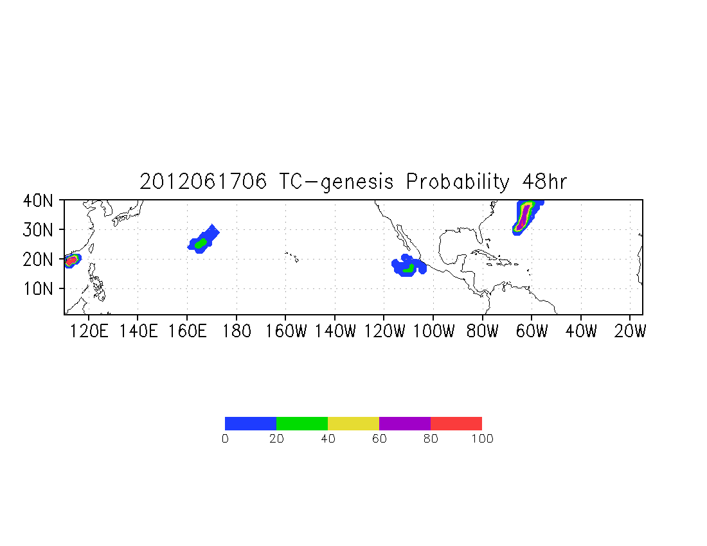
TC Genesis Target Area: 0-40N, 110E-350E Forecast Time Window: 48-hour genesis
NCEP GEFS TC Genesis Probability Forecast Within 48 hours
HC03
HC05
WP92
EP95

Slide 6
TC Genesis Tracker Code
Based on Tim Marchok’s latest version for genesis track, we make the following changes:
Calculation for 300-500hPa temperature anomaly;
Calculation for 200-850hPa zonal wind shear;
Calculation for 500hPa mean relative humidity;
The AL90-99, EP90-99 and WP90-99 are those invest storms named by NHC and JTWC. In case of NHC and JTWC miss potential TC genesis, we create some interested storms based on GFS-T574 operational, Canadian, NOGAPS and ECMWF Deterministic Forecasts, named as HC01, HC02, etc.

Slide 7
Algorithms for TC genesis probabilistic forecast
How to define global model TC genesis?
The prediction vortices in Global Ensemble Forecast Systems are very weak. (25kts ?)
Step No.1:
We track every vortex by checking:
850/700hPa/surface relative vorticity (max)
850/700hPa geopotential height (min)
Sea level pressure (min)
850/700hPa/surface wind speed (min)
SLP gradient (0.0015mb/km), Wind speed at 850hPa (≥ 1.5m/s)
Closed SLP contour checked
Step No.2:
We filter those vortices based on the following criteria:
Surface maximum wind speed ≥ 10kts
850hPa maximum voticity ≥ 10**(-4) 1/s
300-500hPa temperature anomaly ≥ 0.5c
200-850hPa zonal wind shear < 0 m/s
500hPa mean relative humidity > 60%

Slide 8
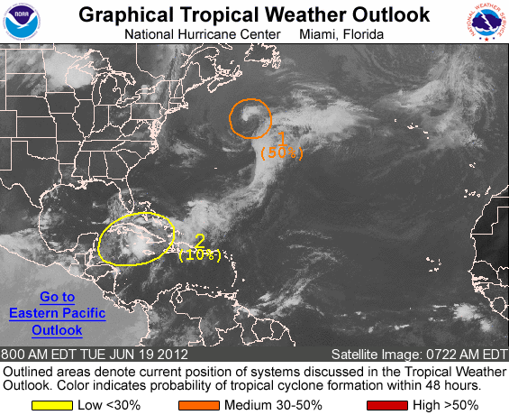
NHC Hurricane Genesis Probability Forecasts
06/19/2012 12Z, will form AL03 (Chris)

Slide 9
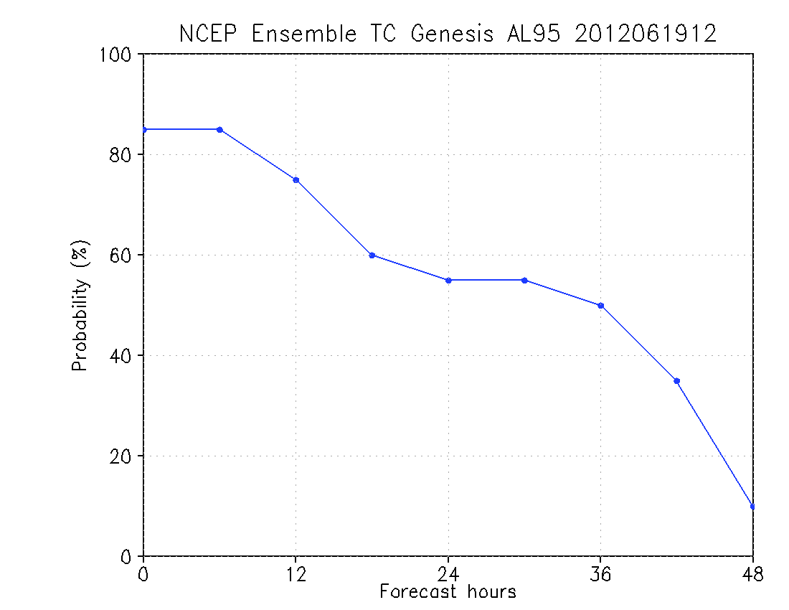
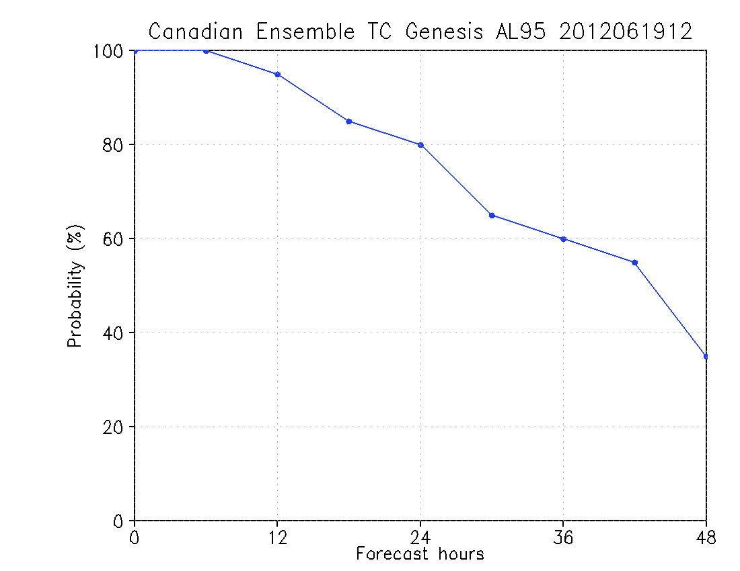
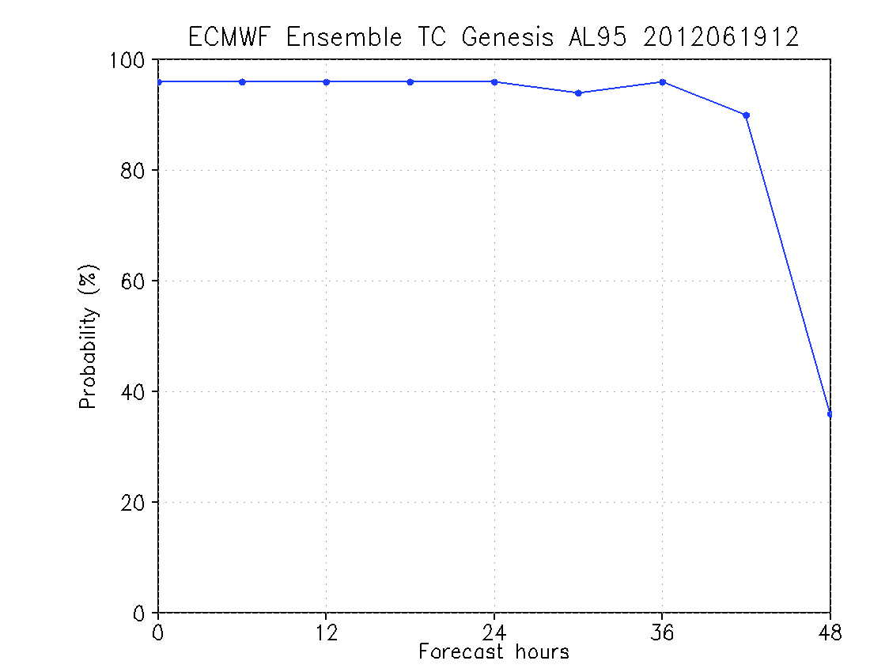
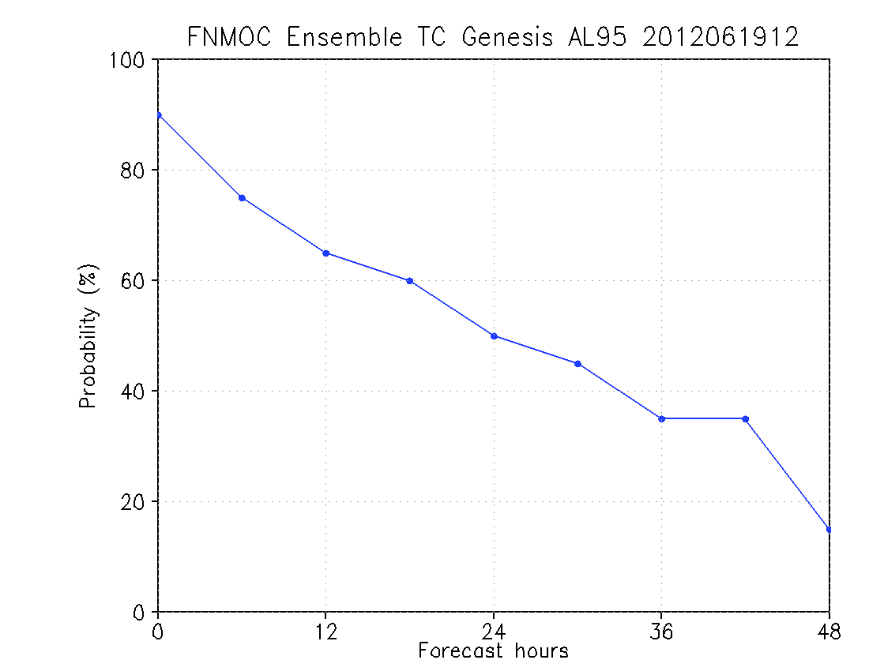
TC genesis probability forecasts from NCEP GEFS, Canadian, Navy and ECMWF ensemble forecast systems

Slide 10
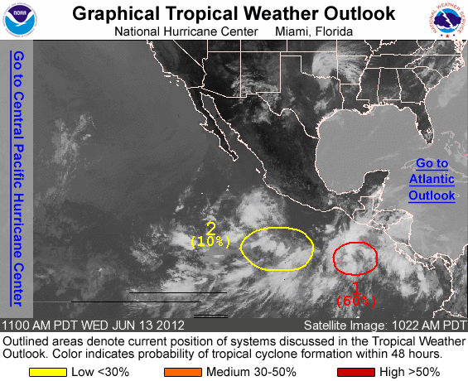
NHC Hurricane Genesis Probability Forecasts
06/13/2012 15Z, will form EP03 (Carlotta)

Slide 11
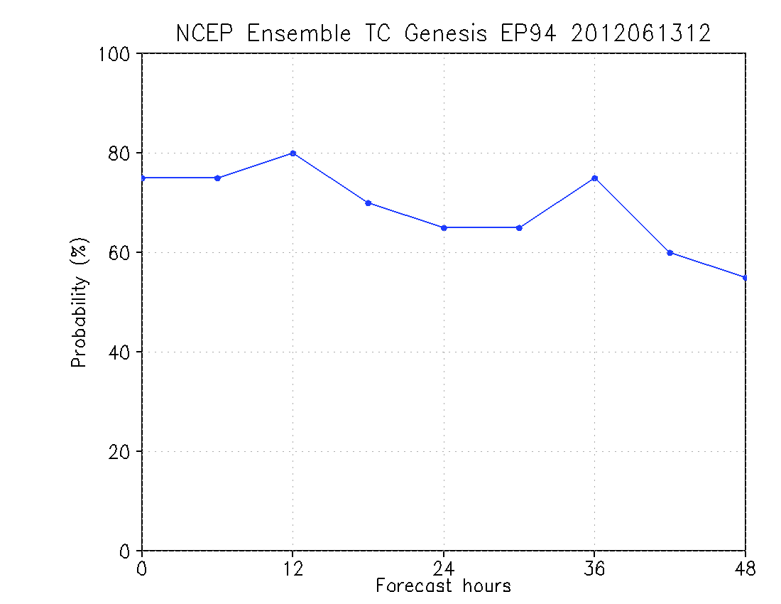
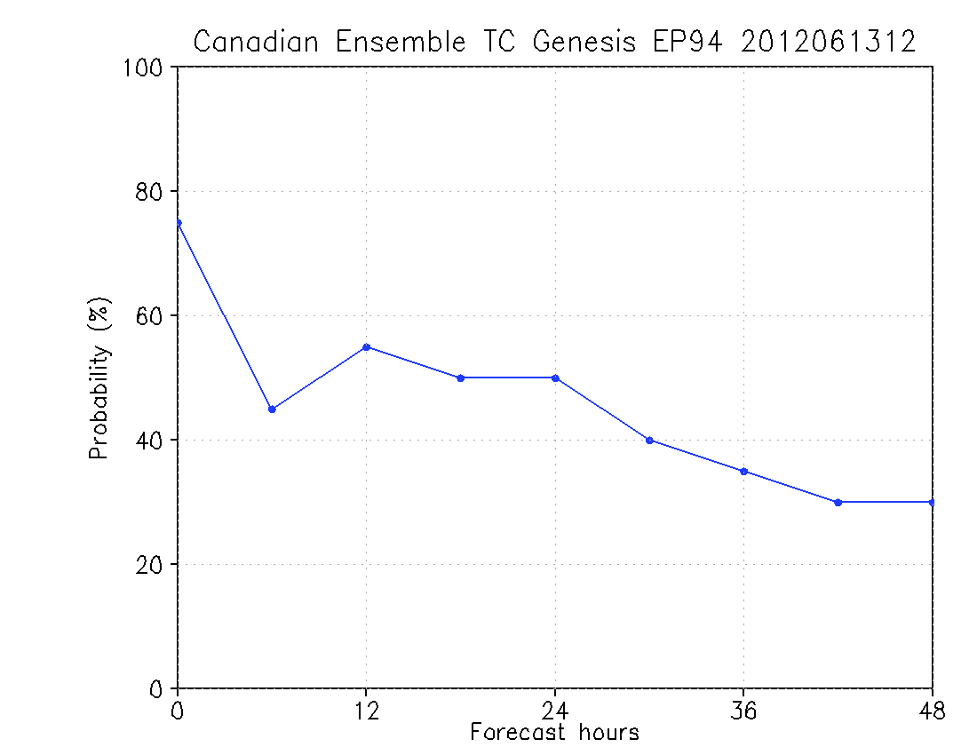
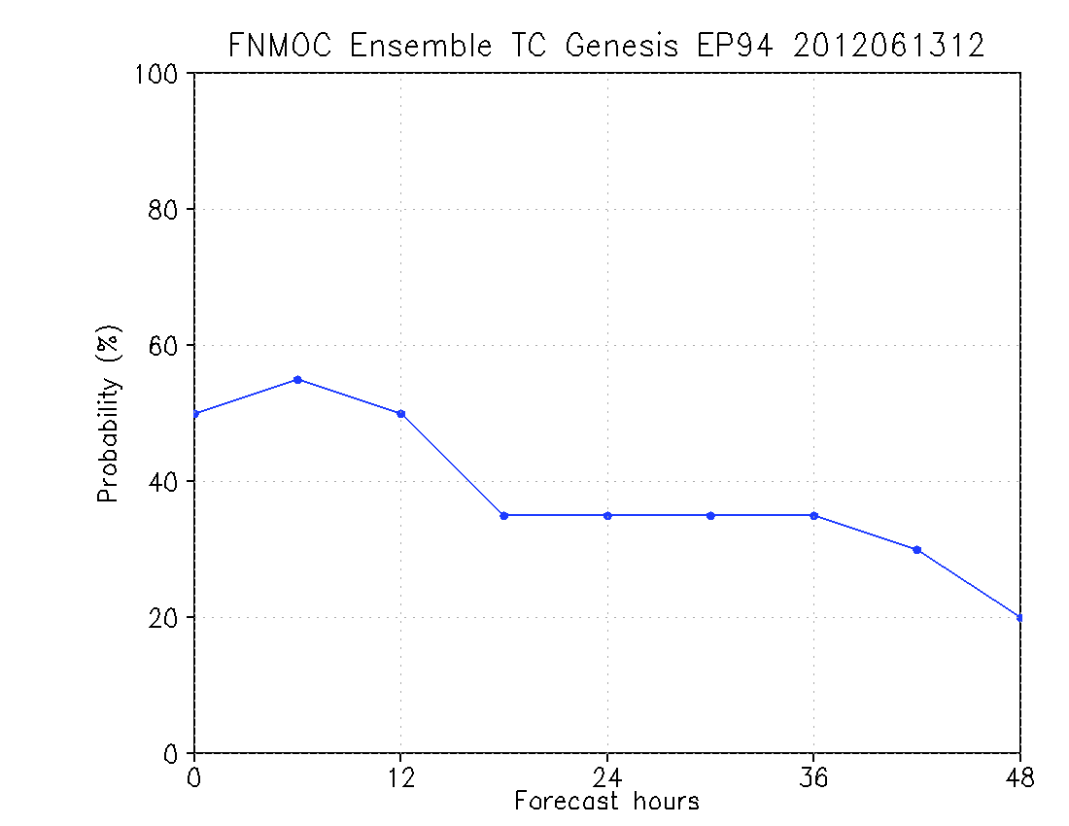
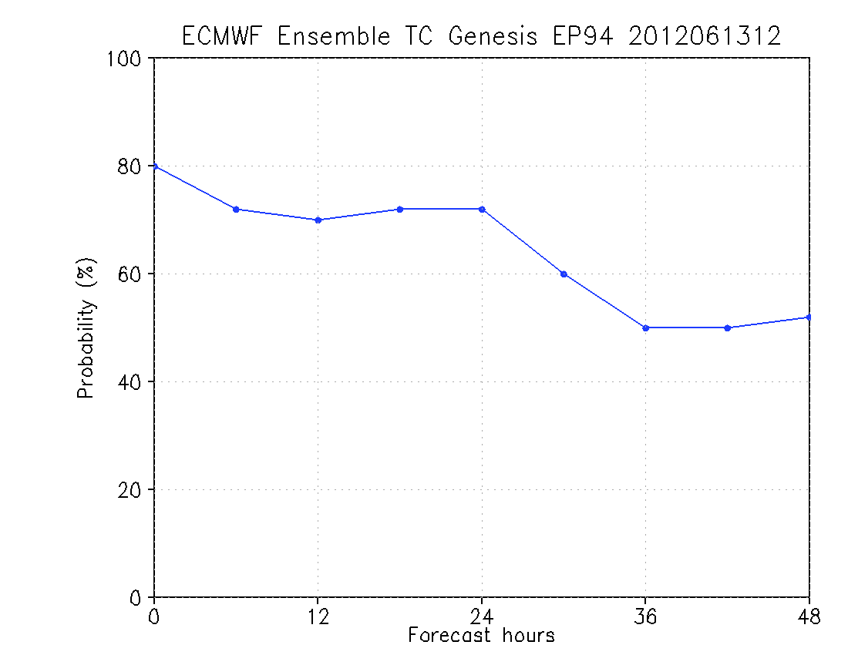
TC genesis probability forecasts from NCEP GEFS, Canadian, Navy and ECMWF ensemble forecast systems

Slide 12
Future plans and ongoing works:
TC genesis verifications for NCEP GEFS, Canadian, Navy and
ECMWF ensemble forecasts.
Investigate more reliable TC genesis criteria for
each ensemble forecast system.
Develop multiple model ensemble TC genesis products.
Develop TC genesis products for those vortices forming
in the middle of the forecast time window.
Please visit:
http://www.emc.ncep.noaa.gov/gmb/jpeng/TC_ens_V1.html
for 2012 real time TC track and genesis probabilistic forecasts.

Slide 13
2011 Atlantic TC Genesis Forecast Reliability Diagram (NHC forecast)
Verifying (%) or Distribution (%)
Forecast (%) N=482
Red line: perfect reliability
Blue line: the relationship between the forecast and verifying genesis probability
Green line: distribution of the forecast genesis probability

Slide 14
2011 Atlantic TC Genesis Forecast Reliability Diagram (NHC, with TC)
Verifying (%) or Distribution (%)
Forecast (%) N=172
Red line: perfect reliability
Blue line: the relationship between the forecast and verifying genesis probability
Green line: distribution of the forecast genesis probability

Slide 15
Invest storm to TC genesis (06~11/2011)
MM | 06 | 07 | 07 | 07 | 07 | 08 | 08 | 08 | 08 | 08 | 08 | 08 | 08 | 09 | 09 | 09 | 09 | 10 | 11
IN | 95 | 98 | 99 | 90 | 91 | 95 | 94 | 93 | 97 | 90 | 91 | 92 | 93 | 95 | 96 | 99 | 90 | 96 | 98
AL | 01 | 02 | 03 | 04 | 05 | 06 | 07 | 08 | 09 | 10 | 11 | 12 | 13 | 14 | 15 | 16 | 17 | 18 | 19
MM----month IN----invest storm number AL----Atlantic storm number
The other invest storms:
June: 93L, 94L July:96L, 97L
August: 92L, 98L, 99L September:94L, 97L, 98L, 91L
October: 92L, 93L, 94L, 95L, 97L
November: 99L, 90L
June~November 2011, invest storms: 37 19 TC genesis (51%)

