Slide 1
Preliminary Notes on Adrian
D. Zelinsky & W. Hogsett
NHC

Slide 2
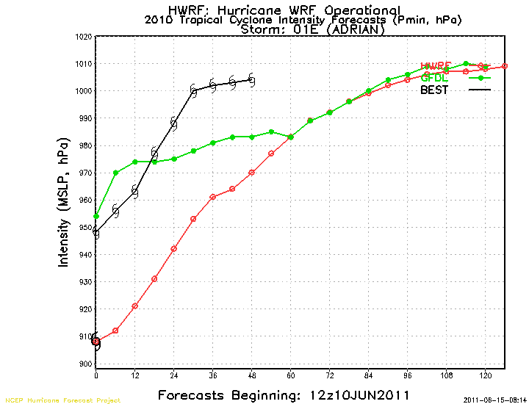
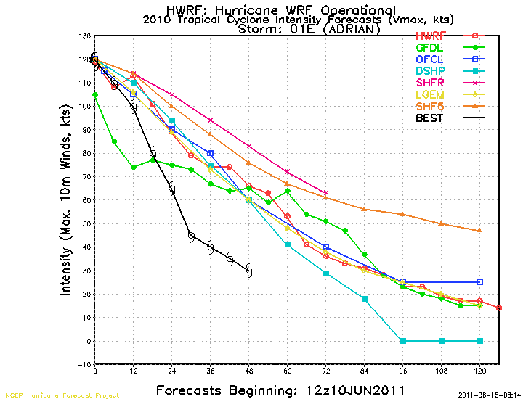
Adrian: Peak Intensity

Slide 3
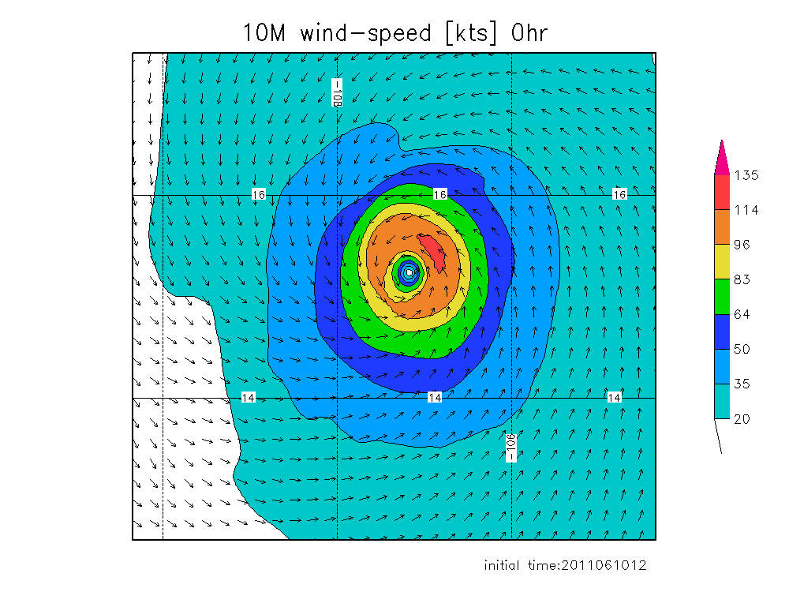
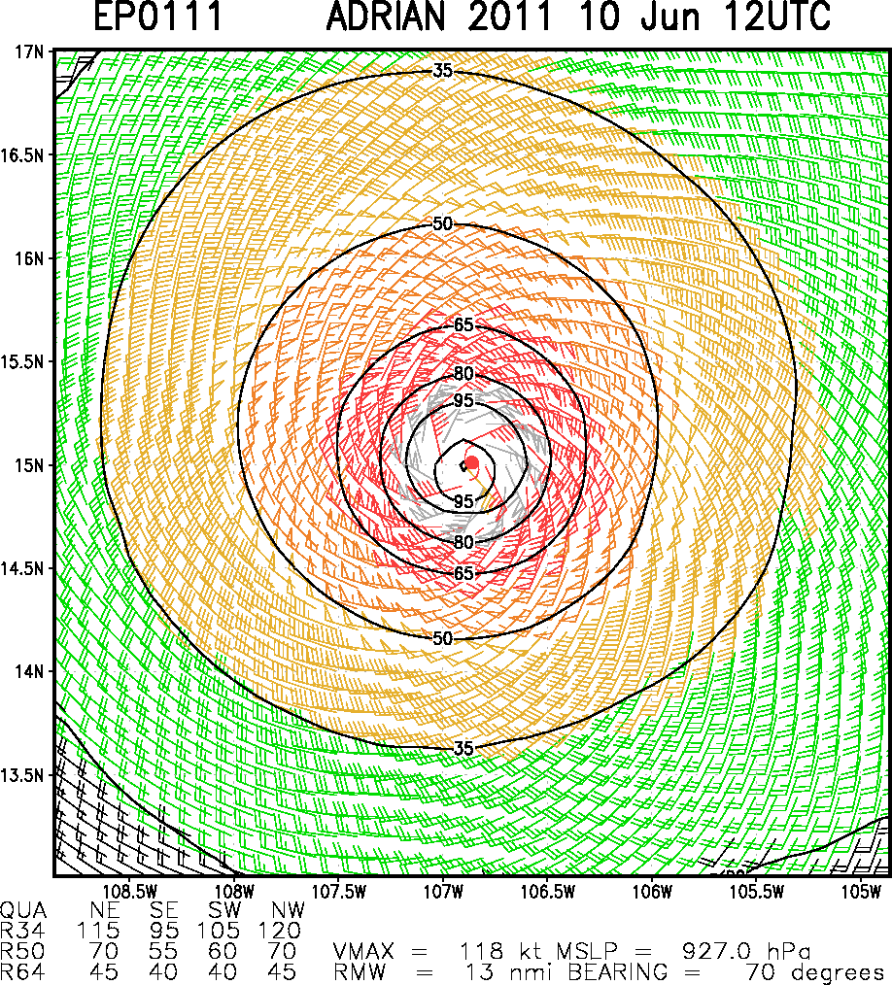
HWRF-x (3km)
Hurricane-force wind radii comparisons
NHC 64kt radii (25nm)
Multiplatform Satellite Surface Wind Analysis

Slide 4
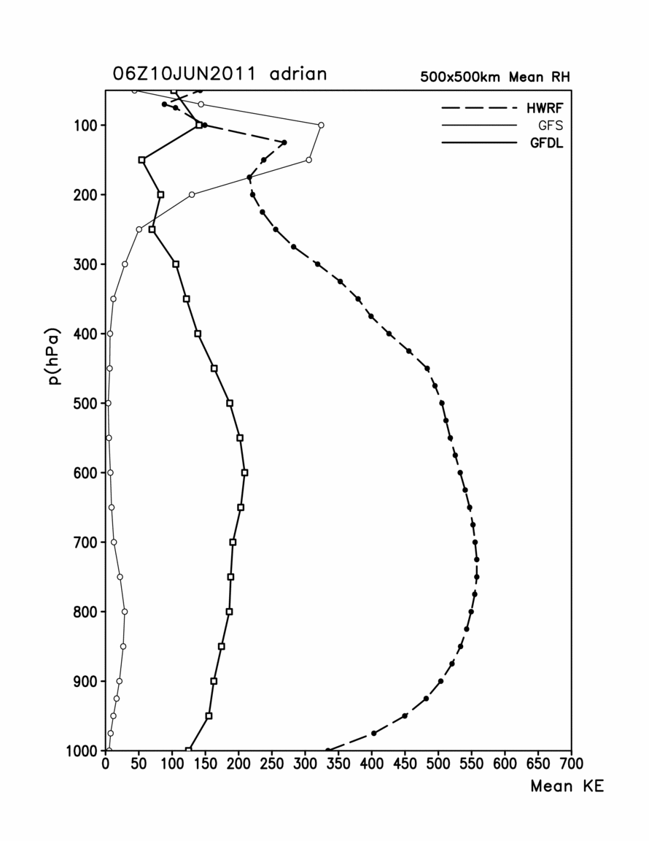
x
CIRA
GFDL
CIRA
HWRF
GFDL
CIRA
GFDL
CIRA
Still some work to do on size issue.

Slide 5
Still some work to do on size issue.

