Slide 1
HWRF EMC-HRD 1.5 Stream Forecast
EMC HWRF team
HRD Modeling team
Present by
Xuejin Zhang & Stanley Goldenberg

Slide 2
Model Configuration
 | Stream 1.5 HWRF | Operational HWRF
Domain | 27 KM: 77.76˚ X 77.76˚ 9 KM: 10.56˚ X 10.2˚ 3 KM: 7.6˚ X 6.4˚ | 27 KM: 77.76˚ X 77.76˚ 9 KM: 7.2˚ X 6.0˚
Vortex Initialization | 27-9 KM: Yes 3 KM: No (Downscaling) | 27-9 KM: Yes
Cycling | Yes | Yes
Ocean Coupling | 27-9 KM: Yes 3 KM: No (Downscaling) | 27-9 KM: Yes
GSI | Yes | Yes
Platform | JET-Linux | IBM
Physics schemes
Microphysics | Ferrier | Ferrier
Radiation (SW) | GFDL | GFDL
Radiation (LW) | GFDL | GFDL
Surface Scheme | GFDL (2010 implementation) | GFDL (2011 implementation)
PBL Scheme | GFS (Modified for HR implementation) | GFS
Cumulus Parameterization | New SAS (27-9 KM); no CP (3 KM) | New SAS
Land Surface | GFDL Slab | GFDL Slab

Slide 3
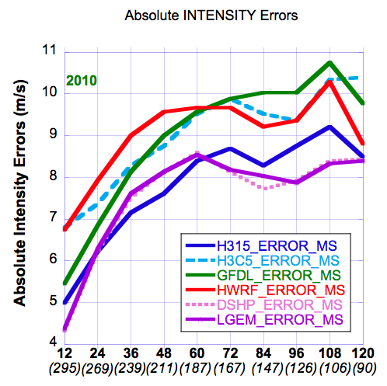
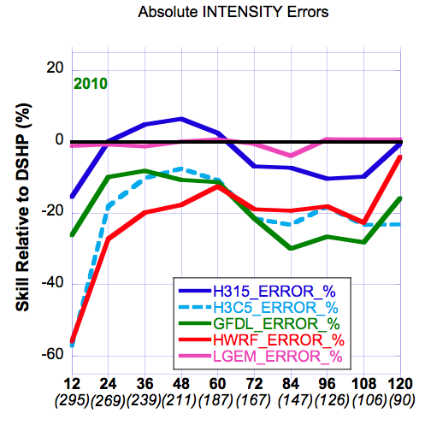
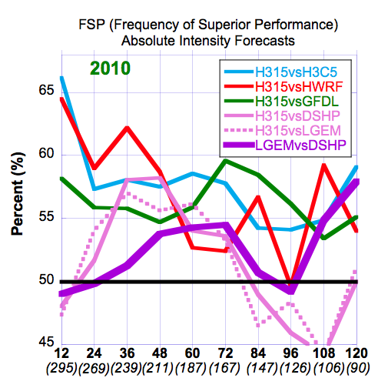
2010 Verifications – Intensity Forecasts
HWRF (operational 27:9), H3C5 (research/operational 9:3/COAC), H315 (27:9:3), GFDL (oper)
Absolute Errors
Skill vs DSHP
FSP

