Slide 1
HWRF EMC-HRD 1.5 Stream Forecast
EMC HWRF team
HRD Modeling team
Presented by
Xuejin Zhang (AOML/HRD & CIMAS)
Stanley Goldenberg (AOML/HRD)

Slide 2
DTC HWRF work update
Shaowu Bao
DTC
June 16 2011

Slide 3
Basin Scale Modeling Update
Kevin Yeh
AOML/HRD & CIMAS

Slide 4
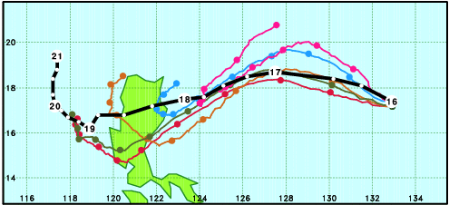
Megi runs starting at 2010101600
Red: Single 45-km mesh, without NAVDAS
Blue: Single 45-km mesh, with NAVDAS
Gold: Triple-nest (45/15/5), without NAVDAS
Olive: Single 15-km mesh, without NAVDAS
Pink: Triple-nest (45/15/5), with NAVDAS (Control run)
Richard Hodur,NRL

Slide 5
Adrian Synoptic Errors
Chris Landsea
NHC

Slide 6
Hurricane Adrian 01E
HWRF No-Init Runs
Zhan Zhang and Vijay Tallapragada, EMC

Slide 7
Preliminary Notes on Adrian
D. Zelinsky & W. Hogsett
NHC

Slide 8
Hurricane Adrian: GFDL Model
Discussions initiated by:
Morris Bender,GFDL

