Slide 1
HWRFx Parameter Test (Reduced Mixing)
Earl Forecast initialized 0Z August 31, 2010
Modeling Meeting July 21, 2011
Kathryn Sellwood

Slide 2
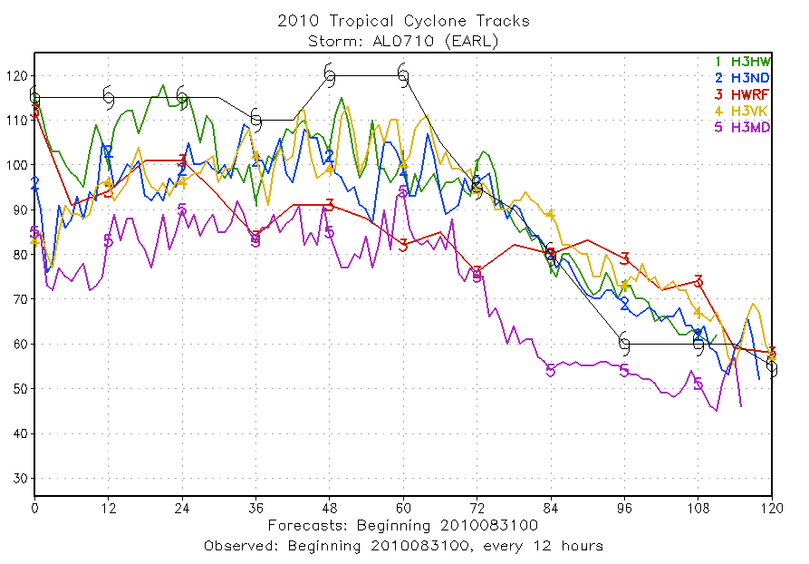
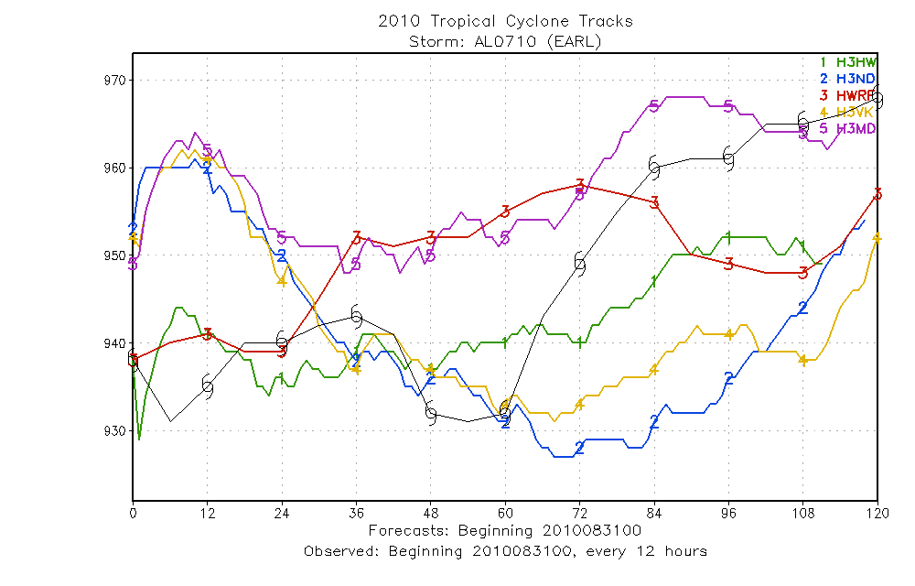
Best Track Comparision

Slide 3
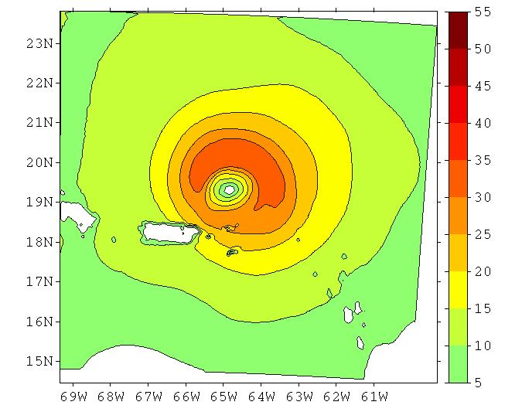
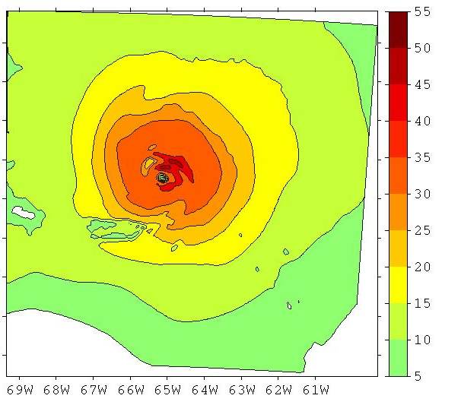
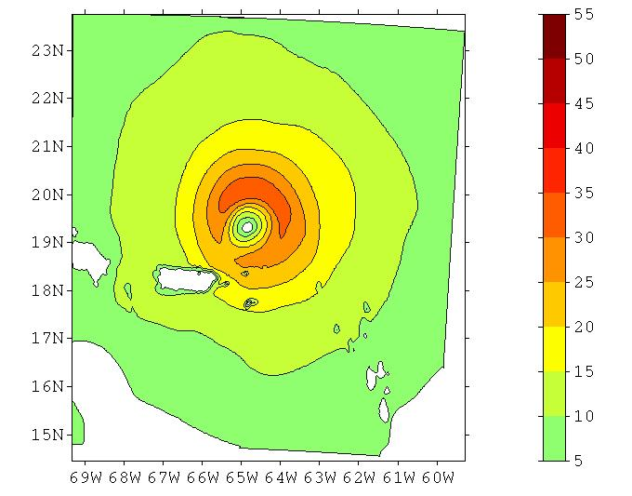
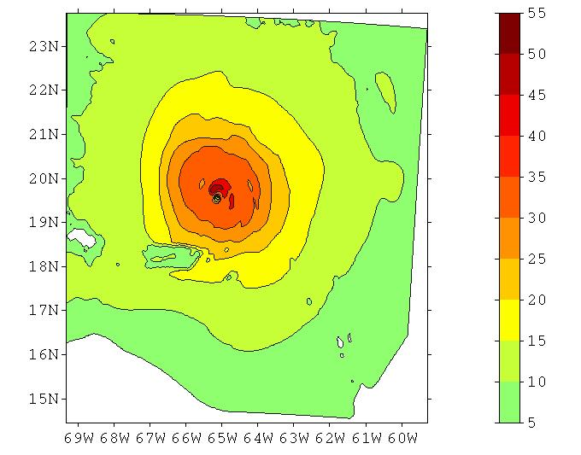
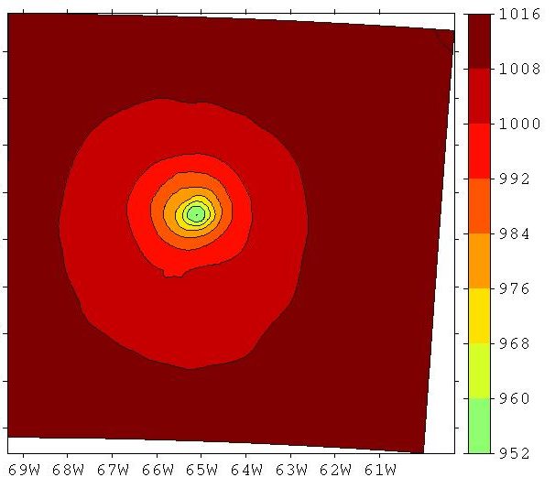
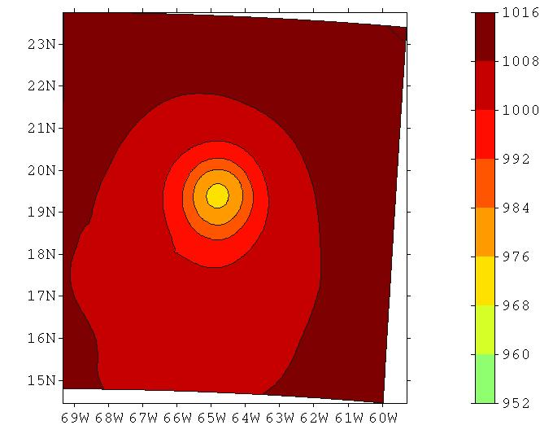
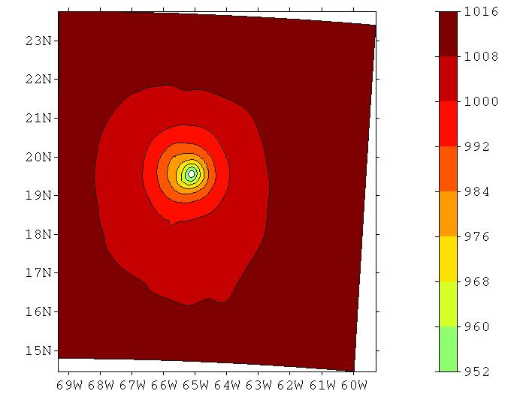
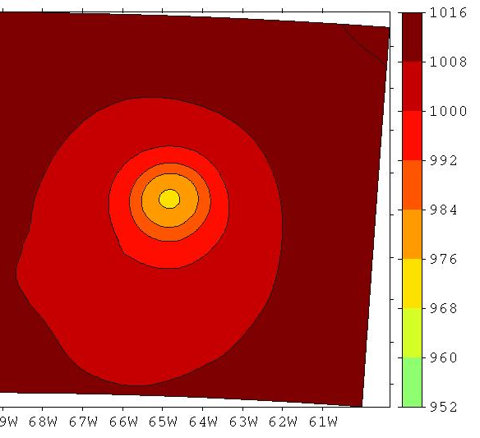
Initial Condition(orig) Analysis (orig) Initial Condition(new) Anlaysis (new)
10 Meter Wind Speed
MSLP

Slide 4
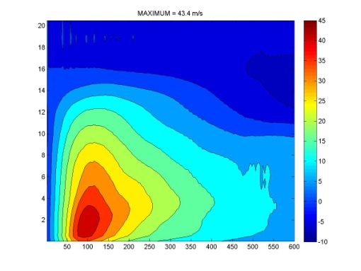
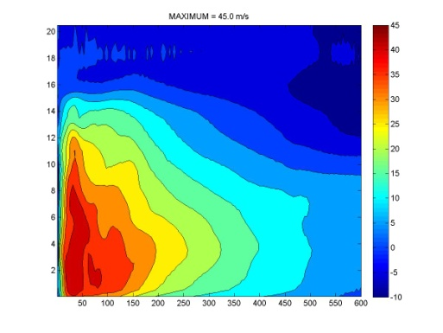
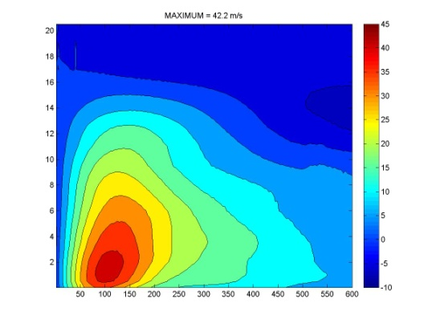
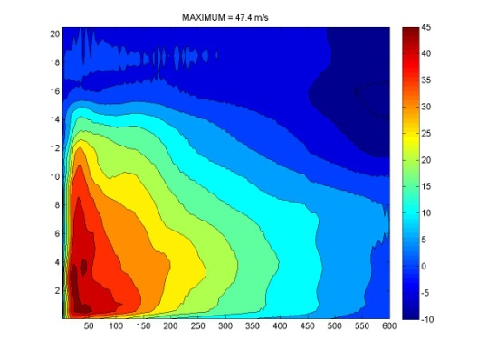
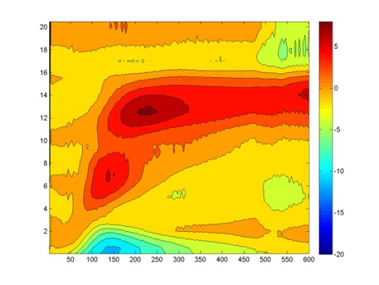
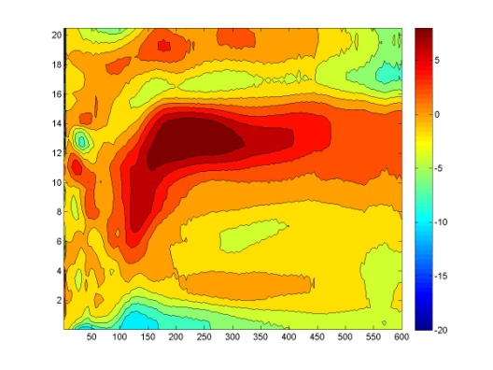
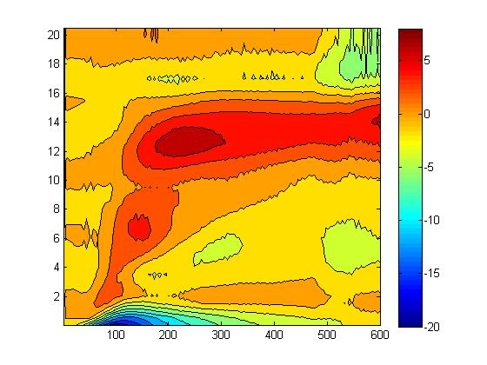
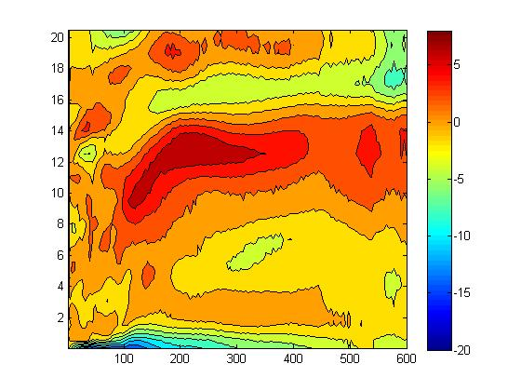
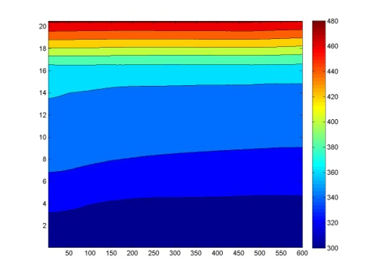
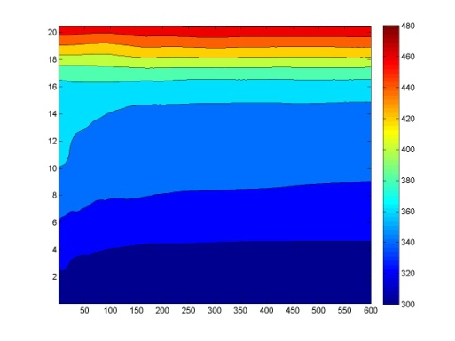
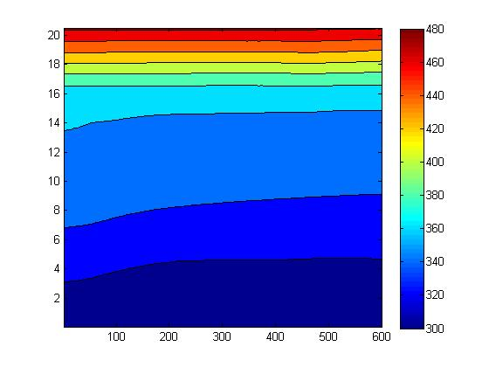
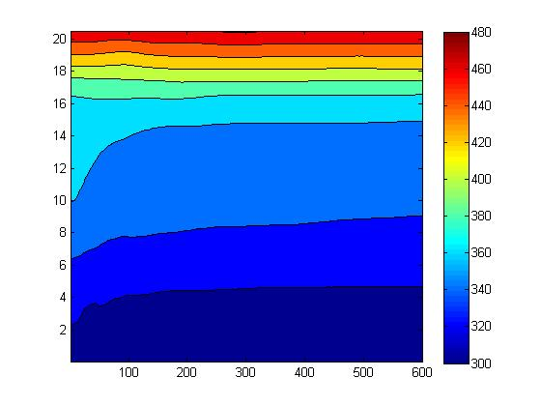
Initial (orig) Analysis (orig) Initial (new) Anlaysis (new)
Tangential Wind Speed
Radial Wind Speed
Theta

Slide 5
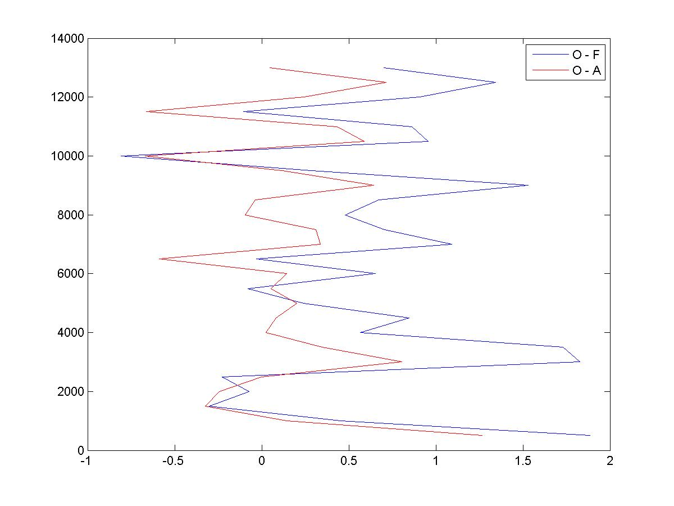
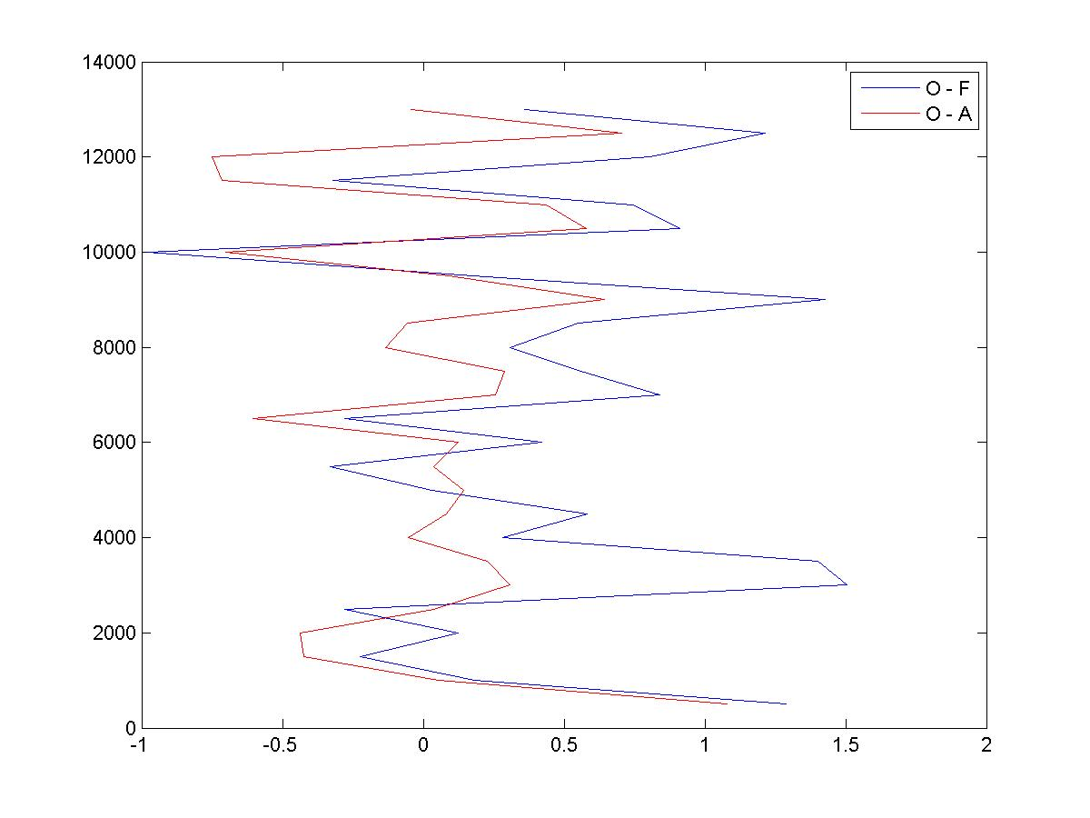
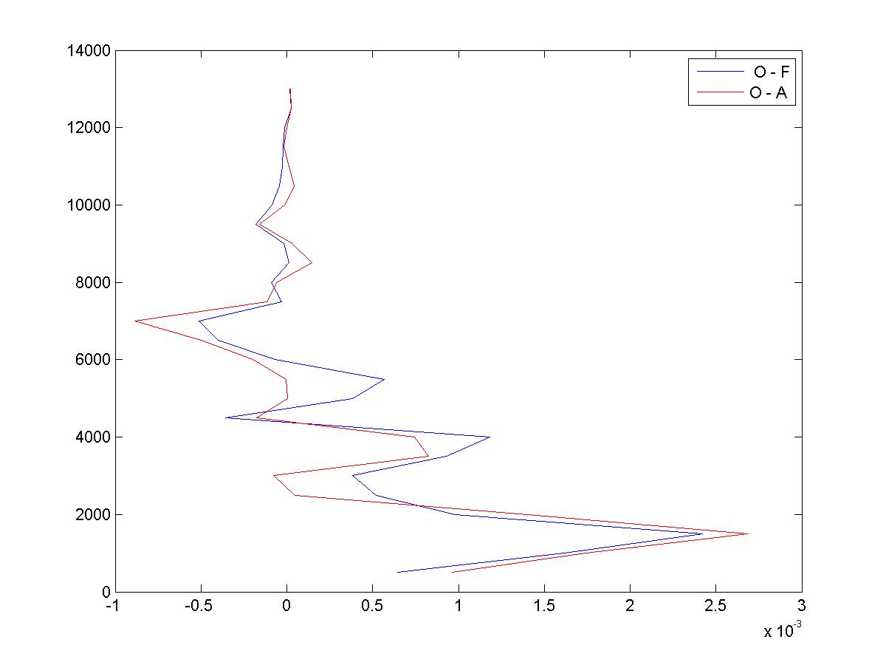
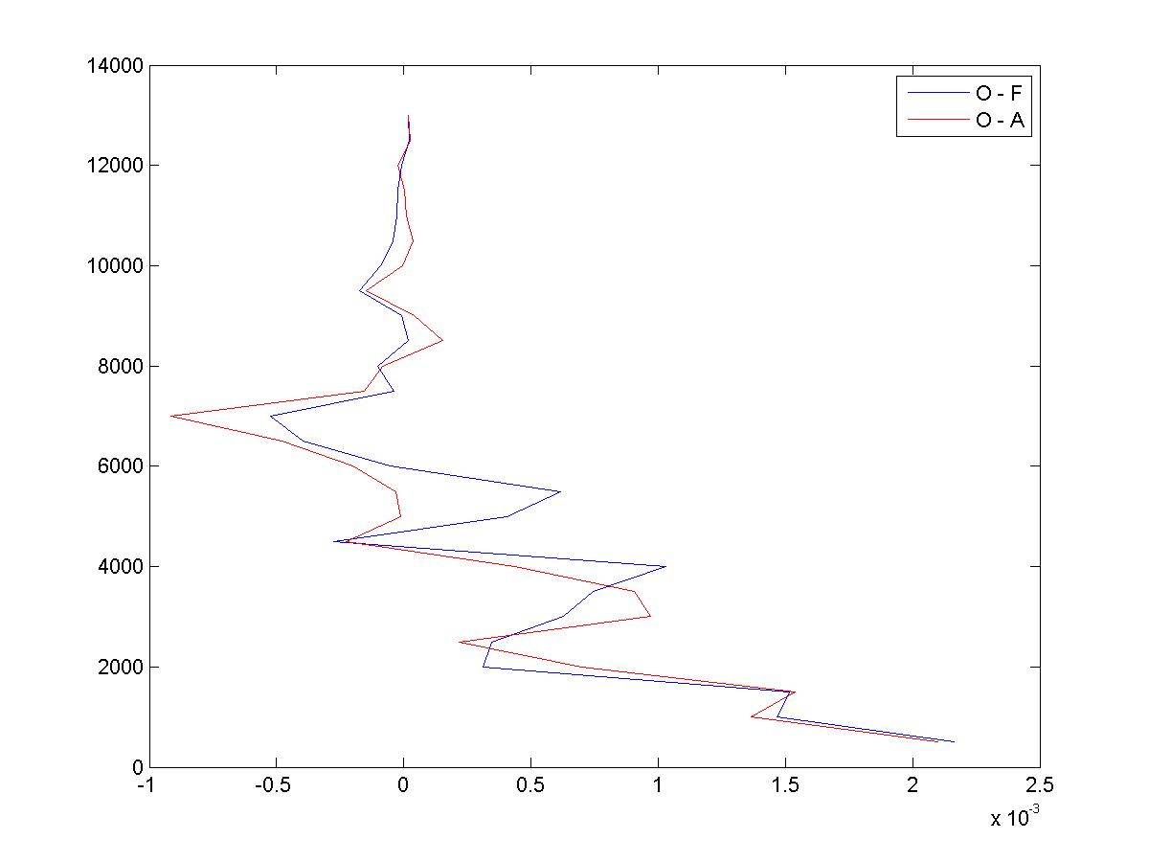
Observed Temperature – Forecast (blue)/ Analysis (red)
Original New Diffusion Parameter
Observed Specific Humidity – Forecast (blue)/ Analysis (red)
Original New Diffusion Parameter

Slide 6
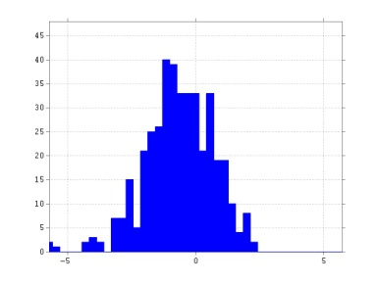
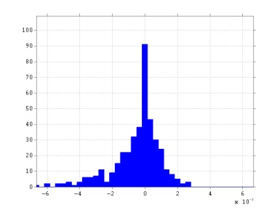
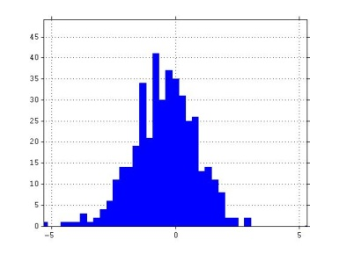
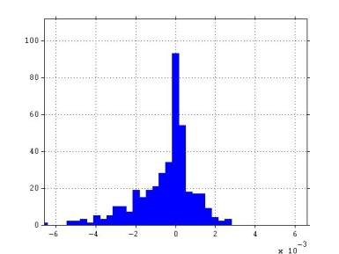
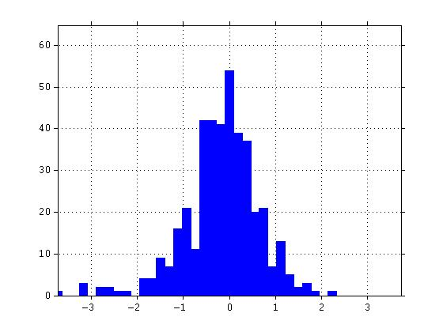
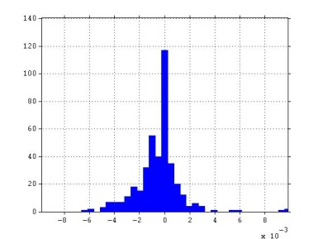
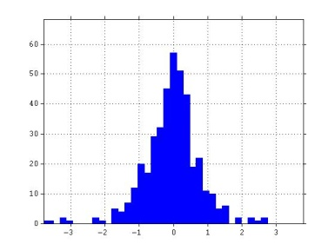
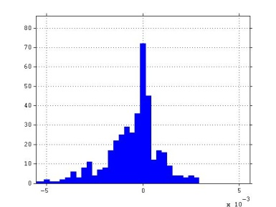
Observed – Model
Temperature Specific Humidity
Prior
Original
Prior
Reduced Mixing
Analysis
Original
Analysis
Reduced Mixing

Slide 7
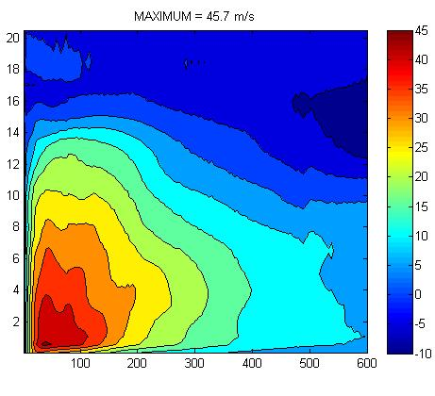
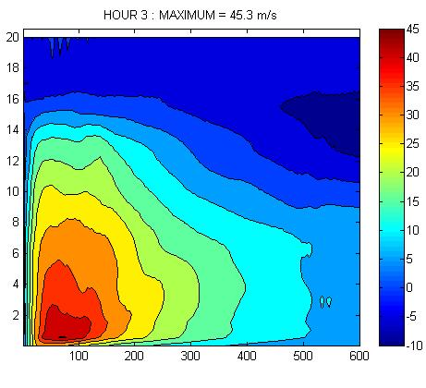
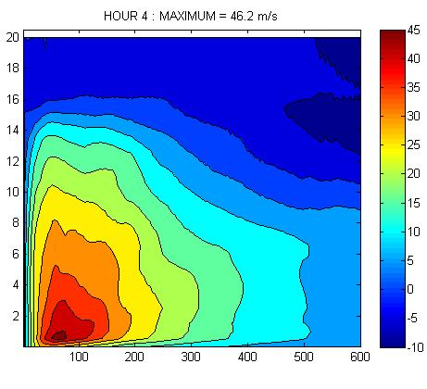
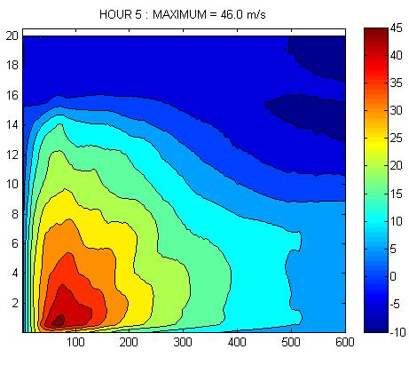
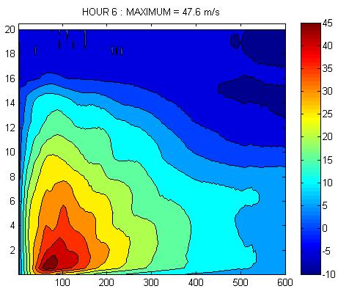
Evolution of RZ mean Tangential Wind Speed during first 6 hours of forecast
1 Hour 2 Hour 3 Hour
4 Hour 5 Hour 6 Hour

Slide 8
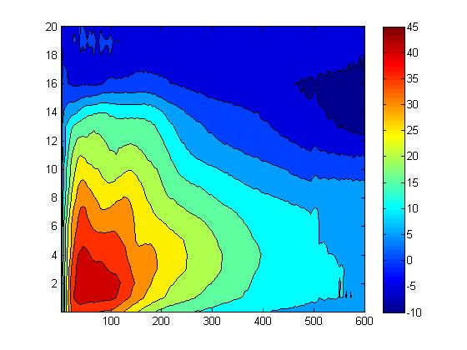
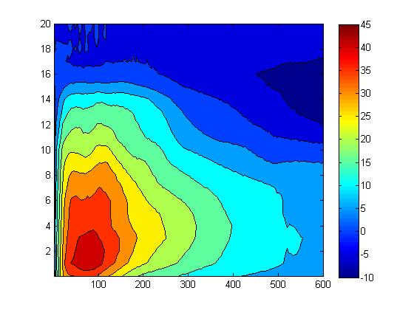
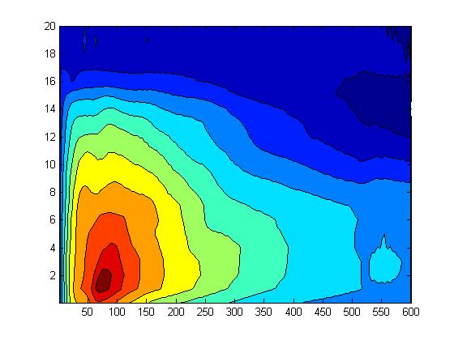
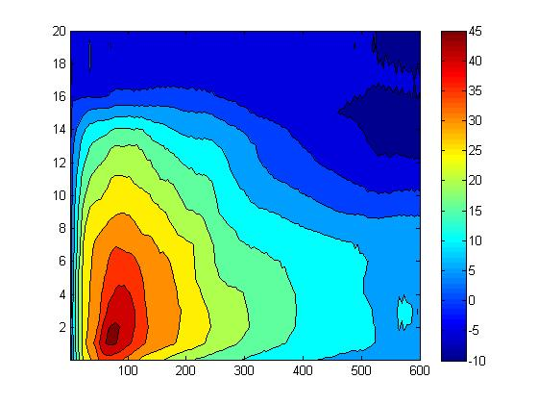
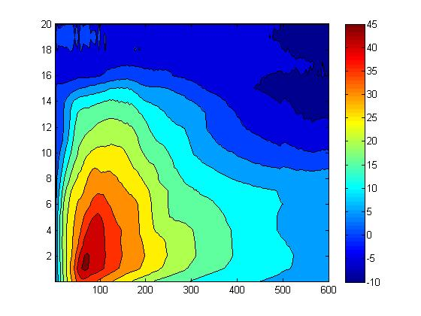
Original HWRFx Configuration:
Evolution of RZ mean Tangential Wind Speed during first 6 hours of forecast
1 Hour 2 Hour 3 Hour
4 Hour 5 Hour 6 Hour

Slide 9
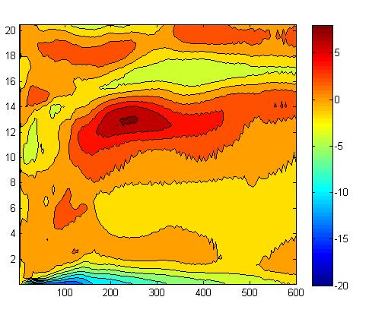
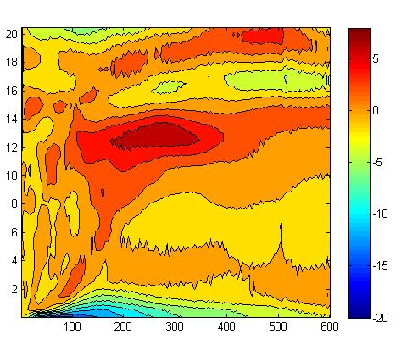
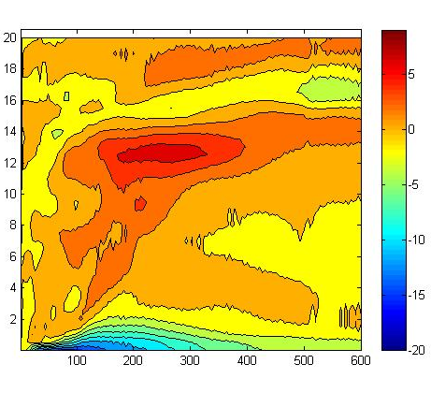
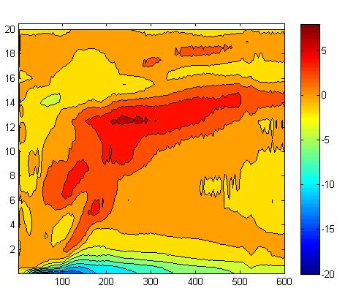
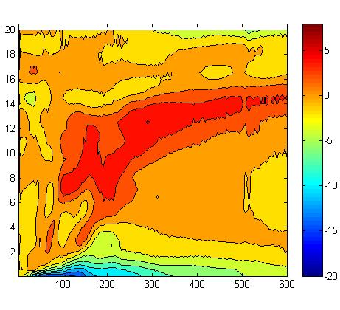
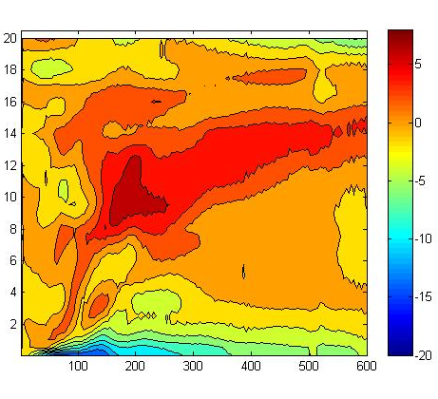
Evolution of RZ mean Radial Wind Speed during first 6 hours of forecast
1 Hour 2 Hour 3 Hour
4 Hour 5 Hour 6 Hour

Slide 10
Evolution of RZ mean Radial Wind Speed during first 6 hours of forecast
1 Hour 2 Hour 3 Hour
4 Hour 5 Hour 6 Hour

Slide 11
Comparison of Wind Radii with Best Track
Model Landfall between 72 and 84 hours

Slide 12
Doppler Radar SFMR
Operational
RMS Error (Red)
Absolute Error (Red dashed)
Spread / Error ratio ( Black)
New Diffusion Parameter
Dropsonde U Dropsonde V Dropsonde T Dropsonde Q Dropsonde P
Operational
New Diffusion Parameter

Slide 13
O-F Distibution
Radar SFMR Dropsonde T Dropsonde Q Flight Level V
Prior (orig)
Prior (new)
Analysis (orig)
Analysis (new)

Slide 14
Significant Wind Radii
First 6 hours of forecast
hourly values
120 hour forecast
12 hour values
Landfall

