Slide 1
High Temporal Frequency Diagnostics: 2012 Products
David Zelinsky, NHC
HRD Modeling Meeting 1/19/12

Slide 2
Model Output
2011 HFIP Stream 1.5 HWRF (27-9-3)
Output every 5s
14 201109100000 0.00 1003.610 15.251 59.273 40.686 15.607 58.206 14.748 59.140
14 201109100000 5.00 1003.571 15.251 59.273 40.686 15.607 58.206 14.748 59.140
14 201109100000 10.00 1003.546 15.251 59.273 40.686 15.607 58.206 14.748 59.140
14 201109100000 15.00 1003.555 15.232 59.294 40.643 15.607 58.206 14.748 59.140
14 201109100000 20.00 1003.453 15.191 59.254 40.643 15.607 58.206 14.748 59.140
14 201109100000 25.00 1003.453 15.191 59.254 40.643 15.607 58.206 14.748 59.140
14 201109100000 30.00 1003.471 15.231 59.253 40.724 15.607 58.206 14.748 59.140
14 201109100000 35.00 1003.372 15.251 59.273 40.724 15.607 58.206 14.748 59.140
Note:
3 km gridspacing = 9km² ‘footprint’
At 10,000’, SFMR footprint =~ 9km² for a 30s average wind

Slide 3
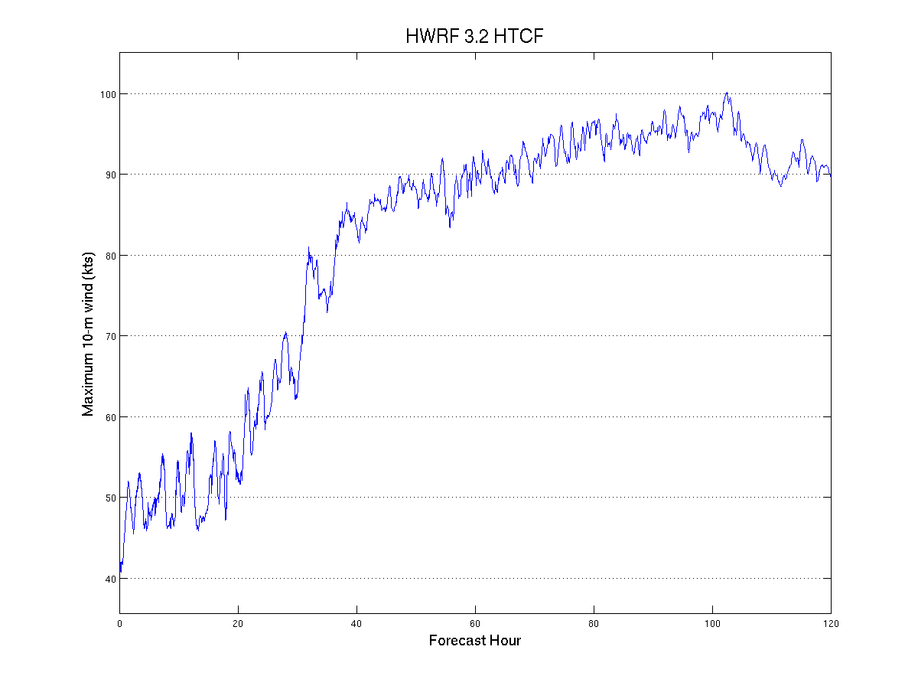
Max Wind

Slide 4
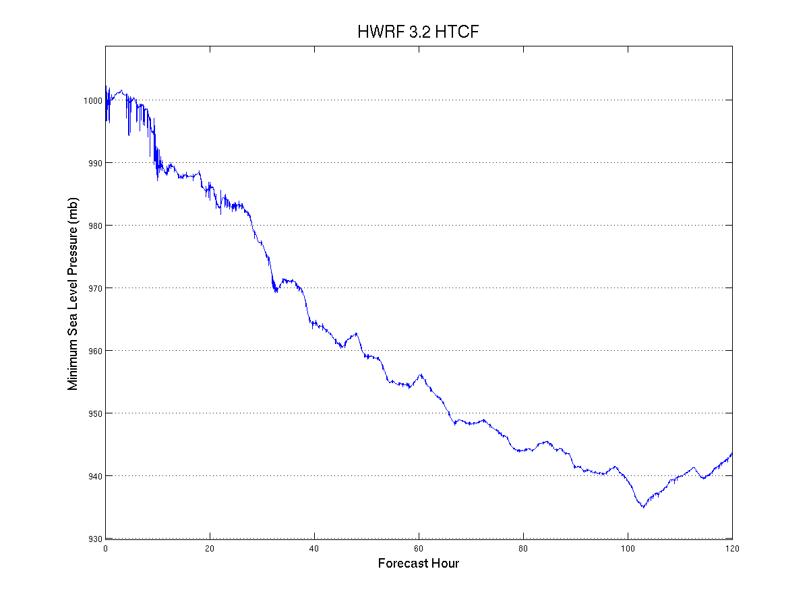
Pressure

Slide 5
Sources of Variability
Max Wind
  Sources:
    Axisymmetric spin up/down of storm
    Growth/decay of individual convective elements
    Fluctuation of wind at individual gridpoints
    Nest movement
    Diurnal component?
  Behavior:
    More variability in weak, but strengthening storms
    Less variability in strong, weakening storms
Pressure
  Sources:
    Axisymmetric spin up/down of the storm
    Nest movement
    Diurnal component?
  Behavior:
    Stronger (deeper) storm = less variability

Slide 6
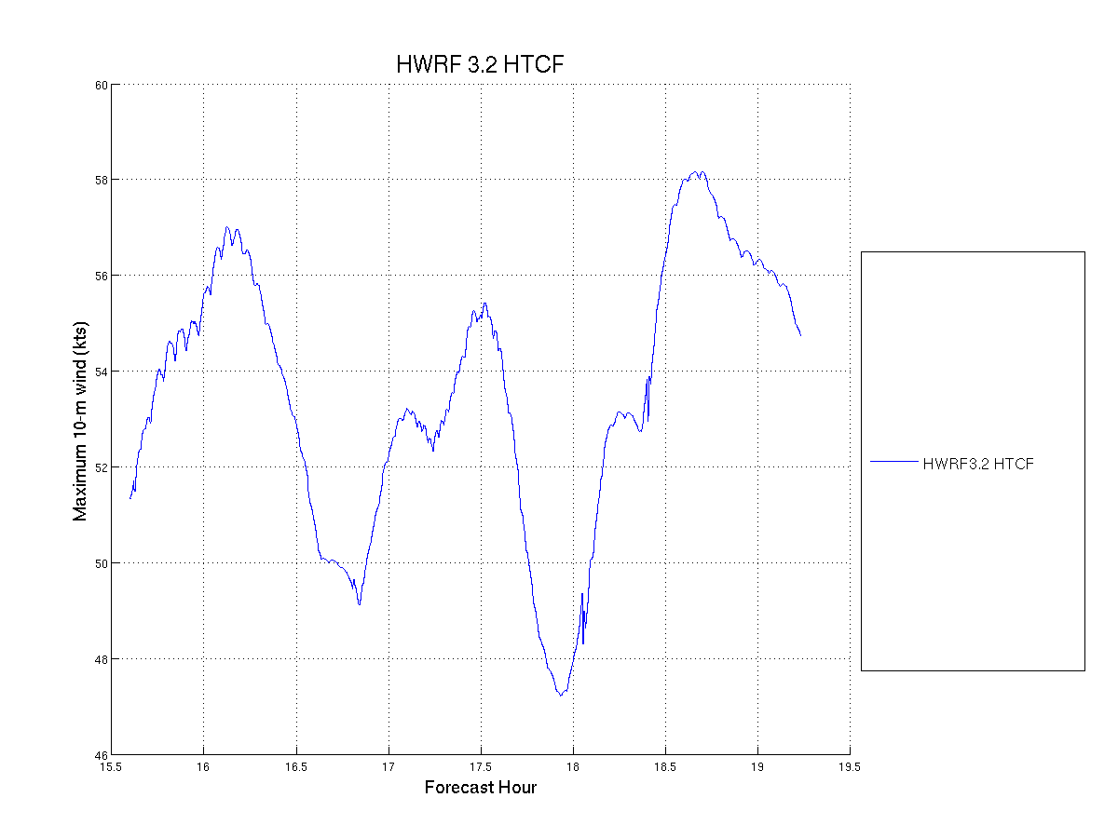

Slide 7
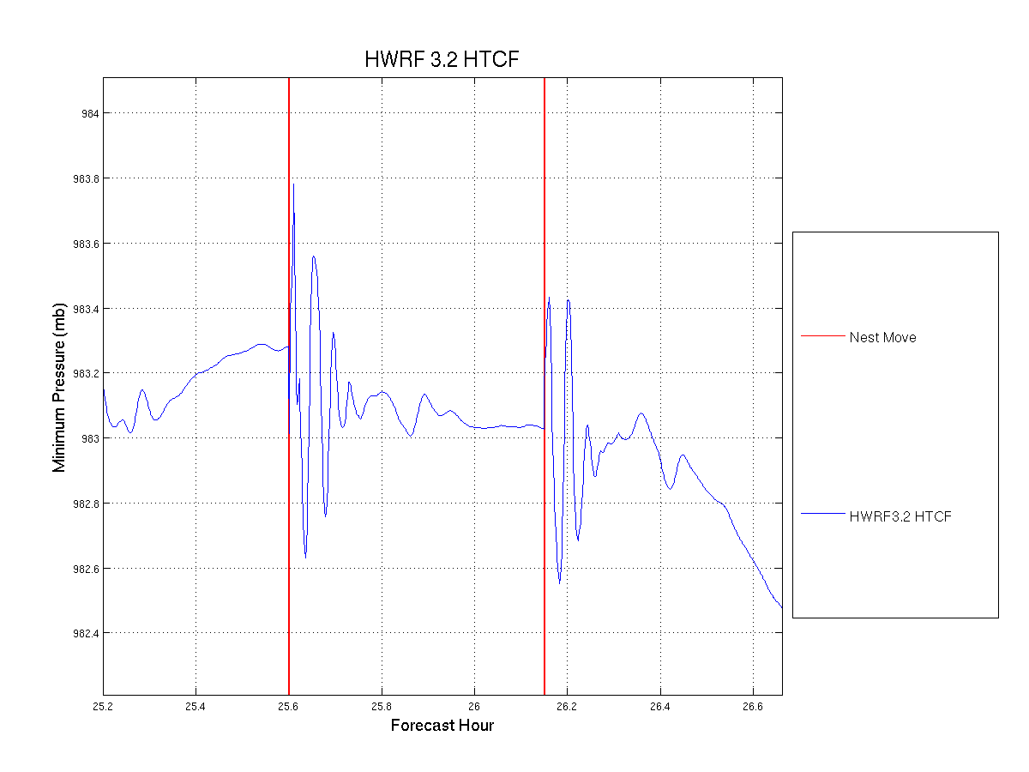

Slide 8
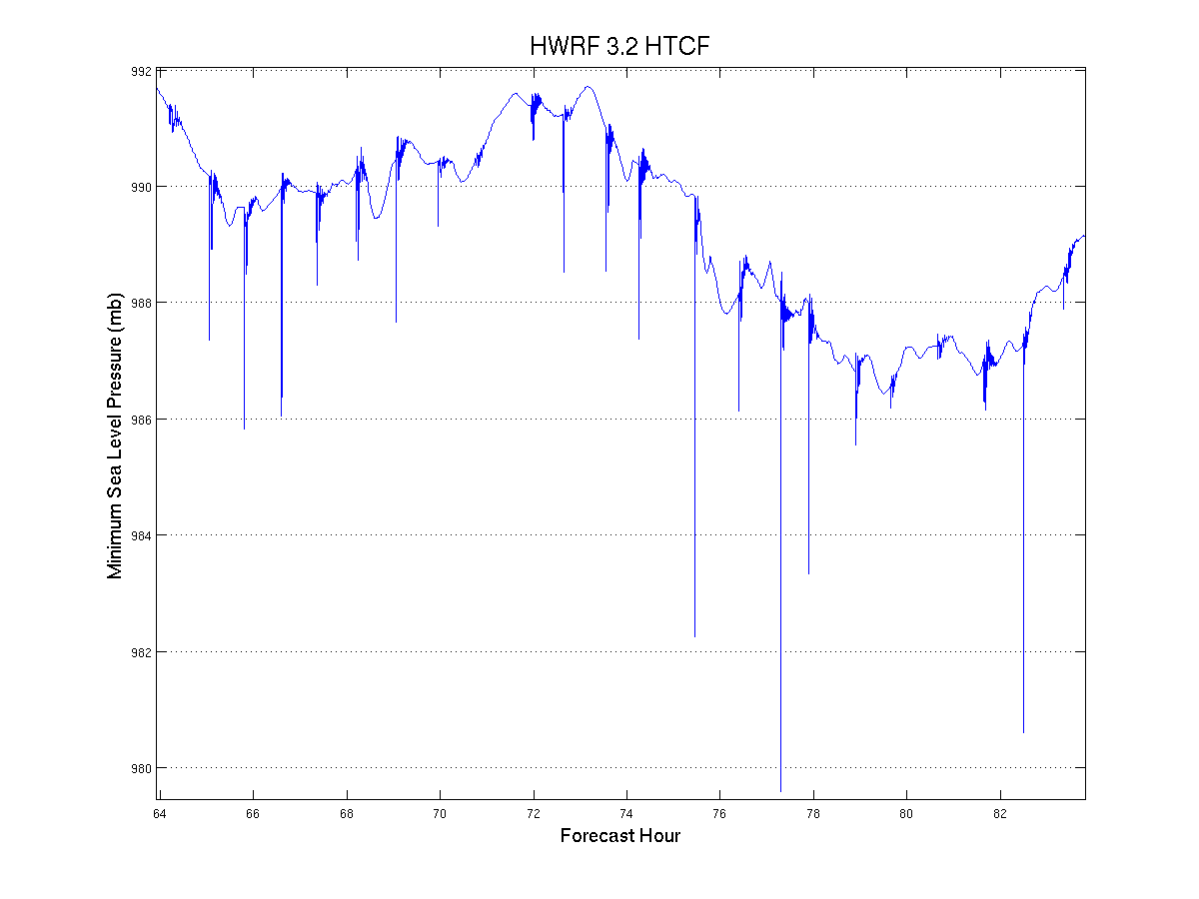

Slide 9
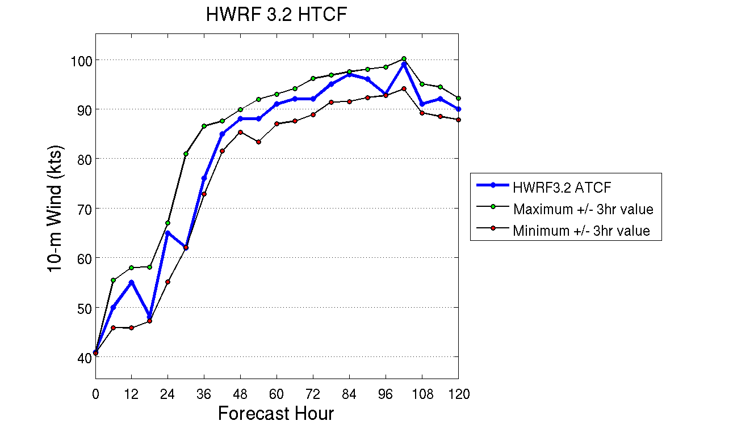
New Products and Diagnostics
Bounded Intensity

Slide 10
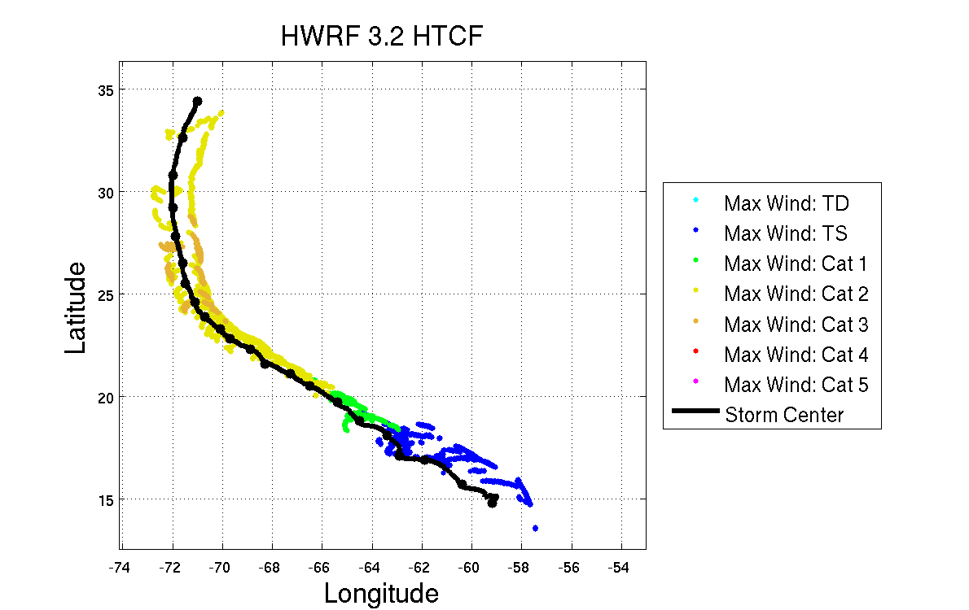
Track and Intensity

Slide 11
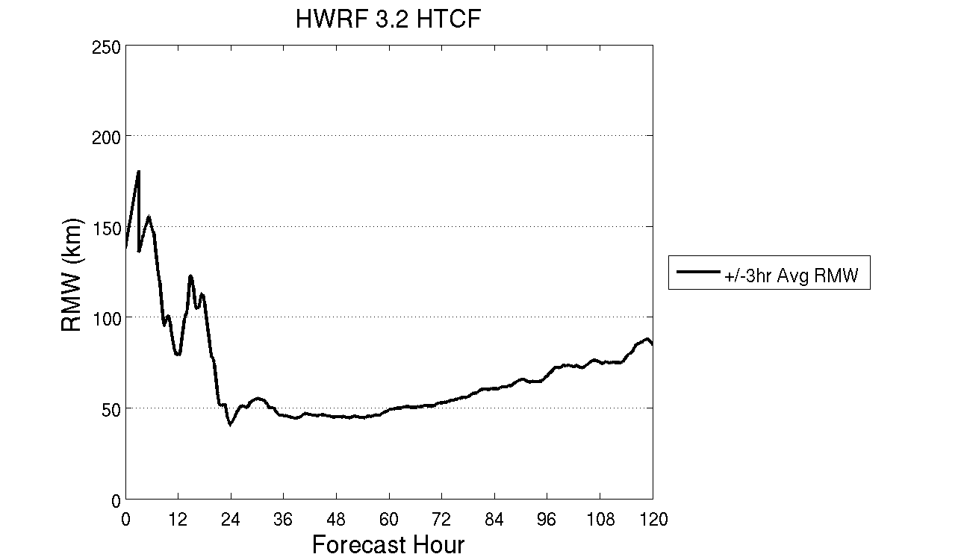
Radius of Maximum Wind

Slide 12
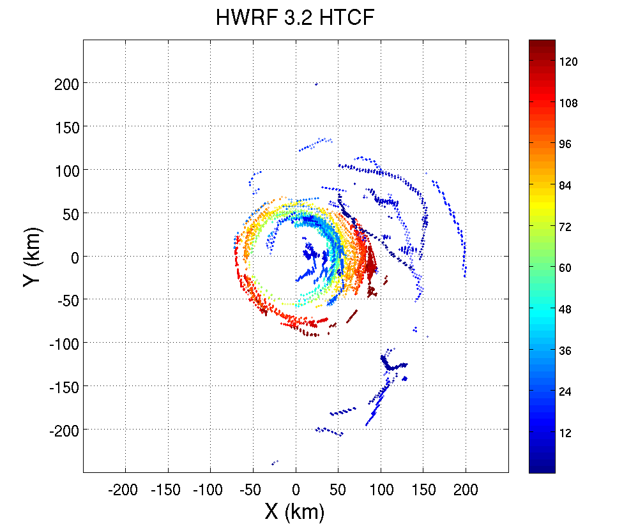
RMW storm-relative position

Slide 13
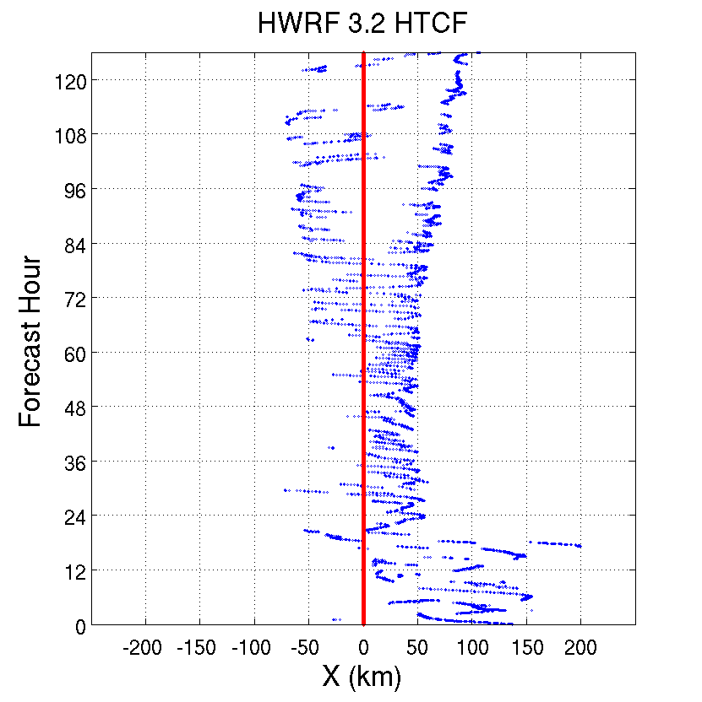
RMW: X and Y Components

Slide 14
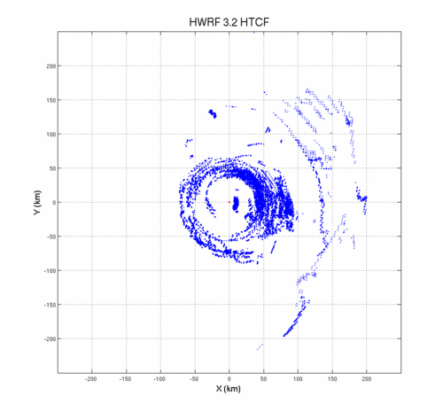
3-D Diagnostics

Slide 15
Extra Slides

Slide 16
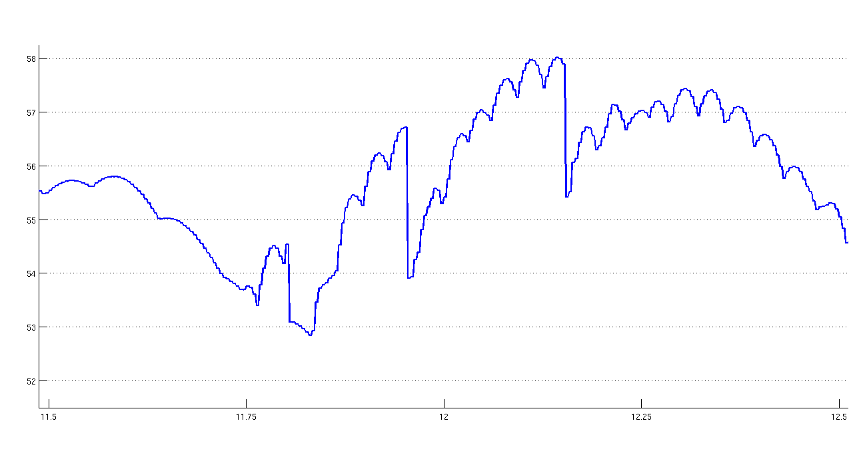

Slide 17
