Slide 1
Basin-scale Multiple Movable Nest HWRF Modeling System
(Stream 1.5)
--A pathway toward operational implementation
Xuejin Zhang & Thiago Quirino
UM/CIMAS & AOML/HRD
Collaborators:
AOML/HRD modeling group
NCEP/EMC HWRF Team
Acknowledgement:
This research funded by NOAA/HFIP (NOAA Award: NA12NWS4680007)

Slide 2
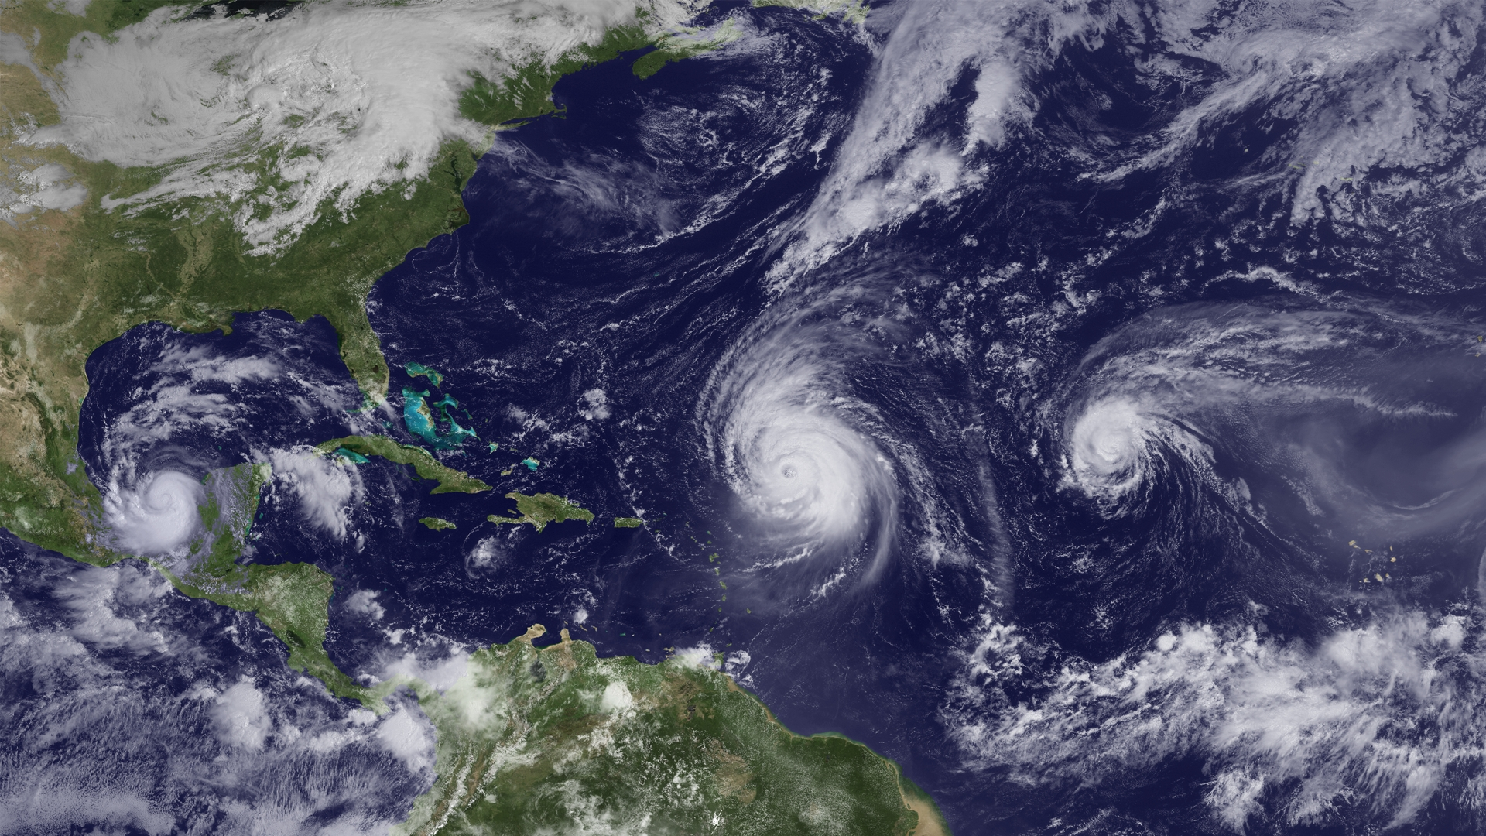
Motivation
Julia
Igor
Karl

Slide 3
Annual Storm Days (ATL+EP)
Not include invest cases!
 | 1+ storm days | 2+ storm days | 3+ storm days | 4+ storm days | Total storm days
ATL | 87.4(57.6%) | 31.3(35.8%) | 9.6(11.1%) | 1.4(1.6%) | 151.8
EP | 77.8(48.0%) | 25.5(32.8%) | 5.4(6.2%) | 0.3(0.4%) | 161.9
ATL+EP | 124.7(65.1%) | 66.2(53.1%) | 31.1(35.6%) | 10.9(8.8%) | 191.6

Slide 4
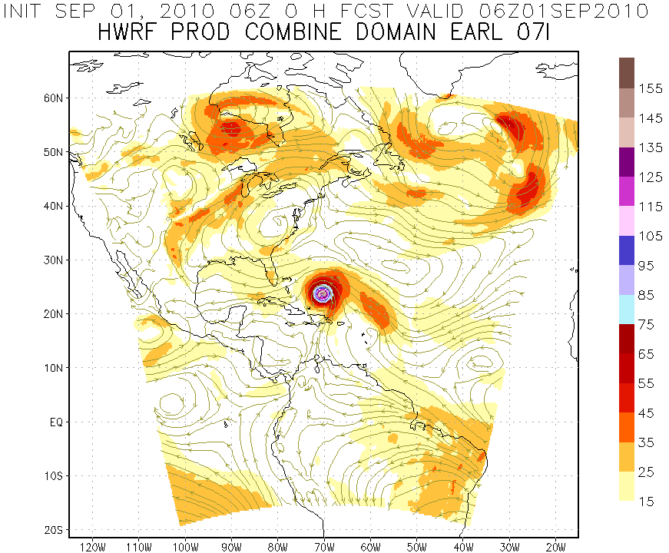
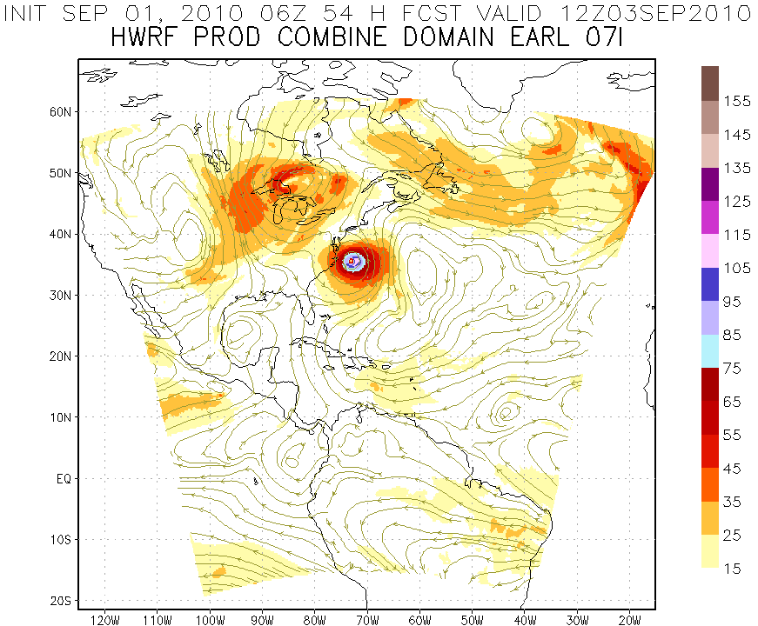
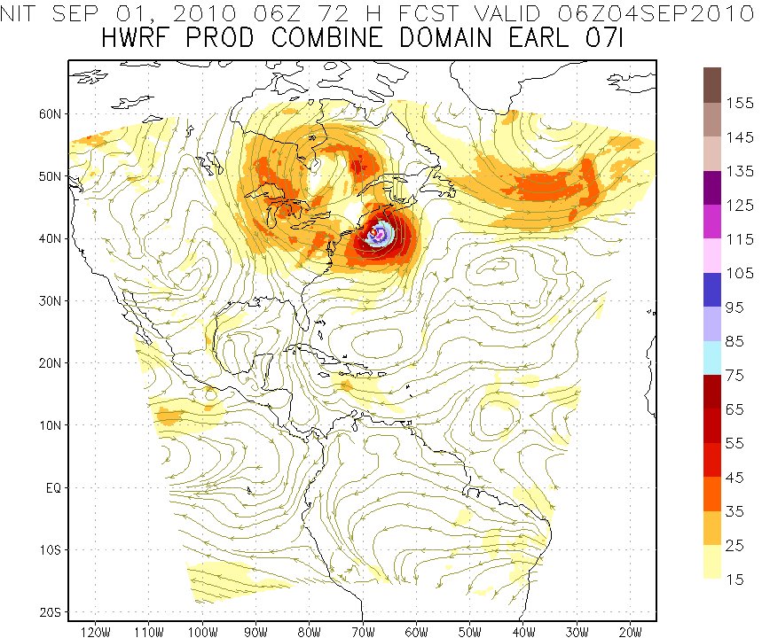
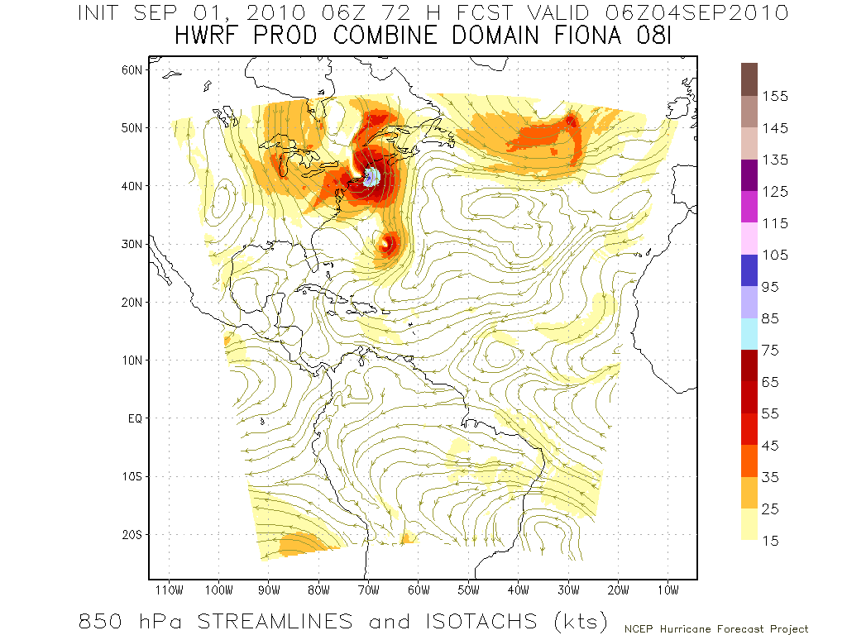
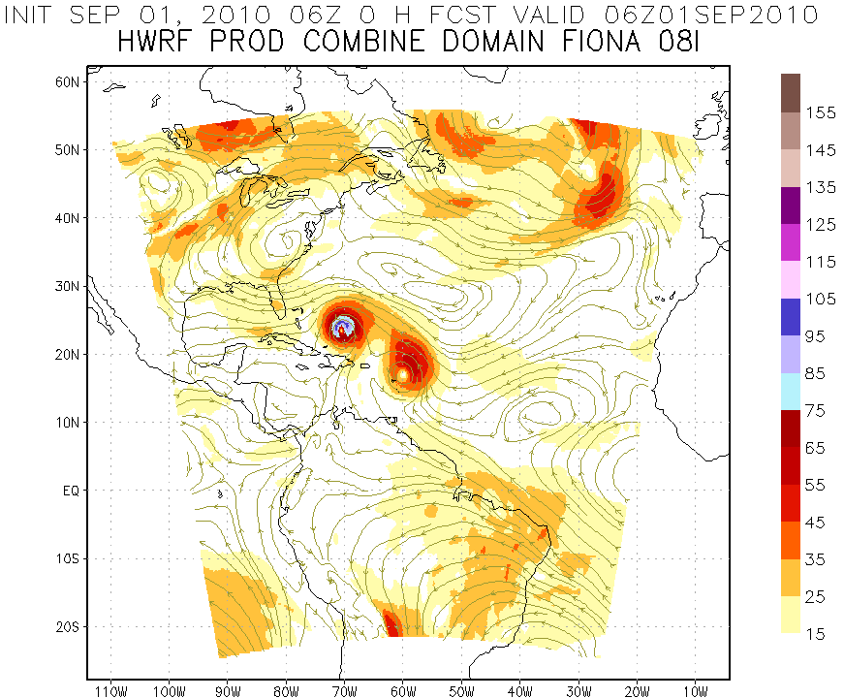
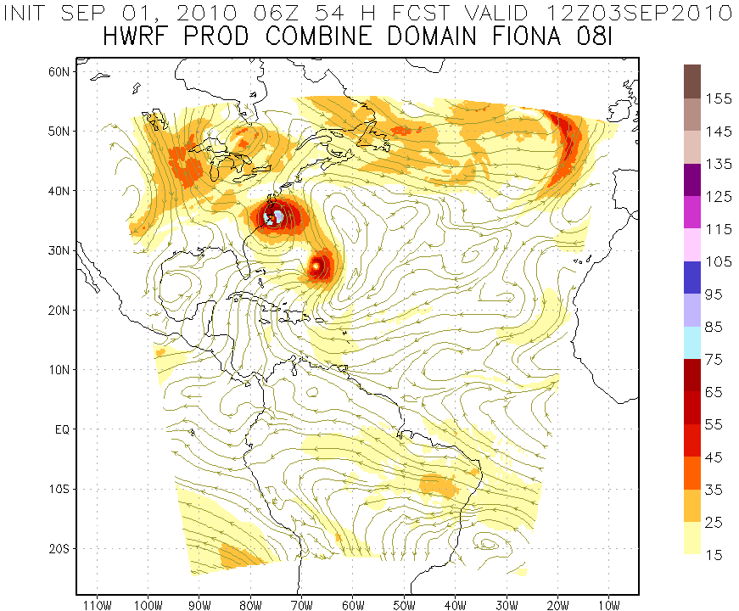
Real-time forecast case
Initialize Earl Vortex
Earl
Earl
Earl
Fiona
Initialize Fiona Vortex
Earl
Earl
Earl
Fiona
Fiona
Fiona
850hPa Streamlines and Isotachs (kts)
Credit to EMC HWRF webpage http://www.emc.ncep.noaa.gov/gc_wmb/vxt

Slide 5
The Modeling System
Initialization
Static terrestrial initialization
Initialization & Cycling
Vortex initialization (Relocation & modification)
Data assimilation
Forecast System
Trigger mechanism
Resource allocation
Submission & monitor system (jobs & resources management)
Products
&
Dissemination
Post-processing
Diagnostic & forecast products
Web products
Product real-time dissemination
Tape archive
Grib file generation
UPP implementation

Slide 6
Initialization framework (Current)
WPS
Generate static terrestrial data for 27-km resolution domain
Prep-hybrid
Generate ICs & BCs for 27-km resolution domain from GFS
Filtering
Filter vortex in ICs from GFS
Bogus or Cycling
Create bogus vortex or modify vortex cycled from previous cycle based on tcvital
Trigger Mechanism
GFS environment
HWRF vortex
Relocation & Merging
Generate static terrestrial data for 27-km resolution domain
WPS
Generate static terrestrial data for all resolution domains
GSI DA
Forecast System

Slide 7
Initialization framework (Near future)
WPS
Generate static terrestrial data for 27-km resolution domain
Prep-hybrid
Generate ICs & BCs for 27-km resolution domain from GFS Ensemble
Vortex Separation
Trigger Mechanism
GFS Ensemble environment
GFS Ensemble vortex
Relocation & Merging
Generate static terrestrial data for 27-km resolution domain
WPS
Generate static terrestrial data for all resolution domains
Hybrid DA
Forecast System

Slide 8
Initialization framework (Future final)
WPS
Generate static terrestrial data for 27-km resolution domain
Prep-hybrid
Generate ICs & BCs for 27-km resolution domain from GFS Ensemble
GFS/HWRF Ensemble ICs
WPS
Generate static terrestrial data for all resolution domains
Trigger Mechanism
Hybrid DA
Vortex DA
Forecast System

Slide 9
Trigger mechanism
Decide forecast configuration from tcvital
  Number of storms
  Priority storm if number of storms more than four
  Forecast length (Need genesis forecast product)
Set up domain location
Prepare vortex initialization domains (until hybrid DA available)
Allocate resources (disk space, CPUs, running time, and post-processing resource)

Slide 10
Basin-scale Model Configurations
 | 2012 HWRF Operational | Basin-scale Model (Stream 2)
Domain | 27 KM: 77.76˚ X 77.76˚ 9 KM: 10.56˚ X 10.2˚ 3 KM: 6.12˚ X 5.42˚ | 27 KM: 178.20˚ X 77.58˚ 9 KM: 10.56˚ X 10.2˚ 3 KM: 6.12˚ X 5.42˚
Vortex Initialization | Modified Vortex Initialization at 3 KM, with 30x30º analysis domain and GSI | 27KM: GFS 9-3 KM: No, Downscaled
Cycling | Yes (3 km vortex only) | No
Ocean Coupling | 27-9 KM: Yes 3 KM: No, Downscaled | 27-9-3 KM: No
Physics schemes
Microphysics | Modified Ferrier (High-Res) | Modified Ferrier (High-Res)
Radiation | GFDL | GFDL
Surface | GFDL (High_res) | GFDL (High_res)
PBL Scheme | 2012 GFS (High_res) | 2012 GFS (High_res)
Convection | SAS (High-Res), No CP (3 KM), Shallow Convection | SAS (High-Res), No CP (3 KM), Shallow Convection
Land Surface | GFDL Slab | GFDL Slab
GWD | Yes(27km); No(9-3km) | No(27km); No(9-3km)
Notes:
10

Slide 11
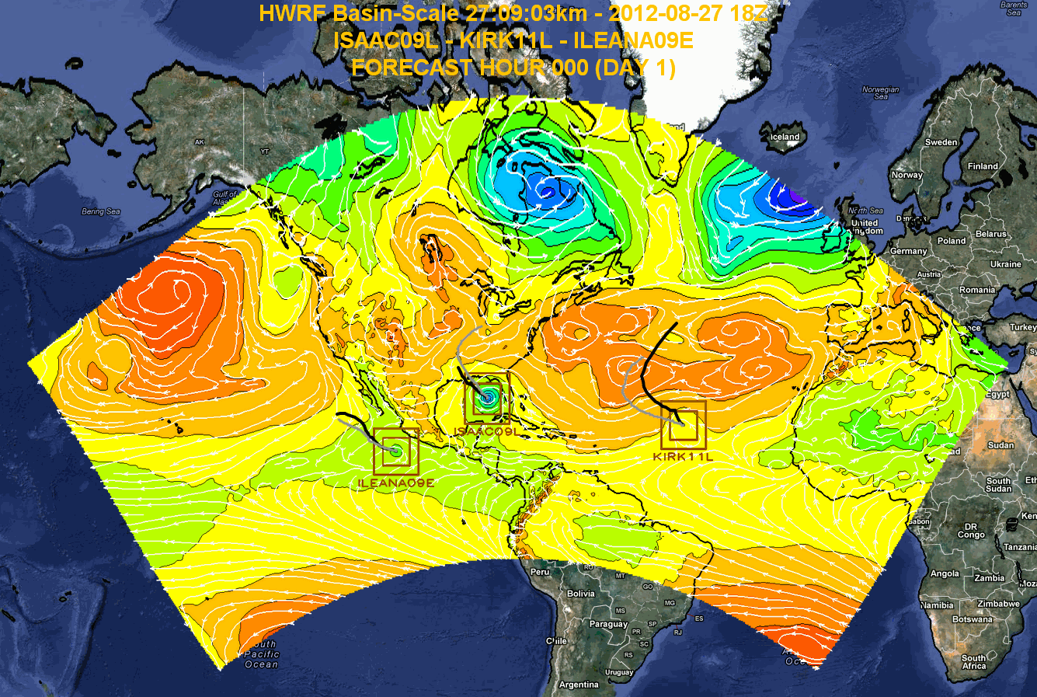
Isaac-Ileana-Kirk real-time forecast

Slide 12
Retrospective & Real-time Forecasts
Cycles start from 00Z 05/19/2012 to 00Z 11/04/2012
Real-time test: Isaac (37 cycles); Sandy (33 cycles)
Web products:
  3 categories (27km environment; 3km moving nest; multi-model)
  20 products
  https://storm.aoml.noaa.gov/basin

Slide 13
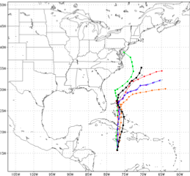
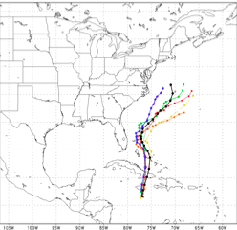
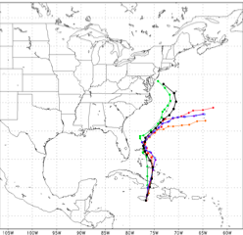
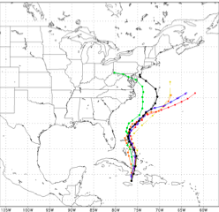
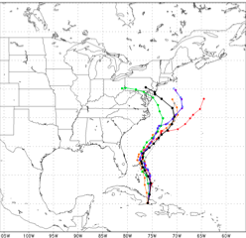
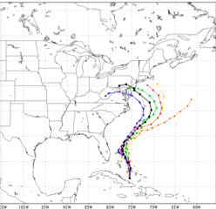
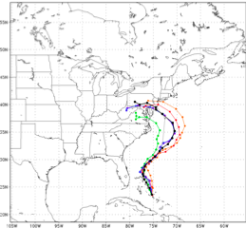
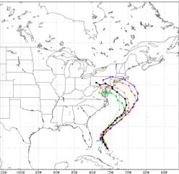
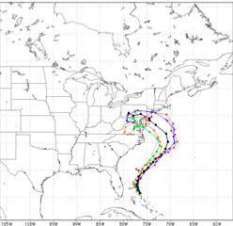
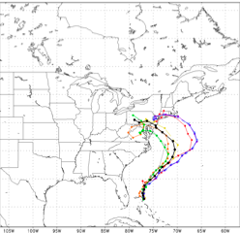
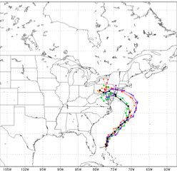
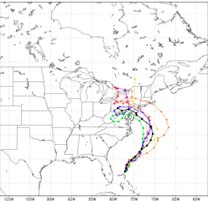
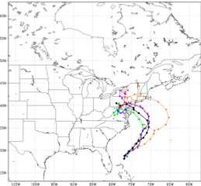
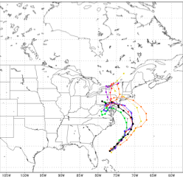
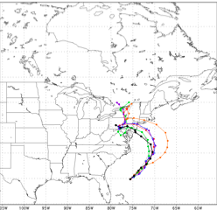
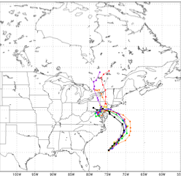
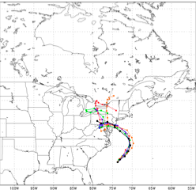
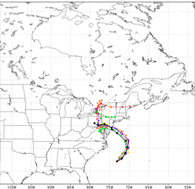
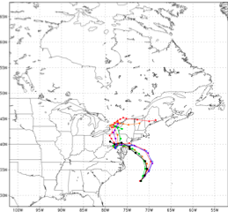
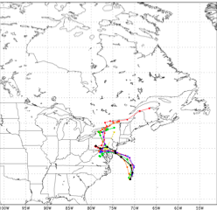
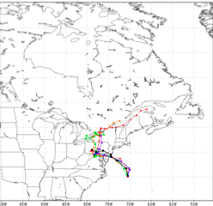
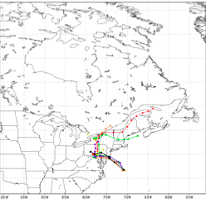
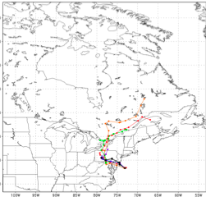
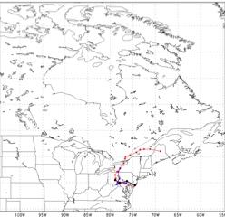







Hurricane Sandy Track Forecasts
2012102406
2012102412
2012102418
2012102500
2012102506
2012102512
2012102518
2012102600
2012102606
2012102612
2012102618
2012102700
2012102706
2012102712
2012102718
2012102800
2012102806
2012102812
2012102818
2012102900
2012102906
2012102912
2012102918
2012103000

Slide 14
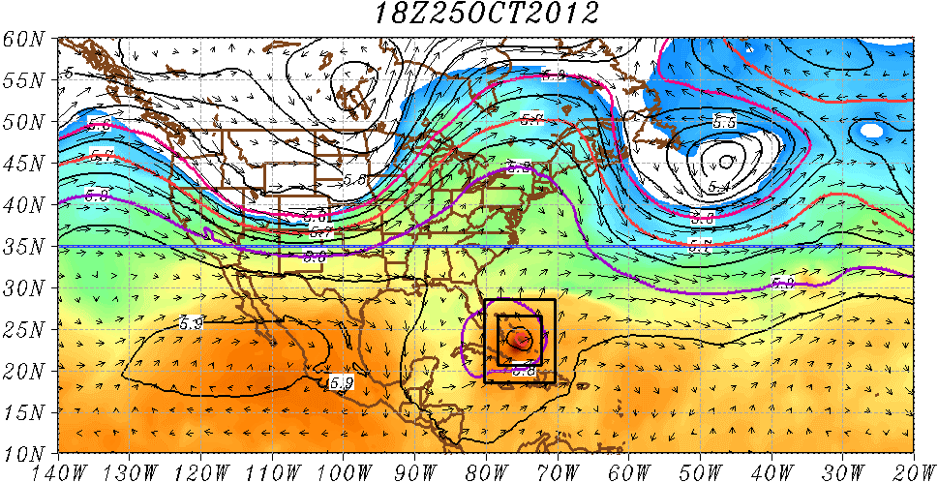
Sandy Forecast by Basin-scale HWRF
Shading: T at 500 hPa
Contour: GHT at 500 hPa
Vector: Flow averaged between
500 hPa and 200 hPa
Credit to Hua Chen

Slide 15
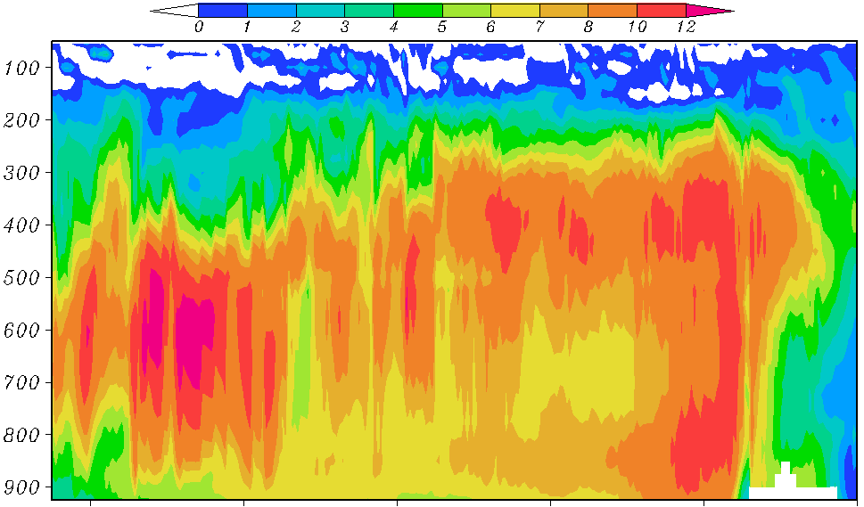
Time-Height cross section of temperature perturbation (the mean is defined as 1000 km × 1000 km area averaged surrounding the storm center)
Pressure (hPa)
Time series of central pressure from basin scale HWRF and best track
MSLP (hPa)
25/18
26/18
27/18
28/18
29/18
30/18
Credit to Hua Chen

Slide 16
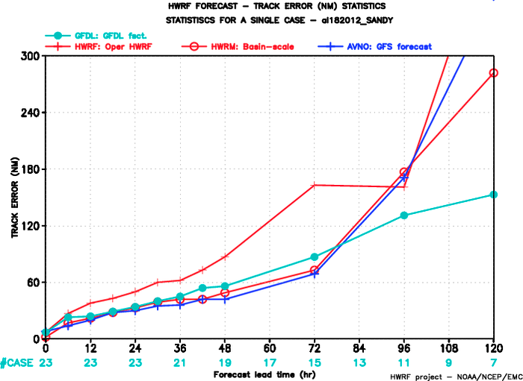

Slide 17
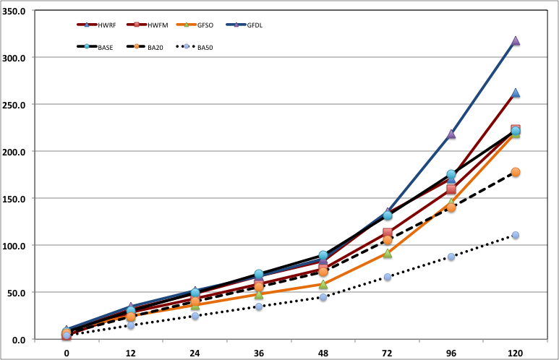
Track error (Atlantic 01-19)
Track error (NM)
Forecast lead time (hr)

Slide 18
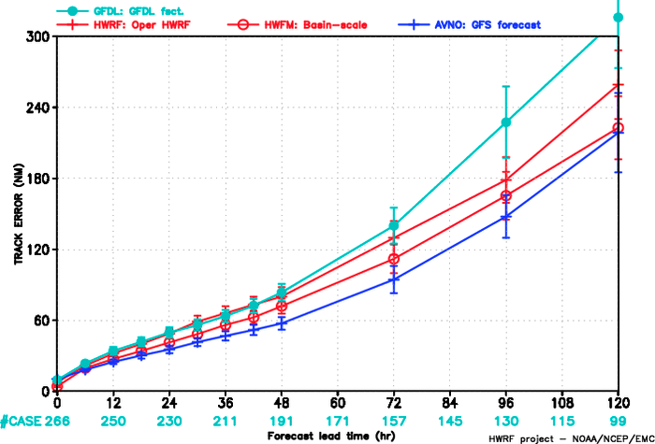
Track error (Atlantic 09-19)

Slide 19
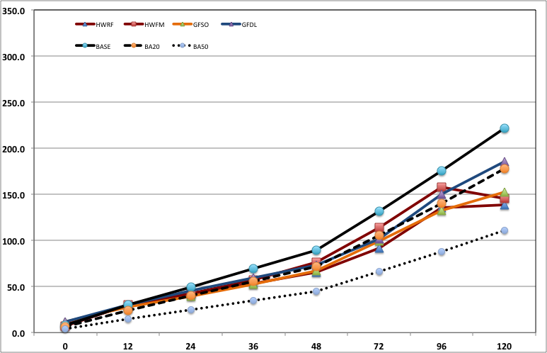
Track error (East Pacific 01-17)
Track error (NM)
Forecast lead time (hr)

Slide 20
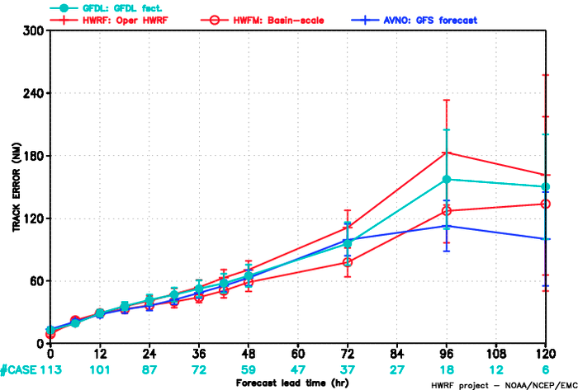
Track error (East Pacific 09-17)

Slide 21
Ongoing research & Implementations
Complete verification of the season retrospective forecasts (Stan, Thiago, & Xuejin)
Diagnose differences among good and bad cases (Hua & Gopal)
Automate vortex initialization and create a benchmark (Thiago, Qingfu, Xuejin)
Test different initial conditions from different DA systems (Xuejin & ??)
Implement UPP for basin-scale modeling system (Thiago & ??)

Slide 22
Challenges
Optimize the code to meet the operational time constraint (Javier & ??)
Initialize the forecast system (Qingfu & Xuejin)
Ocean coupling (??)
Post-processing (Thiago & ??)
Forecast products (??)

Slide 23
Conclusion
The modeling system is under development and showing significant improvement on track forecast
Vortex initialization through DA or cycling is an essential part to improve intensity forecasts
Forecast efficiency will be critical to the pathway toward operational implementation

