Slide 1
HWRF simulations of landfalling tropical cyclones – Effect of land surface charateristics on the evolution and life of storms.
Subashini Subramanian
Purdue University

Slide 2
Idealized study to study sustenance & decay of tropical storms over land using HWRF
Two major changes of the storm environment at landfall cause it to weaken:
  loss of the ocean energy source/ moisture
  increased friction.
But there are instances where the storm has been known to reintensify/ sustain itself over land eg. TS-Erin over N. Atlantic, Phet over Arabian Sea etc.
Land Use and soil type were changed to study the evolution of storms

Slide 3
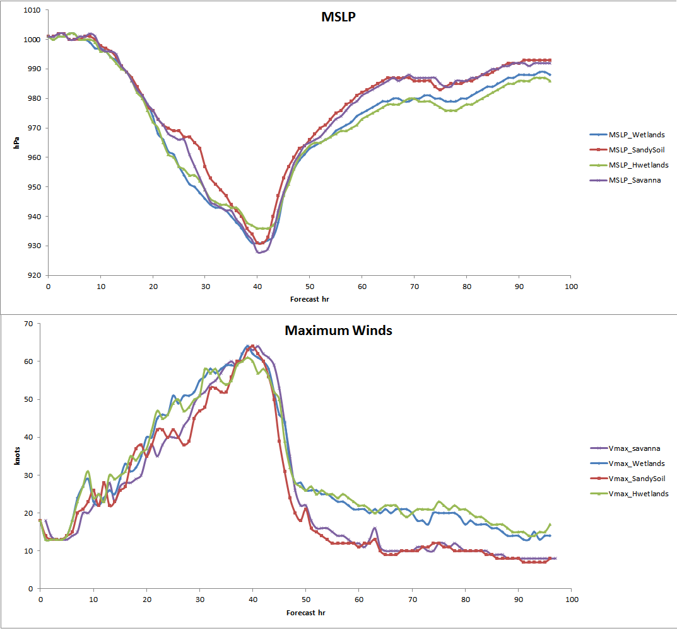
MSLP & Max. winds

Slide 4
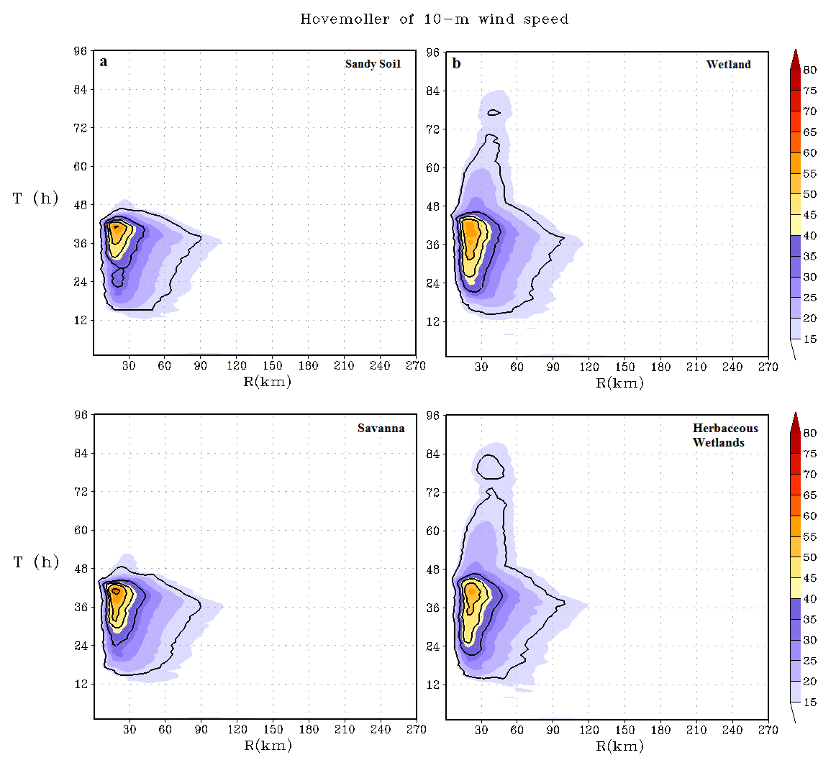
Axisymmetric mean tangential winds at a height of 10 m at 60th forecast hour

Slide 5
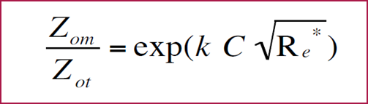
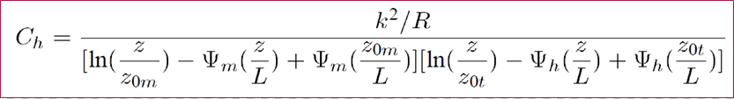
Surface layer parameterization for roughness length for moisture and temperature
Surface fluxes are more sensitive to treatment of roughness length for heat/ moisture than compared to Monin-Obhukhov Similarity based surface layer schemes. (Chen et al., 1997)

Slide 6
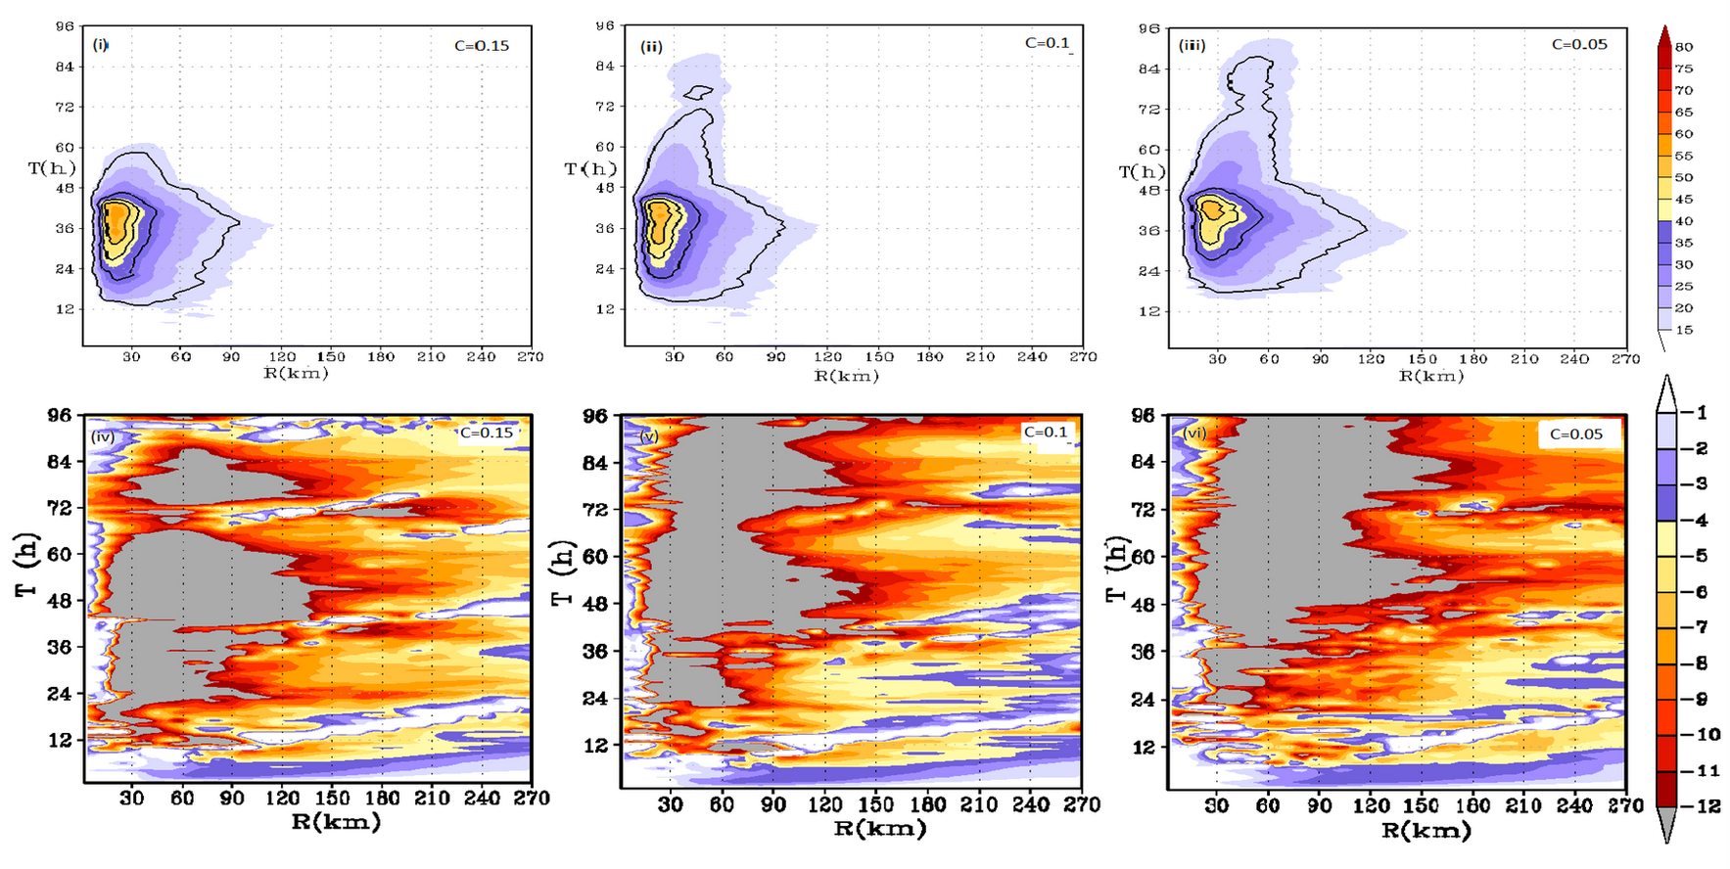
Fig 2: Time history of intensification for Desert Conditions (i, ii, iii) Hovemoller of axisymmetric winds (m/s) at 10 m and (iv, v, vi) Hovemoller of inflow (m/s) for different Zilitinkevich coefficient. (C=0.15, 0.1, 0.05)

Slide 7
Conclusions
Changing the cloud droplet concentration as indicative of increase in ccn from aerosols causes no changes in simulations
Surface layer and its parameterizations play an important role in sustaining and re-intensifying storms.
In the absence of latent heat fluxes over land, sensible heat flux can contribute to the sustenance of storms. By modifying Zilitinkevich coefficient, the surface exchange coefficient for heat changes and increased C_{h} decreased the inflow and the intensity of storms and vice-versa.
Higher the sensible heat flux, higher is the evaporation from the surface and the precipitation from the low pressure system helps in keeping the moisture fluxes high enough to sustain the storm for a short duration.

Slide 8
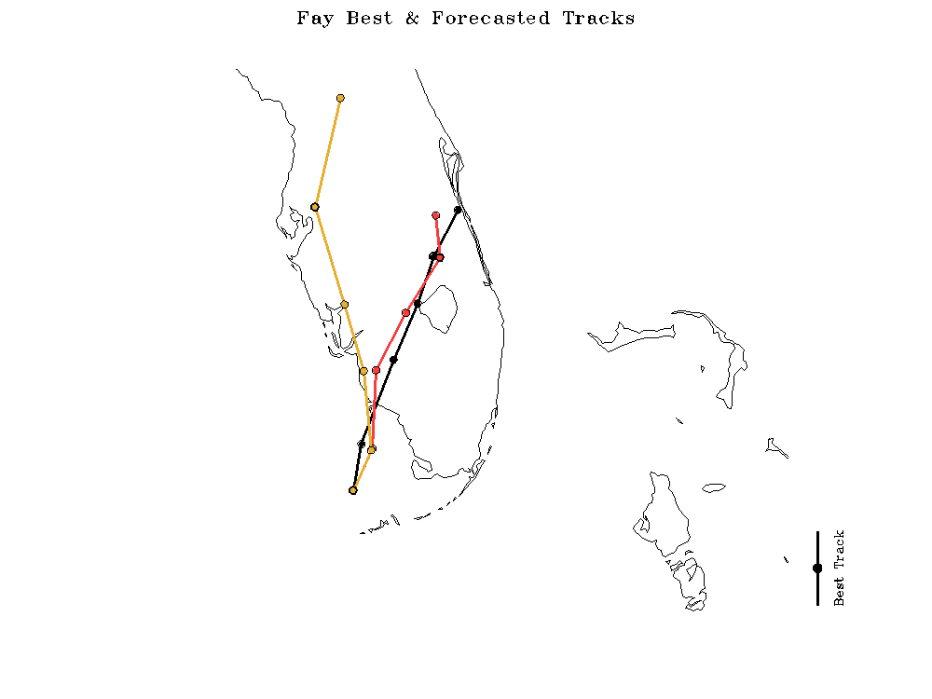
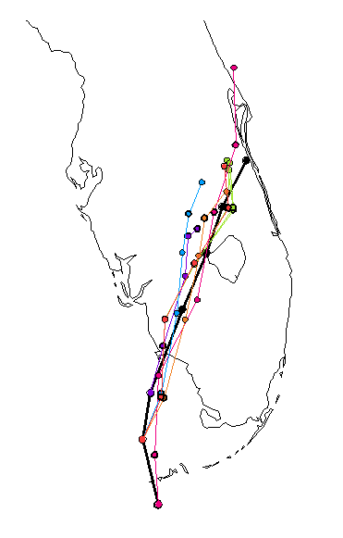
Ensemble LSM response on TS Fay (2008) track (Laureano et al. 2011)
Black – NHC best track observations
Red – Noah LSM (dynamic soil moisture/temperature)
Yellow –default simple Slab land model (constant soil moisture)
a)
c)
Critical need for improved land models and coupled boundary layer physics to benefit from the plethora of satellite LC products now available. Need to move beyond representation and help improve processes of LC feedbacks

Slide 9
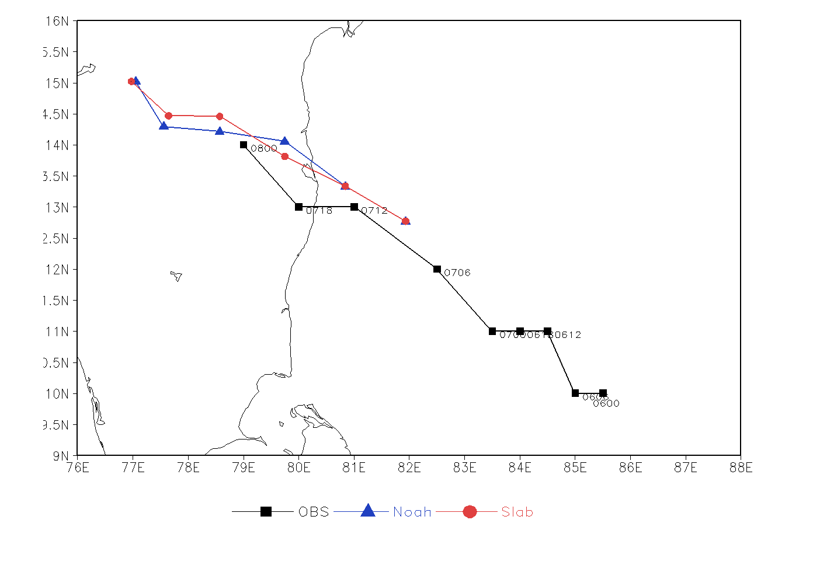
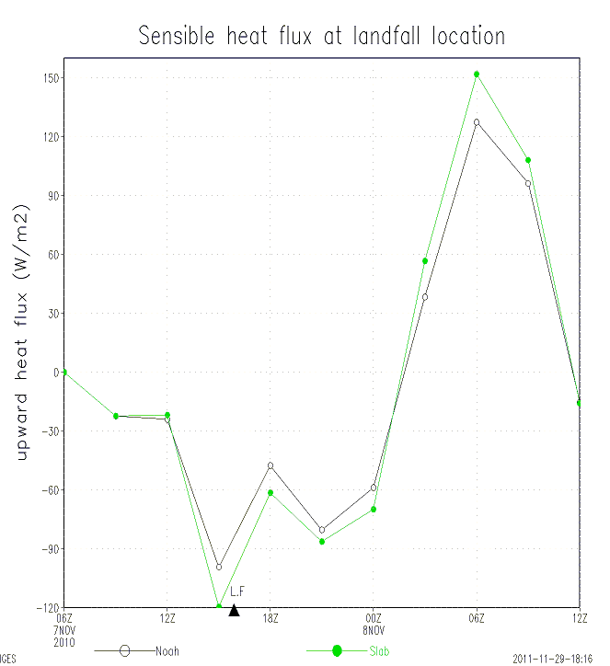
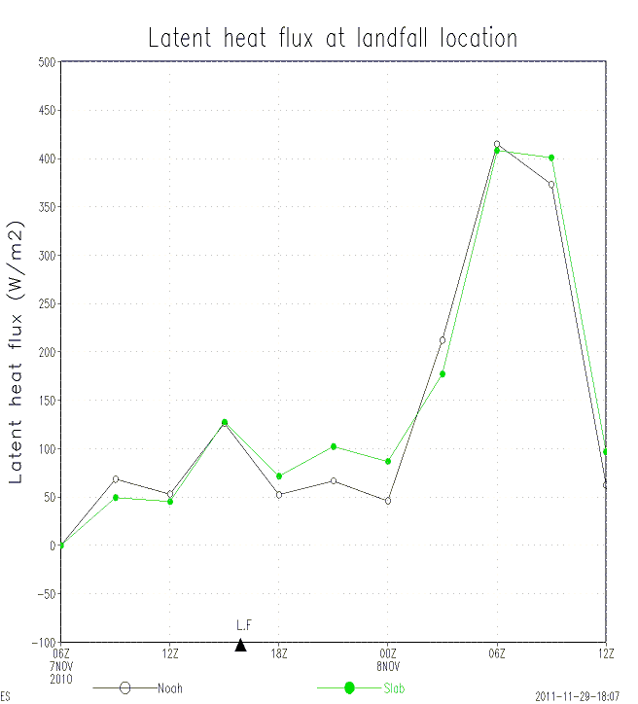
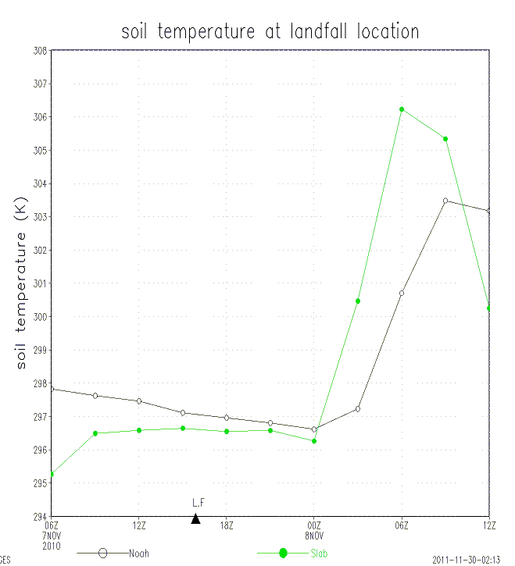
Cyclone Jal – Indian Monsoon Region
WRF – ARW study
SLAB does better in terms of track though either SLAB or NOAH did not predict landfall correctly
Study for more cyclone in IMR underway
Tendencies of SLAB and NOAH to predict Soil temperature, sensible heat flux and latent heat flux

Slide 10
Future work
Understand mechanism by which sustenance/ reintensification occurs using HWRF. (Emanuel et al. 2008, Gopal 2012, Laureano 2012 etc.)
Develop a climatology of landfalling TCs and monsoon depressions similar to Kishtawal et al (2012).
The soil heat capacity measurements along with 3-hourly TRMM/TMPA rainfall observations to assess how fast or slow storms is decay and arrive at an analytical relationship between the two which would help establish a strong interaction between land surface conditions and TC activity over land. (Predator-Prey cycle???) (Basin scale)

Slide 11
Performance of the Slab to Noah transition will be documented using the model simulations for select cases over IMR using HWRF and include rainfall verification. WRF-ARW runs already complete.
HWRF with LDAS (or LIS) and 3D-variational (3DVAR)-based satellite data initialization (HWRF Basin Scale)

Slide 12
Questions??

