Slide 1
Updates on DTC HWRF RI forecast evaluation
Shaowu Bao and Ligia Bernardet
Feb 16 2012

Slide 2
What’s new
Data source: HWRF baseline output.
Performance diagram.
Stratification based on track errors.
Scatter-plot.

Slide 3
Data source:
2012 hwrf-baseline output (~500 cases)
Best performance
Low POD, high FAR
Slight improve with time relax
No relax
12h relax
24h relax
36h relax
48h relax
bias
CSI
(1-FAR)

Slide 4
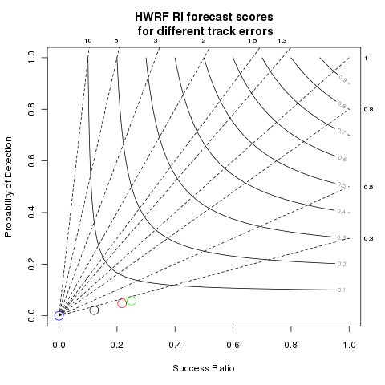
Data source:
2012 hwrf-baseline output (~500 cases)
Best performance
Low POD, high FAR
Choice of low track error did not lead to better RI forecast
Track error <50 nm
50 nm < Track error < 100 nm
100 nm < Track error < 150 nm
150 nm < Track error
Bias
(1-FAR)
CSI

Slide 5
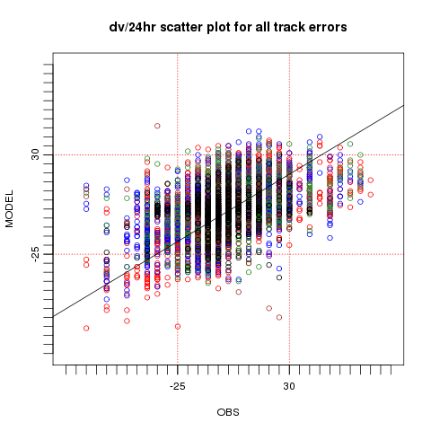
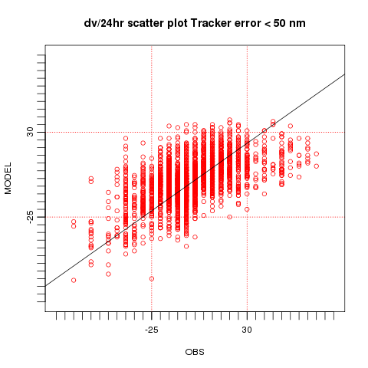
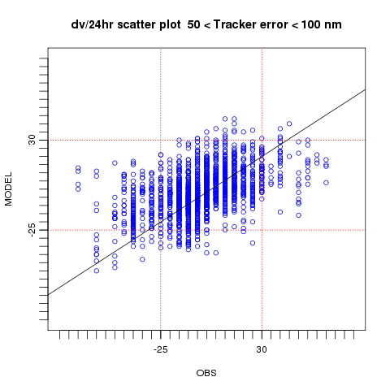
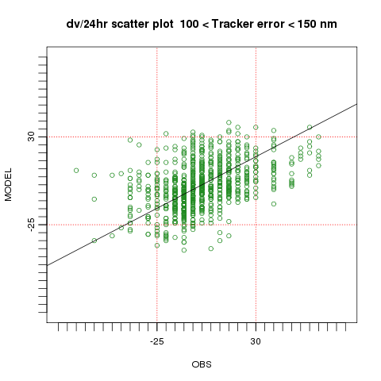
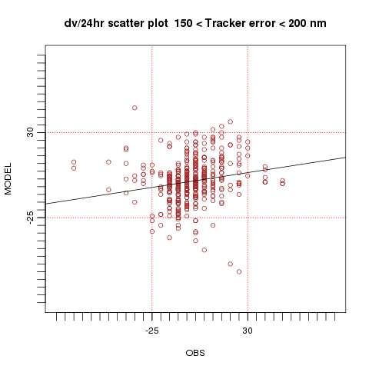
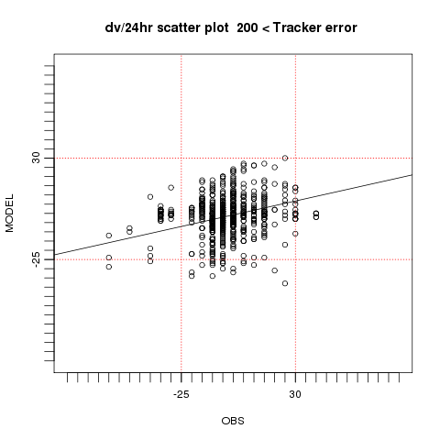
(a)
(b)
(c)
cor=0.48
cor=0.57
cor=0.49
(d)
(e)
(f)
cor=0.18
cor=0.42
cor=0.15
Low track error cases have higher correlation between forecast and best track.

Slide 6
Summary
2012 hwrf baseline output is used to evaluate the intensity change forecast performance.
POD is low and FAR is high.
Relaxation of RI event matching time windows led to better scores, but the improvement is not much.
When track forecast error is low, the DV/24hr in best track and model forecast have relatively higher linear correlations. The correlation decreases when track forecast errors are high.
The RI forecast scores are comparable for different track errors.

Slide 7
Next steps
Conduct more stratification (environment fields, forecast lead time …?)
Address the issue of different granularities: 5 kt in best track .vs. 1 kt in forecast track
Perform case studies

