Slide 1
HWRF--Genesis application
Xuejin Zhang (UM/CIMAS)
Kevin Yeh (UM/CIMAS)
Thiago Quirino (AOML/HRD)
Mark Boothe (NPS)

Slide 2
Outline
Model configuration (Xuejin)
Web products (Thiago)
Genesis pouch products (Mark)

Slide 3
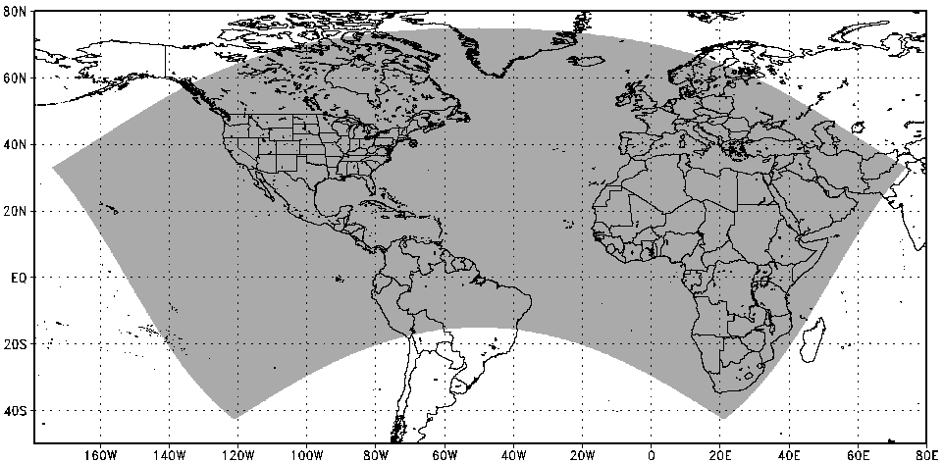
Basin scale domain
Horizontal dimension, 562(W-E)X 502(S-N)
Vertical level: 42 levels
Model top: 50 hPa
Resolution: 0.18 degree
Domain center: 30˚N, 50˚W

Slide 4
Model Configuration
 | HWRF-GEN | Operational HWRF | Stream 1.5 HWRF | GFDL
Domain | 27 KM: 202.14˚ X 90.36˚ Fixed Center: 30˚N, 50˚W | 27 KM: 77.76˚ X 77.76˚ 9 KM: 7.2˚ X 6.0˚ | 27 KM: 77.76˚ X 77.76˚ 9 KM: 10.56˚ X 10.2˚ 3 KM: 7.6˚ X 6.4 | 36 KM: ~75˚ X ~75˚ 18 KM: ~11˚ X ~11˚ 9KM: ~5˚ X ~5˚
Vortex Initialization | No | 27-9 KM: Yes | 27-9 KM: Yes 3 KM: No (Downscaling) | 36-18-9KM: Yes
Cycling | Yes (full domain) | Yes(Vortex only) | Yes (9 km domain vortex only) | No
Ocean Coupling (Ocean model: POM) | No (SST updated by GSI) | 27-9 KM: Yes | 27-9 KM: Yes 3 KM: No (Downscaling) | Yes
GSI | Yes | Yes (Deep case only) | Yes (Deep case only) | No
Platform | JET-Linux | IBM | JET-Linux | IBM
Physics schemes
Microphysics | Ferrier | Ferrier | Ferrier | Ferrier
Radiation (SW) | GFDL | GFDL | GFDL | GFDL
Radiation (LW) | GFDL | GFDL | GFDL | GFDL
Surface Scheme | GFDL (2010 implementation) | GFDL (2011 implementation) | GFDL (2010 implementation) | GFDL
PBL Scheme | GFS | GFS | GFS (Modified for HR implementation) | GFS
Cumulus Parameterization | 2010 SAS | New SAS | New SAS (27-9 KM) no CP (3 KM) | SAS
Land Surface | GFDL Slab | GFDL Slab | GFDL Slab | GFDL Slab
GWD | No | Yes(27km); No(9km) | Yes(27km); No(9-3km) | Unknown

