Slide 1
Comparing HWRF Large-scale fields with GFS analysis
---- Introduction of an evaluation package
Weiguo Wang, Young Kwon, Vijay Tallapragada and EMC HWRF team
5/15/2013

Slide 2
Outline
Movitation
Data/method/Evaluation package
Results
- Time series of skill scores
- Scale-dependent scores
- Two-dimensional spatial distributions
Summary

Slide 3
Motivation
Model large-scale features play important role in determining hurricane track, and hence affecting others such as intensity, despite high-resolution modeling on smaller scales (domains)
Some errors can be explained from large-scale perspective to some degree.
Identify issues/improvements. Model phys tuned over hurricane areas, and may not the best for large-scale flow.
Intend to build an evaluation package, like ..verification, .. easy to use.

Slide 4
Data and Method
Data
“obs” --- GFS analysis
model --- HWRF H131
Method
Use an evaluation package (…..still being built)
Functions
► Direct comparisons, difference, statistics
► Layer-average comparison (e.g., wind), shear
► Derived variables
Steps
► Get meteorological data from GFS ANA and from HWRF GRIB files + track data
► Bi-linearly Interpolate all to a common grid system
► Compute statistics
► Graphics

Slide 5
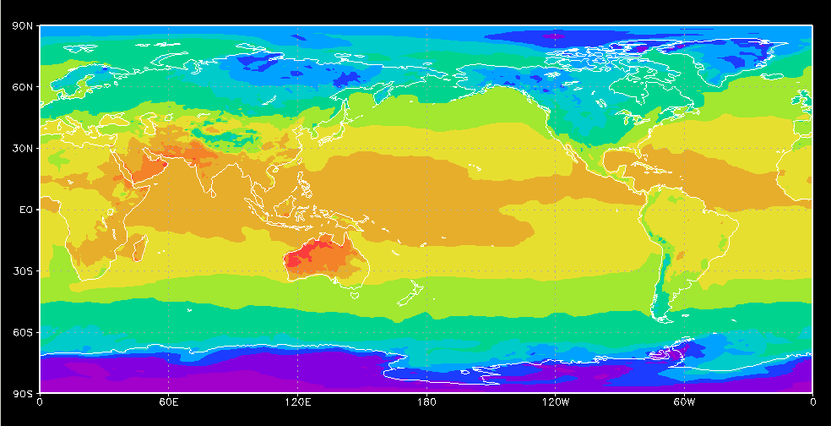
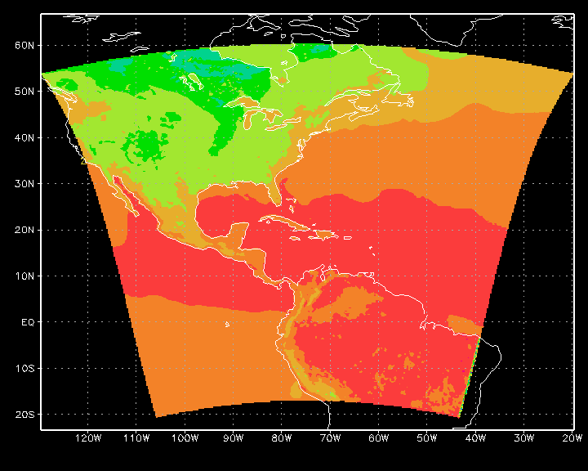
Workflow
GFS-ANA
HWRF
Comparison
Analysis

Slide 6
Statistics (skill scores)
Mean difference
RMS of difference
Max difference
Min difference
Spatial correlation
Scale-dependent R, RMS. R(L), RMS(L)
……More products….

Slide 7
Results
- Time series of statistics
- Correlation on different scales
Differences in 2-D spatial distributions

Slide 8
1. Time series of skill scores (statistics)
HGT 500mb
RH 850mb
TMP 850mb
TMP SFC
WIND 10m

Slide 9
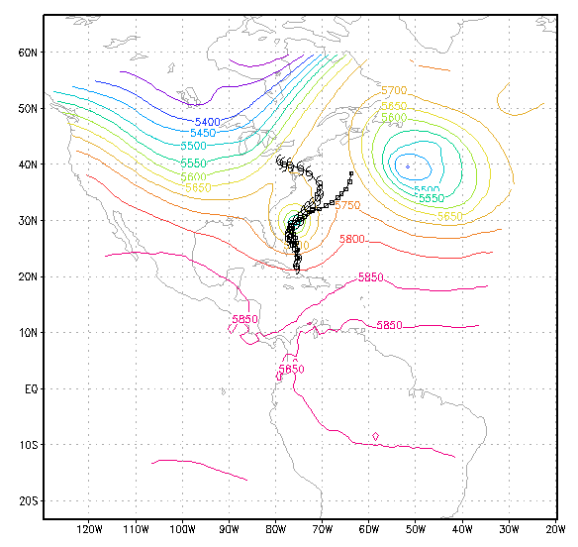
Use Sandy18L 2012102512 as an example
Overview
Go to different directions roughly after 2 days

Slide 10
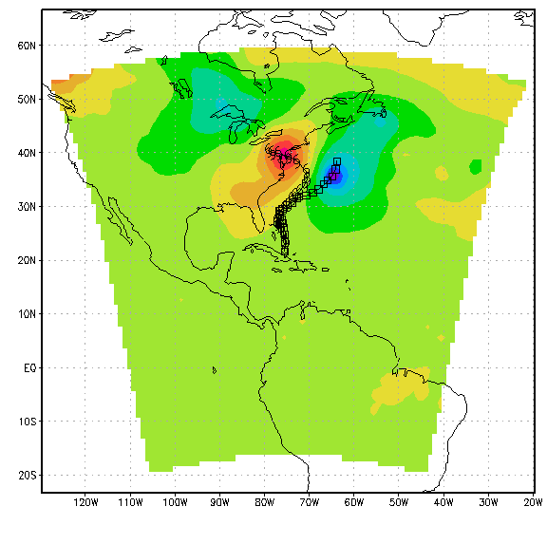
Mask hurricane areas (10X10), e.g., difference in hgt500 at 114hr

Slide 11
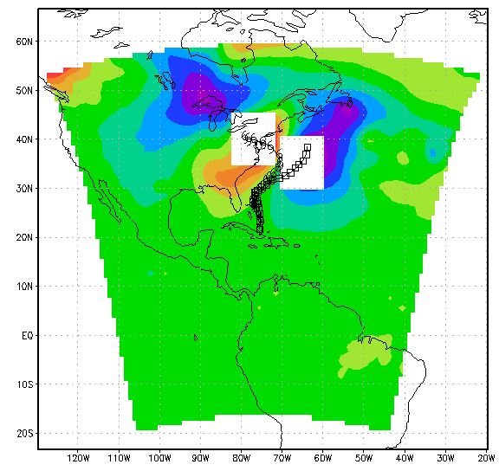
Mask hurricane areas (10X10), e.g., difference in hgt500 at 114hr
11
Notes:
11

Slide 12
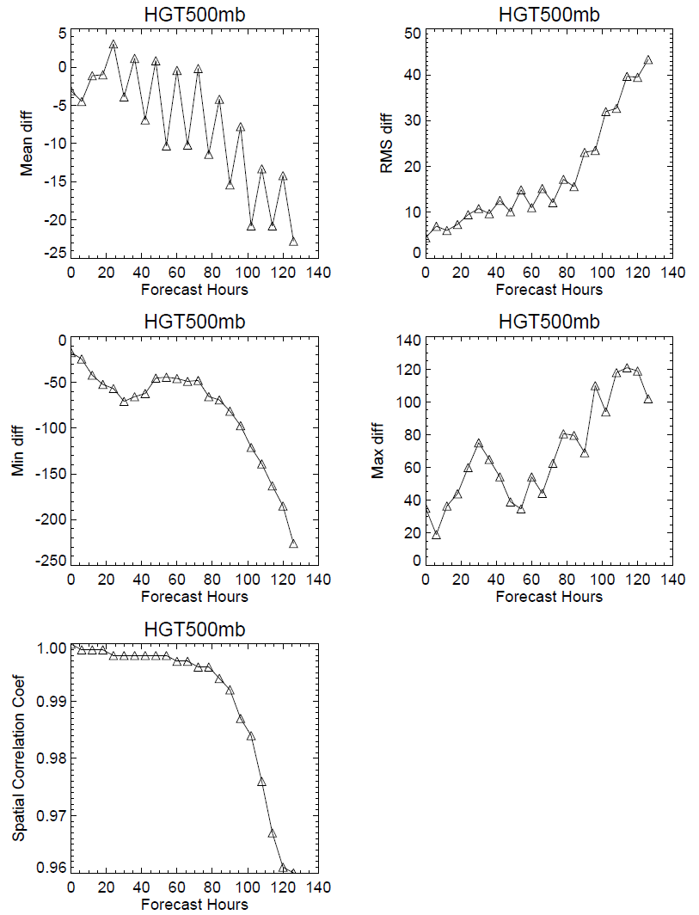
Mean diff
RMS diff
Min diff
Max diff
Mean ..Lower
Very weak diurnal
Spatial pattern similar
Correlation
HGT 500mb

Slide 13
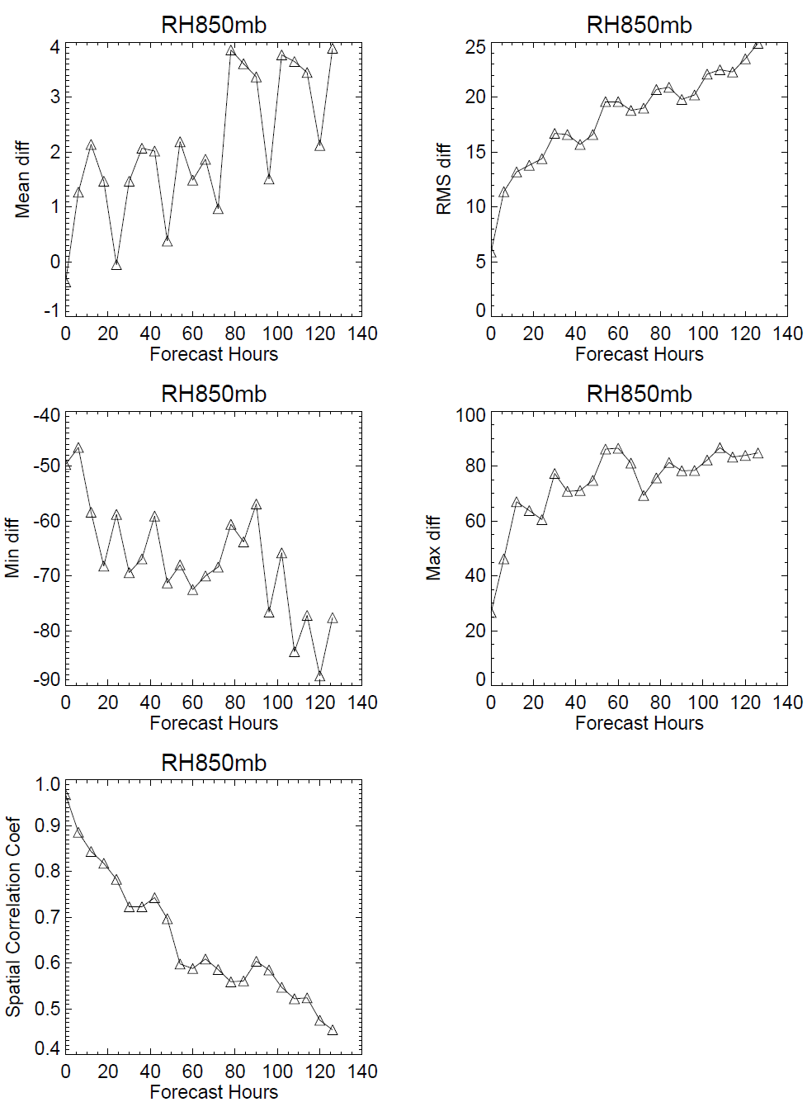
Mean diff
RMS diff
Min diff
Max diff
RH 850mb
Correlation

Slide 14
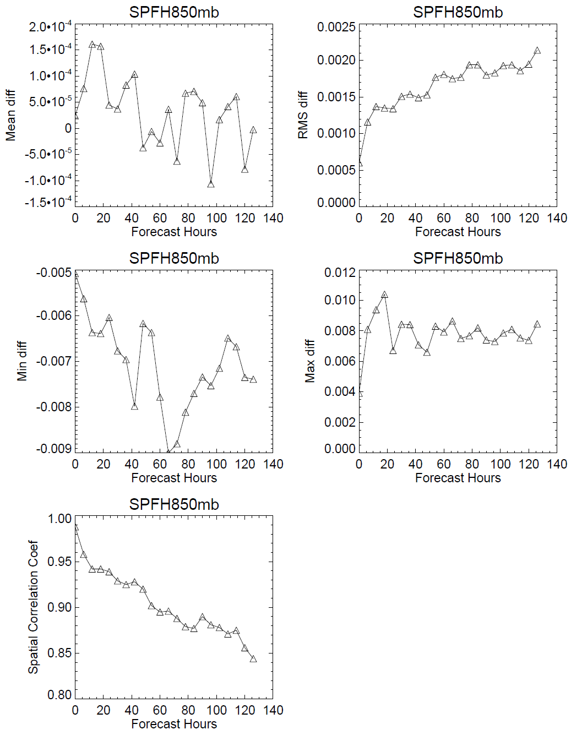
Mean diff
RMS diff
Min diff
Max diff
SPH 850mb
Correlation

Slide 15
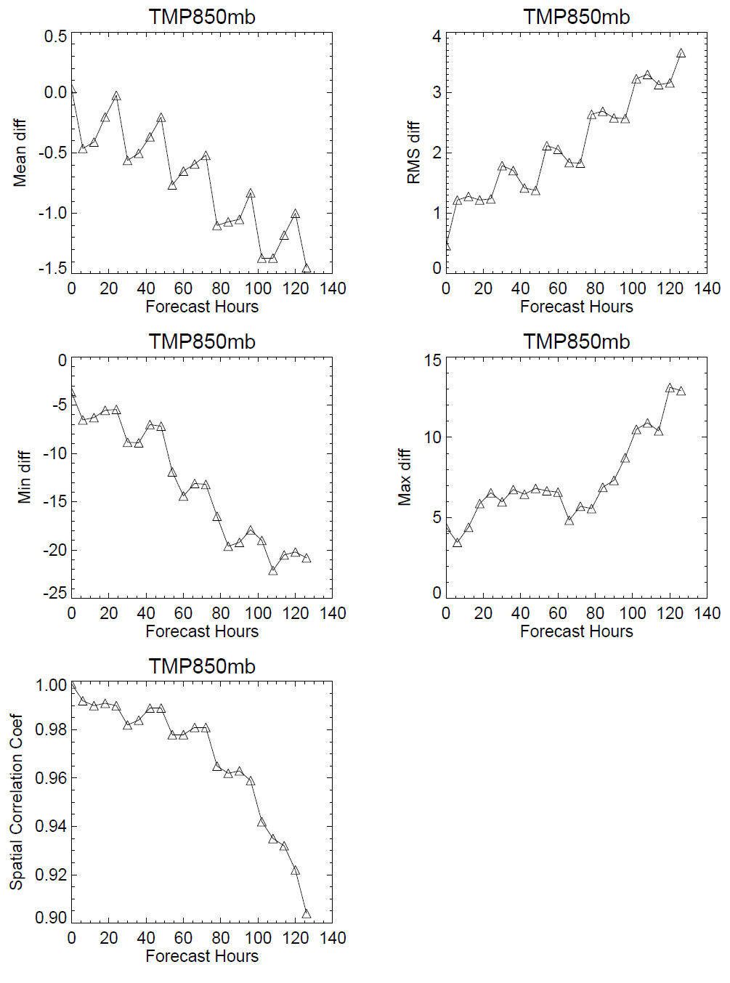
Mean diff
RMS diff
Min diff
Max diff
Diurnal cycle
Land area contributes more
TMP 850mb
Correlation

Slide 16
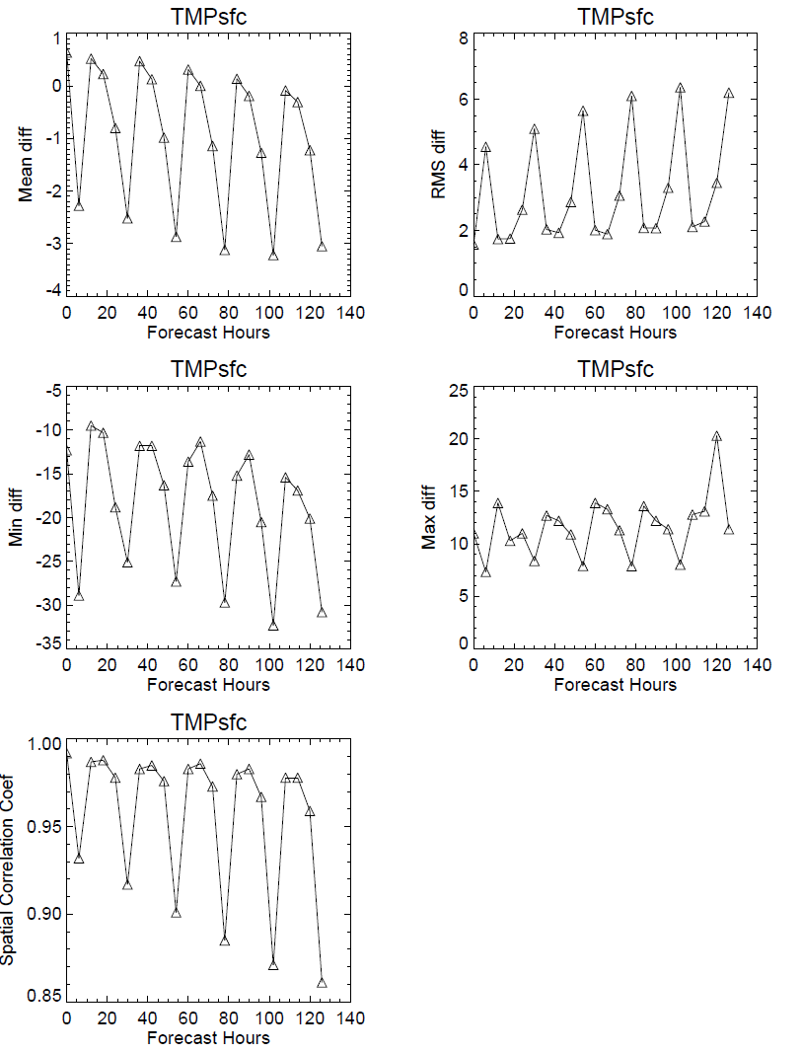
Mean diff
RMS diff
Min diff
Max diff
Diurnal cycle
Land area contributes more
Mountain area
TMP sfc
Correlation

Slide 17
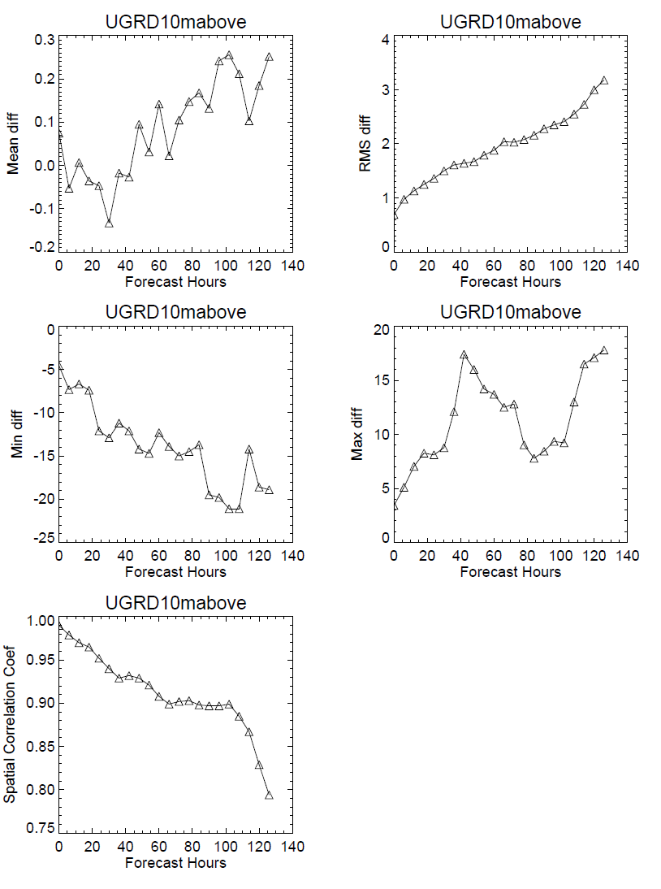
Mean diff
RMS diff
Min diff
Max diff
No diurnal
Spatial pattern similarity not as good as HGT
U 10m
Correlation

Slide 18
2. Scale-dependent scores
Wind 850mb
HGT 850mb
TMP 850mb
TMP SFC

Slide 19
Formula
Fractional contribution of MS at L
[0—1]

Slide 20
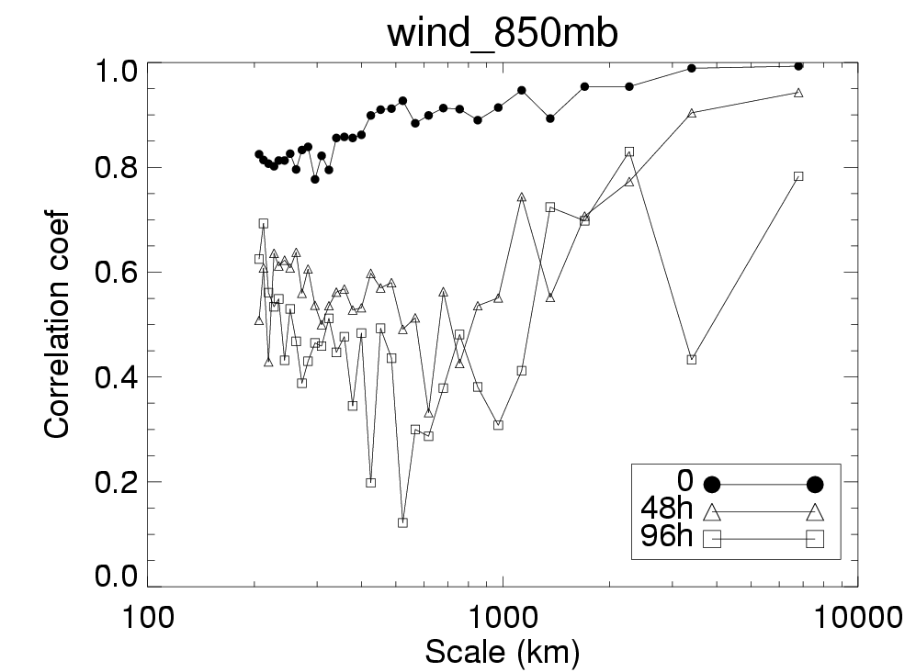
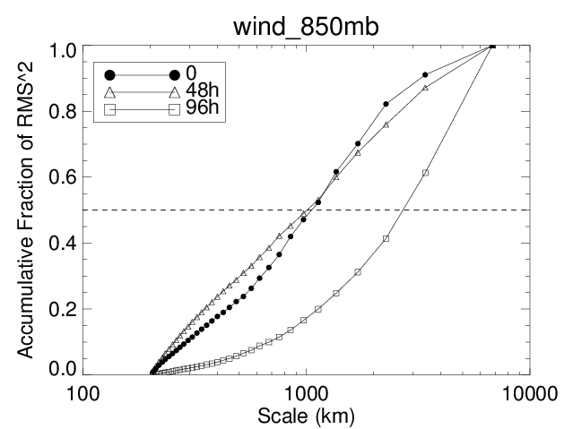
48h
850mb Wind speed
Time 0 : low on (relative)small scales
48h: decreases more on small scale
96hr: decrease on large scales
0/48hr: 50% of mean square of difference contributed by scales <1000km
96hr, larger scales contribute more.
96h
50%
96h

Slide 21
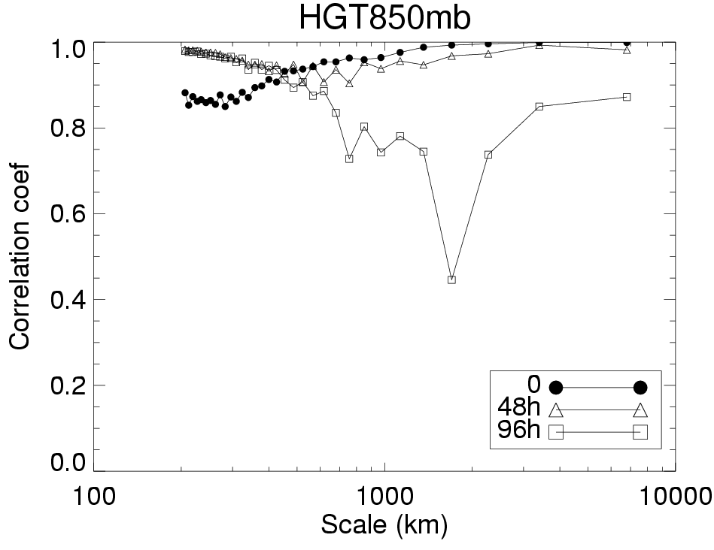
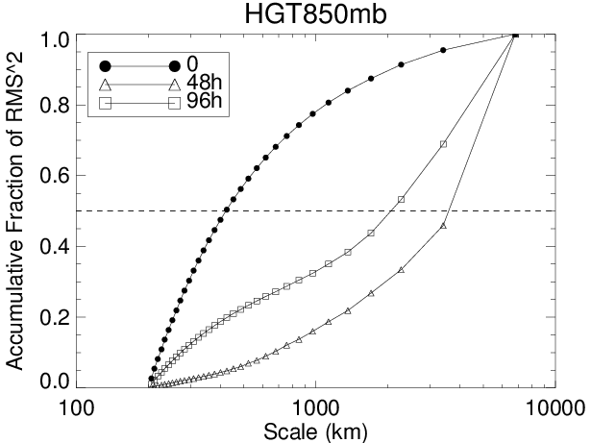
96h
Initial time: low on small scales
Later: low on larger scales, may be due to hurricane locations
Larger scale contribute more with time (in terms of fraction)

Slide 22
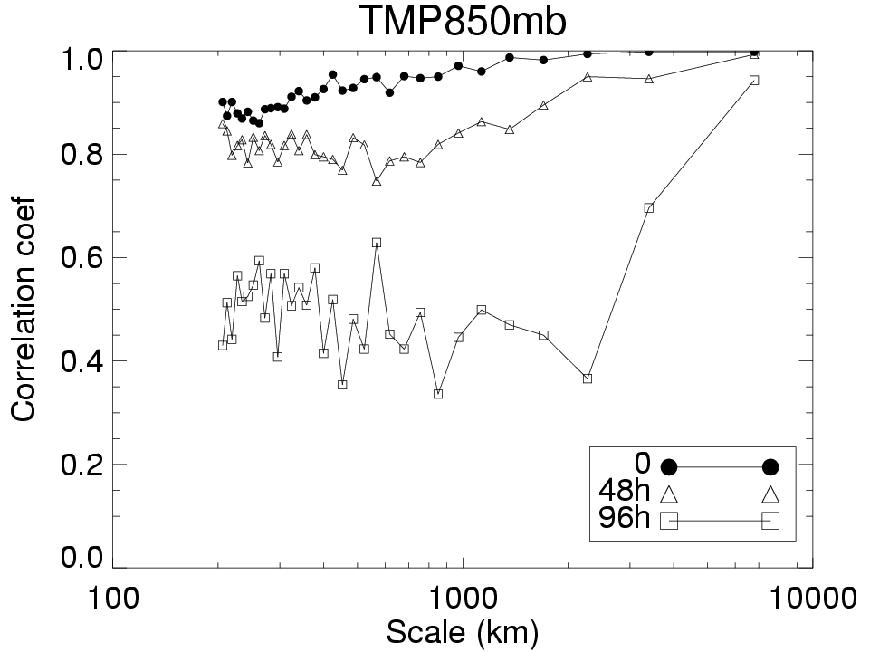
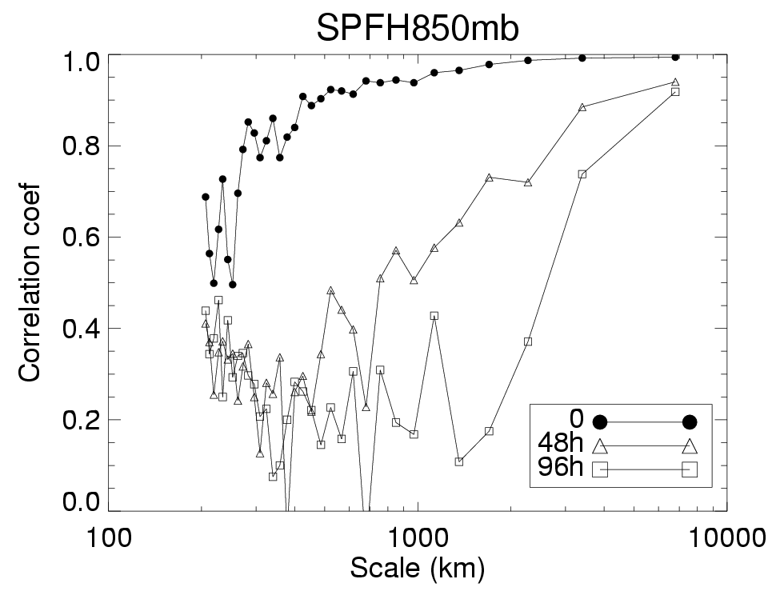
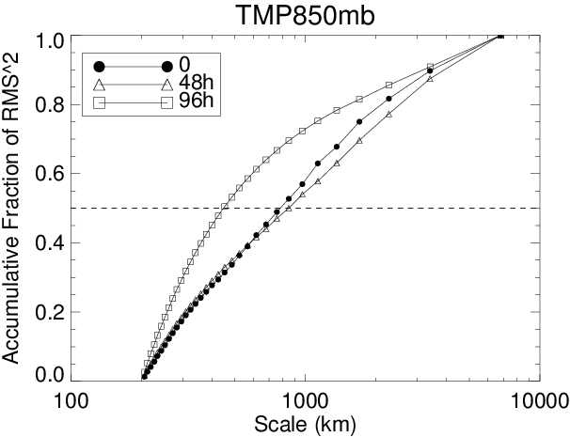
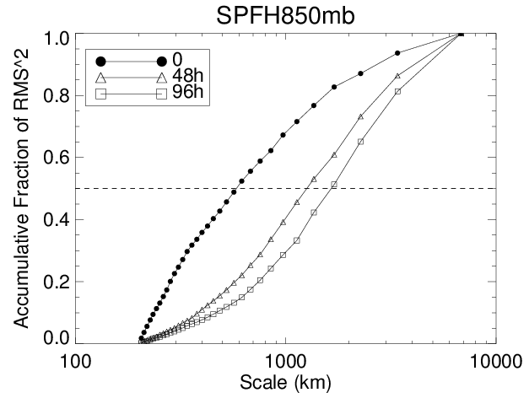
48h
Decrease more with time at smaller scales
48h
96h
96h
96h
96h
With time, small scales contribute more
With time, lg scales contribute more

Slide 23
Discussion:
Why are those scores different at different scales ?
Scale-dependent physical processes, dynamical processes? numerical ?
Improve?
……

Slide 24
3. Two-dimensional patterns
TMP 850mb
SPH 850mb
HGT 500mb
Mean wind 850-200mb
Share 200-850mb
TMP SFC

Slide 25
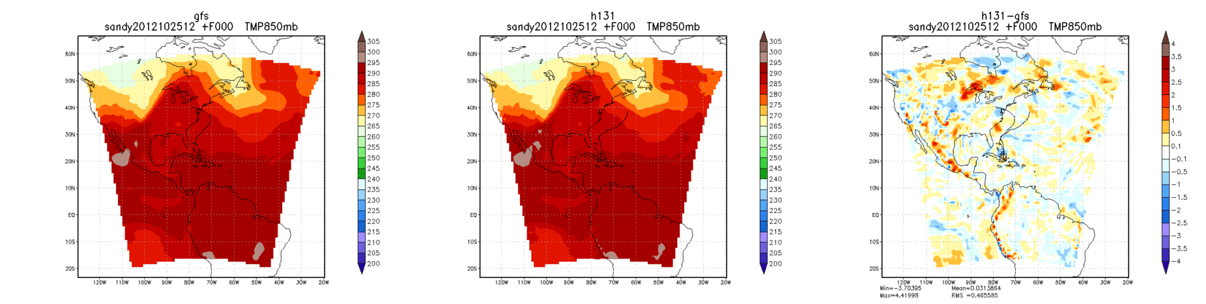
850mb Temperature
GFSANA
H131
H131-GFSANA
Similar Spatial distribution
Diurnal cycles
Significantly colder over land; a little bit warmer over ocean

Slide 26
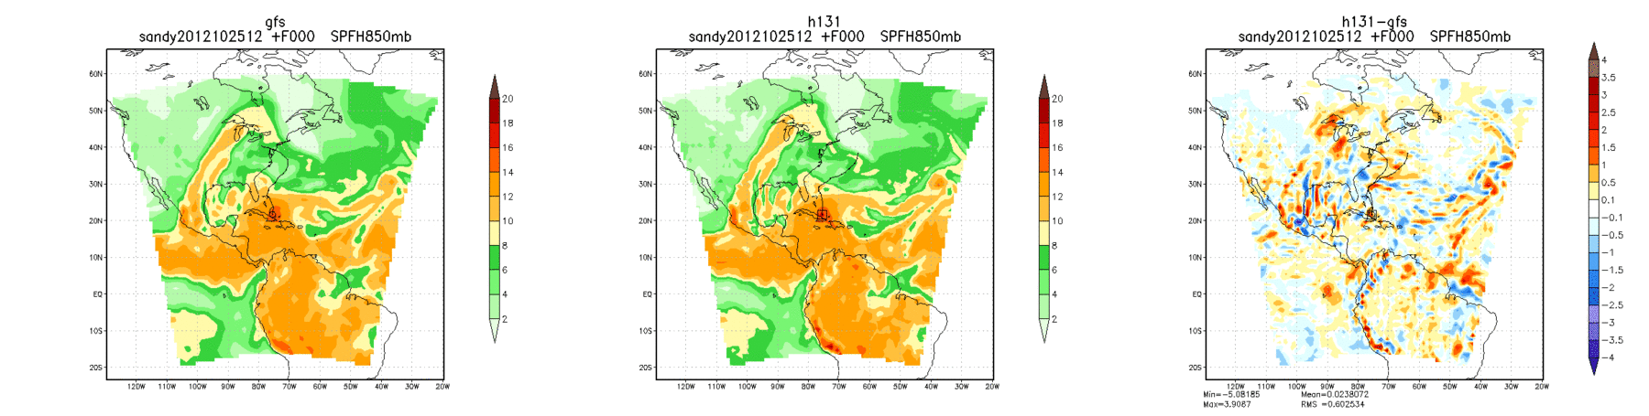
850mb Specific Humidity
GFSANA
H131
H131-GFSANA
Weaker diurnal cycle of difference
Large spatial variation, maybe associated with microphys

Slide 27
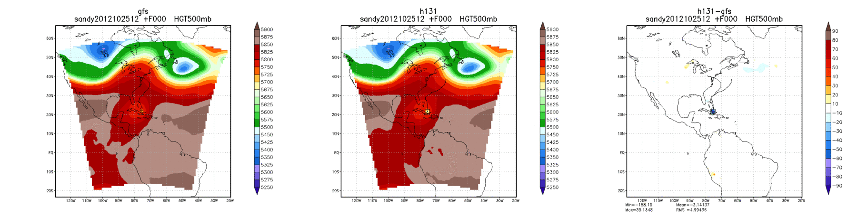
500mb HGT
GFSANA
H131
H131-GFSANA
Before 48hrs, differences are small
H131’s weaker trough over land in early hours may give a clue to explain why track goes NE rather than NW in later hours
improvements over land may be needed

Slide 28
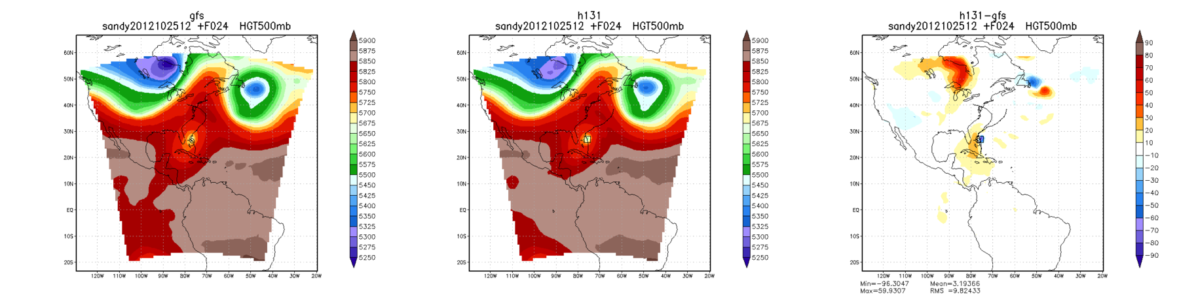
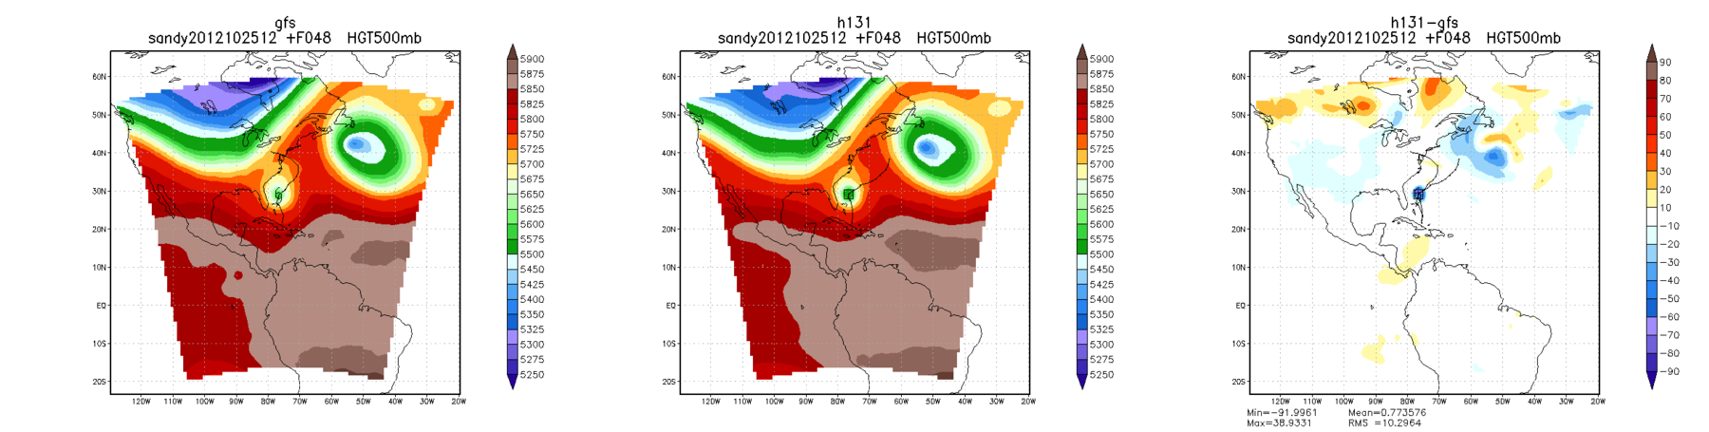
GFSANA
H131
H131-GFSANA
24hr
48hr
Weaker low pressure/trough, H131 may move a bit slower ? Even very small diff may lead to large diff later, complicated flow

Slide 29
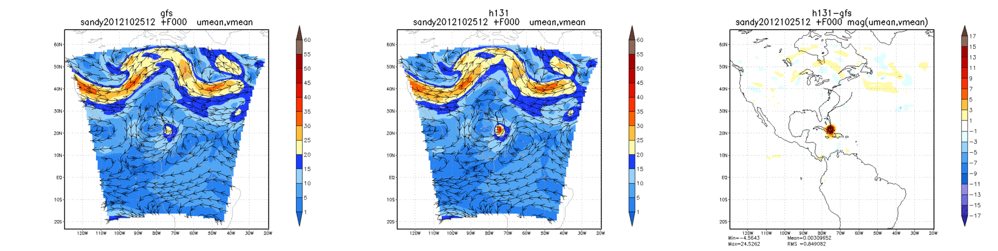
850 to 200mb layer-mean wind
GFSANA
H131
H131-GFSANA
Sandy roughly follows the mean flow streamline
H131 position in the west-east flow at ~48hr, while real hurricane goes into circulation area, changing track afterwards

Slide 30
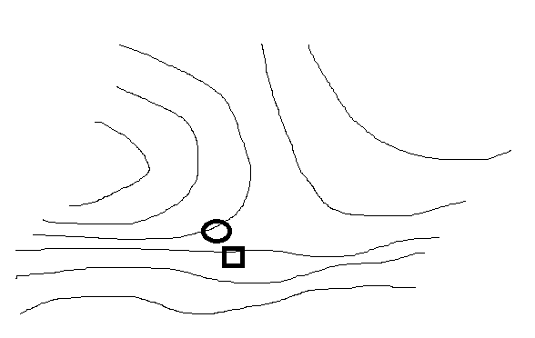
A sketch
Hurricane Positions before going to different directions
OBS
HWRF
Complicate flow area, wind direction shear, circulation, H moving speed
Small diff -> large diff later; Improve phys ? Ensemble ?

Slide 31
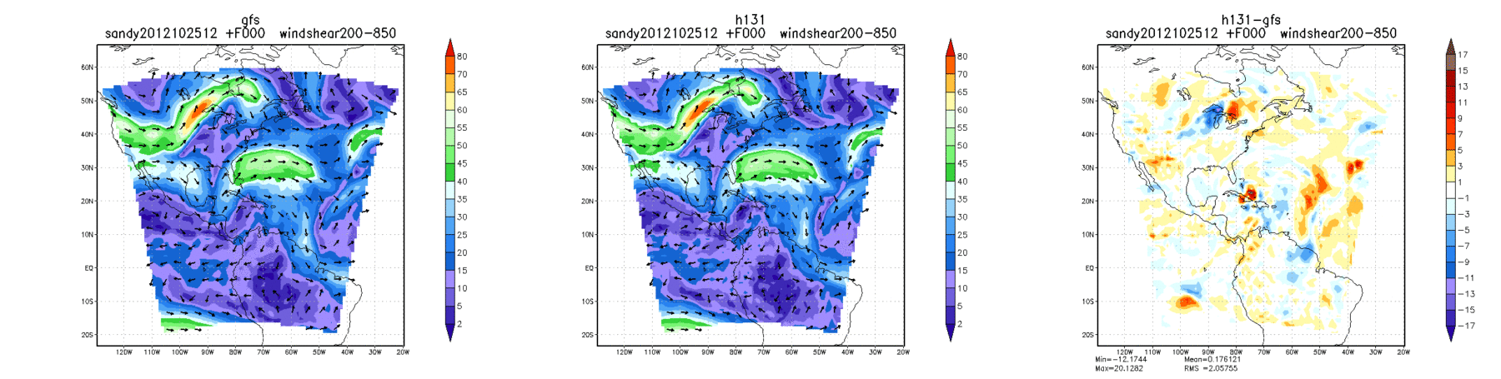
200-850mb wind shear
GFSANA
H131
H131-GFSANA
Before 48hr, similar pattern
Overall, H131 shear larger over ocean

Slide 32
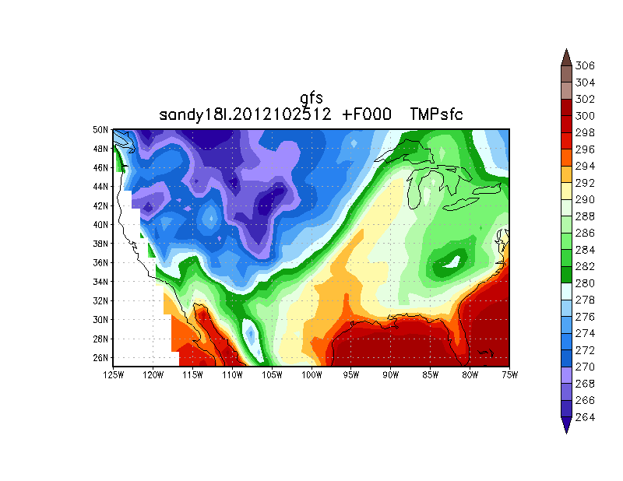
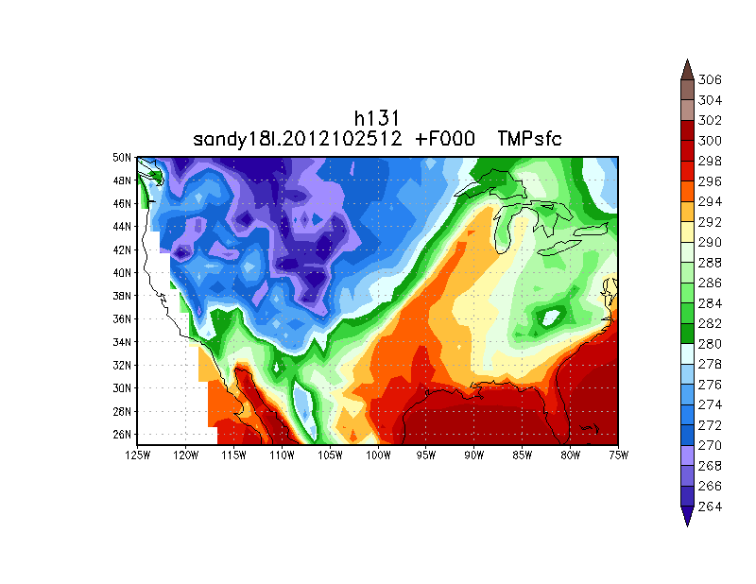
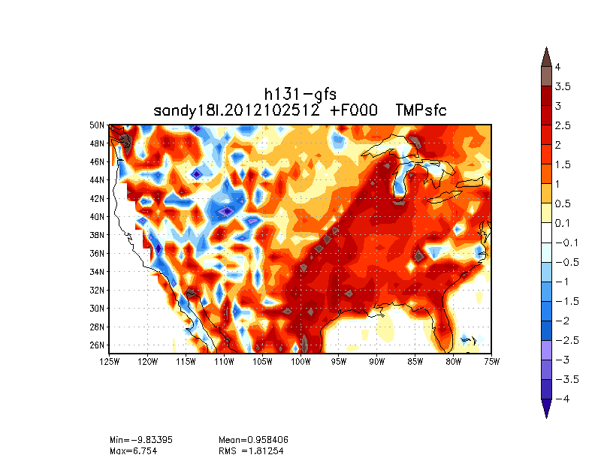
Skin temperature over CONUS
GFSANA
H131
H131-GFSANA

Slide 33
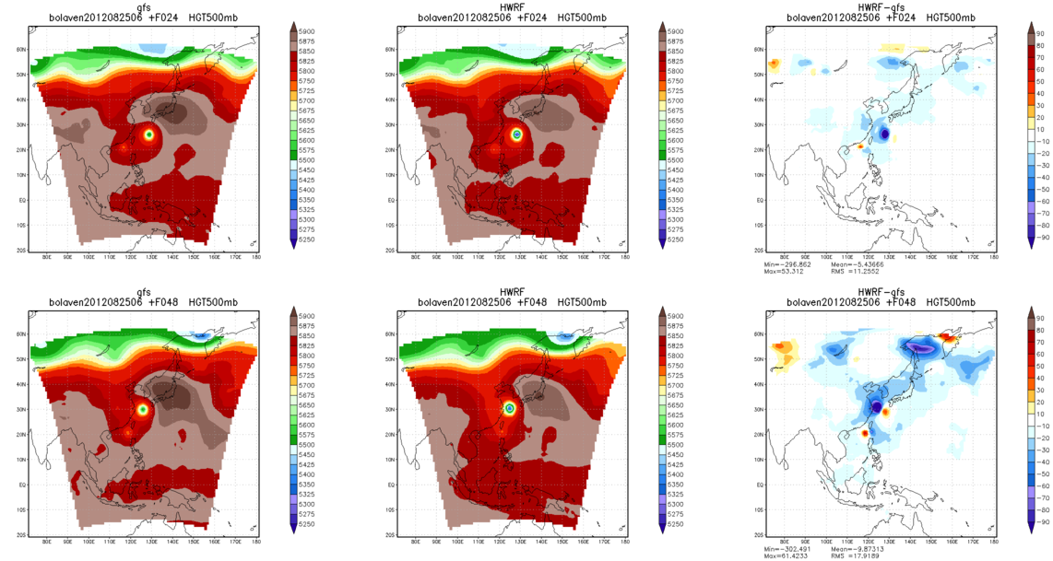
Application to West Pacific Area
Track errors partly due to Weaker Western Subtropical High(16W)
24h
48h

Slide 34
Summary
Evaluation of HWRF-generated large-scale fields is introduced, may further develop
Sandy case indicates
- generally very good spatial distribution
- point-to-point differences may be large
- obvious diurnal cycles of temp, humidity difference
- colder over land, a bit warmer over ocean
- skill scores changes with time differently on different scales
Future work: Continue to develop evaluation (including precipitation…); try more cases….

