Slide 1
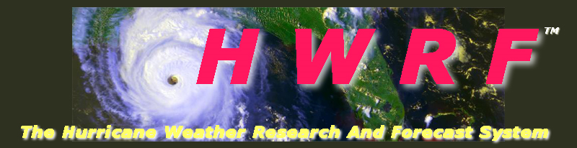
HWRF Real-Time FY2011 Parallel Experimental Forecasts (Stream 1.5 & Stream 2)
Vijay Tallapragada, NOAA/NCEP/EMC
Notes:
1
1

Slide 2
Planned HWRF Experimental Forecasts FY2011
  HFIP Stream 1.5 Demo Configurations (EMC/HRD):
    High-Resolution triple nested 27:9:3 HWRF
      2011 Operational HWRF Physics (EMC)
      Alternate physics options for high-resolution (EMC/HRD/ESRL)
      Coupled to POM/HYCOM (EMC)
      Operational vortex Initialization and cycling at highest resolution (3 km) (EMC/HRD)
      Alternate vortex initialization procedure (EMC)
      GSI run on 3 km analysis domain and 27 km outer domain (EMC)
      High-resolution vortex tracker (EMC)
      Hourly output for 3-D and 2-D variables (EMC/HRD)
      High-Frequency (9-minute or higher) output for storm location, Vmax, Pmin and location of Vmax and Pmin from 3 km domain (EMC)
      Post-processed output includes high-resolution satellite imagery (EMC/HRD)
  HFIP Stream 2.0 Demo Configurations from EMC:
    HWRF-HYCOM coupled system with 2011 operational HWRF physics and initialization and cycling (27:9:3)
    HWRF-POM-NOAH LSM coupled system with 2011 operational HWRF initialization and cycling (27:9:3)
    HWRF-Hybrid DA experiments (27:9 and/or 27:9:3) with emphasis on assimilating real-time TDR data
    HWRF with modified GFS Shallow Convection, PBL, radiation and microphysics (27:9 and/or 27:9:3)

Slide 3
Selection of Stream 1.5 Configuration
(Advance FY2012 Pre-implementation T&E)
Experiment | Physics | Coupling | Initialization | Evaluation
H3P1 HWRF 27:9:3 | 2011 Oper. Physics | POM | 2011 Oper. Init w/ cycling | In Progress. Similar experimental runs for 89 cases from HRD are expected to feed into proposed Stream 1.5 configuration
H3P2 HWRF 27:9:3 | Modified 2011 Oper. Physics and other parameters configured for 3 km domain | POM | Modified 2011 Oper. Init for d03 w/ cycling
H3HW HWRF 27:9:3 | Modified 2011 Oper. Physics and other parameters configured for 3 km domain | Uncoupled | HWRF ICs | HRD experiments

Slide 4
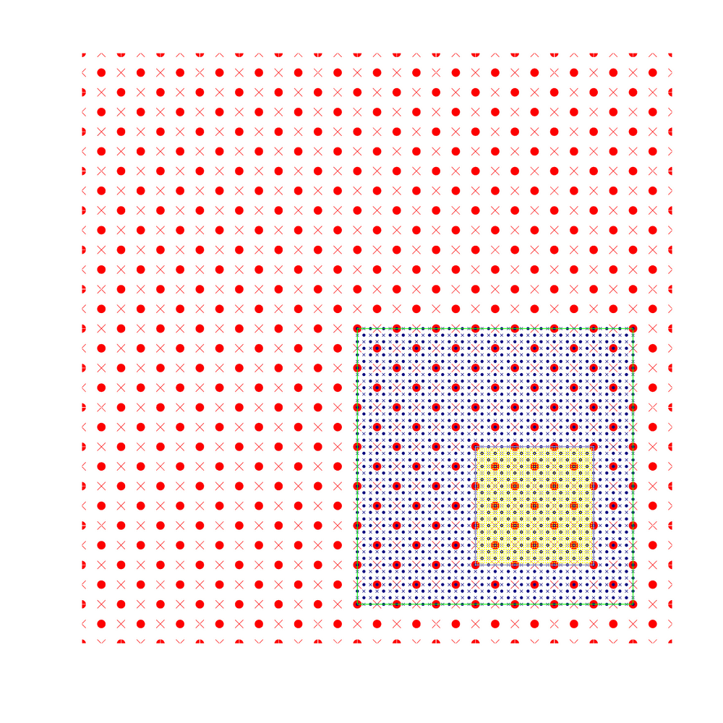
Third Nest Configuration
D01 (27 km)
D02 (9 km)
D03 (3 km)
Nest movement (HRD’s Centroid based algorithm)

Slide 5
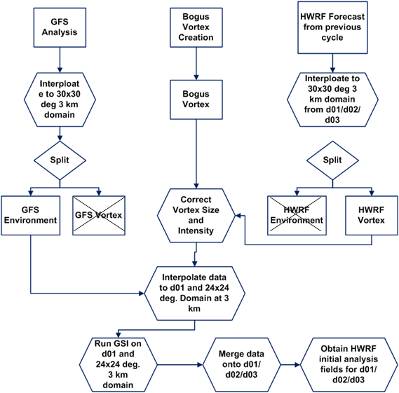
Initialization for Third Nest
Extension of EMC/HRD 2011 HWRF operational initialization

Slide 6
Background
HWRF vortex initialization/relocation
Warm start: GFS environment + relocated and modified HWRF 6hr forecast vortex
cold start: GFS environment + bogus vortex
hybrid
short range ensemble forecast x_{k}^{en}
x
(multiple time levels of background if FGAT)
… x ^{t-1}, x, x^{t+1}, …
GSI (includes Hybrid DA Capability)
Assimilated obs
Potential and future obs
rawinsonde, pibal, class sounding, profiler, dropsonde, AIRCFT, AIRCAR, GPSIPW, surface marine/land/splash-level/mesonet satellite wind
satellite radiance data: HIRS, AMSU-A, AMSU-B/MHS, AIRS, GOES sounder
NOAA P3 TDR
Pseudo-MSLP
Data selection, quality control, data thinning
NOAA and USAF: flight level data, SFMR data
new dropsonde
cloud radiance data
Iterative minimization
3DVAR cost function
2J(x) = x^{T}B ⁻¹ x + (Hx - y)^{T} R⁻¹ (Hx - y) + J_{c}
climatological isotropic B_{c}
flow-dependent anisotropic B_{a}
hybrid
B=(β₁⁻¹B_{c} + β₂ ⁻¹ P^{en}oS)
ensemble covariance P^{en} = Σ x_{k}^{en} ( x_{k}^{en})^{T}
EnKF
Update ensemble members (x_{k}^{en})
Analysis x_{a}
Post Balance
Ensemble forecast
126 hours forecast
(3, 6, 9 hr forecast)

Slide 7
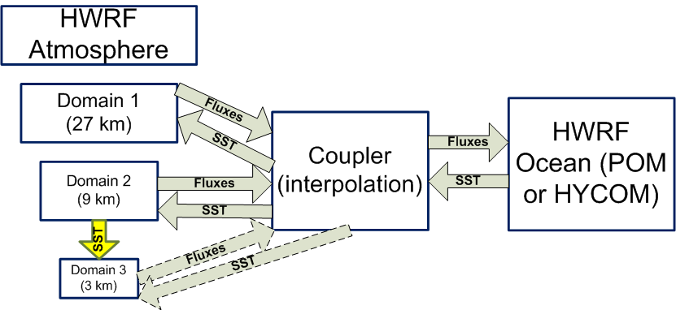
Coupler for Third Nest
Extension of 2-way interactive NCEP coupler (dashed lines represent future development)

Slide 8
Planned FY2011 Real-Time Experiments on t-Jet
Experiment | Physics | Coupling | Init | Resources
Stream 1.5* HWRF 27:9:3 | Choose from Table 1 | POM | Chose from Table 1 | 172 cores per forecast for 4 hrs 15 GB archive space per forecast
Stream 2.0 HWRF-NOAH LSM | NOAH LSM and 2011 Oper. Physics | POM | 2011 Oper. Init w/ cycling | To be run on CCS
Stream 2.0 HWRF-Hybrid DA⁺ | 2011 Oper. Physics | POM | 2011 Oper. Init w/ cycling | 172 cores per forecast for 4 hrs 15 GB archive space per forecast
Stream 2.0 HWRF-HYCOM (Global) | 2011 Oper. Physics | HYCOM | 2011 Oper. Init w/ cycling | 232 cores per forecast for 4 hrs 30 GB archive space per forecast
Stream 2.0 HWRF 27:9:3 HYCOM | Modified Oper. Phys. | HYCOM | 2011 Oper. Init w/ cycling | Development in Progress To be run on CCS or Vapor
Stream 2.0 HWRF 27:9:3 with SC and PBL | GFS Shallow Convection and PBL | POM/ HYCOM | 2011 Oper. Init w/ cycling | Development in Progress To be run on CCS or Vapor
Stream 2.0 HWRF | Radiation & Microphysics | POM/ HYCOM | 2011 Oper. Init w/ cycling | Development in Progress To be run on CCS or Vapor
Stream 2.0 HWRF 27:9:3 w/new init | 2011 Oper. Phys | POM/ HYCOM | New Init w/ cycling | 172 cores per forecast for 4 hrs 15 GB archive space per forecast
 |  |  | Total | 748 cores per forecast cycle 75 GB archive space per forecast
+Tagged to real-time GFS Hybrid DA Ensemble Runs on CCS or tJet

Slide 9
Some outstanding issues:
Interpolation of SSTs from d02 to d03
  use nearest neighbor approach to avoid inconsistencies due to land/sea mask
  interpolation is done inside WRF and consistent with other interpolations at the leading edge as well as for the child domain
Initialization for d03 is to be finalized soon
Product Generation, Dissemination and Graphics
Tier I and Tier II products for TCMT evaluation
Model Diagnostics

