Slide 1
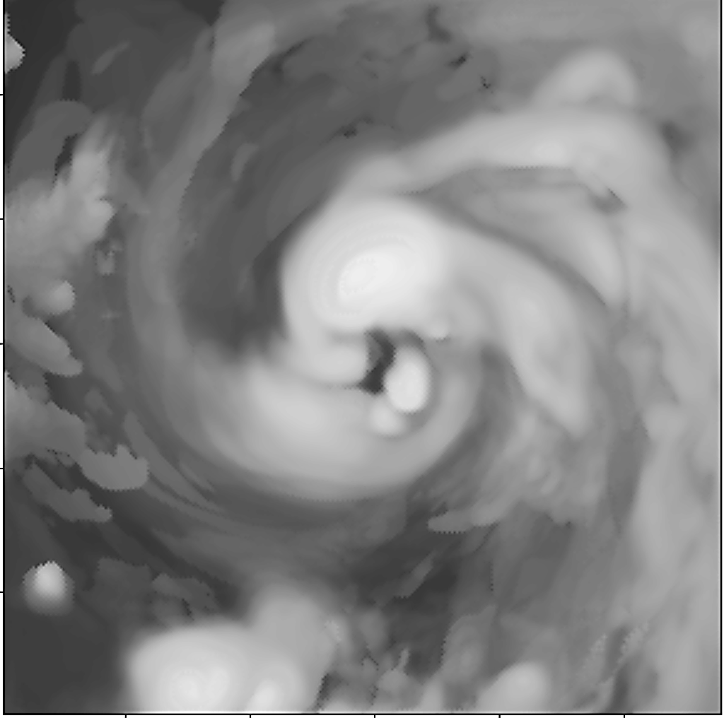


THE RESEARCH HWRF SYSTEM: LOOKING BEYOND THE 10-m WIND SPEED FOR IMPROVED STORM PREDICTIONS
Sundararaman G. Gopalakrishnan (Gopal)
NOAA/AOML/HRD, Miami
AOML IRR, June 19, 2014
Adopted from 31st Conference on Hurricanes and Tropical Meteorology
31 March–4 April 2014, San Diego, California
1
0
Notes:
Hurricane Bill: HWRF Equivalent of GOES-East Imager 10.7 micro m

Slide 2

CREDITS AND ACKNOWLEDGEMENTS
NOAA AOML HWRF Team
Dr. S. G. Gopalakrishnan
Dr. Xuejin Zhang
Dr. Thiago Quirino
Dr. Hua Chen
Mr.Stanley Goldenberg
Dr. Javier Delgado
Dr. Joseph Prusa
Dr.Jun Zhang
Mr.Robert Black
Russell St.Fluer
NOAA NCEP HWRF Team
Dr. Vijay Tallapragada
Dr. Young Kwon
Dr. Qingfu Liu
Dr. Zhan Zhang
Dr. Samuel Trahan
Dr. Weiguo Wang
Dr. Chanh Kieu
Dr. Mingjing Tong
Dr. Hyun Sook Kim
NOAA/ESRL Modeling Team
Dr.Jian-Wen Bao
S.A.Michelson
DTC/NCAR
code support and management
Partners
JPL/NASA, Pasadena
Purdue University
IIT.BBSR & IMD, India
HWRF: EMC
HWRF: DTC
NOAA
HFIP
HRD: Modeling & Observations
Thanks to Dr. Frank Marks and Dr.Robert Atlas for their sustained support of the AOML modeling activities and my esteemed colleagues at HRD for scientific insights.
University
Collaborations
Forecast Offices
NHC, JTWC, international
12

Slide 3

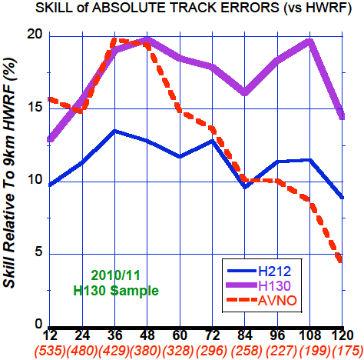
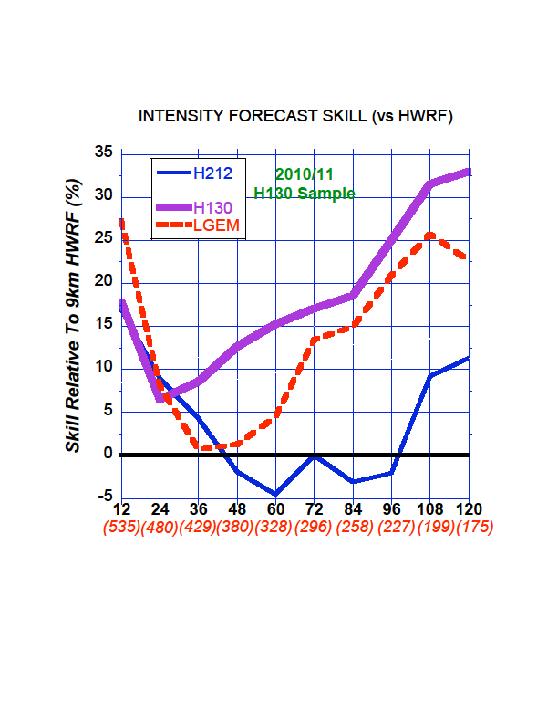
Goals
Improve Forecast Accuracy
  Hurricane impact areas (track) – 50% in 10 years
  Severity (intensity) – 50% in 10 years
  Rapid intensity change detection
Extend forecast reliability out to 7 days
Quantify, bound and reduce forecast uncertainty to enable risk management decisions
Multi-seasonal ATL and EPAC statistics
2013 HWRF
2012 HWRF
Response
NOAA research (AOML/HRD), NWS (NCEP/EMC) and HFIP partners are developing the HWRF modeling system to address our immediate and future operational needs.
2013 HWRF
2012 HWRF
Highlights
2011: First cloud resolving operational TC forecasting system for Atlantic and East Pacific basins
2012: Official guidance model for JTWC and India Meteorological Department
2013: Significant progress in TC track, structure, intensity and RI predictions over all basins
Tallapragada et al., 2013 and Goldenberg et al., 2014
http://www.hfip.org/
Notes:
In response to the HFIP goals, NOAA operations and research along with the community have worked together to develop the high resolution HWRF system

Slide 4
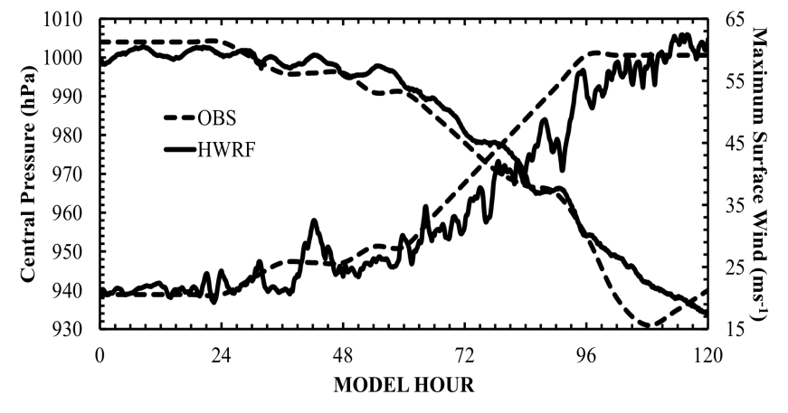
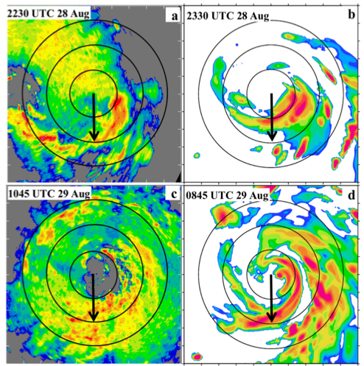
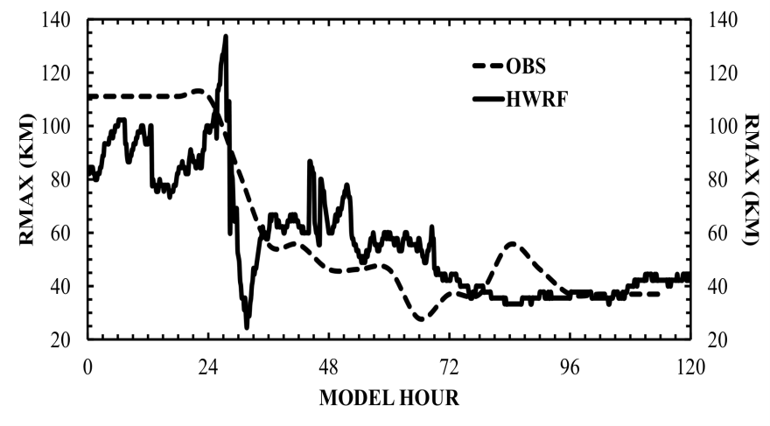
OPERATIONAL HWRF: RI PREDICTIONS
An example of RI case in a sheared environment
Earl 2010, 3-km HWRF
P-3 Lower fuselage
HWRF simulated
Pre-Ri
Pre-Ri
Intensity Predictions
Ri
Ri
Size Predictions
The High Resolution HWRF is starting to get the organized cloud at the right spot. This is critical for improved intensity predictions
Aug 26/18 27/18 28/18 29/18 30/18 31/18
How much close to reality is the modeled intensification process?
Consistency in RI predictions—need for understanding multi-scale processes
Chen Hua and Gopal., 2014

Slide 5
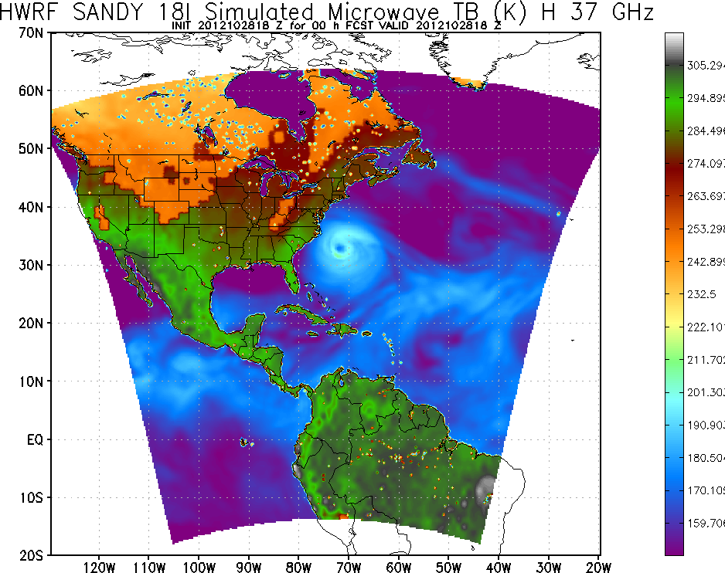
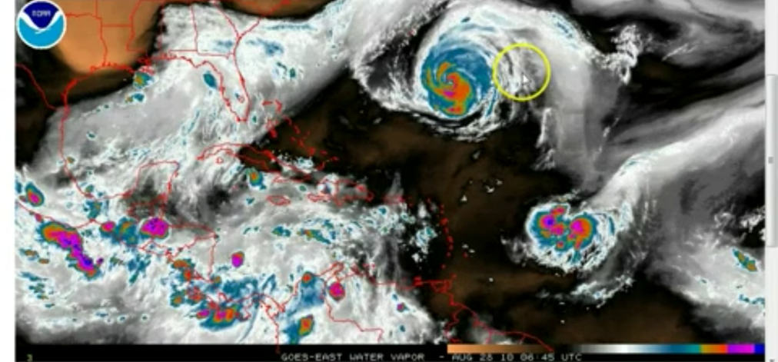
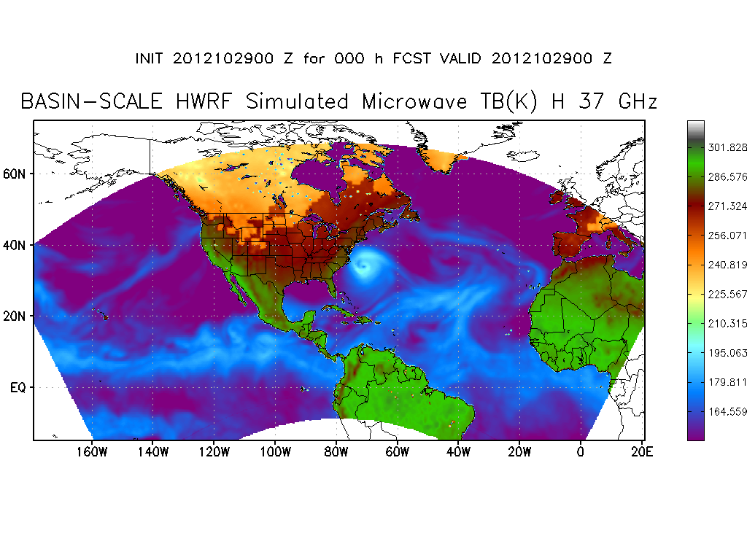
BASIN SCALE HWRF:
ADDRESSING FUTURE FORECAST NEEDS
A busy day in the tropics
Storm Centered
HWRF domain
Danielle
Sandy
Earl
Earl
Frank
Sandy
Storm Centric -VS- Domain Centric Forecasts
- Tropical predictions system (Extended predictions)
- Improved storm-storm & multi-Scale interactions
- Landfall and post landfall (storm surge & rainfall)
- Genesis
- Regional ensembles
- Data assimilation/Satellite data assimilation
Credits: Xuejin Zhang and T. Quirino
Domain Centered HWRF domain
Sandy
Rosa
Notes:
NOAA has progressed well on track, structure and intensity forecasting. Incremental improvements are forthcoming. However, in order to improve storm-storm and land storm interactions we may need to think of advancing HWRF beyond the well laid paradigm of storm centric forecasts. Domain centric forecasts may be useful for improved land fall predictions and also for down stream products such as inland flooding due to storm surge (size) as well as rainfall. Left hand side shows the problem of tropical predictions has more to it than 10-m wind predictions. Right hand side shows how a basin scale (and eventually global) HWRF may be useful in the next generation.

Slide 6
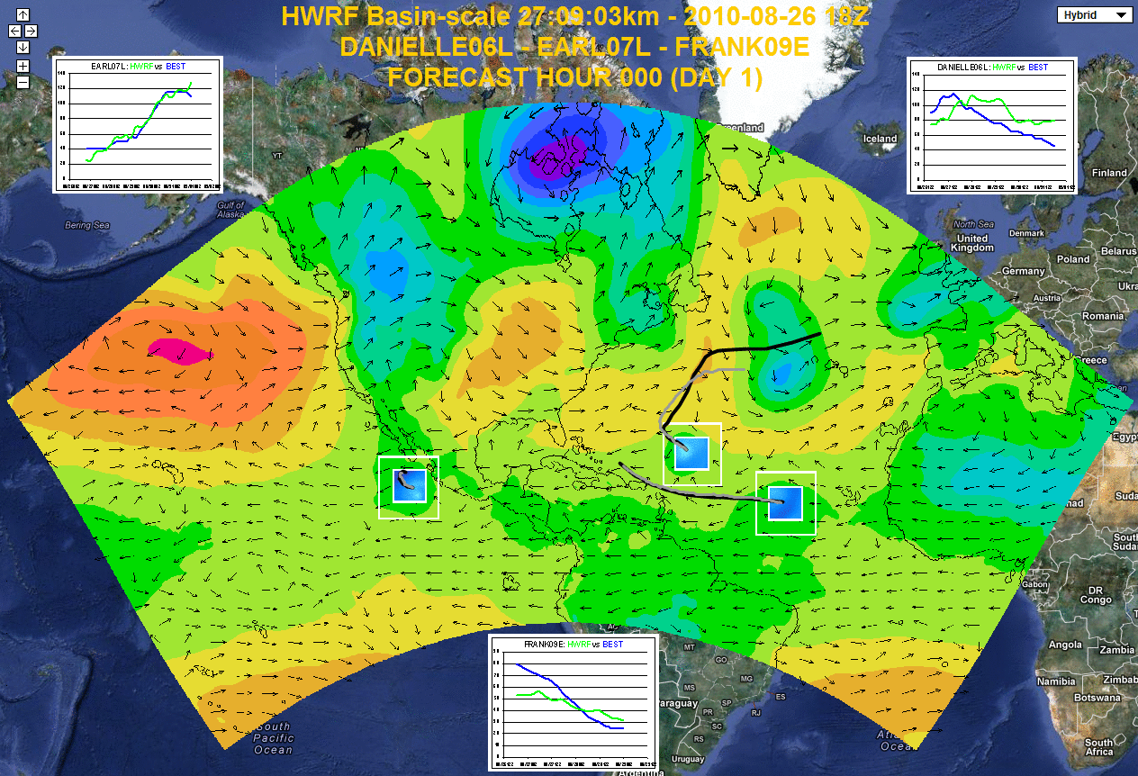
BASIN SCALE HWRF:
THE EXPERIMENTAL PREDICTION SYSTEM
Basin Scale HWRF: 2013 version of HWRF with multiple moving nest, with initialization, cycling and physics all consistent with operational HWRF, with 61 levels, w/o active ocean coupling
Track
Intensity
Earl
Percentage
Sandy
Verification wrt 2013 HWRF
Example of Earl-Danielle-Frank, 2010 (Retrospective run)
http://hwrf.aoml.noaa.gov
Zhang, X et al., 2014
Notes:
NOAA has progressed well on track, structure and intensity forecasting. Incremental improvements are forthcoming. However, in order to improve storm-storm and land storm interactions we may need to think of advancing HWRF beyond the well laid paradigm of storm centric forecasts. Domain centric forecasts may be useful for improved land fall predictions and also for down stream products such as inland flooding due to storm surge (size) as well as rainfall. Left hand side shows the problem of tropical predictions has more to it than 10-m wind predictions. Right hand side shows how a basin scale (and eventually global) HWRF may be useful in the next generation.

Slide 7
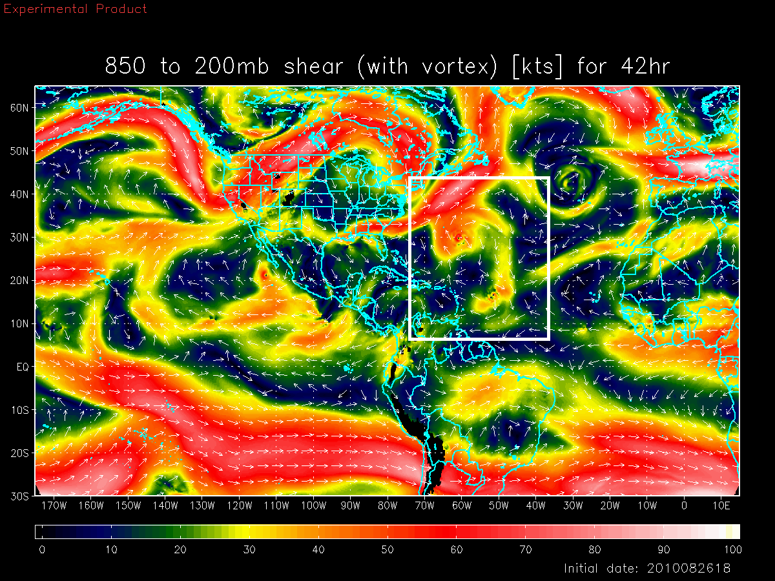
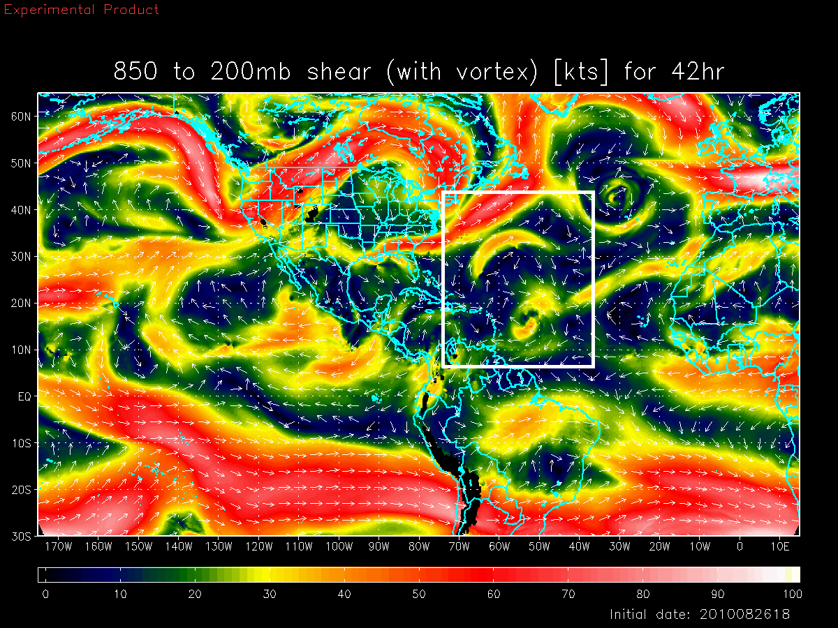
BASIN SCALE HWRF:
IMPORTANCE OF MULTI-SCALE INTERACTIONS
Shear vortex interactions during RI in Hurricane Earl, 2010
Earl
Deep-Layer Shear with Danielle
Deep-Layer Shear without Danielle
Notes:
Earl interactions with Dannielle

Slide 8
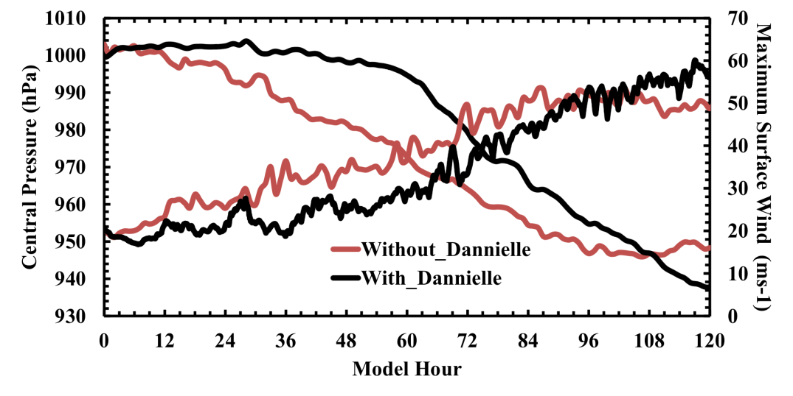
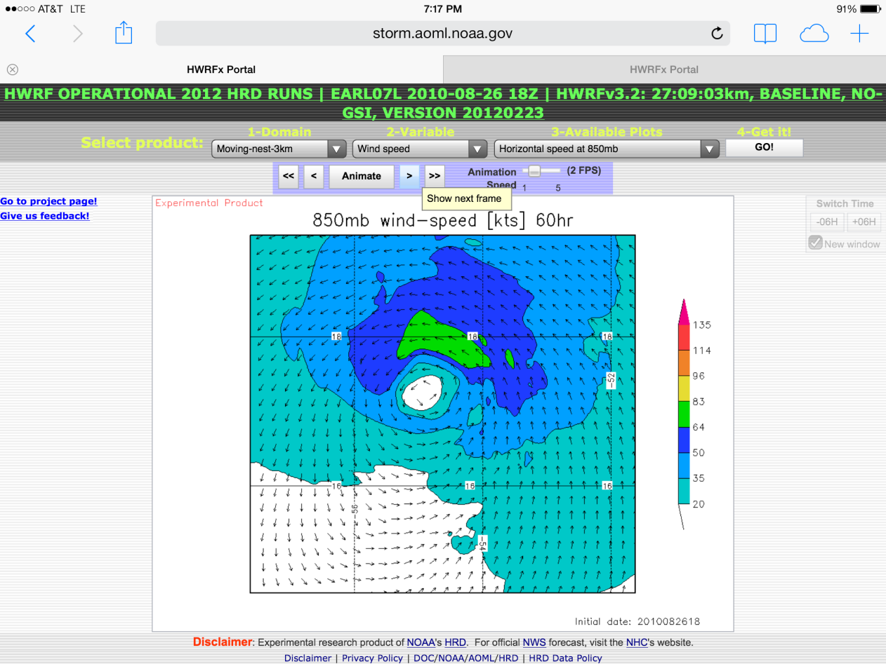
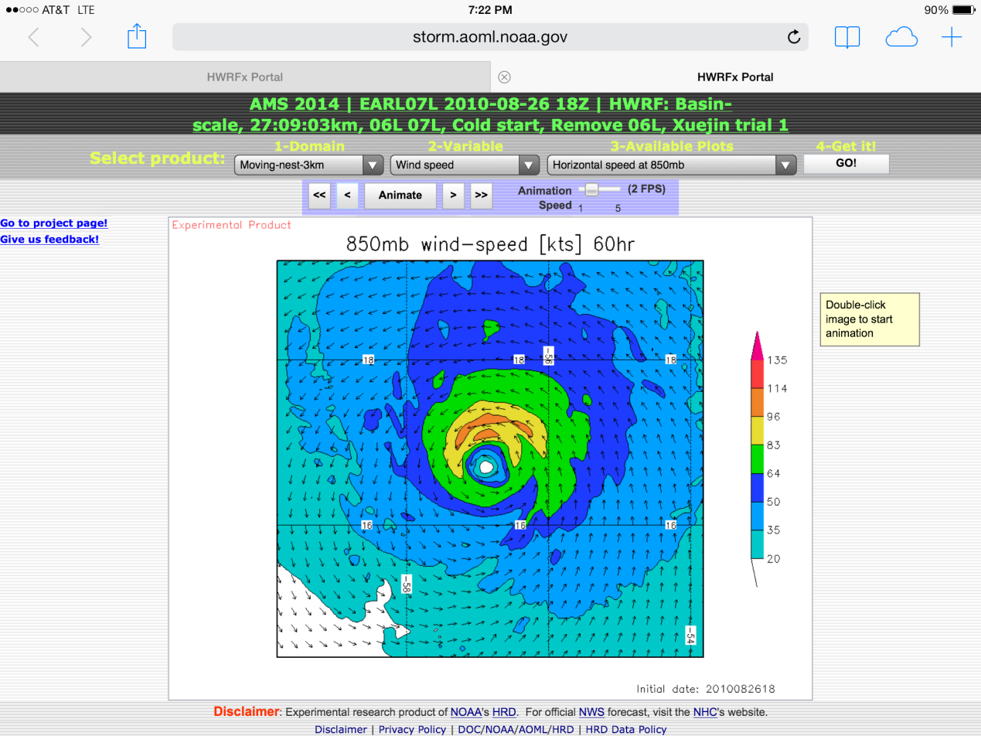
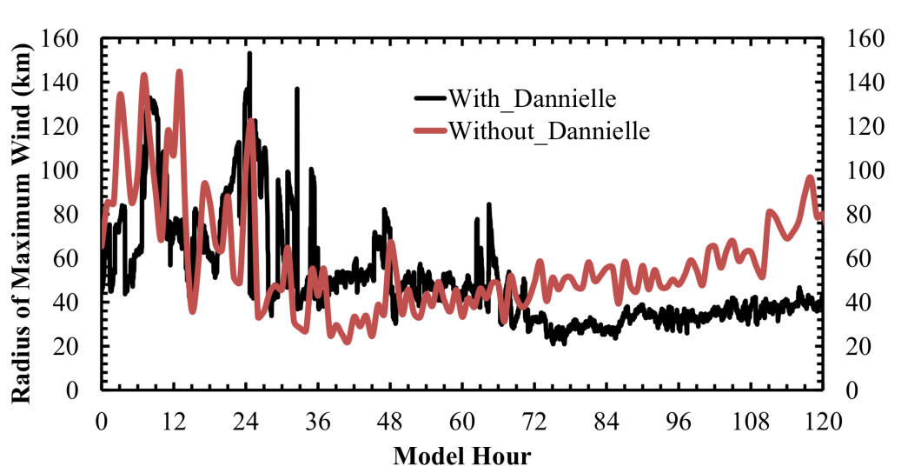
BASIN SCALE HWRF:
SYMMETRIC -vs- ASYMMETRIC INTENSIFICATION
Case study: Hurricane Earl, 2010
Earl wind structure at 60 h (850 mb)
Earl
With influence of Danielle
Sandy
Without influence of Danielle
Large- and vortex-scale processes are critical to RI

Slide 9
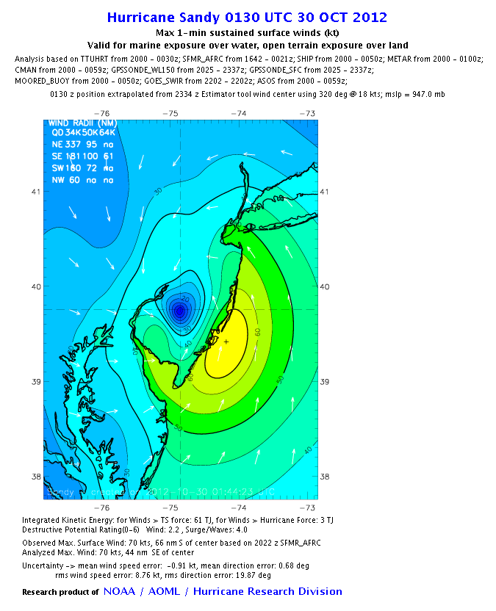
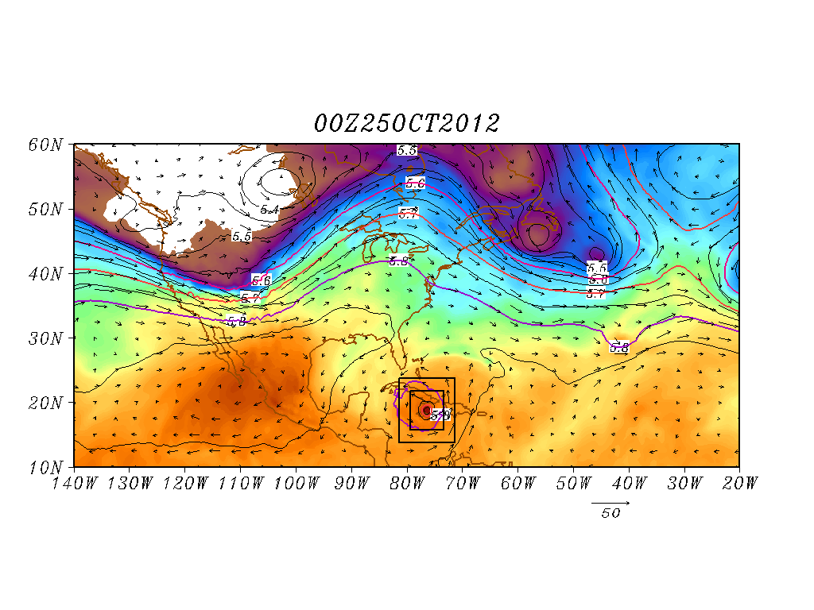
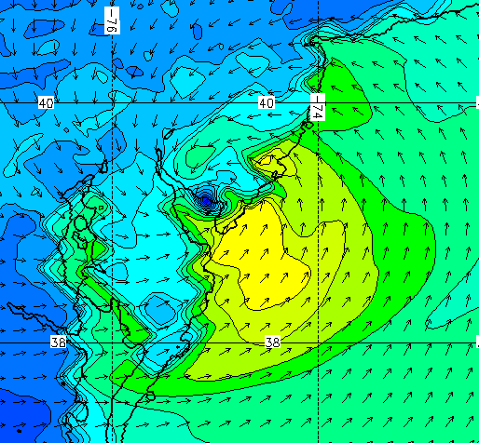
BASIN SCALE HWRF: SIZE MATTERS
Case study: Hurricane Sandy 2012
Verification
H*Wind
Improved scale interactions and improved track & size forecasts (25 00Z Predictions)
108h Forecast
Shading: T at 500 hPa; Contour: GHT at 500 hPa
Vector: Flow averaged between 500 hPa and 200 hPa
Notes:
The Basin scale HWRF was run real time under HFIP last season and shows a lot of promise. Example application of the basin scale HWRF for Sandy. The basin scale HWRF turned Sandy towards land (Good run) 18 hours in advance of the operational HWRF. A study is undertaken to understand the reason. Right hand side shows two runs from basin scale HWRF. 2500Z that turned towards land and 2400Z that was still turning into the Ocean (Bad run). It appears that the differences originate at the vortex scales between these two runs. Influence of steering will be different between a deeper vortex and a more shallow on (on 2500 Z)

Slide 10
BASIN SCALE HWRF: Sandy Predictions
Case#:
29 | 28 | 27 | 26 | 25 | 24 | 23 | 22 | 21 | 20 | 19 | 18 | 17 | 16 | 15 | 14 | 13 | 12 | 11 | 10 | 9
Track Abs Errors (nm)
Forecast Hours
Track Verification

Slide 11
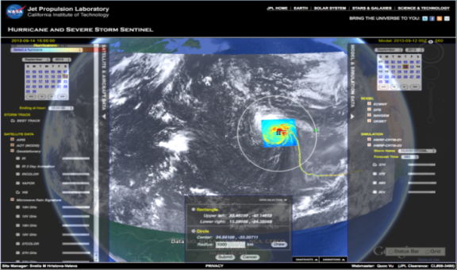
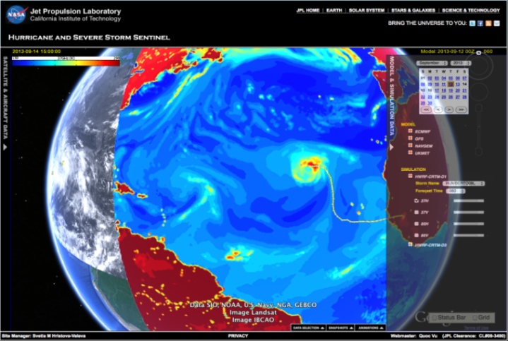
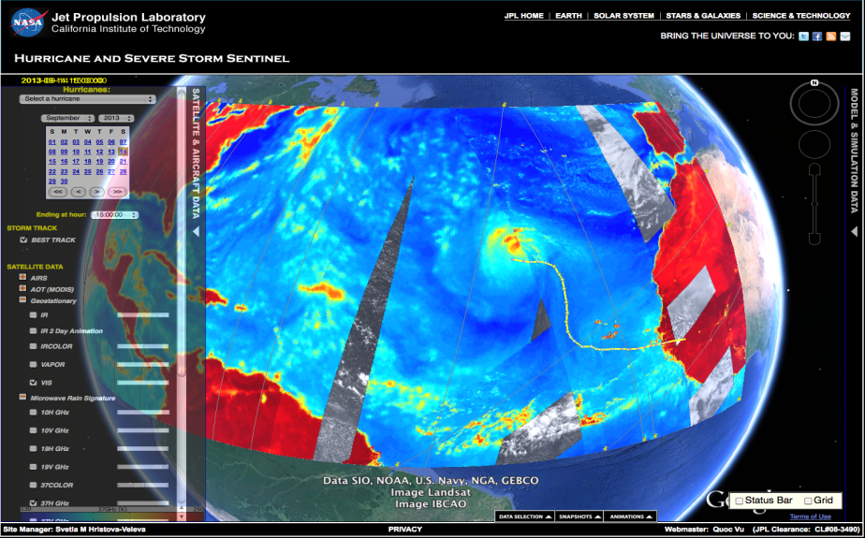

SUMMARY
HWRF 2012
Key to improving RI predictions may lie in modeling the multi scale interactions better – requires basin scale domain with 2-way interactive, high resolution nests
Basin Scale HWRF is showing significant promise in track, intensity and structure predictions.
Transitions to NEMS infrastructure is ongoing
NEMS-HWRF will be run eventually in a global configuration.
Sustained partnership between NOAA research and operations (NCEP) and other agencies and universities hold the key to our future success.
BASIN HWRF 2016
GLOBAL HWRF (Research)
High Impact Weather Prediction Project
Notes:
Picture shows Satellite equivalents from model and future Tropical Prediction system

Slide 12
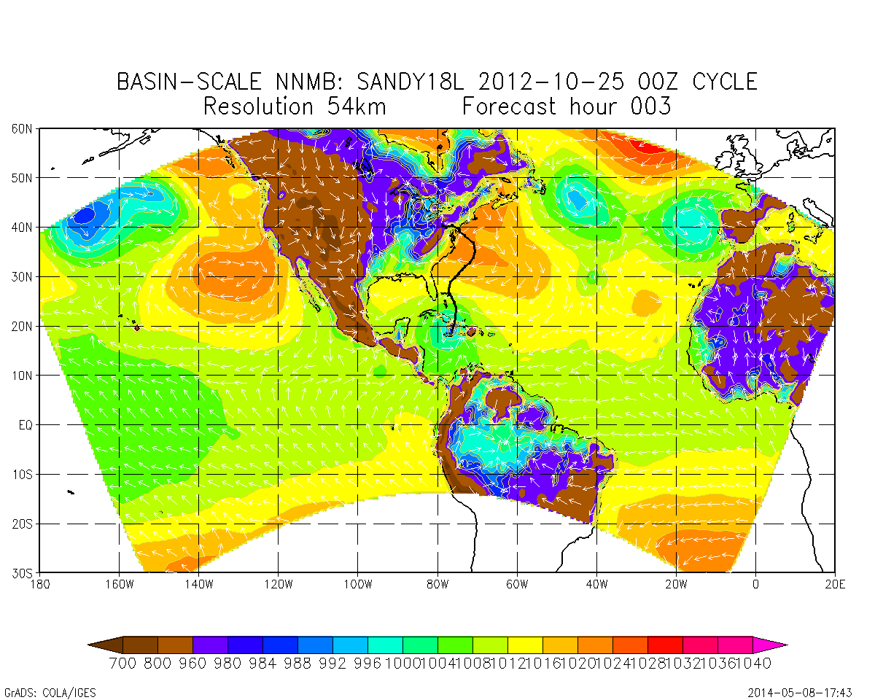


BENCHMARK CASE 1: NEMS/NMMB EVALUATION
54 km
27 km
9 km
- 576p; 7 days fcst 4 m
- 61 levels; 359x157
- GFDL radiation; MYJ;BMJ;
- Ferrier; NOAH LSM
- 576p; 7 day fcst - 13 m
- 61 levels; 716x313
- GFDL radiation; MYJ;BMJ;
- Ferrier; NOAH LSM
- 576p; 7 day fcst - 2h 10 m
- 61 levels; 1988x868
- GFDL radiation; MYJ;BMJ;
- Ferrier; NOAH LSM
- Uniform 3-km basin scale run in progress – needs more dedicated nodes (3000p)
- Uniform 3-km basin scale NEMS will be used as base line for testing 2-way interactions
Work done in collaboration with Tomas Black, Zavisa Janjic and Matt Pyle, NCEP EMC

Slide 13
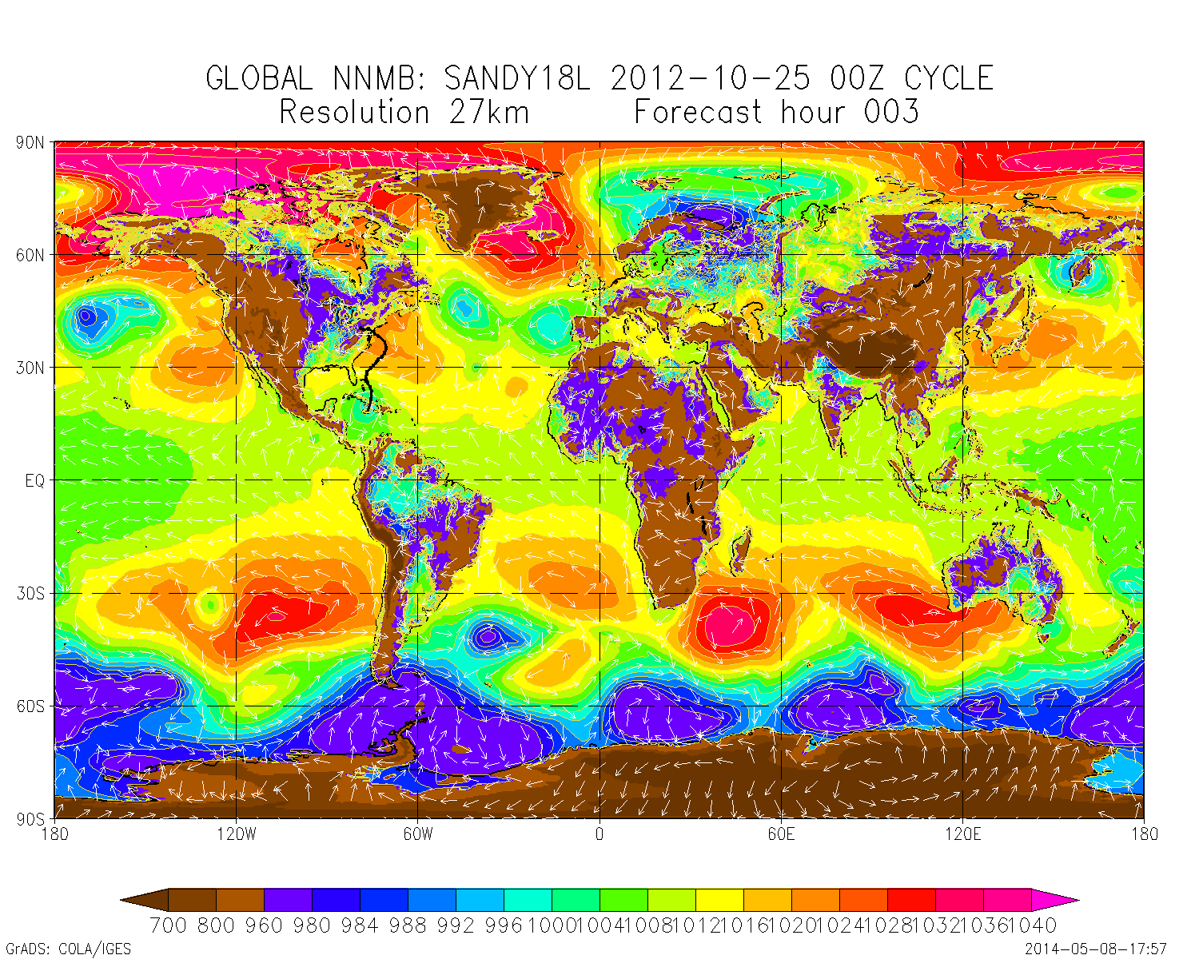
BENCHMARK CASE 1: NEMS/NMMB EVALUATION
27 km
- 576p; 7 days fcst - 3h 45m
- 61 levels; 1441x1019
- GFDL radiation; MYJ;BMJ;
- Ferrier; NOAH LSM
Work done in collaboration with Tomas Black, Zavisa Janjic and Matt Pyle, NCEP EMC

Slide 14
FUTURE DEVELOPMENTS AND CHALLENGES
Roadmap
Nesting Transition (Evaluation of Earl & Sandy cases)
Development of Idealized vortex
HWRF physics transitions
Transition of the basin scale HWRF multi-nest initialization
Multi-Season Testing

Slide 15
PUBLICATIONS 2011-2014
Bozeman, M., D. Niyogi, S. Gopalakrishnan, F. D. Marks, Jr., X. Zhang, and V. Tallapragada, 2012: "An HWRF-based ensemble assessment of the land surface feedback on the post-landfall intensification of Tropical Storm Fay (2008)," Natural Hazards, 63(3), p.1543-1571.
Bao, J.-W., S. G. Gopalakrishnan, S. A. Michelson, F. D. Marks, M. T. Montgomery, 2012: Impact of Physics Representations in the HWRFX on Simulated Hurricane Structure and Pressure–Wind Relationships. Mon. Wea. Rev., 140, 3278–3299.
Chen Hua and S. Gopalakrishnan, 2014: "Study on the Asymmetric, Rapid Intensification of Hurricane Earl (2010) using the HWRF modeling system” (under review, J. Atmos Sci)
Gopalakrishnan, S., F. Marks, J. Zhang, X. Zhang, J.-W. Bao, and V. Tallapragada, 2013, "A study of the impact of vertical diffusion on the structure and intensity of tropical cyclones using the high-resolution HWRF system," J. Atmos. Sci. 70(2), 524-541.
Gopalakrishnan, S.., S. Goldenberg, T. Quirino, X. Zhang, F. D. Marks Jr., K.-S. Yeh, R. Atlas, V. Tallapragada, 2012: "Toward Improving High-Resolution Numerical Hurricane Forecasting: Influence of Model Horizontal Grid Resolution, Initialization, and Physics," Weather and Forecasting, 27(3), p. 647-666
Gopalakrishnan, S., F. Marks, Jr., Zhang X, Bao, Jian-Wen, Yeh, Kao-San, and Atlas, Robert, 2011a: "The Experimental HWRF System: A Study on the Influence of Horizontal Resolution on the Structure and Intensity Changes in Tropical Cyclones Using an Idealized Framework", Monthly Weather Review 139(6) , p.1762-1784.
Gopalakrishnan, S., Q. Liu, T. Marchok, D. Sheinin, N. Surgi, M. Tong, V. Tallapragada, R. Tuleya, R. Yablonsky, and X. Zhang, 2011b: Hurricane Weather and Research and Forecasting (HWRF) model: scientific documentation. NOAA/Development Tech Center, 81 pp. [online: http://www.dtcenter.org/HurrWRF/users/docs/scientific_documents/HWRFScientificDocumentation_August2011.pdf]
Gopalakrishnan, S: The Hurricane Boundary Layer (Lecture notes to appear in text book entitled: “An advanced course on modeling and data assimilation techniques for Tropical Cyclone Prediction (Editors: Prof.U.C.Mohanty and Dr.S..Gopalakrishnan, Springer)
Goldenberg, S.B, S. Gopalakrishnan, Xuejin Zhang, Vijay Tallapragada, Samuel Trahan, Thiago Quirino, Frank Marks, Jr., and Robert Atlas: Analyses of Retrospective Runs (2010-2011) with the New Operational Version of the Hurricane Weather Research and Forecasting System (HWRF): Enhancements to resolution, physics, and initialization (to be submitted to Weather and Forecasting)
Pattanayak, S., U.C. Mohanty, and S. Gopalakrishnan, 2012: Simulation of very severe cyclone Mala over Bay of Bengal with HWRF modeling system. Natural Hazards, 63(3):1413-1437 (doi:10.1007/s11069-011-9863-z).
Yeh, K.-S., X. Zhang, S. Gopalakrishnan, S. Aberson, R. Rogers, F Marks, and R. Atlas, 2012: "Performance of the experimental HWRF in the 2008 Hurricane Season," Natural Hazards, 63(3), p.1439-1449.
Zhang, X., T. S. Quirino, K.-S. Yeh, S. Gopalakrishnan, F. D. Marks, Jr., S. B. Goldenberg, and S. Aberson, 2011: HWRFx: Improving Hurricane Forecast with High-Resolution Modeling. Computing in Science and Engineering, 13(1), 13-21.
Zhang, J. A., S. Gopalakrishnan, F. D. Marks, R. F. Rogers, and V. Tallapragada, 2013: A Developmental Framework for Improving Hurricane Model Physical Parameterizations Using Aircraft Observations. Trop. Cycl. Res. Rev, 1(4), 419-429.
Zhang Xuejin, S. Gopalakrishnan, Samuel Tarhan, Vijay Tallapragada and Thiago Quirino : Design of Multiple Moving Nests in Hurricane Weather Research and Forecasting Modeling System. Part I: Nest design and forecast system (to be submitted to Weather and Forecasting)
13

Slide 16


QUESTIONS?
AOML Program Review

