Slide 1
Secondary eyewalls in HWRF
Sergio Abarca & EMC team
09/07/2016
Notes:
At EMC wehave been carefully studying secondary eyewalls. We released the news a few weeks ago that HWRF 2016 has secondary eyewalls consistently in storms that had them in nature (unlike previous versions of HWRF where secondary eyewalls were rare). Our work, along the lines of the ideas that Lin presented in Puerto Rico, support the idea that the new PBL in HWRF 2016 is beneficial for the secondary eyewall emergence and maintenance. I believe this is a good example of an analysis that assess HWRF capabilities from an unique perspective, bringing understanding on how the physics used operationally are determining the storm structure.

Slide 2
Assessment of secondary eyewalls (HWRF 2015)
a) Rare
b) Too close to the primary eyewall
c) Too quick to replace the primary eyewall
HWRF 2015
Notes:
HWRF 2015 secondary eyewalls
Edouard

Slide 3
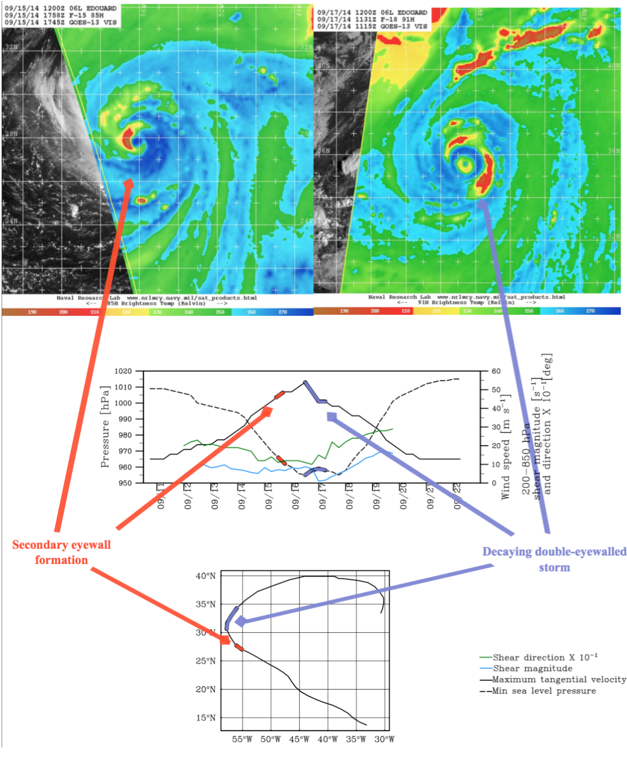
Edouard (2014)
Well observed case:
NOAA- reconnaissance flights
NASA- Global Hawk (HS3)

Slide 4
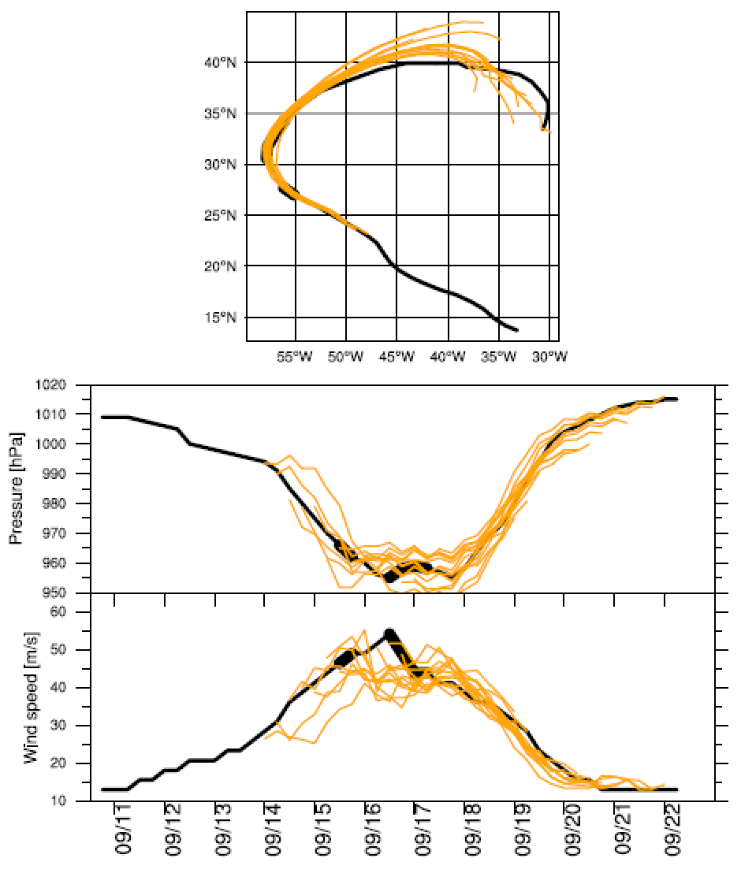
Bestrack
HWRF
Edouard (2014)
Good track and intensity
forecast!
HWRF 2015

Slide 5
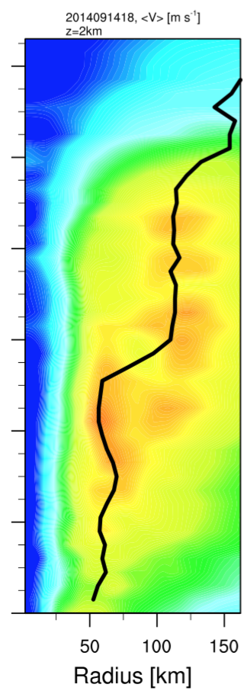
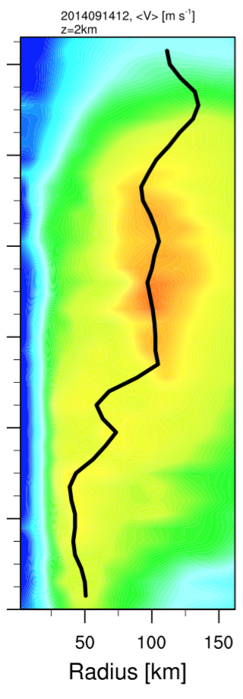
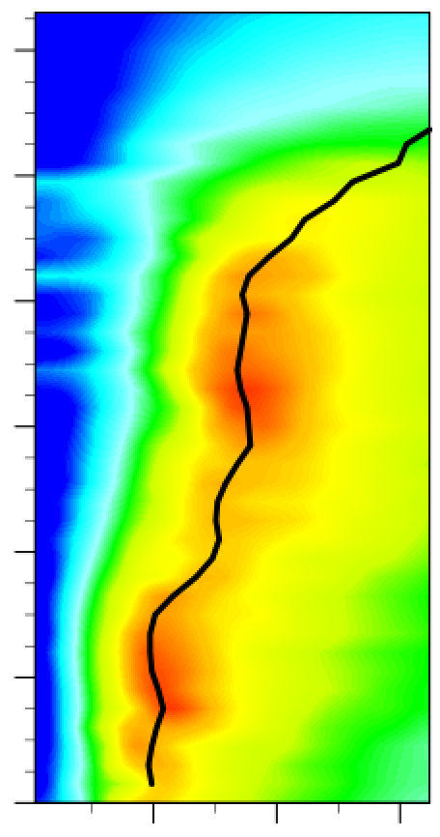
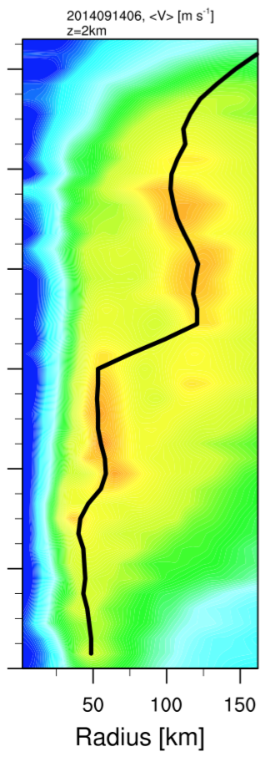
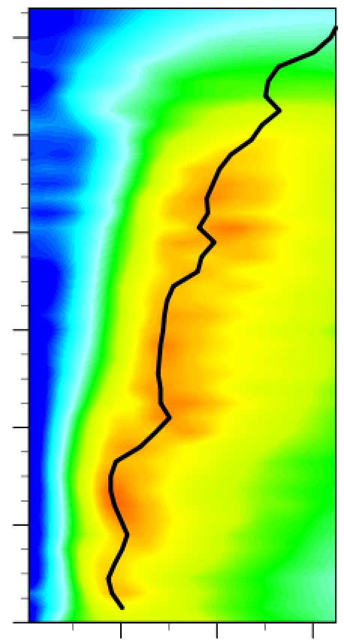
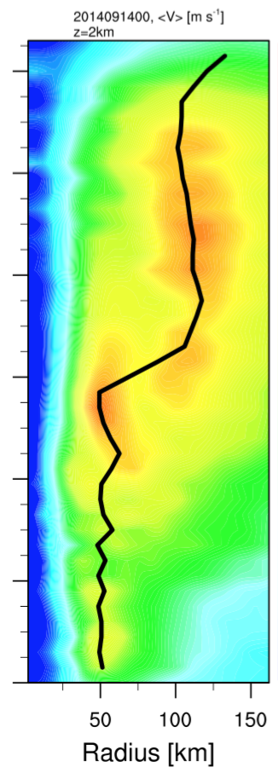
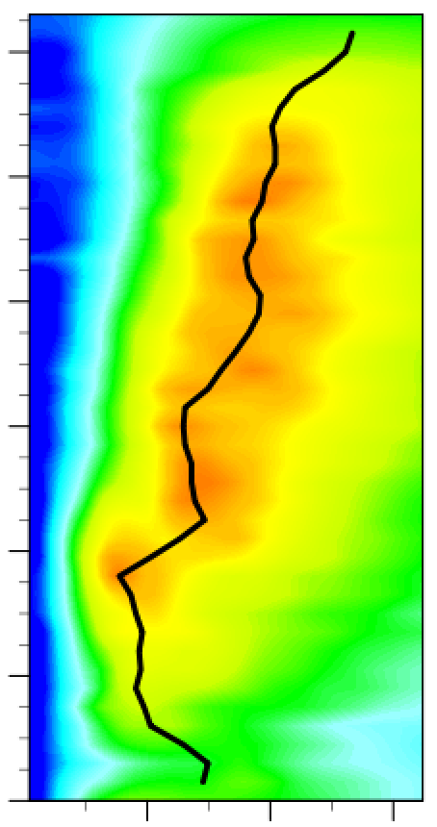
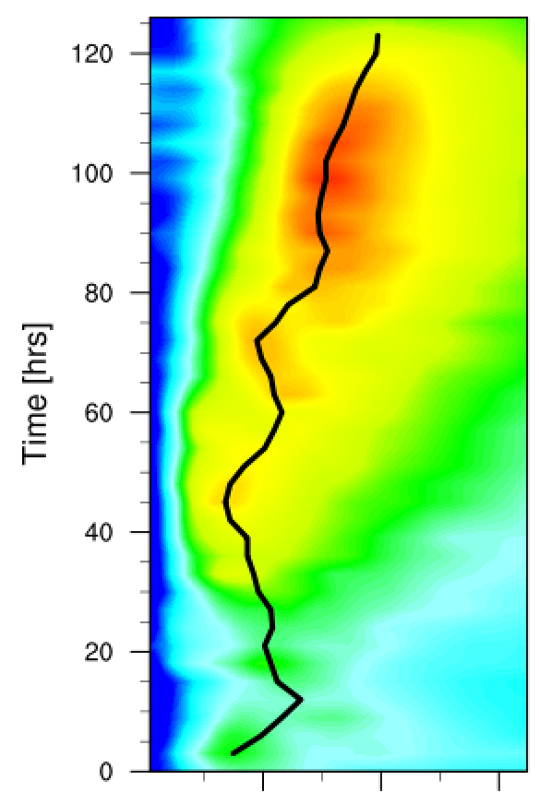
Edouard (2014)
09/14
ms⁻¹
SE
HWRF 2015

Slide 6
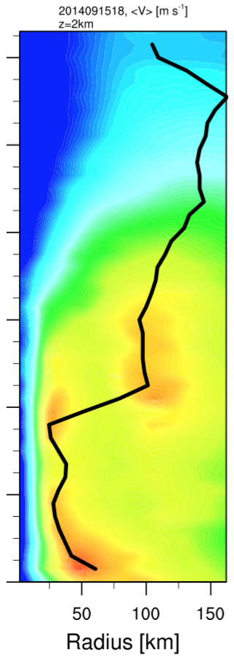
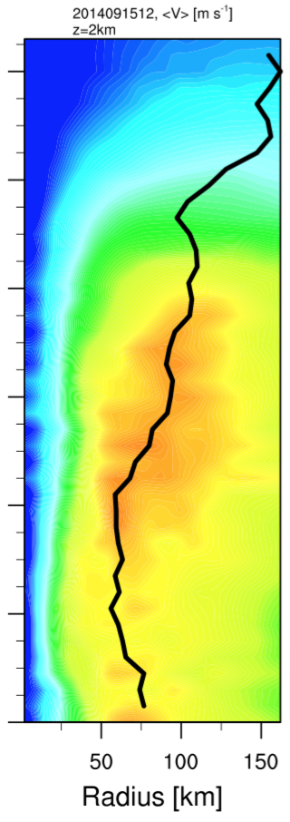
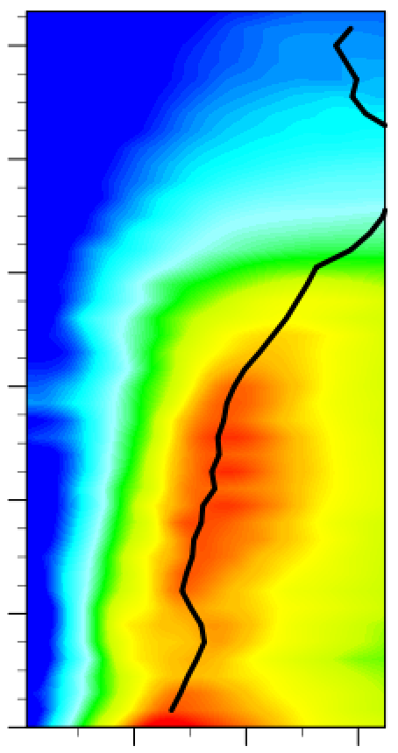
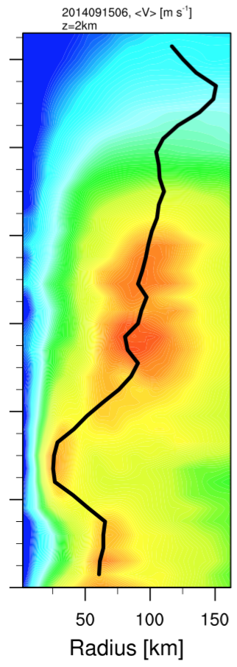
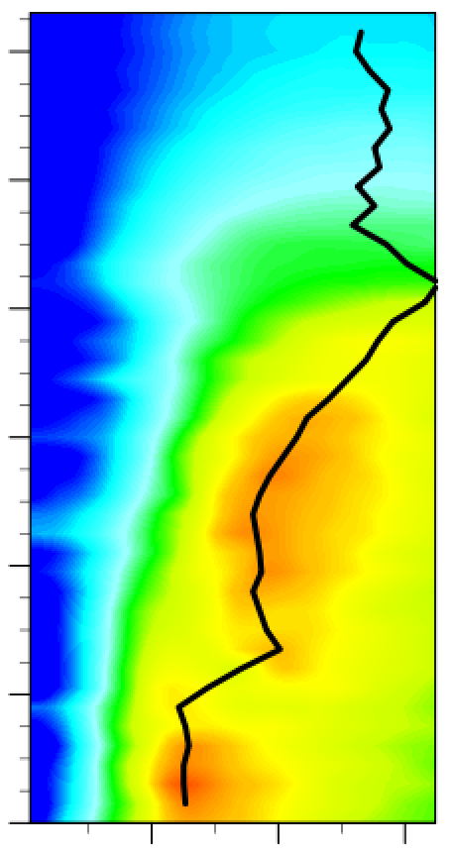
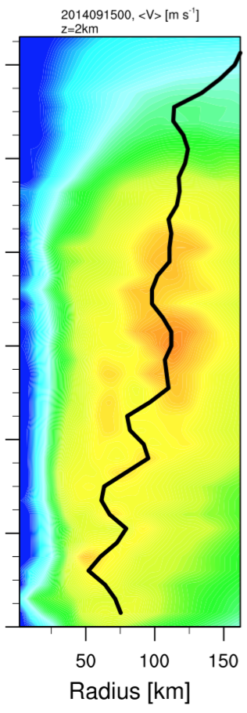
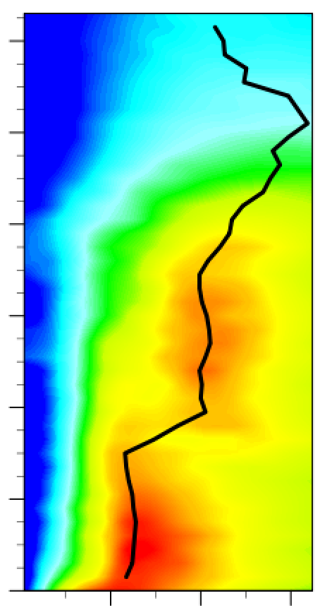
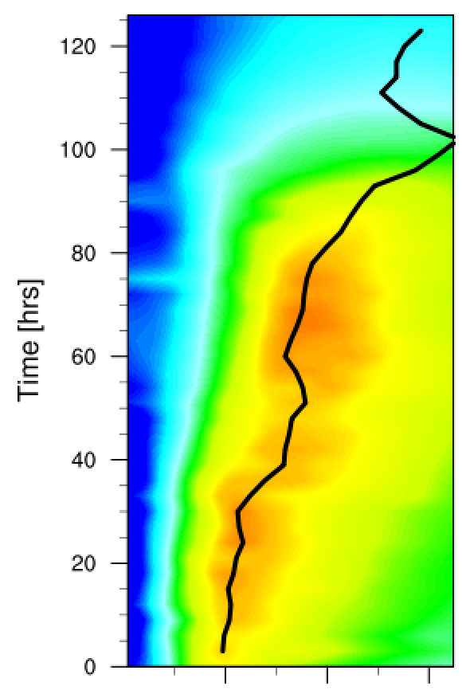
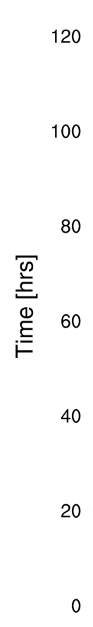
Edouard (2014)
09/15
ms⁻¹
SE
HWRF 2015

Slide 7
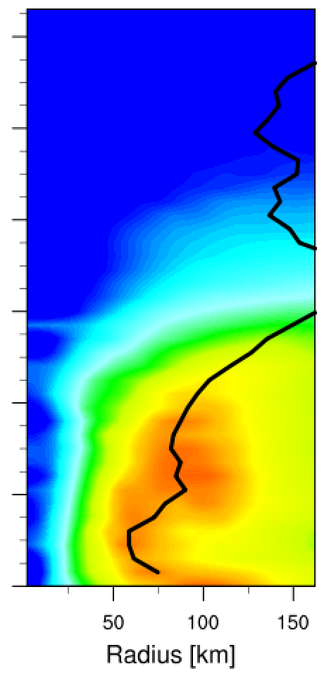
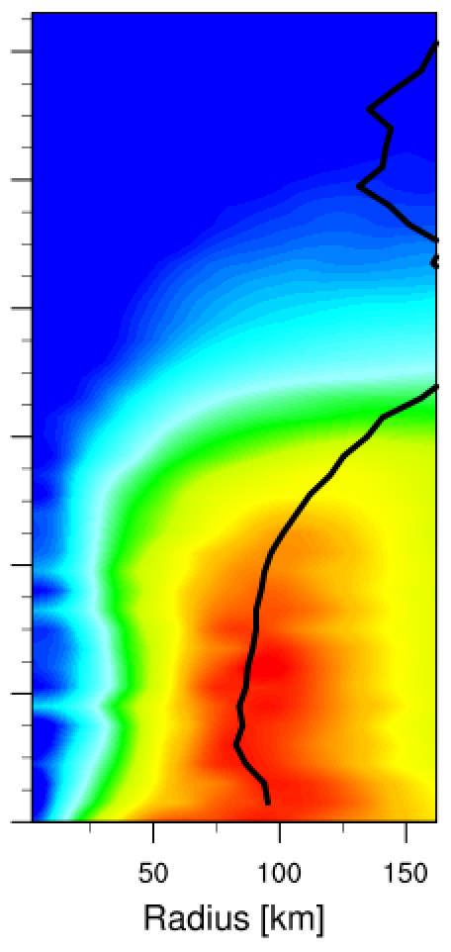
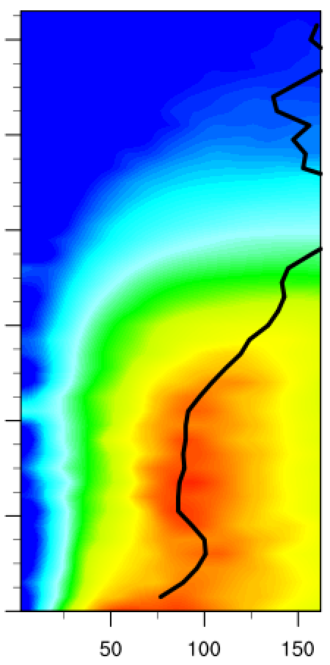
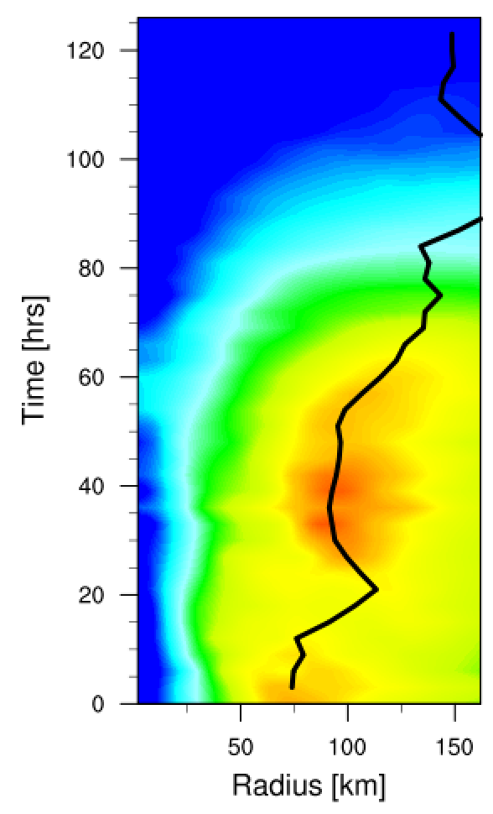
Edouard (2014)
09/16
ms⁻¹
SE
HWRF 2015

Slide 8





Secondary Eyewall in idealized HWRF simulations
Lin Zhu¹ , Sergio F. Abarca¹, Weiguo Wang¹, Zhan Zhang¹, Vijay Tallapragada²
¹IMSG at EMC/NCEP/NOAA, College Park, MD
²EMC/NCEP/NOAA, College Park, MD
AMS 32nd Hurricane Conference, San Juan PR, April 18 2016
Lin et al

Slide 9
Idealized model configurations
Experiment | CTL |  | NEWPBL
Initial condition | Vt= 20 m/s, RMW=45km, no mean flow
Grid number (nx×ny×nz) | 265×472×62
Resolutions | 18/6/2 km
Microphysics | Thompson
Radiation scheme | RRTM
Convection scheme | Kain-Fritsch
PBL scheme | GFS eddy-diffusivity counter-gradient (EDCG) PBL (as operational HWRF 2015) | GFS eddy-diffusivity mass-flux (EDMF) PBL (as operational HWRF 2016)
Choice of parameterizations following Zhu et al. (2015)
Lin et al
Notes:
Operational HWRF
-Ferrier micro-physics
-Simpliﬁed Arakawa-Schubert cumulus
-GFDL surface layer
-GFS planetary PBL
-GFDL longwave/shortwave radiation
EDMF PBL
-Assumes that in convective boundary layer the subgrid-scale fluxes result from two different mixing scales:
-Small eddies, that are parametrized by an eddy-diffusivity approach
-Thermals, which are represented by a mass-flux contribution
-Parametrization represents simultaneously local and non-local turbulent transport for the convective atmospheric boundary layer
+EDMF improves convective boundary layer growth, which improve the convective develop in the strain-dominate flow.

Slide 10
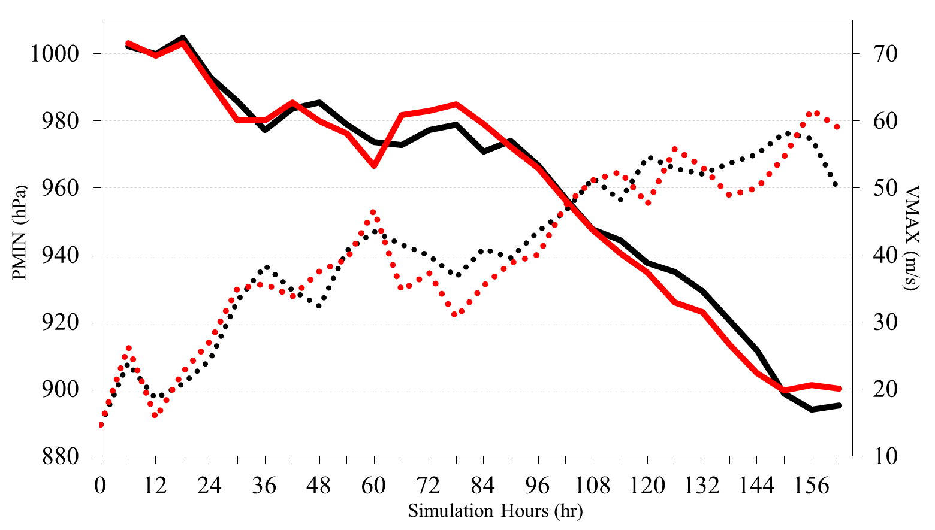
Intensity evolution
P_{MIN}_CTL
P_{MIN}_NEWPBL
…… V_{MAX}_CTL
…... V_{MAX}_NEWPBL
Similar evolution of model integrations
Lin et al

Slide 11
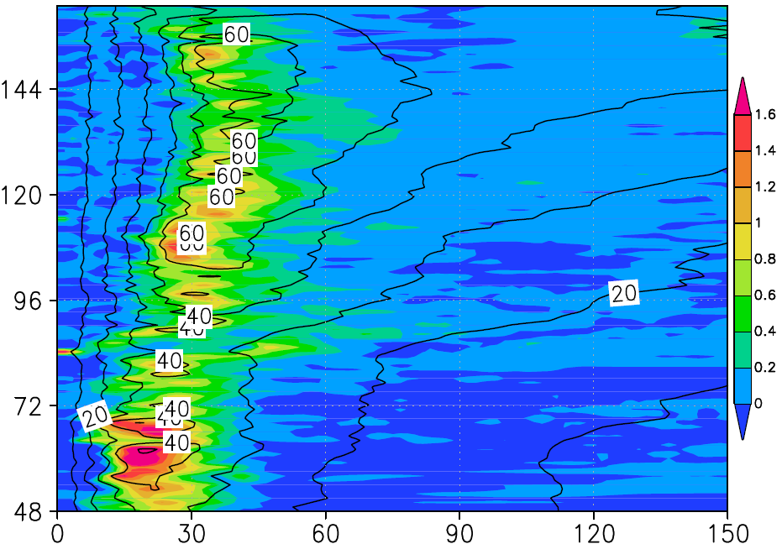
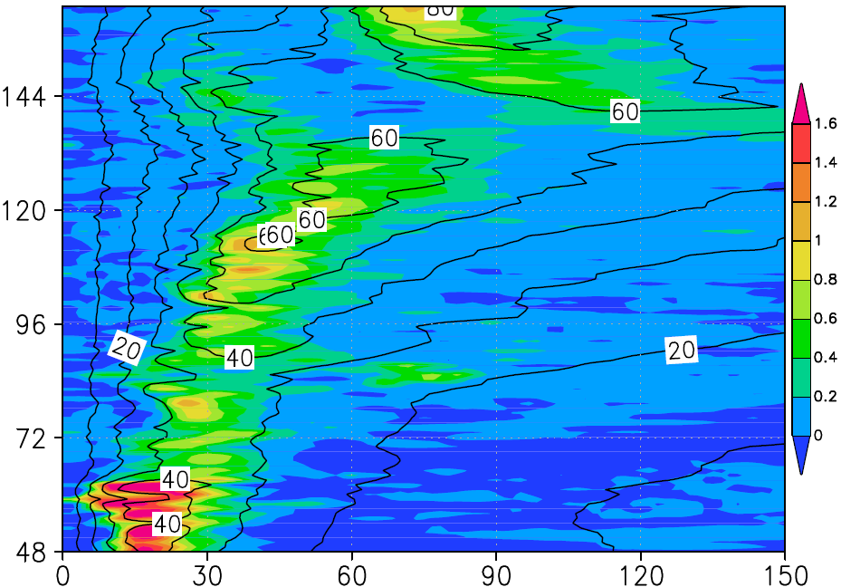
z=1km
CTL
NEWPBL
Simulation hours (hr)
Radius (km)
Radius (km)
Vertical velocity- color, m s⁻¹
Tangential velocity-contours, m s⁻¹
Lin et al

Slide 12
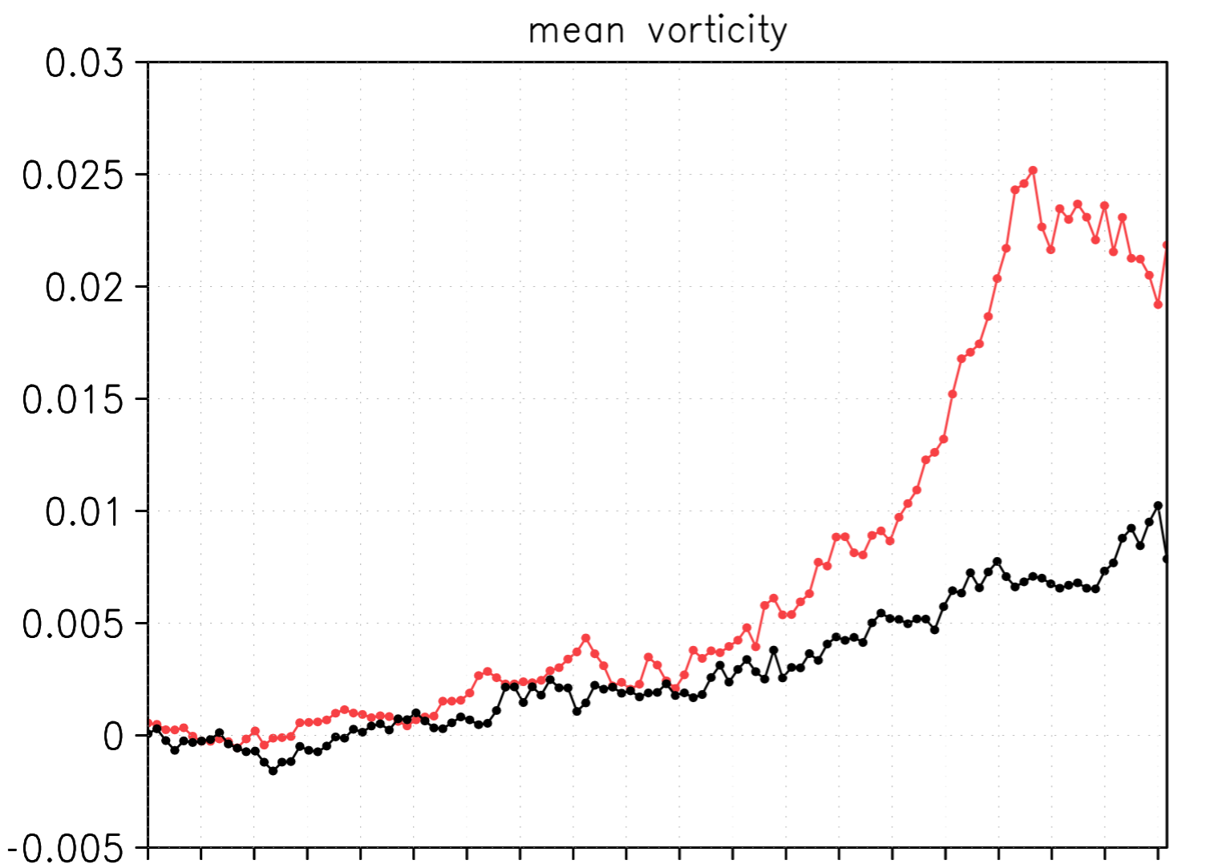
z=1km
Azimuthally averaged vorticity
CTL
NEWPBL
Azimuthally averaged vorticity [s⁻¹]
60
90
120
150
Simulation hours (hr)
Lin et al
Notes:
From early on in the simulation mean vorticity

Slide 13
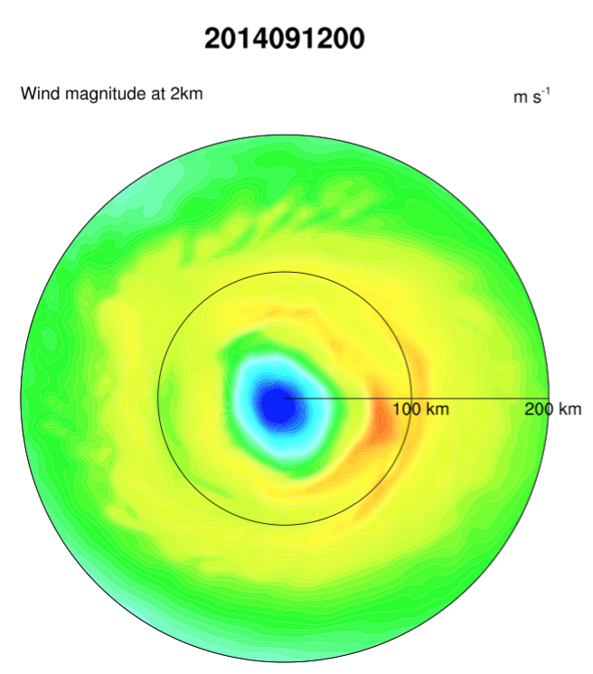
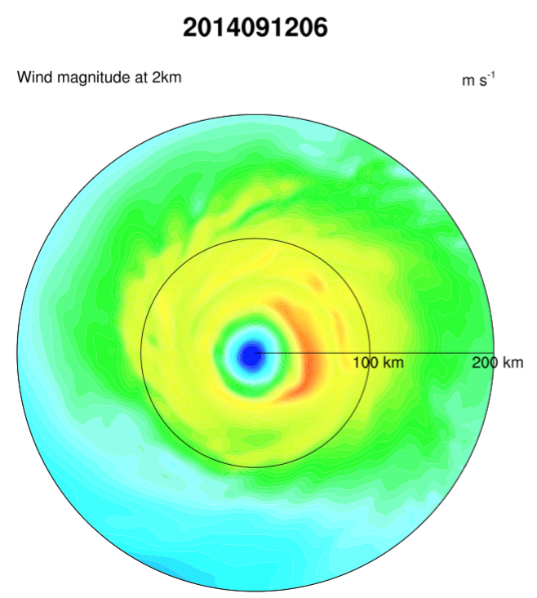
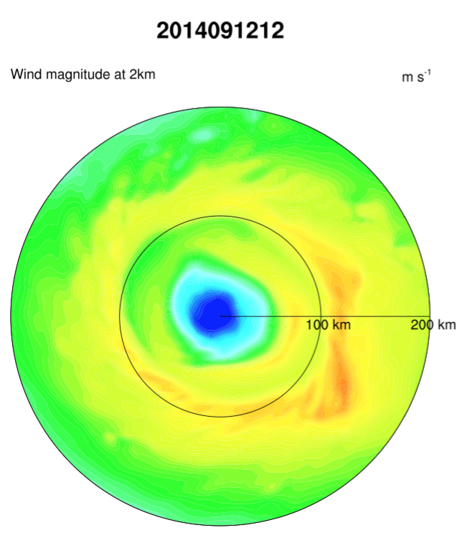
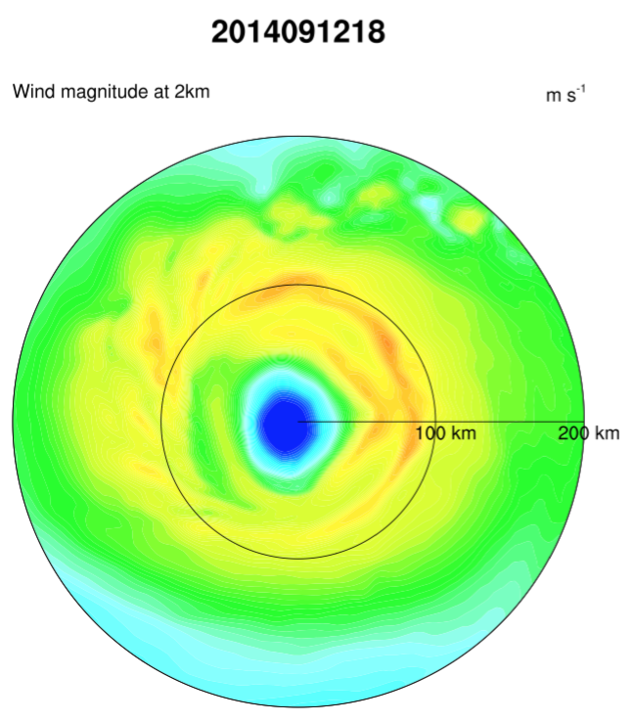
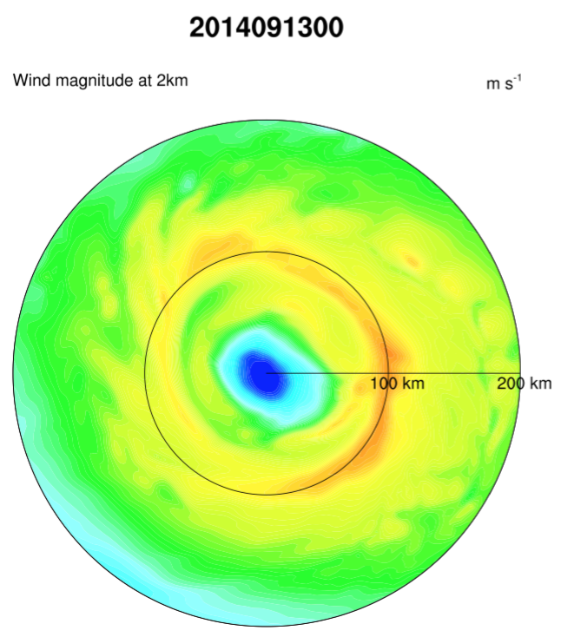
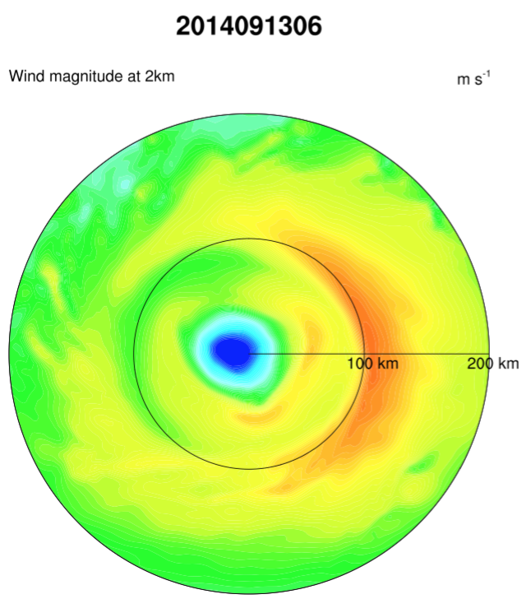
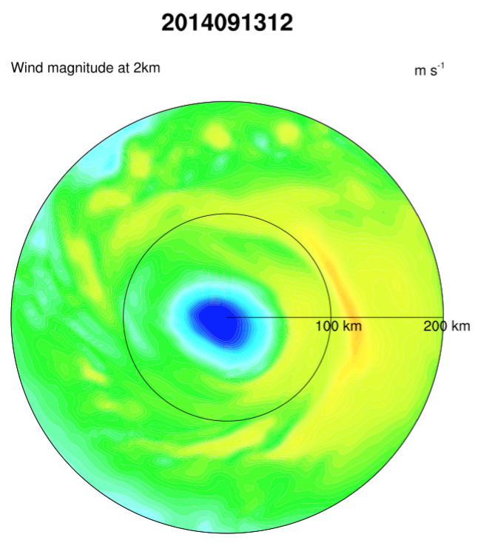
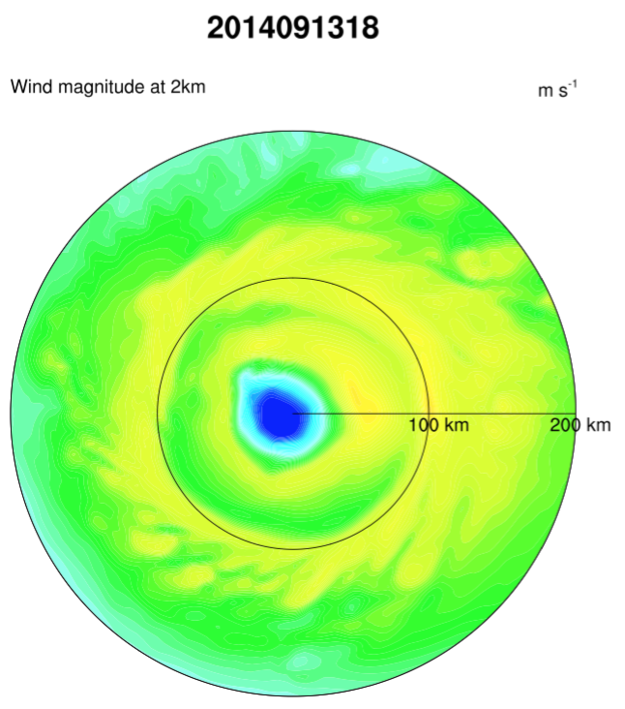
z=2km
ms⁻¹
HWRF 2016

Slide 14
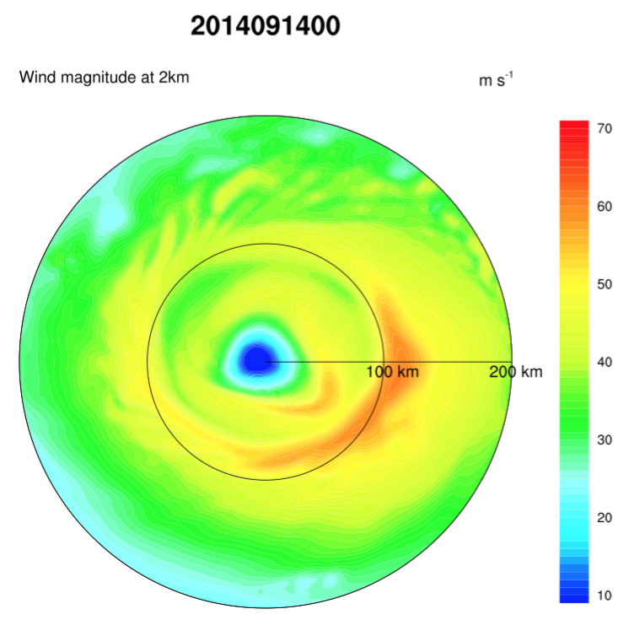
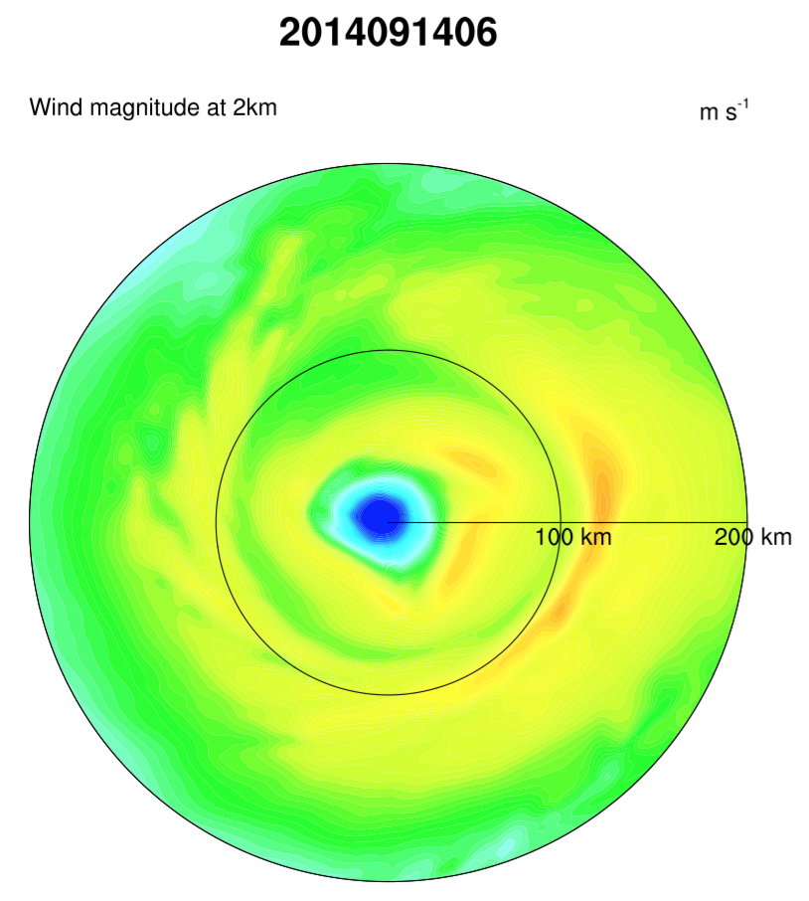
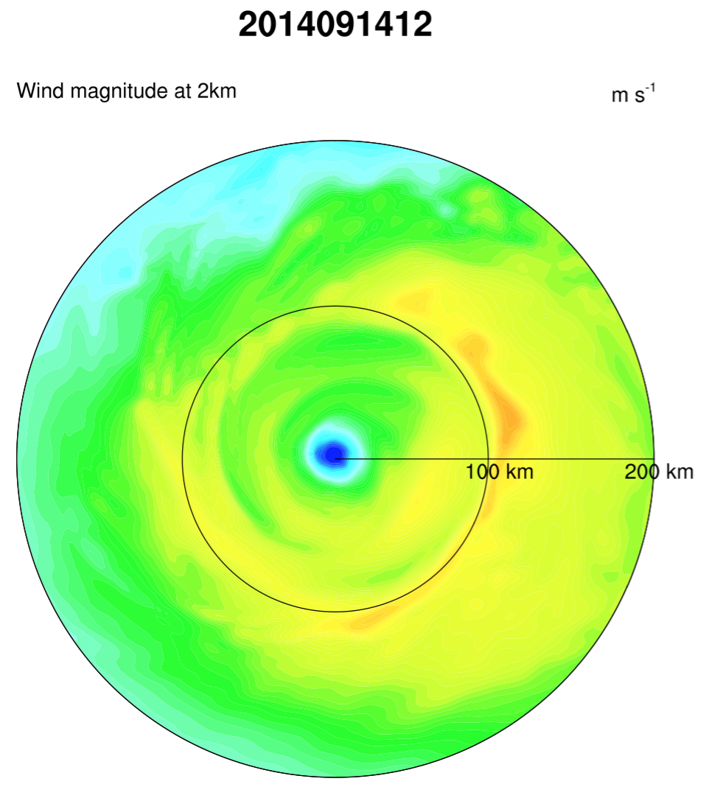
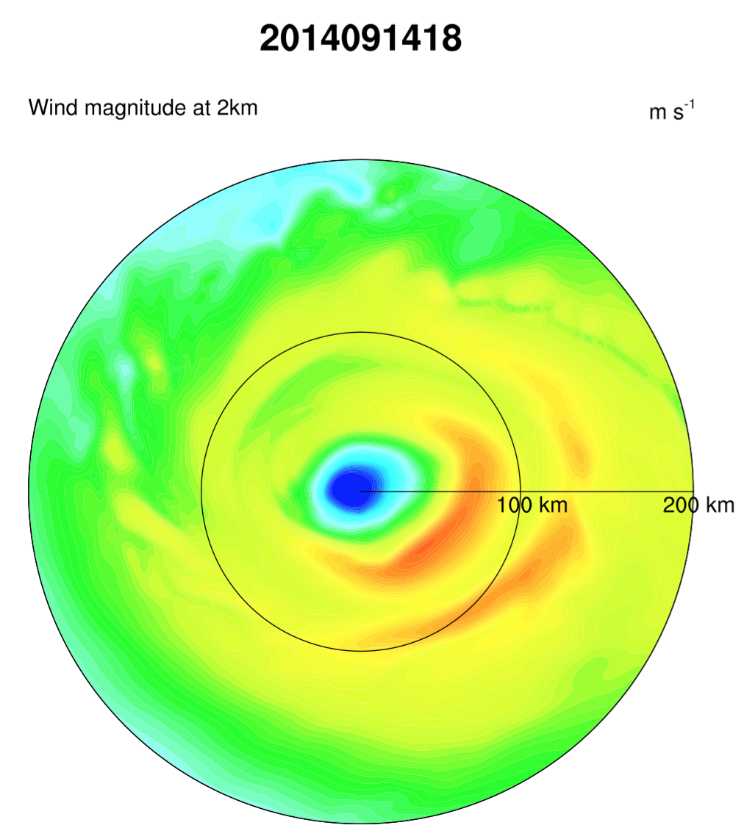
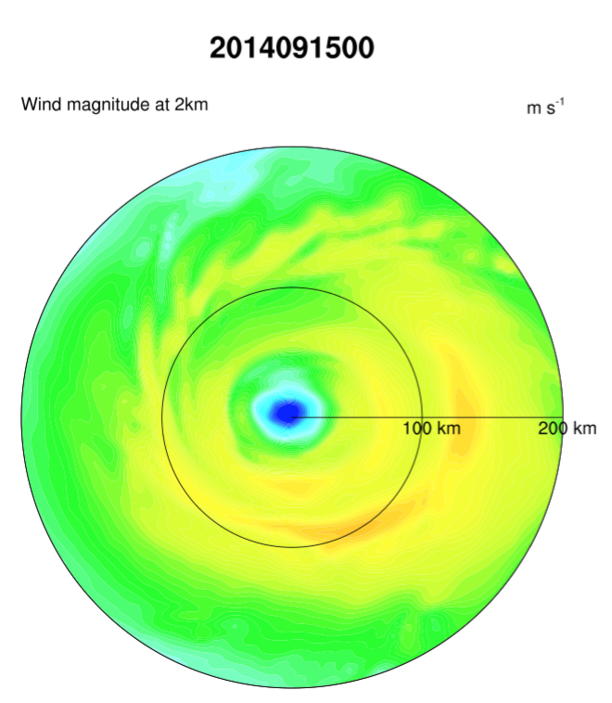
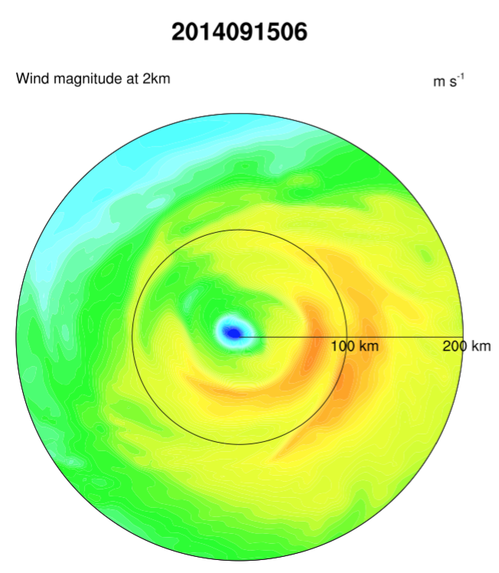
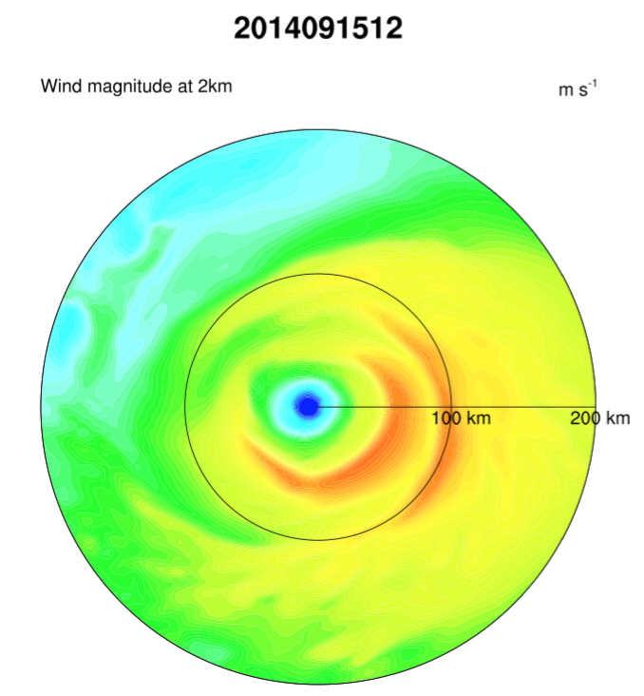
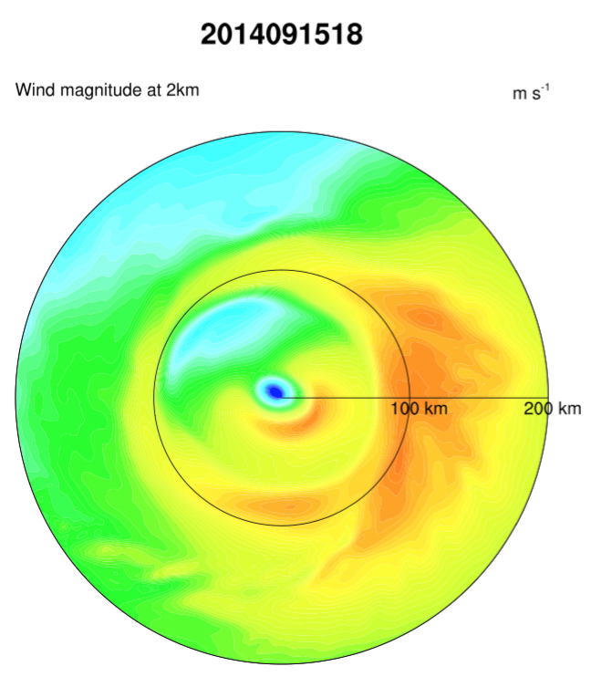
z=2km
ms⁻¹
Hr 66
Hr 60
Hr 54
Hr 48
Hr 48
Hr 48
Hr 45
Hr 42
HWRF 2016

Slide 15
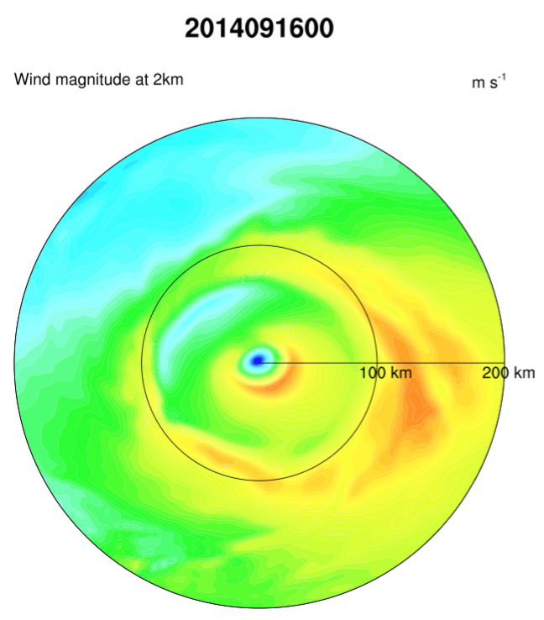
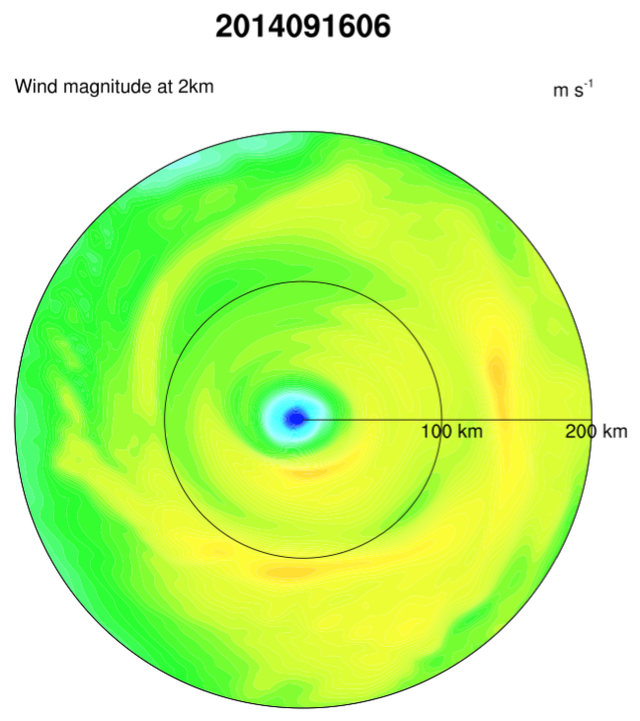
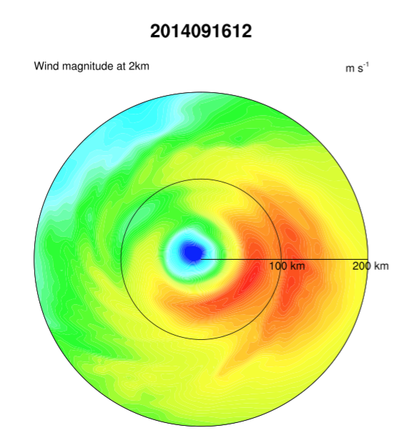
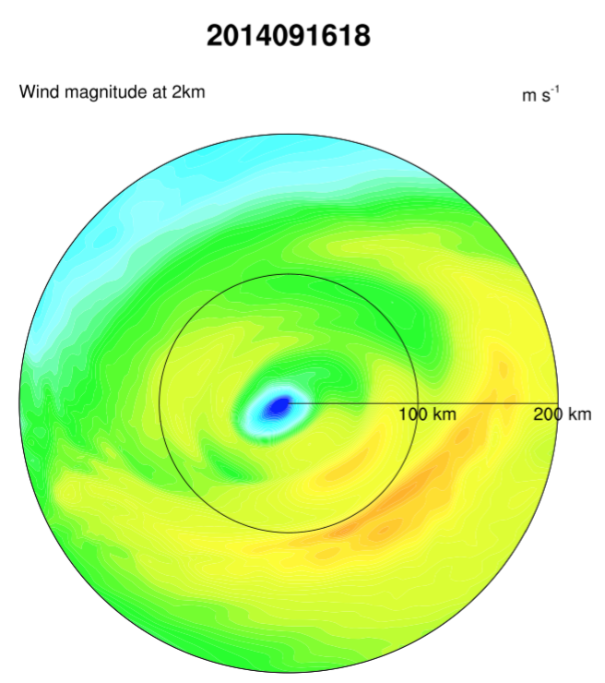
z=2km
Hr 12
Hr 24
Hr 36
Clear secondary wind maxima in
all integrations
ms⁻¹
HWRF 2016

Slide 16
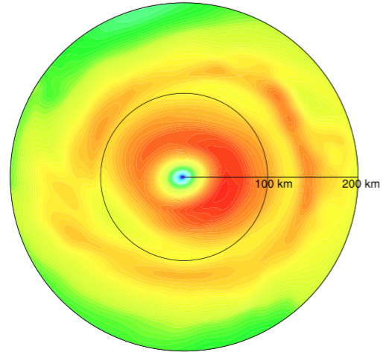
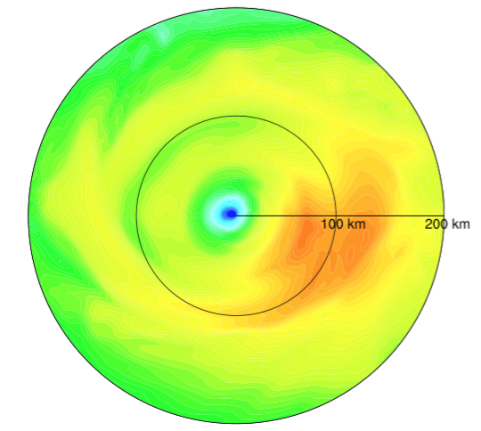
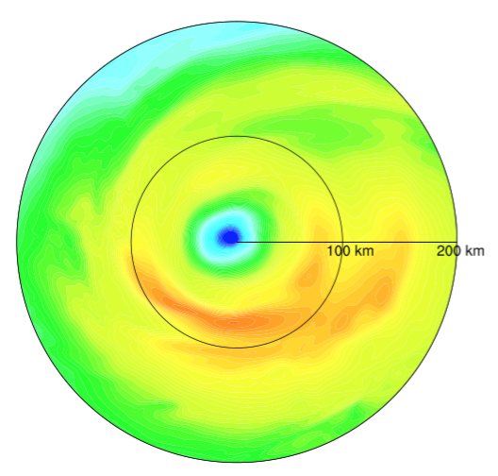





ms⁻¹
09/16 @12 Z
Initialized with a double wind maxima that lasts ~1.5 day
Hr 0
Hr 6
Hr 12
Hr 18
Hr 24
Hr 30
Hr 36
Hr 42
HWRF 2016

Slide 17








09/16 @18 Z
Initialized with a double wind maxima that lasts ~1.5 day
ms⁻¹
Hr 0
Hr 6
Hr 12
Hr 18
Hr 24
Hr 30
Hr 36
Hr 42
HWRF 2016

Slide 18




Edouard (2014)
SE
ms⁻¹
09/12
HWRF 2016

Slide 19




Edouard (2014)
09/13
ms⁻¹
SE
HWRF 2016

Slide 20
Edouard (2014)
09/14
ms⁻¹
SE
HWRF 2016

Slide 21
Edouard (2014)
09/15
ms⁻¹
SE
HWRF 2016

Slide 22




Edouard (2014)
09/16
ms⁻¹
SE
HWRF 2016

Slide 23
Take home messages
Clear secondary wind maxima in all integrations
  Encouragingly long lasting
  Do not necessarily form too close to the primary eyewall
Large diversity in radius of origin and evolution

Slide 24


H4
H3
H2
H1

Slide 25






Gonzalo (2014)
SE
HWRF 2016

Slide 26





Gonzalo (2014)
SE
Hr 77
Hr 75
Hr 69
Hr 87
Hr 84
Hr 69
HWRF 2016

Slide 27


Hurricane Blanca (2015)
H4
H3
H2
Rapid weakening
Upwelling of cooler waters (slow-moving hurricane)
Eyewall replacement
H1
Surface wind products from SSMI, SSMIS, AMSR2 and GMI (provided by H-S. Kim and P. Black)

Slide 28




Blanca (2015)
06/01
ms⁻¹
SE
HWRF 2016, no GSI (no data for it)

Slide 29




Blanca (2015)
06/01
ms⁻¹
SE
Hr 111
Hr 78
Hr 75
Hr 93
HWRF 2016, no GSI (no data for it)

Slide 30




Blanca (2015)
06/02
ms⁻¹
SE
HWRF 2016, no GSI (no data for it)

Slide 31




Blanca (2015)
06/02
ms⁻¹
SE
Hr 66
Hr 48
Hr 51
Hr 69
HWRF 2016, no GSI (no data for it)

Slide 32




Blanca (2015)
06/03
ms⁻¹
SE
HWRF 2016, no GSI (no data for it)

Slide 33

Blanca (2015)
06/03
ms⁻¹
SE
Hr 66
SE is less clear. Often two transient wind max are identified (they re-apear ~the same radii)
HWRF 2016, no GSI (no data for it)

Slide 34




Blanca (2015)
06/04
ms⁻¹
SE
HWRF 2016, no GSI (no data for it)

Slide 35


Blanca (2015)
06/04
ms⁻¹
SE
Hr 12
Hr 00
Hr 42
=(
HWRF 2016, no GSI (no data for it)

Slide 36
Let’s focus on Blanca 2015 06 01 00
  Began as tropical depression
  No GSI (no TDR data)

Slide 37


HWRF 2015
HWRF 2016
Blanca
Began as tropical depression
No GSI (noTDR data)
<V>_{2km}
[ms⁻¹]
SE
Nature

Slide 38
HWRF 2015
HWRF 2016
<V>_{2km}
[ms⁻¹]
SE
Nature

Slide 39


HWRF 2015
HWRF 2016
<V>_{2km}
[ms⁻¹]
SE
Nature

Slide 40



HWRF 2015
HWRF 2016
𝜍_{a2km}Variance
[X10⁻⁴s⁻²]
SE
Nature

Slide 41
Take home messages
HWRF 2016 seems to systematically capture secondary eyewall formation
There is large variation in secondary eyewall evolution from one cycle to the next
The common existence of secondary eyewalls in HWRF 2016 is proposed to be linked to the EDMF PBL

Slide 42

RMW~2x!!
Courtesy of Joe Cione

Slide 43


Slide 44


Slide 45

Atlantic
2013-2015
(pre-implementation)
From Jason Sippel
Notes:
Difference between H216 and H16O
Impact on Al storms:
New tracker vs. old tracker;
Two more vertical levels (L61 vs L63) and stratosphere dw/dt damping;
Additional impact on EP storms:
RTOFS ocean initialization for EP storms;
DA for all EP storms;

Slide 46


Physics test – RMW bias
HWRF 2016 PBL, COAC, and Cd/Ch change all reduced Vmax and RMW bias
RMW bias still larger at analysis time than at 6h for all tests & remains positive throughout forecast
From Jason Sippel

Slide 48








Okubo-Weiss parameter at 850 hPa
OW > 0, rotation dominate (red, s⁻²)
OW < 0, strain dominate (blue, s⁻²)
132 h
135 h
138 h
141 h
large strain-dominate flow outside RMW
CTL
convections survive in strain-dominate flow
NEWPBL
Lin et al

Slide 49


f000
f024
Lin et al

Slide 50



HWRF 2015
HWRF 2016
Total added positive
𝜍_{a2km}
[X10⁻⁴s⁻¹]
SE
Nature

Slide 51


HWRF 2015
HWRF 2016
Num grid points
with 𝜍_{a2km} >0
SE
Nature

Slide 52



HWRF 2015
HWRF 2016
Agradient Force, z=1km
ms⁻¹hr⁻¹
SE
Nature

Slide 53



HWRF 2015
HWRF 2016
<𝜍_{a}>_{2km}
[X10⁻⁴s⁻¹]
SE
Nature

