Slide 1
HFIP real-time demo: HWRF Ensemble Prediction System, 2016 Hurricane Season
Zhan Zhang
EMC/NCEP/NWS/NOAA, College Park, MD 20740
HFIP telecon, October 05, 2016
Notes:
1
1

Slide 2
Background
Two jet real time reservations;
HWRF EPS real time parallel for one AL storms;
Multi-Model Combined Ensemble Prediction;
80-member HWRF EPS for SHOUT, intensity change guidance for Global Hwak

Slide 3
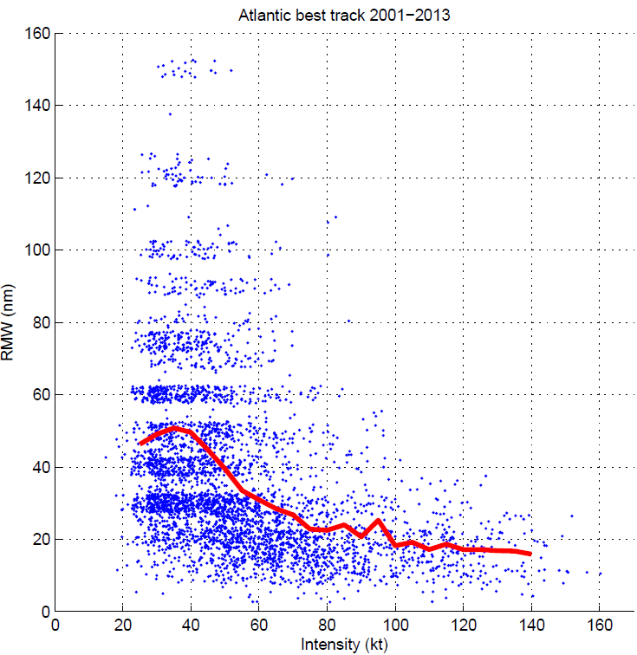
2016 HWRF ensemble Configuration
Use 2016 operational deterministic HWRF model except for
Less horizontal resolution: 27/9/3km vs. 18/6/2km
Less vertical resolution: L43 vs. L61;
No GSI due to lack of GDAS data;
IC/BC Perturbations (large scale): 20 member GEFS.
Model Physics Perturbations (vortex scale):
Stochastic Convective Trigger Perturbations in SAS: -50hPa to + 50hPa white noise ;
Stochastic boundary layer height perturbations in PBL scheme, -20% to +20%;
Stochastic Cd perturbation;
Stochastic initial wind speed and position (TCVital) perturbations considering best track uncertainty.
Difference from 2015 HWRFES:
Larger D02 and D03;
Scale-aware convection scheme turned on for all domains.
(Degrees/Sec) | 18 km | 6 km | 2 km
2015 HWRF | 75 x 75 38 4/7 | 12 x 12 12 6/7 | 6.5 x 7 4 2/7
2016 HWRF | 75 x 75 30 | 25 x 25 10 | 8.3 x8.3 3 1/3

Slide 4
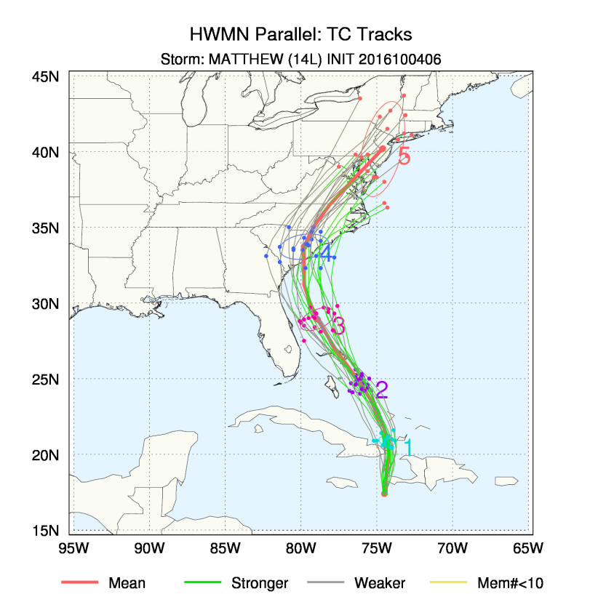
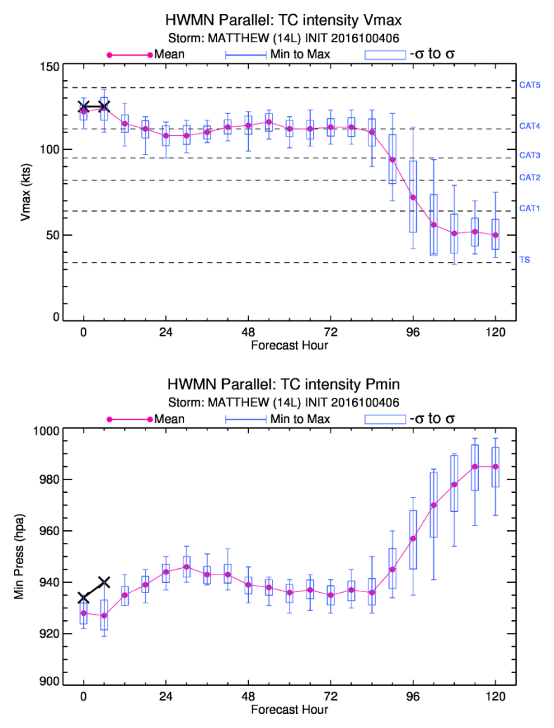
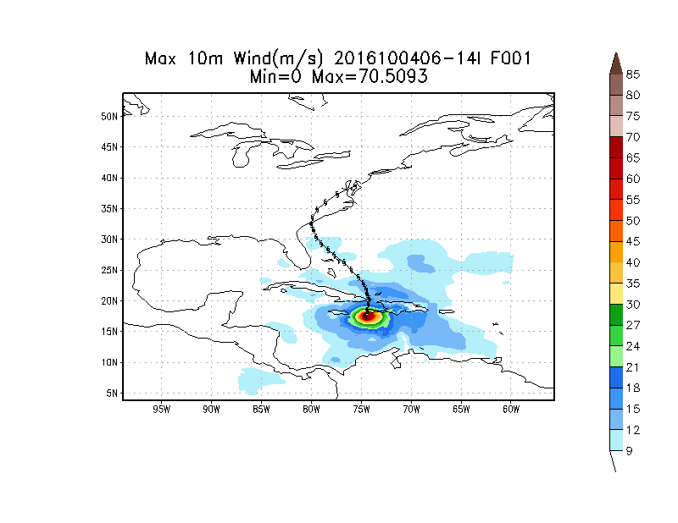
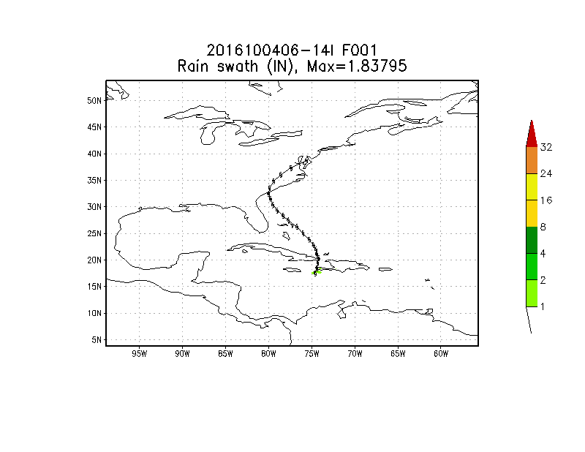
Probabilistic Forecast Products from HWRF-EPS
http://www.emc.ncep.noaa.gov/HWRF/HWRFEPS/index.php

Slide 5
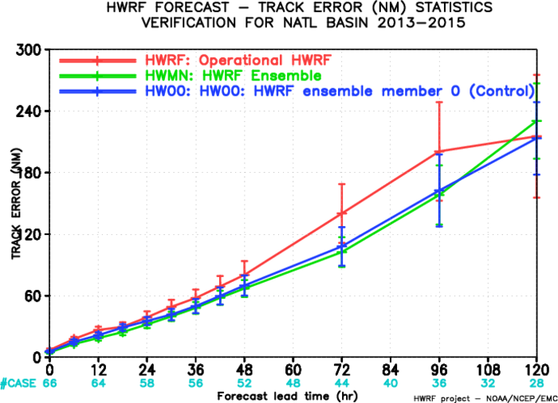
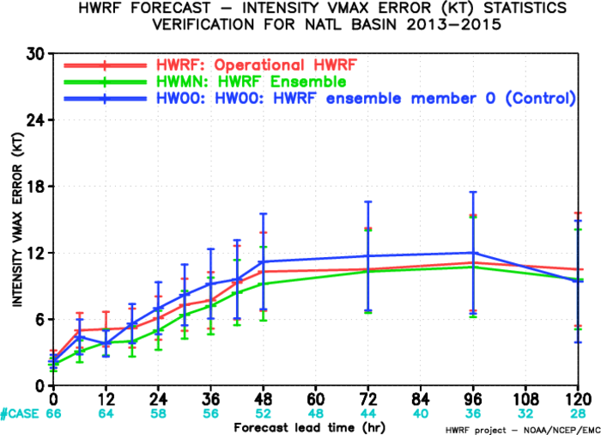
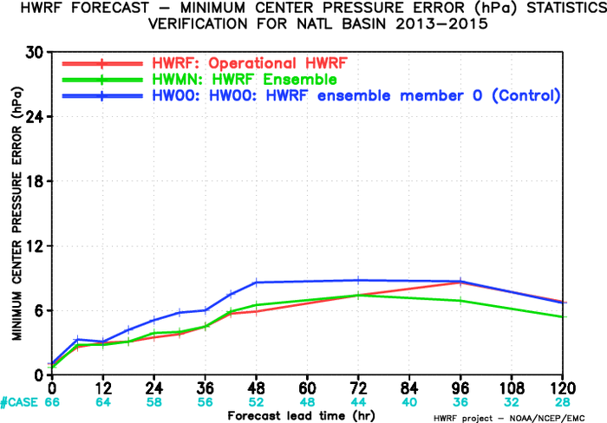
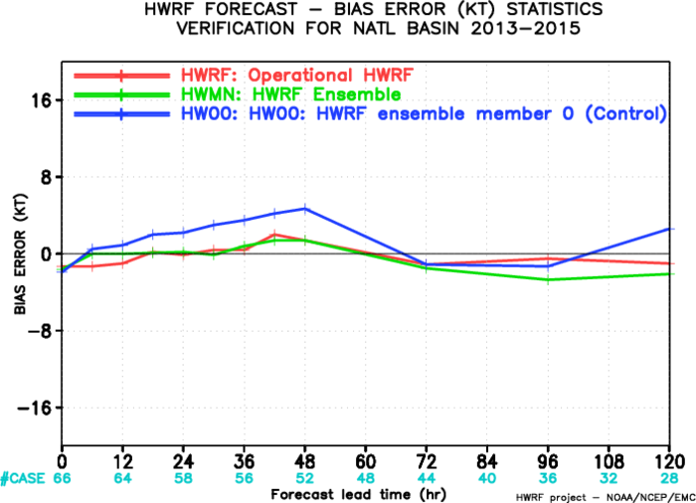
Verification: HWRF-EPS vs Deterministic HWRF

Slide 6
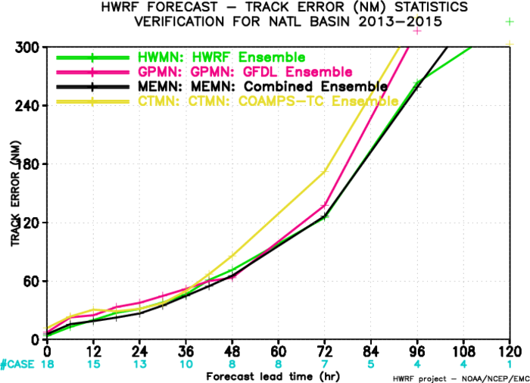
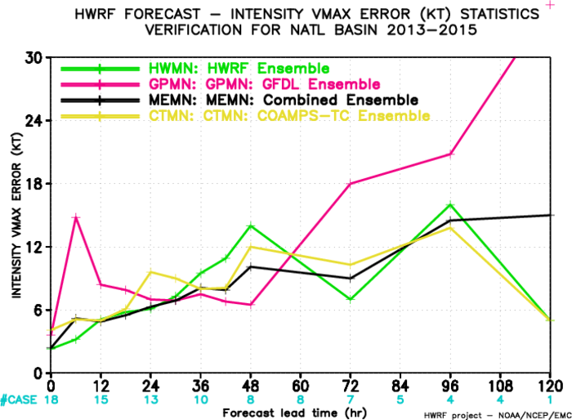
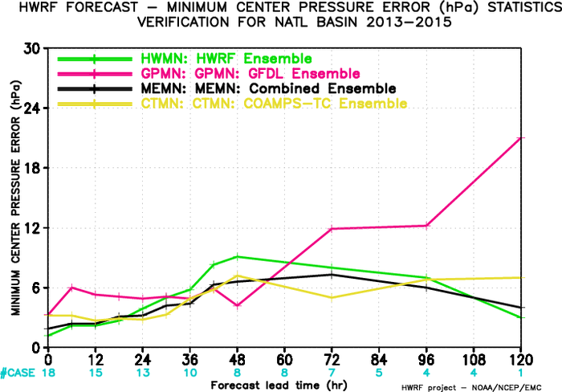
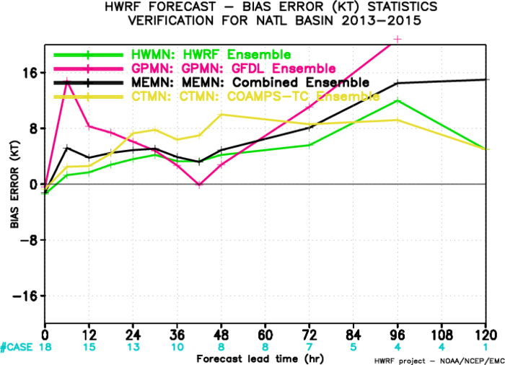
Verification: Multi-Model EPS

Slide 7
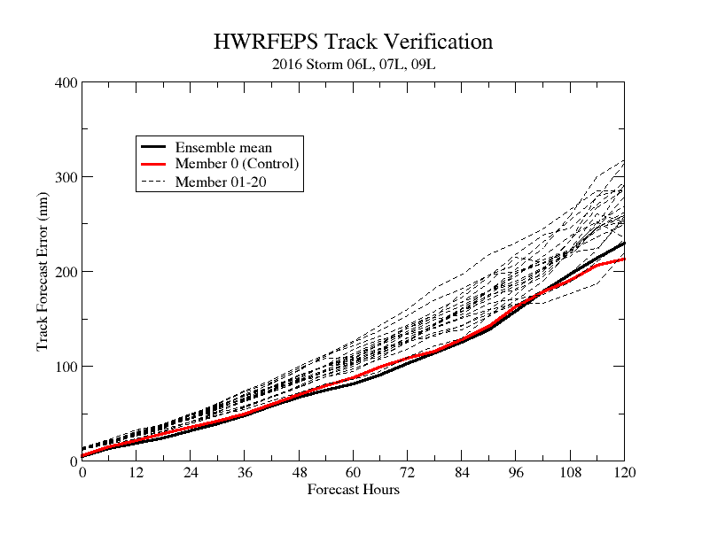
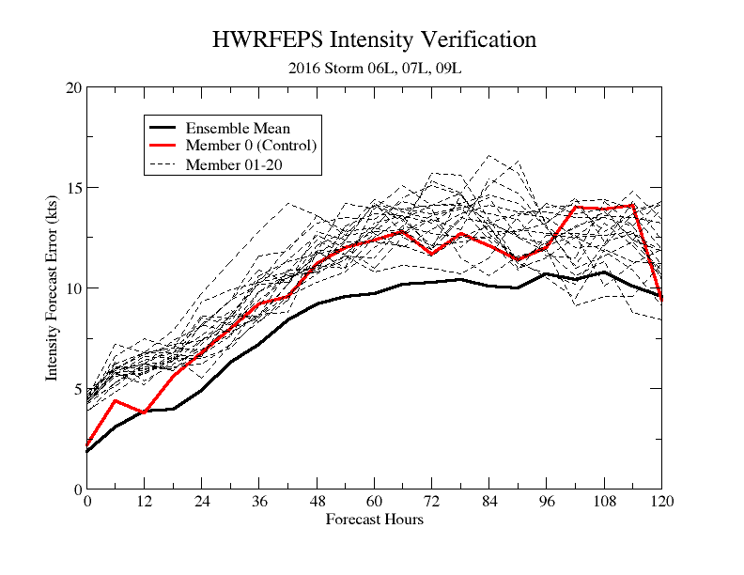
Verification: Individual Members vs Ensemble mean
1. HWRF EPS outperforms both the operational HWRF and its control (HW00) in terms of track and intensity;
2. HWRF ensemble mean has the smallest forecast errors compared to its individual ensemble members.

Slide 8
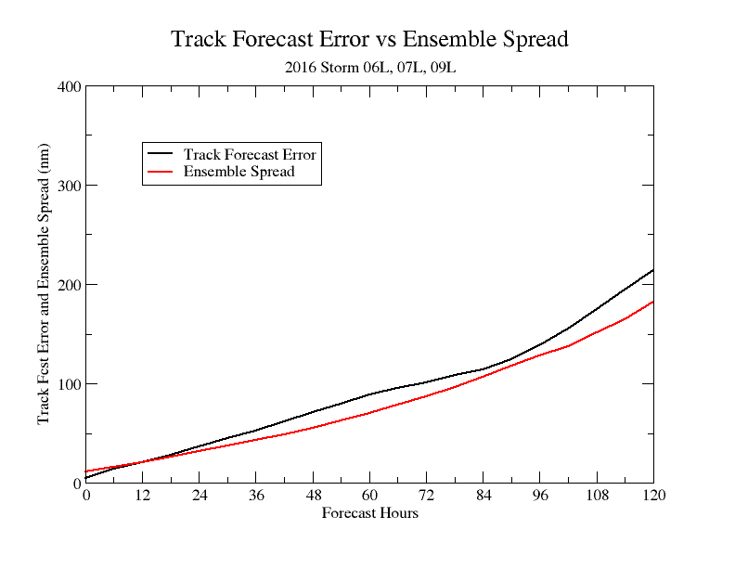
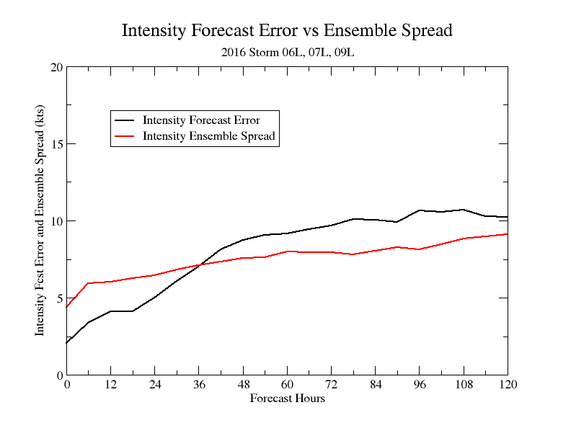
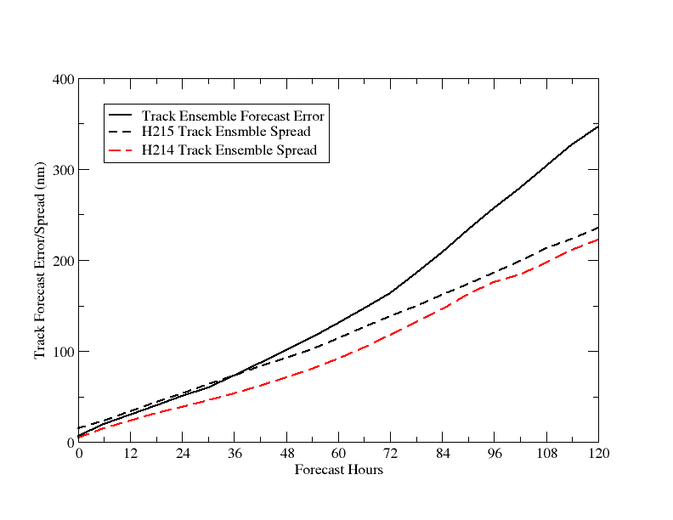
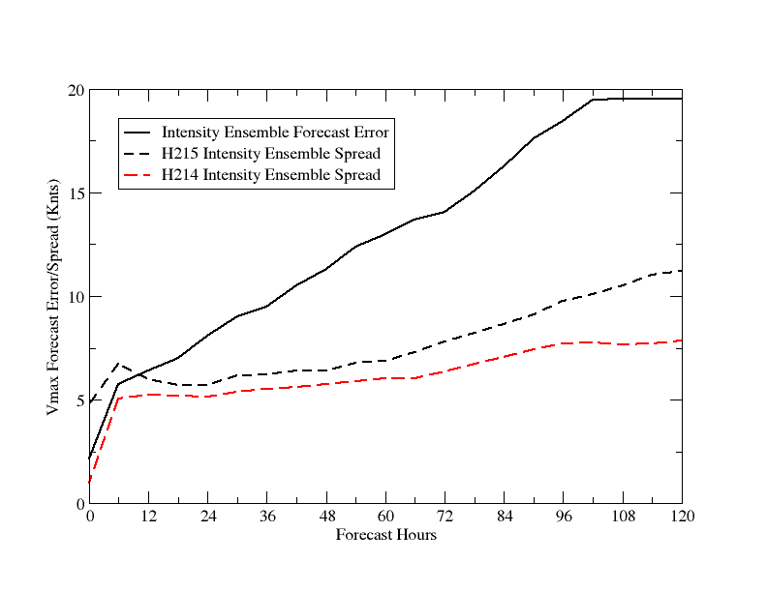
Forecast Error vs Ensemble Spread
2016-Track
2016-Intensity
2015/2014
2015/2014

Slide 9
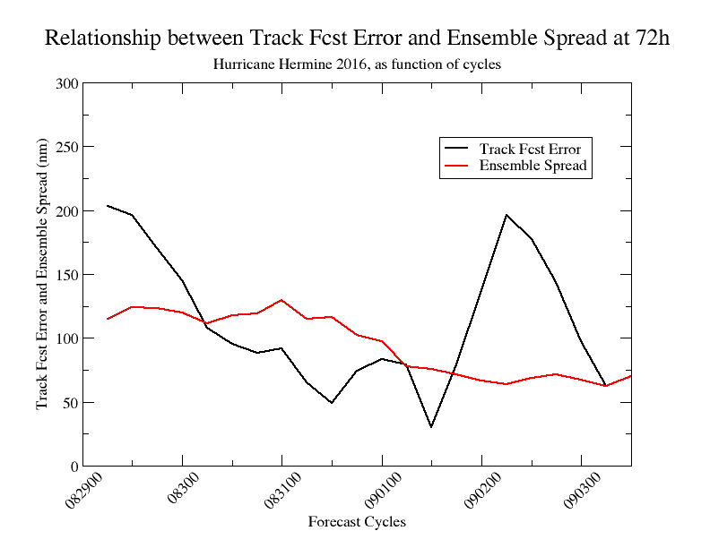
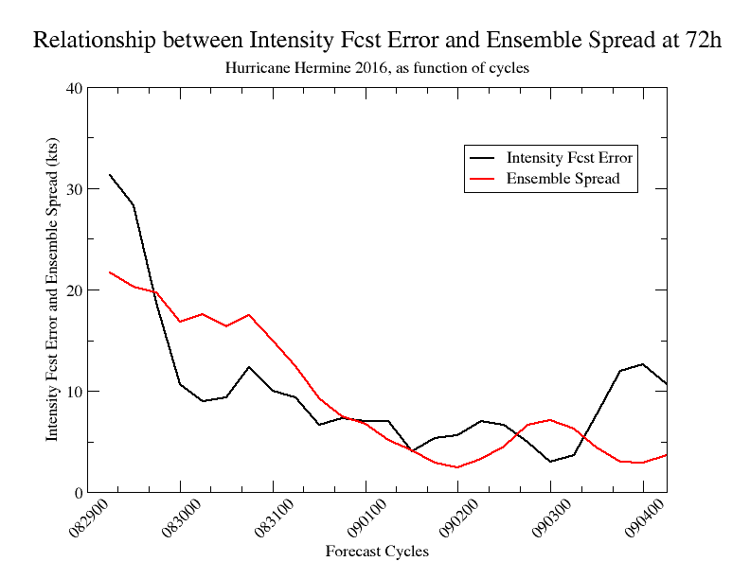
Forecast Error and Ensemble Spread as Function of Cycles
Hurricane Hermine, (2016083000-2016090400) at 72h
Forecasting forecast skills:
The spread of ensemble intensity forecasts are consistent with the intensity forecast errors.
No correlations between ensemble track spread and ensemble track forecast error.

