Slide 1



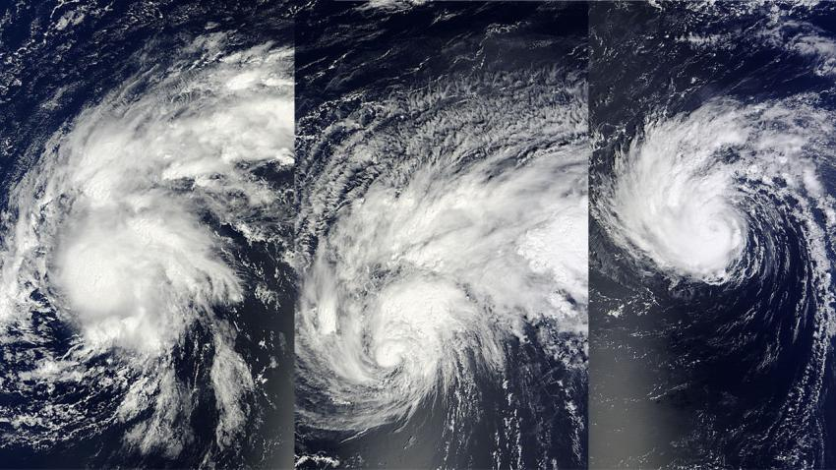
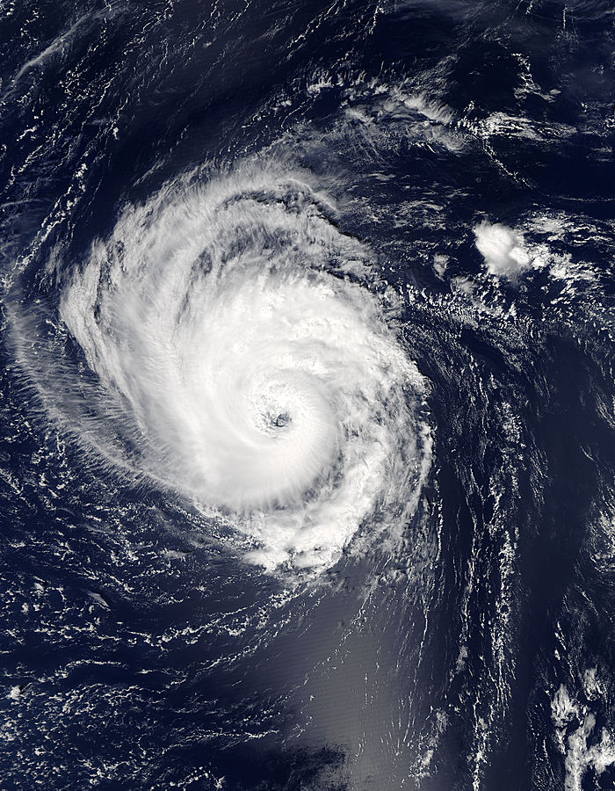
Edouard’s (2014) Intensification: An Investigation of the Relationship between Precipitation and Thermodynamic Properties
(Trey) George Alvey ¹
Ed Zipser ¹, Jonathan Zawislak ², Haiyan Jiang ²,
Rob Rogers ³, Jun Zhang ^{3,4}, Stephanie Stevenson ⁵
¹ University of Utah, ² Florida International University , ³ NOAA/AOML/HRD,
⁴ CIMAS/RSMAS/UM, ⁵ University at Albany, State University of New York
Part I: Observational Component
SEPT. 12
SEPT. 13
SEPT. 14
SEPT. 15
Courtesy NASA’s Goddard MODIS Rapid Response Team

Slide 2
HURRICANE EDOUARD (2014)
Jonathan Zawislak, Haiyan Jiang, George R. Alvey III, Edward J. Zipser, Robert F. Rogers, Jun A. Zhang, and Stephanie N. Stevenson, 2016: Observations of the Structure and Evolution of Hurricane Edouard (2014) during Intensity Change. Part I: Relationship between the Thermodynamic Structure and Precipitation. Mon. Wea. Rev., 144,3333–3354, doi: 10.1175/MWR-D-16-0018.1.
Robert F. Rogers, Jun A. Zhang, Jonathan Zawislak, Haiyan Jiang, George R. Alvey III, Edward J. Zipser, and Stephanie N. Stevenson, 2016: Observations of the Structure and Evolution of Hurricane Edouard (2014) during Intensity Change. Part II: Kinematic Structure and the Distribution of Deep Convection. Mon. Wea. Rev., 144, 3355–3376,doi: 10.1175/MWR-D-16-0017.1.

Slide 3
HURRICANE EDOUARD (2014)
Aircraft On-station Periods
Locations of GH and NOAA
Dropsonde Observations
GLOBAL
HAWK
NOAA
P3/GIV
(closed bars)
(open bars)
9/18-19 (GH)
WEAK
PEAK
9/16-17 (GH/NOAA)
9/14-15 (GH/NOAA)
RI
SI
9/11-12 (GH)

Slide 4
PRECIPITATION CHARACTERISTICS
250
WWLLN
Lightning
DSL
USR
DSR
USL
200
DSL
USL
DSR
USR
150
100
50
IR T_{B} Time series
12
13
14
15
16
17
18
DSL & DSR exhibits most persistent precipitation
(& deep convection)
Upshear precipitation more variable (episodic) during early intensification
“moderate” precipitation (PCT < 250 K)
PMW Time Series of 85-91 GHz PCT

Slide 5
Mean Inner Core Profiles: RELATIVE HUMIDITY
Biggest change from
SI to RI is DOWNSHEAR
Greatest occurrence (area, persistence, and intensity) of rainfall
Pressure [hPa]
SI
RI
PEAK
WEAK
Humidification/moistening UPSHEAR is more progressive from
SI to RI to PEAK particularly in the mid–upper troposphere
DSL
DSR
most delayed USR
(SI same as RI)
Precipitation is more variable
(less persistent) UPSHEAR
Pressure [hPa]
USL
USR
Humidification (moistening) required upshear; remains asymmetric until PEAK

Slide 6
SUBSIDENCE
UPSHEAR PROFILES
1348Z
0856Z
1339Z
0856Z
1339Z
Subsidence Inversions
1348Z
“onion” signature (mesoscale downdraft)
Dynamically-forced (e.g., convective-induced, vortex-induced) at upper-levels
Downdrafts in mid- to low troposphere

Slide 7
MODEL CONFIGURATION
Part II: Model Component
Initial conditions: NCEP FNL (1 degree)
Run Period: 12th 00 UTC – 17th 00 UTC
Domains: 27, 9, 3, 1 km
Microphysics: Thompson
PBL: YSU
Cumulus: Kain-Fritsch
*1 simulation w/ no CU at 9 km*
Notes:
Why I chose the times I did? Initially I tried running simulation starting at 00 UTC and 12 UTC on the 11th – continuously produced failed simulations
Why no CU parameterization? Simulations were failing; Parker et al. found strongest simulation sensitivity to cu params in Yasi
Why Thompson?

Slide 8
BEST TRACK COMPARISON
(S1)
No cumulus parameterization at 9 km
Best Track

Slide 9
BEST TRACK COMPARISON
(F1)
KF cumulus parameterization at 9 km

Slide 10
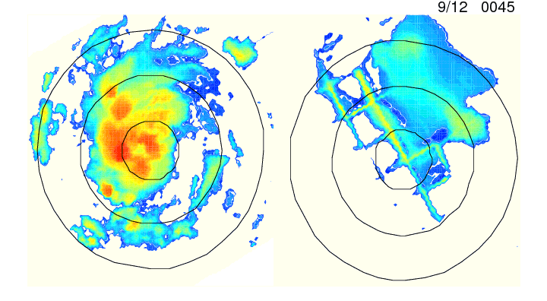
IR SATELLITE COMPARISON
Shear vector pointing up
Real GOES IR S1 Brightness Temps
UTC
K
Circles = 100, 250, 400 km
Notes:
Mention = favorable thermodynamic comparison to P-3 reflectivity and GH dropsondes on 14th-15th flight

Slide 11
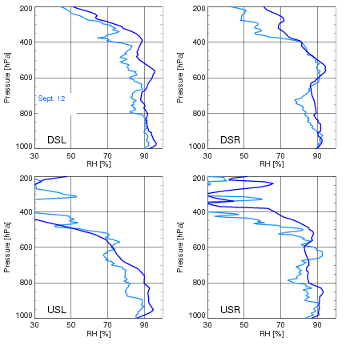
DROPSONDE COMPARISON
Observation = lighter, Model = darker

Slide 12
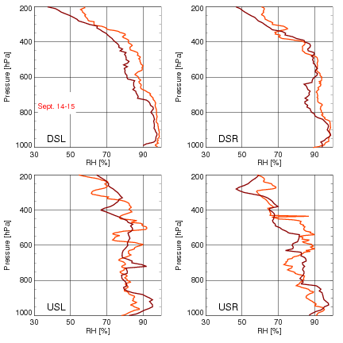
DROPSONDE COMPARISON
Observation = lighter, Model = darker
Notes:
Key thing is even though there are differences with the model v obs, the model show common results and changes/tendencies

Slide 13
VERTICAL WIND SHEAR
0 – 500 km Shear
Fail (F1)
Success (S1)
SHIPS
UTC
Notes:
while magnitudes aren’t overly different, About a 4-5 knot difference by 12 UTC on the 13th. Doesn’t seem drastic but with baseline values around 15 knots this is a 30% greater shear!!!!
Track doesn’t appear to play a significant roll in differences – show large scale plots to see if large scale features change or maybe it’s just very sensitive to small change in track. Small window of opportunity for development. One of many reasons we have so many failed genesis cases

Slide 14
Sept. 13
Sept. 13
Sept. 13
Sept. 13
8 KM Wind Vectors, 2 KM Color Fill, Black X = surface center, Red circle = 8KM Center
Notes:
Both are displaced appx 50 km around 0500 UTC.
S1 propagates more DSL and expands. F1 remains DS – DSR and does not expand.

Slide 15
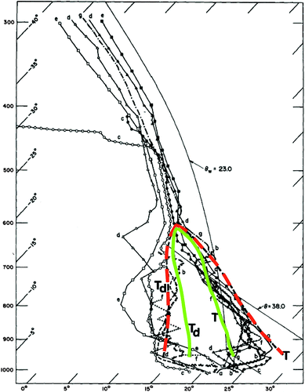
WARMING MECHANISMS
S1 – 13th 0400 UTC near center sounding
Dolling and Barnes (2012)
Kerns and Chen (2015)
Notes:
Area of mesoscale descent caps air beneath it allowing for build up of theta e via sea surface fluxes. High thetae reservoir is not in high wind area of storm, however, as would be expected by WISHE – check this; does it eventually get advected into higher winds?

Slide 16
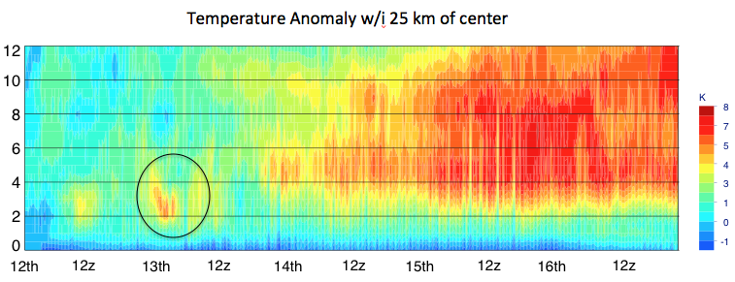
WARMING MECHANISMS
S1

Slide 17
S1
NEAR SURFACE THETA-E
F1
Zawislak et al. 2016
S1
Vertical Velocity > 3 m/s
Notes:
Significant thetae differences
Also model agrees well with the obs showing a right of shear maximum
Under the MCV and stratiform rain there is sinking air that blocks deep convection, which allows the moist entropy to increase via the surface fluxes. This creates a situation where the conditional instability builds, akin to the tornado proximity sounding discussed by Fawbush and Miller (1952). Eventually as the subsidence weakens and or the moist entropy reaches extreme values, new convection breaks out along the edge of the subsidence region dominated by large CIN. The development of Cbs around the edge of the circulation rather than the center eliminates the problematic issue of having deep convection form in the very center of the nascent TC only later to be replaced by an unsaturated, warm, and dry layer that is typical of the upper portion of an eye

Slide 18
Shear
Notes:
Shear vector pointing up – all rotated wrt shear. Explain each of the 4 panels one by one.
Dipole / displacement vertically in heating. Upper level center aligned with upper level heating, low-mid center collocated with low-mid warm anomaly.
Upper level warm anomaly primarily diabatic heating from deep convection and precipitation. In fact diabatic cooling in response to the upper level anvil and precipitation evaporatively cooling is seen over the low-mid level warm anomaly
Precipitation primarily downshear, asymmetric and stratiform. Black line indicates cross section.
Anvil and stratiform region over the mesoscale subsidence mid-level warm anomaly. Similar to Dolling and Barnes, Kerns and Chen.

Slide 19
Shear
Notes:
1. Upper level center rotated slightly upshear and nearer to the low-level center. Upper level temperature anomaly has also advected upshear and nearer the low-mid warm anomaly.
2. Diabatic heating primarily downshear still but much nearer to the low level center than previously
3. Convection now upshear wrt upper level center and nearing upshear wrt low level center.
4. Increased deep convection downshear

Slide 20
Shear
Notes:
Upper level warming now completely overtop low level center and a slightly weaker low-mid warm anomaly. Vertically aligned storm
Upper level diabatic heating now upshear.
Primarily stratiform but still some deep convection

Slide 21
PRECIPITATION AND HUMIDIFICATION
Quadrant averaged precipitation (within 80 km)
S1 – F1 (6-10 km)
S1
F1
Successful simulation features a propagation/increase in precipitation upshear after 0600 UTC on the 13th
Notes:
Biggest differences in RH upshear initially

Slide 22
Precipitation Partitioning
S1
F1
Notes:
Define shallow (20 dbz 0-6 km) , mdt (6-12) , deep (>12). Similar to Haiyan and Cheng Tao. Averaged within inner core or 100 km

Slide 23
Cloud Fraction [%]

Slide 24
S1 – F1 Simulation Differences
km
km
UTC
UTC
12th 13th
12th 13th
km
km
UTC
UTC
Notes:
What causes the differences between the 2 simulations??
Penny et al. (2016) looked at sensitivity of TC formation to microphysics – found that stronger convective processes related to graupel differences in schemes led to intensification.

Slide 25
Summary / Conclusions
Relatively low RH in the upshear quadrants is initially the greatest hindrance to increasing symmetry (intensification)
remove unfavorable, relatively dry layers upshear
Both simulations are misaligned initially, however, vortex becomes aligned in successful simulation on 13th. Failed simulation gets sheared apart.
Successful simulation has lower 0-500 km shear than failed simulation.
Mesoscale subsidence under the anvil upshear appears to play a crucial role in the early intensification of Edouard.
Increase in RH upshear coincident with precipitation increase – indications that relative humidity in the upper troposphere may actually increase first.
Importance of quadrant based analyses particularly in asymmetric sheared storms.
Notes:
caps air beneath it due to the formation of a mid-level warm anomaly. Promotes high thetae reservoir and increased convective development on subsidence flank, downshear right. These results tend to agree with Dolling and Barnes (2012) and Kerns and Chen (2015) regarding early intensification mechanisms.
– a result differing from Penny et al. (2016).

