Slide 1





Indo-US Joint Center for Advanced Modeling of Tropical Land-Atmosphere-Ocean System for Simulation of Extreme Weather Events
Principal Investigators:
Prof. U.C. Mohanty
School of Earth Ocean and Climate Sciences,
Indian Institute of Technology, Bhubaneswar
Dr. Frank Marks
Hurricane Research Division AOML/NOAA/DOC
Presenter: Dr.Sundararaman Gopalakrishnan
Hurricane Research Division AOML/NOAA/DOC

Slide 2
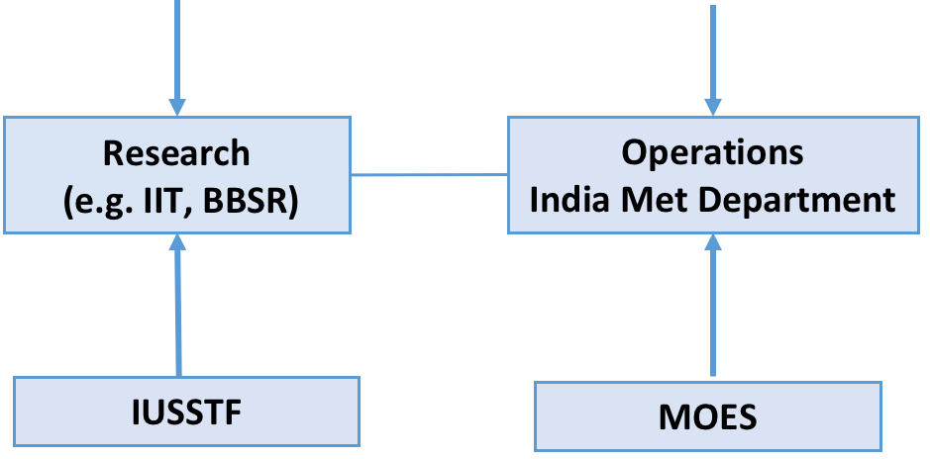
Objective
Combine resources and advancements made in US and India in terms of NWP and advanced DA techniques to create the next generation tropical prediction system for forecasting high impact weather over India.
Use NOAA’s HWRF modeling system and DA techniques at IIT/BBSR, INCOIS, and Purdue University to create and demonstrate a next generation severe weather prediction system.
Goal is to transfer this capability to IMD by the end of the proposal to pave the way to a sustainable severe severe weather prediction model.
HWRF: EMC
HWRF: DTC
HRD: Modeling & Observations
HWRF
University
Collaborations
Forecast Offices
NHC, JTWC, IMD, international

Slide 3



Background: US Context
10-year program with ambitious forecast improvement goals
HFIP Motivation:
Decrease Evacuations
Increase forecast accuracy,
  especially at longer lead times
  especially during periods of rapid intensity changes;
Raise confidence levels for all forecast periods
2012 Snapshot
Total: $54,931K
HFIP
IFEX & HS3
NOAA Total
$16,990
http://www.hfip.org/
Notes:
Slide provided by Ed Rappaport

Slide 4

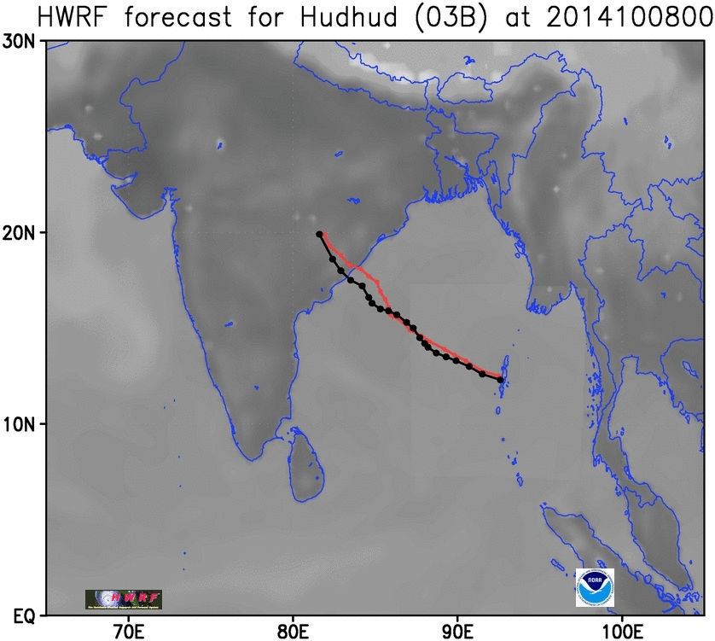
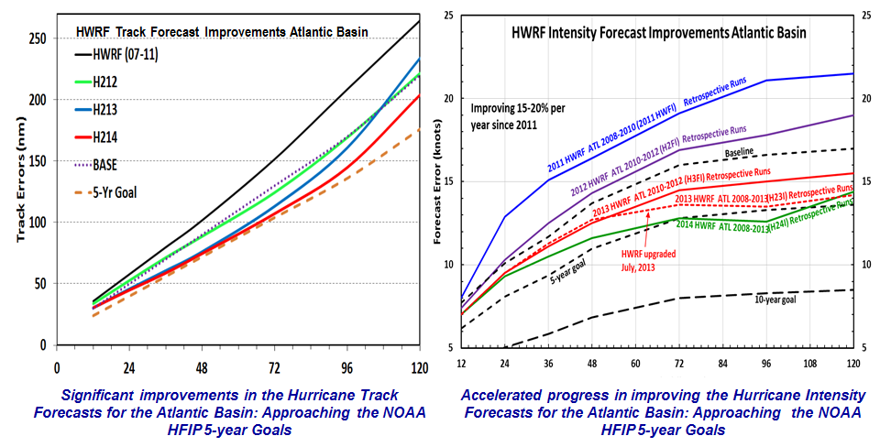
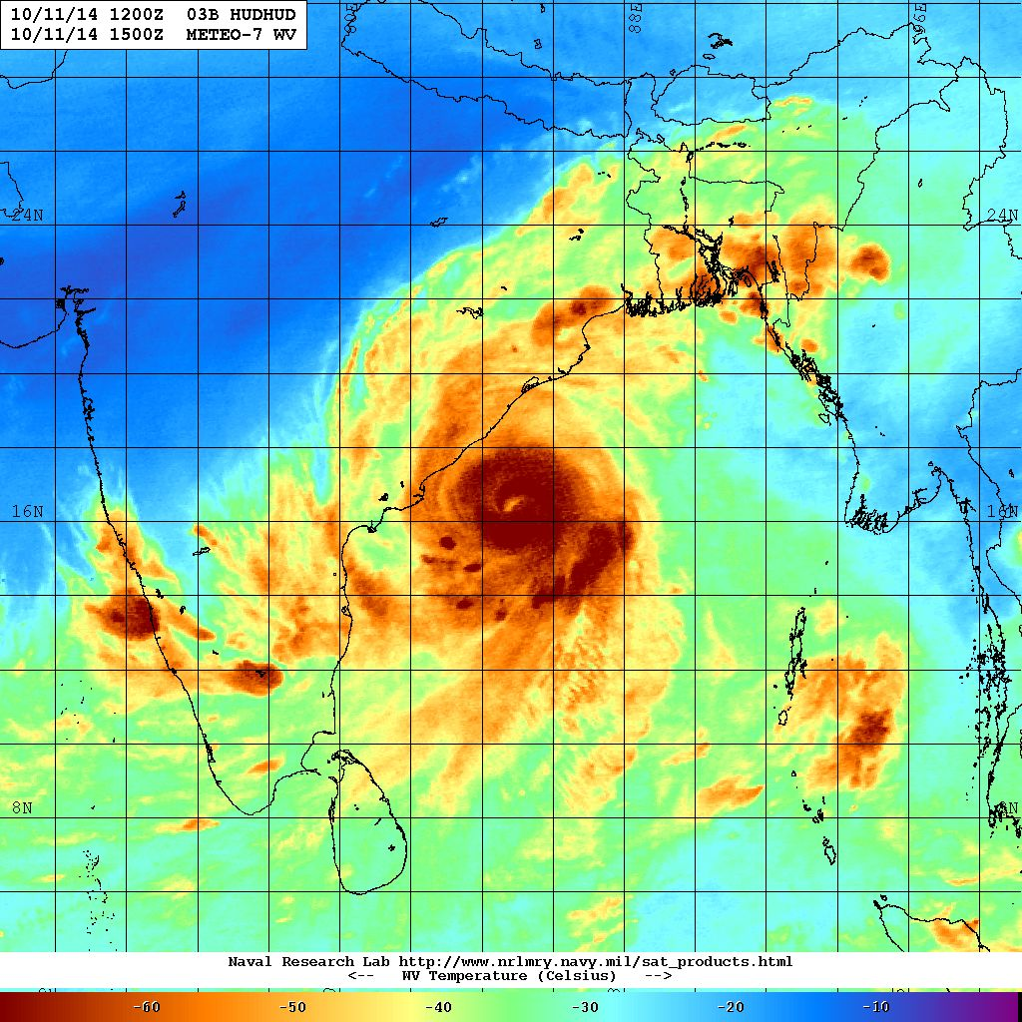
Response to HFIP: Creation of the high-resolution HWRF system
Highlights
2011: First cloud resolving operational TC forecasting system for Atlantic and East Pacific basins
2012: Official guidance model for JTWC and India Meteorological Department
2013: Significant progress in TC track, structure, intensity and RI predictions over all basins
Notes:
HFIP Goals: (i) Hurricane impact areas (track improvements) – 50% in 10 years, (ii) Severity (intensity improvements) – 50% in 10 years (iii) Improve detection of Rapid intensity changes especially near land fall. Such a problem is a very big challenge for forecasting (iv) Extend forecast reliability out to 7 days.
Response: NOAA research (AOML/HRD), NWS (NCEP/EMC) and HFIP partners (DTC) are developing the HWRF modeling system to address our immediate and future operational needs.
Highlights
2011: First cloud resolving operational TC forecasting system for Atlantic and East Pacific basins
2012: Official guidance model for JTWC and India Meteorological Department
2013: Significant progress in TC track, structure, intensity and RI predictions over all basins

Slide 5
Background: Indian Context
80% of India’s annual rainfall attributed to convection. These rain events critical for agricultural, hydroelectric, and water resource needs and the nation’s economy, however they are also responsible for the majority of flooding and associated economic damages and loss of lives.
Although only 5-6% of global tropical cyclones (TCs) have their genesis over Indian seas, landfalling TCs over the Indian subcontinent account for the highest number of cyclone related deaths in the world
Since 2007, the IIT group led by Prof. U. C. Mohanty are providing experimental operational forecast of TCs using state-of-the-art mesoscale models
Through HFIP NOAA is striving towards the goal of improving TC forecasts to save life and property. Improvements were possible because of improved NWP, observations, and DA techniques to initialize these forecast models.
Under HFIP development of HWRF and high resolution DA techniques, NOAA has started making significant advancements in TC intensity forecasting through high resolution HWRF.

Slide 6
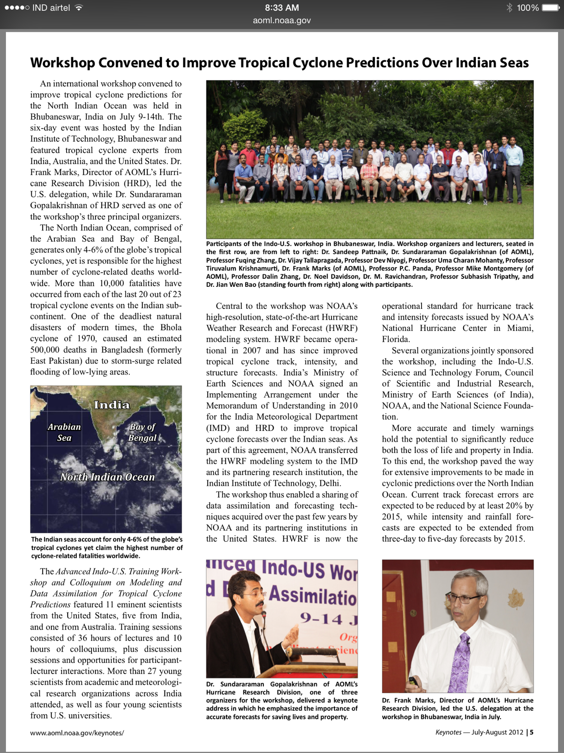
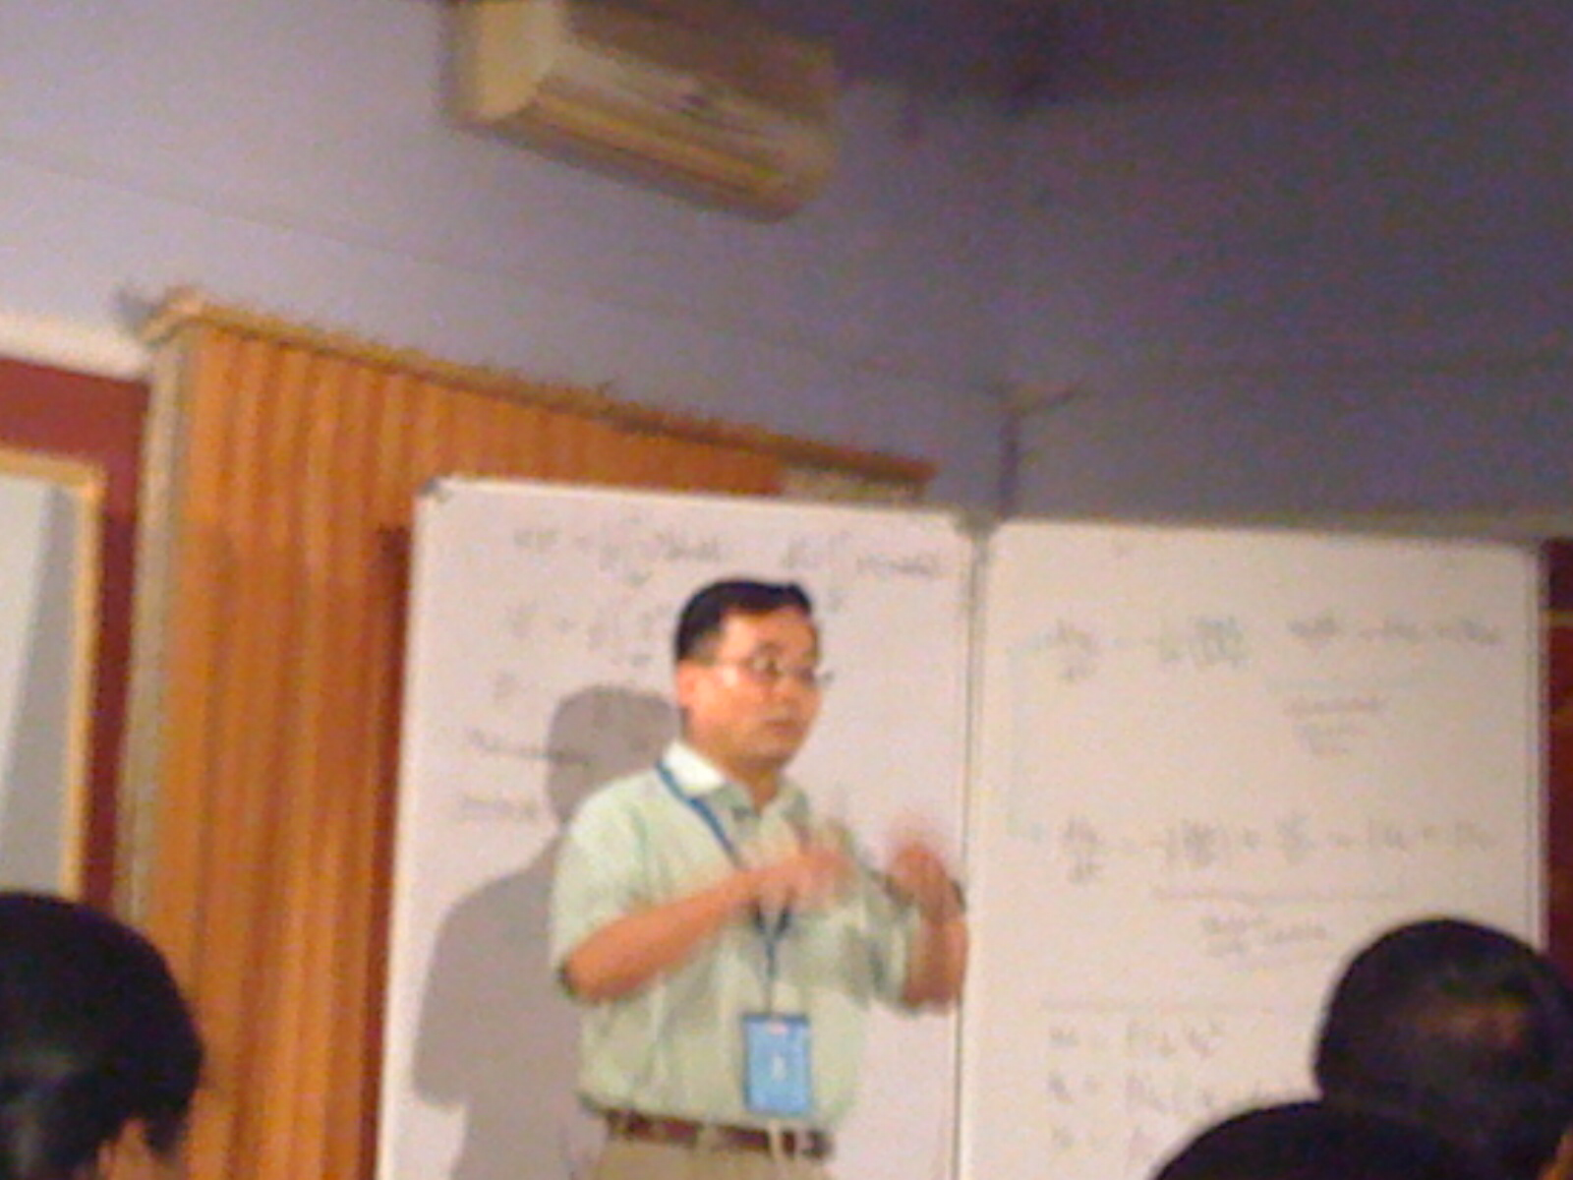
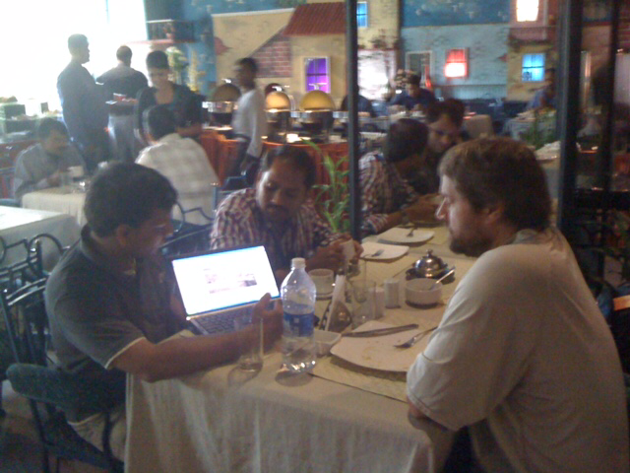
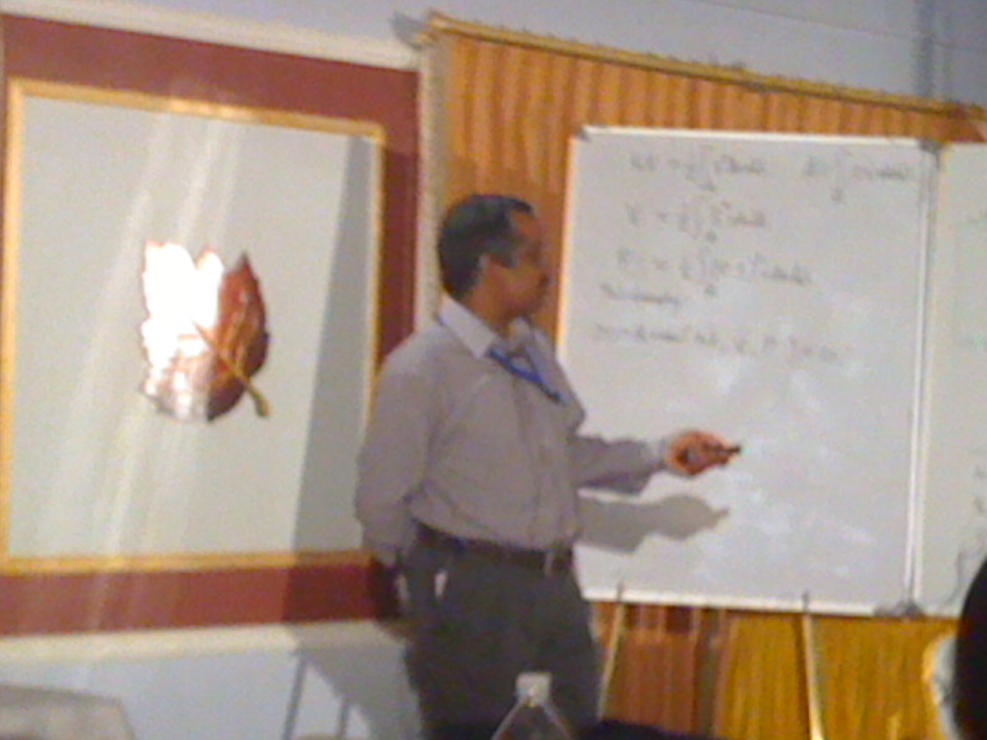
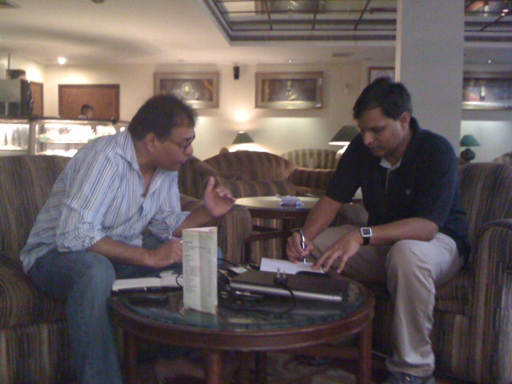
Milestone 1: Capacity Building
Monograph on
Advances in Observations, Assimilation and Modelling of Tropical Cyclones
Editors: Prof. U C Mohanty, IIT Bhubaneswar, India
Dr. S.G.Gopalakrishnan, NOAA/AOML/HRD, US
Technical Editor: Dr. Krishna Kishore Osuri
Publisher: The Springer
[Sponsored by Indo-US Science & Technology Forum]

Slide 7
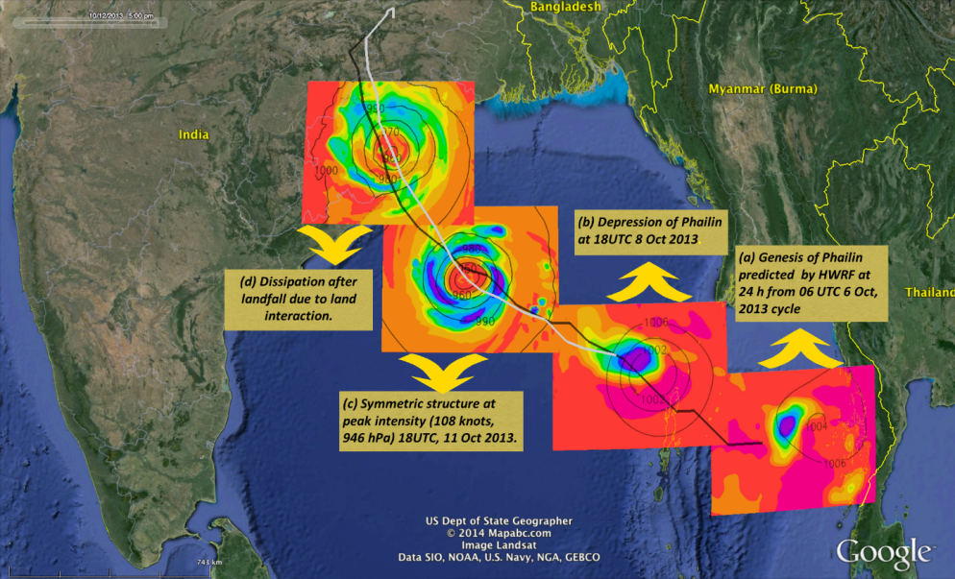

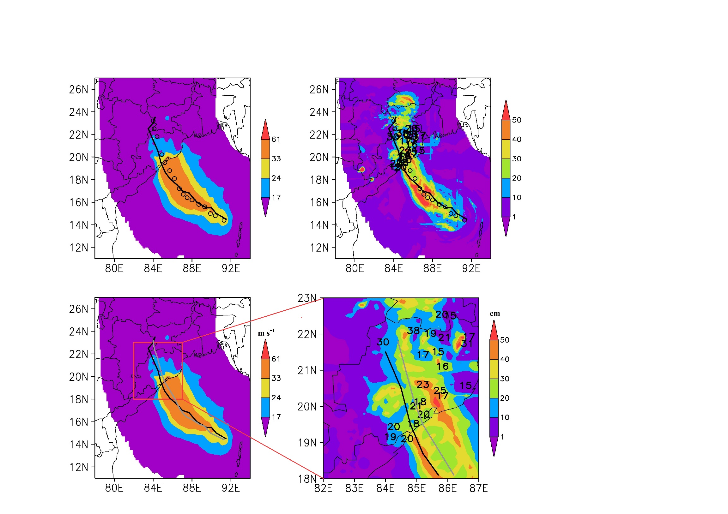

Milestone 2: Research to Operational Transitions
HWRF Predictions of Phailin (2013)
Peak surge (m) Sea surface elevation (m)
Mohanty et al. (2014), Earth Interactions
Highlights
High resolution HWRF system is implemented (by IITBBS group) at IMD, New Delhi for operational use
High resolution HWRF system is implemented (by IITBBS group) at INCOIS for ocean coupling
IITBBS group shares experimental realtime products from HWRF with IMD on Phailin, Hudhud and Lehar

Slide 8
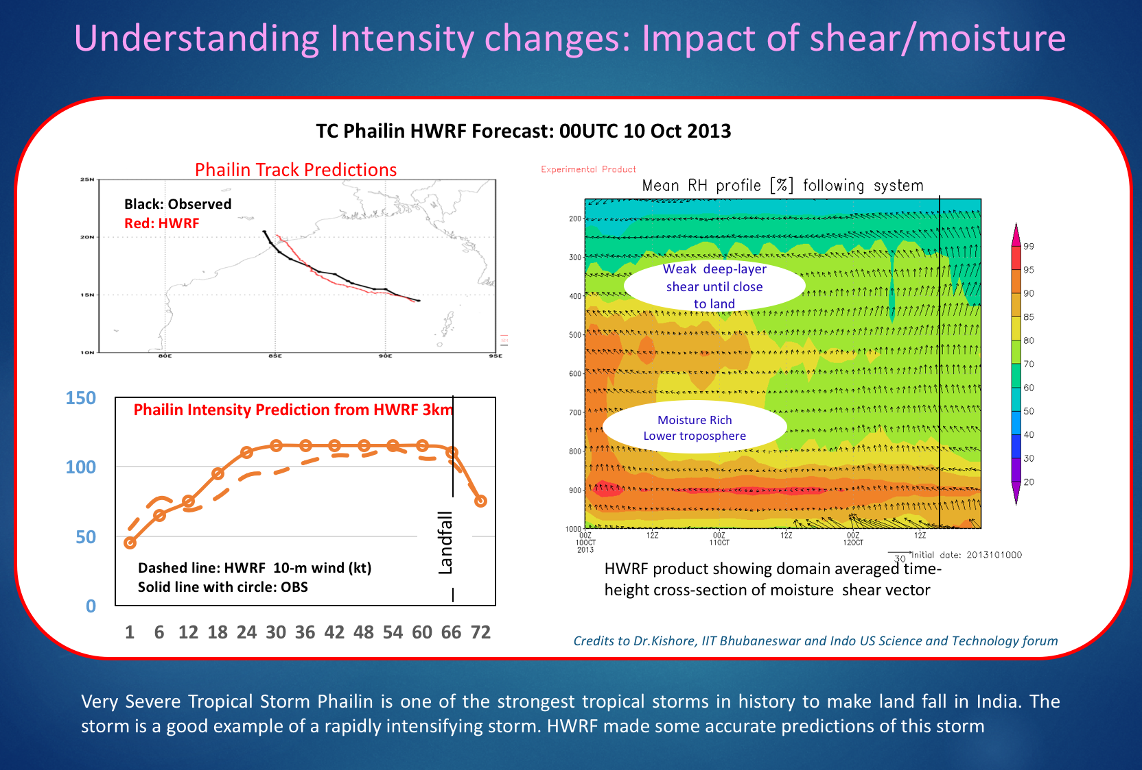
Tropical Cyclone Research over Indian Seas
Notes:
Height-Time cross section of domain averaged moisture. Note the shear, dry air interactions in Lehar.

Slide 9
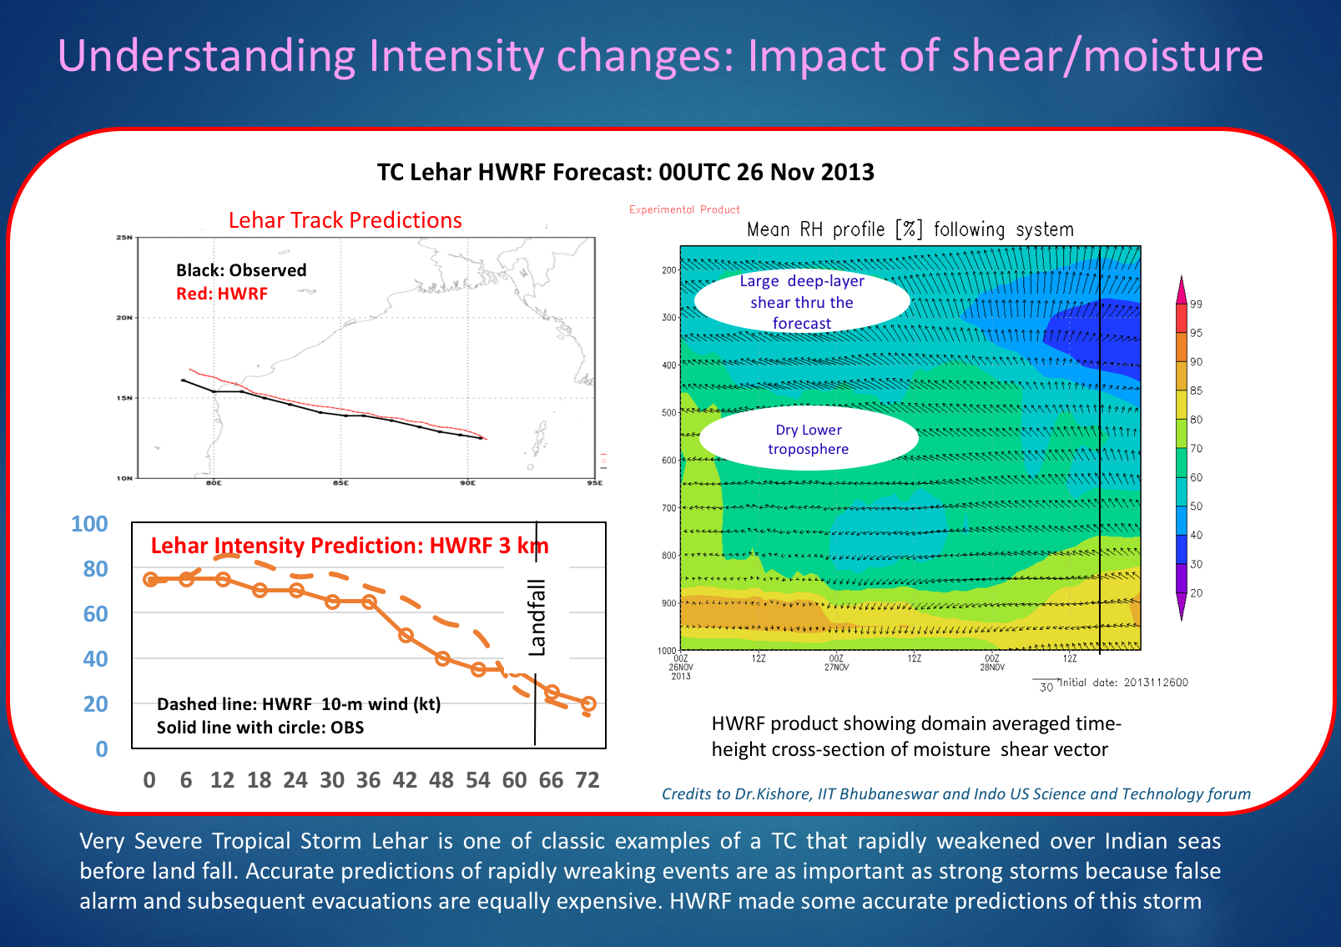
Tropical Cyclone Research over Indian Seas
Notes:
Height-Time cross section of domain averaged moisture. Note the shear, dry air interactions in Lehar.

Slide 10

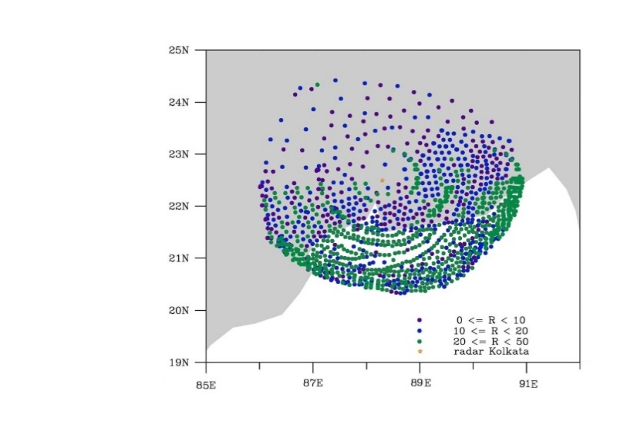
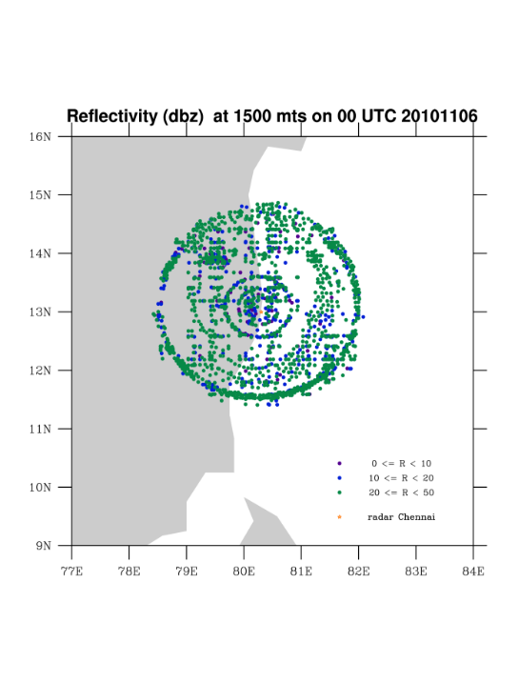
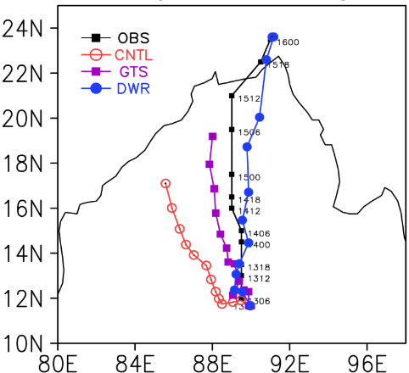
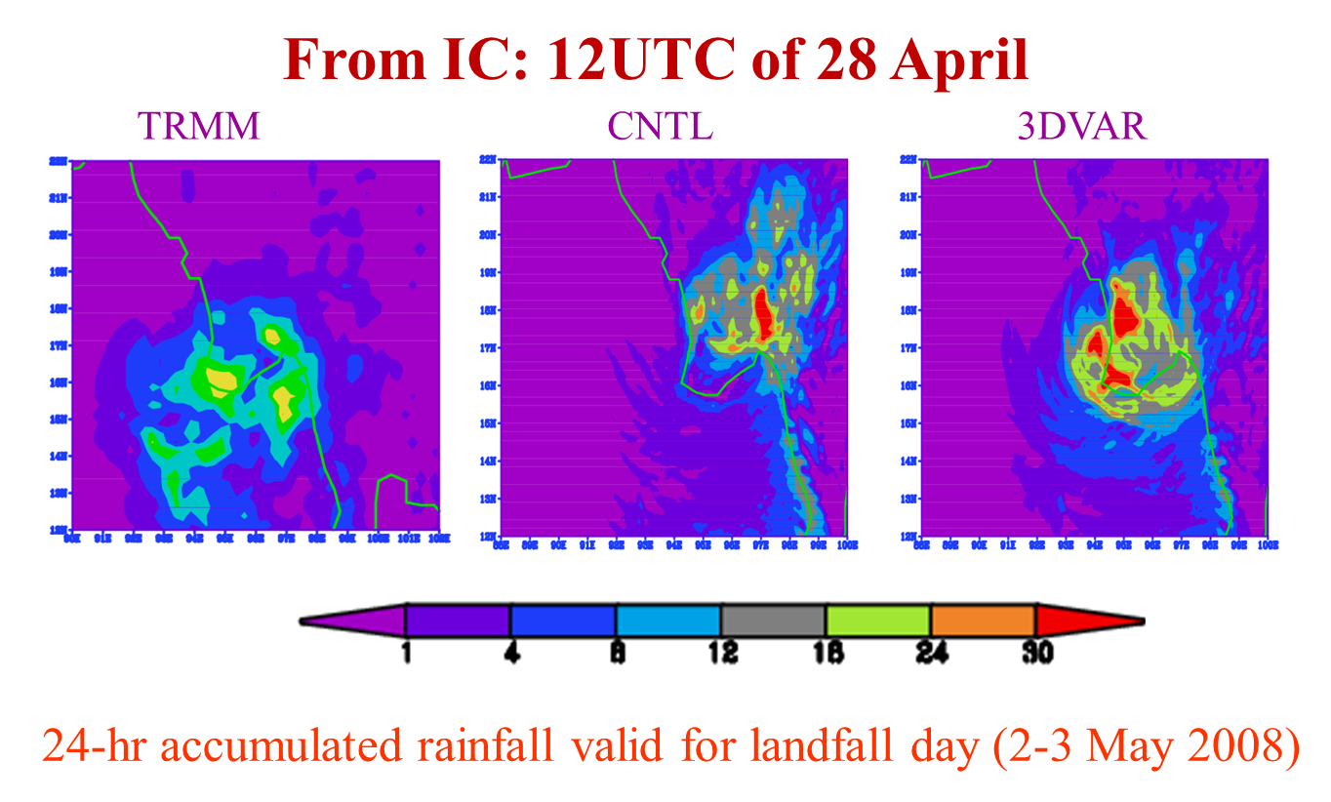
Ongoing Research Activities
Advancement of Data Assimilation Techniques for extreme event predictions
25 N
24 N
23 N
22 N
21 N
20 N
19 N
16 N
15 N
14 N
13 N
12 N
11 N
10 N
9 N
Kolkata DWR
Chennai DWR
Kolkata DWR Reflectivity
85E 86E 87E 88E 89E 90E 91E 92E
77E 78E 79E 80E 81E 82E 83E 84E
Improving Land State for severe weather predictions using HWRF system

Slide 11
Usefulness of the exchange visits of US Faculty
Two US visits have been completed this year.
Gopal’s Visit:
Discussion and finalization on HWRF configuration for Indian domain.
TC Monograph review process
Discussions on evaluation of HWRF performance and diagnostics for Indian region
Frank’s Visit:
State-of-the-art methods for rainfall verification associated with TC
TC monograph finalization
Discussions on long-term collaborations between HRD and IIT Bhubaneswar

Slide 12
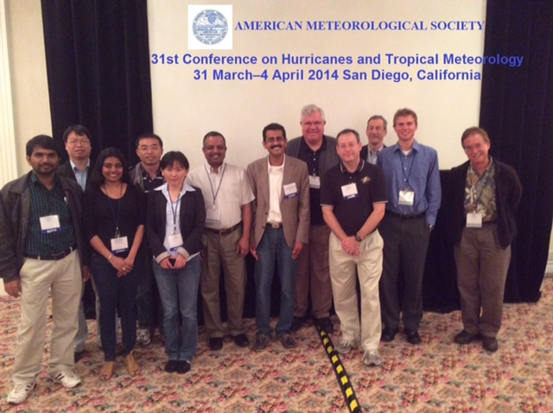
Other Complimentary Visits
Visit of Dr. Krishna Kishore IIT Bhubaneswar: Visited to NCEP(EMC),HRD and JPL for six months in 2014 to work with latest version of HWRF of HRD
Visit of Prof U C Mohanty IIT BBS: visited under his Professional Development Fund in June 2014 for 3 weeks to HRD and Purdue University to work with broad objectives of IUSSTF Net Work project
Visit of Prof. Devdutta Niyogi , Purdue University, visited in January 2015 for 2 weeks under ITRA and spend time with IIT BBS to work with LSP parameterization in HWRF system.

Slide 13
Usefulness of the exchange visits of Indian Faculty
One Indian faculty visit from IIT Bhubaneswar to Purdue University and HRD is planned in this summer
Two Indian students visit from IIT Bhubaneswar are planned in this summer [coinciding with Hurricane season in USA]
            One to NOAA/DTC to work on data assimilation within GSI system of HWRF.
To Purdue University to implement Noah LSM within HWRF system for improved land surface conditions

Slide 14
Progress to date
Configured/Customized the NOAA HWRF system for North Indian Ocean (at IITBBS, HRD, NCEP).
Evaluated the HWRF model configuration for TC track, intensity and rainfall over the NIO (Joint efforts)
  Very severe cyclonic storms (VSCS) Phailin (October 2013),
  SCS Helen (November 2013)
  VSCS Lehar (November 2013)
  VSCS Madi (December 2013)
  VSCS Hud-Hud (October 2014)
Testing and evaluation of an POM model for NIO to replace the existing ocean model in the NOAA HWRF system (at INCOIS in progress)
Testing and evaluation of Noah LSM for Indian subcontinent to replace existing LSM in the NOAA HWRF system (at Purdue University and IIT BBS in progress)
Produced textbook on advances in observing and modeling TCs for publication in India from IUSSTF sponsored workshop in July 2012 (at IITBBS/IIT Delhi and HRD)
2 US scientist visits to date

Slide 15
Challenges
How can we use this research capacity and approach to accelerate TC forecast improvement in India?
  HFIP approach & infrastructure allows for rapid T&E of emerging research and observations for potential R2O into operational hurricane model and DA systems.
  Expand and leverage HFIP partnership to take advantage of new initiatives to foster and enhance existing HFIP partnership, promote collaboration with international research community, and address near-term opportunities
Notes:
With increasing budget uncertainty we need to leverage on the successful HFIP approach to further our enhancements of the operational system. HFIP demonstrated an approach similar to that outlined in the OFCM Interagency Strategic Research Plan for Tropical Cyclones: The Way Ahead that is working and accelerating improvements.
In challenging and volatile budget times OFCM serves as an honest broker in bringing together partners from across federal services to insure return on investment and coordination. WG/TCR serves as lynch pin in this endeavor to coordinate and track research across agencies to insure operational requirements are addressed. IHC plays critical role in providing a forum to monitor progress, and for this coordination to be discussed and debated.

Slide 16
Lesson learned
Program may be synchronized with Atlantic Hurricane Season to get the best benefit from US partnership (starting date: Nov 2014)
Arranging travel for students to US during TC season to experience all aspects of the TC research/operation process during TCs critical to success
Having IMD and NWS involved in the effort is critical to success
Workshop prior to proposal beginning provided a great base to launch the proposed effort putting everyone in the correct frame for success. Textbook should further the effort.
Insure students have access to the models and observations is critical to success

Slide 17
Any future sustainable partnership envisaged after completion of IUSSTF support
MOU between Purdue University and IIT Bhubaneswar for exchange of Faculty and Students
  MOU between HRD and IIT Bhubaneswar for next 5 years as an append to the NOAA-MoES MOU on “Technical Cooperation In Development of Tropical Cyclone Numerical Weather Prediction System for the Indian Seas
  WMO-Forecast Demonstration Project & SARC-STORM

Slide 18
Publications
U C Mohanty, Krishna K Osuri, Vijay Tallapragada, Frank D. Marks, Sujata Pattanayak, M. Mohapatra, S.G. Gopalakrishnan, Dev Niyogi, 2015: A Great Escape from the Bay of Bengal 'Super Sapphire-Phailin' Tropical Cyclone - A case of improved weather forecast and societal response for disaster mitigation", Earth Interactions, (under review)
Osuri Krishna K. , U.C. Mohanty, A. Routray, and D. Niyogi, 2015: Improved Prediction of Bay of Bengal Tropical Cyclones through Assimilation of Doppler Weather Radar Observations, Monthly Weather Review (under revision)

Slide 19
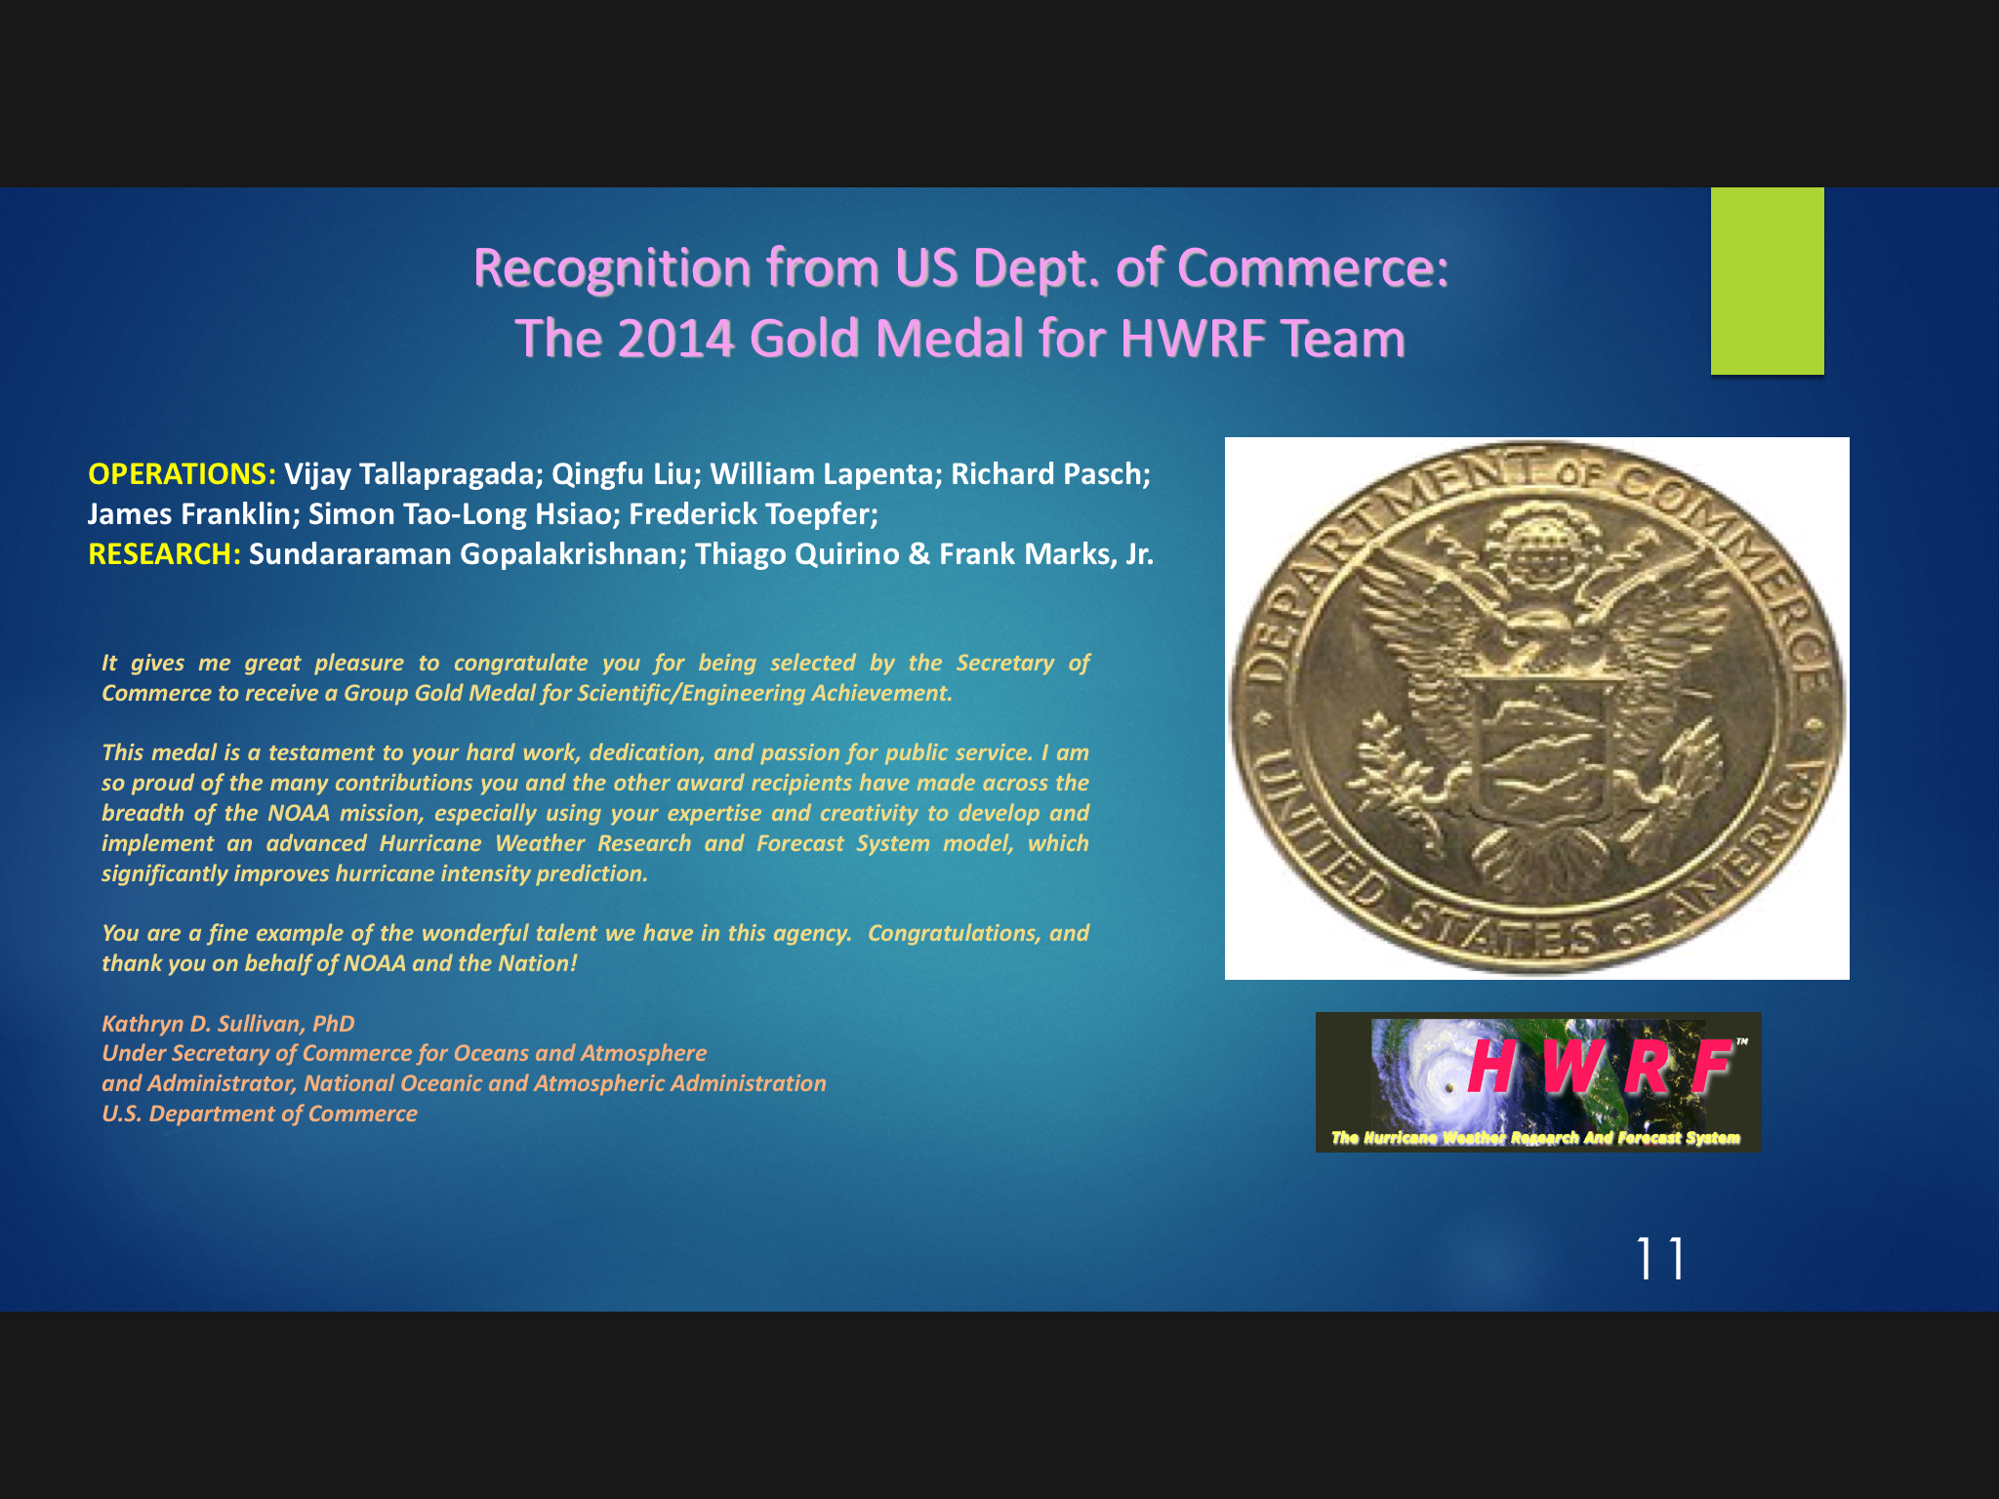

Slide 20
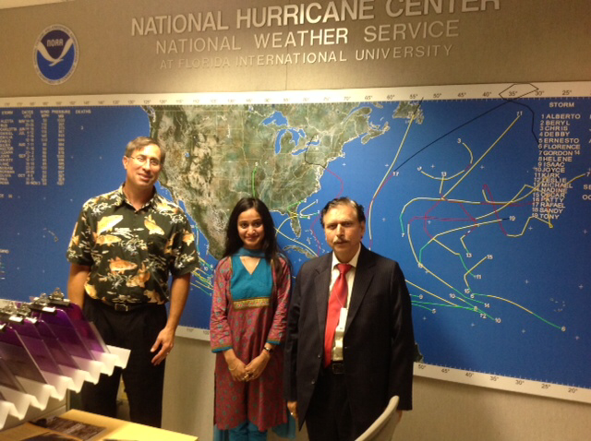
Thanks

Slide 21
Specific activities to be undertaken in the two years period (plan of work, experimental methods, activities to be undertaken by the Indian and US collaborator, proposed dates/ duration of visits etc.)
Tasks | Research & Development | Students/Post Doc | PI | Time period (man year)
1 | Configure, test and develop appropriate criteria for tracking severe weather with the high resolution grid in HWRF system (criteria for nest motion already available for TCs) | 1 Post Doc | HRD/Gopal, Marks | 1 year
2 | Test and evaluate appropriate physics packages, amongst several parameterization schemes available in the HWRF for the tropical predictions | 1Ph.D students | EMC/Vijay IITBBS/Prof.UCM | 1 year
3 | Link WRF-VAR with the latest version of the HWRF and develop vortex scale initialization for tropical cyclones and depressions | 1 Ph.D student | IITBBS/Prof.UCM and HRD/Gopal | 1 year
4 | Development of advanced diagnostics based on what is available for the TC version of HWRF | 1 Ph.D student | HRD/Gopal/Quirino IITBBS/Prof.UCM | 1 year
5 | Evaluate Slab versus Noah LSM impacts within the WRF suite | 1 Ph.D / Post Doc | Purdue/Dev Niyogi | 1 year
6 | Rainfall/SDA/ LDAS tests over the Indian region | 1 Ph.D student | Purdue/Dev Niyogi | 1 year
7 | Ocean Data Assimilation | 1 Ph.D student | INCOIS/Ravi | 1 year

