Slide 1
The NOAA’s HWRF system: State-of-the-art and beyond

Slide 2
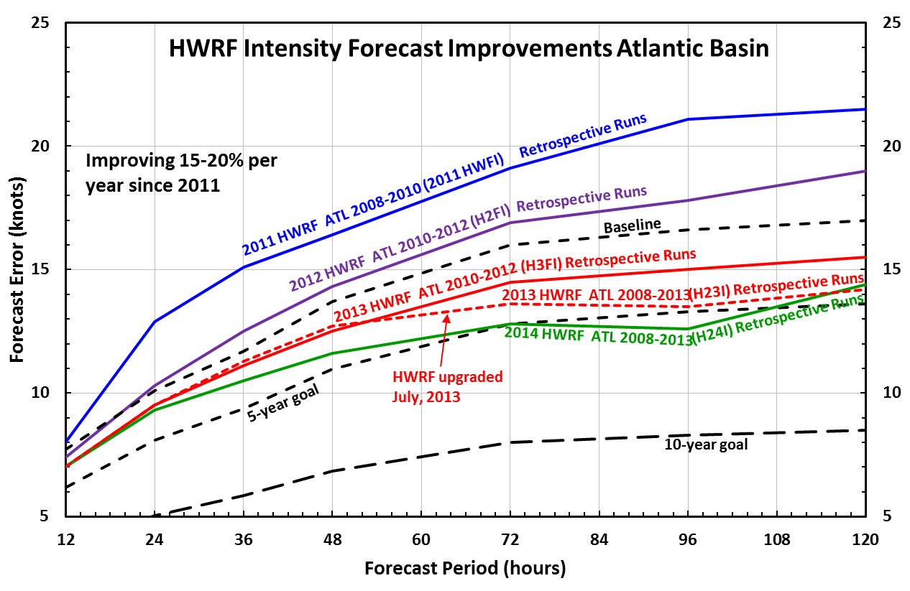
Operational HWRF: State-of-the-Art
Steep Step progress in intensity and track predictions with operational HWRF, largely due to improved resolution (3 km nest) and physics carefully calibrated using NOAA P3, aircraft observations.

Slide 3
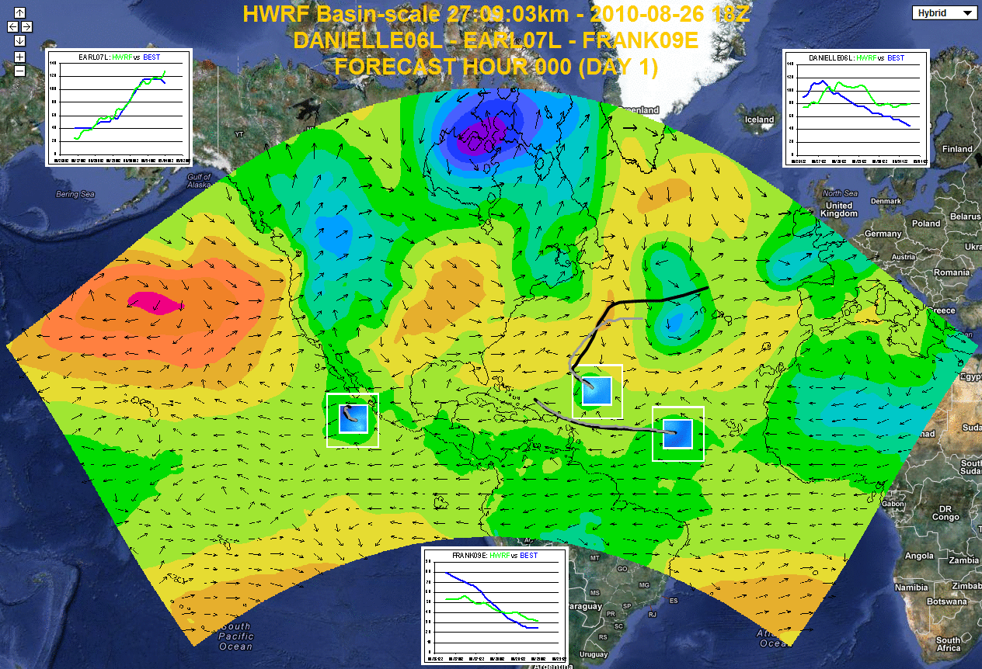
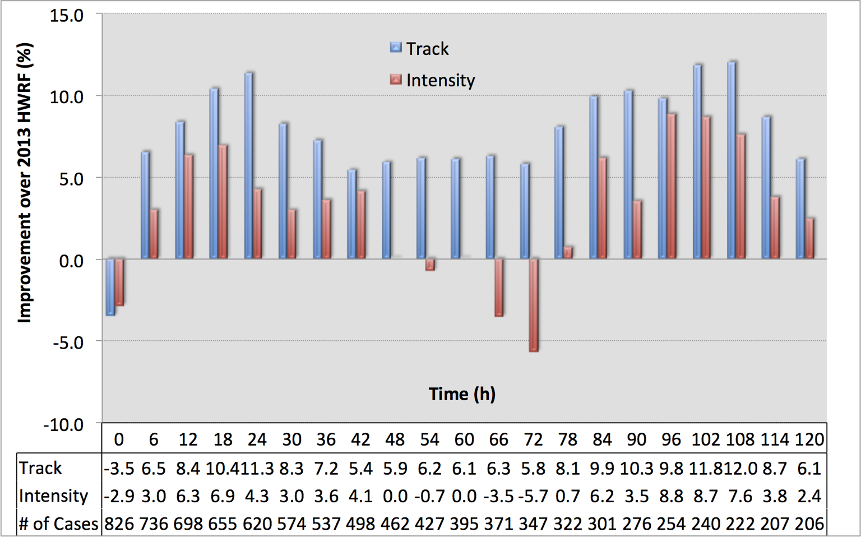
Basin-Scale HWRF: Next Operational System
Basin Scale HWRF is expected to improve the predictions of Storm-Storm interactions and Land storm interactions. Will be the backbone of NOAA’s future Tropical Prediction System

Slide 4
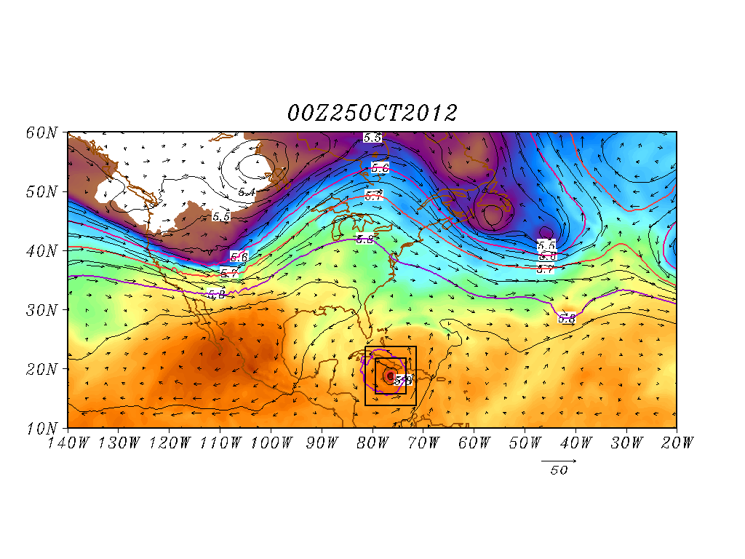
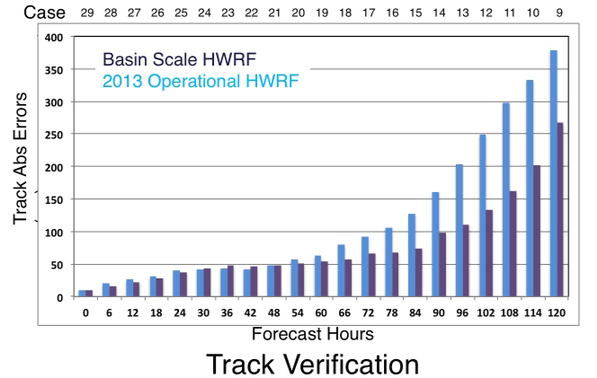
Basin Scale HWRF: Improved Land-Storm Interactions
Improved scale interactions and improved track & size forecasts
(25 00Z Predictions)
Shading: T at 500 hPa; Contour: GHT at 500 hPa
Vector: Flow averaged between 500 hPa and 200 hPa
Shading: T at 500 hPa; Contour: GHT at 500 hPa
Vector: Flow averaged between 500 hPa and 200 hPa
Hurricane Sandy Predictions: Domain size and vortex- mean flow interactions

Slide 5
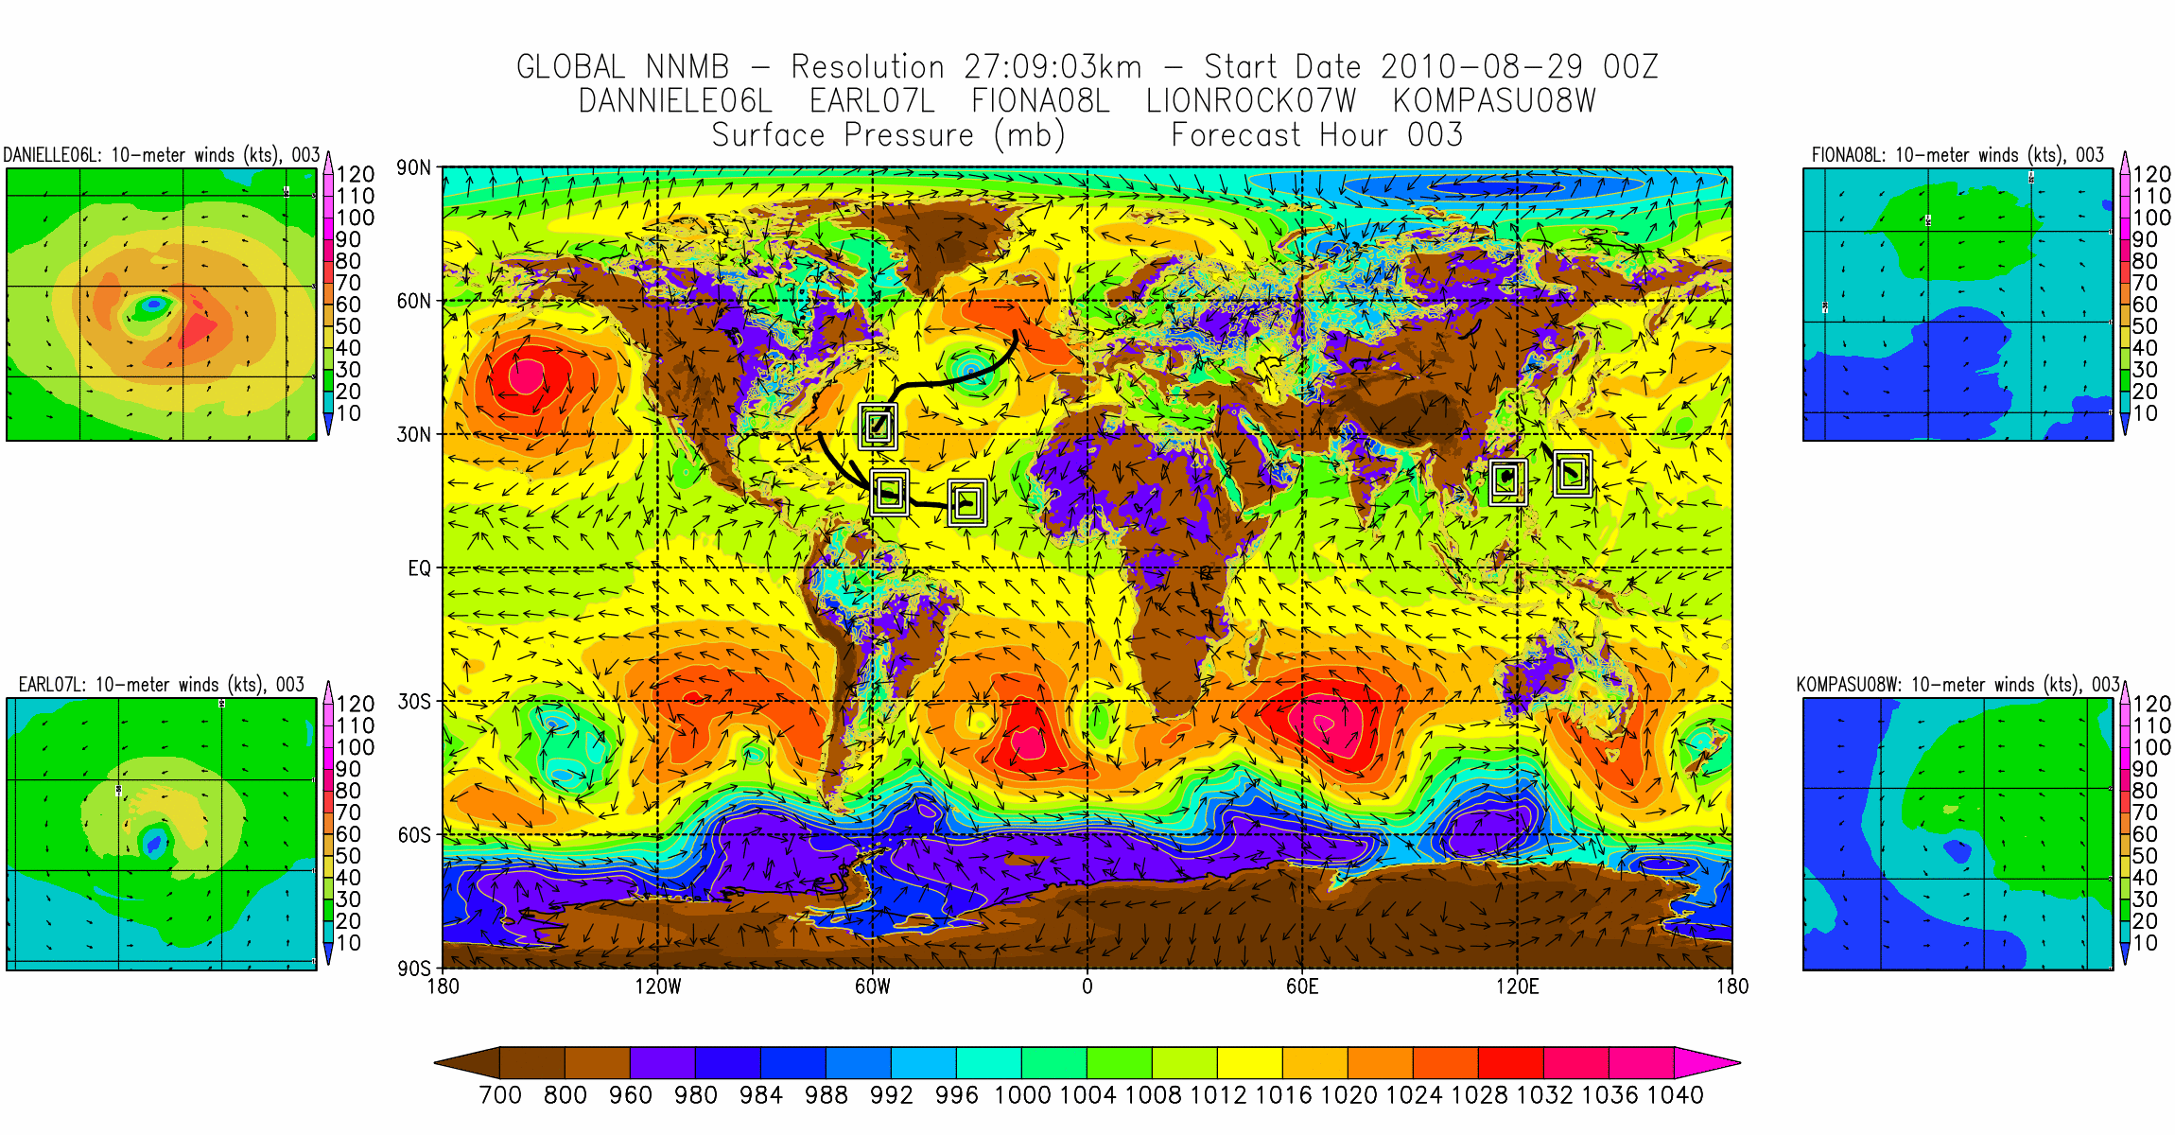
Next Generation Effort: A Global Tropical Prediction System

