Slide 1


A Global to Local-Scale Hurricane Forecasting System
Sundararaman gopalakrishnan (gopal)
noaa/aoml/Hurricane research division, Miami, FL, USA
DEVELOPERS: Thiago quirino (AOML), xuejin zhang(AOmL), Thomas black (Ncep), Joseph prusa (AoML), Vijay TallapragadA (AOML) & Zavisa Janjic (NCEP)
Acknowledgements: Frank marks, robert atlas & timothy Schneider
Presented at World Weather Open Science Conference 16-21 August 2014, Montreal, Canada

Slide 2

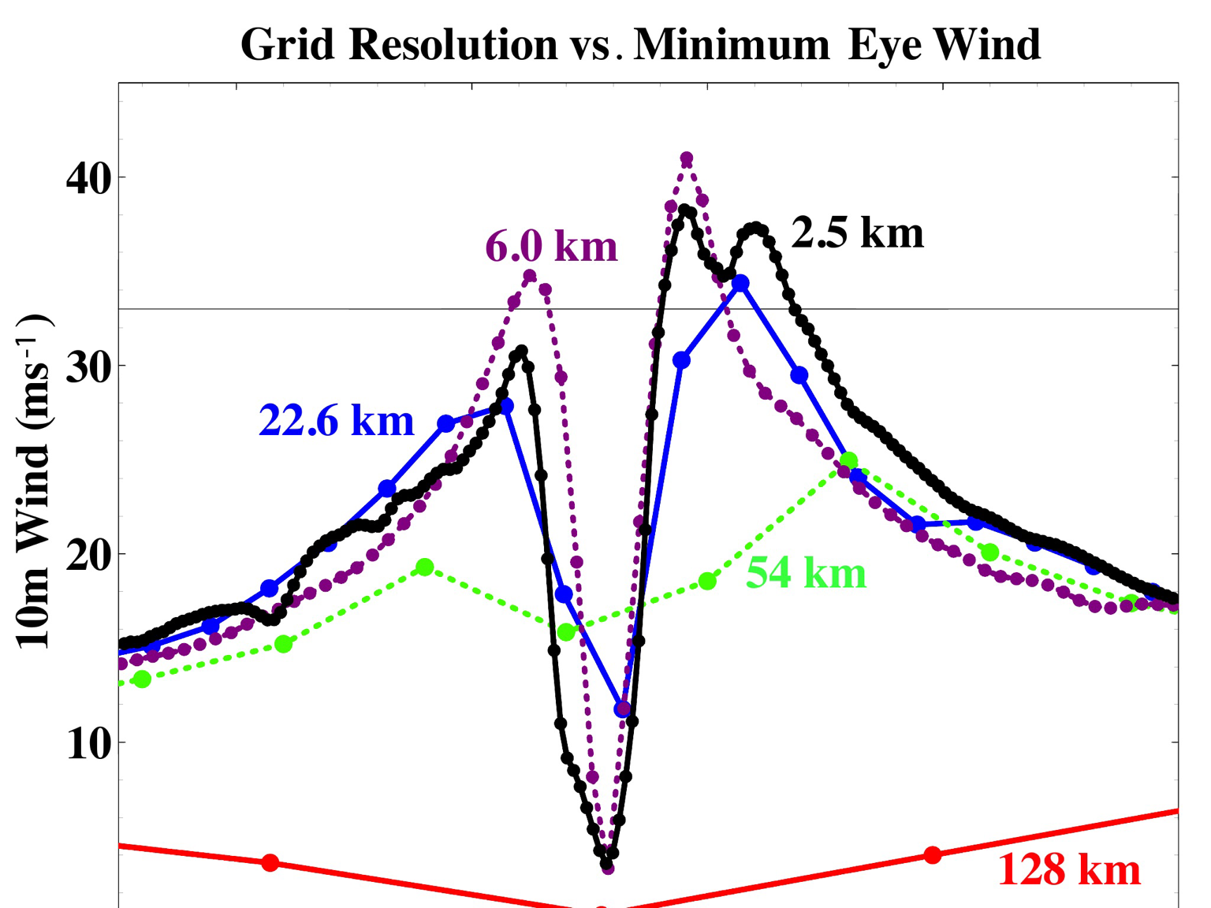
Motivation: Need For Global Nests
2
NOAA's High Impact Weather Prediction Project goal will be to develop a system that can produce 10-day forecasts at ~3-km global resolution fast enough to meet operational requirements by the end of the decade, with forecast skill exceeding that of the updated hydrostatic GFS and other chosen baselines.
HWRF is now used for guidance in all basins in the globe. Proven value for track, intensity and structure predictions.
Leverage on NOAA’s success with the HWRF system and accelerate progress towards creating high resolution, next generation model with the potential transitions to regional and global "HWRF".
We propose a seamless approach and illustrate how this approach is important for TC predictions
Impact of global model resolution on prediction of the inner core structure of Hurricane Earl (2010)

Slide 3

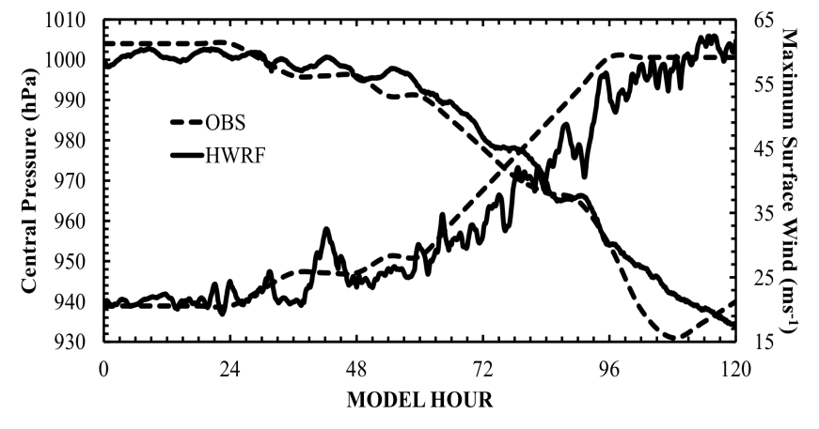
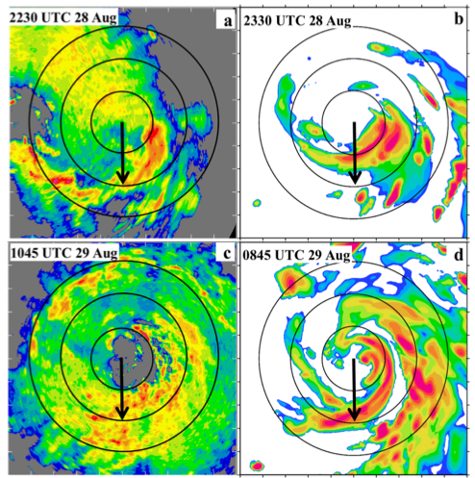
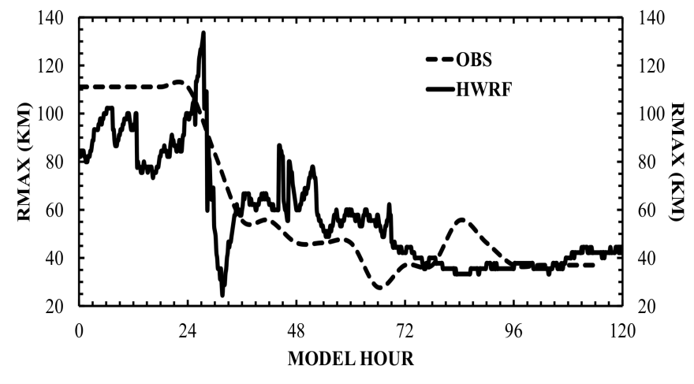
HWRF Nesting: High Resolution for TC vortex
3
Hurricane Earl (2010): example of RI case in a sheared environment
Structure predictions
Intensity Predictions
Size Predictions
Back Bone of HWRF: 3-km, two-way interactive moving nest; any number can be placed anywhere in a domain!
Spatial organization of convection is key for improving intensity predictions (Chen & Gopal, 2014 JAS)

Slide 4
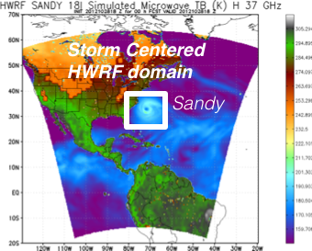
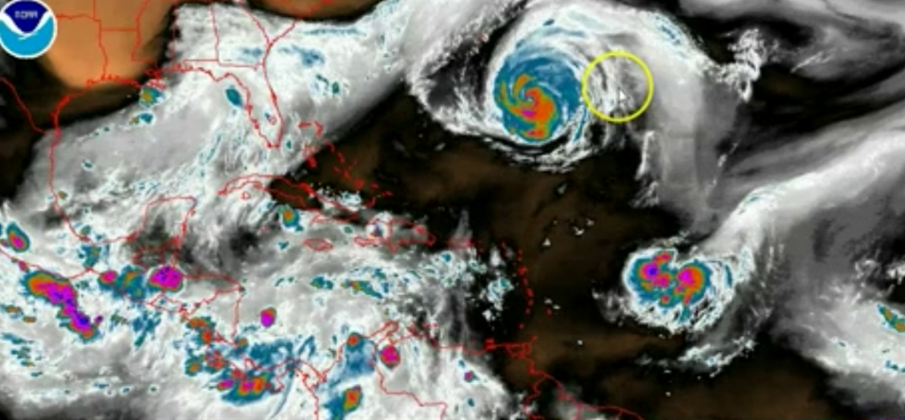
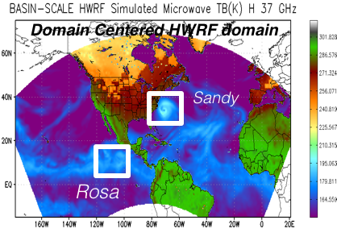
Addressing Our Immediate TC Prediction Needs
4
A Busy Day in the Tropics
Storm Centric -VS- Domain Centric Forecasts
- Tropical predictions system (Extended predictions)
- Improved storm-storm & multi-Scale interactions
- Landfall and post landfall (storm surge & rainfall)
- Genesis
- Regional ensembles
- Data assimilation

Slide 5
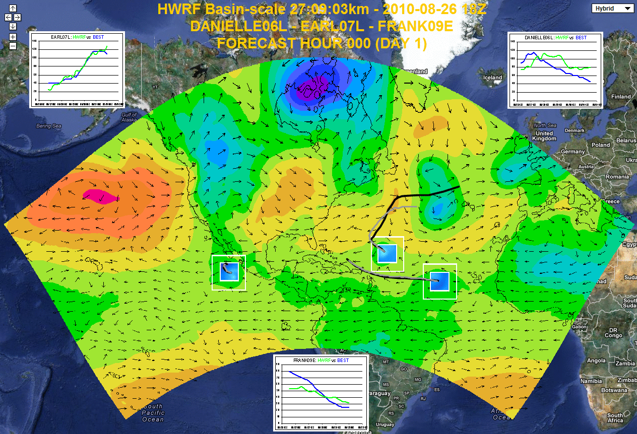
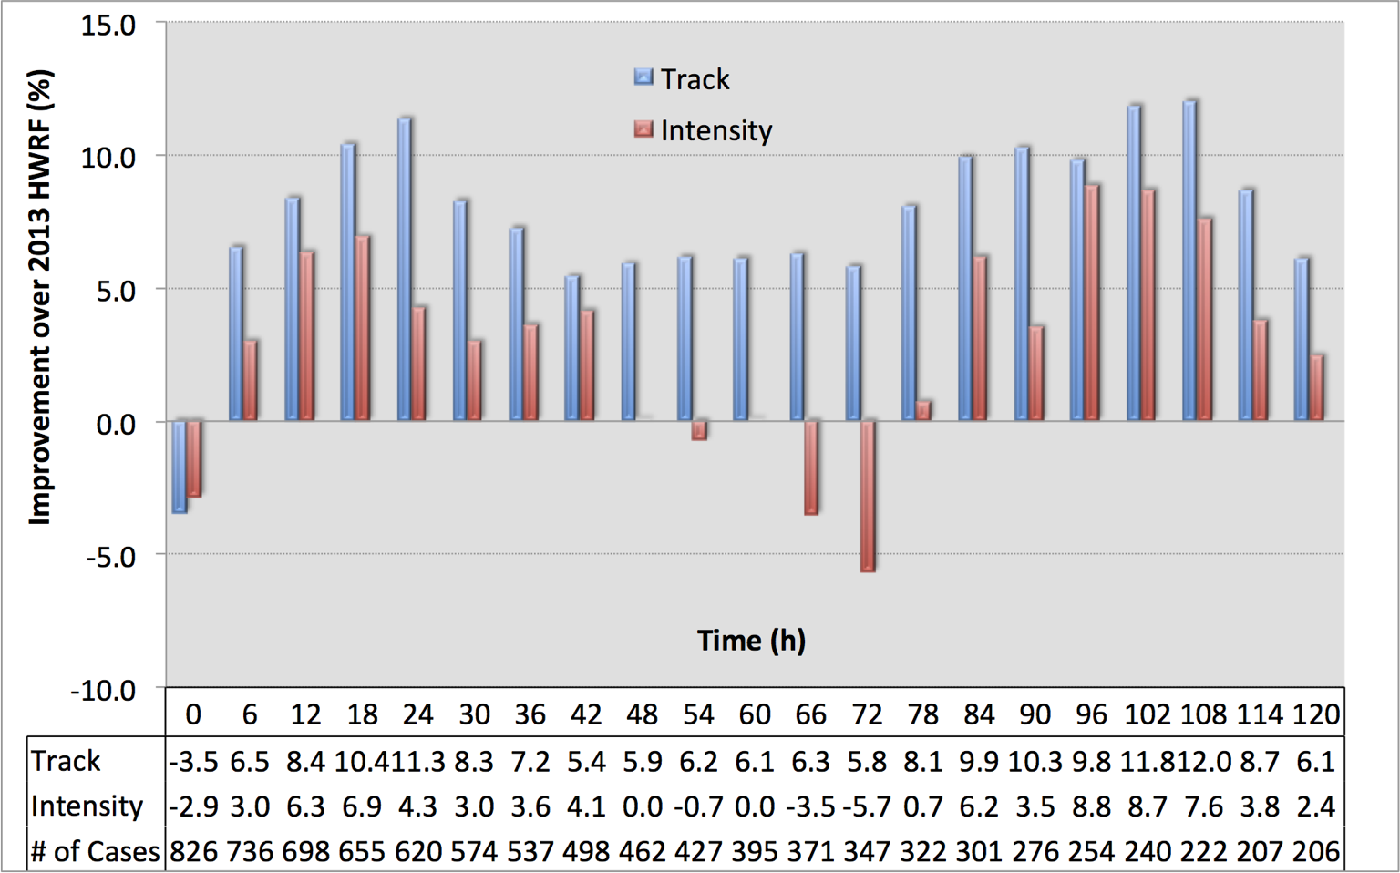

Basin-Scale HWRF: Experimental Prediction System
5
Basin-Scale HWRF: same version of HWRF but operates with multiple moving nest, initialization, cycling and physics all consistent with operational HWRF, with 61 levels, w/o active ocean coupling (http://storm.aoml.noaa.gov/realtime)

Slide 6
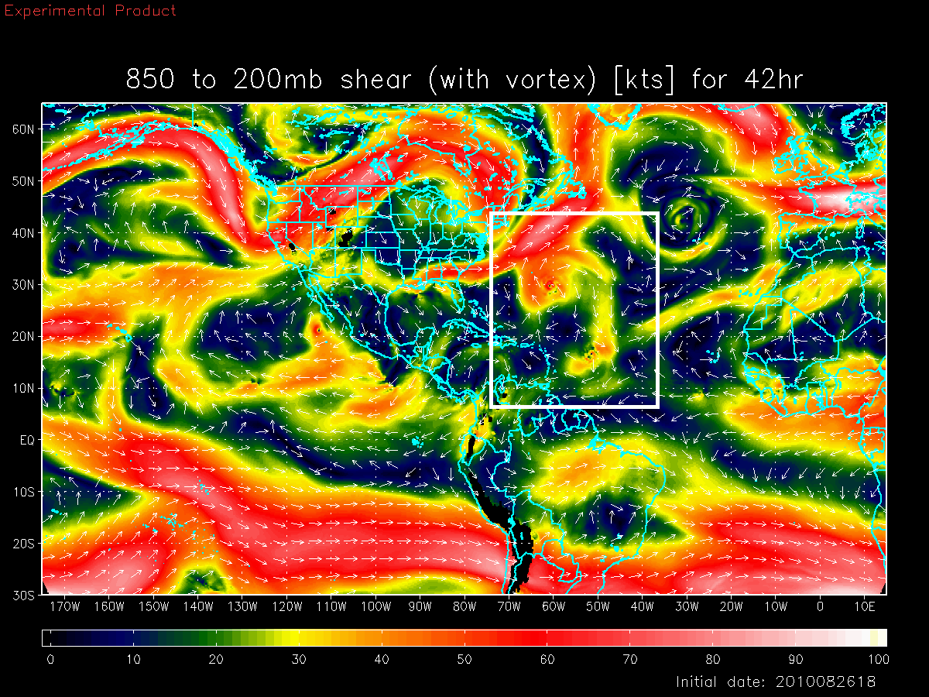
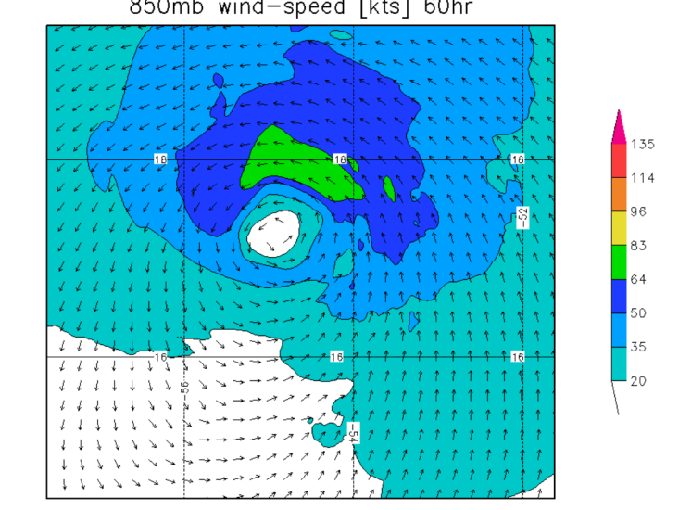
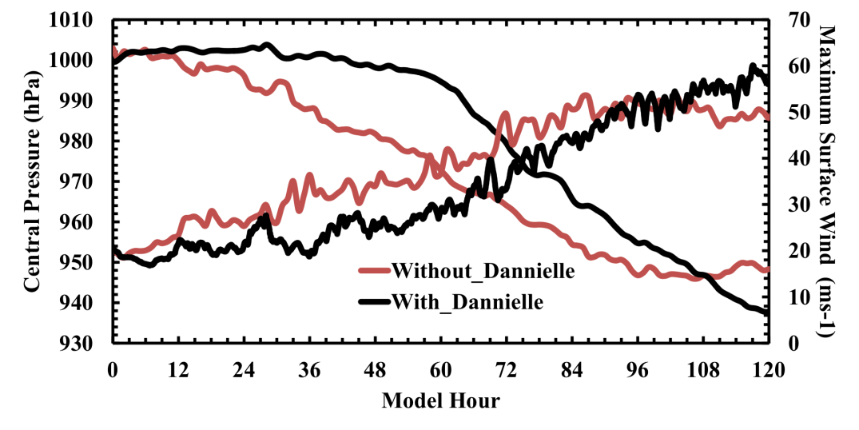
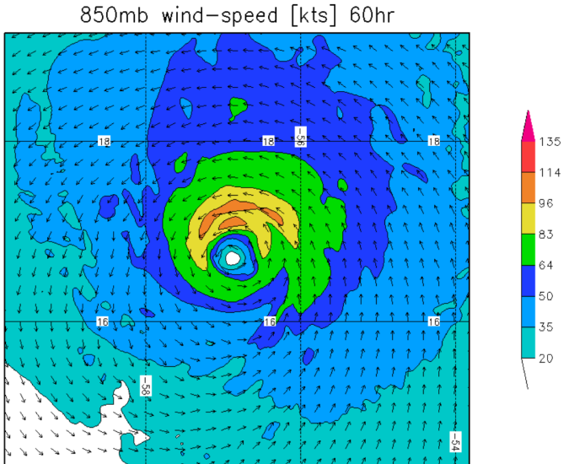
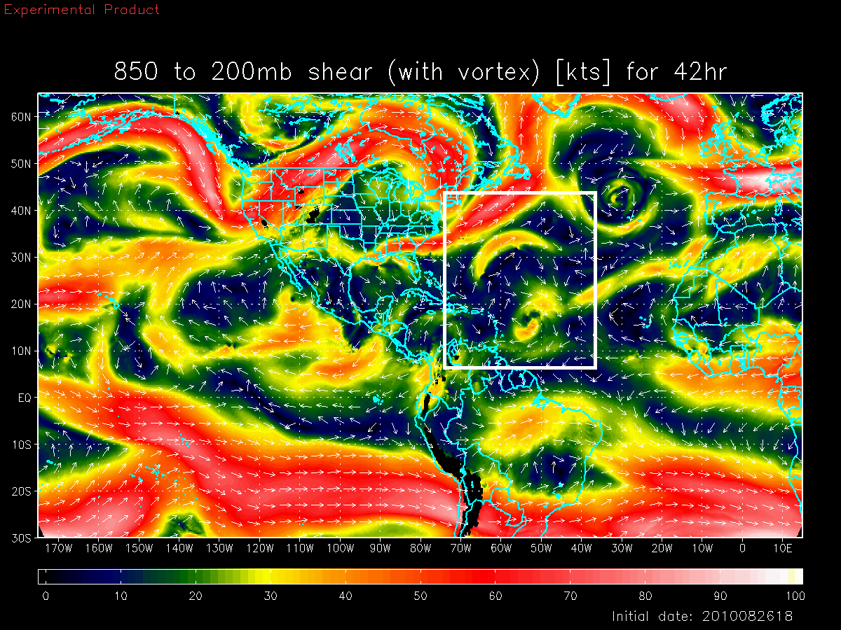
Basin Scale HWRF: Environmental Interactions
6
Shear vortex interactions during RI in Hurricane Earl, 2010
Deep-Layer Shear with Danielle
Earl
Earl with Danielle Interactions
Deep-Layer Shear without Danielle
Both large and vortex scale processes are critical for forecasting RI events
Earl
Earl W/O Danielle interactions
Notes:
Earl interactions with Dannielle

Slide 7
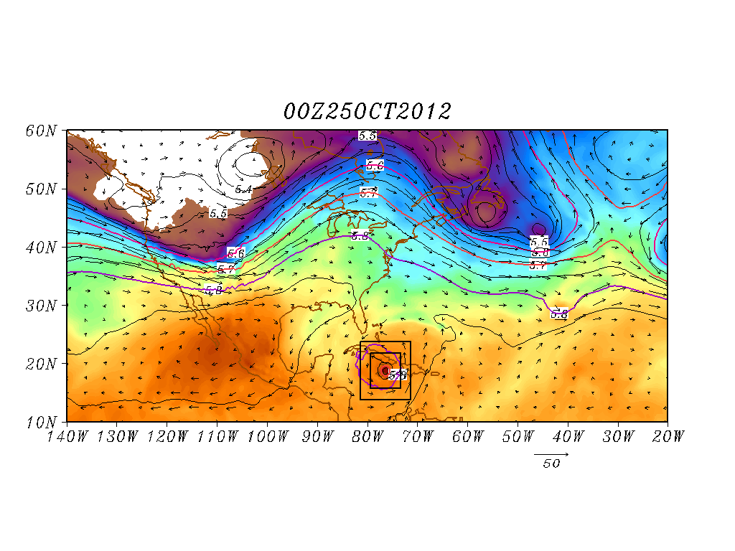
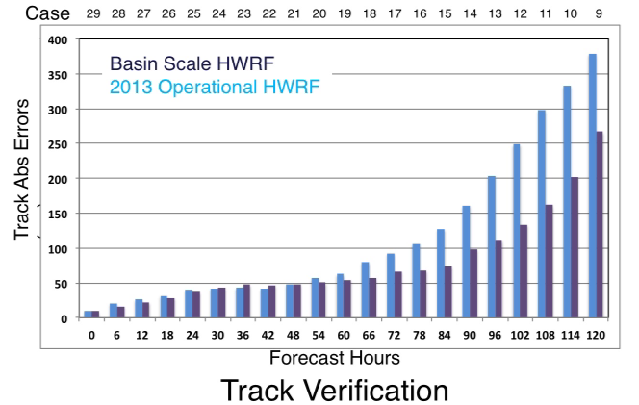
Basin Scale HWRF: Land-Storm Interactions
7
Hurricane Sandy Predictions: Domain Size and Vortex- Mean Flow interactions
Improved scale interactions and improved track & size forecasts (25 00Z Predictions)
Shading: T at 500 hPa; Contour: GHT at 500 hPa
Vector: Flow averaged between 500 hPa and 200 hPa
Shading: T at 500 hPa; Contour: GHT at 500 hPa
Vector: Flow averaged between 500 hPa and 200 hPa

Slide 8
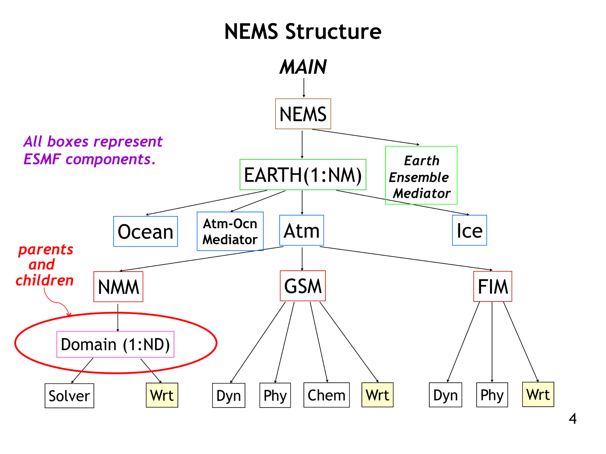
8
Addressing Next-Generation TC Prediction Needs
Common modeling infrastructure geared towards global models
Created for sharing developments (e.g, coupler, physics)
NMM and HWRF shares the same dynamics except grid structure (E vs B).
NMM can be configured in both regional (basin scale) and global mode
Nesting within NMM (under development) based on HWRF paradigm but recoded within NEMS
HWRF nest motion algorithms, physics and initialization under transition
Non-Hydrostatic Multi-scale Model (NMM) embedded within the NOAA Environmental Modeling System Framework (NEMS)

Slide 9
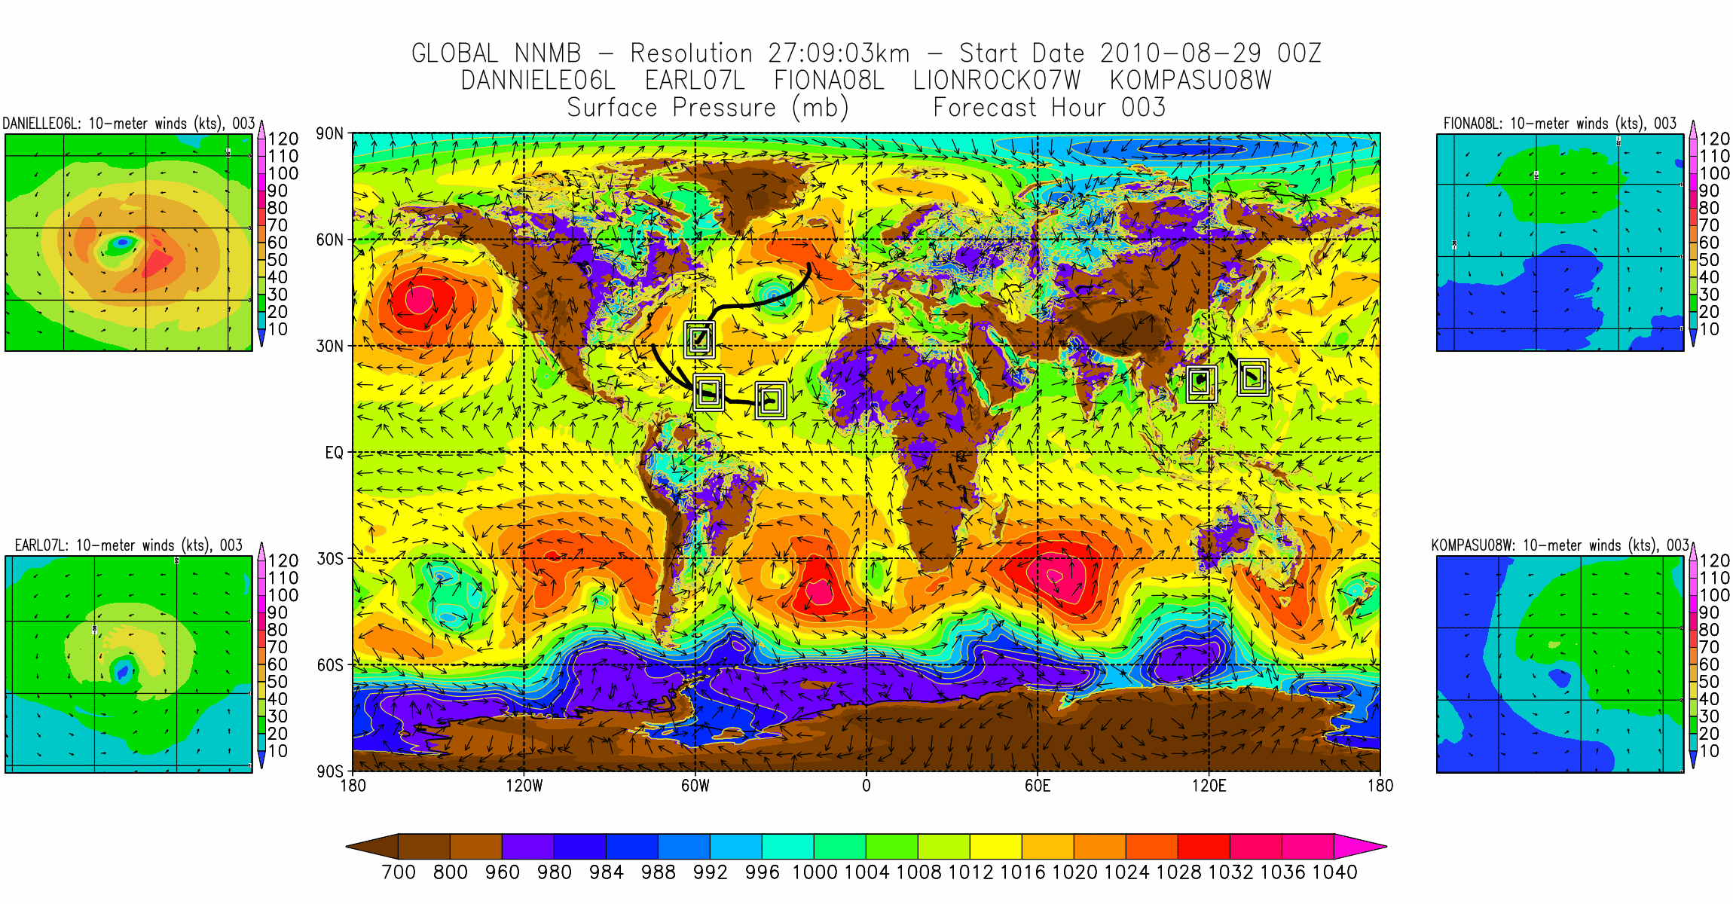
A Global Tropical Prediction System
9

Slide 10
Questions

